Slide 1

Applied Portfolio Management, Prof. Richard Excell
Economic Forecasting
Group 3 - 02/25/2025
Abhinn Tejpal Sharma Aakash Bansal
Aastha Shah Chenghao Zhu
Sharang Mantri Nick Sommer

Slide 2
Outline
Introduction
Approach
Model and Methodology
Results & Forecasting
Limitations
Conclusion

Slide 3
Introduction
Understanding economic trends is crucial for businesses, policymakers, and investors.
Our approach predicts the Coincident Economic Indicator (CEI), a key measure of overall economic activity and Consumer Price Index (CPI) as a measure for Inflation using robust regression methods
Objective: Develop a regression-based model leveraging leading economic indicators to forecast growth and Inflation for 6 to 9 months ahead.
This provides holistic economic insights for better decision-making.

Slide 4
Approach
To achieve this, we utilize the Coincident Economic Activity Index for the United States (CEI), a widely recognized composite index which is a coincident indicator of the economy
Nonfarm Payroll Employment
Unemployment Rate
Average hours worked in Manufacturing
Wages and Salaries

Slide 5
Model and Methodology
Performed a polynomial linear regression with variables:
PMI - Manufacturing
University of Michigan: Consumer Sentiment Report (UMSCENT)
New Orders Manufacturing Excluding Transport
S&P500
Building Permits

Slide 6
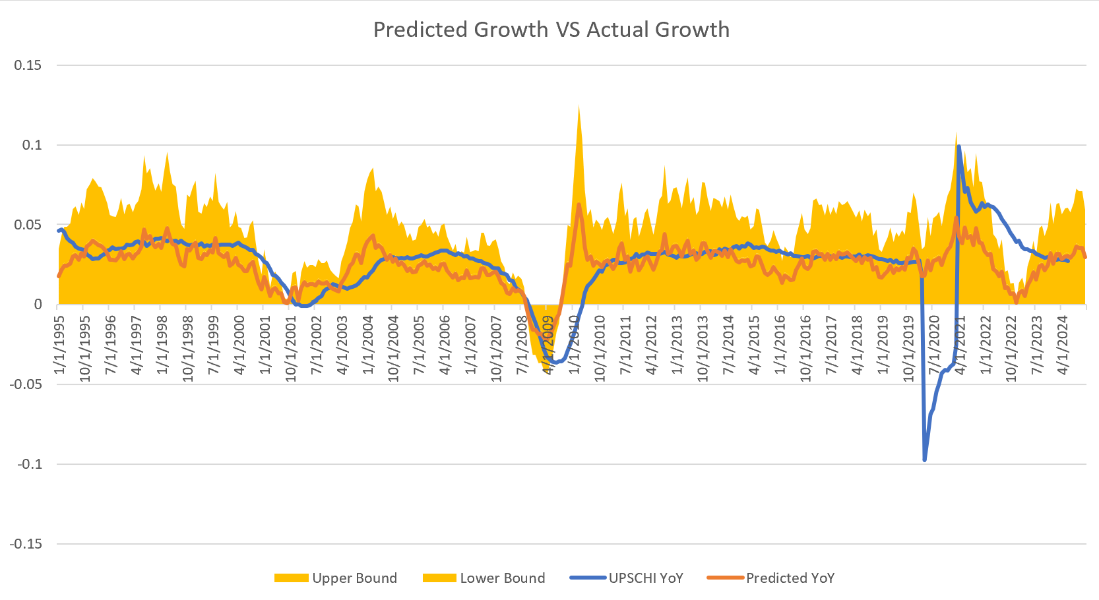

Slide 7
Model and Methodology
For inflation we regressed the Consumer Price Index (CPI) to estimate the inflation direction for the next 6-9 months using following variables:
10Y - 2Y Treasury Yield
% change M2 YoY
Producer Price Index (PPI)
Leading Credit Index (LCI)
Credit Managers Index (CMI)

Slide 8
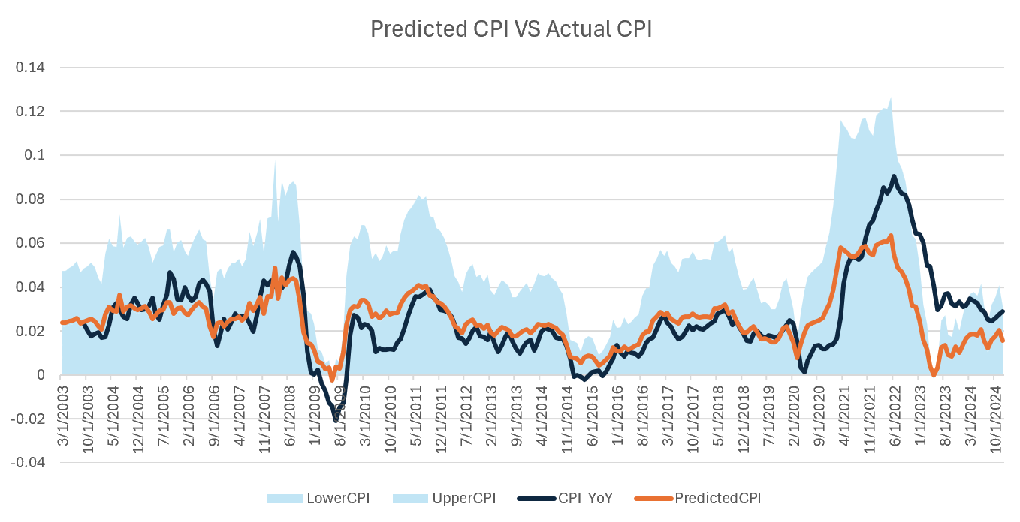

Slide 9
Limitations
The models based on our regression can be used to predict the direction of growth and inflation but can not be used for more precise prediction of these variables.
For more precise calculation, we will need to do time series analysis via ADF test, cointegration test, followed by a VECM/VAR model.
The models although powerful are unable to predict outlier events due to a 95% confidence interval so about 5% of the time the model will not capture the true inflation and growth.

Slide 10
Conclusion
Based on our robust approach using regression we can conclude the following major points about the economic forecast:
Our variables for the prediction of CEI lead us to the conclusion that our model is leading the CEI by 6 months
Based on that, we conclude that growth will experience a slowdown* in economic activity
*Initially we predict a constant growth with a slowdown in later months of prediction

Slide 11
Conclusion
Following our methodology for inflation we found:
Through regression for inflation on CPI, we concluded that our model is leading inflation rate by 6 months
Based on that we conclude we will be in an increasing* inflation period
*Based on that we predict that there will be a sticky inflation to rising inflation

Slide 12
Thank You

