Slide 1
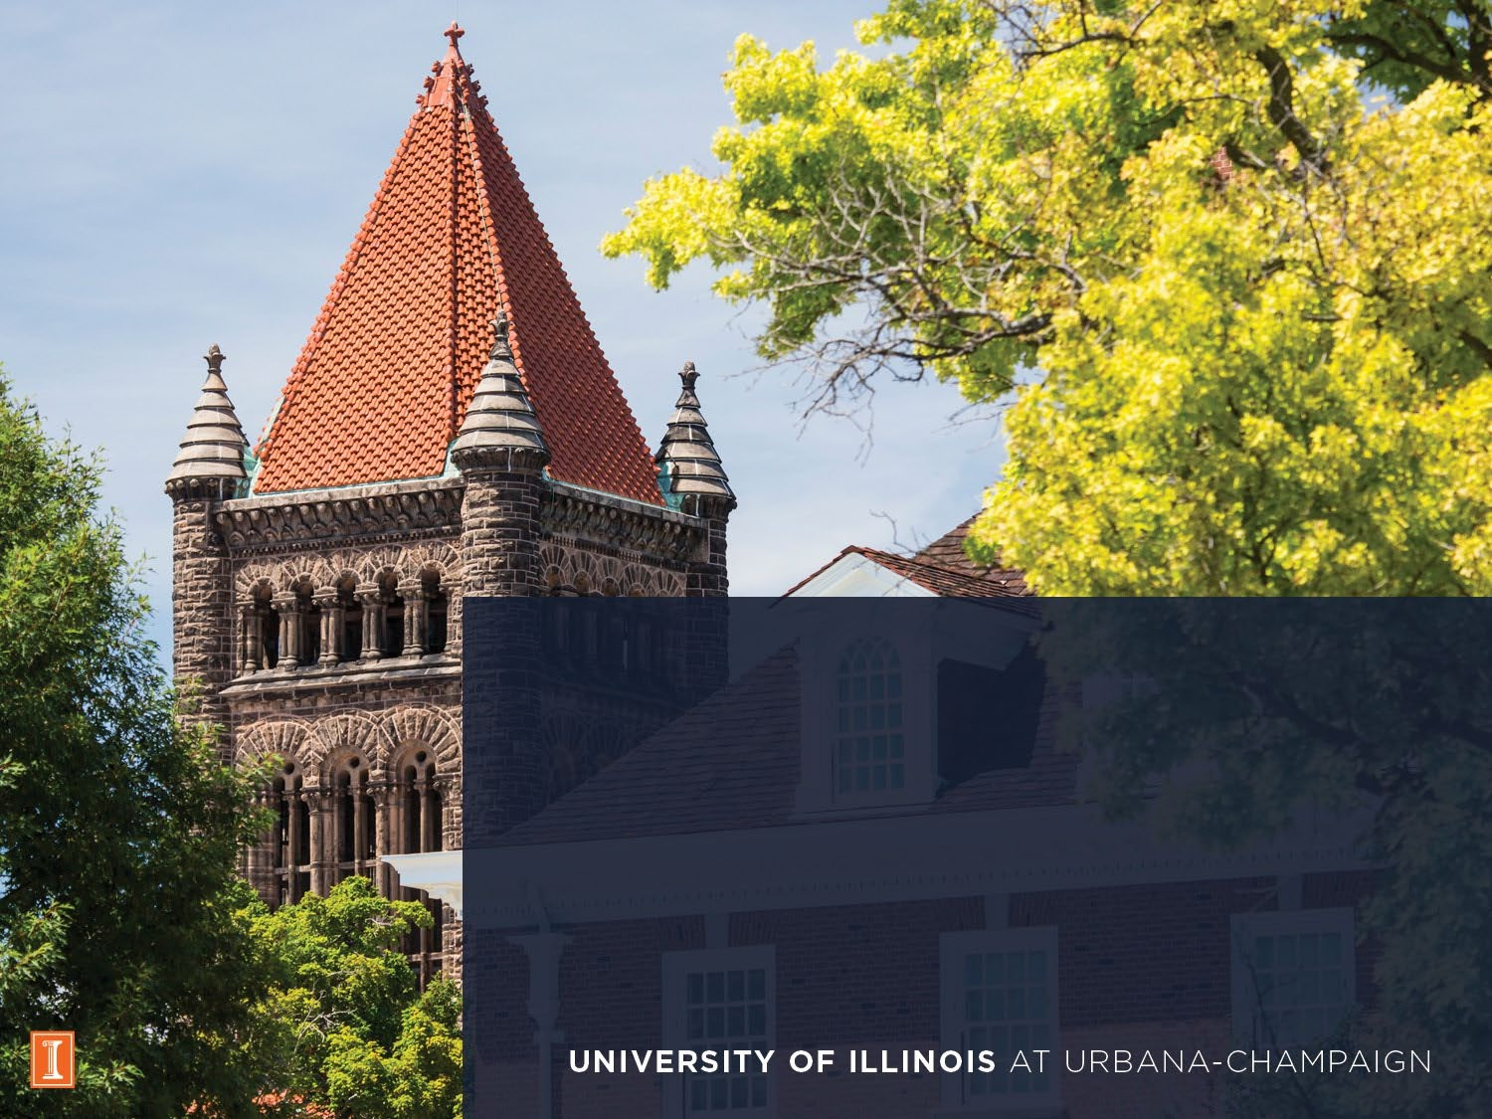
Applied Portfolio Management, Prof. Richard Excell
Group ABBV & JNJ
Abhinn Tejpal Sharma Aakash Bansal
Aastha Shah Chenghao Zhu
Sharang Mantri Nick Sommer

Slide 2
Introduction
Stagflation
HealthCare
LLY ~ Buy
JNJ ~ Hold
ABBV ~ Sell

Slide 3









Economic Model Integration
Current Stage
Base Case: Stagflation
-Falling Growth
-Inflation Rising/Sticky
Bull Case: Reflation
-Rising Growth
-Falling Inflation
Sector
Performance
Healthcare
Energy
Financials
Bear Case: Deflation/Recession
-Falling Growth
-Falling Inflation
Style
Implications
Defensive-Value
Defensive-Growth

Slide 4
Industry Analysis
Low:
High Capital and R&D Costs
Strict Regulatory Barriers
Threat of New Entrants
Low to Medium:
Strong Pricing during Patent Period
Erodes Post-Patent
Low to Medium:
Newer Drugs Displace Older Ones
Innovation Drives Change
Bargaining Power of Buyers
Threat of Substitutes
High:
Intense R&D Competition
First-Mover Advantage is Key
Rivalry Amongst Competitors
High:
Few Specialized Suppliers
Heavy Regulatory Dependence
Bargaining Power of Suppliers
Insert Title

Slide 5
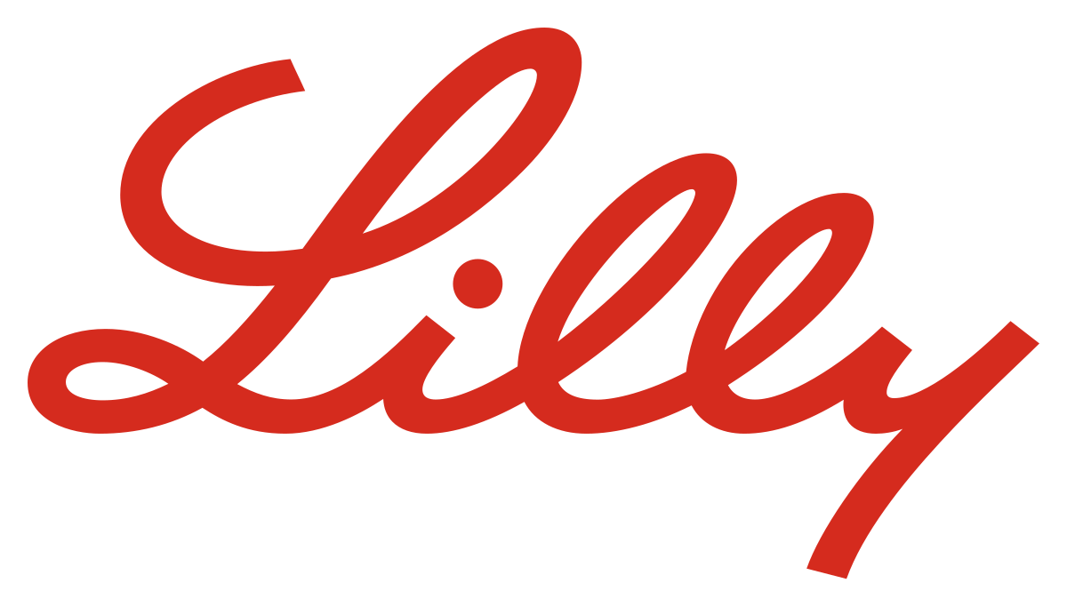
Leads anti-obesity $53 billion market (Zepbound, Mounjaro, Orforglipron).
S
FY 2024 revenue +32% YoY, Q4 +45%.
$3B returned in Q4, $2B buyback, 15% dividend hike
Vulnerable to pricing pressure & IRA policies.
W
40% of revenue comes from to incretin markets
Trulicity is being cannibalized by Mounjaro, -25% YoY
Jaypirca, Omvoh, Kisunla, Ebglyss – oncology, neurology, immunology
O
$50 billion worth of plants will begin manufacturing in H12025 in US
Obesity on the rise, nearly 50% of US adults will be obese by 2030.
Medicare Price Negotiation: Jardiance impacted; others likely
T
Regulatory challenges and pricing pressure in the U.S. and abroad.
Patent expirations and rising biosimilar competition.
Notes:
Orforglipron beats Ozempic from novo nordisk on all metrics.
Zepbound and Mounjaro are both drugs aimed at helping individuals deal with obesity and type 2 diabetes.
Currently 53 Billion market size and is expected to grow by 17% CAGR. North America is about 77% of market share for GLP-1 receptor agonists.
FY 2023 revenue ~34 billion and increased to 45billion ~32% increase YoY.
Inflation Reduction Act: U.S. government can negotiate prices for certain high-cost drugs. Trulicity and Jardiance were selected
Incretins/GLP-1 receptor agonists account for about 40% of revenue
Trulicity is down 25% YoY due to cannibalization from Mounjaro as they are both GLP-1 receptor agonists.
New facilities opening in Indiana and Wisonsin 9 billion in Indiana
Expanding into other medicines including oncology, neurology, and immunology
Jardiance and Trulicity were both hit by Medicare Price negotiation
Trulicity patent expires in 2027, Jardiance expires in 2028, Verzinio expires in 2031

Slide 6
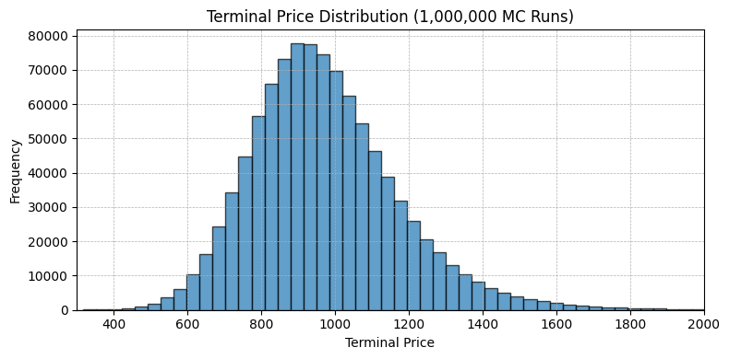
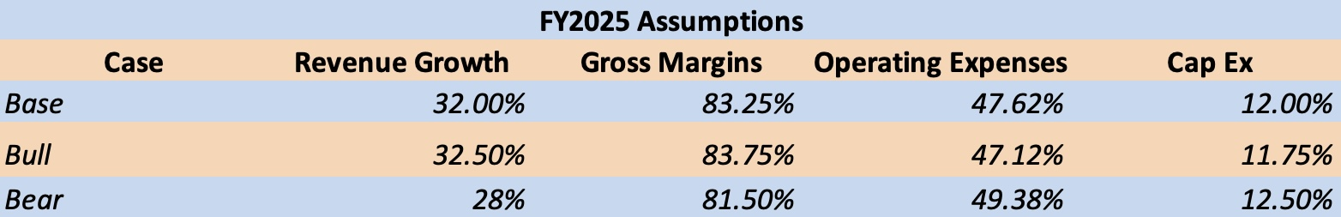
Valuation of LLY
$1191.1
Bull
45.3%
$1046.5
Scenario Analysis
Base
27.9%
$687.4
Terminal Value
90% Confidence Interval
Bear
15.9%
$954.79
$632.66 - $1366.79

Slide 7
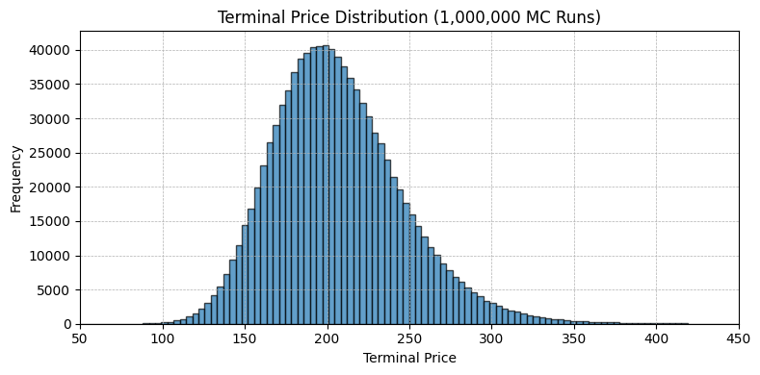
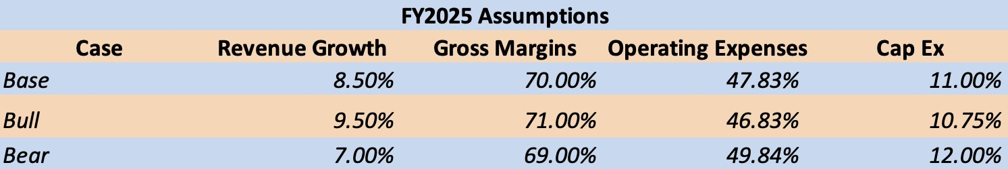
Valuation of ABBV
$220.94
Bull
18.8%
$194.84
Scenario Analysis
Base
4.7%
$150.93
Terminal Value
90% Confidence Interval
Bear
18.9%
$206.68
$148.95 - $277.64

Slide 8
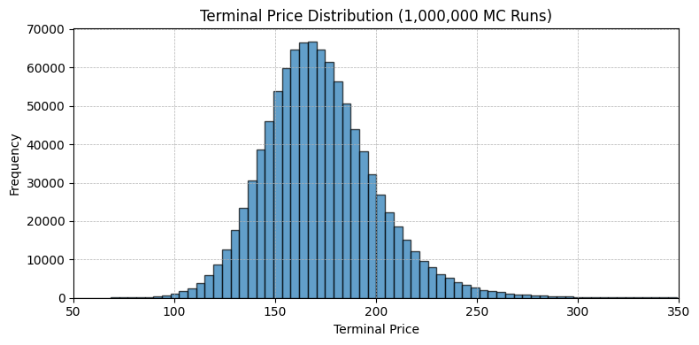
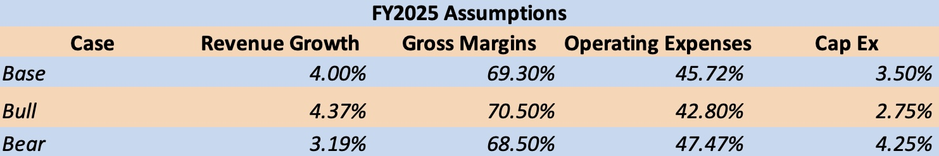
Valuation of JNJ
$203.7
Bull
31.4%
$181.3
Scenario Analysis
Base
16.9%
$134.4
Terminal Value
90% Confidence Interval
Bear
13.3%
$171.48
$133.25 - $216.42

Slide 9




Final Recommendation
Eli Lilly and Company
(LLY)
BUY
Abbvie Inc.
(ABBV)​
SELL
Johnson & Johnson
(JNJ)
HOLD
01
02
03

Slide 10
Thank You!

