Slide 1


Supervisor :
Prof. Haripriya Gundimeda, Department of Economics,
IIT Bombay
Submitted by: Sharang Mantri, 18B080022
B.S. Project

Slide 2
Problem Statement
In 2022, there was considerable debate about whether the USD was strengthening or INR was losing its value. Through this study, we want to examine and comment on the debate, with the help of the econometrics model, along with finding out about the macroeconomic variables which affect the value of the INR/USD exchange rate with particular emphasis given to the time of high volatility in INR/USD and recommend the policies to counter the high volatility of the INR/USD exchange rate.

Slide 3
Introduction
To examine the various macroeconomic variables which affect the INR/USD exchange rate value and cause of its volatility
The volatility in INR/USD has increased over time with more integration of Indian economy with rest of the world and a excessive volatility can cause damage to the growth of economy
India follows flexible exchange rate system post 92’ with the interference from RBI from time to time to counter high volatility in INR depreciation
Ehrmann, Fratzscher, & Rigobon (2011) underlined "the dominance of U.S. markets as the main driver of global financial markets: U.S. financial markets explain, on average, more than 25% of movements in euro area financial markets, whereas euro area markets account only for about 8% of U.S. asset price changes." With India expected to be one of the fastest-growing economies in the 2020s, we examine how various economic factors, which, according to economic theory, affect the exchange rate and thus affect the investment pattern in India.

Slide 4
Literature Review
Mirachandani (2012) and Khera and Singh (2015) uses uses Pearson's correlation analysis
between 1991 to 2010 and 2012 respectively for yearly data to comment on movement of INR/USD based on macroeconomic variables.
Both authors find negative relation between INR/USD and inflation rate, lending interest rate and significant, while, Mirachandani (2012) finds current account deficit to to have negative but insignificant correlation while Khera and Singh (2015) find current account deficit to to have negative but significant
Both authors find positive relation between INR/USD and GDP, FDI.
Both authors do not check for any biases due to the such as reverse causality and omitted variable bias due to consideration of linear relation.
Use of annual data does not capture the volatility caused within the short term period
Khera and Singh (2015) considers devaluation of INR/USD negative for Indian economy at any rate, and provides policy measures without taking into account the broader impact of the policy i.e ignores the other two factors inflation and economic development in RBI trifacta.

Slide 5
Suthar (2008), Sinha and Kohli (2013), Murari and Sharma (2013), Bhandari (2014), Thakur et al. (2016), and Williams et al. (2019) all uses linear regression method to determine the relation between macroeconomic variables and INR/USD.
While Suthar (2008) uses monthly time series data between Apr 96’ to June 07’ others uses yearly data between 90’ to 12’, 01’ to 13’, 00’ to 13’, 05’to 15’, 00’ to 18’ respectively.
Suthar (2008) finds negative correlation between INR/USD and call rate and bank rate, foreign exchange reserve and Long term and short term government security bond differentials, change in money supply have insignificant effect on determination of INR/USD
Sinha and Kohli (2013) finds significance between USD/INR, Stock return, oil prices and GDP, BSE IT and BSE Oil & Gas have no significant relationship with USD/INR for period of Jan 06’ to Mar 12’, inflation differential, lending interest rate, current account deficit as % of GDP, public debt have considerable effect on USD/INR between period 1990 to 2011 and GDP to have negative relation with USD/INR.
Murari and Sharma (2013) finds that INR/USD is highly correlated to money supply, trade balance, inflation and interest rate

Slide 6
Bhandari (2014) finds GDP, export growth, money supply, and FIIs have a negative correlation and FDI and Inflation have a positive relation with INR exchange rate
Thakur et al. (2016) finds high positive correlation between INR/USD and external debt and GDP, mild positive correlation between FDI and INR/USD, negative relation between INR/USD and interest rate and no correlation between inflation and INR/USD
Williams et al. (2019) finds that current account balance, net trade, and personal remittances have effect on currency fluctuations of INR, JPY, mild effect on CNY and no effect no KRW.
All the authors except Suthur (2008) uses yearly data and therefore fails to capture short term volatility.
All authors considers linear relation and does not check for any biases arriving due to the consideration

Slide 7
Dua and Sen (2006), Mallick (2010), Hsingh (2015), Gupta and Mishra (2017), Jain et al. (2016), Kumar and Aluvala (2020) all use appropriate Time series methods and test to find relation between INR/USD and macroeconomic variables.
Dua and Sen (2006) using ADF test, Johansen cointegration test and Vector Error Correction Model (VECM) to find that variables level of capital inflows and their volatility, government expenditure, current account surplus and money supply for Indian economy are cointegrated and affects REER for quarterly data between 1993 Q2 to 2004 Q1
Mallick (2010) using unit root test and Stock-Watson model for monthly time series data between 1996 to 2007 finds FIIs, growth rate differentials, money supply, real bank credit and 3-month forward premium rate affect INR/USD exchange rate.
Hsingh (2015) using yearly time series between year 1976 and 2013 through simultaneous-equation model of demand and supply using the 2SLS method for estimation and EGARCH model to estimate the conditional variance of the exchange rate finds INR/USD positively related to US real government bond yield, Indian real GDP, US real stock prices and expected INR/USD exchange rate, and negatively related to Indian real Interest rate, US real GDP and Indian real stock prices

Slide 8
Jain et al. (2016) using DCC-GARCH model and non linear causality test for yearly time series of 2006 to 2015 finds correlation between crude prices and INR/USD, and concludes that fall of gold prices leads to depreciation of INR which causes fall of Sensex 30 and fall of crude causes depreciation of INR which causes fall of Sensex 30
Gupta and Mishra (2017) using ADF test, Johansen cointegration test and VECM for yearly time series between 1993 to 2014 finds differential Interest rate,differential GDP and differential Inflation affect USD/INR in long run and no affect by differential GDP and differential Inflation in short run unlike differential Interest rate
Kumar and Aluvala (2020) using ANOVA finds that Inflation and Import growth explains USD/INR movement while GDP, export growth and call money rate have no significance.
Except Mallick (2010), Dua and Sen (2006) all authors uses yearly time series data thus considerably reducing affect of volatility capture
All authors czech for stationarity and errors which would have arised if linear model would have been used.

Slide 9
QuangMy and Sayim (2016) using Enter and Stepwise multiple regression method for quarterly time series data between 2005 to 2015 finds USD/INR has negative relation with FDI, trade balance, and national reserves and Positive relation with public debt of India.
They also work on exchange rate of USD/CNY, USD/BRL, and USD/MNX apart from USD/INR and finds different relation for all 4 developing countries wrt USD

Slide 10
Jaiswal (2022), using daily data between April 2, 2002 to May 29, 2020 in RBI working paper using recently developed methods of causality-in-quantile test by Nishiyama et al. and Jeong et al finds that:
WTI oil predicts exchange rate for much better quantile range than brent oil but in variance brent prices are better in prediction
Gold prices predict exchange rate at almost all quantiles except at tail ends
BSE and NSE index also predict exchange rate at all quantile while BSE predicts variance much better that NSE index, S&P 500, MSCI, FTSE 250 predicts and affects volatility heavily
India VIX predicts for whole range while S&P 500 predicts for 0.15 to 0.8 quantile range

Slide 11
Results of most of the study are in line with the economic theory except few like that of Jain et al. (2016) which tells that fall in crude prices lead to depreciation of INR and the fall of BSE 30, though many of the study only consider linear relationship between exchange rate and the macroeconomic variable and does not check for any biases due to that
Relationship with GDP is difficult to predict as authors have given results in which GDP affects INR/USD in positive, negative way with correlation and is also insignificant in that
Most of the study have used yearly time series data for the analysis and thus those studies are not able to comment on the short term volatility either mathematically or theoretically
Except Dua and Sen (2006), Mallick (2010) all early studies uses linear models without considering stationarity and cointegration factors
Most studies have regarded depreciation of INR as bad for economy, and have suggested the policy only with respect to improving the valuation of INR not concentrating on inflation and economic affect of it as they are part of trilemma as defined by Pushpa Trivedi and Harpreet Singh (2022)

Slide 12
Research Gap
India used Pegged Regime from 71’ to 92’ and Par value system from 47’ to 71’ prior to liberalization which does not show the proper currency exchange rate with respect to market conditions and thus change in macroeconomic factors post liberalization might not show proper effect due to already overvalued INR.
Most studies took into account east asia crisis, dotcom bubble crisis, 2008 recession and eurozone debt crisis, no study mention the spillover effects caused by the stopping on subsidies of petrol and diesel permanently on June’10 and Oct’14 which caused heavy volatility at that time combining with eurozone debt crisis.

Slide 13
1947
1971
1992
Lately, RBI is making effort to interfere as little as possible in INR exchange rate market
Between 47’ to 71’ India followed Par - Value System, in which INR external par value was fixed in terms of gold with the pound sterling as the intervention currency
Following which India adopted a Pegged Regime, under which INR was pegged to basket of currency till the economic reforms of 1992
After 1992-93 economic crisis India adopted market-determined exchange rate regime, with interventions from RBI to prevent rapid devaluation of INR

Slide 14
1992
2008
2013
2018
2020
2022
Heavy devaluation in INR till 2000s post 1992 economic reforms
Rapid decline following global financial crisis as foreign investors started pulling their investments
Heavy depreciation due to bad economic reforms, high Inflation, ending of subsidies, Taper Tantrum
With start of US Fed rate hike, there was again a heavy depreciation in INR
March 2020, During start of covid, as a result of halting of economy, INR formed a all time low of 77
With post covid shock slowing of economies, High Inflation, Aggressive rate hikes by central banks around the world, and war between Russia and Ukraine led to a volatile depreciation

Slide 15
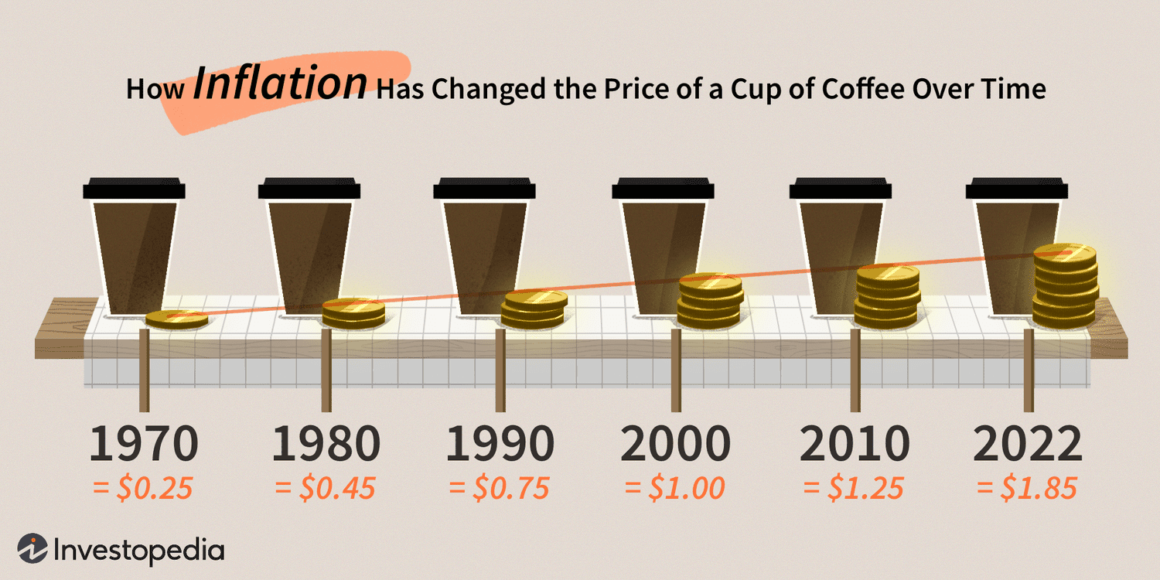
Macroeconomic Factors Affecting the Value of INR/USD
Inflation Rate in India and USA: Rise of Inflation at higher rate than USA can lead to a depreciation of INR, as it can erode the purchasing power of INR
It can also lead to central bank tightening its monetary policy, which will lead to the appreciation of INR
Strong effect of the inflation rate on INR/USD when the inflation rates of India and the USA are outside their respective acceptable Range as decided by central banks (For India range is 4±2%, and For USA acceptable range is 2±1%)
Oil Prices: Increase in oil prices for a country which is net importer of oil will lead to widening of current account deficit and will lead to depreciation of the domestic currency

Slide 16

Interest Rate: An increase in interest rate by central bank of domestic country should lead to ad appreciation of domestic currency.
A positive interest rate differential increases the demand for domestic money in the exchange of foreign money, which leads to an appreciation of the spot exchange rate.
Increase in the 10 -year bond yield show a sign of high inflation, which can lead to investors withdrawing and thus weakening of the domestic currency.
Gold Prices: Since it is a dollar-denoted commodity, if gold prices rise, it will make holding USD more expensive, and USD prices will decrease and domestic currency will appreciate
Stock market: If India's principal stock exchange Nifty50 outperforms the foreign stock market and with positive investor sentiment, it will lead to an increase in demand for INR which will appreciate the INR.

Slide 17
Other Factors Affecting the Value of INR
Political Stability: An unstable political situation in the domestic country can lead to a sharp depreciation of the domestic currency of that country in the short run, Ex.) during the 3 months in 2022 for the U.K.'s currency Pound-Sterling when a situation of 3 Prime Ministers in a year led to a sharp depreciation of the pound-sterling in that period
Liberalization Process: A close or ineffective liberalization process can lead to the depreciation of the currency of the domestic country asexports of that country will become less attractive, leading to less demand for domestic currency in the financial market, which will cause depreciation of the domestic currency
Global Factors: Various global shocks can lead to sharp appreciation or depreciation of the domestic currency
Central Bank Intervention: Central banks intervene in the financial market by buying or selling the currency using foreign exchange reserves to counter sharp variations in currency valuation

Slide 18
Data
Currency exchange rate via-a-vis USD for all the countries, WTI crude prices, USA's 3-month bond yield, and USA's 10-year bond yield are obtained from S.T. LOUIS FED.
Gold Prices in INR/troy ounce are obtained from World Gold Council.
CPI India and CPI USA from the Bank of International Settlements
Nifty50 data is obtained from NSE India
India's foreign exchange reserve is obtained from RBI
India's 3-month bond yield and India's 10-year bond yield are obtained from Yahoo Finance
Our period of study is from February 2002 to April 2023

Slide 19

Methodology
To avoid the multicollinearity problem, the variable CPI USA is removed because of its high collinearity with CPI India, in which the correlation between CPI India and CPI USA is 0.97.
The model to be estimated becomes

Slide 20
Hypothesis building:
● The microeconomic theory indicates a negative relationship between INR/USD exchange rate and gold prices. Since gold is priced in rupees in our study, then an increase in gold price should lead to a decrease in the value of USD, i.e. an appreciation for the INR.
● As per the theory, we expect WTI crude price to have a positive correlation with INR/USD, i.e. an increase in WTI prices should lead to depreciation in INR
● We expect CPI India to have a negative coefficient based on the previous study.
● Nifty50 should also have a negative correlation with INR/USD, i.e. an increase in nifty should cause an appreciation of INR wrt USD.
● India's foreign reserve should have a negative coefficient as per economic theory.
● India's 3-month and 10-year bond yields should have positive coefficients, and USA's 3-month and 10-year bond yields should have negative coefficients since they are forward values about market expectation.
Stata 15 is used for the computation of results.

Slide 21
Unit Root Test: Since we are working with time series data, we need to check for the variables' stationarity to avoid spurious regression with non-stationary variables. This study uses the Augmented Dickey-Fuller (ADF) unit root test by Said and Dickey (1984). The condition for rejecting the null (i.e. for the series to be stationary) is that the test statistic should be less than the critical value (at 5% significance) in the ADF test.
Cointegration Test: After performing the stationarity test, we need to establish whether there exists a long-run relationship between the variables. For this, a cointegration test is required. Here, we will be using the Johansen Cointegration test, where we will be testing the null of having no cointegrating equation against the alternative of the presence of cointegration.
The model selected to determine causality depends on the cointegration test result. If the result shows a long-run relationship, VECM is a better choice model. If no long-run relationship exists among the variables, only the VAR model applies.

Slide 22
 | Mean | Min | Max | Std. Dev. | Skewness | Kurtosis
ExR | 56.98 | 39.267 | 82.599 | 12.32163 | .3372405 | .337240
GoldPr | 69214.15 | 14325.36 | 164066.5 | 39961.38 | .3413199 | 2.213466
WTICrude Pr | 66.1369 | 16.55 | 133.93 | 24.60509 | .2689645 | 2.311254
CPI_IND | 121.4535 | 62.0549 | 202.7375 | 41.57543 | .2496963 | 1.818059
CPI_USA | 104.6211 | 4.047609 | 139.1219 | 15.09612 | -.8454996 | 9.62127
Nifty50 | 7076.991 | 955.1167 | 18385.13 | 4622.17 | .7927951 | 2.884769
FxRes | 1.96e+13 | 2.48e+12 | 4.88e+13 | 1.30e+13 | .765841 | 2.601497
Ind3monYie | 6.197887 | 2.93 | 11.18 | 1.704779 | -.0054791 | 2.453571
Ind10yrYie | 7.288821 | 5.1 | 9.316 | .9105015 | -.4024386 | 2.612184
US10yrYie | 2.972783 | 0.533 | 5.406 | 1.150411 | .0366783 | 2.032437
US3monYie | 1.348574 | -.01 | 5.417 | 1.594037 | 1.180275 | 3.21389
Table 1: Descriptive Statistics of all the variables
Source: Estimates by the Author
R
E
S
U
L
T

Slide 23
Unit Root Test Results; Table 2: ADF test results for monthly series of variables
p-value/variable | ADF (At Level) | ADF (F.D)
ExR | 0.2887** | 0.0000*
GoldPr | 0.9945** | 0.0000*
WTICrude Pr | 0.1037** | 0.0000*
CPI_IND | 0.6695** | 0.0000*
Nifty50 | 0.6283** | 0.0000*
FxRes | 0.9731** | 0.0000*
Ind3monYie | 0.2320** | 0.0000*
Ind10yrYie | 0.0698** | 0.0000*
US10yrYie | 0.1195** | 0.0000*
US3monYie | 0.4882** | 0.0000*
** Probability >0.05 then Null Hypothesis is accepted. * Probability < 0.05, then Null Hypothesis is rejected

Slide 24
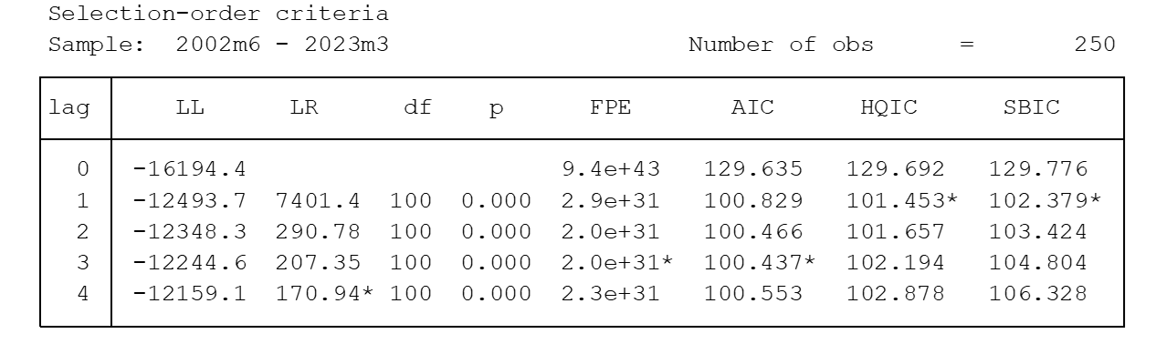
Unit Root Test Results: By applying the ADF test at the level for all variables, we observed all variables accepted the null hypothesis at 5% critical value and at the first difference, all variables rejected the null hypothesis at 5% critical level.
Cointegration Test Results: Since all variables in the model are integrated of order one I(1), the cointegration test is applicable. Johansen test is carried out with the appropriate number of lags to eliminate serial correlation.
Table 3: Select order criteria for the cointegration test; Source: Estimates by the Author

Slide 25
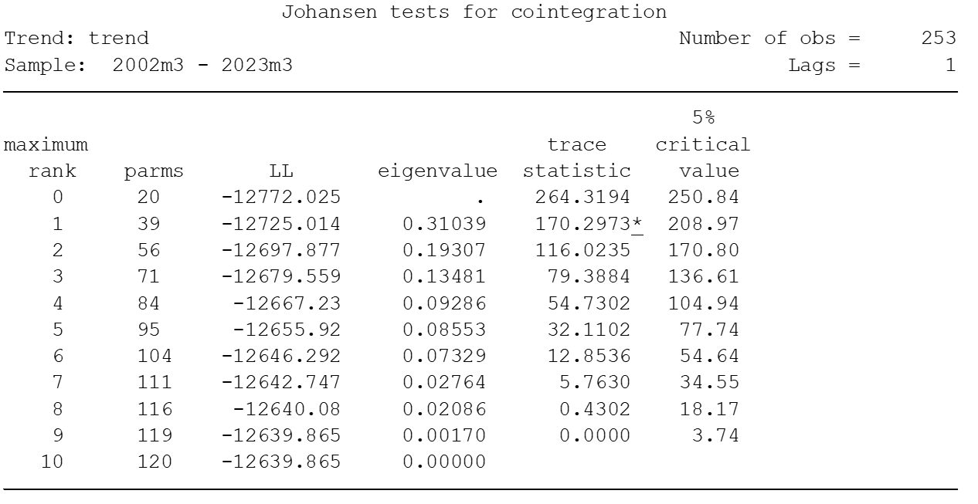
Table 4: Johansen tests for cointegration, Source: Estimates by the Author
The Trace Test indicates 1 cointegrating equation as the null hypothesis of r = 1 is rejected, meaning that there is 1 long-run equilibrium relationship between the variables.

Slide 26
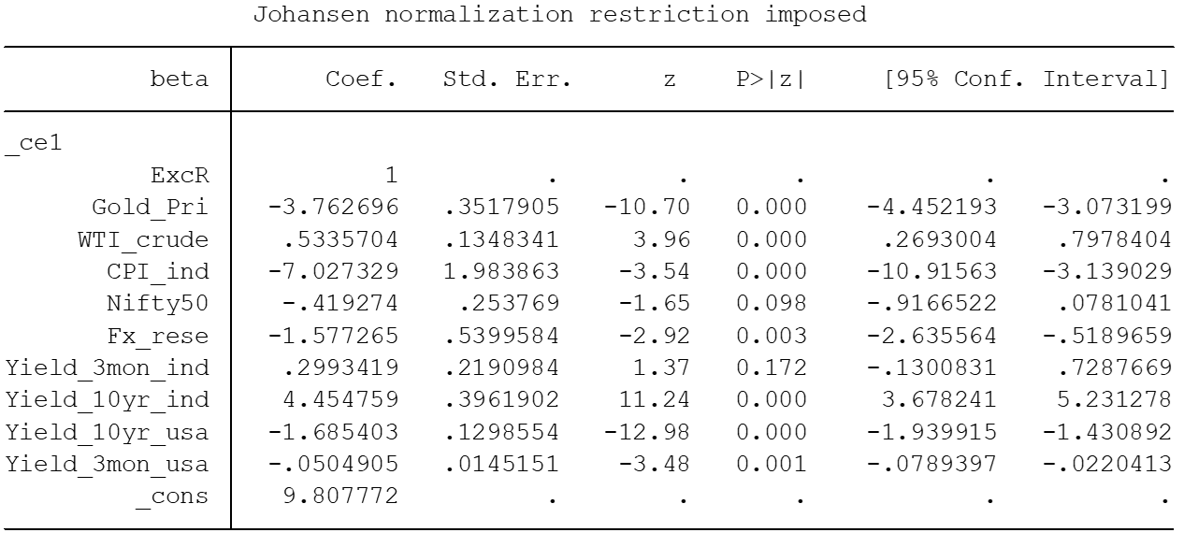
VECM Estimation for Long Run: Since all the variables are I(1), we take the percentage changes of all the variables, i.e., (Xt - Xt-1) *100 / (Xt-1).
Table 5: Vector error-correction model for INR/USD return, Source: Estimates by the Author

Slide 27
All the coefficients (except nifty50 and India's 3-month bond yield) are significant even at a 1% significance level, while nifty50 is significant at a 10% significance level.
The inflation rate is the main factor influencing the changes in the value of the INR/USD exchange rate.in the long run with the highest coefficient
1% increase in gold price leads to a decrease in the INR/USD value by 3%, the decline in the dollar value against rupees can be interpreted as a gold price increase in rupee denomination and vice versa
Value of WTI crude and INR/USD move hand in hand, which is in line with economic theory, as increases in the price of crude for a country that is a net importer of crude results in the depreciation of the currency of that country
Increase in the country's foreign exchange reserve will lead to the appreciation of the currency (INR), i.e. a decrease in the value of INR/USD
The 10-year bond yield of India and the USA are respectively with positive and negative coefficients, as an increase in long term bond yield is seen as sign of higher Inflation (above the acceptable range of central banks) which leads to investors moving away from investing in assets of that country which leads to depreciation of the domestic currency

Slide 28

Nifty50, is significant at a 10% level of significance, an increases in return on the Indian equity market value lead to increases in investment by foreign investors which in turn increases the demand for INR (domestic currency) leading to the appreciation of INR
This makes the long-run error correction term:
where all the variables are the percentage change from last month (or monthly returns).

Slide 29
Regression analysis between September 2021 to April 2023 to observe the effect of the macroeconomic variable on INR/USD during the recent high volatility post covid-19 period
We dropped Nifty50, USA's 3-month bond yield, and India's 3-month bond yield
VAR model to capture the effect of macroeconomic variables in the short run after performing the ADF test and finding the appropriate lag order
Results
All our selected variables to be non-stationary at the level and stationary at the first difference after the ADF test, for the selected time period.

Slide 30
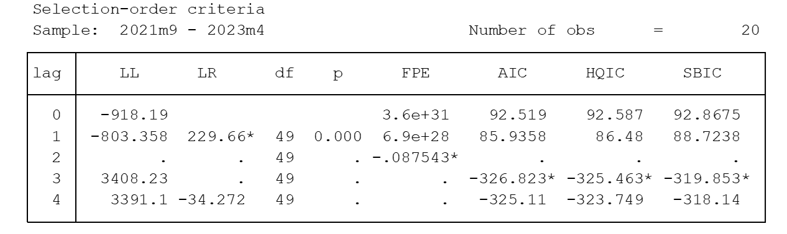
Table 6: Select order criteria for the VAR model, Source: Estimates by the Author
Based on Table 6 test result for lag order determination, we used the VAR model with lag order 3 to find the results as mentioned in Table 7
1st lag of gold prices has a negative effect on the exchange rate, and 2nd and 3rd lag of gold prices has a positive effect on the value of INR/USD at 1% level of significance.
1st lag of WTI crude has a positive effect, while 2nd and 3rd lag has a negative effect on the exchange rate at a 1% significance level.

Slide 31
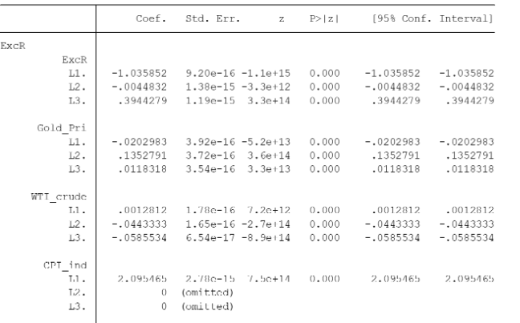
Inflation has the highest coefficient but has a positive effect on the value of INR/USD at 1st lag order at a 1% level of significance, which is according to our stated behaviour, i.e. the effect of Inflation is sharp and different when it is outside its acceptable Range decided by the central bank.

Slide 32
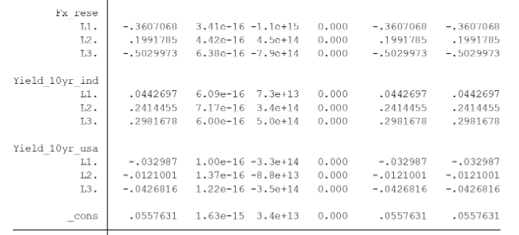
India's foreign exchange reserve has a negative effect at the 1st and 3rd lag order while a positive effect at the 2nd lag order at a 1% significance level
India's 10-year bond yield has a positive effect, and USA's 10-year bond yield has a negative effect on all 3 lag orders, respectively, at a 1% significance level.
Table 7: Vector Autoregression Test Results for the Period of Sep21 to April 23, Source: Estimates by the Author

Slide 33
Comparison with other countries' exchange rate
Next, we compared the changes in valuation of currencies of QUAD nations, BRICS nations, Euro, Pound-Sterling, Mexican Peso, South Korean Won and Indonesian Ruppee wrt USD post covid-19.
The period of comparison is between June' 21 to April 23
Observations:
We observe that INR/USD has devalued 12.26% on comparison between its maximum and minimum value, only bettered by IDR/USD at 10.83% and similar to CAD/USD at 12.02% and CNY/USD at 13.34%

Slide 34
 | The relative distance of maximum from the minimum value | The relative size of Range compared to the central spread
INR_USD | 12.2608 | 25.2626
EUR_USD | 22.2769 | 163.0429
GBP_USD | 23.9709 | 90.3495
CAD_USD | 12.0204 | 76.5553
JAY_USD | 33.8624 | 76.4488
AUD_USD | 19.9858 | 125.7366
KRW_USD | 27.0315 | 144.4791
CNY_USD | 13.3463 | 80.0196
RUB_USD | 64.3463 | 136.9197
ZAR_USD | 31.2396 | 74.0295
BRL_USD | 18.9319 | 289.173
IDR_USD | 10.8317 | 122.5768
MXN_USD | 15.6464 | 235.8464
Table 8: Percentage devaluation of currencies and relative size of Range compared to iqr
Source: Estimates by the Author

Slide 35
RUB/USD the most depreciating at 64.34% wrt its minimum value followed by other significant devaluation of JAY/USD at 33.86%, ZAR/USD at 31.23%, KRW/USD at 27.03%, GBP/USD at 23.97%, EUR/USD at 22.27%, AUD?USD at 19.98%, and BRL/USD and MXN/USD at 18.93% and 15.64% respectively.
INR/USD has the lowest kurtosis meaning it has the least heavy tails compared to others, and data points are more evenly spread out,compared to exchange rates with high kurtosis who likely to have more extreme values or a heavily pronounced tail either on left or right side of mean depending upon the sign of their skewness.
We can confer that INR, like all currencies, has devalued wrt USD post covid-19 but has performed relatively much better than both in terms of its percentage devaluation, presence of extreme values when compared to the mean based on its kurtosis, and the spread of Range compared to the relative spread of inter-quantile Range.
Among important global economic groups such as QUAD and BRICS, of which India is a vital part, we can conclude that INR has performed best among all currencies when compared their devaluation against USD
Also, is also one of the top-performing currencies among G-20 nations.

Slide 36
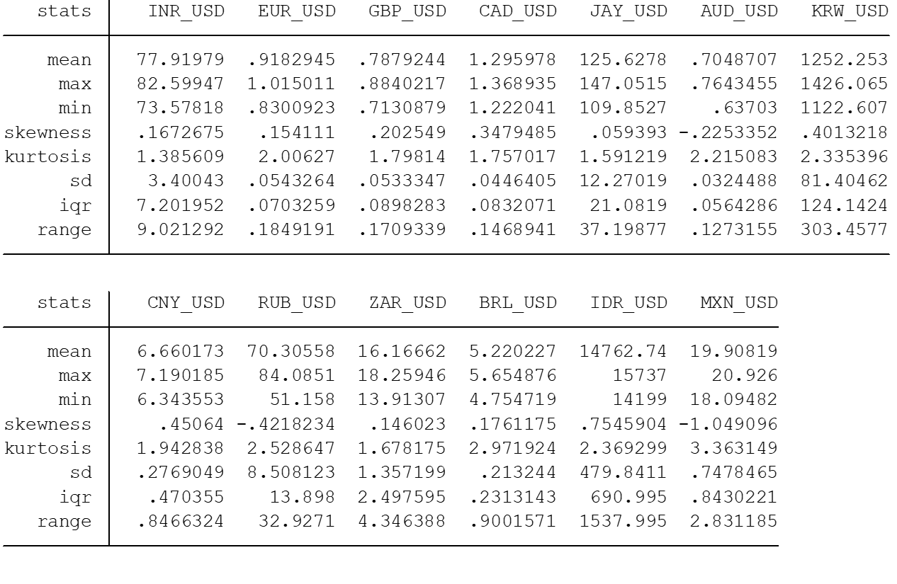
Table 9: Descriptive Statistics of Exchange Rate
Source: Estimates by the Author

Slide 37
Conclusion and Discussion
For the Period of Feb 2002 to Apr 2023 we found that movement in INR/USD has a negative relation to gold prices, cpi India, India's foreign exchange reserve, USA's 10-year bond yield and USA's 3-month bond yield and positive relation with WTI crude price, India's 10-year bond yield has a positive correlation with INR/USD at 1% level of significance, while nifty50 has negative correlation at 10% level of significance
In the short period of high fluctuations in INR/USD we fund that except for CPI India, all variables have the same correlation with the exchange rate (in terms of the direction of their effect) at 1st lag order, while Inflation in a high volatility period during which it was outside its acceptable Range has a positive effect at 1st lag order on the exchange rate of INR vis-a-vis USD.

Slide 38
To comment on the recent discussion of whether the INR has lost its value or USD has strengthened, we compared INR devaluation to other currencies devaluation wrt USD, and concluded that INR has performed much better compared to all the currencies around the world in terms of its relative extreme values during the period and relative variation in its Range compared to the inter-quantile Range
The Study does not consider the devaluation of INR a bad thing for the Indian economy, rather devaluation of INR for the highly growing economy is good for the overall increase in export of the Indian economy as long as the exports are also rising for the Indian economy.
The study considers sudden fluctuations and sharp devaluations to be bad for the economy as they can lead to the exit of foreign investors, loss for the Indian companies operating at the global level while also making the financial market unattractive due to high volatility, a sudden increase in current account deficit which in turn cause the downfall in GDP d

Slide 39
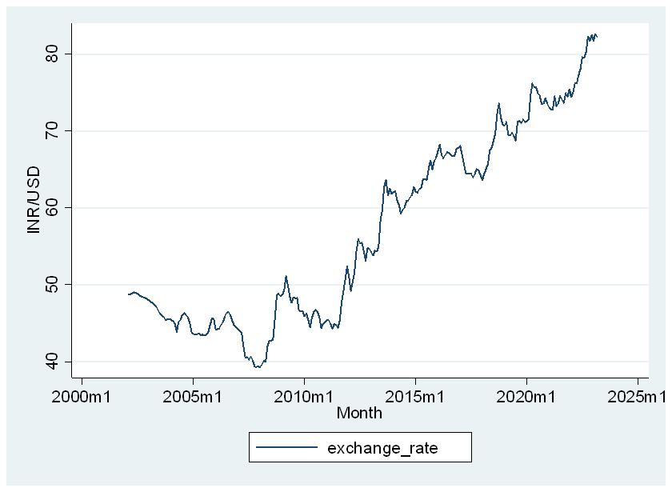
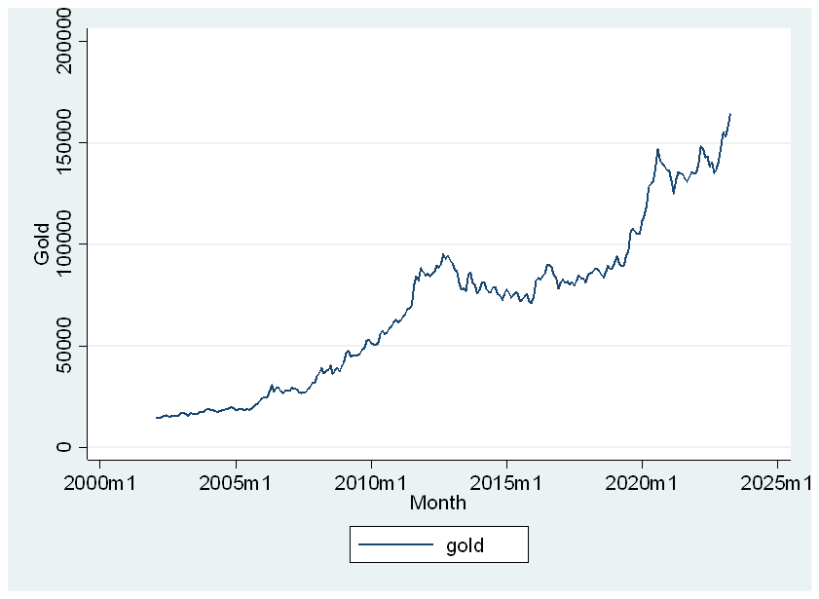
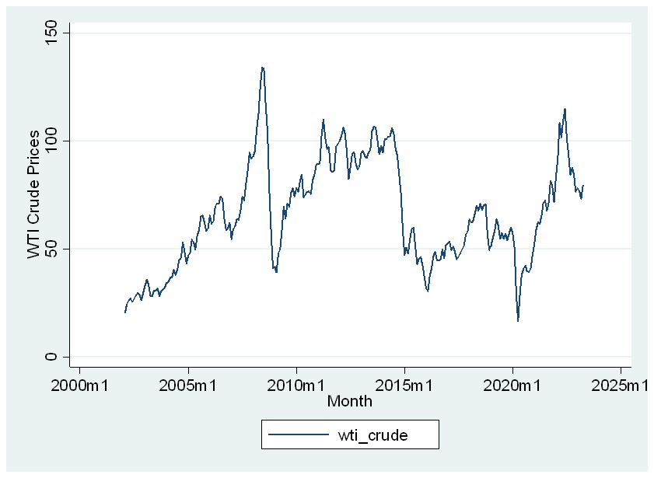
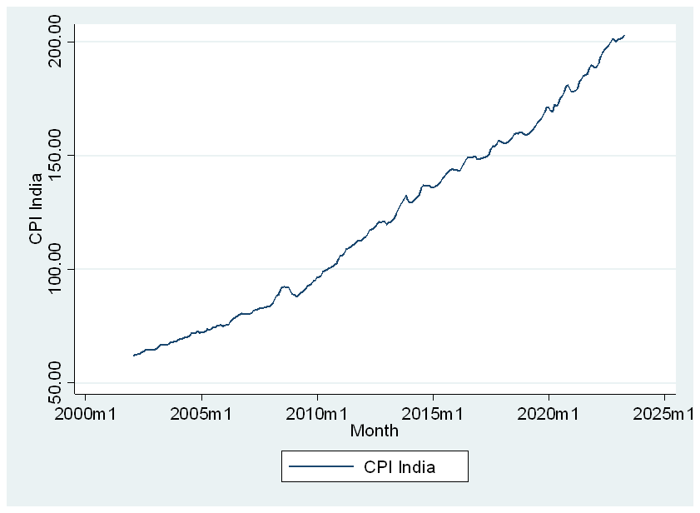
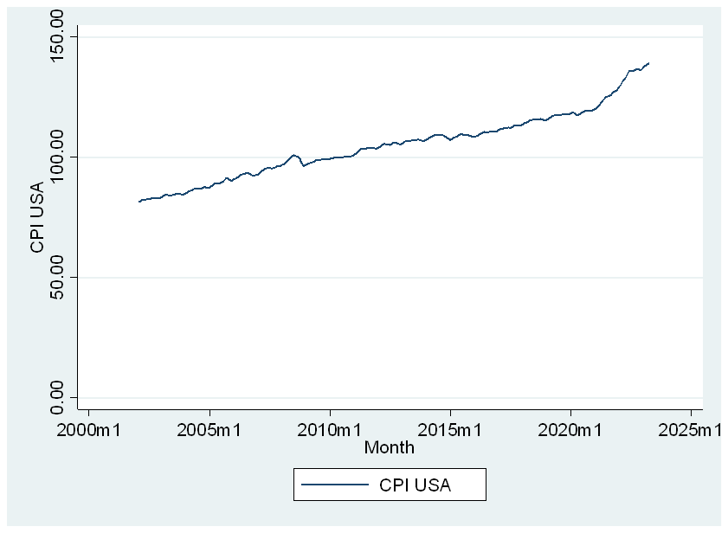
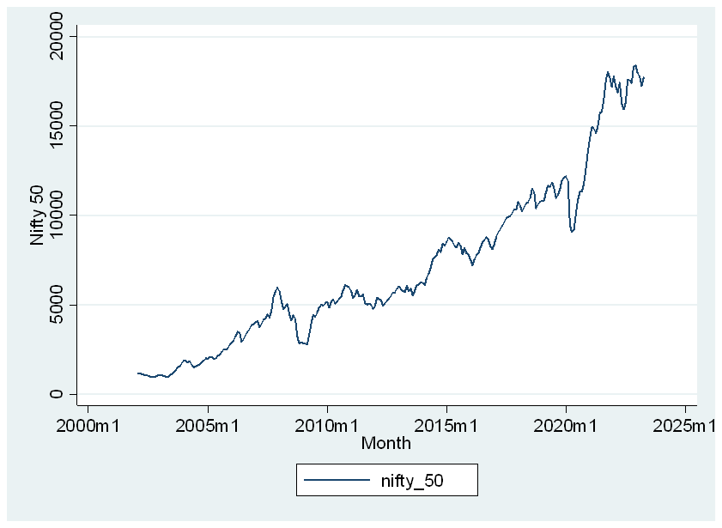

Slide 40
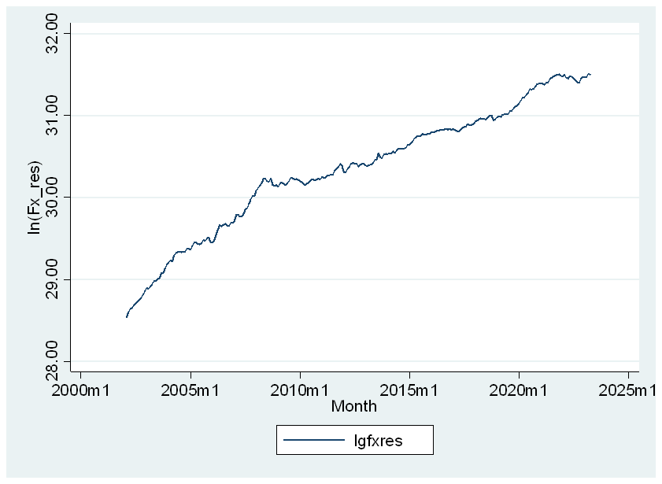
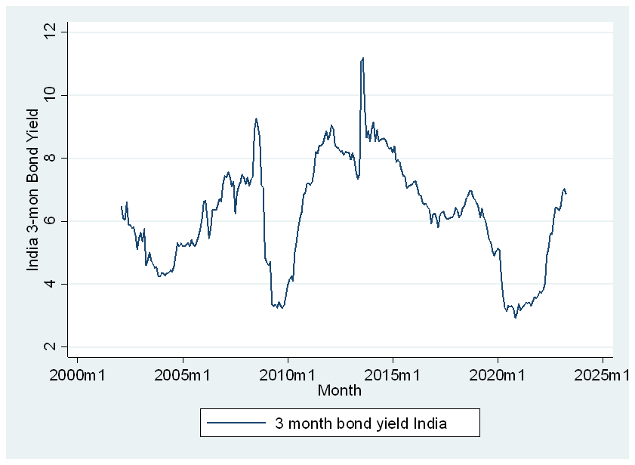
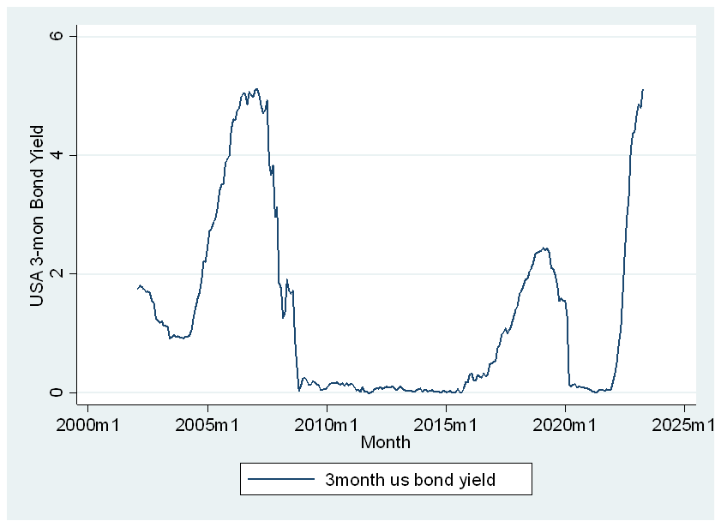
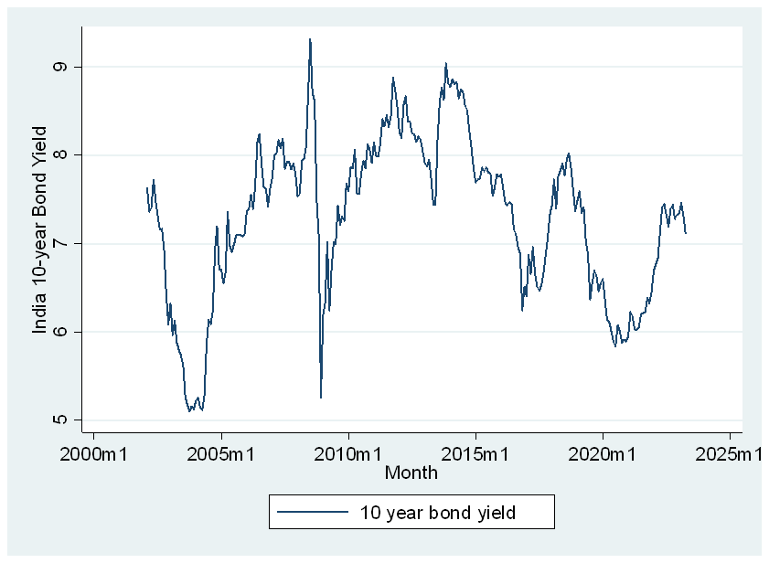
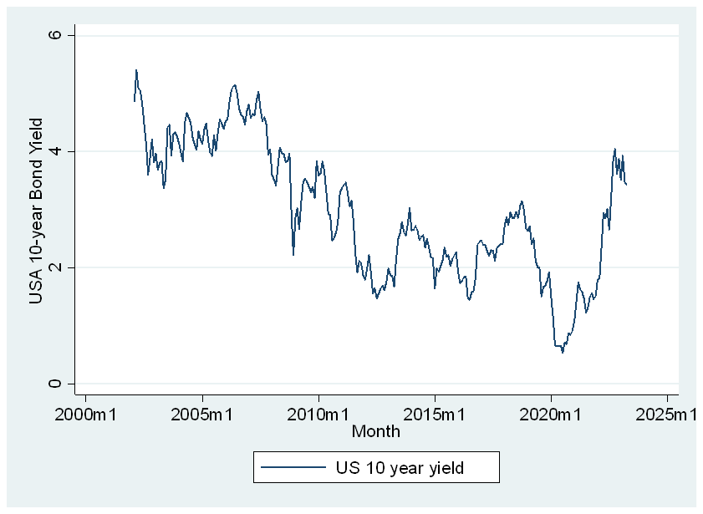

Slide 41
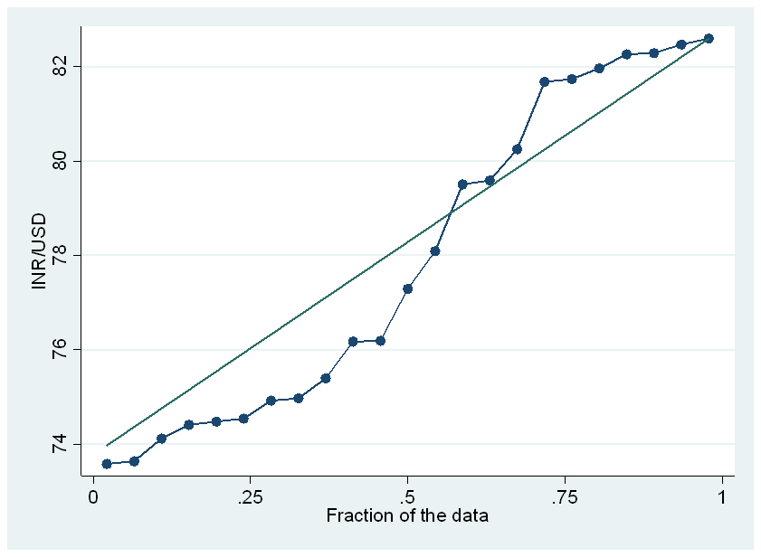
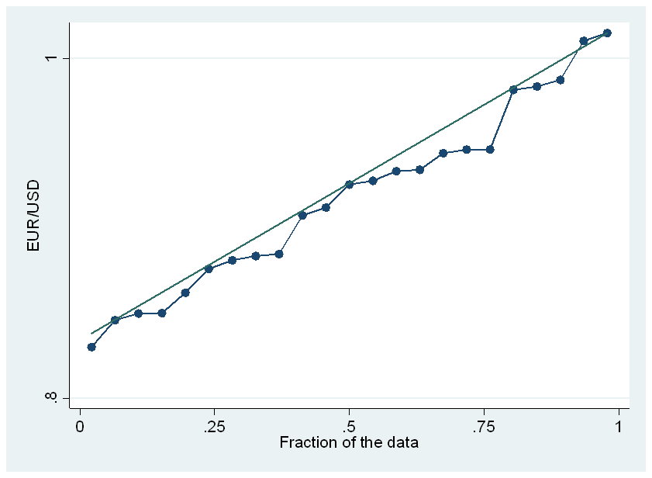
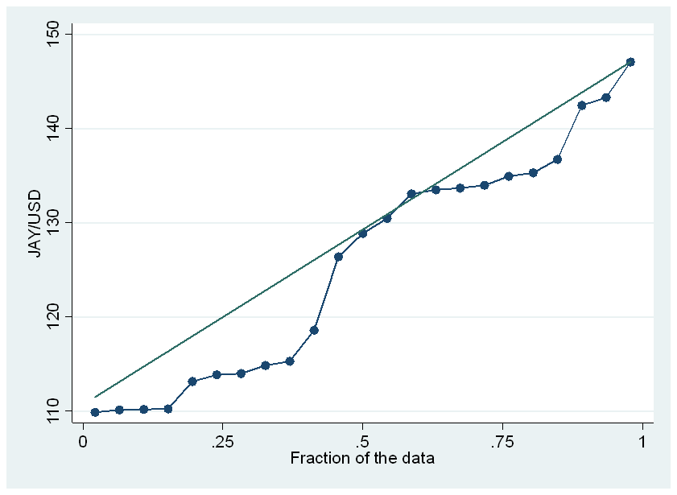
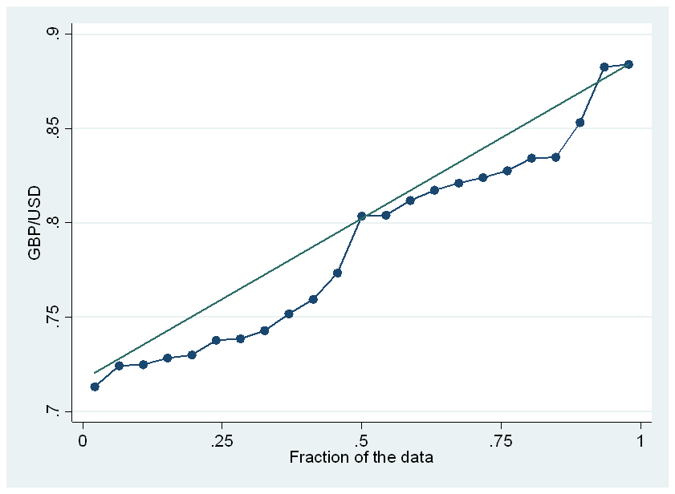
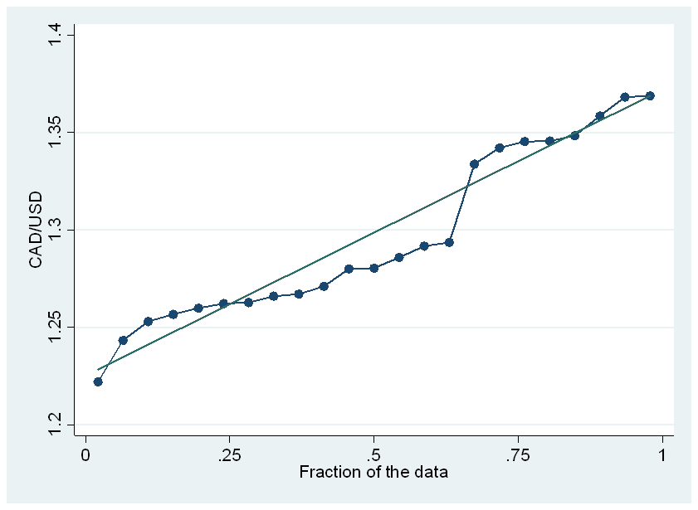

Slide 42
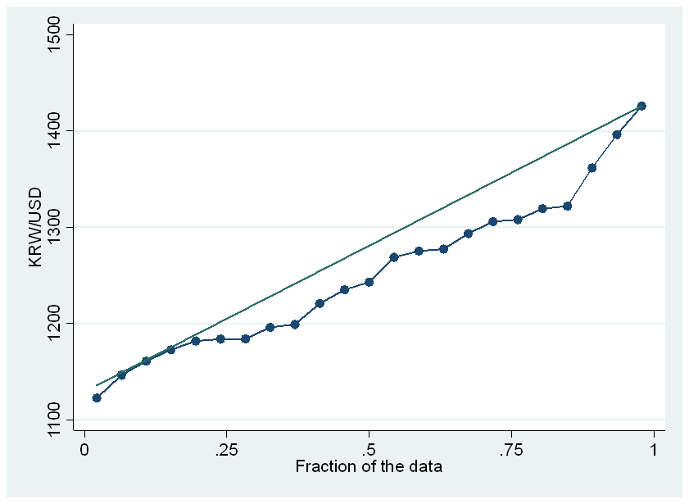
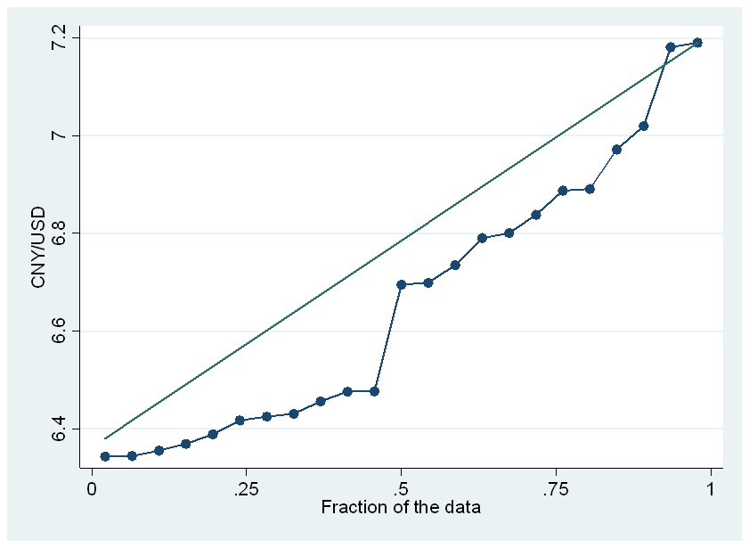
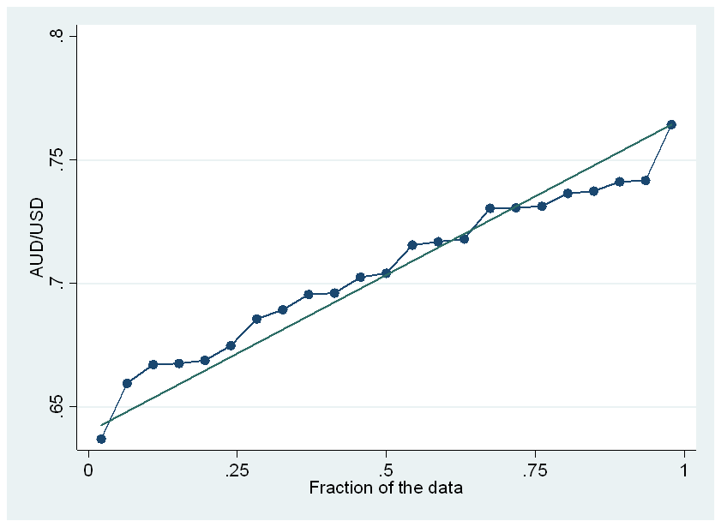
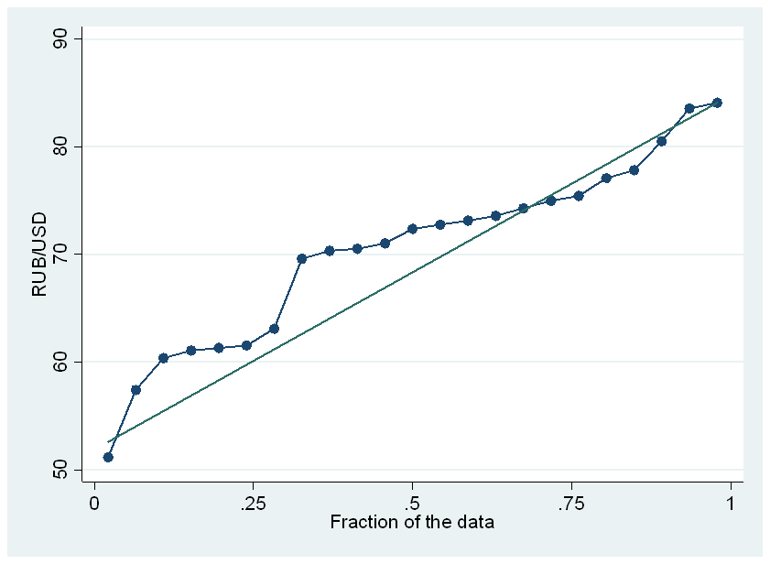
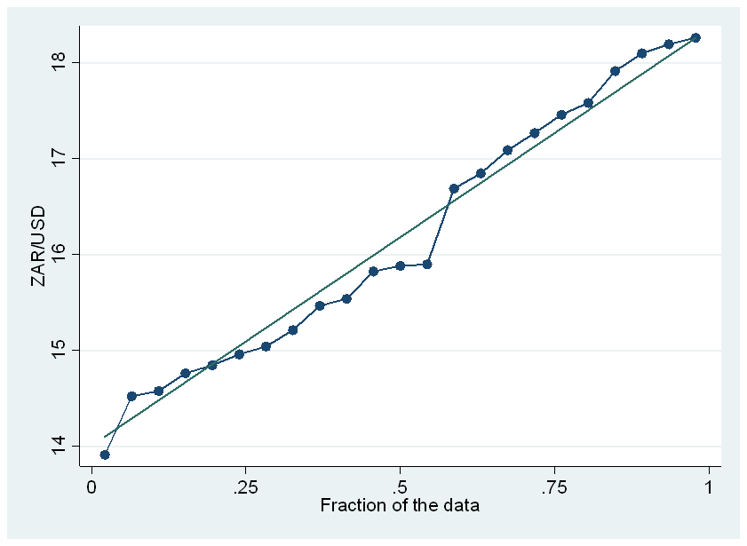

Slide 43
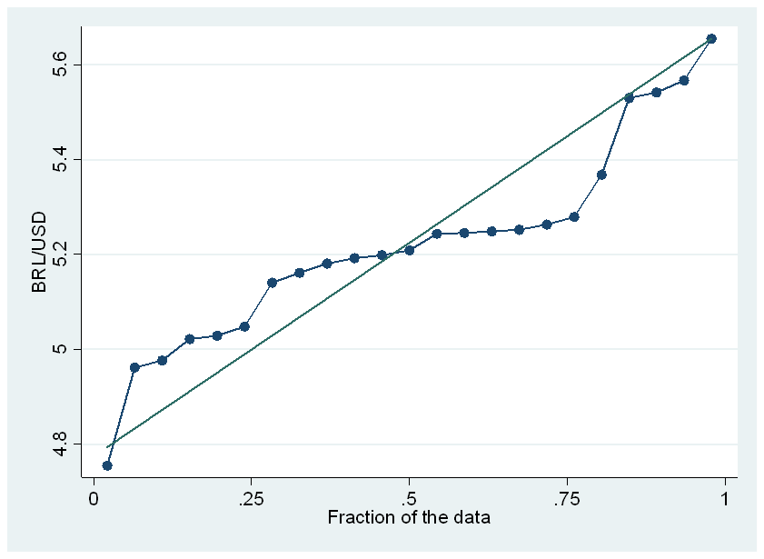
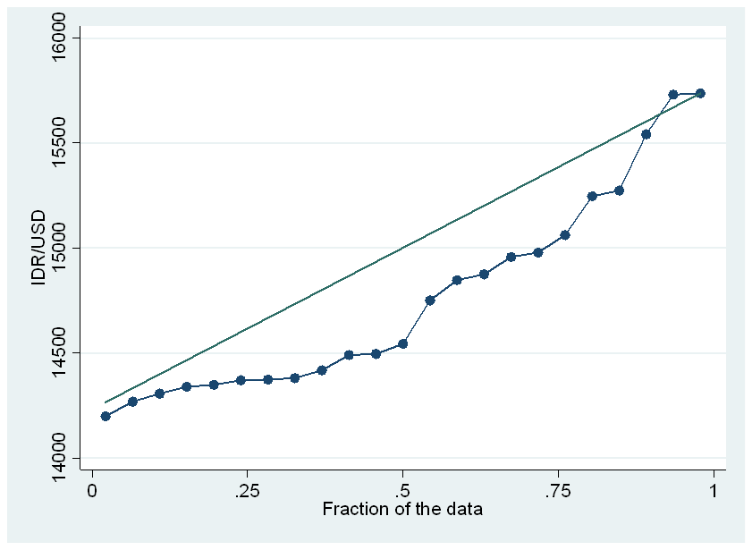
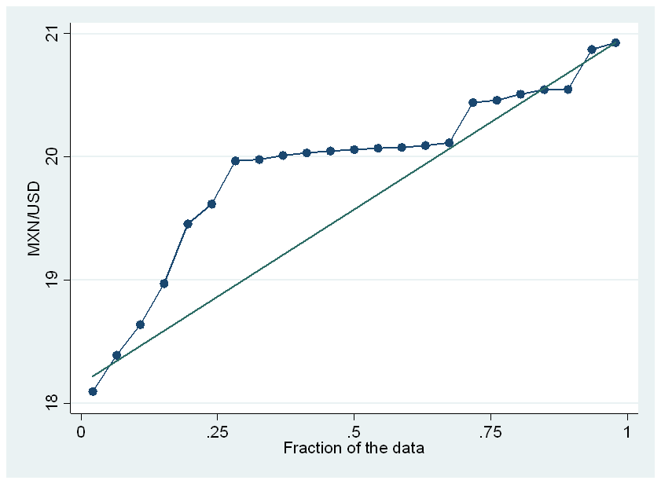

Slide 44
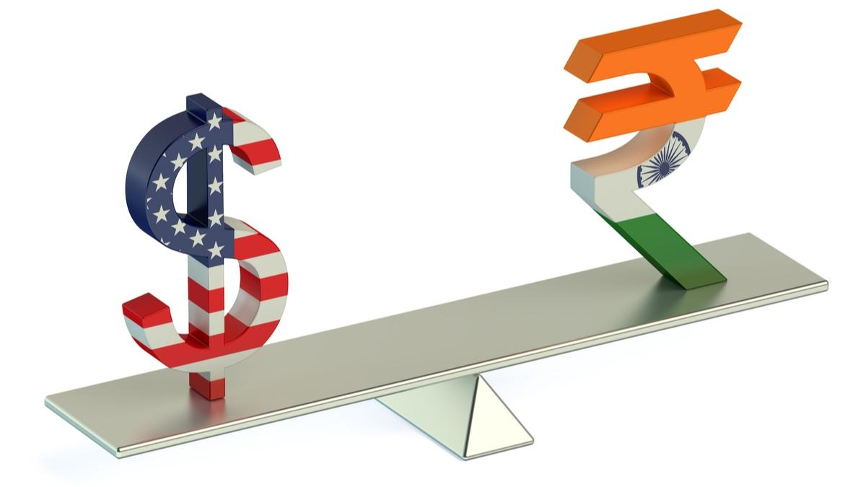
Thank You

