Slide 1

Data Engineer Case Study
- Manu Raghuvanshi

Slide 2
Agenda
Introduction to the Dataset
Code Walkthrough
Analysis
Data Warehousing
Challenges Faced
Q&A

Slide 3
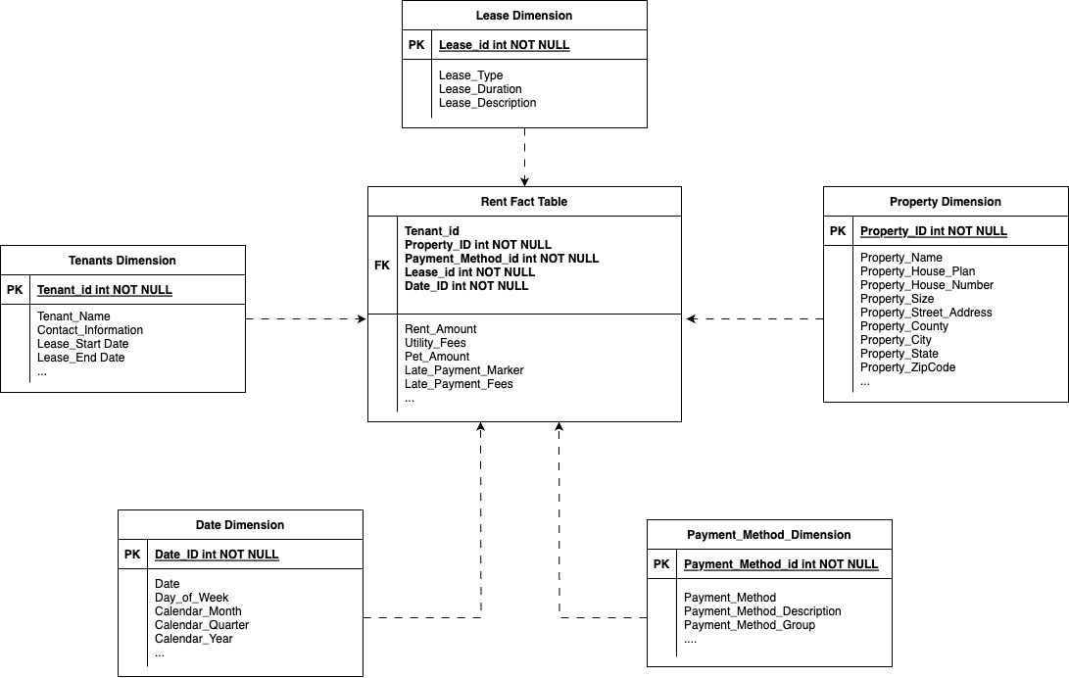
Data Warehousing
Data Warehouse setup to track rent activity

Slide 4
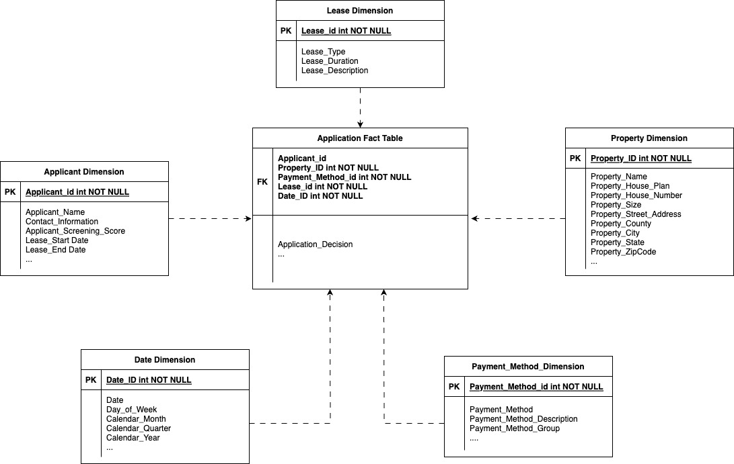
Data Warehousing
Data Warehouse setup to track applicant activity

Slide 5
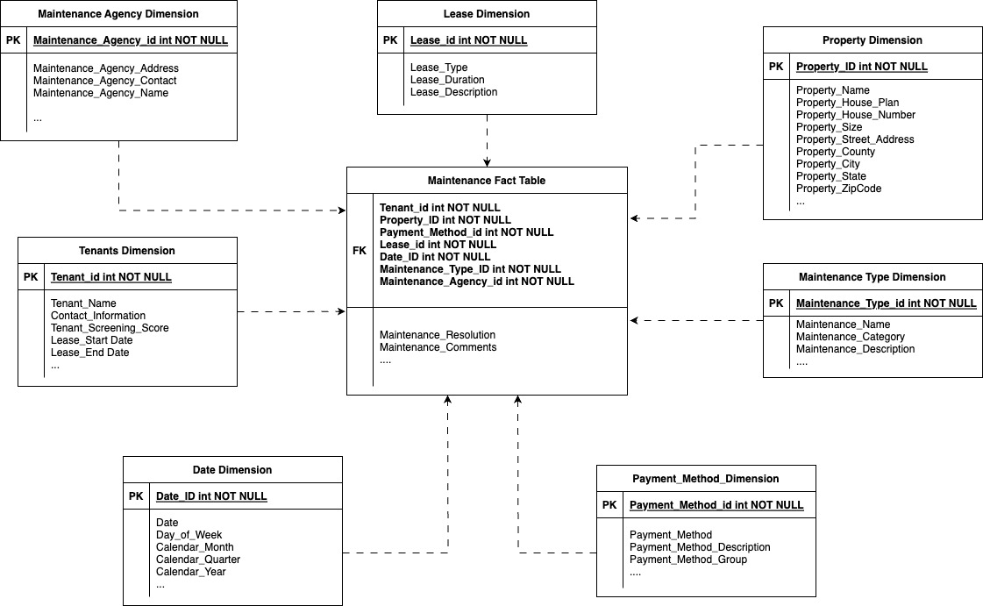
Data Warehousing
Data Warehouse setup to track maintenance activity

Slide 6
Challenges Faced
Generating random data
Extracting analysis
Determining which technology to choose

Slide 7
Q&A

Slide 8
Thank you!

