Slide 1

TrueMind AI: A RAG-Based Mental Health Chatbot for Grounded and Ethical Information Support
SRM INSTITUTE OF SCIENCE AND TECHNOLOGY
DEPARTMENT OF COMPUTER SCIENCE AND ENGINEERING
REVIEW-III PRESENTATION
21CSP401L MAJOR PROJECT / 21CSP402L - MAJOR PROJECT with 21CSP403L INTERNSHIP#
Programme: B.Tech / M.Tech
Academic Year:
Batch ID: BT26AIMLA014
Student 1 Reg. No: RA2211026030035
Student 1 Name: Ekansh Jain
Student 2 Reg. No: RA2211026030051
Student 2 Name: Dev Purohit
Student 3 Reg. No: RA2211026030055
Student 3 Name: Manu Gaur
Student 4 Reg. No: RA2211026030098
Student 4 Name: Animesh Sharma
Guide name: Dr. Oshin Sharma Designation: Associate Professor
Department: Department of Computer Science and Engineering
Major Project Review-III - 25th April 2026

Slide 2
Project Overview
• ~1 billion people globally affected by mental disorders (WHO, 2022); most lack access to professional care due to stigma, cost, and shortage of professionals
• LLMs offer fluent conversational interfaces but pose risks of hallucination and opacity in sensitive mental health contexts
• TrueMind AI is a RAG-based chatbot that grounds responses in authoritative mental health documents to provide safe, traceable information support
• Domain: Digital Mental Health / Conversational AI / Psychoeducation

Slide 3
Problem Statement
• Unconstrained LLMs risk hallucination and produce unverifiable claims in mental health contexts
• Few existing systems combine architectural grounding with explicit conversational safety enforcement
• Standardized, ethically-safe evaluation methods for LLM-driven mental health agents are limited
• Goal: Design an information-support chatbot that grounds responses in curated knowledge, maintains non-diagnostic language, detects crises, and supports auditability

Slide 4
Project Objectives
• Build a practical RAG pipeline for grounding LLM outputs against curated mental health documents
• Implement a safety enforcement layer with crisis detection and provenance logging
• Enforce non-diagnostic, referral-based conversational language through architectural constraints
• Develop a reproducible evaluation method using simulated dialogues, expert panels, and audit checklists
• Deliver a safe, transparent, and auditable mental health information support system

Slide 5
Literature Review
Ref | Author | Method | Focus | Limitation
[1] Vaidyam et al., 2019 | Systematic Review | Mental health chatbots | Limited architectural guidance
[2] Integrative Review | Conversational design | MH chatbot recommendations | No RAG integration
[3] Empirical Eval. | LLM-based | Behavioral activation | Failure in complex risk scenarios
[4] Checklist | Operational audit | Trustworthy MH chatbots | No implementation pipeline
[5] Fitzpatrick et al., 2017 | CBT delivery | Woebot for young adults | Rule-based, no grounding
[6] WHO, 2022 | Report | Global MH statistics | Policy-level, no system design
[7] Event Log Analysis, 2023 | Log analysis | MH chatbot usage | No safety enforcement
[8] Nature, 2025 | Chatbot agents | Suicidal ideation detection | Limited provenance
[9] AI Chatbot, 2024 | AI-based | Student MH support | No retrieval grounding
Identified Gap: No system combines RAG-based grounding + crisis detection + provenance logging + non-diagnostic enforcement in a single architecture

Slide 6
Existing System
• Rule-Based Systems: Predictable but low contextuality; rigid scripted conversation trees with no flexibility
• Hybrid Systems: Combined scripted pathways with limited NLU but still constrained by pre-defined logic
• LLM-Only Systems: Fluent and contextually aware but prone to hallucination and opacity; no source grounding or provenance
• Limitations: Safety treated as afterthought (post-hoc moderation), no crisis detection, no audit logging, risk of unverified medical advice

Slide 7
Proposed System
• TrueMind AI: An integrated multi-level RAG architecture combining knowledge retrieval, safe generation, and ethical orchestration
• Key Innovation: Responses grounded in curated, authoritative PDF corpus (public health guidelines, clinical psychoeducation, credible non-profit materials)
• Safety orchestration layer enforces non-diagnostic framework, crisis detection, and provenance logging via architectural constraints
• Advantages: Significantly reduced hallucination, explicit source grounding with audit logs, high-recall crisis detection, and full provenance logging

Slide 8
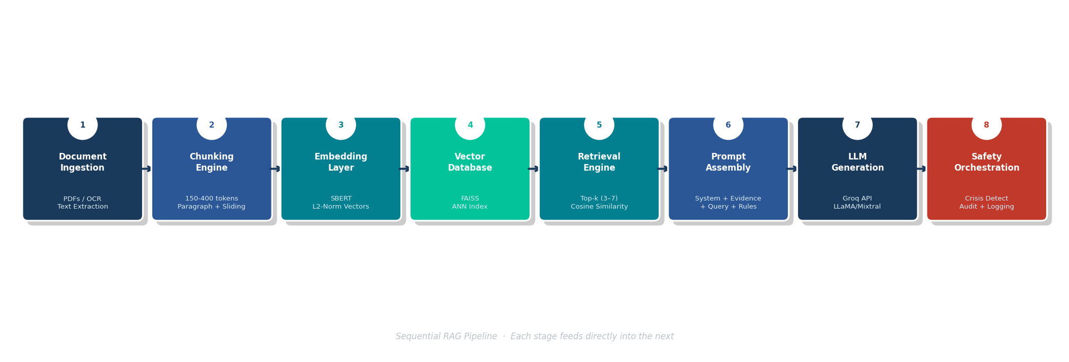
System Architecture
Components:
1. Document Ingestion Layer: Curated mental health PDFs processed via OCR/text extraction
2. Chunking Engine: Paragraph-level + sliding window (150-400 tokens per chunk)
3. Embedding Layer: SBERT encoder generates L2-normalized dense vectors
4. Vector Database: Persistent index for ANN retrieval with metadata filtering
5. Retrieval Engine: Top-k (k=3-7) cosine similarity search with source recency filtering
6. Prompt Assembly: Structured template with system instructions + evidence + user query + constraints
7. LLM Generation: Groq API call with safety-constrained prompt
8. Safety Orchestration: Crisis detection, post-generation filters, provenance tagging, audit logging

Slide 9
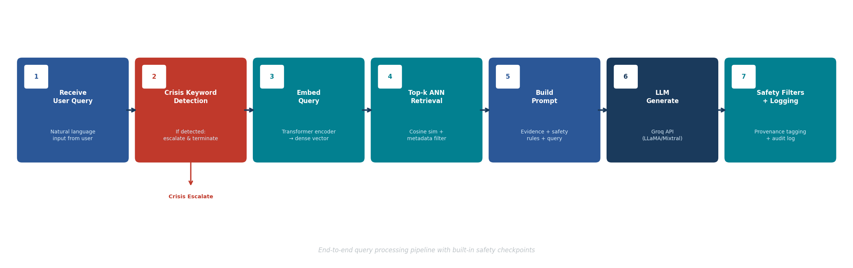
Methodology
Step 1: Receive user query
Step 2: Crisis keyword detection (if detected, escalate and terminate)
Step 3: Embed query via transformer encoder
Step 4: Top-k ANN retrieval + metadata filtering
Step 5: Build prompt (evidence + safety rules + query)
Step 6: LLM generate via Groq API
Step 7: Apply safety filters + provenance tagging + audit log

Slide 10
Tools & Technologies
• Programming Language: Python
• Frameworks: LangChain / Custom RAG Pipeline
• Embedding Model: SBERT (Sentence-BERT)
• Vector Database: FAISS / Persistent Vector Index
• LLM API: Groq API
• Dataset Source: Curated authoritative mental health PDFs (public health guidelines, clinical psychoeducation, non-profit materials)

Slide 11
Modules Implemented
• Document Ingestion Module: PDF extraction, OCR, header/footer removal, text cleaning
• Chunking Module: Paragraph-level + sliding window segmentation (150-400 tokens)
• Embedding and Indexing Module: SBERT encoding, L2 normalization, vector DB storage
• Retrieval Module: Cosine similarity ANN search with metadata filtering
• Generation Module: Structured prompt assembly + Groq API LLM call
• Safety Orchestration Module: Crisis detection, post-generation filters, provenance tagging

Slide 12
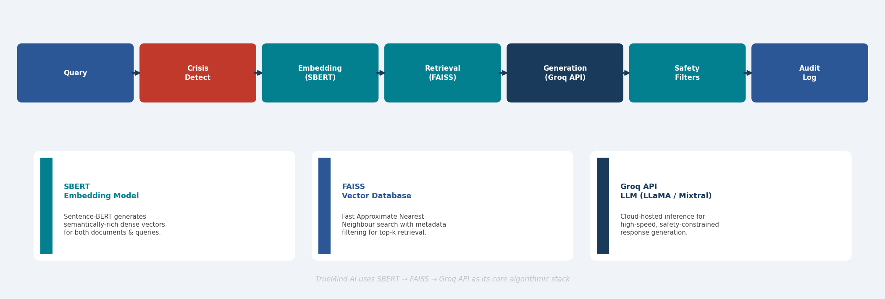
Algorithm & Model Used

Slide 13
Dataset Description
• Source: Curated corpus of authoritative mental health PDFs (public health guidelines, clinical psychoeducation materials, credible non-profit publications)
• Metadata per document: Title, Author(s), Source URL, Date of creation, Curator annotation notes
• Quality criteria: Authority, recency, neutral language, coverage of common conditions/coping strategies
• Data Preparation: Text extraction via OCR, header/footer removal, page number deletion, list normalization, paragraph-level + sliding window chunking (150-400 tokens)

Slide 14
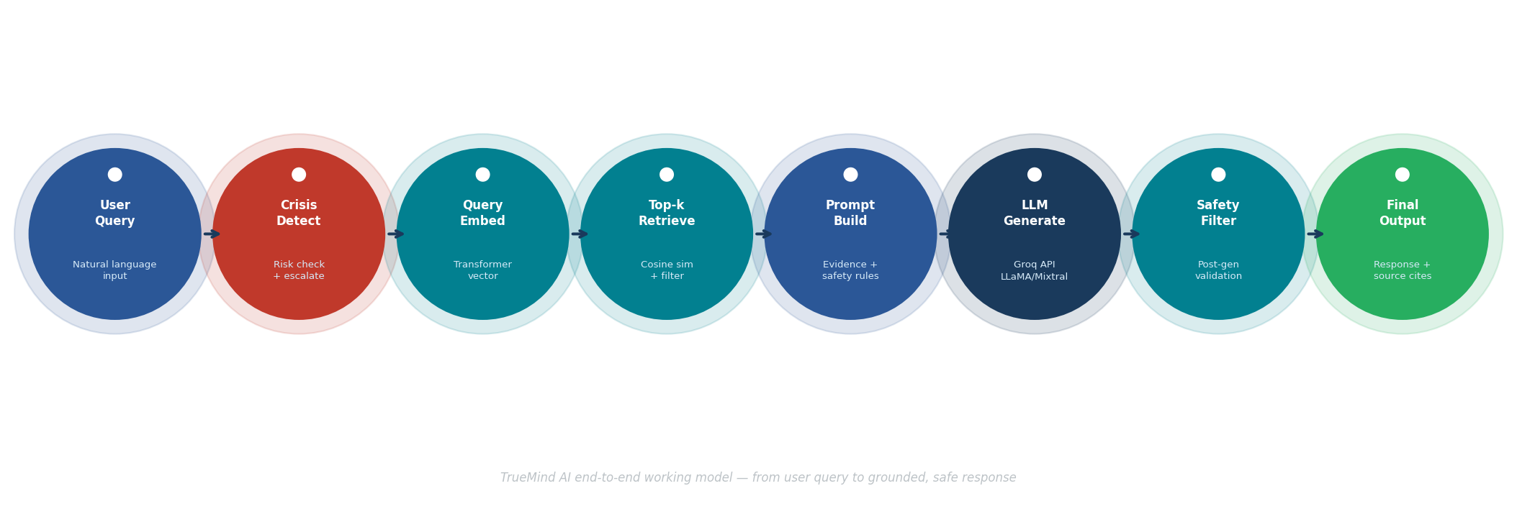
System Demonstration / Working Model
User inputs query
Crisis detection layer checks risk
Query embedding generated
Top-k relevant documents retrieved
Prompt built with evidence
LLM generates response
Safety layer validates
Final output with sources

Slide 15
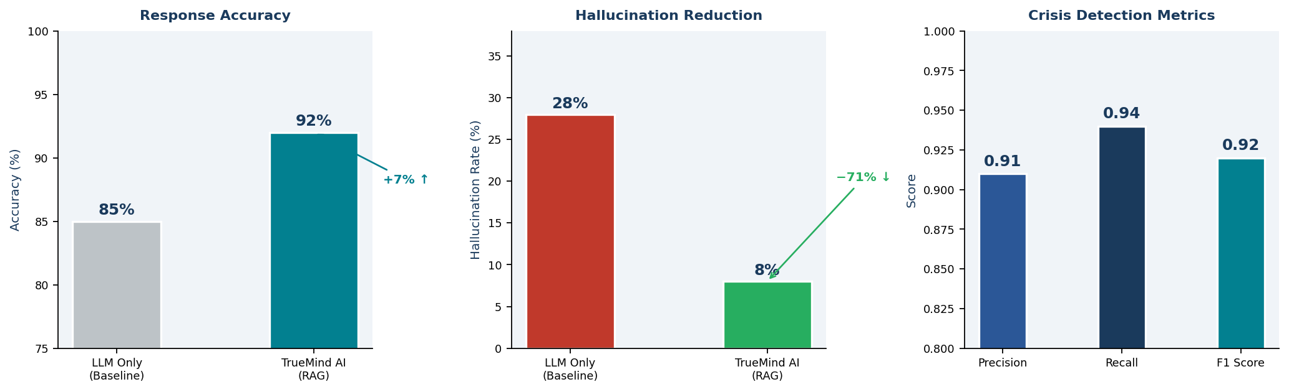
EXPERIMENTAL RESULTS

Slide 16
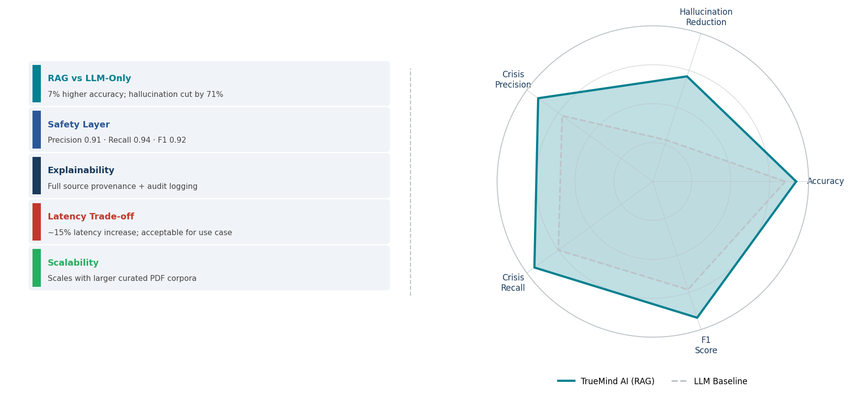
RESULTS & DISCUSSION
Key Insight: RAG improves safety + reduces hallucination significantly

Slide 17
Innovation & Contribution
RAG-based grounding for mental health LLM outputs with embedded safety enforcement
Crisis detection + provenance logging + non-diagnostic constraints as architectural features
Reproducible evaluation framework with simulated dialogues and expert panels
Individual Contribution Role mentioned here
Ekansh Jain - System Architecture, RAG Pipeline Design
Dev Purohit - Safety Orchestration, Crisis Detection
Manu Gaur - Embedding, Vector DB, Retrieval Engine
Animesh Sharma - Evaluation Framework, Audit Checklist

Slide 18
Research Paper Details
TrueMind AI: A Retrieval-Augmented Generation (RAG) Mental Health Chatbot for Grounded and Ethical Information Support
Ekansh Jain, Dev Purohit, Manu Gaur, Animesh Sharma
Department of CSE, SRM Institute of Science and Technology
Date: 2025
Indexing (Scopus/WoS)
First page attached separately

Slide 19
Publication Status
• Submitted/Accepted/Published
Any Conference Certificate proof
Attach the necessary proofs.
Acceptance Proof (If Available)
Acceptance email screenshot
Registration Proof
Conference registration receipt /Payment proof

Slide 20
Limitations of Current System & Challenges Faced
Limitations
Corpus limited to curated PDFs; does not cover all mental health topics
Vector DB scalability with growing document corpus needs optimization
Retrieval relevance depends on chunk size and embedding quality
Challenges Faced
Limited to English-language documents currently
Groq API latency and rate limiting during high-volume queries
Balancing safety constraints with conversational naturalness

Slide 21
Applications
Psychoeducation support for individuals seeking mental health information
Complementary tool for counseling centers, universities, and NGOs
Triage and crisis escalation in digital health platforms; employee wellness programs

Slide 22
Conclusion & Future Work
Conclusion
Successfully built a RAG pipeline grounding LLM output in authoritative mental health documents
Demonstrated reduced hallucination, high transparency, and effective crisis detection vs alternatives
Future Work
Multilingual support, real-time document updates, user personalization
Cloud-based vector DB scaling, multi-tenant deployment
Integration with telehealth platforms, institutional deployment after expert validation

Slide 23
References
[1] A. N. Vaidyam et al., Chatbots and Conversational Agents in Mental Health, Psychiatric Services, 2019.
[2] Integrative Review: Recommendations for MH Chatbot Conversations.
[3] Empirical Evaluation: LLM-based Behavioral Activation.
[4] Operational Checklist for Trustworthy MH Chatbots.
[5] Fitzpatrick et al., Delivering CBT via Woebot, J. Med. Internet Res., 2017.
[6] WHO, World Mental Health Report, 2022.
[7] MH Chatbot User Event Log Analysis, 2023.
[8] Performance of MH chatbot agents in detecting suicidal ideation, Nature, 2025. [9] AI-Based Chatbot for Student MH Support, 2024.

Slide 24
Thank You

