Slide 1

STM32WBA Workshop GPDMA

Slide 2


Agenda
#
Overview
#
Structure of example
#
ADC+UART+TIM with LLI controlled GPDMA
#
Conclusion
Theory
#
What’s next
Hands-on

Slide 3
DMA overview

Slide 4
DMA overview
A new DMA module
2 hardware instances
GPDMA with symmetric configuration
Dual port DMA with dedicated path to APB
Integrated DMAMUX features
Linked-list based programming
Flexible intra-channel and inter-channel input/output control
Run-time isolation features
Off-load CPU for data transfers from a memory-mapped source to a memory-mapped destination
Application benefit
Notes:
Possiamo fare linked list programming – sequenza di differenti transfer, che e’ quello che dimostriamo in questo handson
Ovviamente lo scopo e’ quello di offlodare la cpu

Slide 5
GPDMA integration
STM32F4x9
STM32H563
APB1
DMA1
DMA2
APB2
TZ
TZ
Periph
Mem
Periph
GPDMA1
GPDMA2
MPCWMx water-mark
memory protection controller
Mem
port0
port1
port0
port1
FLASH
FLASH
MPCBBx block-based MPC
SRAM1
117Kb
SRAM1
SRAM2
16Kb
SRAM2
SRAM3
64Kb
APB1
SRAM3
AHB2
AHB1
BKSRAM
AHB1
APB2
AHB2
FMC
OTFDEC
OCTOSPI
FMC
AHB4
Notes:
Comparazione con F4
DMA1 nell’F4 era connesso a periferiche diverse vs DMA2
In H5 GPDMA1 e 2 possono interfacciarsi con le stesse periferiche
Port1 di solito e’ suggerita per le memorie
Port 0 suggerita per accedere alle periferiche
Dual DMA, managing requests in //. It is easy to split DMA configuration
Dual port managing in // transfers on the bus
Split between slow & fast

Slide 6
GPDMA key features 1/2
Bidirectional AHB master port(s): GPDMA1/2: 2 ports
Memory-mapped data transfers from a source to a destination
Peripheral-to-memory
Memory-to-peripheral
Memory-to-memory
Peripheral-to-peripheral
Autonomous data transfers during Sleep mode
8 Concurrent DMA channels for each controller
Transfers arbitration is based on a 4-grade priority policy
One reserved highest priority queue for time-sensitive traffic
Three lower priority queues with weighted round robin allocation
Notes:
Possiamo supportare diversi tipi di transfer mem/mem periph/mem mem/periph
Possiamo transferire in sleep mode in maniera autonoma
Possiamo avere 8 differenti transfer concorrenti avendo 8 canali
Abbiamo 2 controller con 8 channel vs 1 controller 16 channels in stm32u5
Abbiamo una lista di priorita’ – 4 livelli, l’ultimo e’ un real time priority che blocca ogni altro data transfer

Slide 7
GPDMA key features 2/2
GPDMA data handling
Byte-based reordering
packing/unpacking
Linear addressing mode
Fixed addressing (typically for peripheral data register)
Contiguously-incremented addressing (typically for memory access)
Blocks up to 64kB (16-bit BNDT)
2D addressing mode (ch6..7), additional
Repeated block mode: programmable repeated block counter (11-bit BRC, up to 2k blocks)
Programmable source/destination signed burst address offset (2x 14bit, up to +/-8kB)
Non-contiguous incremented/decremented addressing after each burst
Programmable source/destination signed block address offset (2x 17bit, up to +/-64kB)
Non-contiguous incremented/decremented addressing after each block
padding/truncation
sign extension
left / right alignment
Notes:
Possiamo riordinare I buffer e riallineare I bytes, possiamo fare padding
Linear addressing supportato da tutti I canali– possimao rimpire parte della memoria
2 canali per controller supportano il 2D addressing mode ad esempio in grafica e audio viene utilizzato per fare sorting dei dati

Slide 8
GPDMA linked-list register file
The GPDMA will use nodes for those registers
TR1 - Transfer register 1
TR2 - Transfer register 2
BR1 - Block register 1
SAR - Source address register
DAR - Destination address register
TR3 - Transfer register 3 ... SA & DA offsets incremet for 2D
BR2 - Block register 2 ... block repeated SA & DA offsets for 2D
LLR - Linker list register ... link to next LL node & update parameters In our case each linked list node will update this GPDMA registers after previous GPDMA node is finished. This is automatically reconfiguring the GPDMA channel.
Notes:
Linked list mode
E; una struttura in memoria che contiene la struttura per il transfer
Nella structure abbiamo il linked list register che punta all item successivo

Slide 9
DMA block diagram
GPDMA
Channel datapath and transfer input control
Arbitration
Transfer output control
AHB master port 0
32-bit AHB
DMA requests
Channel 7
Data transfer generation
DMA triggers
Channel1
Link transfer generation
AHB master port 1
Channel0
32-bit AHB
DMA clock
AHB slave interface
Interrupt generation
DMA channel interrupt
DMA global registers
DMA channel registers
Event generation
DMA channel xfer complete
Stop DMA channel
in debug mode
Channel 7
Channel state management
Channel1
Security and privilege management
DMA illegal event (vs. security)
Channel0
Clock management
DMA clock request
32-bi t
AHB
Notes:
Abbiamo DMA request, trigger per triggherare I transfer, 8 channel slave ahb slave, master port
Contiene la security and priviledge menagment – alcuni canali DMA possono essere sicure e priviledge ad esempio per bloccare l’accesso ad alcune memorie/periferiche

Slide 10
DMA specific implementation & user guidelines
Feature | GPDMA
Master port(s) | 2x (32-bit) AHB (*)
DMA transfers | Single and bursts
DMA scheduler | FIFO-based bursts (dual issue)
Number of channels | 8
Channel FIFO size | Ch0-3 (**): 8 bytes (2 words) Ch4-7 (***): 32 bytes (8 words)
Channel addressing mode | Ch0-5: linear Ch6-7: 2D addressing
Channel with peripheral early termination (I3C) | Ch0 and Ch7
Maximum request ID | 135
Maximum trigger ID | 43
(*): GPDMA master ports:
Port#0 should be typically allocated for transfers to/from peripherals
There is a direct hardware datapath to APBx peripherals, out of the AHB matrix
AHB1 peripherals are the default slave target of the AHB matrix
Port#1 should be typically allocated for transfers to/from memory
SRAM1 is the default slave
In any case, any GPDMA target can be addressed from any port
(**): These channels should be typically allocated for transfers from/to an APB/AHB peripheral and SRAM
(***): These channels may be also used for transfers from/to a data-demanding AHB peripheral and SRAM, or for transfers from/to external memories
4-word burst should be privileged when applicable for faster performances (faster back-to-back transfers, lower bus utilization)
Notes:
Alcuni canali hanno una fifo piccola
Altri hanno una fifo piu grande
Possiamo assegnare ogni periferica ad ogni canale che vogliamo

Slide 11
Structure of example

Slide 12

ADC and UART with LLI controlled GPDMA transfer triggered by TIMER
Use NUCLEO-WBA52 board and STM32CubeIDE
Setup ADC to
convert 4 channels in circle - channels 0, 2, 6, 13
generate DMA requests
Setup USART to
transmit obtained data
Setup TIM to
generate a 1 second trigger
Set GPDMA with linked list
to get data from ADC and transfer them to buffer after trigger
to get data from buffer and transfer them to UART3
Notes:
Usiamo ADC1 per ocnvetire 4 canali in continua x una DMA request
Usiamo USART3 per plottare dati sul PC
TIM15 per fare il trigger
Useremo il linked list mode

Slide 13

ADC + UART + TIM with LLI controlled GPDMA transfer
If ADC and UART work in loop without a trigger, it may cause a crash of terminal due to high baud rate.
We can slow down the GPDMA by adding trigger.
As trigger source in our case, we will use a timer TIM15 with period of 1s.
Then the GPDMA transfer will be conditioned by this trigger event.
Notes:
Timer e’ usato per evitare che il terminale crashi e per far vedere la feature di trigger

Slide 14
ADC + UART + TIM with LLI controlled GPDMA transfer
GPDMA QUEUE
GPDMA NODE 1
GPDMA NODE 2
SRC - ADC
SRC - MEM
DST - MEM
DST - UART
64 - BDTR
64 - BDTR
ADC1
GPDMA ch
Destination memory
DR
64(BDTR)
CH1
Trg – TIM15
CH2
UART3
…
CH4
CH4
TIM 15
Notes:
All’inizio dalla linked list facciamo il load della config 1
Attendiamo il trigger di tim 15 e trasferiamo I dati da ADC a memoria
Una volta che il transfer e’ finite, carichiamo il nodo 2 della linked list e iniziamo il transfer verso la usart3

Slide 15
ADC + UART + TIM with LLI controlled GPDMA transfer
GPDMA QUEUE
GPDMA NODE 1
GPDMA NODE 2
SRC - ADC
SRC - MEM
DST - MEM
DST - UART
64 - BDTR
64 - BDTR
ADC1
GPDMA ch
Destination memory
DR
64(BDTR)
CH1
Trg – TIM15
CH2
UART3
…
CH4
CH4
TIM 15

Slide 16
ADC + UART + TIM with LLI controlled GPDMA transfer
GPDMA QUEUE
GPDMA NODE 1
GPDMA NODE 2
SRC - ADC
SRC - MEM
DST - MEM
DST - UART
64 - BDTR
64 - BDTR
ADC1
GPDMA ch
Destination memory
DR
64(BDTR)
CH1
Trg – TIM15
CH2
UART3
…
Trigger
CH4
CH4
TIM 15

Slide 17
ADC + UART + TIM with LLI controlled GPDMA transfer
GPDMA QUEUE
GPDMA NODE 1
GPDMA NODE 2
SRC - ADC
SRC - MEM
DST - MEM
DST - UART
64 - BDTR
64 - BDTR
ADC1
GPDMA ch
Destination memory
CH1
63(BDTR)
CH1
Trg – TIM15
UART3
DR
TIM 15

Slide 18
ADC + UART + TIM with LLI controlled GPDMA transfer
GPDMA QUEUE
GPDMA NODE 1
GPDMA NODE 2
SRC - ADC
SRC - MEM
DST - MEM
DST - UART
64 - BDTR
64 - BDTR
ADC1
GPDMA ch
Destination memory
CH2
62(BDTR)
CH1
Trg – TIM15
CH2
UART3
DR
TIM 15

Slide 19
ADC + UART + TIM with LLI controlled GPDMA transfer
GPDMA QUEUE
GPDMA NODE 1
GPDMA NODE 2
SRC - ADC
SRC - MEM
DST - MEM
DST - UART
64 - BDTR
64 - BDTR
ADC1
GPDMA ch
Destination memory
CH4
0(BDTR)
CH1
Trg – TIM15
CH2
UART3
…
CH4
DR
TIM 15

Slide 20
ADC + UART + TIM with LLI controlled GPDMA transfer
GPDMA QUEUE
GPDMA NODE 1
GPDMA NODE 2
SRC - ADC
SRC - MEM
DST - MEM
DST - UART
64 - BDTR
64 - BDTR
ADC1
GPDMA ch
Destination memory
DR
64(BDTR)
CH1
None
CH2
UART3
…
CH4
DR
TIM 15

Slide 21
ADC + UART + TIM with LLI controlled GPDMA transfer
GPDMA QUEUE
GPDMA NODE 1
GPDMA NODE 2
SRC - ADC
SRC - MEM
DST - MEM
DST - UART
64 - BDTR
64 - BDTR
ADC1
GPDMA ch
Destination memory
DR
63(BDTR)
CH1
None
CH2
UART3
…
CH4
CH1
TIM 15

Slide 22
ADC + UART + TIM with LLI controlled GPDMA transfer
GPDMA QUEUE
GPDMA NODE 1
GPDMA NODE 2
SRC - ADC
SRC - MEM
DST - MEM
DST - UART
64 - BDTR
64 - BDTR
ADC1
GPDMA ch
Destination memory
DR
62(BDTR)
CH1
None
CH2
UART3
…
CH4
CH2
TIM 15

Slide 23
ADC + UART + TIM with LLI controlled GPDMA transfer
GPDMA QUEUE
GPDMA NODE 1
GPDMA NODE 2
SRC - ADC
SRC - MEM
DST - MEM
DST - UART
64 - BDTR
64 - BDTR
ADC1
GPDMA ch
Destination memory
DR
0(BDTR)
CH1
None
CH2
UART3
…
CH4
CH4
TIM 15

Slide 24
Hands-on
Please open STM32CubeIDE

Slide 25
Conclusion

Slide 26
Conclusion
GPDMA implementation on WBA
GPDMA key features
Autonomous data manipulation with no CPU load
Standard request x Linked list based programing
Notes:
/* USER CODE BEGIN 2 */
MX_YourQueueName_Config();
HAL_DMAEx_List_LinkQ(&handle_GPDMA1_Channel6, &YourQueueName);
ATOMIC_SET_BIT(huart3.Instance->CR3, USART_CR3_DMAT);
__HAL_UART_ENABLE(&huart3);
HAL_DMAEx_List_Start(&handle_GPDMA1_Channel6);
ADC1->CFGR |= ADC_CFGR_DMAEN;
HAL_ADC_Start(&hadc1);
HAL_TIM_Base_Start(&htim15);

Slide 27
What’s next

Slide 28
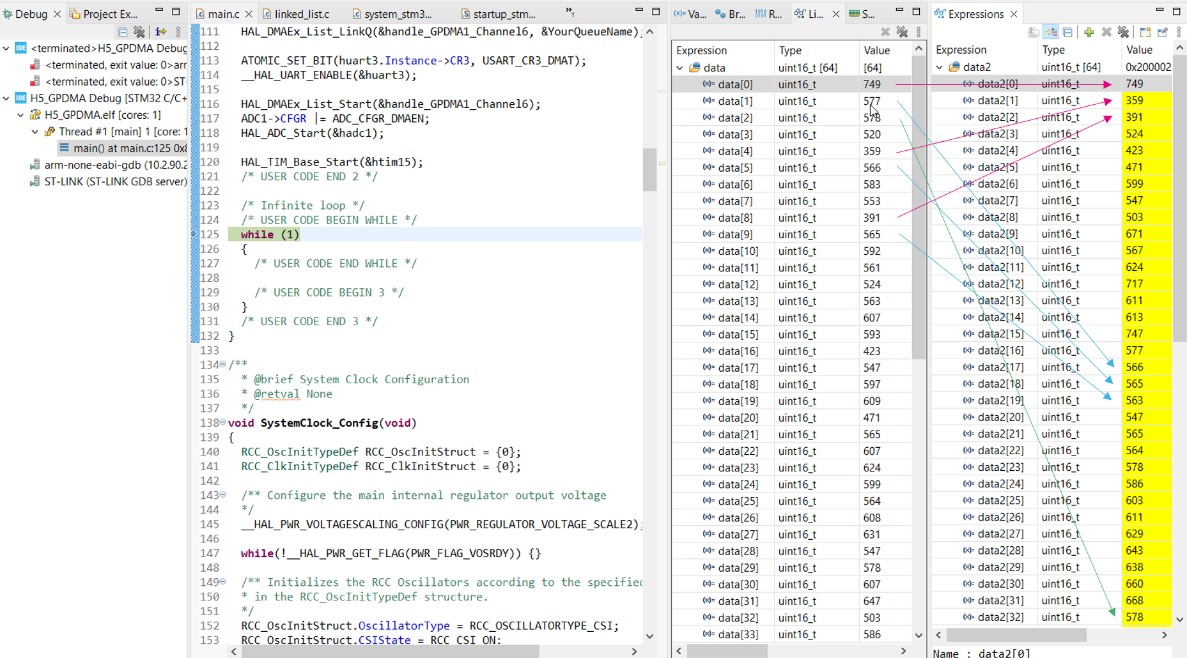
ADC + UART + TIM + 2D – LLI GPDMA

