Slide 1
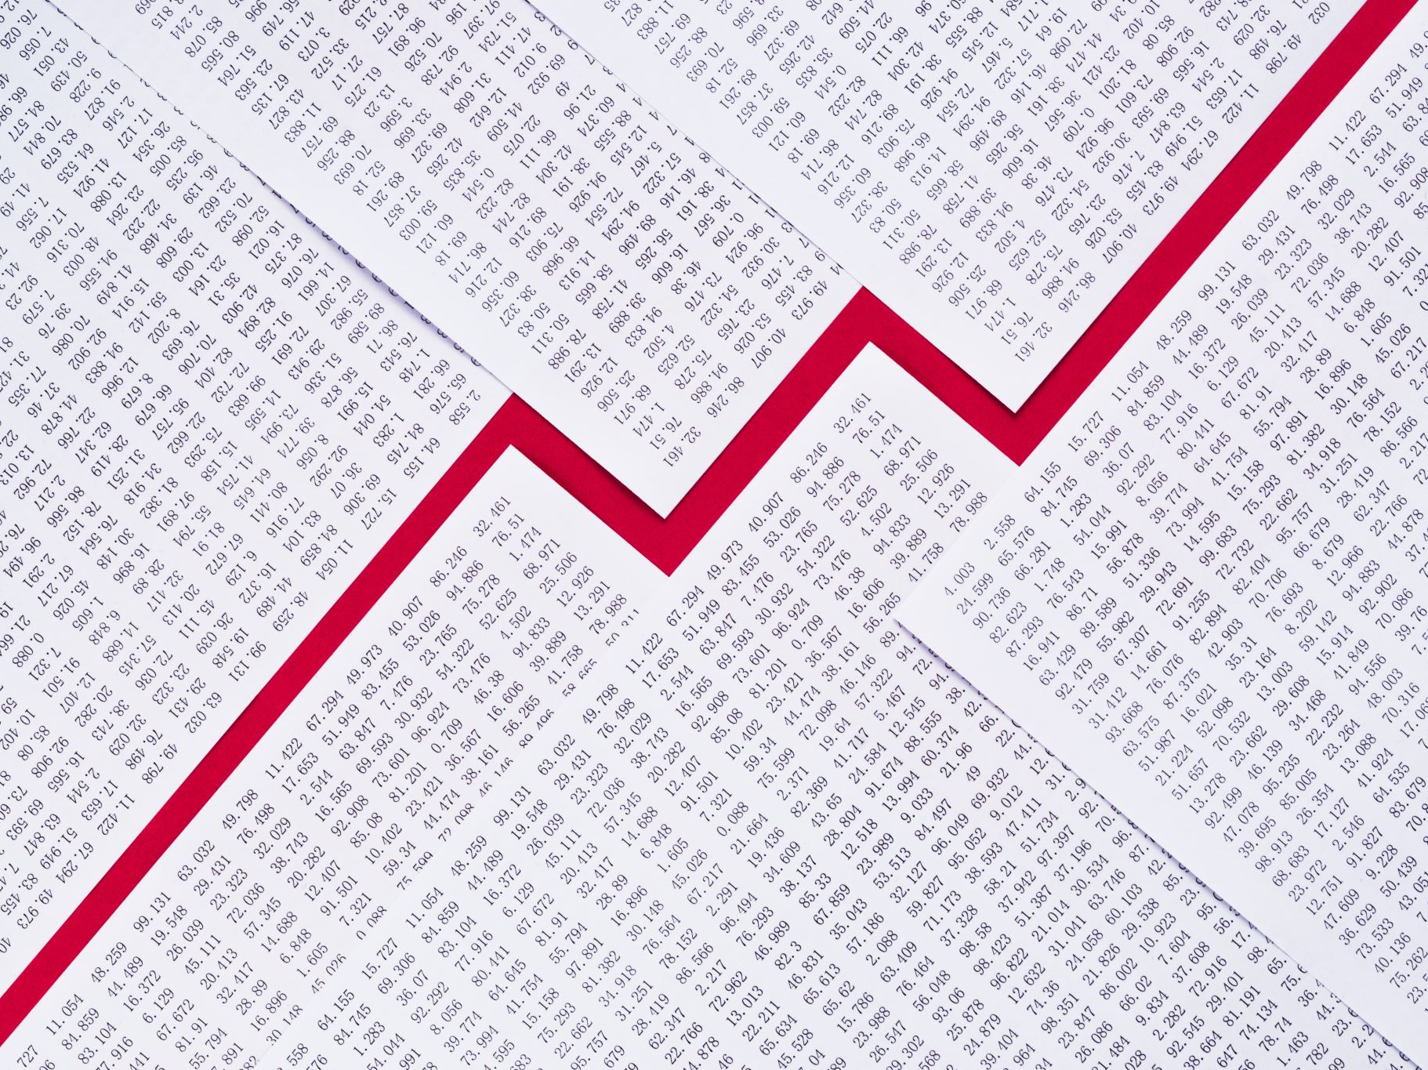
Stock Price Predictor
An Overview of the Architecture, AI Modeling, and User Experience

Slide 2
System Overview
Purpose:
Predict the future prices of stocks using deep learning models and visualize results interactively
Key Features:
User searches for any stock ticker (e.g., NVDA, AAPL, MSFT)
Choose the training window (“model”) and set how many days ahead to predict
Interactive charts show historical, predicted prices, and technical indicators (RSI, MACD, SMA, EMA)
Architecture:
Python backend (FastAPI, TensorFlow)
JavaScript frontend (React.js, Chart.js)

Slide 3
System Architecture Diagram
User
API (FastAPI)
Data (YahooFinance)
Frontend (React)
Model (TensorFlow)

Slide 4
Data Collection & Preparation
Data Source: Yahoo Finance via yfinance API
Tickers Used for Training: 15 diverse stocks (large caps, tech, finance, etc.)
Features Used: Only the daily closing price
Data from all stocks concatenated for a richer training dataset
Scaling: Prices normalized to [0, 1] using MinMaxScaler
Training Windows: Different window sizes for “predict based on” (1, 5, 10, 20, 60, 120 days)

Slide 5
Model Architecture
Model Type: LSTM (Long Short-Term Memory) Neural Networks
Frameworks: TensorFlow, Keras
Three LSTM layers (50 units each, with Dropout)
Dense output layer for predicting next value
Separate model trained for each window size
Data split into test sets (80/20)
Models saved and reused (lazy loading at inference)

Slide 6
Technical Details – Model Training
Training Script: train_model.py
Loop over time window sizes (TIME_STEPS: 1, 5, 10, 20, 60, 120)
Prepare sequential input samples
Train or fine-tune model
Save each model as model_{TIME_STEPS}.h5
Optimization: Adam optimizer, Mean Squared Error loss
Validation: Evaluated on test set after training

Slide 7
Making a Prediction
User Input:
“predict based on” (e.g., last 20 days)
“predict next” (e.g., next 20 days)
Backend Process (main.py + utils.py):
Fetch historical data for selected ticker
Scale latest closing prices
Select right pre-trained model
Recursively predict next N days
Inverse-scale predictions to original price range

Slide 8
Technical Indicators
RSI (Relative Strength Index): Measures price momentum
MACD (Moving Average Convergence Divergence): Trend-following indicator
SMA (50-day Simple Moving Average)
EMA (200-day Exponential Moving Average)
All calculated and overlaid on the stock chart

Slide 9
User Interface & Experience
Frontend (React + Chart.js):
Search/autocomplete for tickers
Select prediction window and horizon
Toggle technical indicators
Interactive charts
Backend (FastAPI):
/predict API for predictions, /search_ticker for suggestions
Handles data and indicator calculations

Slide 10
Example User Flow
Enter ticker & options
Fetch & scale data
Update chart with results
Load model & predict

Slide 11
Technologies Used
Backend:
Python 3.11, FastAPI
TensorFlow/Keras
Yfinance
Pandas
scikit-learn
Frontend:
React
Chart.js
axios
Other:
Docker-compatible, deployable to cloud

Slide 12
Key Strengths & Limitations
Strengths:
Trained on diverse, real-world data
Adaptable window sizes
Includes technical indicators
Limitations:
Only uses closing price
LSTM = black box
Real-world prediction is uncertain

Slide 13
What’s Next / Improvements
Integrate more features (volume, news, macro data)
Add confidence intervals
Model explainability (SHAP, attention)
Live retraining and more updates

Slide 14
References & Credits
yfinance
TensorFlow
FastAPI
React.js
Yahoo Finance data sources

