Slide 1
DS PROJECT
B.Srija -160121733071
B.Chandana -160121733072
N.Aishwarya-160121733081
S.Swathi-160121733085
V .Manasa-160121733089
P .Adhitya Ram-160121733118

Slide 2
PROBLEM STATEMENT: Alice has two queues, Q and R, which can store integers. Bob gives Alice 50 odd integers and 50 even integers and insists that she store all 100 integers in Q and R. They then play a game where Bob picks Q or R at random and then applies the round-robin scheduler, described in the chapter, to the chosen queue a random number of times. If the last number to be processed at the end of this game was odd, Bob wins. Otherwise, Alice wins. How can Alice allocate integers to queues to optimize her chances of winning? What is her chance of winning?

Slide 3
DESCRIPTION:
Two arrays, array_e and array_o are created, containing 50 even random numbers and 50 odd numbers, which are given by Bob. Length of queue Q is taken as input, and length of queue R is 100-(length of queue). The queues are created using linked lists and elements from the combined array (even and odd) are added into Q and remaining numbers are added into R. The node in the linked lists should contain data, burst_time ,initial_burst_time, completion time. Round Robin scheduling is applied to the selected queue. Quantum time is taken as input, and each and every element in the node is executed till the node’s burst time is over, and each time, the element is noted in the final array. And once the burst time is over, the node is deleted from the queue. The completion (turn around time) and waiting time for each node is calculated. This process is continued till all the nodes in the queue are deleted. We get the final array, average completion time and average waiting time. If the number in the final array is even, Alice wins, else Bob wins.

Slide 4
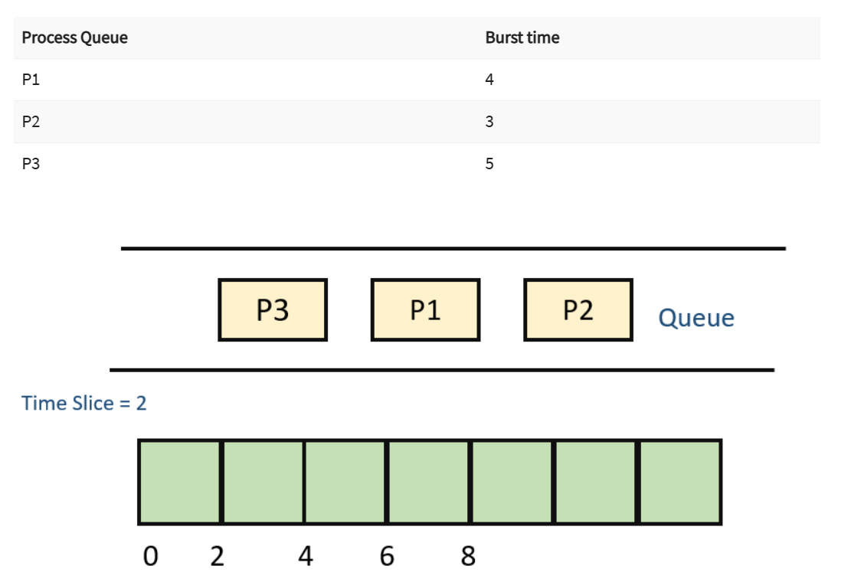
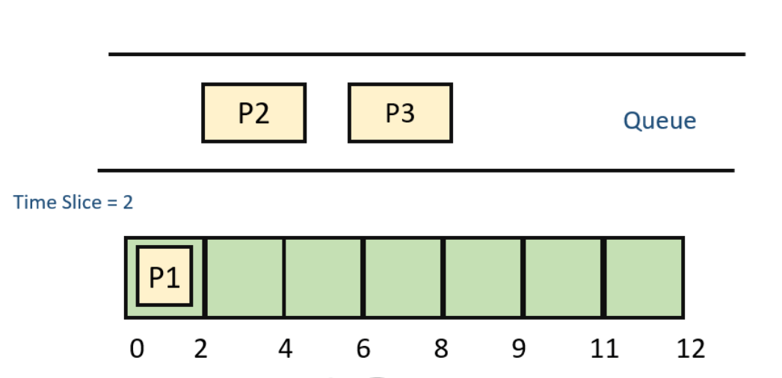
FIRST, P1 IS INSERTED INTO FINAL ARRAY, NOW REAMINING TIME IS BURST TIME IS 2,

Slide 5
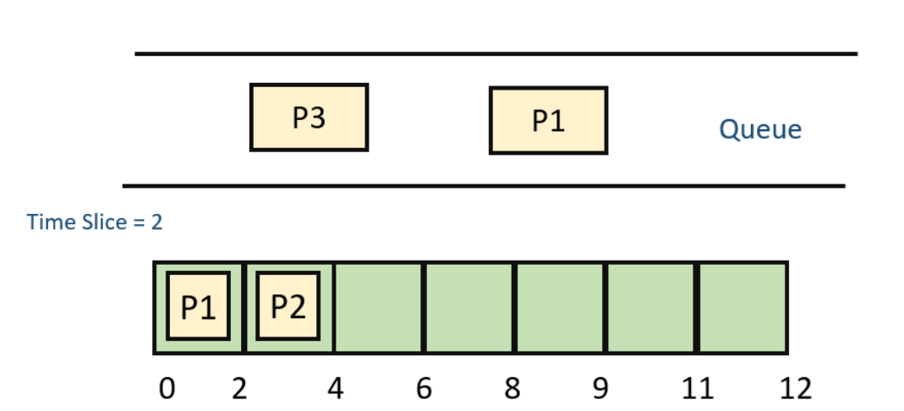
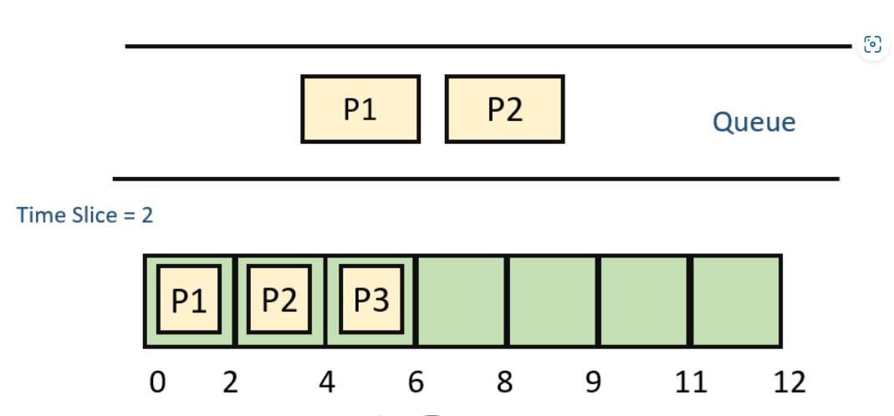
P2 IS ADDED TO FINAL ARRAY AND REMAINING BURST TIME IS 1
P3 IS ADDED TO FINAL ARRAY AND REMAINING BURST TIME IS 3

Slide 6
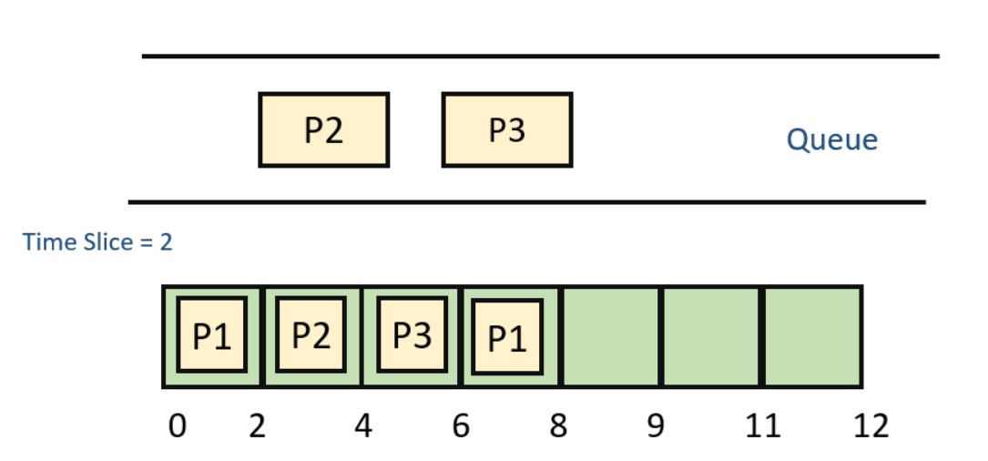
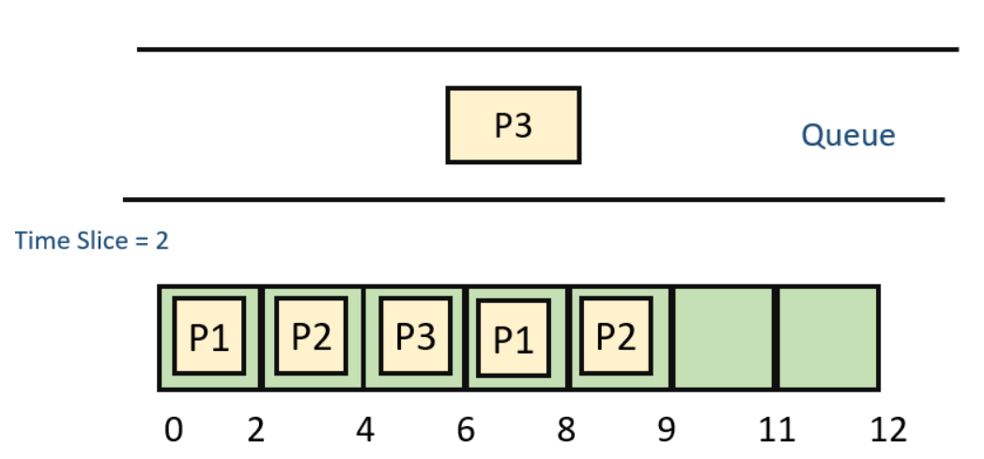
AGAIN P1 IS EXECUTED AND REMAINING BURST TIME IS 0
P2 IS AGAIN EXECUTED FOR PERIOD OF 1(8-9)

Slide 7
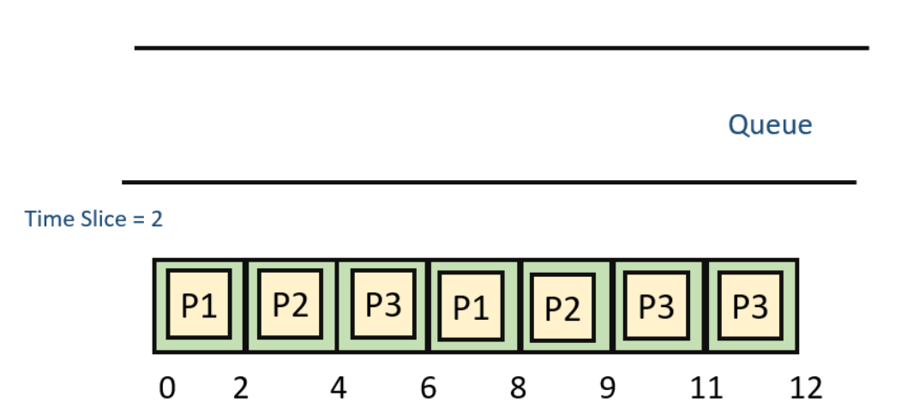
FINALLY, P3 IS EXECUTED FOR 2 AND 1 AGAIN
COMPLETION TIME OF P1 IS 8
COMPLETION TIME OF P2 IS 9
COMPLETION TIME OF P3 IS 12
WAITING TIME OF P1 IS 4
WAITING TIME OF P2 IS 6
WAITING TIME OF P3 IS 7

Slide 8
ALGORITHM: Since linked list is used,each node is a process, which requires unique burst time,completion time so are created in struct node struct node{ int data; int bursttime; int initial_bursttime; int completion_time; struct node *link; };

Slide 9
create(){ input(length of queue Q) length of R=100-length of Q create_queue(length of Q) create_queue(length of R) } create_queue(){ create Q of length_q using linked list create R of length_r using linked list } assign(){ input( Enter numbers from array given by bob) store numbers in queue Q store remaining numbers in R } main(){ numbers(); create(); assign(); roundrobin(); } numbers(){ create array_e using random function containing 50 even numbers create array_o using random function containing 50 odd numbers combine array_e and array_o }

Slide 10
roundrobin(){ input(Select a queue) while( end of queue ){ input(Enter burst time for each number in queue) store initial_burst time initiate completition time to 0 } input(Enter quantum time) temp=first element in queue while(){ if(bursttime_temp > quantumtime){ -->increment completition_time_array -->(bursttime_temp)=(bursttime_temp)-quantum_time -->increment final_order_array -->temp=temp->link; } if(0 <bursttime_temp <= quantumtime){ -->increment completition_time_array -->print(completition and waiting time of that particular process) -->store the completion and waiting time of that process to calculate avg completion and waiting time -->delete that node from queue } if( end of queue reached){ return to starting of queue } } }

Slide 11
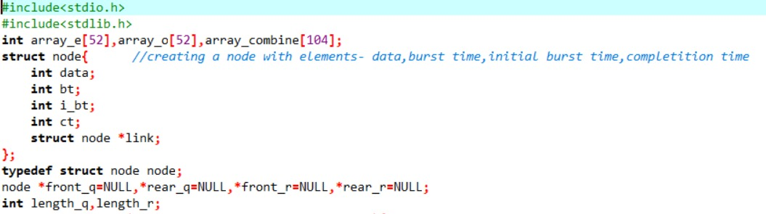
CODE:

Slide 12
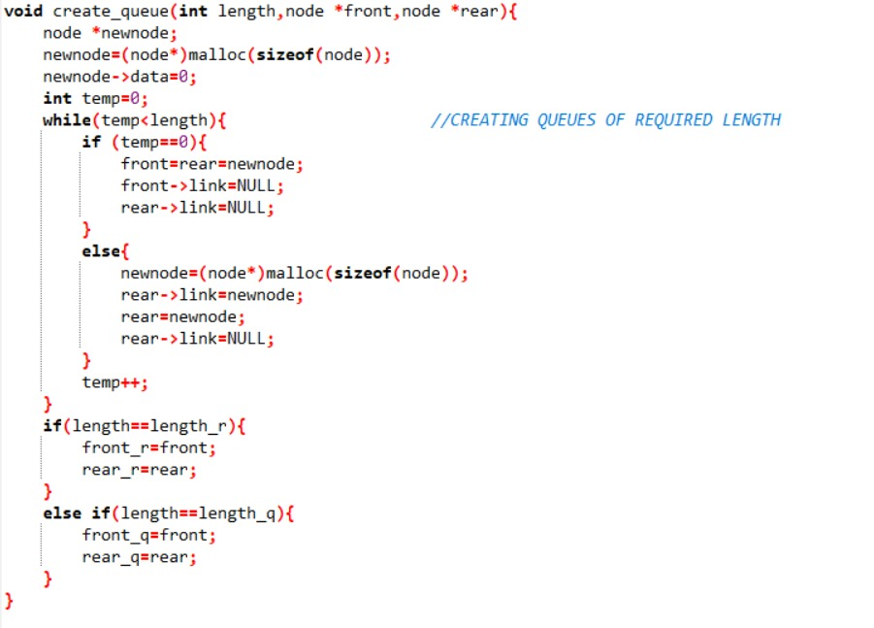

Slide 13
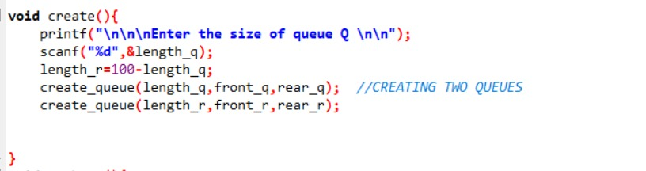

Slide 14
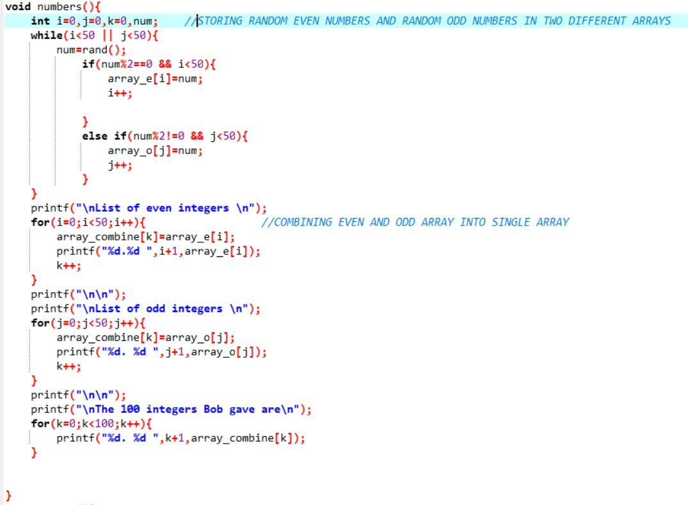

Slide 15
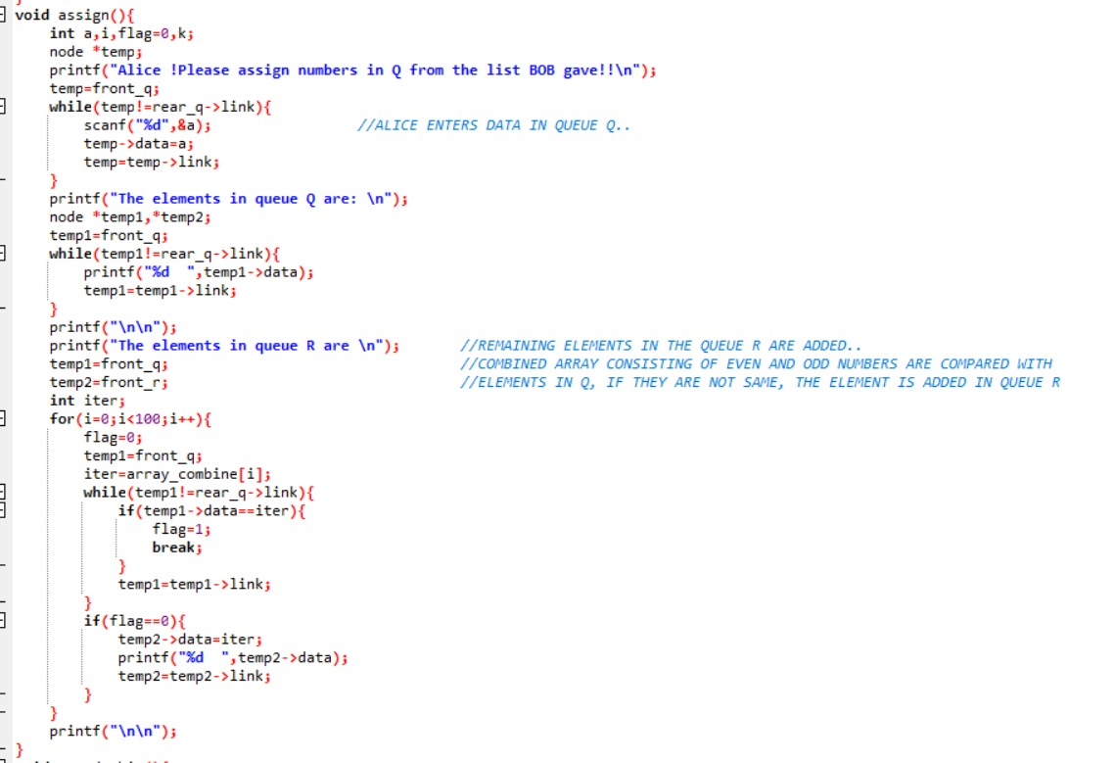

Slide 16
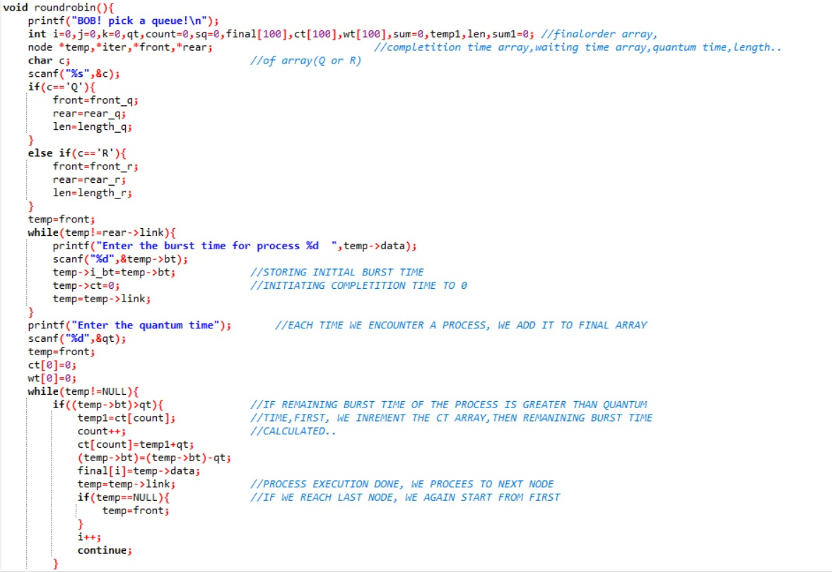

Slide 17
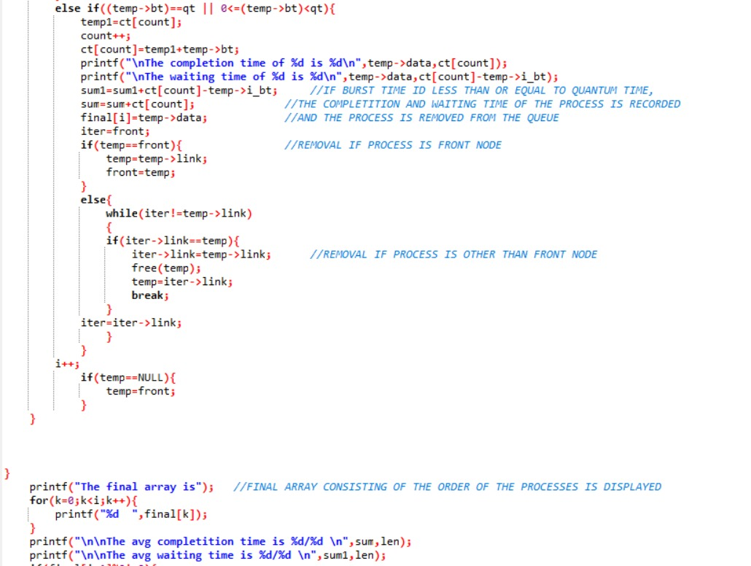

Slide 18
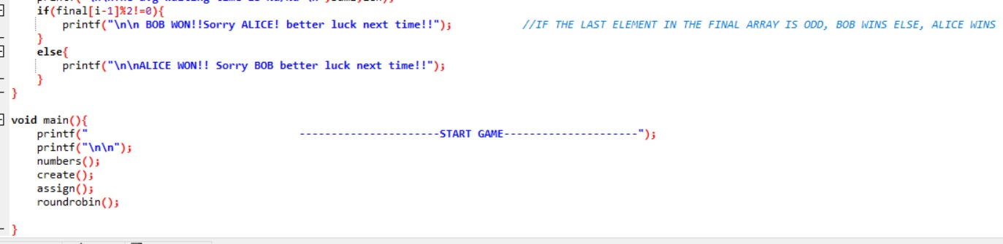

Slide 19
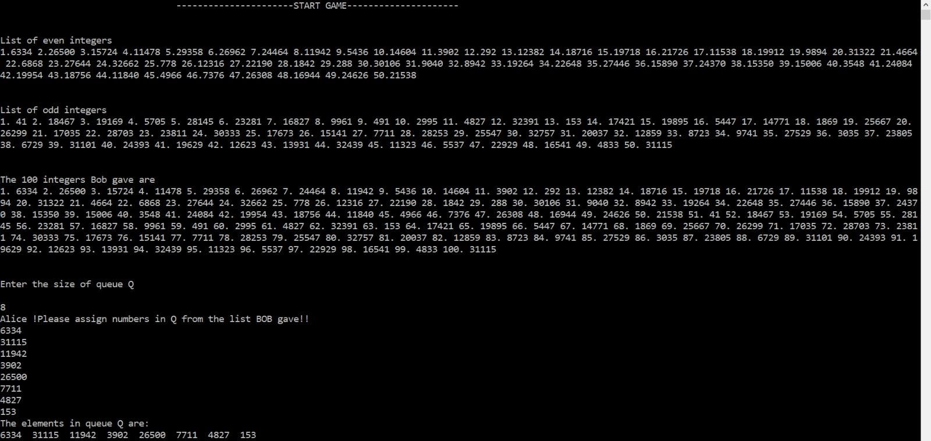
OUTPUT:

Slide 20
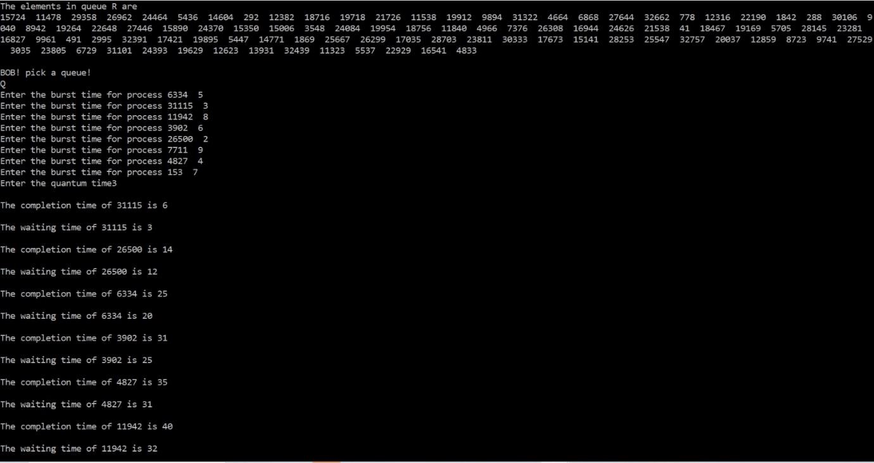

Slide 21
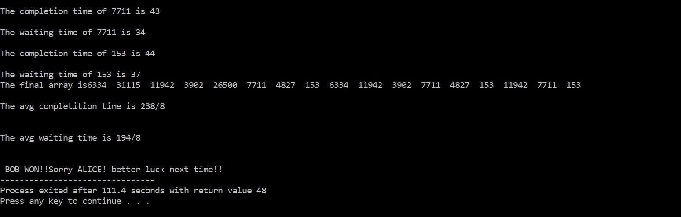

Slide 22
ANALYSIS
How can Alice allocate integers to queues to optimize her chances of winning?
What is her chance of winning?
TEST CASE:
Alice should put on an even integer in Q and all the other 99 integers in R.
The chance that Bob picks Qis 0.5, where Alice must win.
The chance that Bob pocks R is also 0.5, where Alice wins at the chance of 49/99 (49 even integers out of 99 overall integers).
This gives her 0.5*(1+49/99) = 74/99 chance of winning.

Slide 23
RESULTS
If Alice puts any even integer in Q, then the probability that Bob picks Q is 1/2. This is because there are an equal number of even and odd integers, and Bob has an equal chance of picking from each set. If Bob picks R, then the probability that Alice wins is 49/99, as there are 49 even integers and 50 odd integers in R. Therefore, the overall probability that Alice wins is:(1/2) * (1 + 49/99) = 74/99which simplifies to 74/99.So, Alice has a 74/99 chance of winning if she puts any even integer in Q and all the other 99 integers in R, and Bob picks between Q and R with equal probability.

Slide 24
CONCLUSION
The above statement is a solution to the problem of determining the probability that Alice wins in a game where she places an even integer in set Q and all the other integers in set R, and Bob chooses between the two sets with equal probability. The conclusion is that Alice has a 74/99 chance of winning under these conditions.This solution involves identifying the probability that Bob picks Q and the probability that Bob picks R, and then using the number of even and odd integers in set R to calculate the probability that Alice wins in each case. Multiplying these probabilities by the respective probabilities of Bob picking Q and R and summing them gives the overall probability that Alice wins.This is the best method for solving the problem because it takes into account all the relevant probabilities and uses basic probability principles to arrive at a clear and unambiguous answer.

Slide 25
