Slide 1


Slide 2
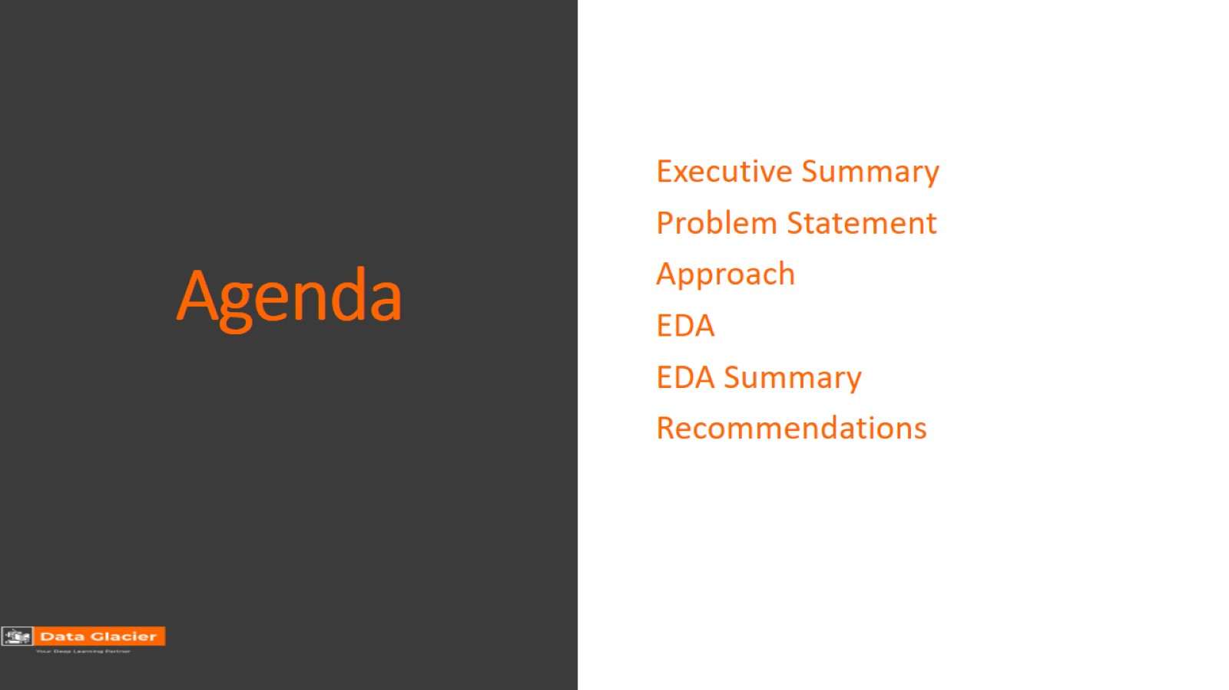
Agenda

Slide 3
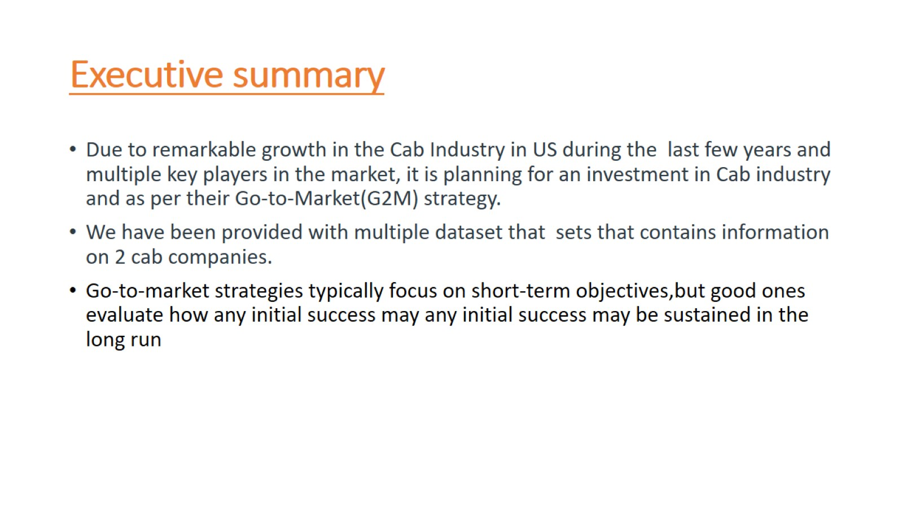
Executive summary

Slide 4
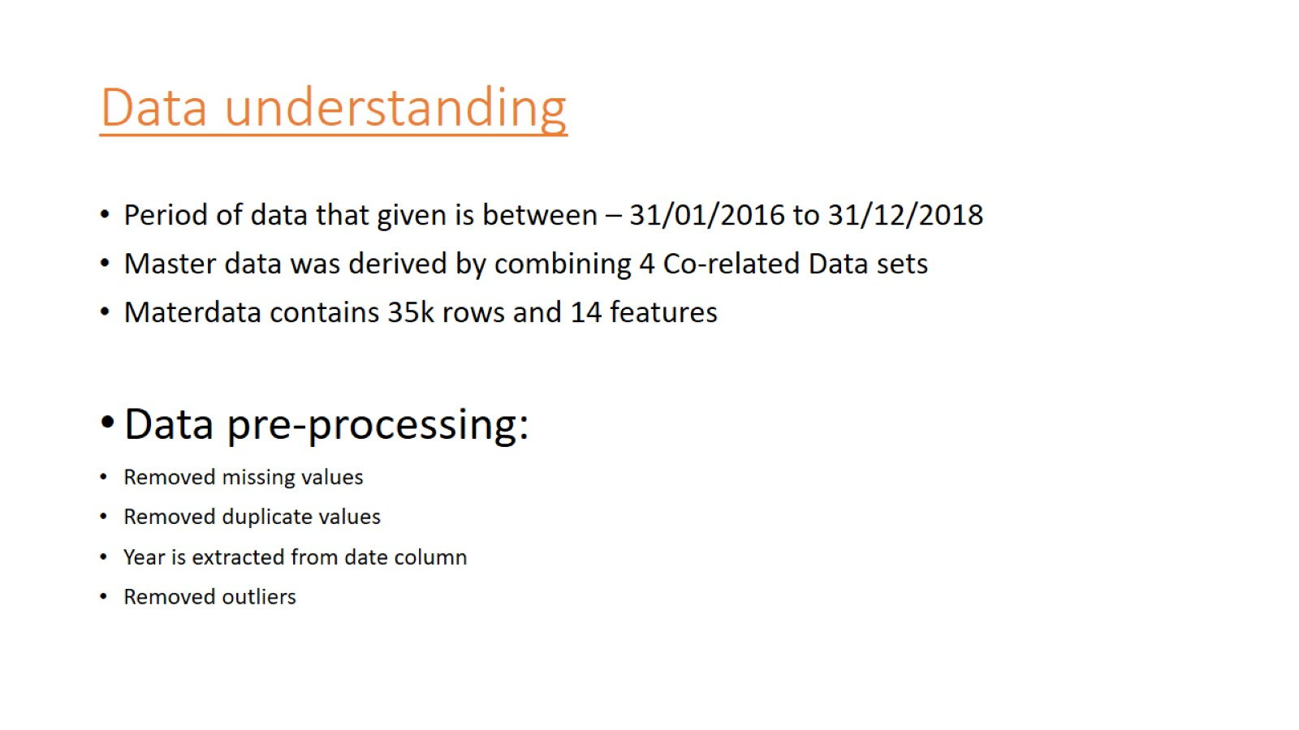
Data understanding

Slide 5
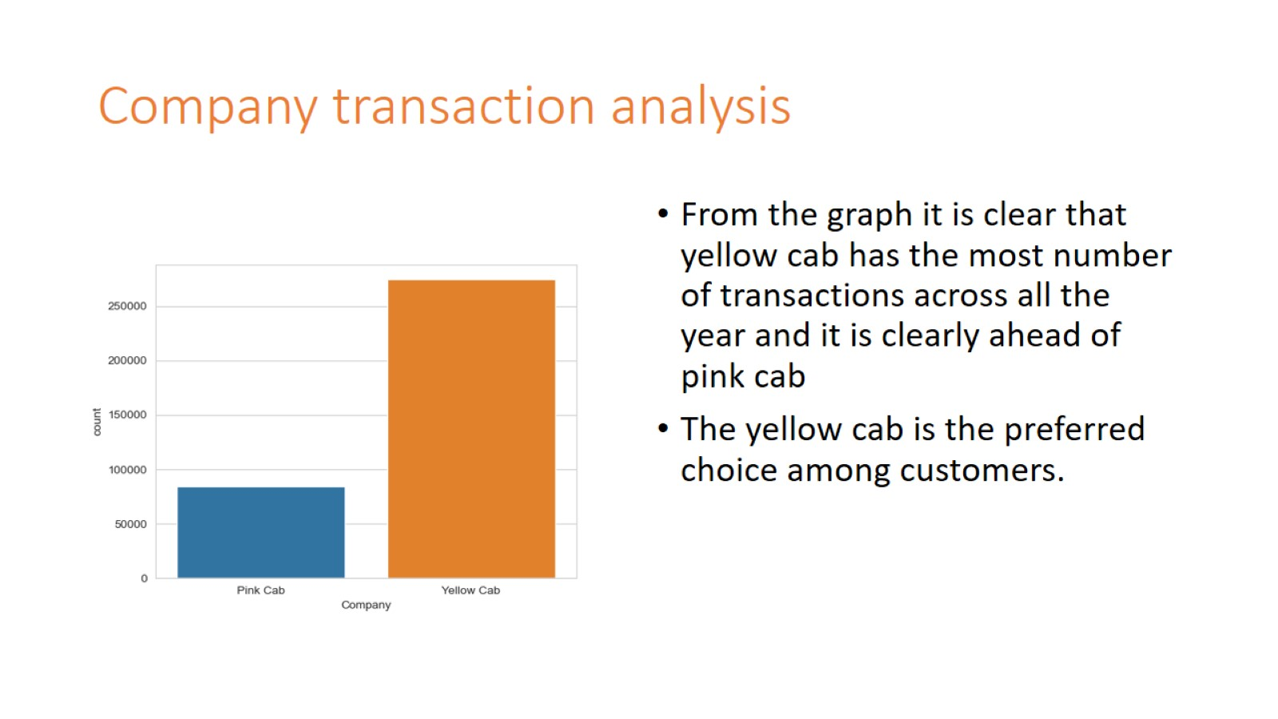
Company transaction analysis

Slide 6
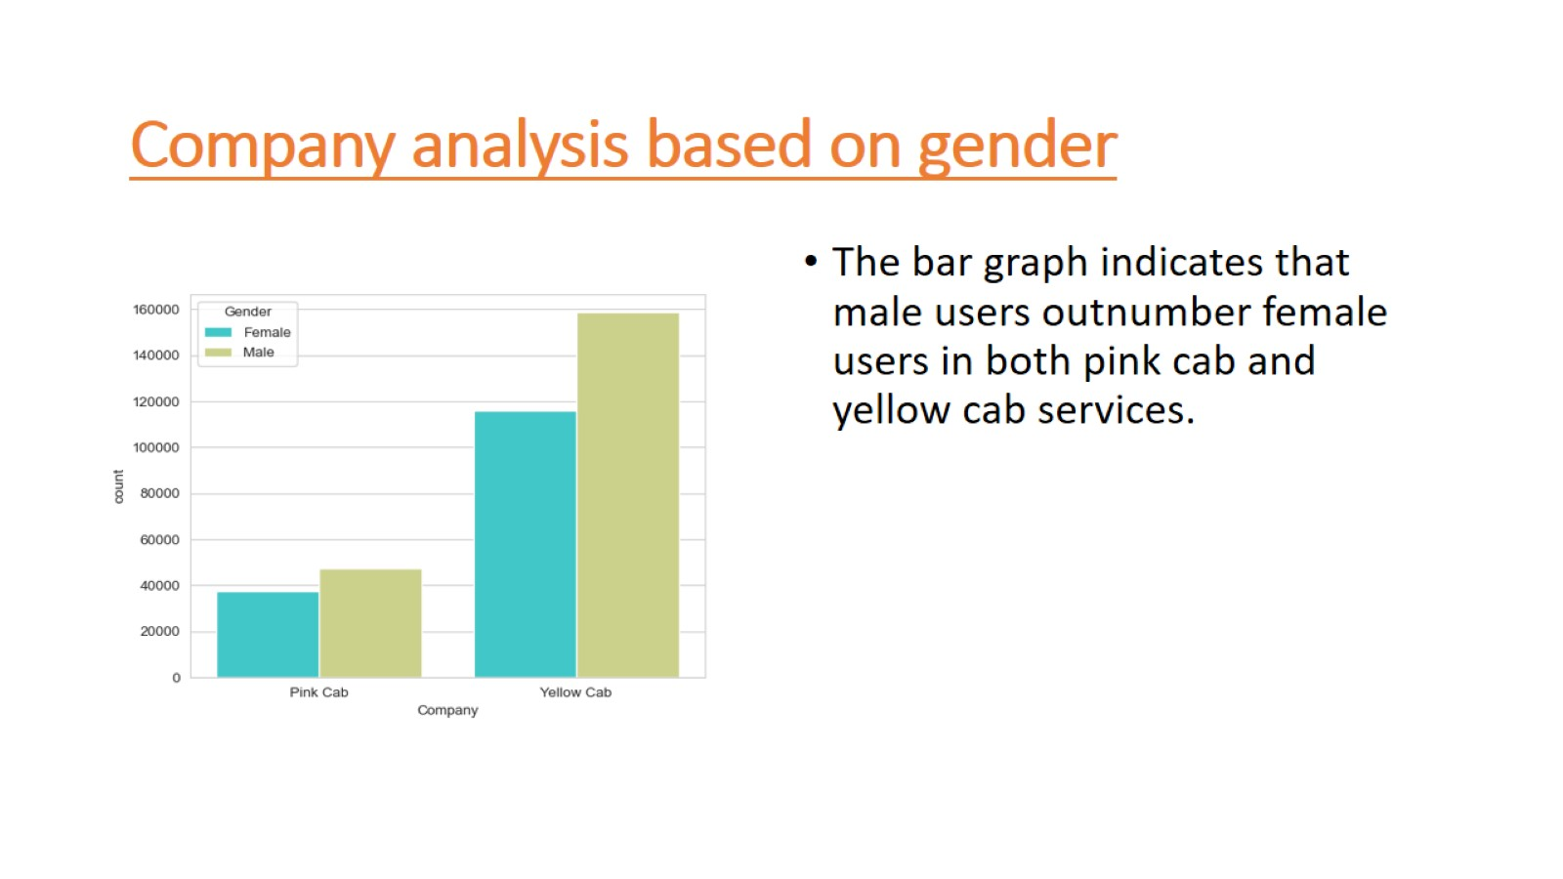
Company analysis based on gender

Slide 7
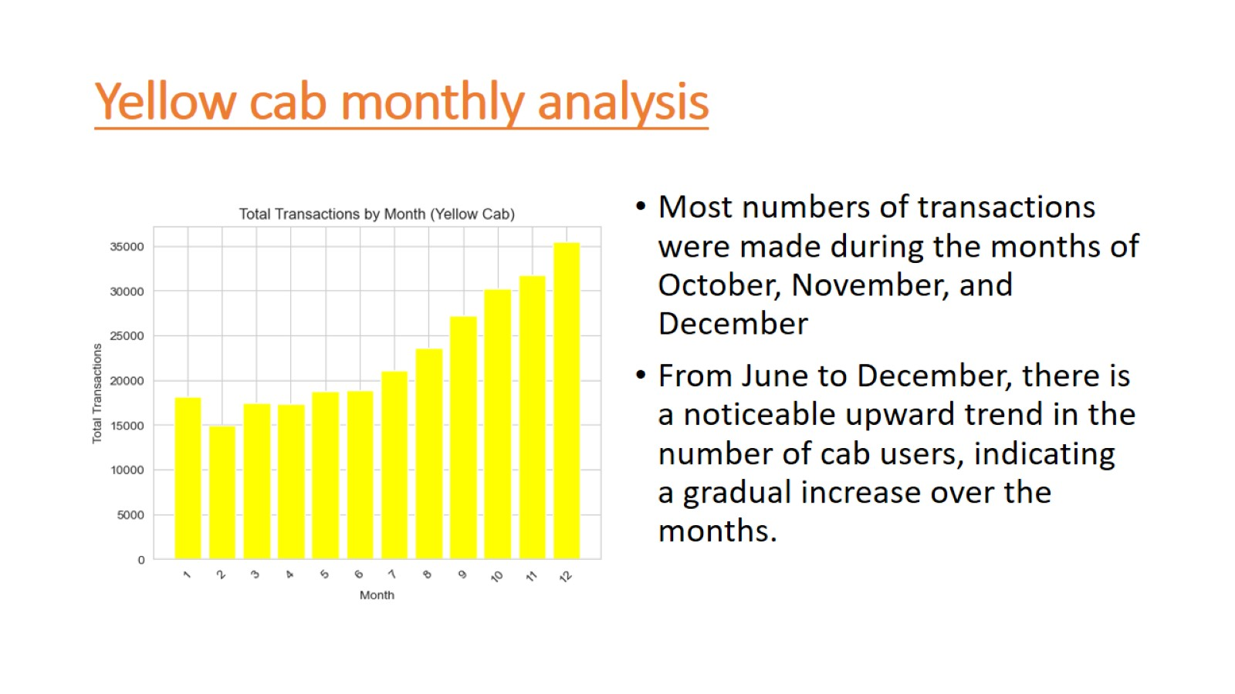
Yellow cab monthly analysis

Slide 8
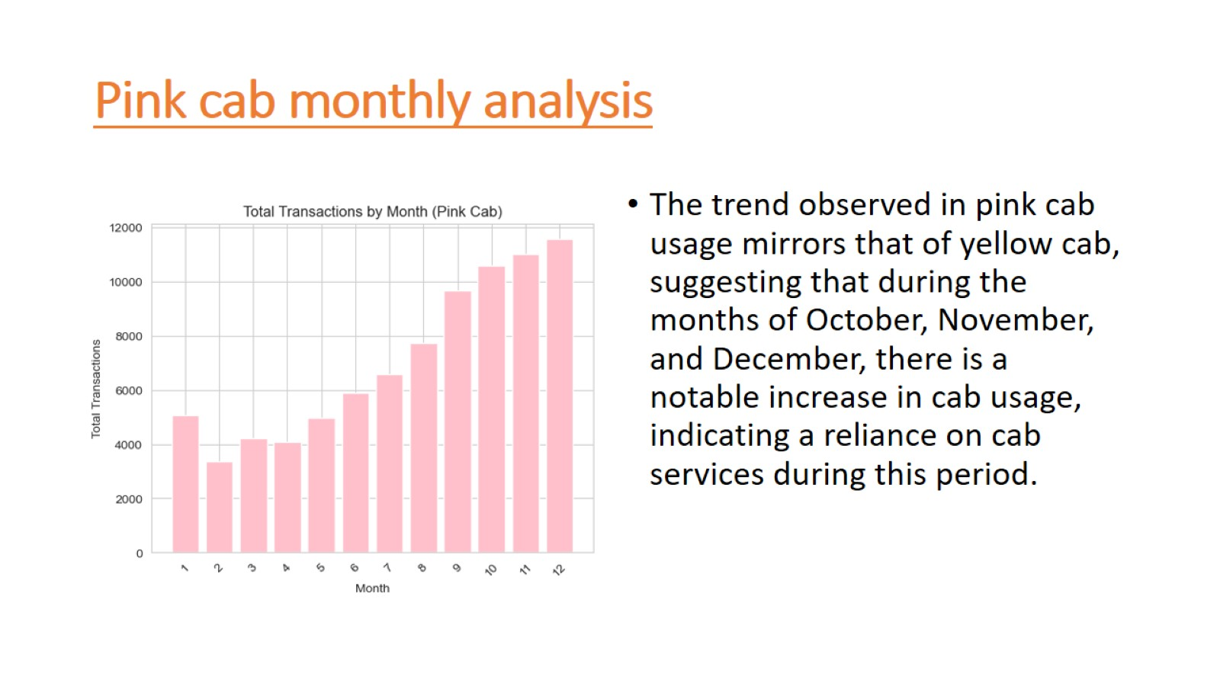
Pink cab monthly analysis

Slide 9
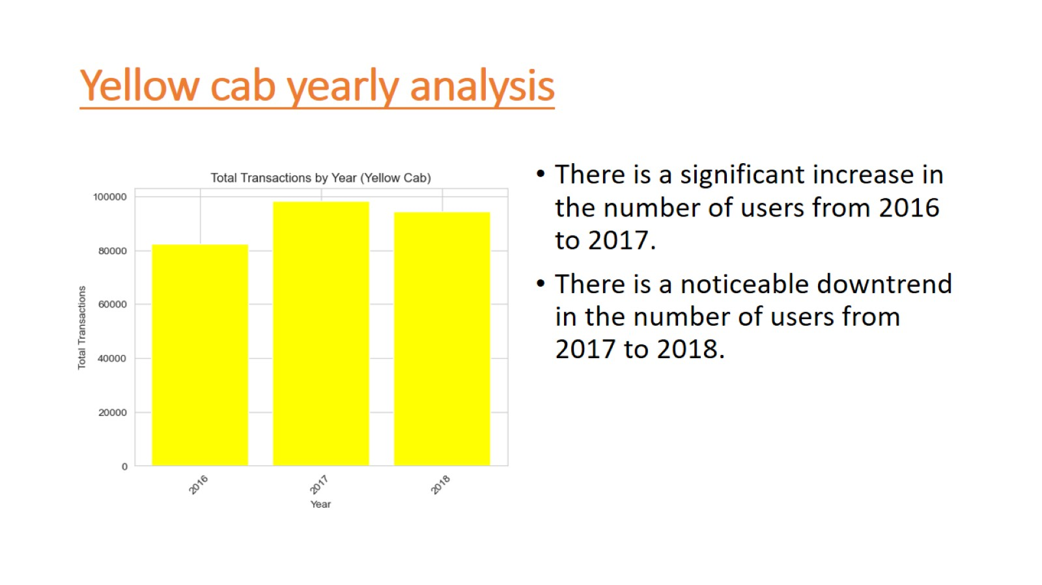
Yellow cab yearly analysis

Slide 10
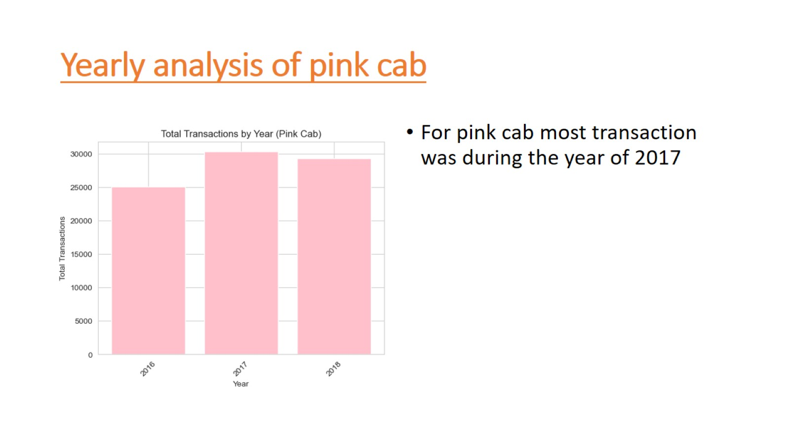
Yearly analysis of pink cab

Slide 11
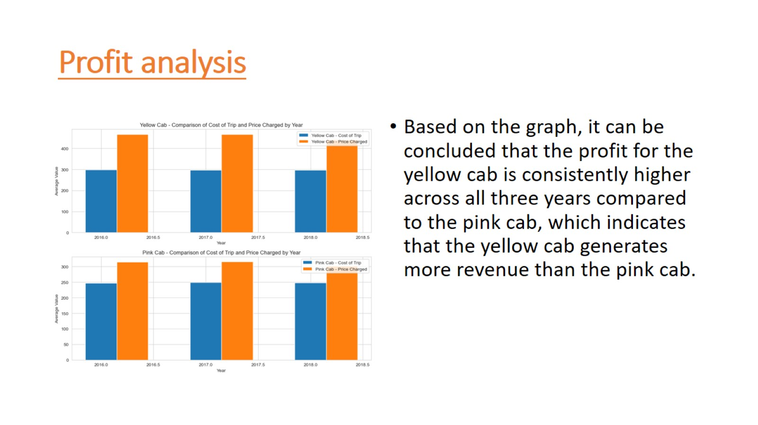
Profit analysis

Slide 12
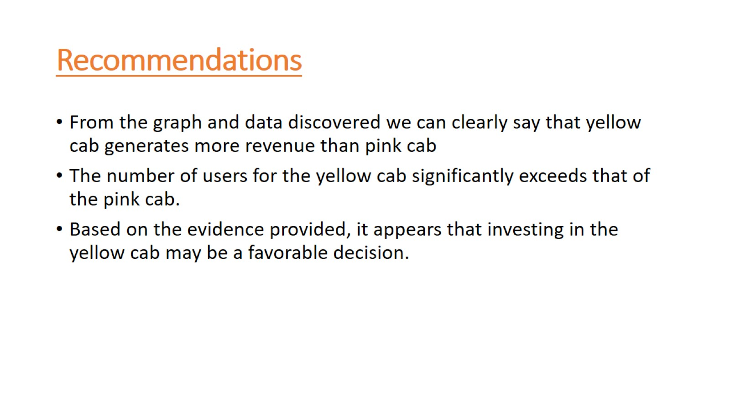
Recommendations

Slide 13


