Slide 1

Face Recognition using Raspberry Pi, zeroCam and Speaker
Manjot Kaur

Slide 2


Background
In a face recognition system, digital images or videos are compared against a database of faces to make sure the faces match.
Chinese police uses face-recognition technology to track down the criminals.
Other Systems.

Slide 3




Problems
It is not always easy to spot a celebrity or someone who does not look the same at the time.
People cannot see behind themselves.
People suffers from blindness or visual impairment.

Slide 4

Solution
Using Raspberry Pi, zeroCam, Speaker and Amazon Cloud Services (AWS)

Slide 5
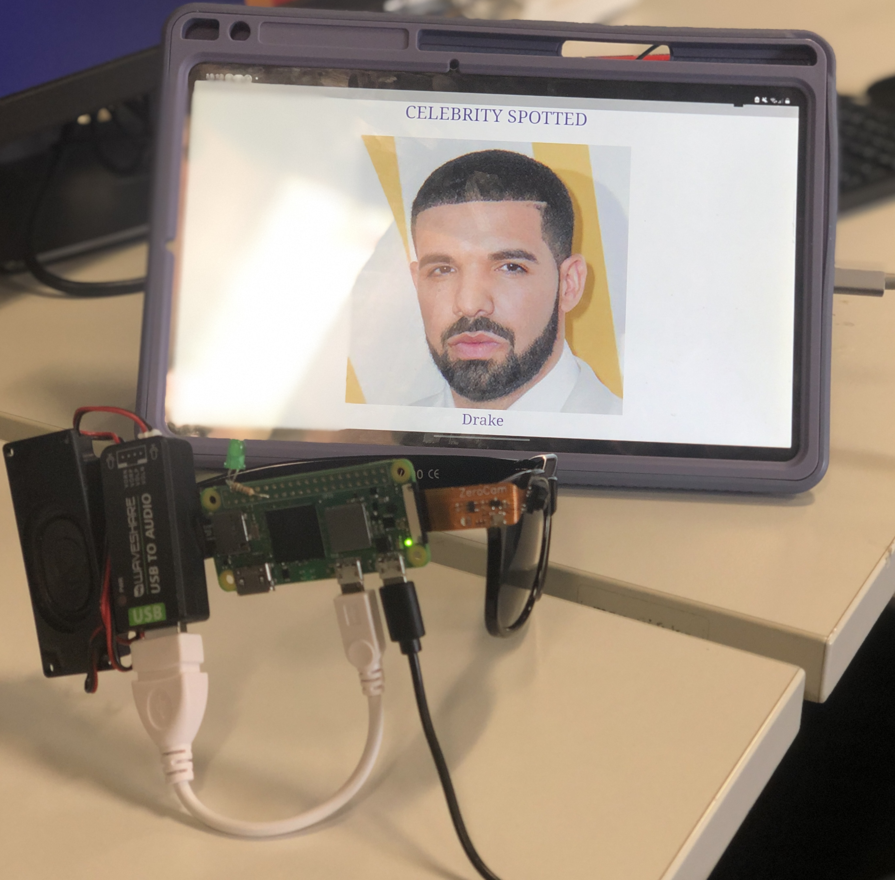
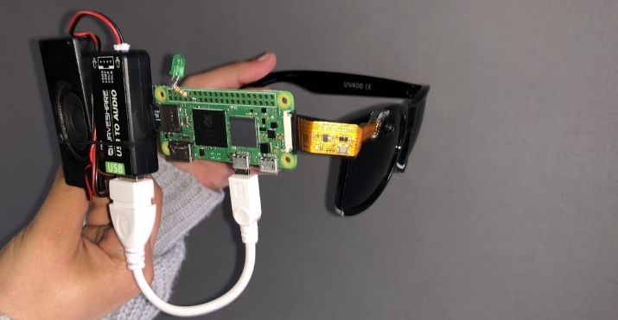
The solution to these problems splits into two sections: hardware and software.
Hardware – Raspberry Pi, zeroCam and Speaker.
Software – Web Application
Rekognition using AWS

Slide 6
Demo
Play the video.

Slide 7
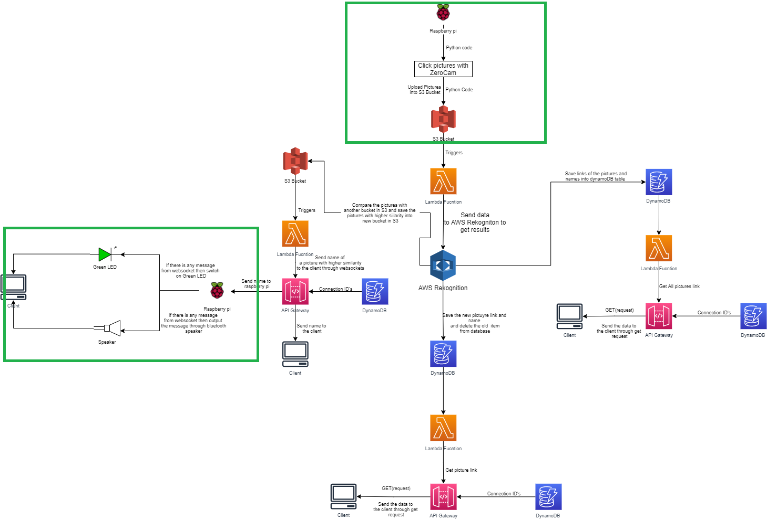
Hardware
zeroCam is attached to the raspberry pi in order to click pictures.
Raspberry pi contains the python file to run the code to click pictures.
After face recognition, it sends the data to client through webSockets .
Python WebSocket client is used to send data from AWS to raspberry pi.
If there is data switch on LED and play name in audio.

Slide 8
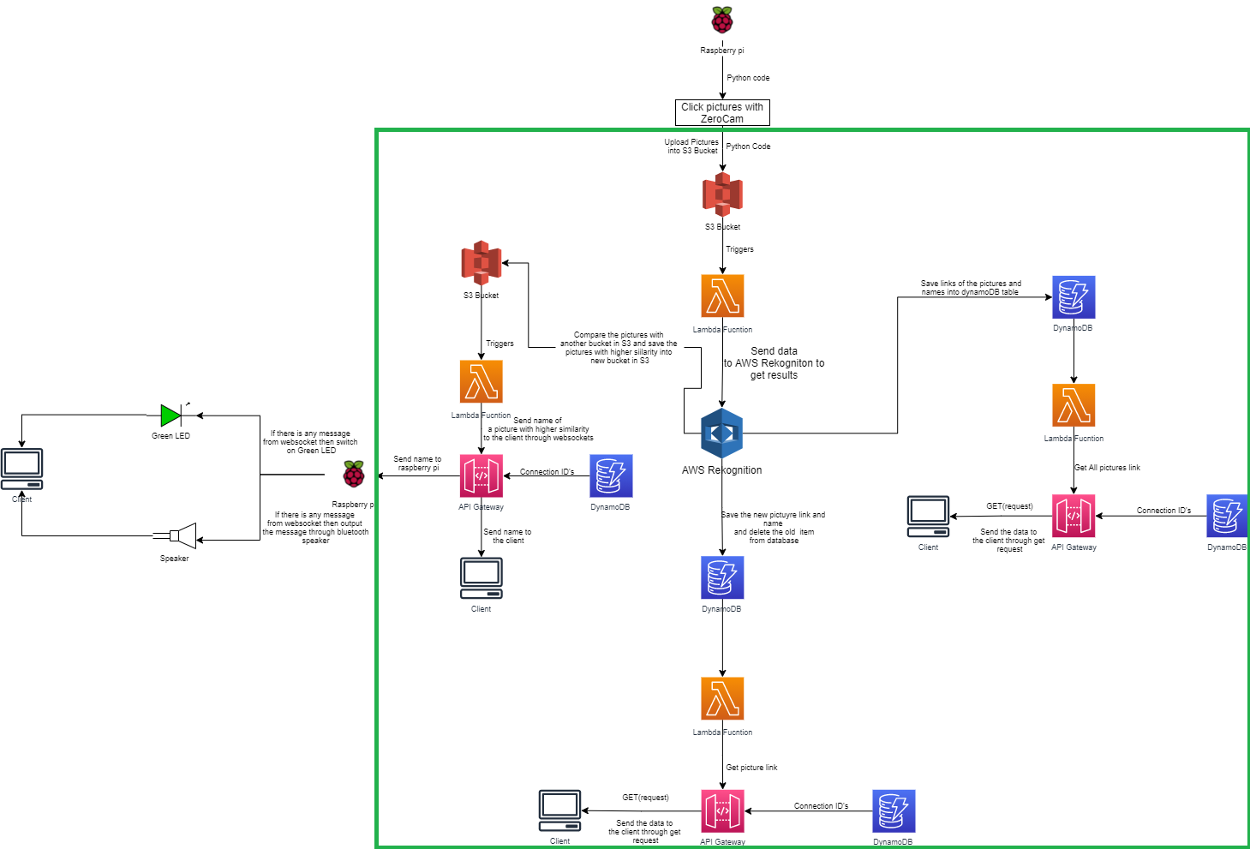
Architecture
Upload images to S3.
Lambda function triggers S3 Bucket.
Send Source and Target Images to AWS Rekognition
Save picture with higher similarity into another S3 Bucket and save image link and name of celeb in DynamoDB
Use webSocket API to send celebrity names to client
Use Rest API to send Images to client

Slide 9
Web application
Display celebrity Image to the clients using REST API
Display all recognised Images from DynamoDB
Display celebrity name using webSocket API

Slide 10
Evaluation
Evaluation is done in order to verify that the hardware and software works properly.
Field testing
Systematic Testing
Rest API Testing

Slide 11
Ethical reflections and Limitations
The faceRek system cannot be used in public. For example, if the task is to take a photo of a random person, some people may object to offering their faces and storing their images in a database.
Hardware- can replace Raspberry pi, can use multiple cameras, can use device to measure the distance between camera and person.
Software- The names of celebrities are obtained via WebSocket API for web applications, and images are obtained via REST API. However, it is also possible to obtain the names using the REST API. This allows the user to view the name for a longer period on the web page. The DynamoDB events can be used instead of scanning the table.

Slide 12
Conclusion
In conclusion, because of face recognition, faceRek has a lot of room for development. Most of the requirements described in the design are met; however, there is still plenty of room for improvements and enhancements. Spending more time designing the front­end of the website, for example, would result in greater intuitiveness and ease of navigation. In addition to recognising celebrities and loved ones in public, faceRek has some other advantages. It can assist a blind person in recognising a person from a distance. It can be used for blind person’s security so that they can react in accordance with the person they know.

Slide 13


Thank You
Manjot Kaur
mm3512@live.mdx.ac.uk

