Slide 1
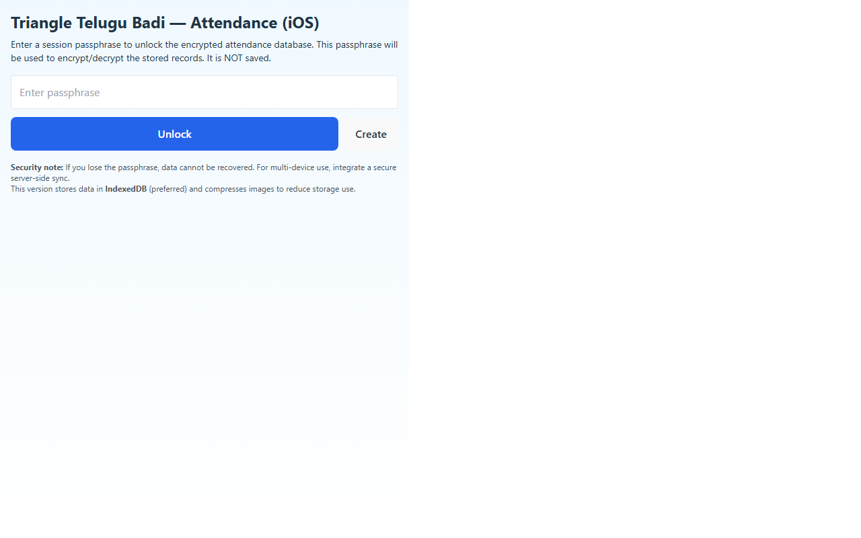
Enrollment

Slide 2
Check In

Slide 3
Check Out

Slide 4
Selected Student

Slide 5
Recent Logs

