Slide 1
Topic 1: Introduction to Data Mining
Instructor: Chris Volinsky

Slide 2
Types of Data: Flat File Data
n
p
Rows = objects
Columns = measurements on objects
Both n and p can be very large in data mining (also p>>n)
Matrix can be quite sparse

Slide 3
Types of Data: Text Data
Can be represented as a sparse matrix
Obama
Text
Documents
Word ID

Slide 4
Types of Data: Transactional Data
Date stamped events (logs, phone calls):
128.195.36.195, -, 3/22/00, 10:35:11, W3SVC, SRVR1, 128.200.39.181, 781, 363, 875, 200, 0, GET, /top.html, -,
128.195.36.195, -, 3/22/00, 10:35:16, W3SVC, SRVR1, 128.200.39.181, 5288, 524, 414, 200, 0, POST, /spt/main.html, -,
128.195.36.195, -, 3/22/00, 10:35:17, W3SVC, SRVR1, 128.200.39.181, 30, 280, 111, 404, 3, GET, /spt/images/bk1.jpg, -,
128.195.36.101, -, 3/22/00, 16:18:50, W3SVC, SRVR1, 128.200.39.181, 60, 425, 72, 304, 0, GET, /top.html, -,
128.195.36.101, -, 3/22/00, 16:18:58, W3SVC, SRVR1, 128.200.39.181, 8322, 527, 414, 200, 0, POST, /spt/main.html, -,
128.195.36.101, -, 3/22/00, 16:18:59, W3SVC, SRVR1, 128.200.39.181, 0, 280, 111, 404, 3, GET, /spt/images/bk1.jpg, -,
128.200.39.17, -, 3/22/00, 20:54:37, W3SVC, SRVR1, 128.200.39.181, 140, 199, 875, 200, 0, GET, /top.html, -,
128.200.39.17, -, 3/22/00, 20:54:55, W3SVC, SRVR1, 128.200.39.181, 17766, 365, 414, 200, 0, POST, /spt/main.html, -,
128.200.39.17, -, 3/22/00, 20:54:55, W3SVC, SRVR1, 128.200.39.181, 0, 258, 111, 404, 3, GET, /spt/images/bk1.jpg, -,
128.200.39.17, -, 3/22/00, 20:55:07, W3SVC, SRVR1, 128.200.39.181, 0, 258, 111, 404, 3, GET, /spt/images/bk1.jpg, -,
128.200.39.17, -, 3/22/00, 20:55:36, W3SVC, SRVR1, 128.200.39.181, 1061, 382, 414, 200, 0, POST, /spt/main.html, -,
128.200.39.17, -, 3/22/00, 20:55:36, W3SVC, SRVR1, 128.200.39.181, 0, 258, 111, 404, 3, GET, /spt/images/bk1.jpg, -,
128.200.39.17, -, 3/22/00, 20:55:39, W3SVC, SRVR1, 128.200.39.181, 0, 258, 111, 404, 3, GET, /spt/images/bk1.jpg, -,
128.200.39.17, -, 3/22/00, 20:56:03, W3SVC, SRVR1, 128.200.39.181, 1081, 382, 414, 200, 0, POST, /spt/main.html, -,
128.200.39.17, -, 3/22/00, 20:56:04, W3SVC, SRVR1, 128.200.39.181, 0, 258, 111, 404, 3, GET, /spt/images/bk1.jpg, -,
128.200.39.17, -, 3/22/00, 20:56:33, W3SVC, SRVR1, 128.200.39.181, 0, 262, 72, 304, 0, GET, /top.html, -,
128.200.39.17, -, 3/22/00, 20:56:52, W3SVC, SRVR1, 128.200.39.181, 19598, 382, 414, 200, 0, POST, /spt/main.html, -,
Can be represented as a time series:
User 1
2
3
2
2
3
3
3
1
1
1
3
1
3
3
3
3
User 2
3
3
3
1
1
1
User 3
7
7
7
7
7
7
7
7
User 4
1
5
1
1
1
5
1
5
1
1
1
1
1
1
User 5
5
1
1
5
…
…

Slide 5
Types of Data: Relational Data
128.200.39.17, -, 3/22/00, 20:55:07, W3SVC, SRVR1, 128.200.39.181, 0, 258, 111, 404, 3, GET, /spt/images/bk1.jpg, -,
128.200.39.17, -, 3/22/00, 20:55:36, W3SVC, SRVR1, 128.200.39.181, 1061, 382, 414, 200, 0, POST, /spt/main.html, -,
128.200.39.17, -, 3/22/00, 20:55:36, W3SVC, SRVR1, 128.200.39.181, 0, 258, 111, 404, 3, GET, /spt/images/bk1.jpg, -,
128.195.36.195, -, 3/22/00, 10:35:11, W3SVC, SRVR1, 128.200.39.181, 781, 363, 875, 200, 0, GET, /top.html, -,
128.195.36.195, -, 3/22/00, 10:35:16, W3SVC, SRVR1, 128.200.39.181, 5288, 524, 414, 200, 0, POST, /spt/main.html, -,
128.195.36.195, -, 3/22/00, 10:35:17, W3SVC, SRVR1, 128.200.39.181, 30, 280, 111, 404, 3, GET, /spt/images/bk1.jpg, -,
…,
128.195.36.195, Doe, John, 12 Main St, 973-462-3421, Madison, NJ, 07932
114.12.12.25,Trank, Jill, 11 Elm St, 998-555-5675, Chester, NJ, 07911
…
07911, Chester, NJ, 07954, 34000, , 40.65, -74.12
07932, Madison, NJ, 56000, 40.642, -74.132
…
Most large data sets are stored in relational data sets
Special data query language: SQL

Slide 6
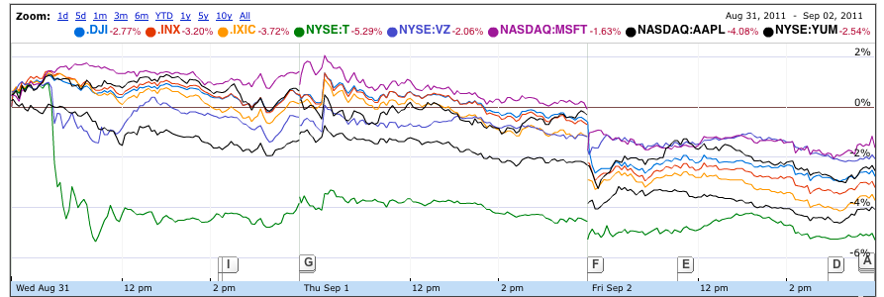
Types of Data: Time Series Data

Slide 7
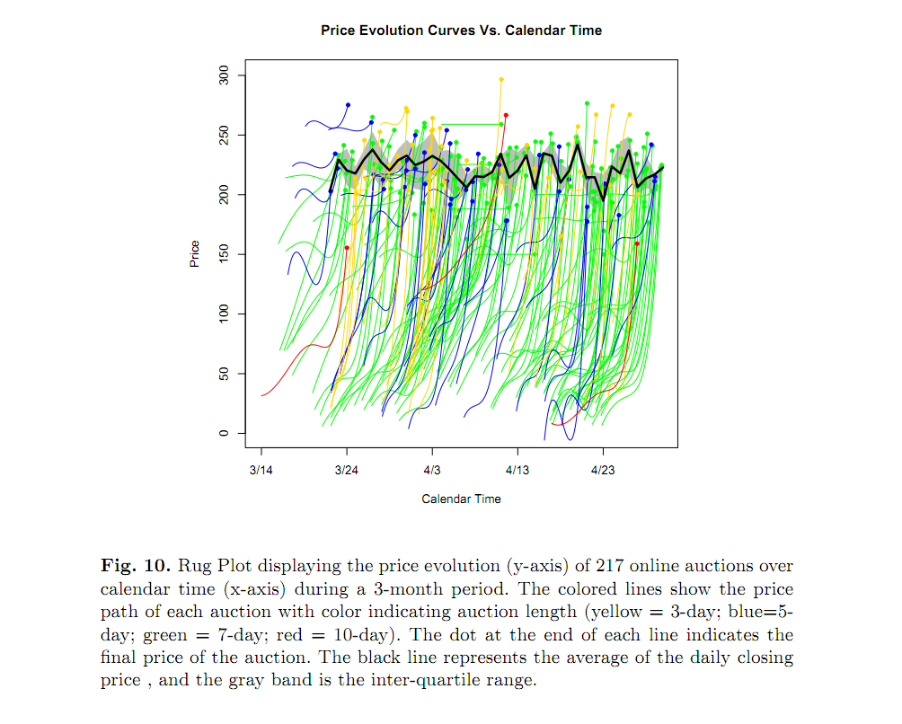
Types of Data: Time Series Data
Jank, Shmueli, et al (2005)

Slide 8
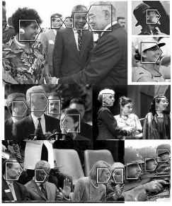
Types of Data: Image Data

Slide 9
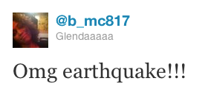
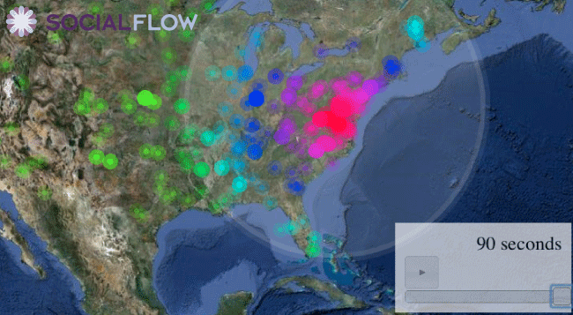
Types of Data: Spatio-Temporal Data
http://senseable.mit.edu/nyte/movies/nyte-globe-encounters.mov-encounters.mov

Slide 10
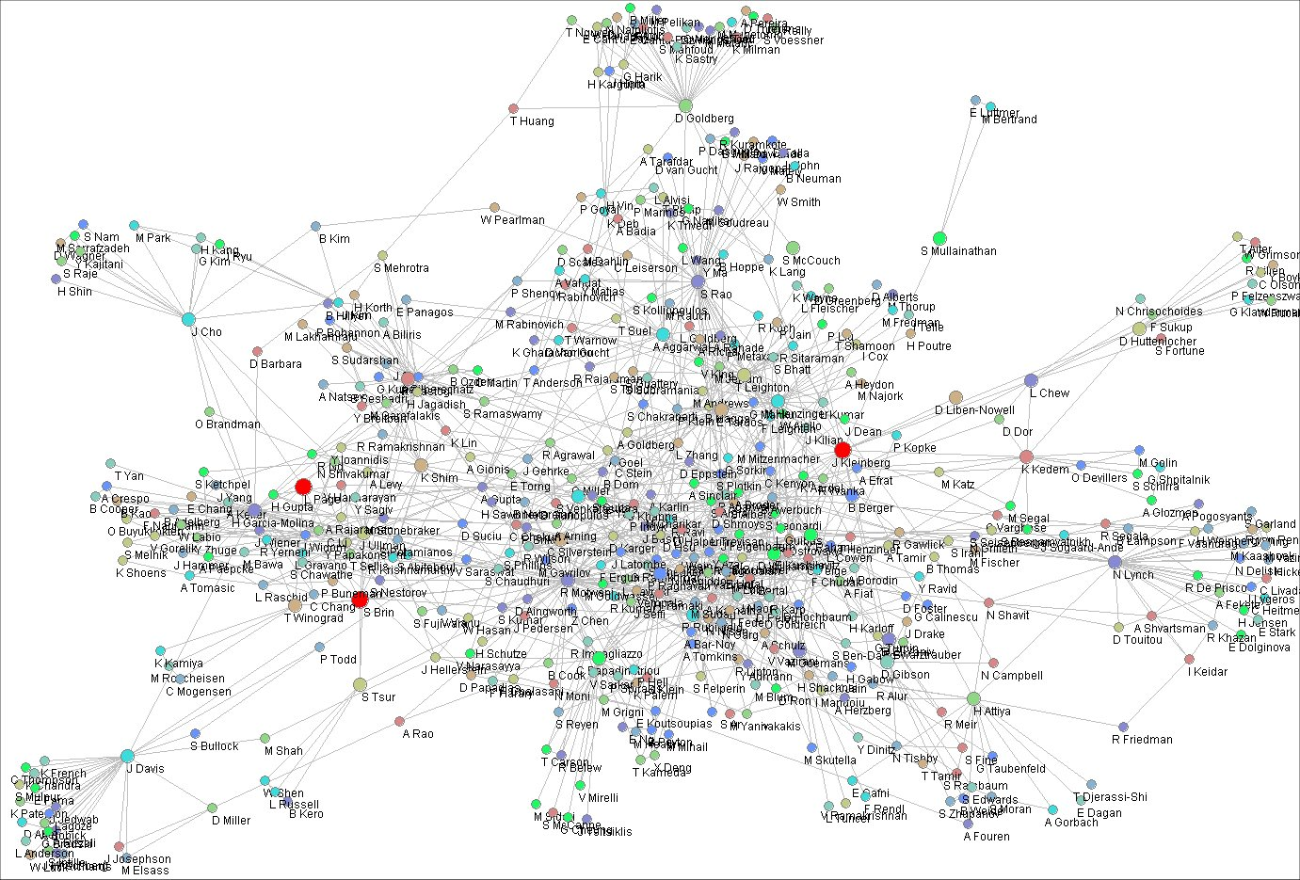
Types of Data: Network Data
Algorithms for estimating relative importance in networks S. White and P. Smyth, ACM SIGKDD, 2003.

