Slide 1
How do machine learning competitions work?

Slide 2
We take a dataset with a target variable – something we’re trying to predict
SalePrice | SquareFeet | Type | LotAcres | Beds | Baths
$88k | 719 | HOME | 1.64 | 1 | 1
$164k | 2017 | APT |  | 3 | 2
$72k | 697 | APT |  | 1 | 1
$85k | 948 | HOME | 1.02 | 2 | 3
$271k | 3375 | APT |  | 3 | 4
$482k | 3968 | APT |  | 4 | 4
$88k | 790 | APT |  | 1 | 2
$128k | 1341 | HOME | 0.66 | 3 | 3
$235k | 2379 | APT |  | 3 | 3
$309k | 2495 | HOME | 0.21 | 3 | 4
$163k | 1356 | APT |  | 1 | 1
$375k | 3361 | HOME | 1.64 | 3 | 4
$98k | 1060 | HOME | 0.05 | 1 | 1
$50k | 582 | HOME | 0.61 | 1 | 1
$145k | 1640 | APT |  | 2 | 3
$394k | 3546 | HOME | 0.4 | 4 | 4
$82k | 903 | APT |  | 2 | 2
$105k | 1096 | HOME | 0.04 | 3 | 4
$129k | 1280 | HOME | 0.15 | 2 | 2
$106k | 1139 | APT |  | 1 | 1
Predicting the sale
price of a home

Slide 3
Split the data into two sets, a training set and a test set
SalePrice | SquareFeet | Type | LotAcres | Beds | Baths
$88k | 719 | HOME | 1.64 | 1 | 1
$164k | 2017 | APT |  | 3 | 2
$72k | 697 | APT |  | 1 | 1
$85k | 948 | HOME | 1.02 | 2 | 3
$271k | 3375 | APT |  | 3 | 4
$482k | 3968 | APT |  | 4 | 4
$88k | 790 | APT |  | 1 | 2
$128k | 1341 | HOME | 0.66 | 3 | 3
$235k | 2379 | APT |  | 3 | 3
$309k | 2495 | HOME | 0.21 | 3 | 4
$163k | 1356 | APT |  | 1 | 1
$375k | 3361 | HOME | 1.64 | 3 | 4
$98k | 1060 | HOME | 0.05 | 1 | 1
$50k | 582 | HOME | 0.61 | 1 | 1
$145k | 1640 | APT |  | 2 | 3
$394k | 3546 | HOME | 0.4 | 4 | 4
$82k | 903 | APT |  | 2 | 2
$105k | 1096 | HOME | 0.04 | 3 | 4
$129k | 1280 | HOME | 0.15 | 2 | 2
$106k | 1139 | APT |  | 1 | 1
Training
Solution
“Ground Truth”
Test

Slide 4
Our community gets everything but the solution on the test set
SalePrice | SquareFeet | Type | LotAcres | Beds | Baths
$88k | 719 | HOME | 1.64 | 1 | 1
$164k | 2017 | APT |  | 3 | 2
$72k | 697 | APT |  | 1 | 1
$85k | 948 | HOME | 1.02 | 2 | 3
$271k | 3375 | APT |  | 3 | 4
$482k | 3968 | APT |  | 4 | 4
$88k | 790 | APT |  | 1 | 2
$128k | 1341 | HOME | 0.66 | 3 | 3
$235k | 2379 | APT |  | 3 | 3
$309k | 2495 | HOME | 0.21 | 3 | 4
$163k | 1356 | APT |  | 1 | 1
$375k | 3361 | HOME | 1.64 | 3 | 4
$98k | 1060 | HOME | 0.05 | 1 | 1
??? | 582 | HOME | 0.61 | 1 | 1
??? | 1640 | APT |  | 2 | 3
??? | 3546 | HOME | 0.4 | 4 | 4
??? | 903 | APT |  | 2 | 2
??? | 1096 | HOME | 0.04 | 3 | 4
??? | 1280 | HOME | 0.15 | 2 | 2
??? | 1139 | APT |  | 1 | 1
Training
Solution
“Ground Truth”
Test

Slide 5

Competition participants use the training set to learn the relation between the data and the target

Slide 6
Competition participants apply their models to make predictions on the test set
SalePrice | SquareFeet | Type | LotAcres | Beds | Baths
$88k | 719 | HOME | 1.64 | 1 | 1
$164k | 2017 | APT |  | 3 | 2
$72k | 697 | APT |  | 1 | 1
$85k | 948 | HOME | 1.02 | 2 | 3
$271k | 3375 | APT |  | 3 | 4
$482k | 3968 | APT |  | 4 | 4
$88k | 790 | APT |  | 1 | 2
$128k | 1341 | HOME | 0.66 | 3 | 3
$235k | 2379 | APT |  | 3 | 3
$309k | 2495 | HOME | 0.21 | 3 | 4
$163k | 1356 | APT |  | 1 | 1
$375k | 3361 | HOME | 1.64 | 3 | 4
$98k | 1060 | HOME | 0.05 | 1 | 1
??? | 582 | HOME | 0.61 | 1 | 1
??? | 1640 | APT |  | 2 | 3
??? | 3546 | HOME | 0.4 | 4 | 4
??? | 903 | APT |  | 2 | 2
??? | 1096 | HOME | 0.04 | 3 | 4
??? | 1280 | HOME | 0.15 | 2 | 2
??? | 1139 | APT |  | 1 | 1
Training
Predicted
$41k
$165k
$280k
$76k
$128k
$115k
$94k
Test
Submission

Slide 7
Kaggle compares the submission to the ground truth
SalePrice | SquareFeet | Type | LotAcres | Beds | Baths
$88k | 719 | HOME | 1.64 | 1 | 1
$164k | 2017 | APT |  | 3 | 2
$72k | 697 | APT |  | 1 | 1
$85k | 948 | HOME | 1.02 | 2 | 3
$271k | 3375 | APT |  | 3 | 4
$482k | 3968 | APT |  | 4 | 4
$88k | 790 | APT |  | 1 | 2
$128k | 1341 | HOME | 0.66 | 3 | 3
$235k | 2379 | APT |  | 3 | 3
$309k | 2495 | HOME | 0.21 | 3 | 4
$163k | 1356 | APT |  | 1 | 1
$375k | 3361 | HOME | 1.64 | 3 | 4
$98k | 1060 | HOME | 0.05 | 1 | 1
$50k | 582 | HOME | 0.61 | 1 | 1
$145k | 1640 | APT |  | 2 | 3
$394k | 3546 | HOME | 0.4 | 4 | 4
$82k | 903 | APT |  | 2 | 2
$105k | 1096 | HOME | 0.04 | 3 | 4
$129k | 1280 | HOME | 0.15 | 2 | 2
$106k | 1139 | APT |  | 1 | 1
Training
Delta
-$9k
$20k
-$14k
-$6k
$13k
-$14k
-$12k
Predicted
$41k
$165k
$380k
$76k
$128k
$115k
$94k
Test
Submission

Slide 8
Kaggle calculates two scores, one for the public leaderboard and one for the private leaderboard
SalePrice | SquareFeet | Type | LotAcres | Beds | Baths
$88k | 719 | HOME | 1.64 | 1 | 1
$164k | 2017 | APT |  | 3 | 2
$72k | 697 | APT |  | 1 | 1
$85k | 948 | HOME | 1.02 | 2 | 3
$271k | 3375 | APT |  | 3 | 4
$482k | 3968 | APT |  | 4 | 4
$88k | 790 | APT |  | 1 | 2
$128k | 1341 | HOME | 0.66 | 3 | 3
$235k | 2379 | APT |  | 3 | 3
$309k | 2495 | HOME | 0.21 | 3 | 4
$163k | 1356 | APT |  | 1 | 1
$375k | 3361 | HOME | 1.64 | 3 | 4
$98k | 1060 | HOME | 0.05 | 1 | 1
$50k | 582 | HOME | 0.61 | 1 | 1
$145k | 1640 | APT |  | 2 | 3
$394k | 3546 | HOME | 0.4 | 4 | 4
$82k | 903 | APT |  | 2 | 2
$105k | 1096 | HOME | 0.04 | 3 | 4
$129k | 1280 | HOME | 0.15 | 2 | 2
$106k | 1139 | APT |  | 1 | 1
 |  | MeanError
 | Public Leaderboard | $14k
 | Private Leaderboard | $15k
Training
Delta
-$9k
$20k
-$14k
-$6k
$13k
-$14k
-$12k
Predicted
$41k
$165k
$380k
$76k
$128k
$115k
$94k
Test
Submission

Slide 9
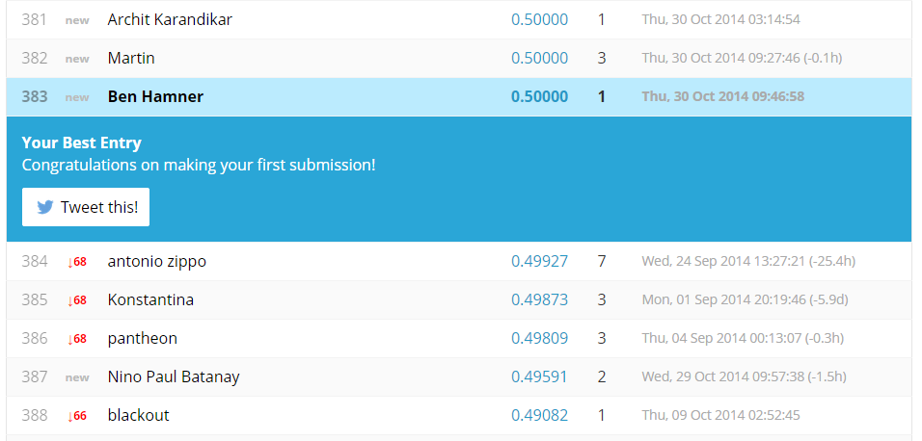
The participant immediately sees their public score on the public leaderboard

