Slide 1
Data Science Clustering

Slide 2
I. Supervised and Unsupervised Learning II. K-Means Clustering III. DBSCAN Clustering
agenda

Slide 3
I. Supervised and Unsupervised Learning
DATA SCIENCE

Slide 4
Machine Learning
One definition: “Machine learning is the semi-automatic extraction of knowledge from data.”
Knowledge from data: Starts with a question that might be answerable using data
Automatic extraction: A computer provides the insight
Semi-automatic: Requires many smart decisions by a human

Slide 5
Supervised Learning
There are two main categories of machine learning: supervised learning and unsupervised learning.
Supervised learning (aka “predictive modeling”):
Predict an outcome based on input data
Example: predict whether an email is spam or ham
Goal is “generalization”

Slide 6
Supervised Learning
There are two categories of supervised learning:
Regression
Outcome we are trying to predict is continuous
Examples: price, blood pressure
Classification
Outcome we are trying to predict is categorical (values in a finite, unordered set)
Examples: spam/ham, cancer class of tissue sample

Slide 7
Supervised Learning
Supervised learning example: Coin classifier
Observations: Coins
Features: Size and mass
Response: Coin type, hand-labeled
Train a machine learning model using labeled data
Model learns the relationship between the features and the coin type
Make predictions on new data for which the response is unknown
Give it a new coin, predicts the coin type automatically

Slide 8
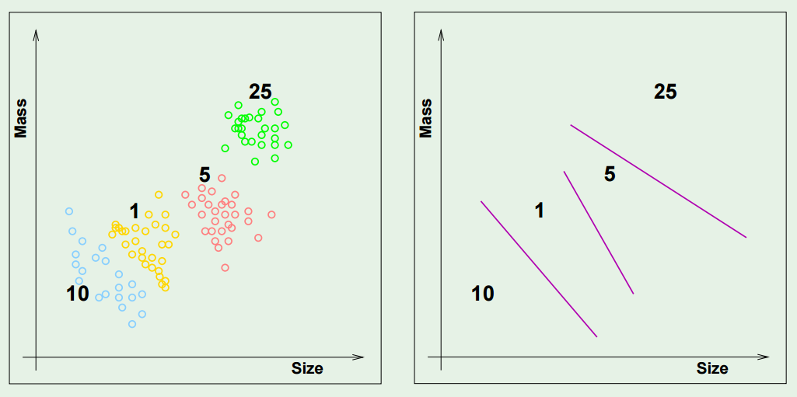
Supervised Learning

Slide 9
Unsupervised Learning
There are two main categories of machine learning: supervised learning and unsupervised learning.
Unsupervised learning:
Extracting structure from data
Example: segment grocery store shoppers into “clusters” that exhibit similar behaviors
Goal is “representation”

Slide 10
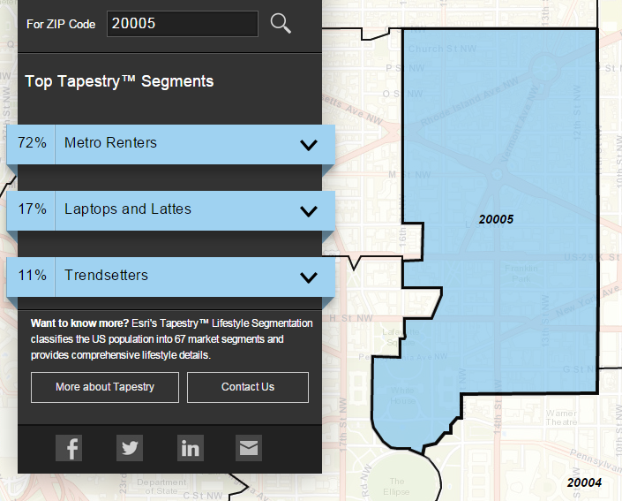
Unsupervised Learning
Group US residential neighborhoods into 67 unique segments based on demographic and socioeconomic characteristics
Metro Renters:
Young, mobile, educated, or still in school, we live alone or with a roommate in rented apartments or condos in the center of the city. Long hours and hard work don’t deter us; we’re willing to take risks to get to the top of our professions… We buy groceries at Whole Foods and Trader Joe’s and shop for clothes at Banana Republic, Nordstrom, and Gap. We practice yoga, go skiing, and attend Pilates sessions.
Source: http://www.esri.com/landing-pages/tapestry/

Slide 11
Unsupervised Learning
Common types of unsupervised learning:
Clustering: group “similar” data points together
Dimensionality Reduction: reduce the dimensionality of a dataset by extracting features that capture most of the variance in the data

Slide 12
Unsupervised Learning
Unsupervised learning has some clear differences from supervised learning. With unsupervised learning:
There is no clear objective
There is no “right anwser” (hard to tell how well you are doing)
There is no response variable, just observations with features
Labeled data is not required

Slide 13
Unsupervised Learning
Unsupervised learning example: Coin clustering
Observations: Coins
Features: Size and mass
Response: There isn’t one (no hand-labeling required!)
Perform unsupervised learning
Cluster the coins based on “similarity”
You’re done!
Sometimes, unsupervised learning is used as a “preprocessing” step for supervised learning. (How?)

Slide 14
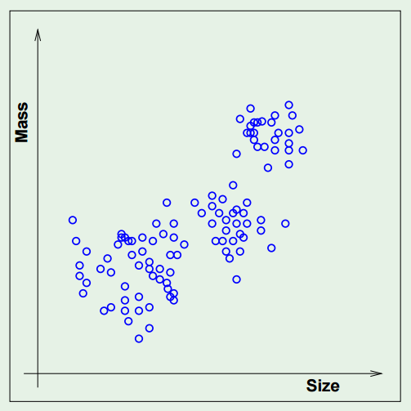
Unsupervised Learning

Slide 15
II. K-means clustering
DATA SCIENCE

Slide 16
K-means algorithm
1) choose k initial centroids (note that k is an input)
2) for each point:
- find distance to each centroid
- assign point to nearest centroid
3) recalculate centroid positions
4) repeat steps 2-3 until stopping criteria met
x₁
x₂

Slide 17
K-means algorithm
1) choose k initial centroids (note that k is an input)
2) for each point:
- find distance to each centroid
- assign point to nearest centroid
3) recalculate centroid positions
4) repeat steps 2-3 until stopping criteria met
x₁
x₂

Slide 18
K-means algorithm
1) choose k initial centroids (note that k is an input)
2) for each point:
- find distance to each centroid
- assign point to nearest centroid
3) recalculate centroid positions
4) repeat steps 2-3 until stopping criteria met
x₁
x₂

Slide 19
K-means algorithm
1) choose k initial centroids (note that k is an input)
2) for each point:
- find distance to each centroid
- assign point to nearest centroid
3) recalculate centroid positions
4) repeat steps 2-3 until stopping criteria met
x₁
x₂

Slide 20
K-means algorithm
1) choose k initial centroids (note that k is an input)
2) for each point:
- find distance to each centroid
- assign point to nearest centroid
3) recalculate centroid positions
4) repeat steps 2-3 until stopping criteria met
x₁
x₂

Slide 21
K-means algorithm
1) choose k initial centroids (note that k is an input)
2) for each point:
- find distance to each centroid
- assign point to nearest centroid
3) recalculate centroid positions
4) repeat steps 2-3 until stopping criteria met
x₁
x₂

Slide 22
K-means algorithm
1) choose k initial centroids (note that k is an input)
2) for each point:
- find distance to each centroid
- assign point to nearest centroid
3) recalculate centroid positions
4) repeat steps 2-3 until stopping criteria met
x₁
x₂

Slide 23
K-means algorithm
1) choose k initial centroids (note that k is an input)
2) for each point:
- find distance to each centroid
- assign point to nearest centroid
3) recalculate centroid positions
4) repeat steps 2-3 until stopping criteria met
x₁
x₂

Slide 24
K-means algorithm
1) choose k initial centroids (note that k is an input)
2) for each point:
- find distance to each centroid
- assign point to nearest centroid
3) recalculate centroid positions
4) repeat steps 2-3 until stopping criteria met
x₁
x₂

Slide 25
K-Means Clustering
Questions:
What if no clusters exist?
How to choose K?
How to choose the initial centroid positions?
When to stop the algorithm?
When might it produce poor results?

Slide 26
K-Means Clustering
What if no clusters exist?
It will still find clusters!
Visualization: I’ll Choose, Uniform Points

Slide 27
K-Means Clustering
How to choose K?
It will find the number of clusters specified
Visualization: I’ll Choose, Gaussian Mixture, K=2/3/4
Try different values for K and pick the “best”

Slide 28
K-Means Clustering
How to choose the initial centroid positions?
Randomly
Doesn’t tend to work well
Visualization: http://asa.1gb.ru/kmeans/1.html
Farthest point
Visualization: Farthest Point, Packed Circles, K=7
K-means++
Similar to farthest point, but adds some randomness
Used by default in scikit-learn
In all cases: Run it several times and pick the best result to avoid local minima

Slide 29
K-Means Clustering
When to stop the algorithm?
Tends to converge quickly
Set stopping criteria:
Maximum number of iterations
Once centroids move less than a threshold amount
Once fewer points than a threshold amount change clusters
Visualization: Randomly, Pimpled Smiley, K=6

Slide 30
K-Means Clustering
When might it produce poor results?
Data with varying shapes
Visualization: I’ll Choose, Smiley Face, K=4
Visualization: I’ll Choose, Density Bars, K=1
Data with different scales
Still the most popular clustering algorithm, used for a wide range of applications

Slide 31
III. DBSCAN clustering
DATA SCIENCE

Slide 32
DBSCAN Clustering
DBSCAN: Density-Based Spatial Clustering of Applications with Noise
For DBSCAN, clusters are areas of high density separated by areas of low density.

Slide 33
DBSCAN Clustering
DBSCAN Algorithm:
Choose “epsilon” and “min_samples”
Pick an arbitrary point, and check if there are at least “min_samples” points within the distance “epsilon”
If yes, add those points to the cluster and check each of the new points
If no, choose another arbitrary point to start a new cluster
Stop once all points have been checked
Visualization: Uniform Points

Slide 34
DBSCAN Clustering
DBSCAN Advantages:
Clusters can be any shape or size
No need to choose the number of clusters
DBSCAN Disadvantages:
More parameters to tune
Doesn’t work with clusters of varying density
Note: Not every point is necessarily assigned to a cluster!

