Slide 1
3TS: ML Engineering
TÉCNICAS básicas DE MODELADO PREDICTIVO

Slide 2
Objetivos
Estructurar el proceso de desarrollo de un modelo
Sistematizar las operaciones de exploración-preparación
Entrenar modelos básicos
Evaluar modelos

Slide 3

Objetivos
Debatir, discutir y compartir experiencias y prácticas.
Preguntarnos por qué
REPO: https://github.com/manualrg/DSLAB_Python

Slide 4
Índice de la sesión
Vocabulario
Visión holística del proceso de exploración-preparación
Modelos básicos
Evaluación de modelos (más allá de ROC)

Slide 5

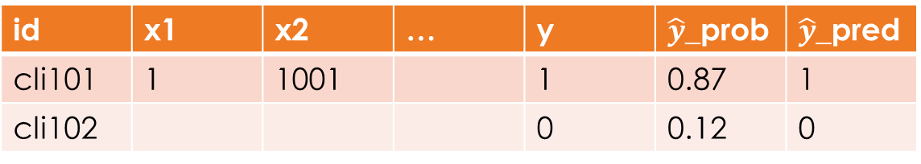
Glossary
Label, target
or response
Features
or
predictors
Prediction
or
scoring
id | x1 | x2 | … | y | $\hat{y}$_prob | $\hat{y}$_pred
cli101 | 1 | 1001 |  | 1 | 0.87 | 1
cli102 |  |  |  | 0 | 0.12 | 0
Example, instance or observation
event
Prior=
AVG(y)
Posterior=
AVG($\hat{y}$_prob)

Slide 6
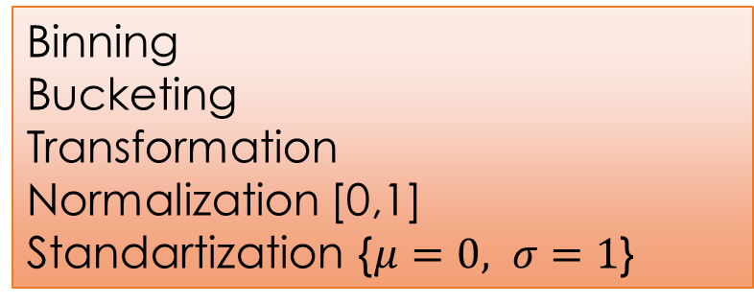
Exploration-Feature Engineering
Numeric
features
Categorical
features
Metadata Analysis
Low skewness
High skewness
Low cardinality
High cardinality
Descriptive Stats
checkMissing()
checkSkewness()
checkCatFreq()
OI_: Outlier idx
MI_: NaN idx
Missing imp.
Missing imp.
Rare levels
Min cell freq
Variable Screening
screenMissing()
screenOutliers()
screenLowFreq()
Binning
Bucketing
Transformation
Normalization [0,1] Standartization {$μ=0, σ=1$}
Low freq grouping
Numeric mapping
OHE
Dense representation
Embeddings
Feature Engineering

Slide 7
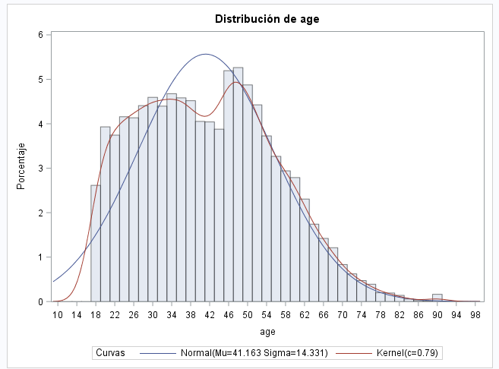
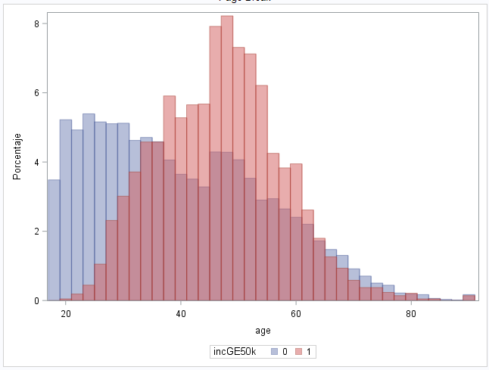
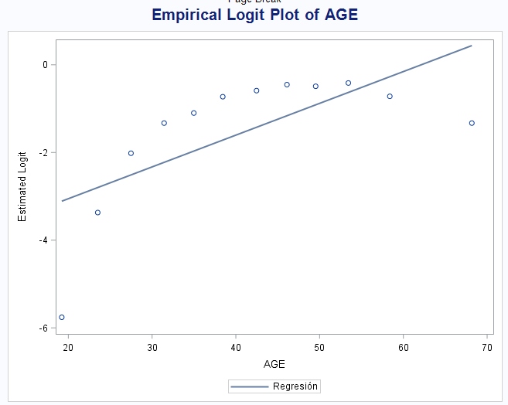
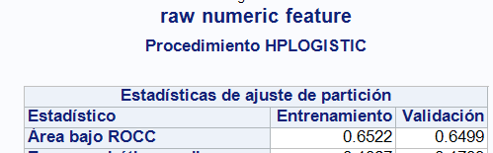
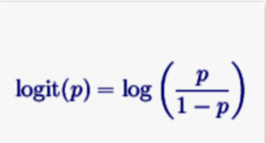
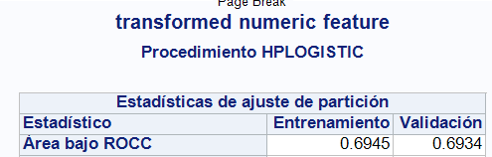
Numeric Features: Low Skewness

Slide 8
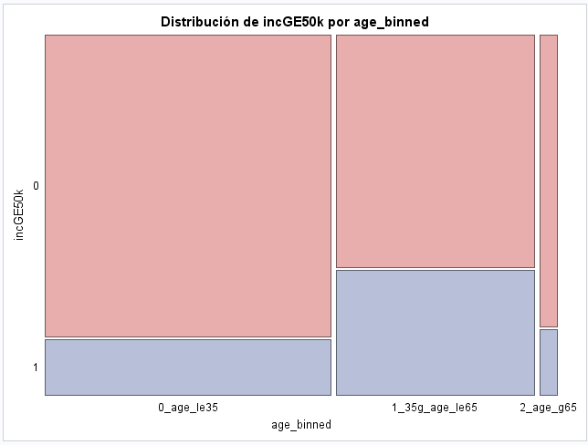
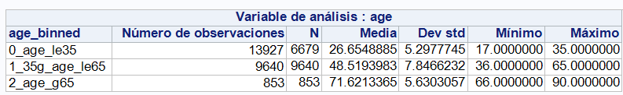
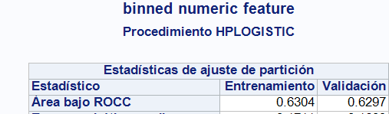
Numeric Features: Low Skewness

Slide 9
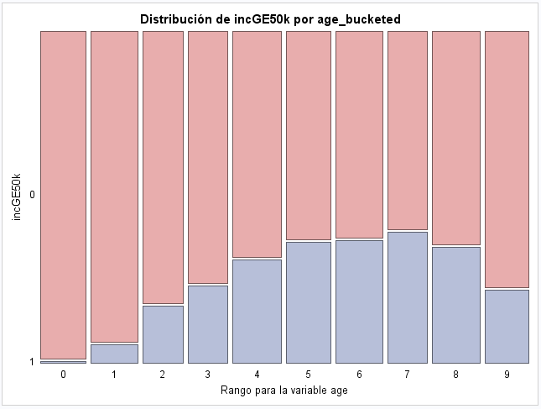
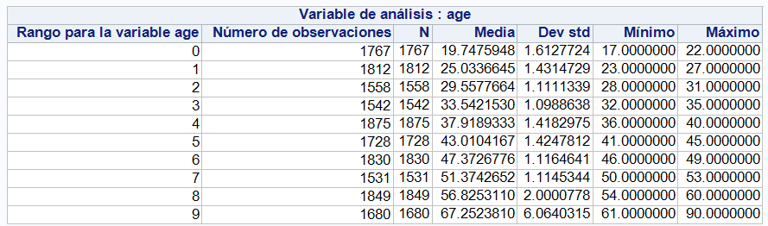
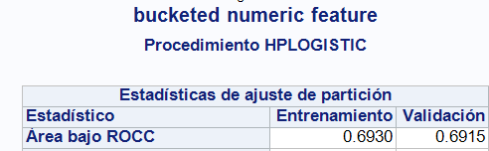
Numeric Features: Low Skewness

Slide 10
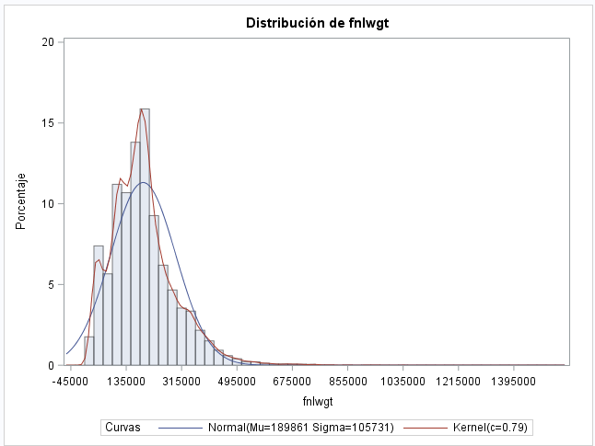
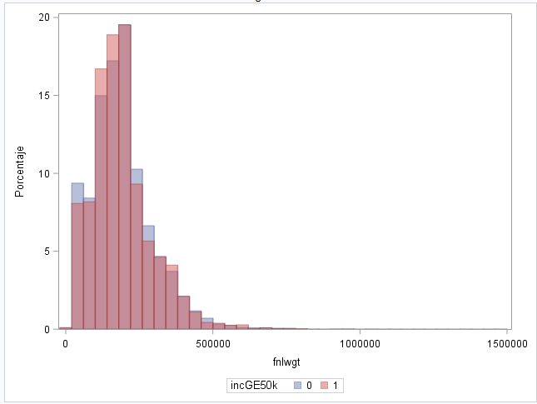
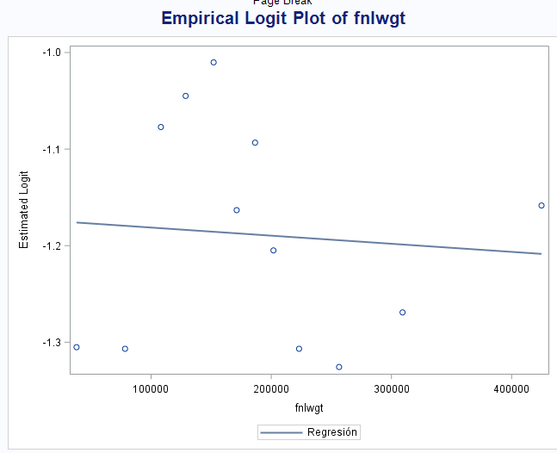
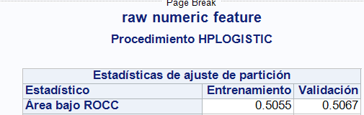
Numeric Features: High Skewness

Slide 11
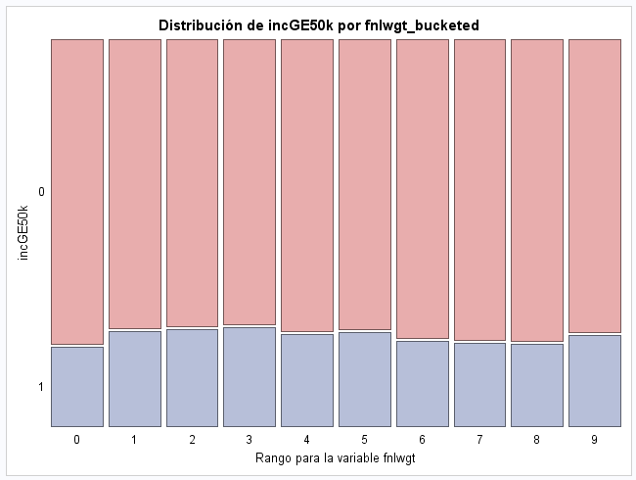
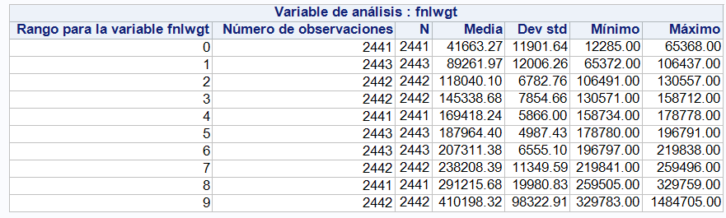
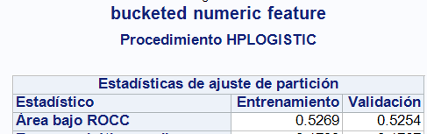
Numeric Features: High Skewness

Slide 12
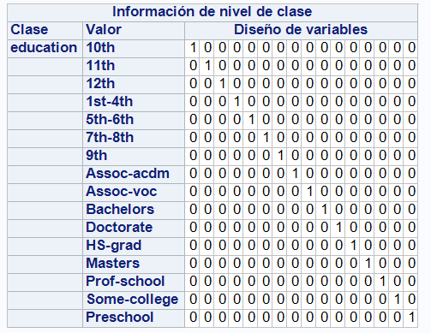
Categorial Features
Design matrix (Sparse representation)
Nominal levels (as strings): OHE
Ordinal levels (as numeric)
Numeric mapping:
Freq count
Freq idx
Event proportion
…

Slide 13
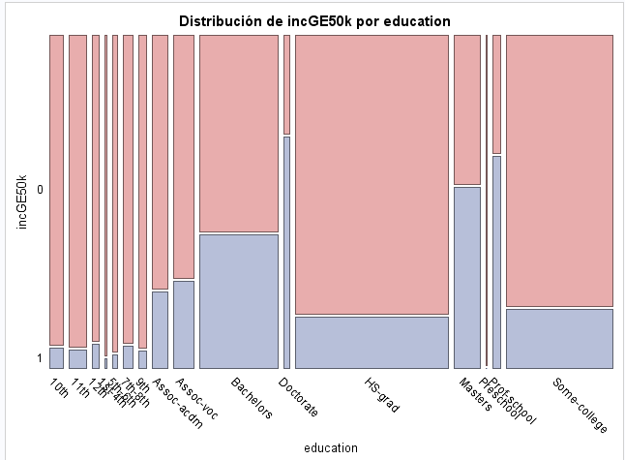

Categorial Features: Nominal

Slide 14
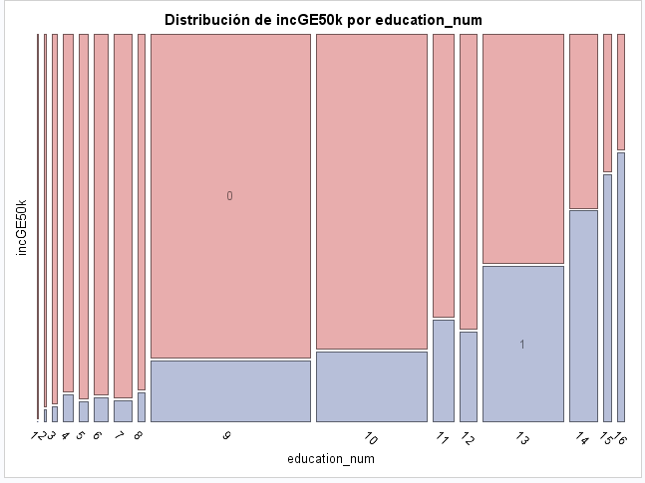
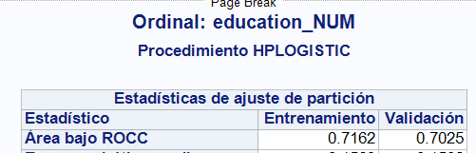
Categorial Features: Ordinal
Magical numbers?
Distances?

Slide 15
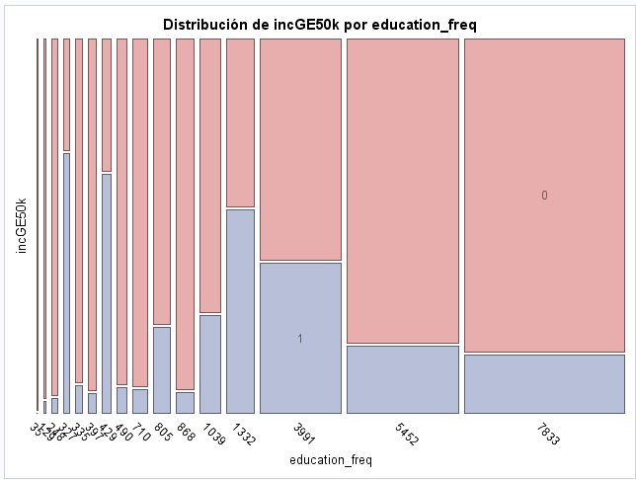
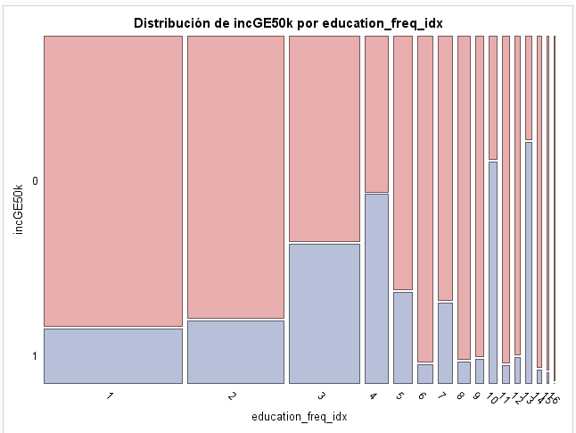


Categorial Features: Freq mappings

Slide 16
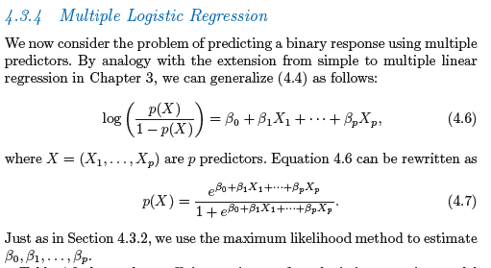
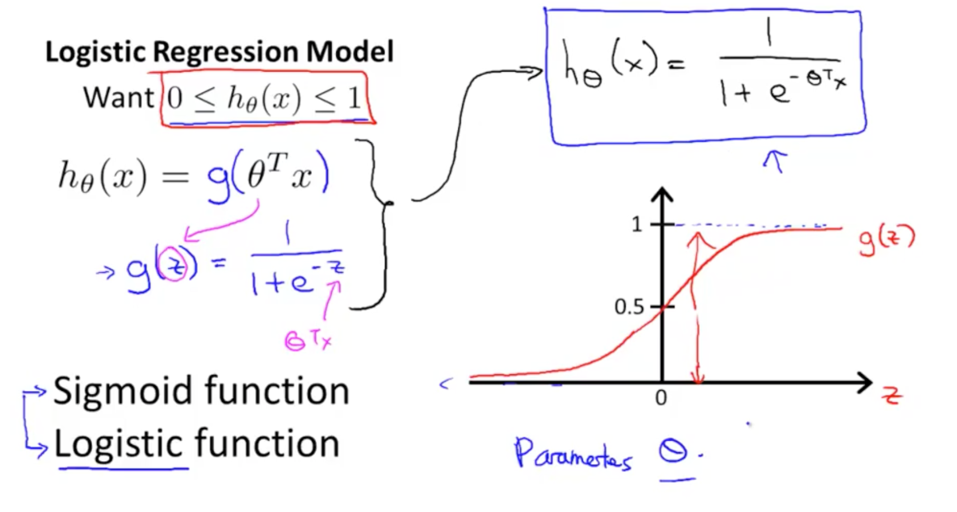
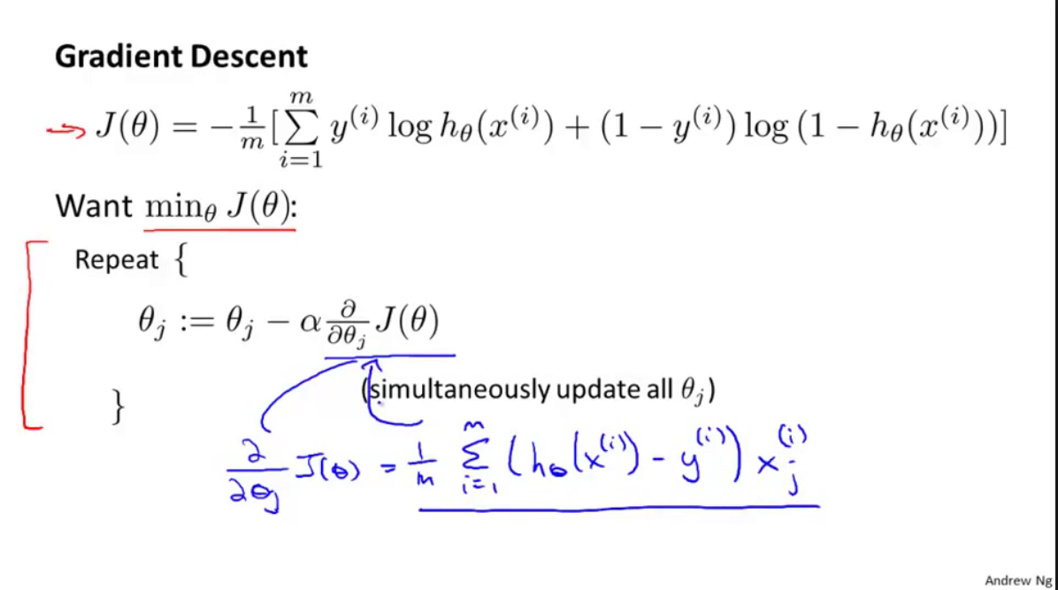
Basic Modelling: Logistic Regression

Slide 17
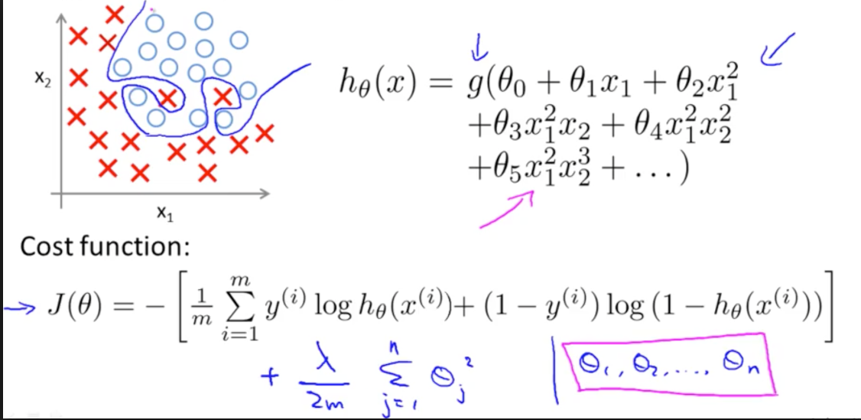
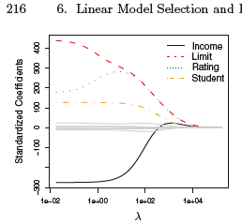
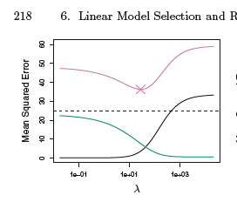
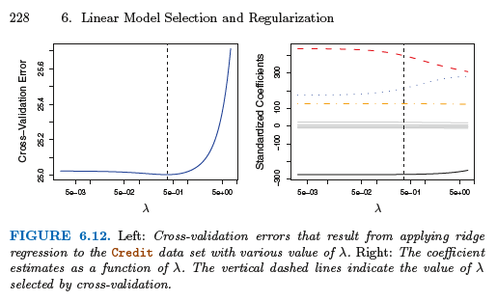
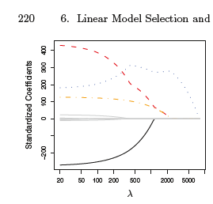
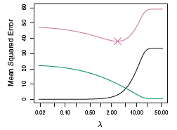
Basic Modelling: Regularization

Slide 18
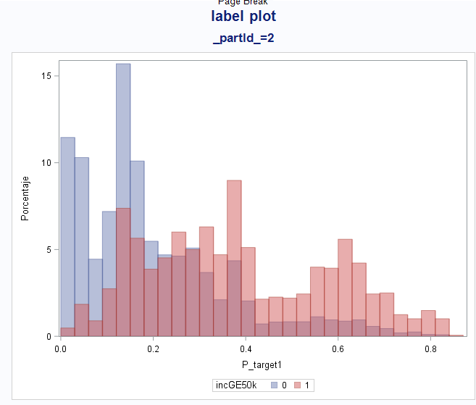
Model Assessment: Beyond ROC
Models that classify low probability examples correctly as non-event can yield a high AUC (>0.99) and not perform properly
RARE EVENT BINARY CLASSIFICATION
What is AUROC?

Slide 19
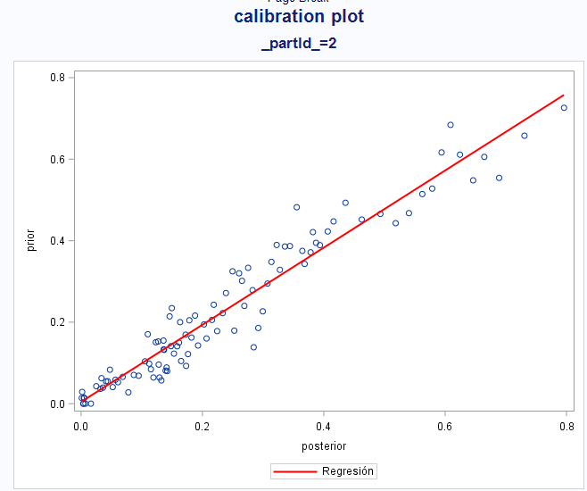
Model Assessment: Beyond ROC
Class separation (KS metric)
PR Curves
Analyze scoring by predicted probability bucket!!! (e.g. calibration plot, Lift, Gain.)

Slide 20
GRACIAS !!!
BIBLIOGRAFÍA:
Introduction to Statistical Learning (R)
https://www-bcf.usc.edu/~gareth/ISL/ISLR%20First%20Printing.pdf
Elements of Statistical Learning (R)
https://web.stanford.edu/~hastie/Papers/ESLII.pdf
Machine Learning Andrew NG (Matlab-Octave)
https://www.coursera.org/learn/machine-learning
Categorical Data Analysis Using Logistic Regression (SAS)
https://support.sas.com/edu/schedules.html?ctry=us&crs=CDALR
Predictive Modeling Using Logistic Regression (SAS)
https://support.sas.com/edu/schedules.html?ctry=us&crs=PMLR

