Slide 1

Power BI Task

Slide 2
Requirements
Movies by Genre representation
Movies by Certificate representation
Review word cloud
Budget in dollars visual (it should show dollar symbol ($) on the visual)
Collections in dollars visual (it should show dollar symbol ($) on the visual)
Overall Profit and Profit for each movie (it should show dollar symbol ($) on the visual)
Oscar nominations Vs Oscar wins
Movies runtime as a tooltip or any other way open to your imagination
Genre and Certificate combined information.
Which certificate movies collected more profit?
Which Genre movies collected more profit?
Budgets by Genre and Certificate.
Any more insights as per your imagination ☺

Slide 3
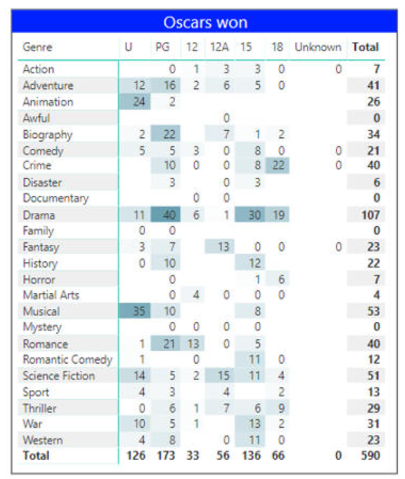
Mandatory Requirement
Create a matrix visual using conditional formatting as shown in example here

