Slide 1

Artificial Neural Networks for Power Management
Enhancing Efficiency and Reliability in Modern Power Systems

Slide 2

Abstract
ANNs enhance power systems by modeling complex, nonlinear relationships for improved efficiency and reliability.
ANNs model high-dimensional electric networks, predicting power consumption patterns with high accuracy.
Accurate predictions from ANNs enable optimized load distribution and improved grid stability.
ANNs improve forecasting accuracy by identifying patterns in vast datasets, aiding in better energy resource management.
ANNs analyze sensor data to detect anomalies and predict failures, reducing downtime and extending infrastructure lifespan.

Slide 3

Introduction
Power management involves the efficient use and distribution of electrical power in a system to ensure optimal performance, reliability, and sustainability
.
Increasing demand for electricity due to population growth and industrialization. Integration of intermittent renewable energy sources, such as solar and wind.
Smart Grids: Utilizing advanced communication and automation technologies to enhance the efficiency and reliability of the power grid.

Slide 4

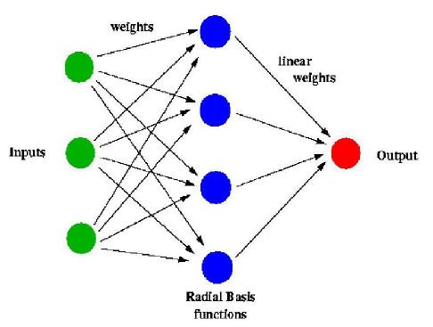
What is ANN?
Inspired by the human brain
Composed of interconnected nodes (neurons)

Slide 5

Applications of ANN in Power Management
Load Forecasting
Predicting future power demand
Fault Detection and Diagnosis:
Maintaining stability in power systems
Energy Supply Management
Optimizing the use of energy storage systems

Slide 6

ANN for Load Forecasting
Ensuring reliable power supply
Reducing operational costs
How ANN Helps:
Handling nonlinear relationships
Processing large datasets

Slide 7

ANN for Fault Detection and Diagnosis
Auto-detection
Minimizing downtime
Preventing equipment damage
How ANN Helps:
Rapid identification of anomalies
Learning from historical data

Slide 8
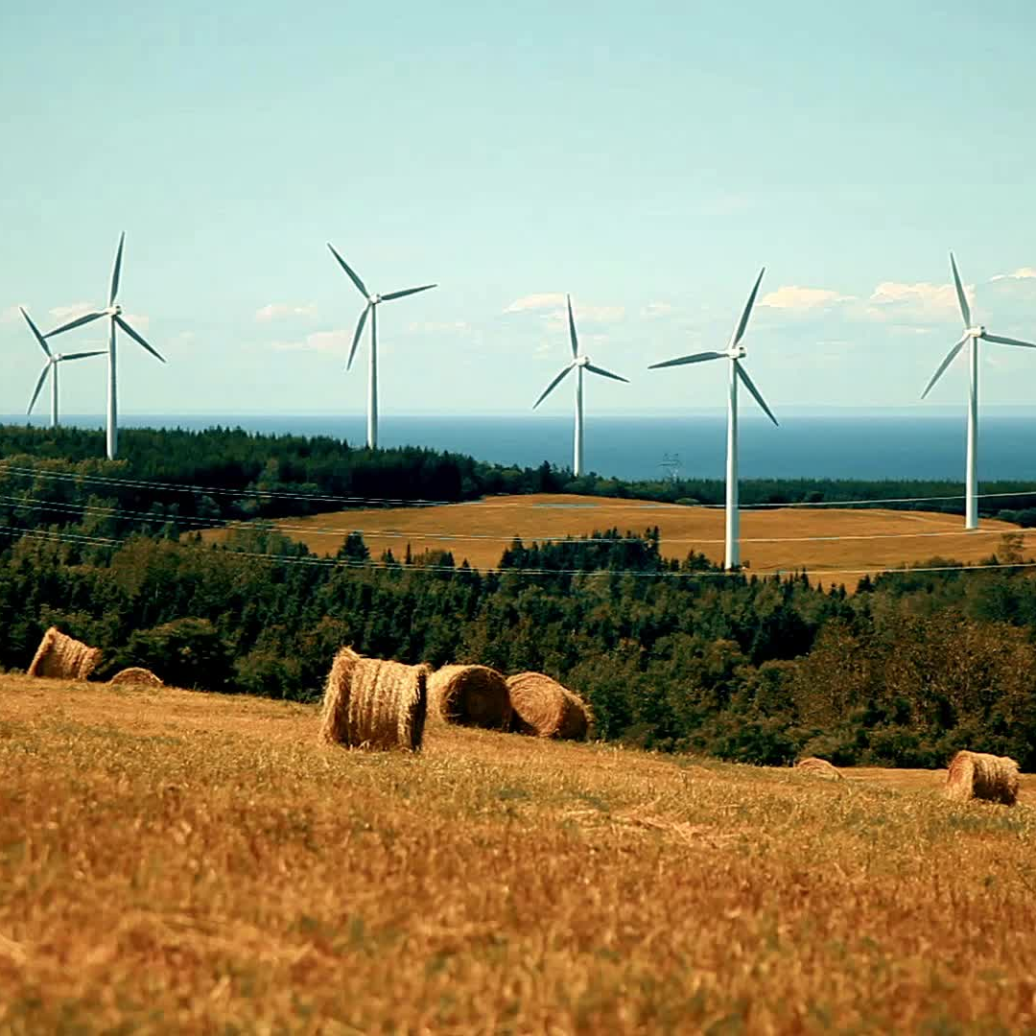
ANN for Energy Supply Management
Balancing supply and demand
Integrating renewable energy sources
How ANN Helps:
Predictive analytics for supply/demand cycles
Optimizing power production

Slide 9

Benefits of Using ANN in Power Management
Improved Accuracy
- Better predictions and diagnostics
Enhanced Efficiency
Optimized operations and reduced waste
Scalability
Handling large-scale power systems
Adaptability
Learning and improving over time

Slide 10

Challenges and Considerations
Data Requirements
Need for large and high-quality datasets
Computational Complexity
High processing power required
Integration with Existing Systems
Compatibility and interoperability issues
Ethical and Security Concerns
- Ensuring data privacy and security

Slide 11

Future Trends
Advancements in ANN Technology:
Deep learning and advanced architectures
Integration with IoT and Smart Grids:
Real-time data and analytics
Sustainable Energy Solutions:
ANN in renewable energy management
Policy and Regulation:
Supportive frameworks for adoption

Slide 12

Conclusion
Summary of Key Points:
- ANN’s role in improving power management
- Benefits and challenges
Future Outlook:
- Continued innovation and adoption
Q&A

Slide 13
References
A. R. Al-Roomi and M. E. El-Hawary, "Fast AI-Based Power Flow Analysis for High-Dimensional Electric Networks," 2020IEEE Electric Power and Energy Conference (EPEC), Edmonton, AB, Canada, 2020, pp. 1-6, doi:10.1109/EPEC48502.2020.9320057. keywords: {Power systems;Mathematical model;Transfer functions;Energymanagement;Generators;Artificial neural networks;Conferences;power operation;power flow analysis;load flow analysis;Newton-Raphson;artificial neural networks},
M. Hanan, W. Yousaf, X. Ai, E. Asghar, M. Y. Javed and S. Salman, "Multi-operating Modes Based Energy Management Strategy of Virtual Power Plant," 2018 2nd IEEE Conference on Energy Internet and Energy System Integration (EI2), Beijing, China, 2018, pp. 1-6, doi: 10.1109/EI2.2018.8582406. keywords: {Batteries;Energy management;Wind turbines;State of charge;Mathematical model;Energy Management;Micro-grid;VPP;Simulink},
K. Shu, X. Ai, J. Wen, J. Fang, Z. Chen and C. Luo, "Optimal Energy Management for the Integrated Power and Gas Systems via Real-time Pricing," 2018 IEEE Power & Energy Society General Meeting (PESGM), Portland, OR, USA, 2018, pp. 1-5, doi: 10.1109/PESGM.2018.8585873. keywords: {Mathematical model;Fluid flow;Natural gas;Power system dynamics;Energy management;Real-time systems;Power system transients;integrated energy system;bi-level programming;equilibrium constraints},
H. Zhang, H. Zhao, H. Li, Y. Chen, J. Ai and Q. Wang, "A Decision Support System of Premium Power Supply Investment," 2020 5th Asia Conference on Power and Electrical Engineering (ACPEE), Chengdu, China, 2020, pp. 934-939, doi: 10.1109/ACPEE48638.2020.9136300. keywords: {Decision support systems;Electrical engineering;Power supplies;Decision making;Power quality;Companies;Power markets;premium power supply;decision support system;user demand;voltage sag},

Slide 14

Thank You
MANU C MADHU
manucmadhu186@gmail.com
Linktr.ee/manucmadhu

