Slide 1
CSE408
Recurrence equations
Lecture #12

Slide 2
Recurrence Relations
equations that express a problem in terms of its smaller subproblems.
commonly used to analyze the time complexity of recursive algorithms.

Slide 3
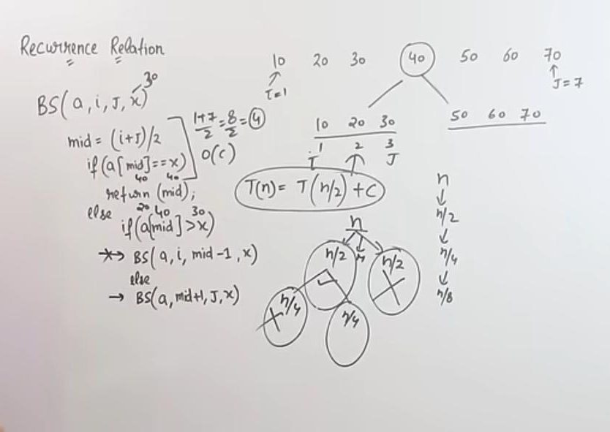
What is Recurrence Relation?
Following is the recurrence of binary search
T(n)=T(n/2)+C

Slide 4
Methods to Solve Recurrence Relations
Substitution Method
Recursion Tree Method
Master Theorem

Slide 5
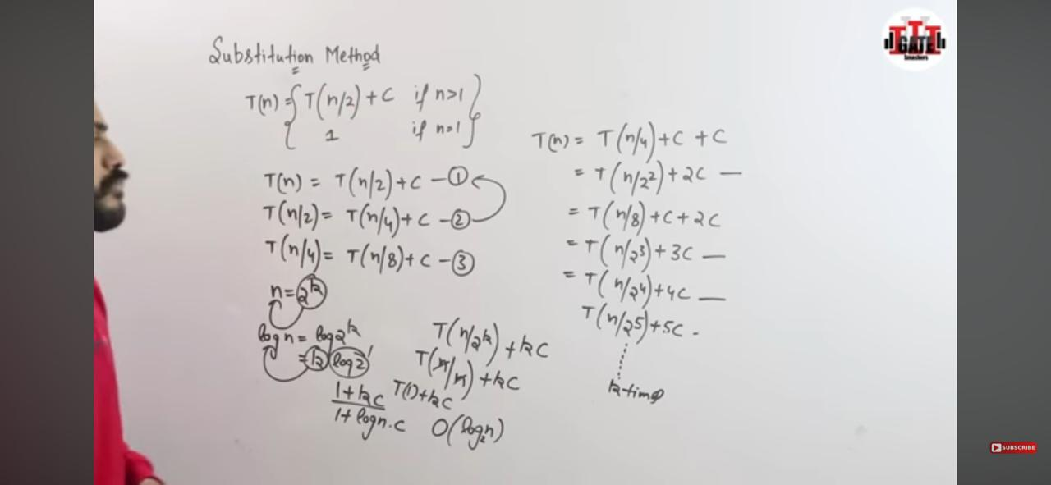
Substitution Method
The recurrence of binary search T(n)=T(n/2)+C
Solved with the help of Substitution Method
The recurrence of binary search T(n)=T(n/2)+C
With Substitution Method, the complexity is calculated as O(log₂n)

Slide 6
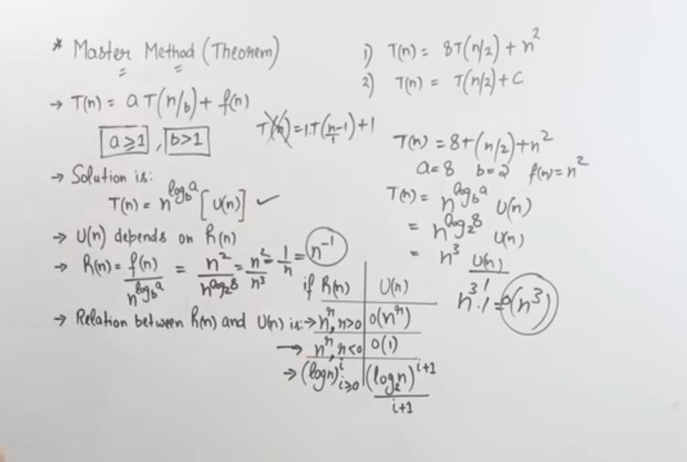
Master Theorem
T(n)=8T(n/2)+n²
Solved with Master Therom
T(n)=8T(n/2)+n²
With Master Therom, the complexity is calculated as n³

Slide 7
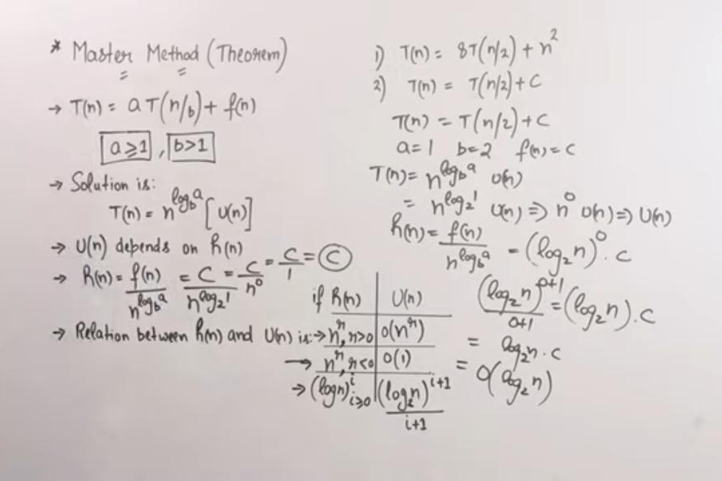
T(n)=(n/2)+c
Solved with Master Therom
T(n)=(n/2)+c
With Master Therom, the complexity is calculated as O(log₂n)

Slide 8
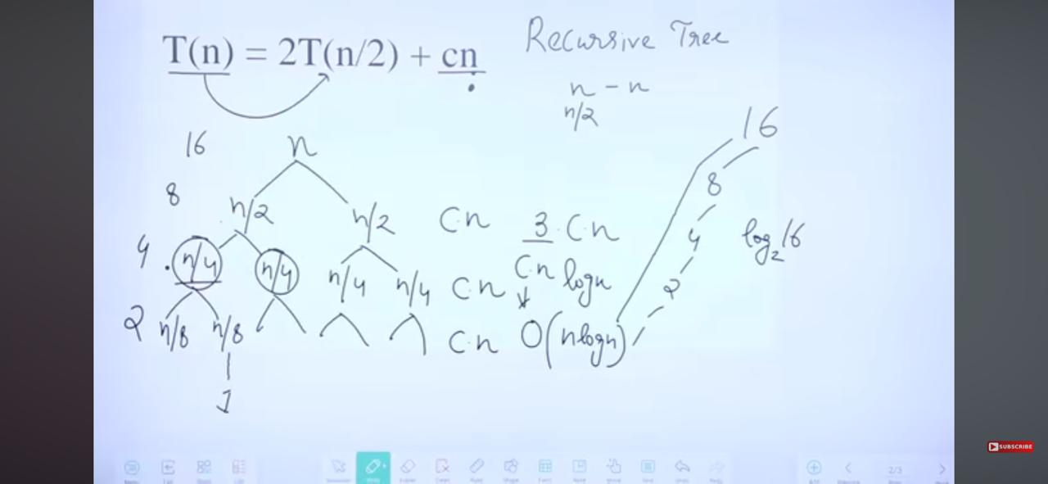
Recursion Tree Method
Recurrence of merge sort T(n)=2T(n/2)+cn
Solved with Recursion Tree Method
T(n)=2T(n/2)+cn
Solved with Recursion Tree Method and get complexity as O(nlogn)

