Slide 1
CSE408
Fundamentals of Data Structure
Lecture #2

Slide 2
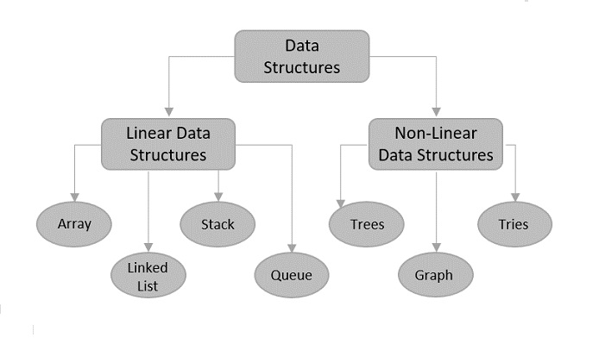
Fundamental data structures

Slide 3
Fundamental data structures
list
  array
  linked list
  string
stack
queue
priority queue/heap
graph
tree and binary tree
set and dictionary

Slide 4
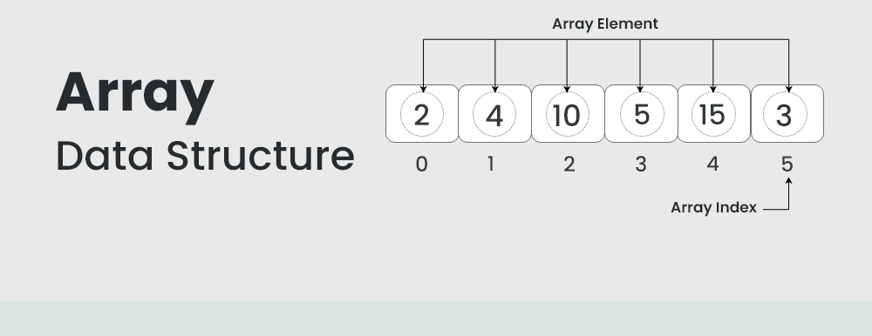
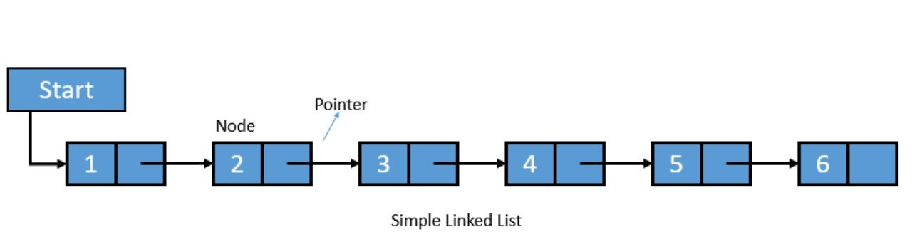
Linear Data Structures
Arrays
  Contiguous n-items of same type accessible
Linked List
  A sequential nodes connected via pointer.
  Singly linked list (next pointer)
  Doubly linked list (next + previous pointers)
Arrays
  fixed length (need preliminary reservation of memory)
  contiguous memory locations
  direct access
  Insert/delete
Linked Lists
  dynamic length
  arbitrary memory locations
  access by following links
  Insert/delete
…
.
a1
a2
Notes:
Arrays
A sequence of n items of the same data type that are stored contiguously in computer memory and made accessible by specifying a value of the array’s index.
Linked List
A sequence of zero or more nodes each containing two kinds of information: some data and one or more links called pointers to other nodes of the linked list.

Slide 5
Stacks and Queues
Stacks
  A stack of plates
    insertion/deletion can be done only at the top.
    LIFO
  Two operations (push and pop)
Queues
  A queue of customers waiting for services
    Insertion/enqueue from the rear and deletion/dequeue from the front.
    FIFO
  Two operations (enqueue and dequeue)

Slide 6
Priority Queue and Heap
Priority queues (implemented using heaps)
  A data structure for maintaining a set of elements, each associated with a key/priority, with the following operations
    Finding the element with the highest priority
    Deleting the element with the highest priority
    Inserting a new element
  Scheduling jobs on a shared computer
9
6
8
5
2
3
9
6
8
5
2
3

Slide 7
Graphs
Formal definition
  A graph G = <V, E> is defined by a pair of two sets: a finite set V of items called vertices and a set E of vertex pairs called edges.
Undirected and directed graphs (digraphs).
What’s the maximum number of edges in an undirected graph with |V| vertices?
Complete, dense, and sparse graphs
  A graph with every pair of its vertices connected by an edge is called complete, K_{|V|}
1
2
3
4

Slide 8
Graph Representation
Adjacency matrix
  n x n boolean matrix if |V| is n.
  The element on the ith row and jth column is 1 if there’s an edge from ith vertex to the jth vertex; otherwise 0.
  The adjacency matrix of an undirected graph is symmetric.
Adjacency linked lists
  A collection of linked lists, one for each vertex, that contain all the vertices adjacent to the list’s vertex.
Which data structure would you use if the graph is a 100-node star shape?
0 1 1 1
0 0 0 1
0 0 0 1
0 0 0 0
2
3
4
4
4

Slide 9
Weighted Graphs
Weighted graphs
  Graphs or digraphs with numbers assigned to the edges.
5
1
2
6
9
7
3
8
4

Slide 10
Graph Properties -- Paths and Connectivity
Paths
  A path from vertex u to v of a graph G is defined as a sequence of adjacent (connected by an edge) vertices that starts with u and ends with v.
  Simple paths: All edges of a path are distinct.
  Path lengths: the number of edges, or the number of vertices – 1.
Connected graphs
  A graph is said to be connected if for every pair of its vertices u and v there is a path from u to v.
Connected component
  The maximum connected subgraph of a given graph.
Notes:
Examples of a simple path and a not simple path.
Connected graphs: starting from any vertex, we can always find a path to reach all the other vertices. (Ball-String example.)
From NIST:
Connected graphs:
Definition: An undirected graph that has a path between every pair of vertices.
Strongly connected graphs:
Definition: A directed graph that has a path from each vertex to every other vertex.
Connected component: …
Strongly connected component:
a strongly connected component of a digraph G is a maximal strongly connected subgraph of G.

Slide 11
Graph Properties -- Acyclicity
Cycle
  A simple path of a positive length that starts and ends a the same vertex.
Acyclic graph
  A graph without cycles
  DAG (Directed Acyclic Graph)
1
2
3
4

Slide 12
Trees
Trees
  A tree (or free tree) is a connected acyclic graph.
  Forest: a graph that has no cycles but is not necessarily connected.
Properties of trees
  For every two vertices in a tree there always exists exactly one simple path from one of these vertices to the other. Why?
    Rooted trees: The above property makes it possible to select an arbitrary vertex in a free tree and consider it as the root of the so called rooted tree.
    Levels in a rooted tree.
rooted
3
  |E| = |V| - 1
1
3
5
4
1
5
2
4
2

Slide 13
Rooted Trees (I)
Ancestors
  For any vertex v in a tree T, all the vertices on the simple path from the root to that vertex are called ancestors.
Descendants
  All the vertices for which a vertex v is an ancestor are said to be descendants of v.
Parent, child and siblings
  If (u, v) is the last edge of the simple path from the root to vertex v, u is said to be the parent of v and v is called a child of u.
  Vertices that have the same parent are called siblings.
Leaves
  A vertex without children is called a leaf.
Subtree
  A vertex v with all its descendants is called the subtree of T rooted at v.

Slide 14
Rooted Trees (II)
Depth of a vertex
  The length of the simple path from the root to the vertex.
Height of a tree
  The length of the longest simple path from the root to a leaf.
h = 2
3
4
1
5
2

Slide 15
Ordered Trees
Ordered trees
  An ordered tree is a rooted tree in which all the children of each vertex are ordered.
Binary trees
Tree with max two ordered children.
Binary search trees
  Each vertex is assigned a number.
  A number assigned to each parental vertex is larger than all the numbers in its left subtree and smaller than all the numbers in its right subtree.
⎣log₂n⎦ ≤ h ≤ n – 1, where h is the height of a binary tree and n the size.
9
6
6
8
3
9
5
2
3
2
5
8
Notes:
A binary tree is an ordered tree in which every vertex has no more than two children and each children is designated s either a left child or a right child of its parent.

Slide 16
Thank You !!!

