Slide 1

by Emmanuel Mokua
Final Project
Global Social Media Virality
29 April, 2025

Slide 2
Introduction
Every second, about 3.4 million swipes decide
what the world sees next.
This projects dissects a part of that global scroll— across platforms, formats, hashtags, and regions— to reveal the repeatable patterns behind true social-media virality.

Slide 3
Hacking Virality
Social Feeds = billions of micro engagement activities
5000 posts analyzed to figure out what patterns drive virality
The goal being to turn data into actionable insight that creators & brand managers can use to drive virality for their content

Slide 4
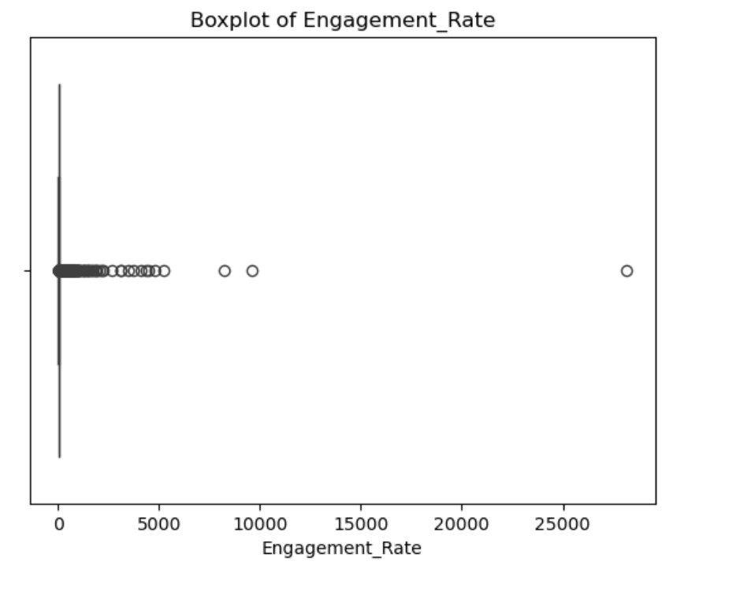
Data Cleaning
Lower-cased all categorical columns
Removed 98 null / duplicate rows
Expressed engagement rate as a percentage
Dataset didn’t have null values so it the process to get to cleaner dataset was faster

Slide 5
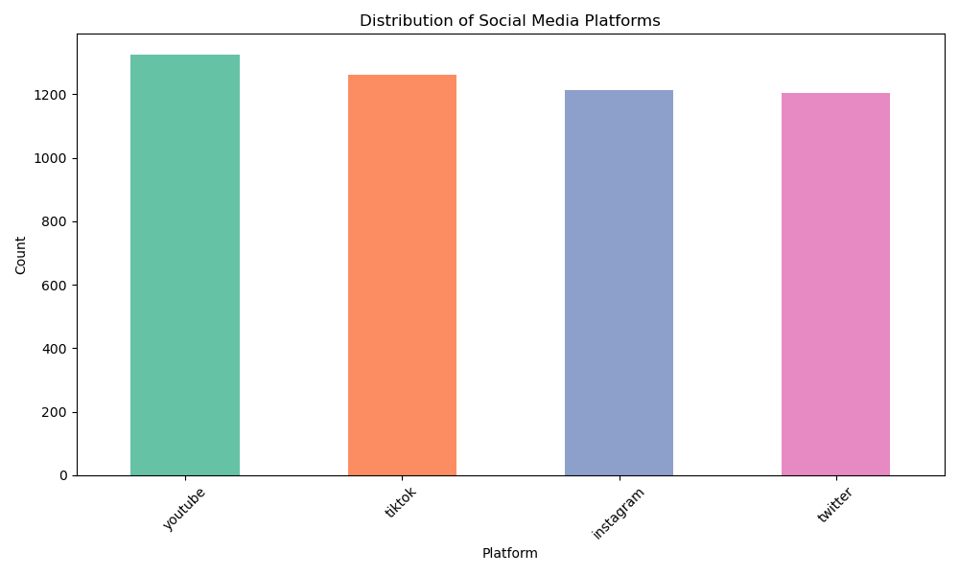
Who owns the feed?
Post volume fairly even across platforms
YouTube uploads lead by ~8 %
TikTok & IG close behind

Slide 6
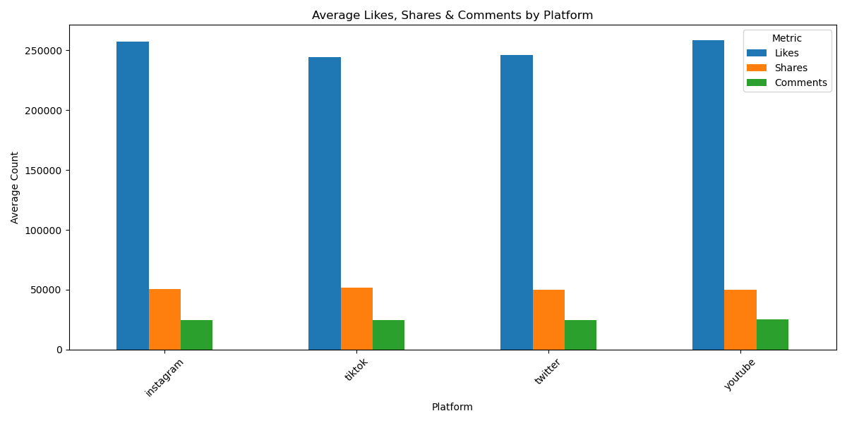
Engagement Breakdown
YouTube tops avg engagement (257 k)
Likes account for a majority of the engagement metrics.
People comment less on content across platforms

Slide 7
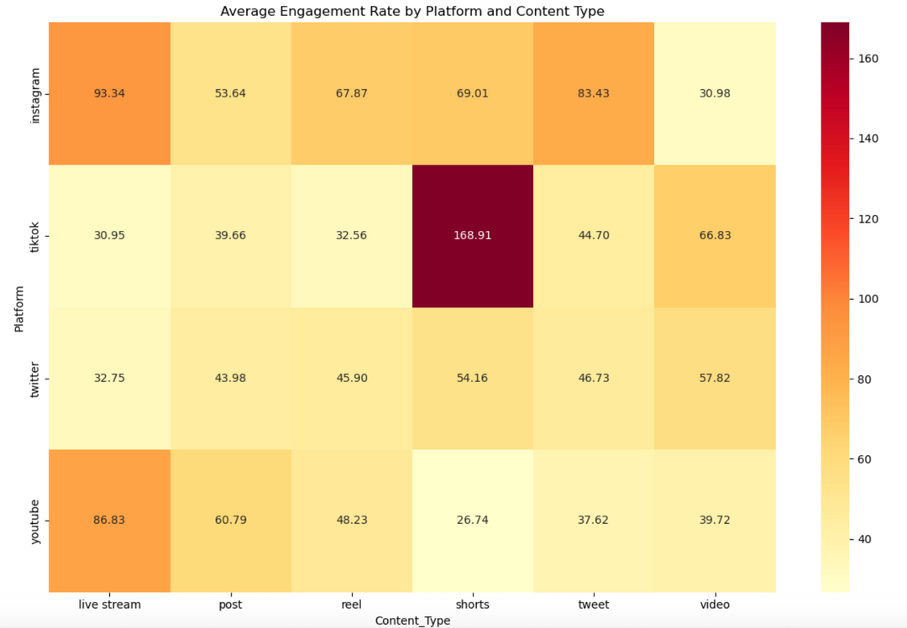
Engagement Heatmap
Short vertical clips ignite higher interactions on tiktok
Real-time content foster comment threads
Traditional posts underperform across the board.

Slide 8
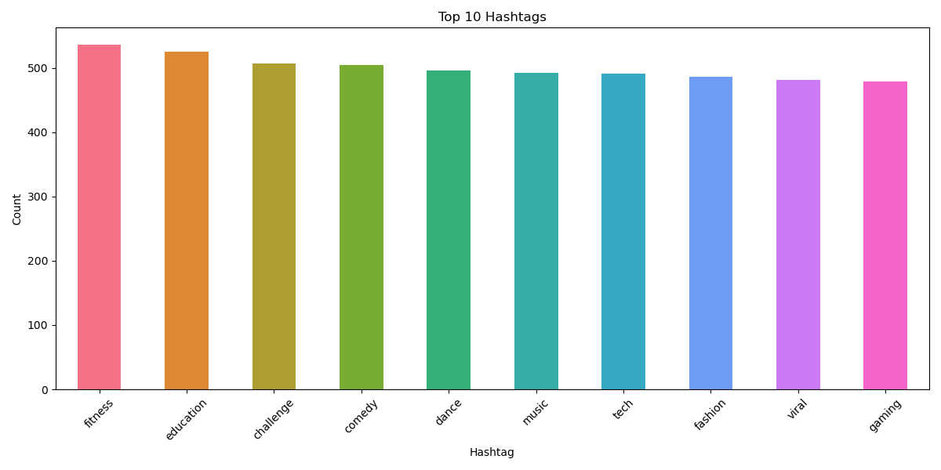
Consistently Viral Hashtags
#fitness, #education are the top hashtags to boost posts
#fitness, #education appear in about 41% of the posts that go viral
#gaming performs the worst in hashtag category

Slide 9
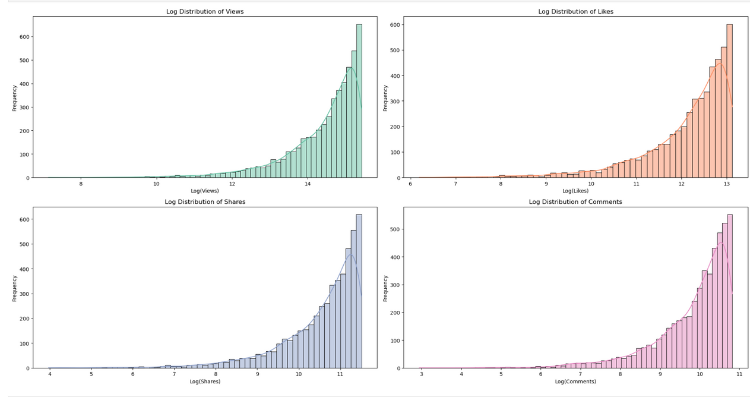
Format Matters
Short-form vertical video = 265 k average engagement
Outperforms full-length video across all metrics
Few videos go super viral (power law)

Slide 10
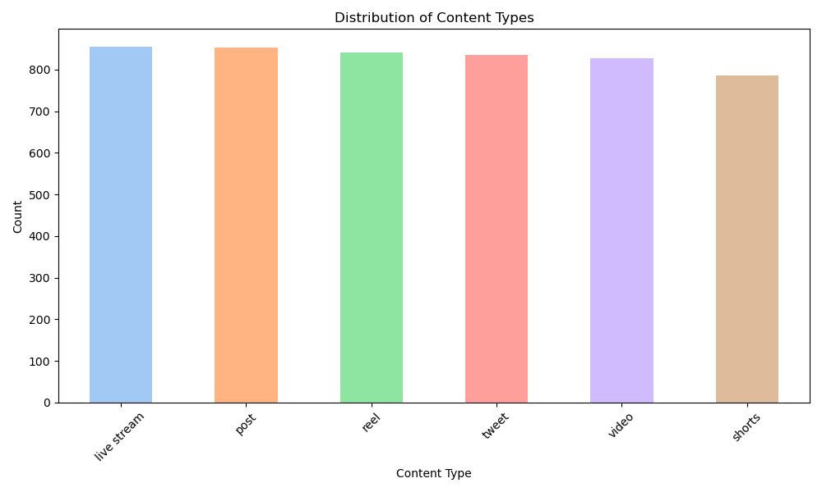
Why Short-Form Wins
Thumb-friendly, auto-play, quick dopamine hits
Algorithm boosts “time watched per pixel”
Shorter watch times increase watch probability

Slide 11
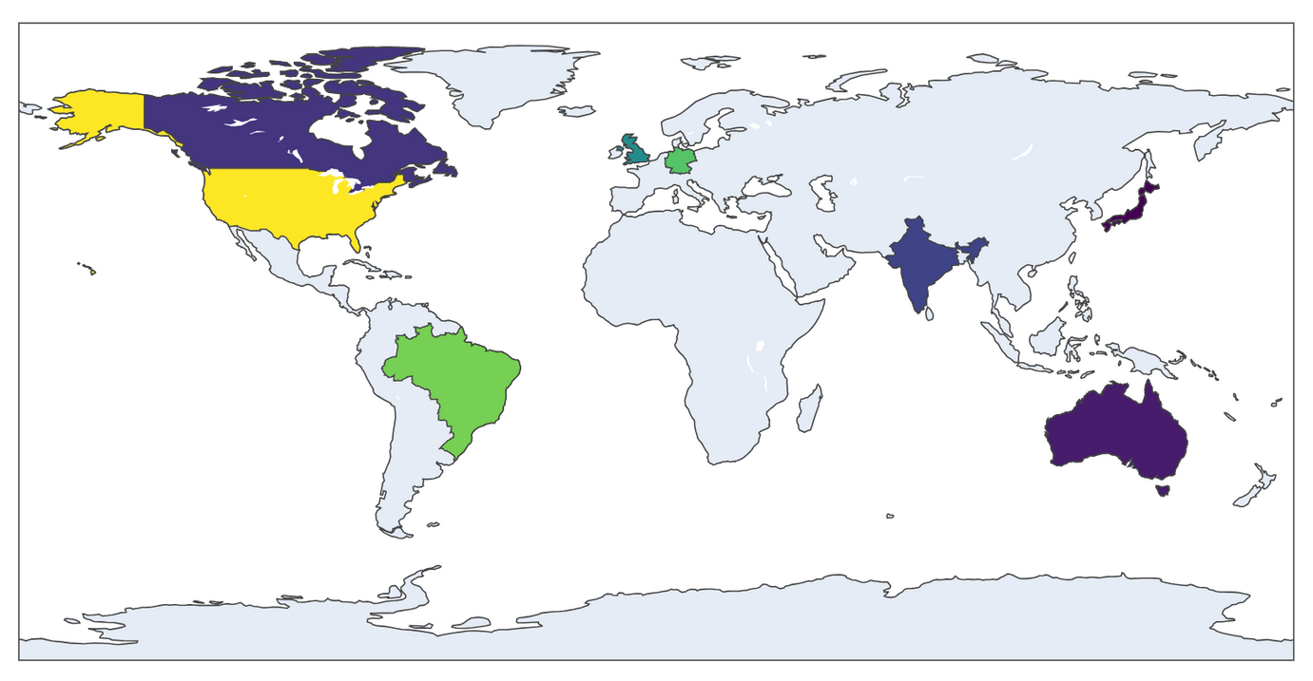
Average View Globally
America averages highest views on content
India leads in comment interactions on video posts.
Short form videos account for majority of views in USA.

Slide 12
Key Insights
YouTube edges others by 5-8 % engagement
5 hashtags dominate viral tier
Shorts/Reels beat every other format
India drives both clicks(comments) in this specific dataset

Slide 13
Strategy Recommendations
Prioritize Shorts/Reels; cross-post to YT & IG
Frame content with #Fitness or #Education hooks
Schedule drops for India-friendly time zones
Foster comment threads; ask direct questions

Slide 14
Limitations
No watch-time, sentiment, or retention metrics
Bias in data because it is only for 1 year

Slide 15
Thank you

