Slide 1



Crime in LA
(2020-Present)
Sophia, Emmanuel, Saiida

Slide 2
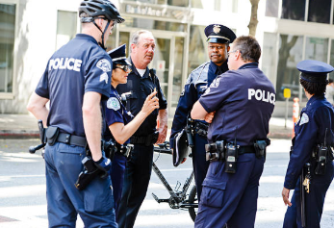
Data Selection
Source (Data.gov)
Los Angeles Police Department, 2020-2025 (LAPD OpenData)
Shape: 1005149 rows × 28 columns
Types of data in rows
Categorical
Victim demographics, crime demographics,
Numerical
Victim age, crime-related information (location, time)

Slide 3
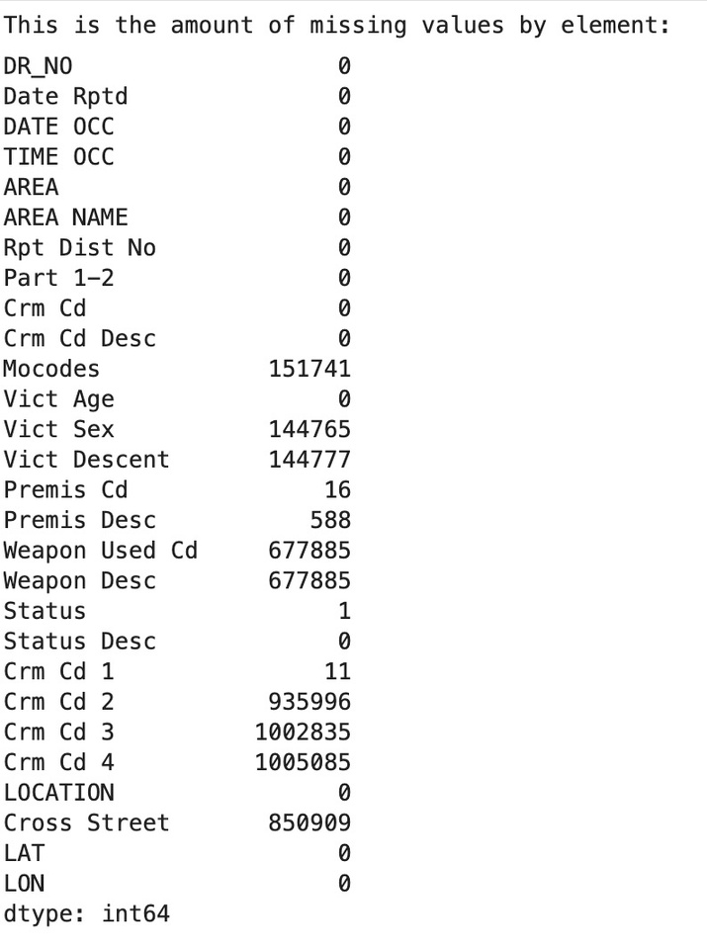
General Data Wrangling
Categorization based on personal analysis
Assuming correlations
Handling numerical vs. categorical data
‘Unknown’
Quantity of Missing Values
Columns dropped
Crm Cd 2-4
Weapon Description

Slide 4
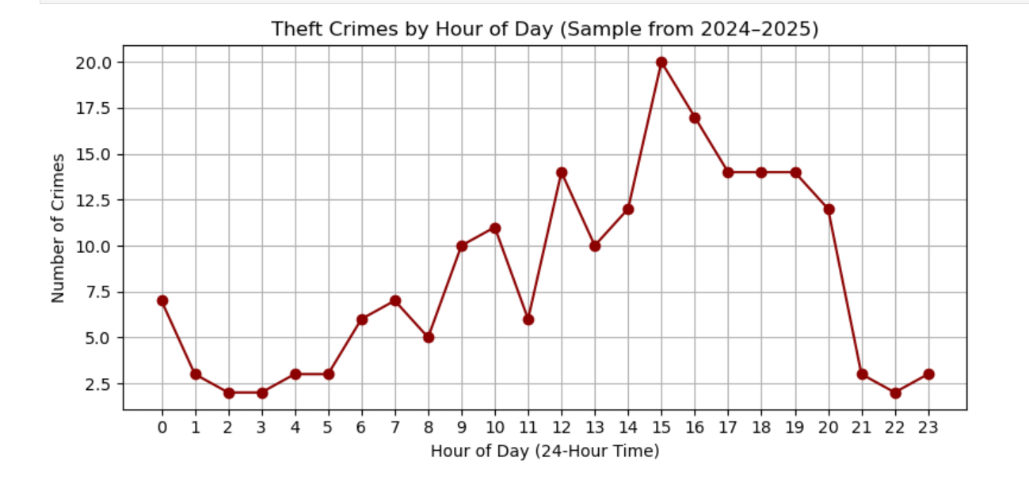
Theft Crimes By Hour of Day
Data selection and wrangling steps:
Data filtered by time, crime type
Interpretation of the Data:
More crime occur between 1pm-5pm, with the peak being at 3pm

Slide 5
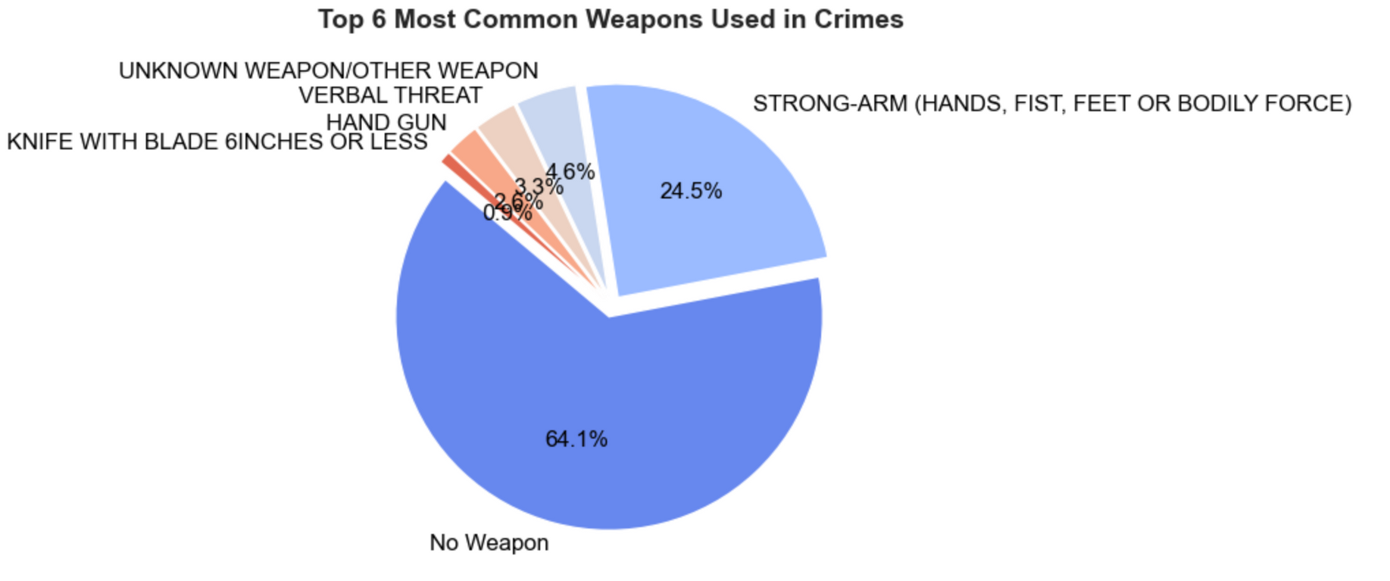
Commonly Used Weapons
Insights from data:
Most crimes in the dataset do not involve a deadly weapon
The fact that 64.1% of incidents involve no weapon and 24.5% involve only bodily force suggests many crimes may not be premeditated.

Slide 6
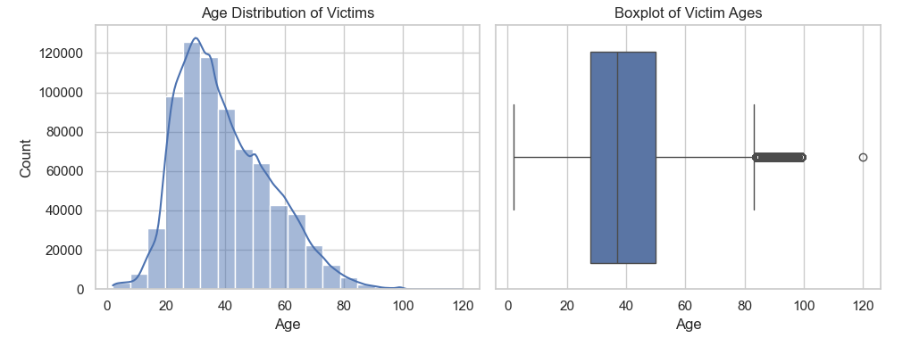
Crime Victim Age Distribution
Data wrangling:
Removed invalid age entries.
Filtered out tows with where the age of the victim was 0.
Insights from data:
Young to middle-aged adults are most frequently affected by crime, which can be helpful in informing targeted prevention efforts or outreach campaigns.

Slide 7
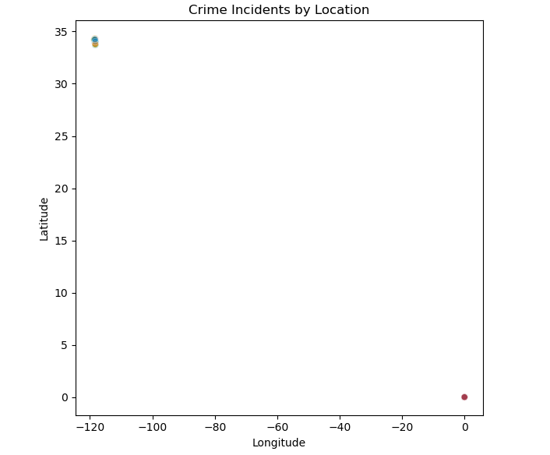
Crime Incidents by Location
Data wrangling:
First ensured that ‘LAT’ and ‘LON’ had no missing or invalid values.
Filtered out rows with missing rows and zeroed-out coordinates.
Avoid misrepresenting real locations
Insights from data:
The concentration of incidents in DTLA (Little Tokyo, South Park, Skid Row) confirms current and historical LAPD data that they are hotspots for crime activity.

Slide 8
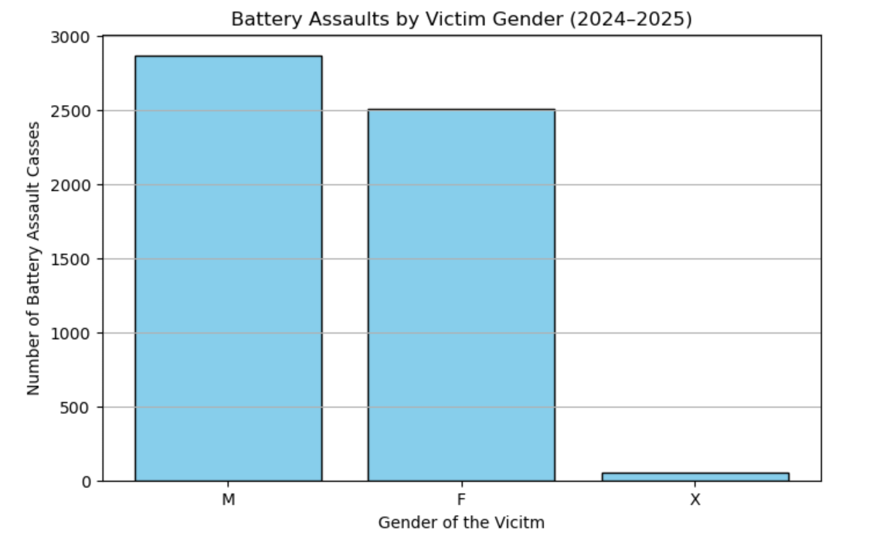
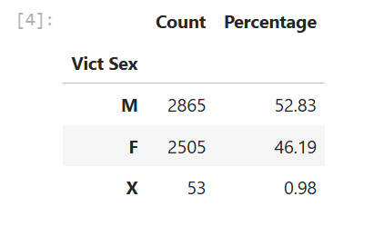
Battery Assault Cases By Victim Gender (2024-25)
Data selection and wrangling steps:
Filtered data includes information from 2024-25, focusing on battery-simple assault and the distribution of the gender of the victim.
Rows were removed with missing values.
Interpretation of data:
Males are more prone to battery assault cases compared to females and non-binary individuals

Slide 9
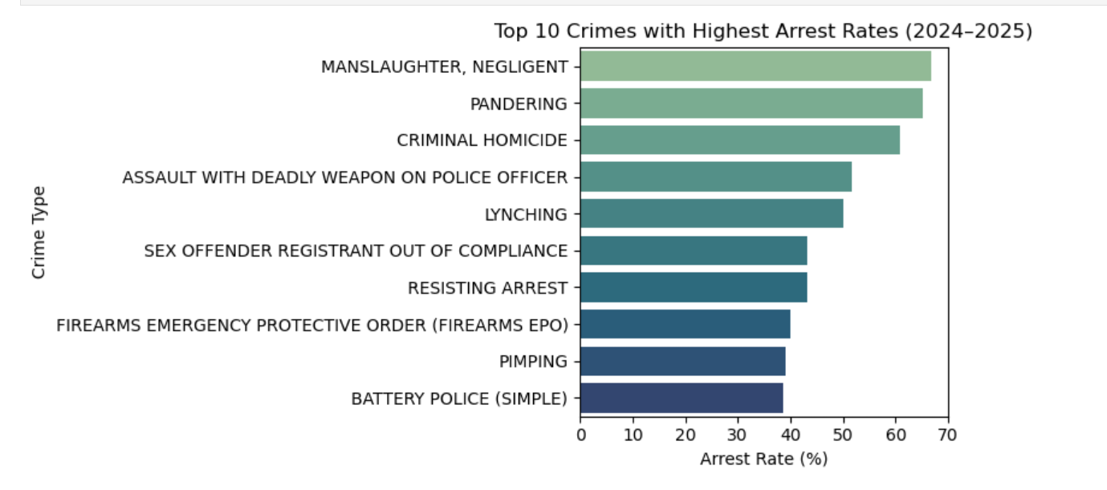
Highest Arrest Rates (2024-2025)
Data selection and wrangling steps:
Selected data that included both crime type and arrest status.
Dropped missing data and unnecessary crime codes
Organized as a barplot
Used .groupby() function
Interpretation of data:
Higher arrest rates might also reflect proactive policing or resources allocated to these crime categories.
Certain crimes such as manslaughter, and criminal homicide might have a higher arrest rate because of their violent nature

Slide 10
Key Insights
🚨 Crimes like manslaughter and criminal homicide show higher arrest rates, likely due to their violent nature and higher priority in investigations.
Males are especially more prone to battery assault cases compared to females and individuals with unidentified genders.
🕐 Most crimes occur in the evening and afternoon, with spikes around 1–5 PM.
📍 Downtown Los Angeles (DTLA) is the primary geographic hotspot for reported incidents, based on the cluster of coordinates around LAT ~34.05 and LON ~–118.25.
The majority of crime victims are young to middle-aged adults, with most falling between 20 and 50 years old (peak about 35 years).
👮 Higher arrest rates reflect a need for proactive policing or greater resource allocation toward certain serious crime categories.
Group Summary

