Slide 1
Shipment

Slide 2








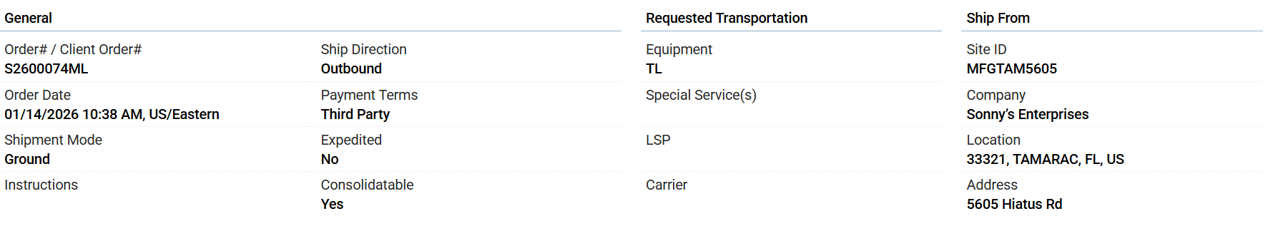
Shipment Planning View
Shipment Exceptions
Monitoring
PGI/PGR
Date Issues 5
Routing Review 7
Tender Issues 7
Tender Review 5
Bid Review 2
Tendering
Accepted
SpotBid
Review
Optimization
Hold
All (Exceptions)
Date Issues
Routing Review
Tender Issues
Tender Review
Bid Review
1
2
Actions v
Buy Shipment
Edit
3
4
5
Buy Shipment | Customer ID(s) | Order # | Order Count | Pickup Date | Delivery Date | Origin | Destination | Gross Weight | Mode | Equipment | SCAC / Tender Status | AP Freight Cost
B28826319 | ERCO_SYS_01 , USALCO | S2600074M , JAN7ERCO7 | 2 | 01/12/2026 09:00 CST | 01/29/2026 09:00 CST | Houston, TX, US, 77001 | Galena Park, TX, US, 77547 | 6000 LB | TL | 53FTDryVan | SEFL – Done | 1080 USD
B28826319 | ERCO_SYS_01 , USALCO | S2600074M | 1 | 01/12/2026 09:00 CST | 01/29/2026 09:00 CST | Houston, TX, US, 77001 | Galena Park, TX, US, 77547 | 6000 LB | TL | 53FTDryVan | SEFL - Done | 2000 USD
6
Stops and Appointment
Order V
Product
Routing Options
Tender History
Cost Allocation
Instructions
History
Documents
Notes
S2600074M
JAN7ERCO7
Notes:
Bottom tab sequence
Stops and Appointment, Order, Product, Routing Options, Tender History, Cost Allocation, Instructions, History, Documents, Notes (Internal)

Slide 3
Table Attributes
Attributes | Example | Description
Earliest Pickup Date | 01/12/2026 09:00 CST | Latest value from orders at the first pickup
Latest Pickup Date | 01/12/2026 11:00 CST | Earliest value from orders at the fist pickup
Earliest Delivery Date | 01/19/2026 09:00 CST | Latest value from orders at the last drop off
Latest Delivery Date | 01/19/2026 14:00 CST | Earliest value from orders at the last drop off
Distance | 635 MI | MI - Miles code
Stops | 2 | count of stops (Pickup stop(s)+Delivery stop(s)
Ship Direction | Outbound | Direction of shipment
Freight Terms | Pre-Paid | -
Seal Number | S345676 | -
Incoterm Info | FOB | -
Shipment Status | Tender | Can be in any status (shipment). New, Hold, Review, Tender, etc
Validation message | CHK_Dates | Message will appear for User Review Status (CHK_Dates, Date in the past, etc)
AR Freight Cost | 1280 USD | Total AR freight cost
Shipment Type | Pooling, Cross customer, Line haul, Rule 11
Shipment Sequence leg | 1 or 2 or 3 | In multi leg buy shipments, which leg this shipment belongs to
Next Shipment ID | ID of the next shipment | Applicable for pooling, Rule 11
Preferred AP Direct Cost | 1000 USD | Direct AP cost
Preferred AR Direct Cost | 1200 USD | Direct AR cost
Load Status | In Shipment | Can be in any status (shipment). New, In shipment etc
Load # | 23567, 45673 | Shows load numbers in the shipment
Load Count | 2 | Count of loads in a shipment
Attributes | Example | Description
Buy Shipment # | 28826319 | -
Sell Shipment # | 25678981 | -
Customer ID | *G20TECH_SYS_01, 2nd customer ID | Cross customer, Customer ID separate by Coma
Order # | JAN6ERCO6, JAN7ERCO7 | Transportation Order #
Pickup Date | 01/12/2026 09:00 CST | Planned Pickup Date
Delivery Date | 01/29/2026 09:00 CST | Planned Delivery Date
Origin | Bastrop, LA, US, 71202 | First pickup (City, State, Country code, Zip)
Destination | GEISMAR, TX, US, 79762 | Last drop off (City, State, Country code, Zip)
Gross Weight | 6000 LB | -
Mode | LTL | -
Equipment Code | LTH | -
Pickup # | 41197 | -
SCAC - Tender Status | CTNS - Done | SCAC and Tender status are together
AP Freight cost | 1080 USD | Total AP freight cost
Hazadous (Y/N) | Y | Hazrdous indicator
Pro#/Booking # | 345678 | -
Customer Name | *USALCO_SYS_01 | -
Consignor | G2O TECHNOLOGIES LLC | Name of the Consignor (First Pickup)
Consignee | MC ATHLON GEISMAR PL | Name of the Consignee (Last Drop Off)
Pkg Count | 2 PLT | Total package count with units
Equipment # | 8043 | -
Net Weight | 3500 LB | -
Tare Weight | 2500 LB | -

Slide 4
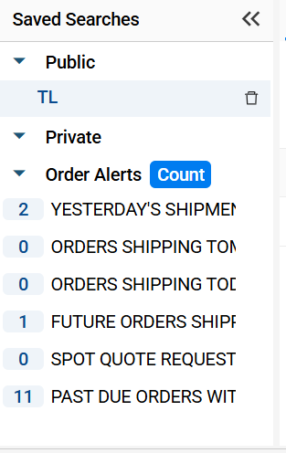
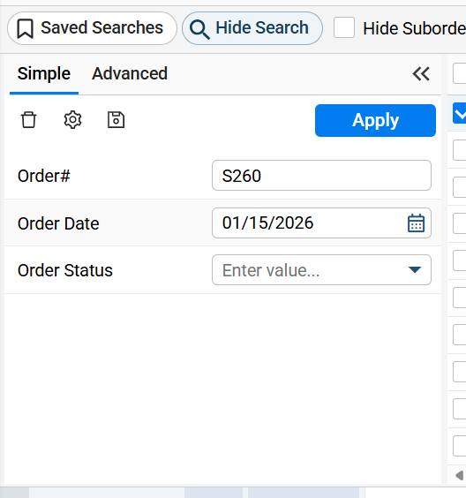
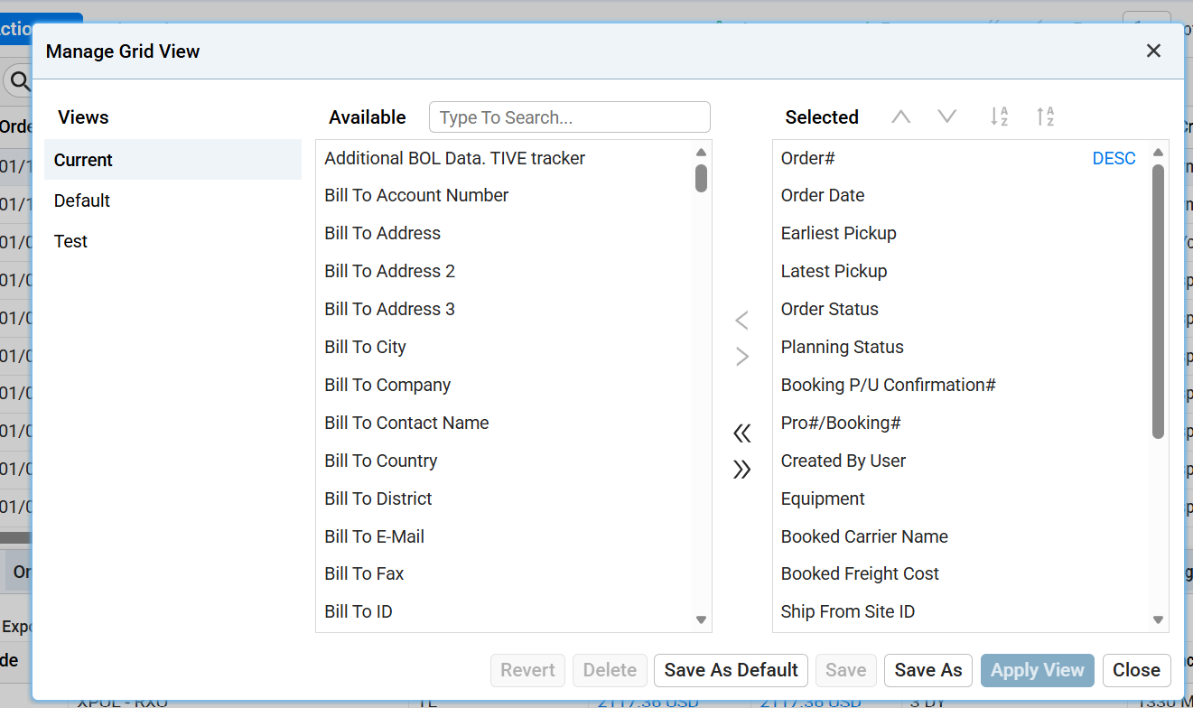
Options:
Export Excel CSV (Current Fields)
Export Excel CSV (All Fields)
Note to the users: “Only the first 10,000 records will be exported to Excel.”

Slide 5
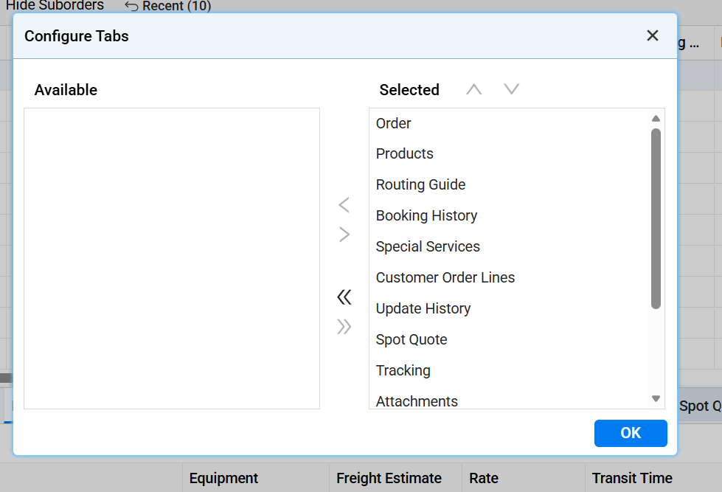
Configuration tab for the bottom screen
Tabs for Shipment
Order
Product
Instruction
Stops and Appointments
Attachment
Cost Allocation
Load Details
Prior Tender
History
Notes

Slide 6

Distance: 1,013 mi
Gross weight: 420 LB
Volume: 328.0 cuft
Accepted Carrier: FXFE – LTL
Seed Equipment – TL
Utilization: 75%
Stop 1: Pickup
Order: LOAD200801
From: 01-BP, COLUMBUS, GA 31907 US (Org Name, City, State, Zip, Country) or
From: 01-BP, 1502 NORTH WASHINGTON, COLUMBUS, GA 31907 US (Org Name, Address 1,2,3 City, State, Zip, Country)
Date: August 20, 2025 14:00 CST
Appointment: 14:00 CST
Weight: 105 LB
Volume: 82 cuft
Package Count: 3
Pickup No:
Stop 2: Pickup
Order: LOAD200802, LOAD200803
From: 02-BP, COLUMBUS, GA 31906 US
Date: August 20, 2025 14:00 CST
Appointment: 14:00 CST
Weight: 105 LB
Volume: 82 cuft
Pickup No:
Stop 3: Delivery
Order: LOAD200801, LOAD200802, LOAD200803
To: SHPTULSA, NEENAH, WI 54956 US
Date: August 22, 2025 14:00 CST
Appointment: 14:00 CST
Weight: 105 LB
Volume: 82 cuft
Pickup No
STOPS
Distance: 1,013 mi
Gross weight: 420 LB
Volume: 328.0 cuft
Accepted Carrier: FXFE – LTL
Seed Equipment – TL
Utilization: 75%
Stop 1: Pickup
Order: LOAD200801
From: 01-BP, COLUMBUS, GA 31907 US (Org Name, City, State, Zip, Country) or
From: 01-BP, 1502 NORTH WASHINGTON, COLUMBUS, GA 31907 US (Org Name, Address 1,2,3 City, State, Zip, Country)
Date: August 20, 2025 14:00 CST
Appointment: 14:00 CST
Weight: 105 LB
Volume: 82 cuft
Package Count: 3
Pickup No:
Stop 2: Pickup
Order: LOAD200802, LOAD200803
From: 02-BP, COLUMBUS, GA 31906 US
Date: August 20, 2025 14:00 CST
Appointment: 14:00 CST
Weight: 105 LB
Volume: 82 cuft
Pickup No:
Stop 1: Delivery
Order: LOAD200801, LOAD200802, LOAD200803
To: SHPTULSA, NEENAH, WI 54956 US
Date: August 22, 2025 14:00 CST
Appointment: 14:00 CST
Weight: 105 LB
Volume: 82 cuft
Pickup No
Alternate
Format
Date available if planning is RSD
Order requested date: August 20, 2025
14:00 CST
Date available if planning is RDD
Order requested date: August 22, 2025
14:00 CST
Notes:
Example Consol: *G20TECH_SYS_01 (USALCO)
Consol: C774092
Order: LOAD200801, LOAD200802, LOAD200803, LOAD200804

Slide 7

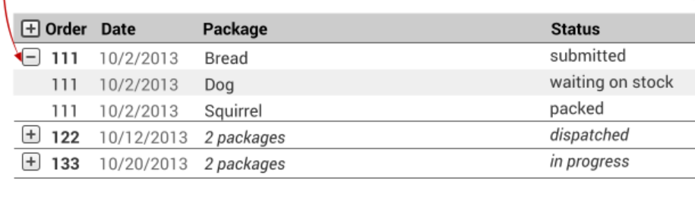
Attributes | Example | Description
Order # | 28826319
Line # | 001
Ship Item | 3204HTO
Description | 3204HTO | Shit item Description
Package Count | 45 Boxes | Package count + Identifier
Gross Weight | 50000 LB | Gross weight + UoM
Volume | 50 cuft | Volume + UoM
Hazmat | Yes | Yes/No
Hazmat Class | Class 2
Hazmat Group | I-Great Danger | Hazmat Packaging group (I,II,III – great Danger, Medium Danger, Minor Danger, N/A)
Hazmat Description | CORROSIVE LIQUID, ACIDIC | Description of Hazmat UN Number
Product Class | Commodity | Can be Commodity, Harmonized, NMFC, Product Class
Shipping Class | 230008 | Commodity -> Rail commodity code, harmonized code, NMFC or product class (55)
Hazmat UN Number | UN3264
Flash Point | 120 F | Value + UoM
Boiling Point | 80 F | Value + UoM
Marine Pollutant | No
WGK Class | 1 | 1,2,3,
Declared value | 100,000 USD | Amount and Currency
Hazmat ID | UN3264 | Hazmat ID and UN Number same? TBD
PRODUCT
Attributes | Example | Description
Tare Weight | 30,000 LB
Net Weight | 20,000 LB
Third part Ref # | S2367 | For outbound shipments, the client’s reference number. For inbound shipments, the vendor’s sales order number
Third Part Line # | 003 | Line number of above reference number
Third Part Ref date | 1/4/2026 | Date of above reference
BatchLot # | S3456
Tunnel Code | A | A -> E
To Partner Reference |  | Required? TBD
Load Constraints | No | Yes/No Value
Country of Origin | USA | Country
Length | 3 FT | length and UoM
Width | 4 FT | Width and UoM
Height | 4 FT | Height and UoM
Marked in Green are to be available under column
Requirement
Product info to be organized as shown
Each + is representation of order lines. If an order has 2 lines, then clicking on + will show 2 lines
Order’s 1st line is always visible to the user

Slide 8
Attributes | Notify DateExample | Description
Route Rank | 4
Rank | 1
SCAC | SEFL
Carrier Name | SOUTHEASTERN FRT | Shit item Description
Cost | 107.35 USD | Package count + Identifier
Tender Status | Accepted | Gross weight + UoM
Pickup / Date Time | 08/20/2025 14:00 | Volume + UoM
Pickup / Day | Wed
Pick up / Org Hours | 07:00-15:30 | Yes/No
Pick up / Time Zone | CST
Delivery / Date Time | 08/22/2025 14:00 | Volume + UoM
Delivery / Day | FRI
Delivery / Org Hours | 00:00-23:59 * | Yes/No
Deivery / Time Zone | CST
Transit | 2 Days
Distance Travelled | 438 MI
Pro # | 45678
Equip #
Route Group
Notify by | API | API / Email / Manual / EDI / Fax / Email and EDI / API
Notify Date time | 08/20/2025 09:59
Response Method | API Update | API Update/Automatic Update/EDI Update/interlink Update/Manual Update/net-native Update
Response Date Time | 08/20/2025 09:59
Response User | LINXQA
Carrier Pickup # | SAA9999
Distance Source | PCMPCL
Description | PC*Miler Practical
Routing Options
Attributes | Example | Description
Transit Time Source | SMC

Slide 9
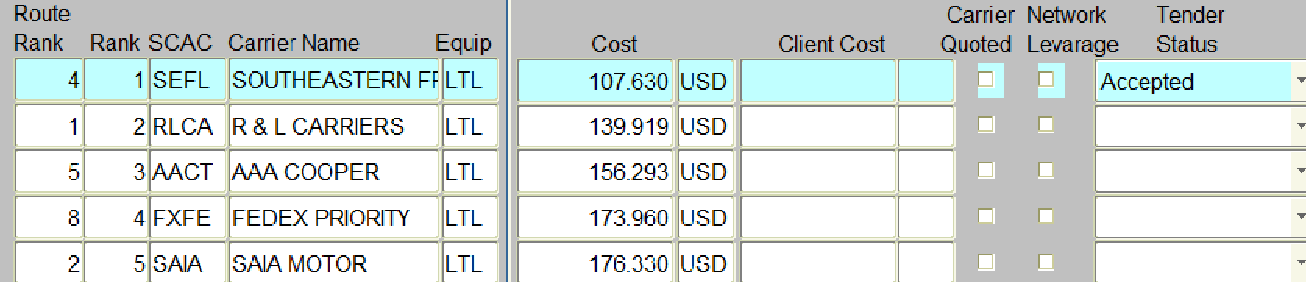
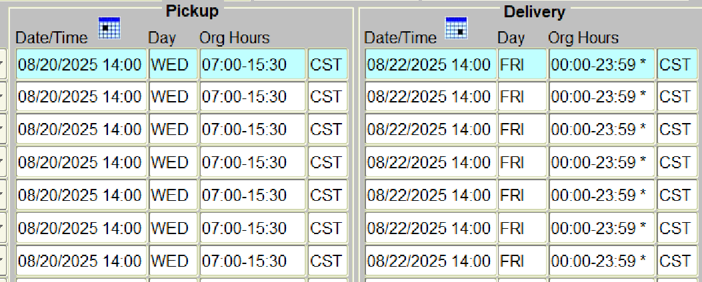
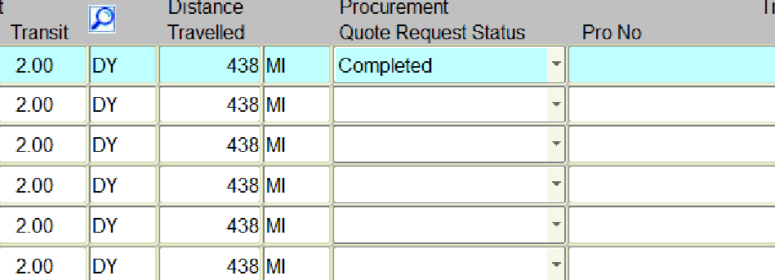
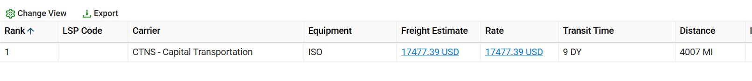
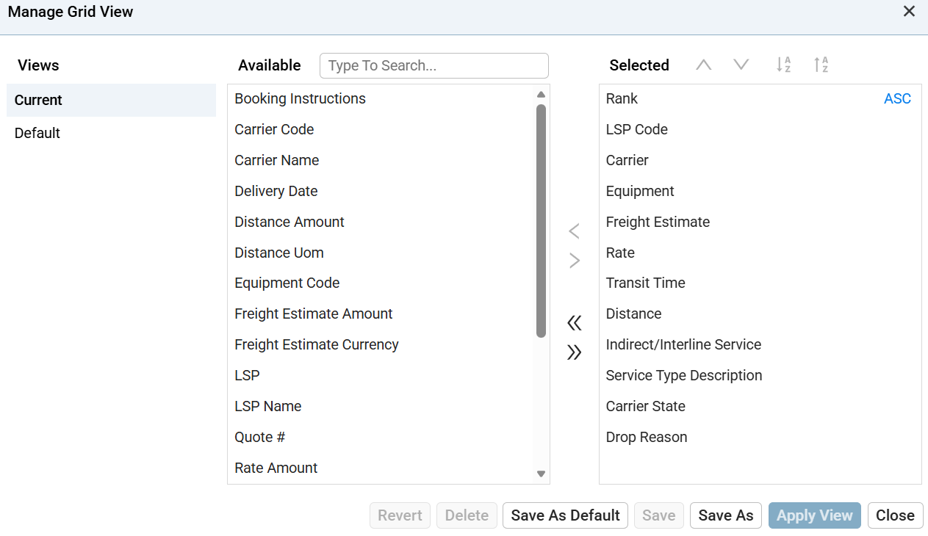
Routing Options Continued
Requirement
Example of the current TMS system is shown above.
Each line is an option
In the mock, will need atleast 3 lines
Manage Grid view required in tabs where there are quite a number of attributes

Slide 10
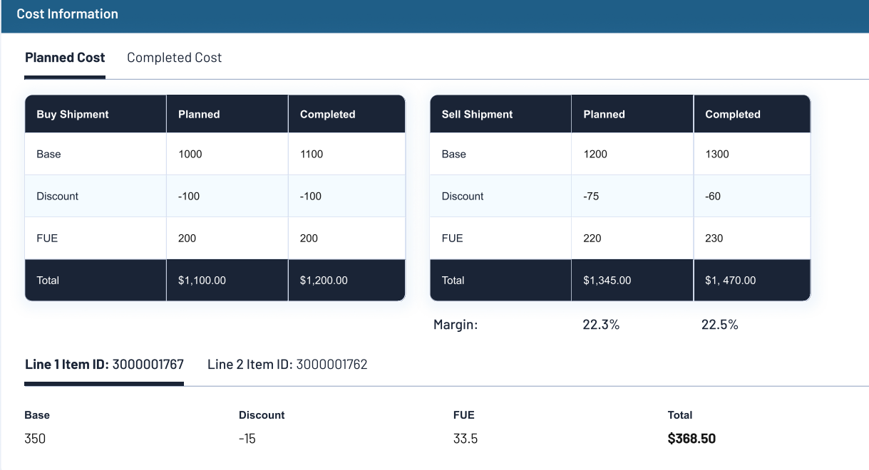
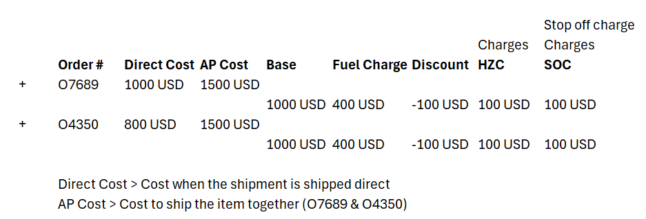
Cost Allocation
Don’t Need Sell Shipment cost
Requirements
Will need ‘Direct Shipment cost’ only
If there are 2 Loads in a shipment, then Direct shipment cost should be available for each of the Load

Slide 11
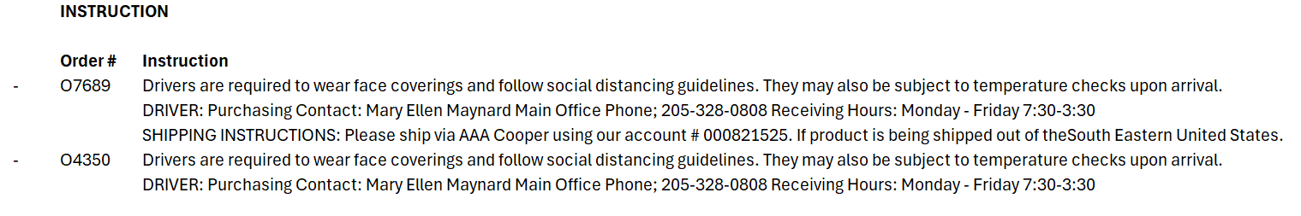
Instruction
Requirements
Each order instruction should be displayed
If the Order has multiple instruction, each instruction should be displayed in sequence
Instruction
Drivers are required to wear face coverings and follow social distancing guidelines. They may also be subject to temperature checks upon arrival.
DRIVER: Purchasing Contact: Mary Ellen Maynard Main Office Phone; 205-328-0808 Receiving Hours: Monday - Friday 7:30-3:30
SHIPPING INSTRUCTIONS: Please ship via AAA Cooper using our account # 000821525. If product is being shipped out of theSouth Eastern United States.
Drivers are required to wear face coverings and follow social distancing guidelines. They may also be subject to temperature checks upon arrival.
DRIVER: Purchasing Contact: Mary Ellen Maynard Main Office Phone; 205-328-0808 Receiving Hours: Monday - Friday 7:30-3:30

Slide 12
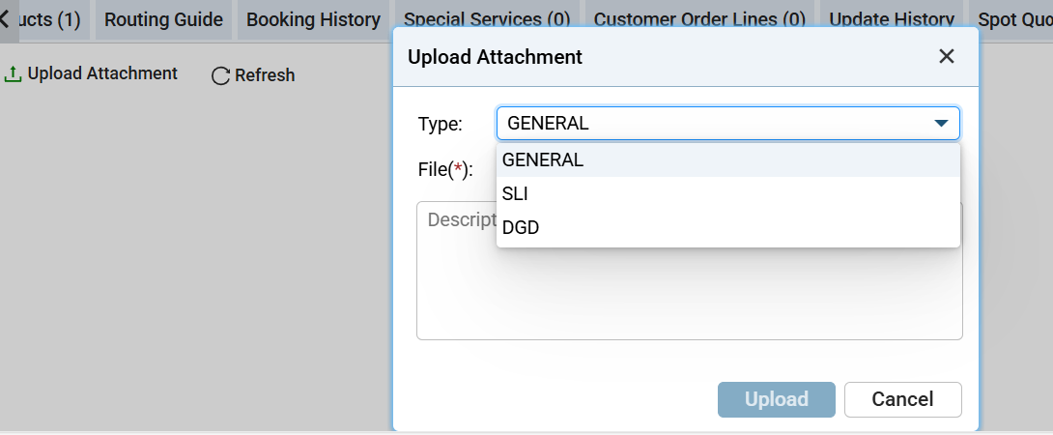
Documents
Requirements
Should have options to upload Doc (BoL, MBoL, Invoice, Instructions, Others)
Attach document and should support PDF, Excel, Word, Csv, Outlook message format
Once attached, each attachment should be a line with
Type | Description | File with link
4. On clicking the file, user should be able to open attachment on a new window
5. Should have an option to delete the attachment via UI

Slide 13
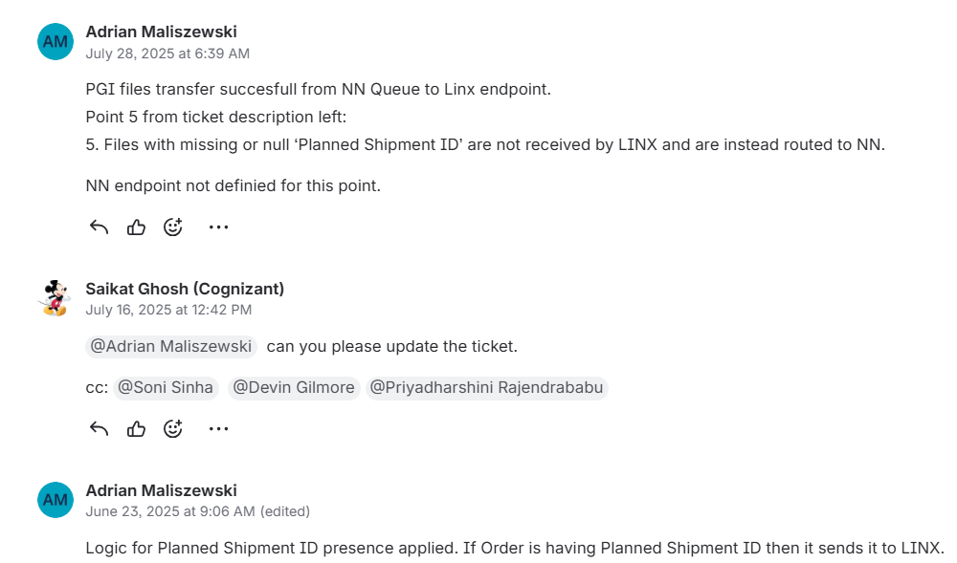
Internal Notes
Requirements
User should be able to add internal notes
For now tagging of name not required (like @)
Who ever writing the note, their ID, Date/Time and message should be captured and displayed on the screen
Option to Add Note, edit and Delete not should be available (for that user)

