Slide 1
Mochi 3
Manuel Abril Lopez, Mateus Guimaraes Pedro, Vladimir Simov, Ondrej Pazourek, Pranay Ghelani, Rebeka Olar

Slide 2
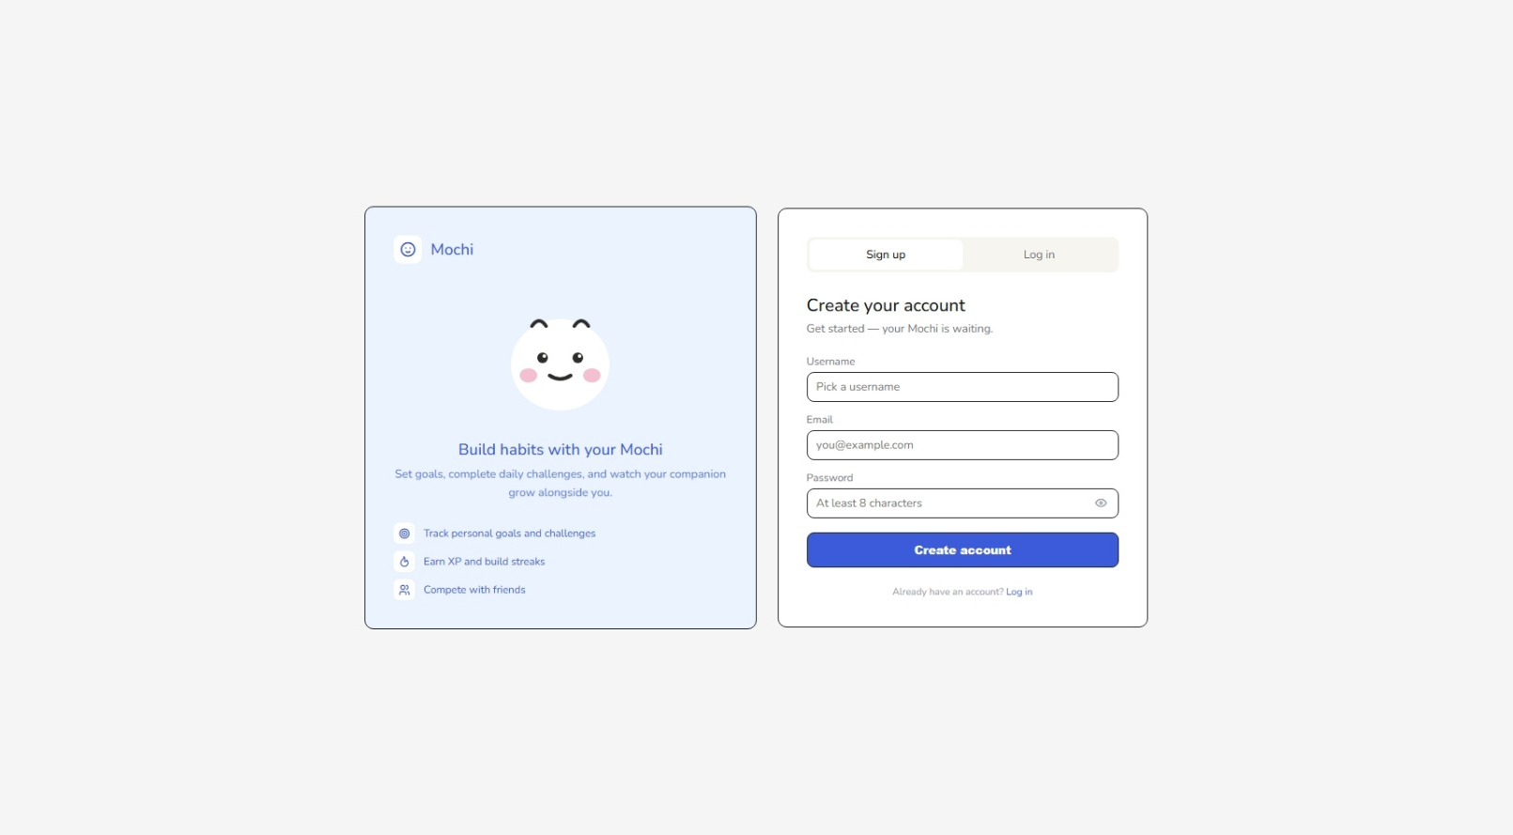
Authentication page

Slide 3
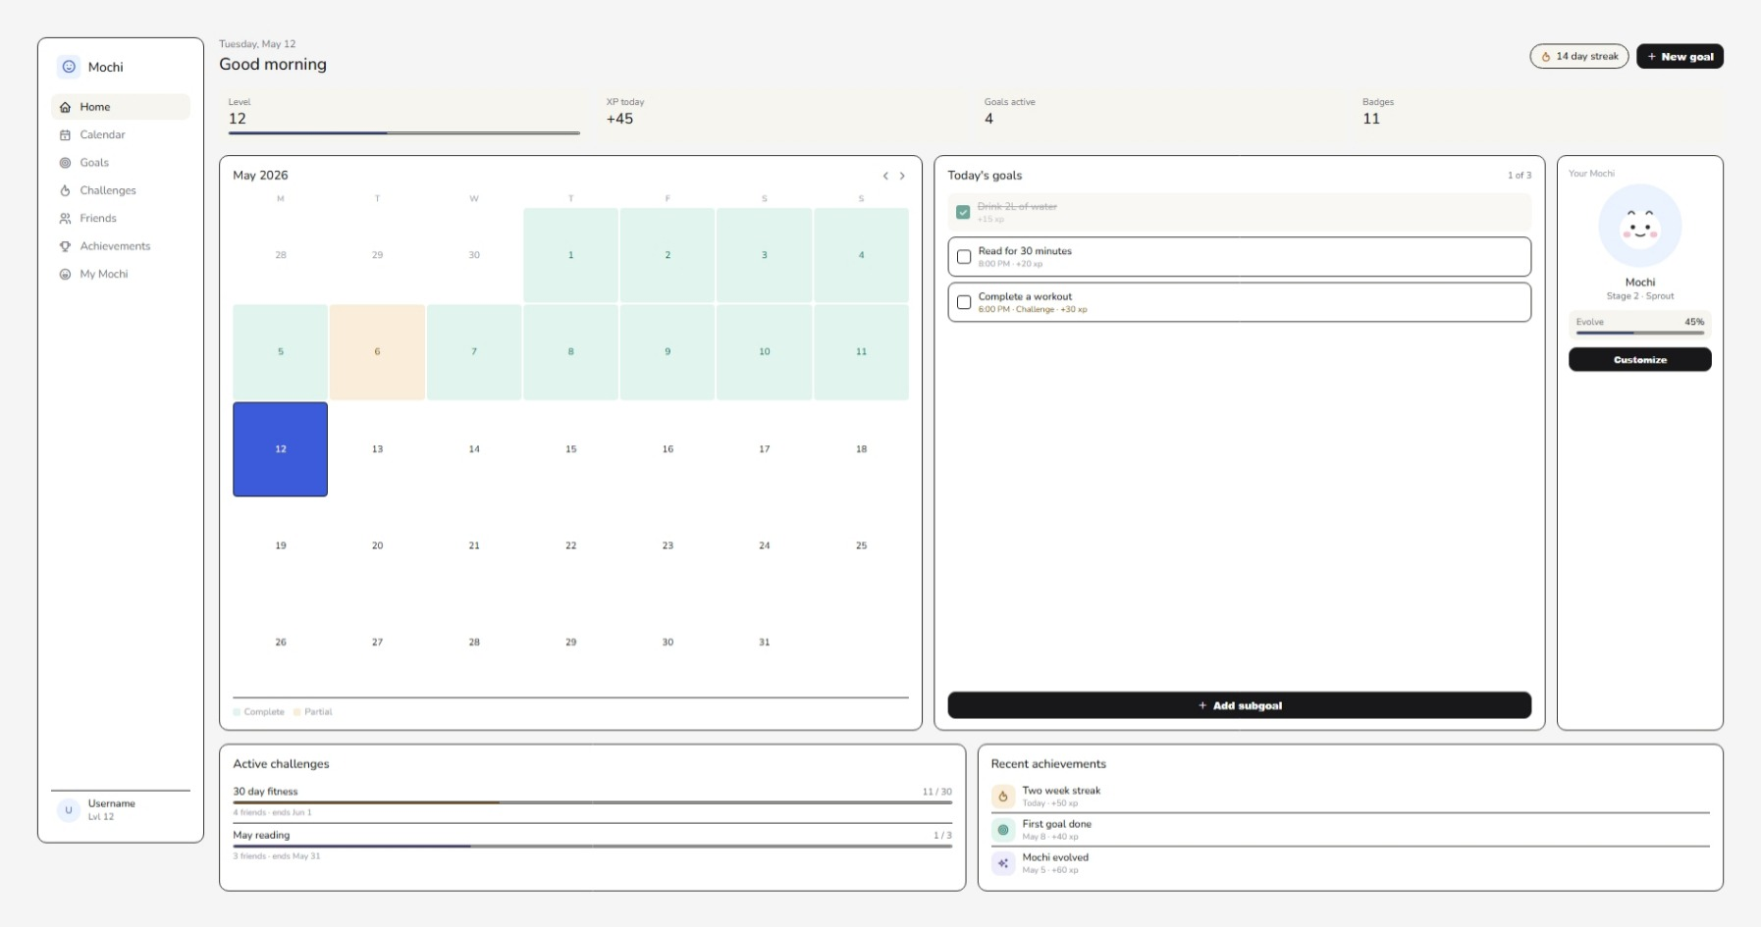
Home Page

Slide 4
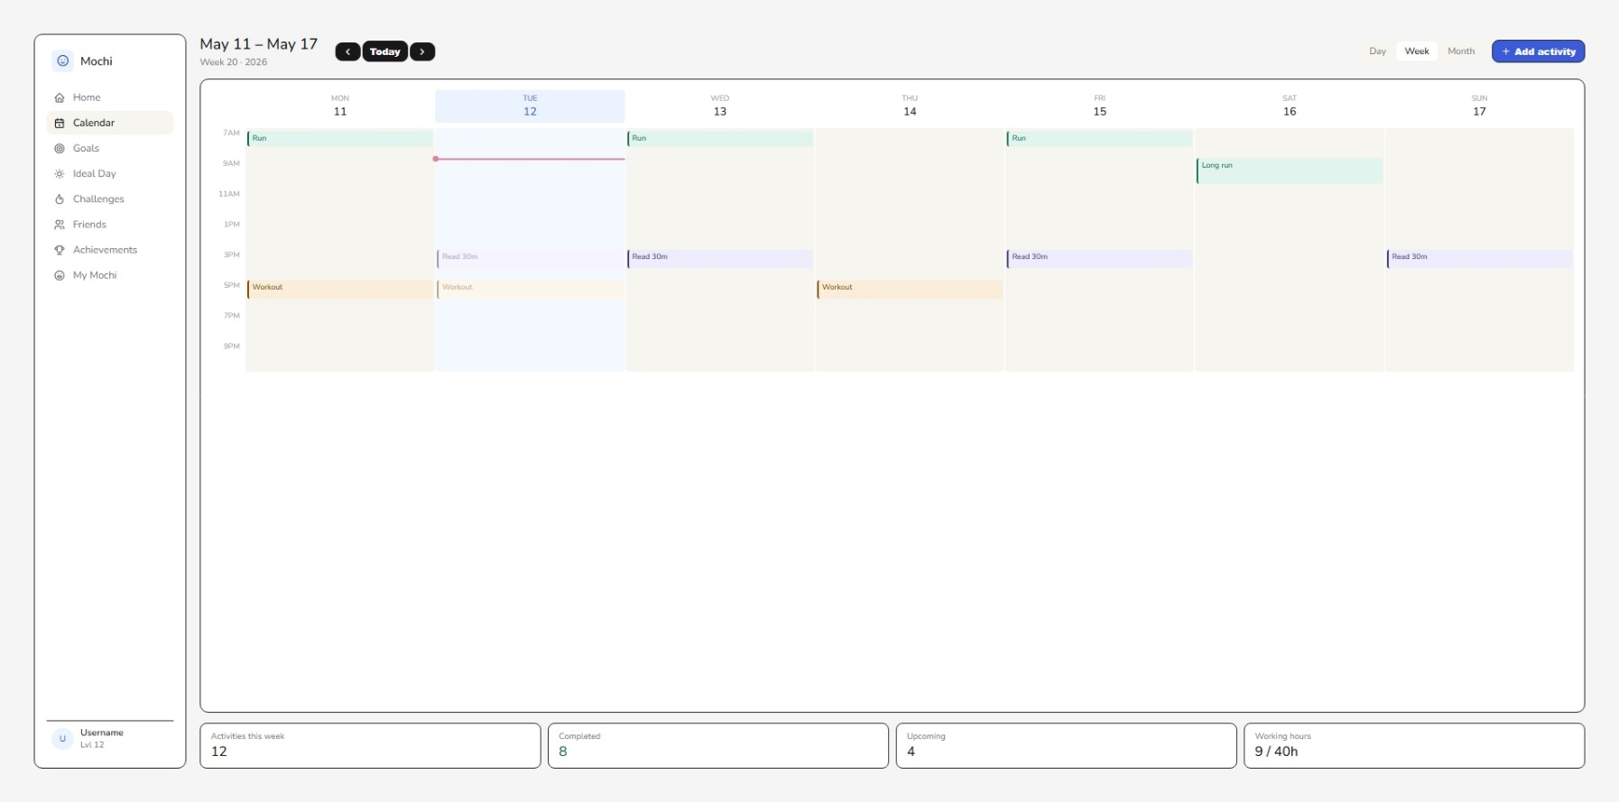
Calendar Page

Slide 5
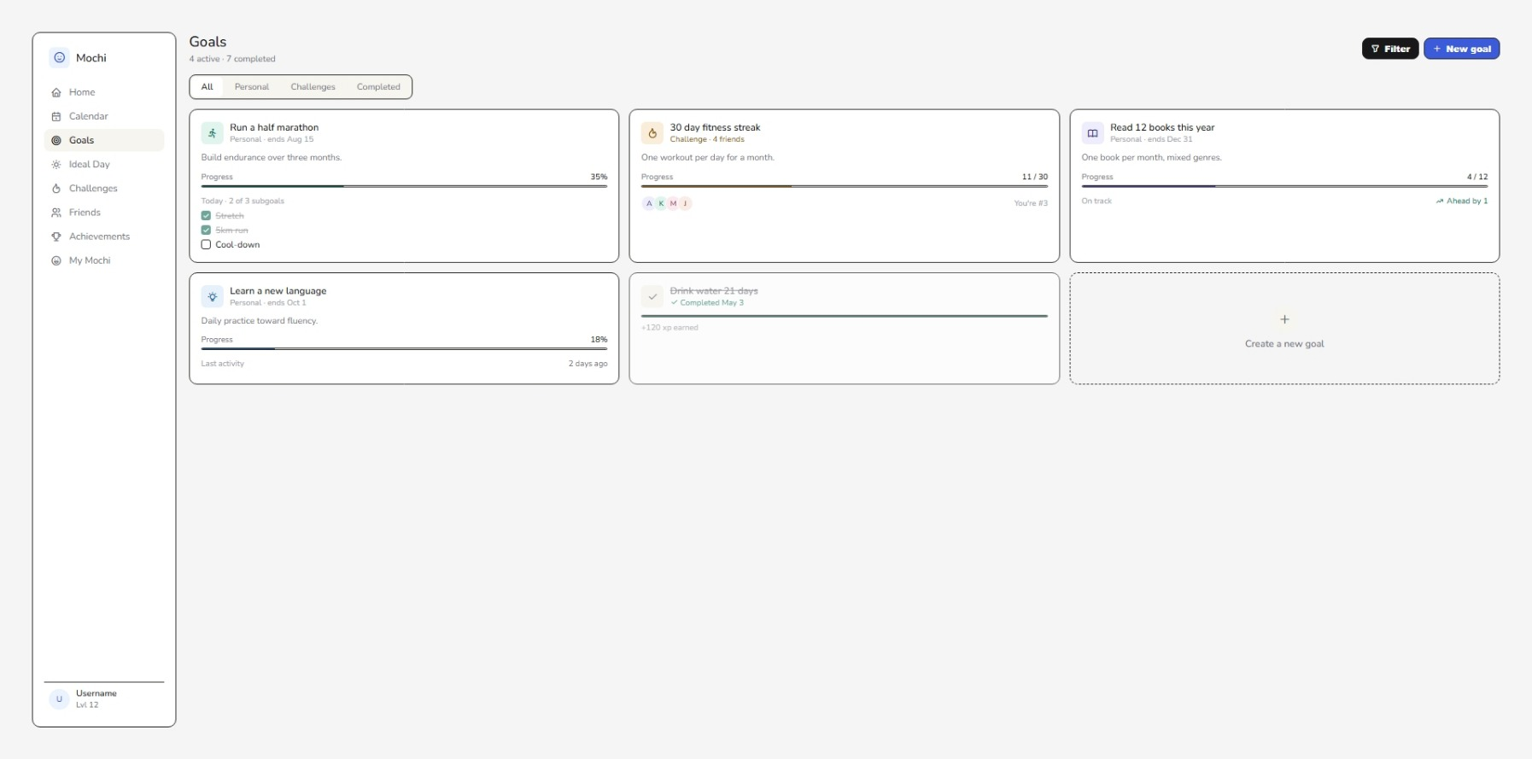
Goals Page

Slide 6
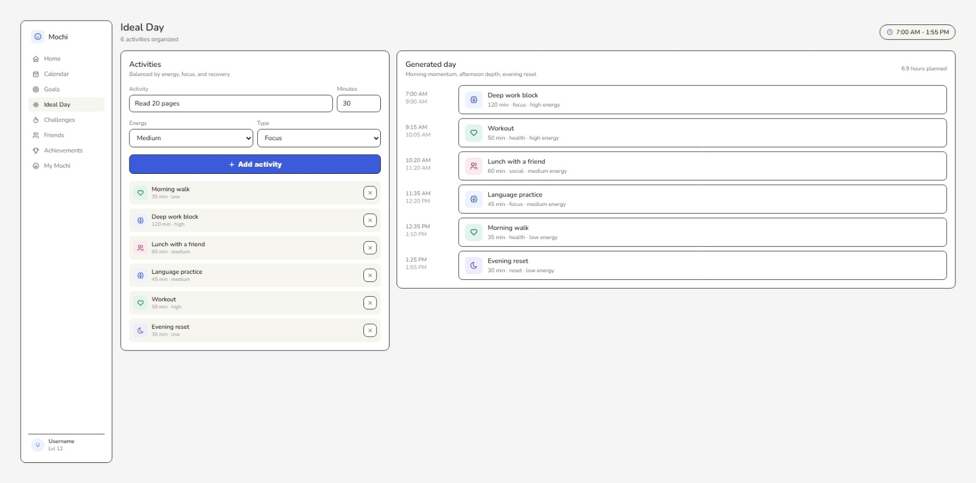
Ideal Day Page

Slide 7
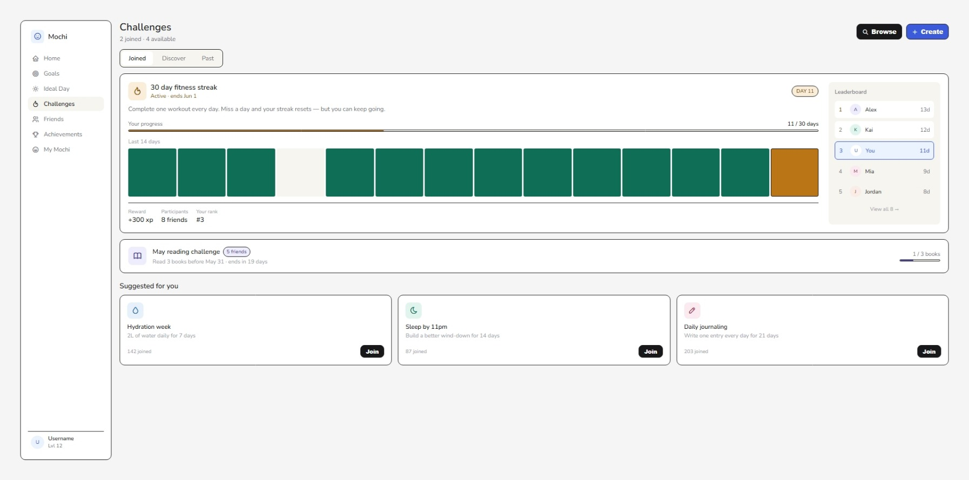
Challenges Page

Slide 8
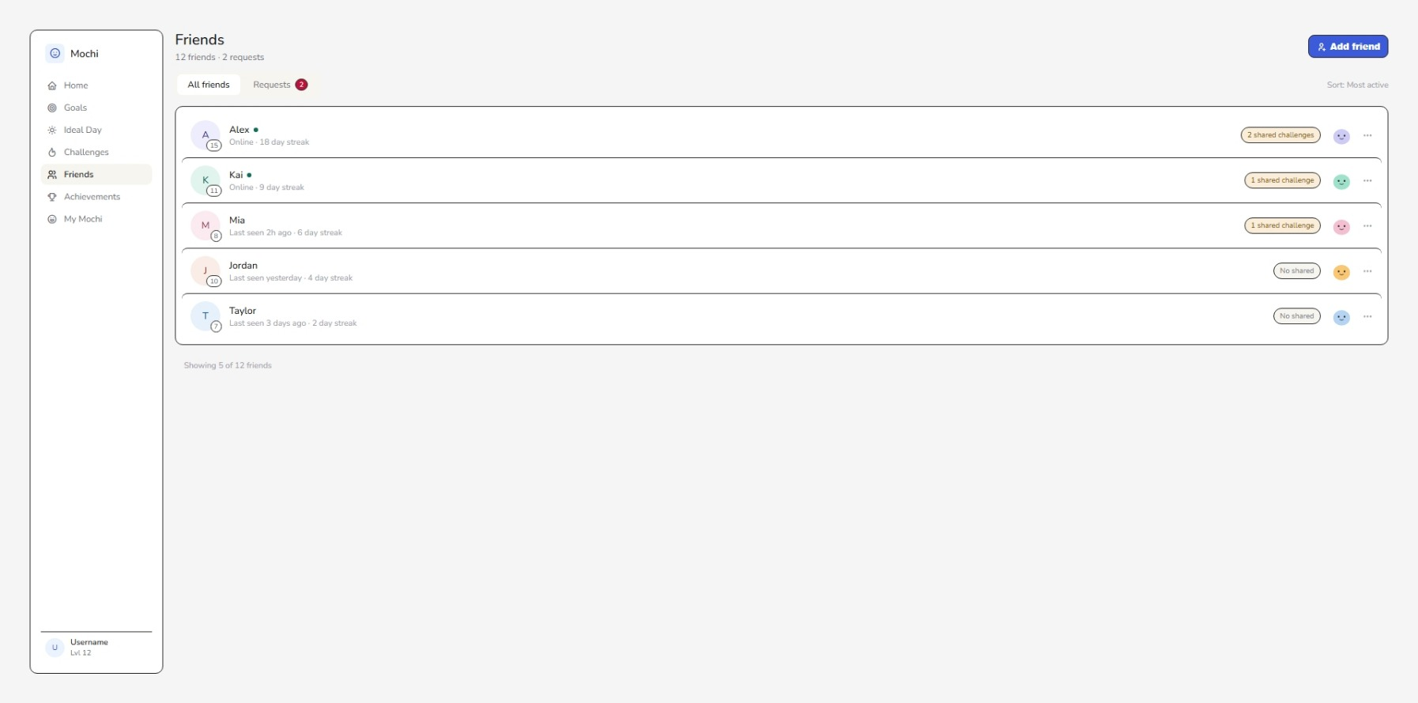
Friends Page

Slide 9
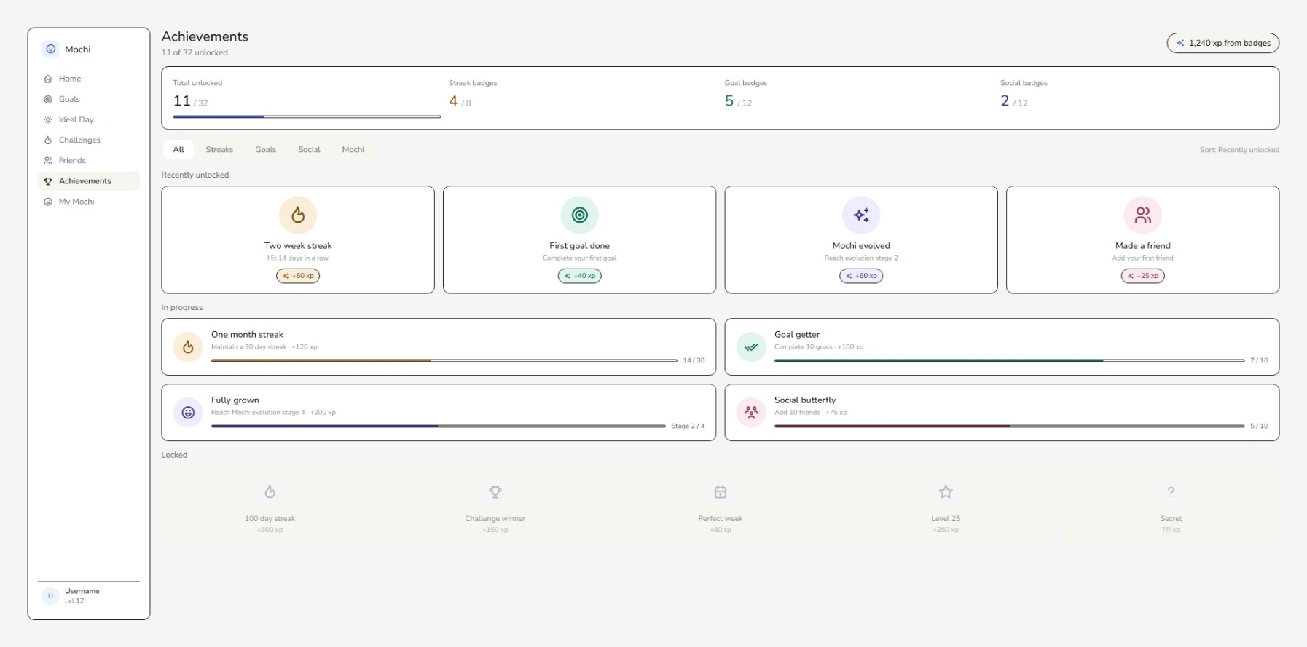
Achievements Page

Slide 10
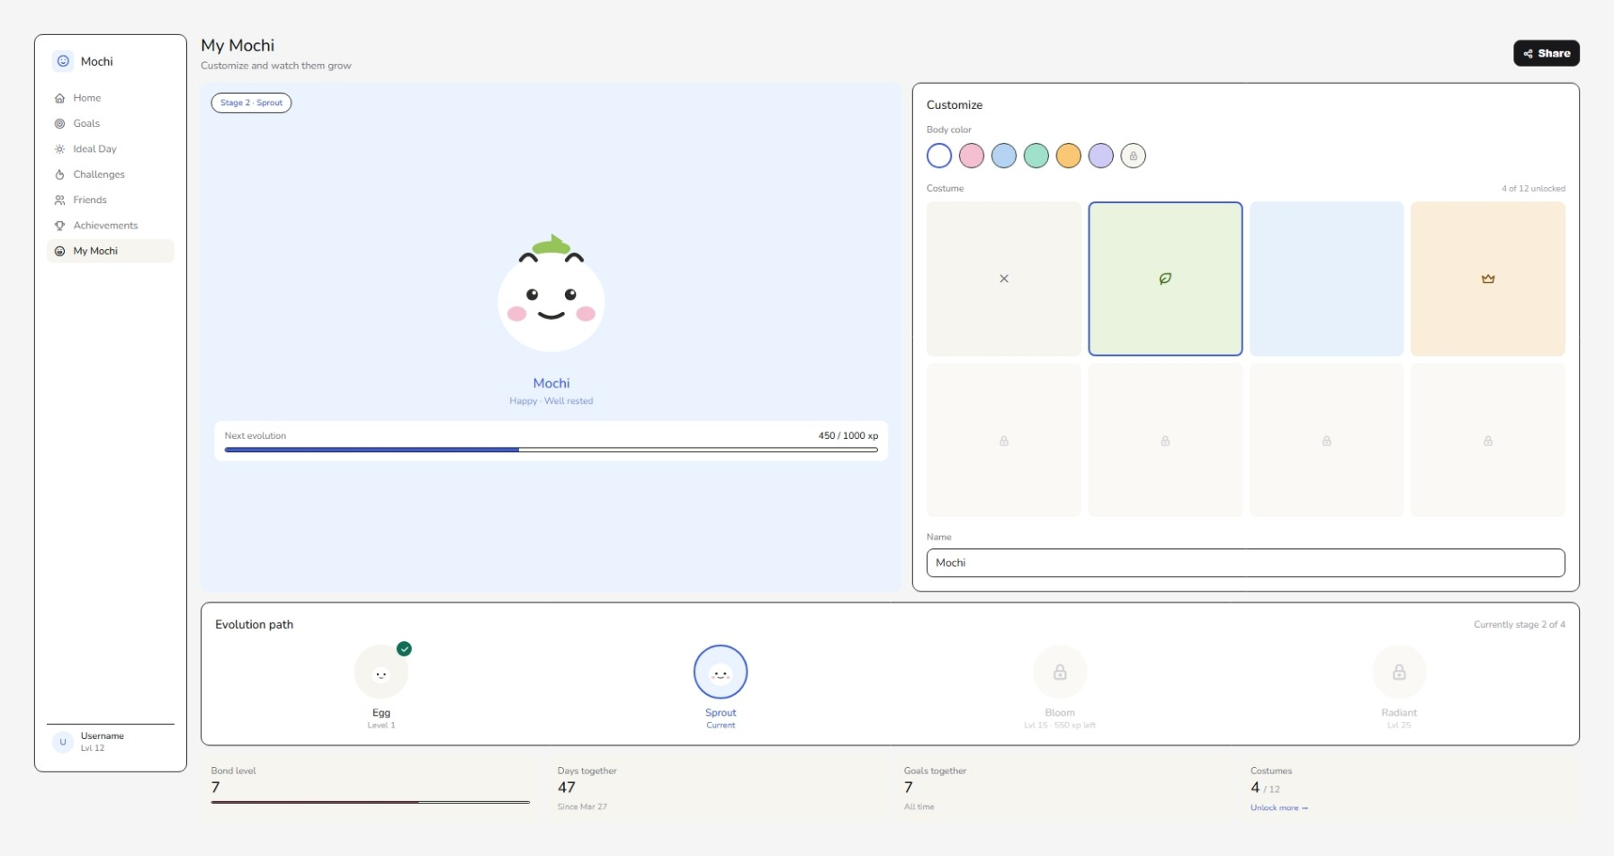
My Mochi Page

Slide 11
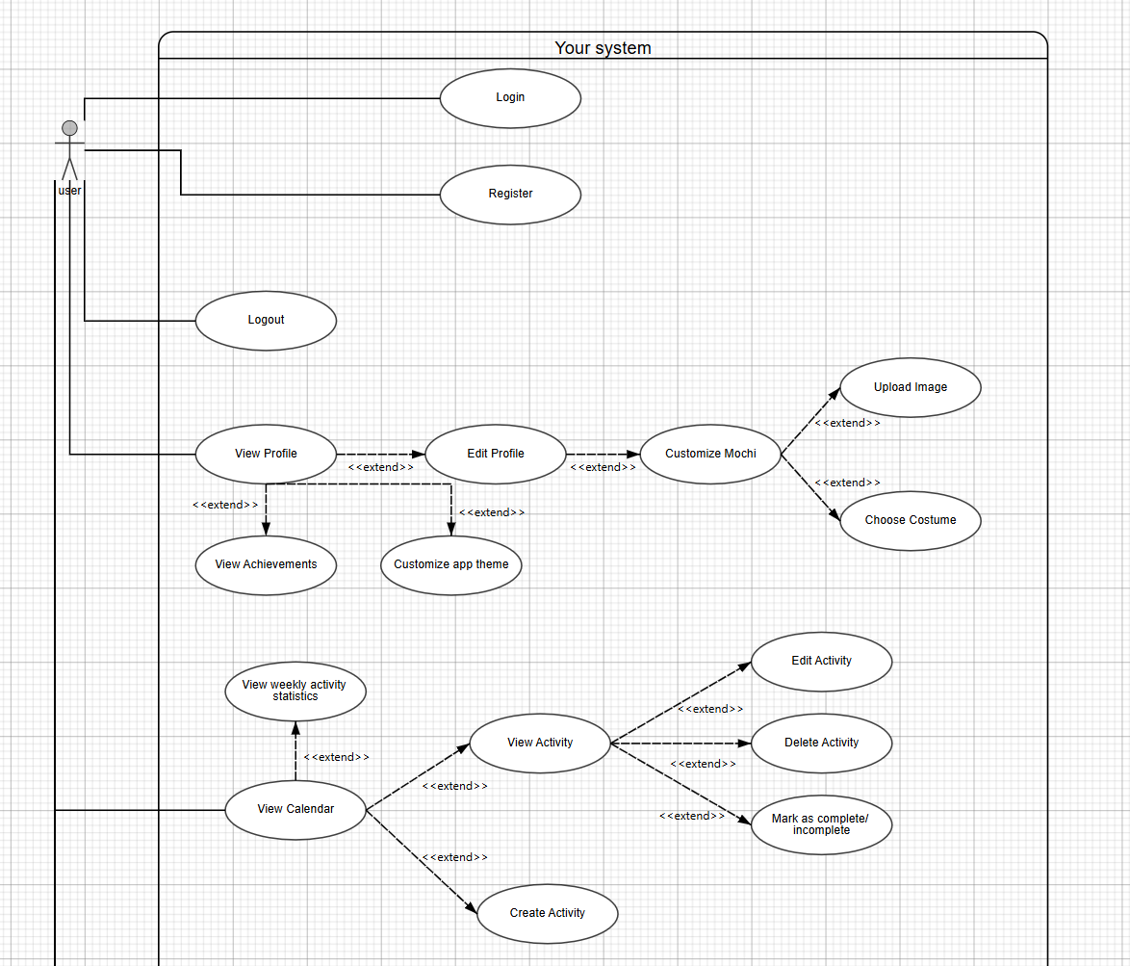
Use Case Diagram

Slide 12
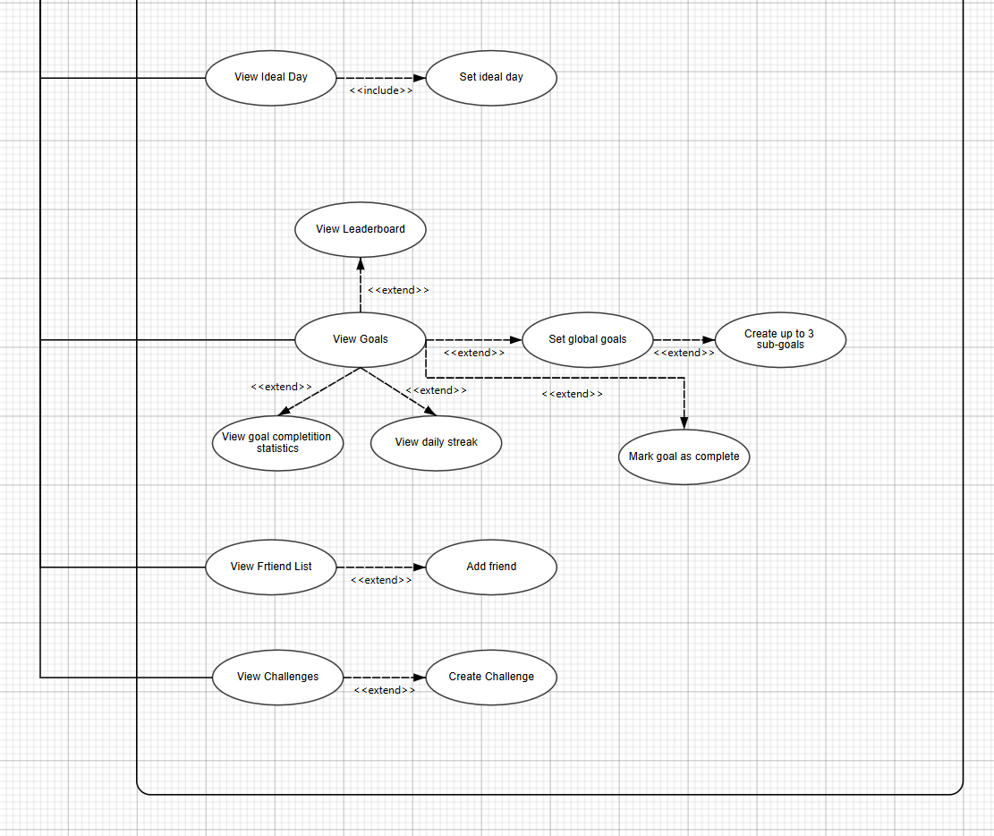
Use Case Diagram

Slide 13
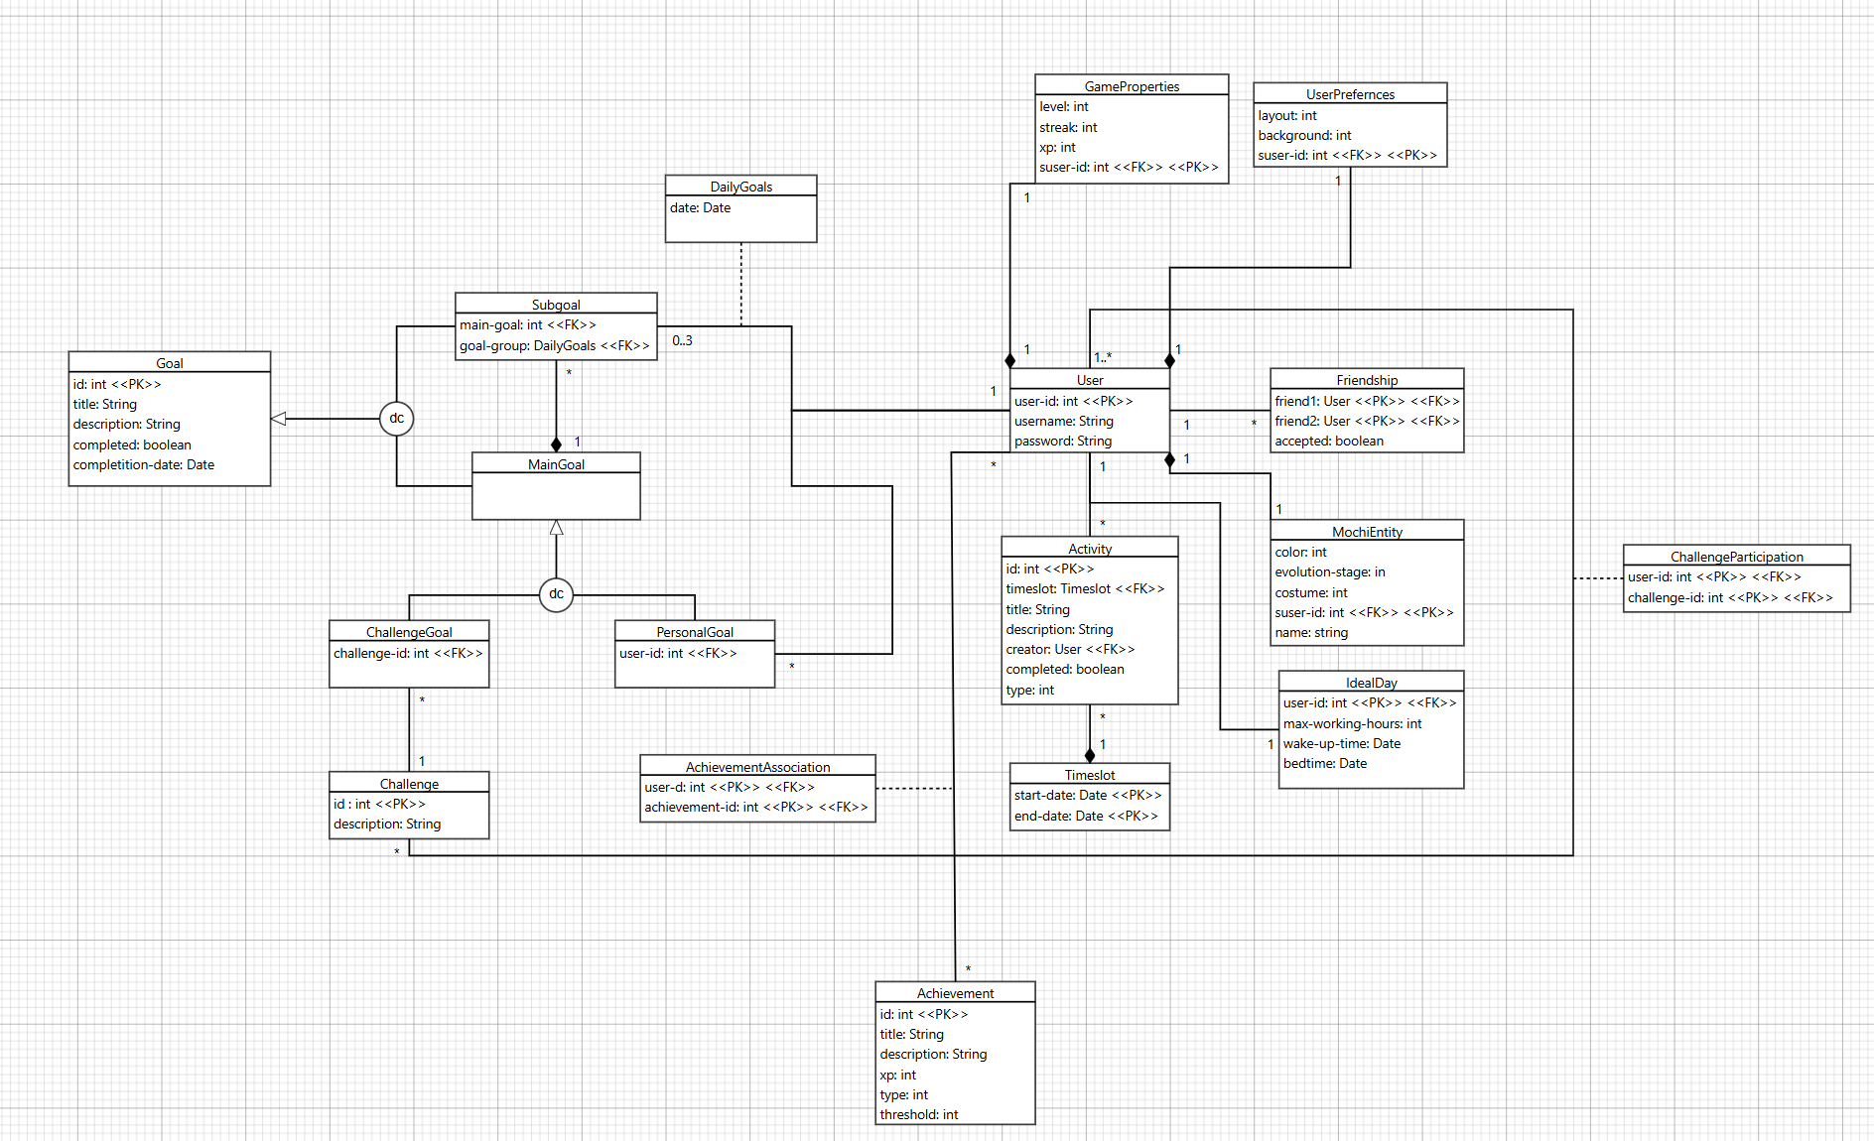
Class Diagram

Slide 14
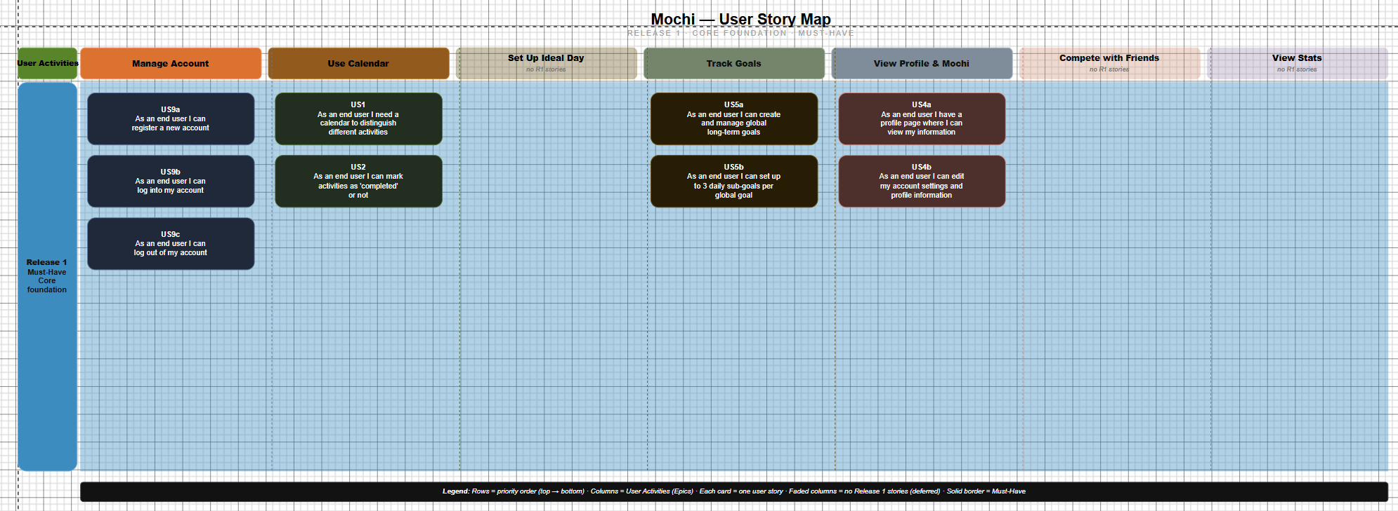
Story Map

Slide 15
—Imam Ramadan (RISE)
“The design has a clean look and usable intuitive features. It is also well structured and the light theme fits nicely (would be nice to have a dark mode). Other than that I couldn’t find any negative points I could comment on except the home page being quite cluttered.”

