Slide 1
The Cognitive Constraints of Musical Scales
Preliminary results

Slide 2
TODO
Compare the interval between the estimated KEY and each note in the melody
Repeat experiment
More data (300 chains)
Extract IOI from scratch including error
Fixed duration in each recording
Filter participants a bit better based on performance

Slide 3
Design
Iterated singing experiment with 5-tone melodies
Melodies evolve over 10 generation
Raw recordings are sent from participant to participant
About 64 UK participants (Prolific)

Slide 4
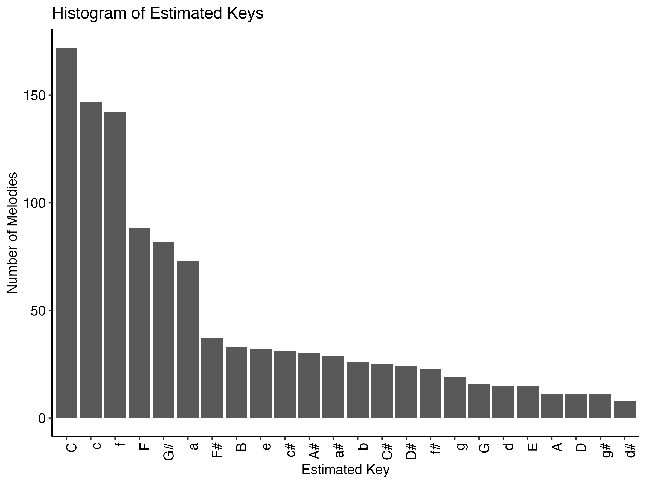
Key-finding algorithm
Steps
Melody notes are rounded to nearest integer
Melodies are all transposed to start in the middle C (Midi note = 60)
Note durations (in sec) are normalized by total duration: (note_duration / total_duration) * 5
Key-finding algorithms applied to each melody
Krumhansl-Schmuckler
Albrecht and Shanahan (2013)
Albrecht and Shanahan (2013)

Slide 5
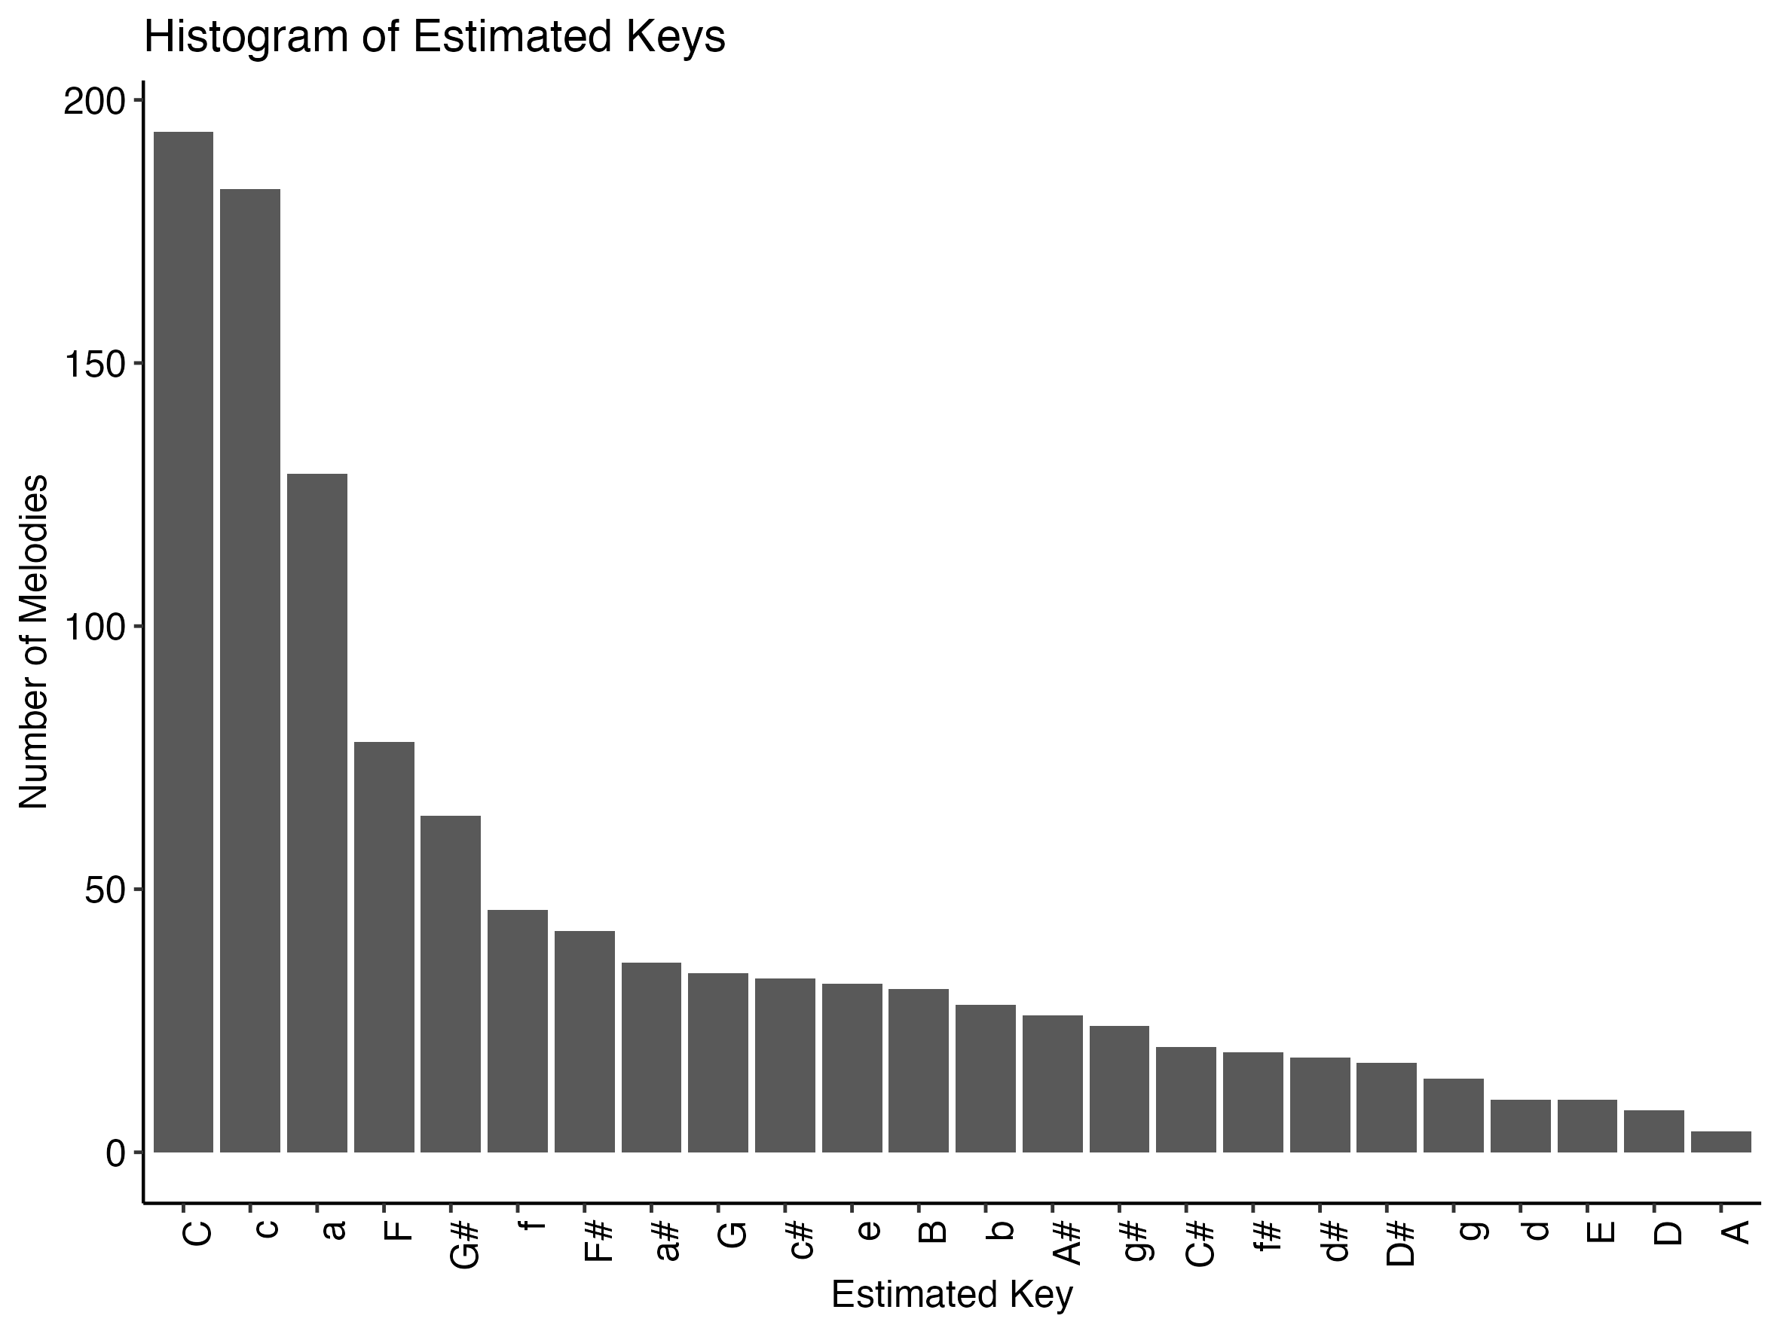
Key-finding algorithm
Albrecht and Shanahan (2013)
Krumhansl-Schmuckler

Slide 6
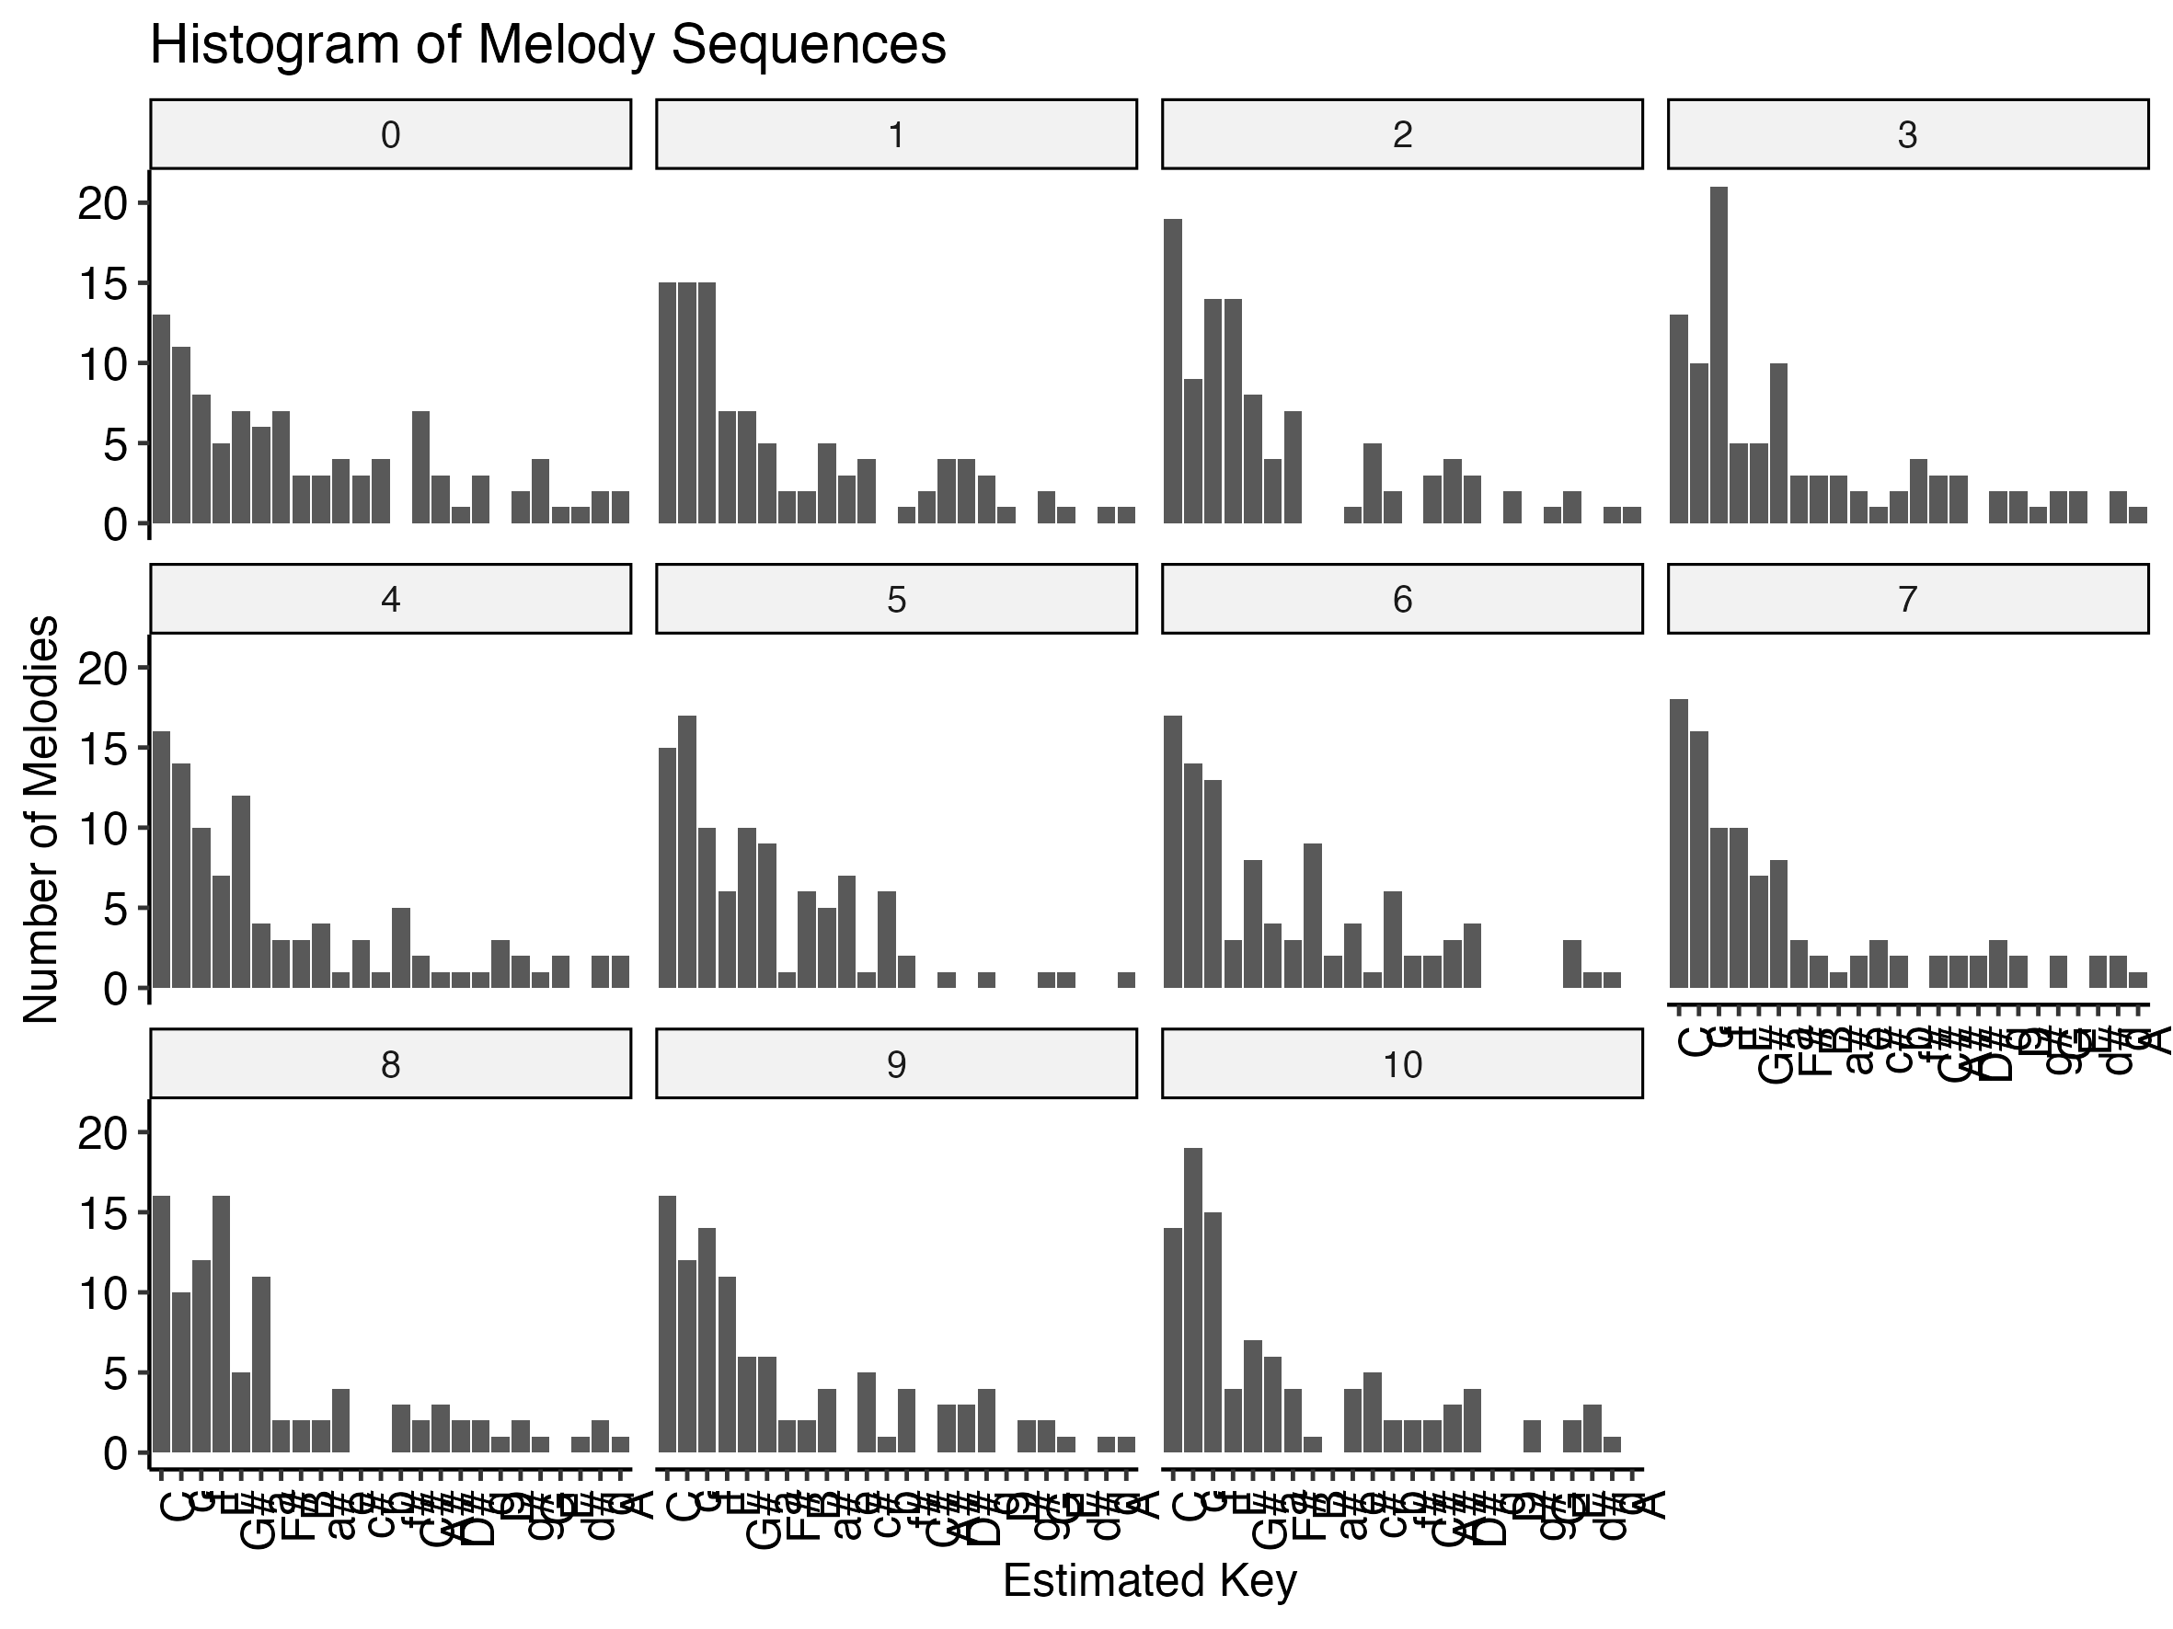
Most melodies converge towards three keys: C, c, and f
Albrecht and Shanahan (2013)

Slide 7
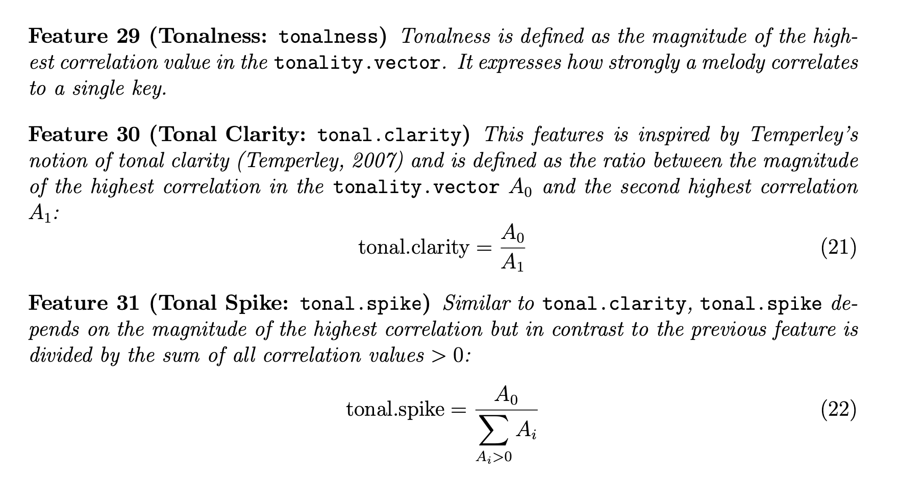
Extracting tonal features from melodies: tonalness, tonal clarity, and tonal spike

Slide 8
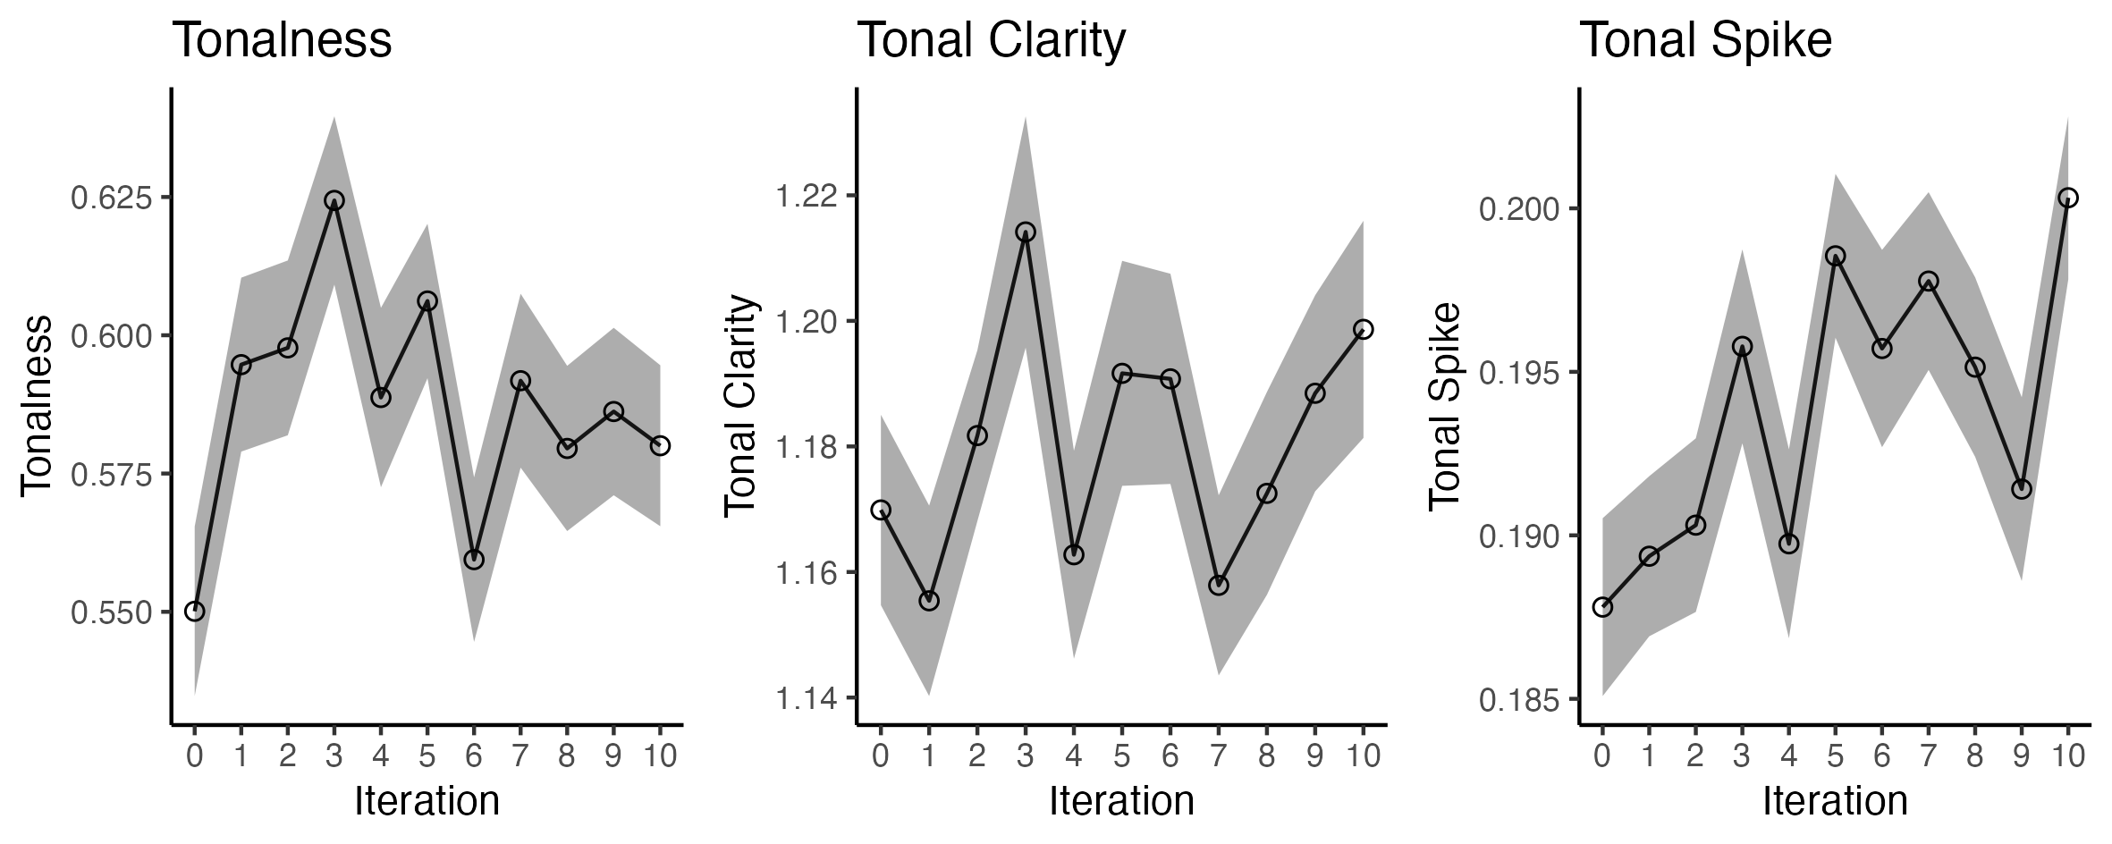
Tonal features from melodies over time
Albrecht and Shanahan (2013)
Small but some effect of melodies becoming “more tonal”, especially with tonal spike
Noisy effects (peaks and dips) of bad participants and small number of melodies (100)

Slide 9
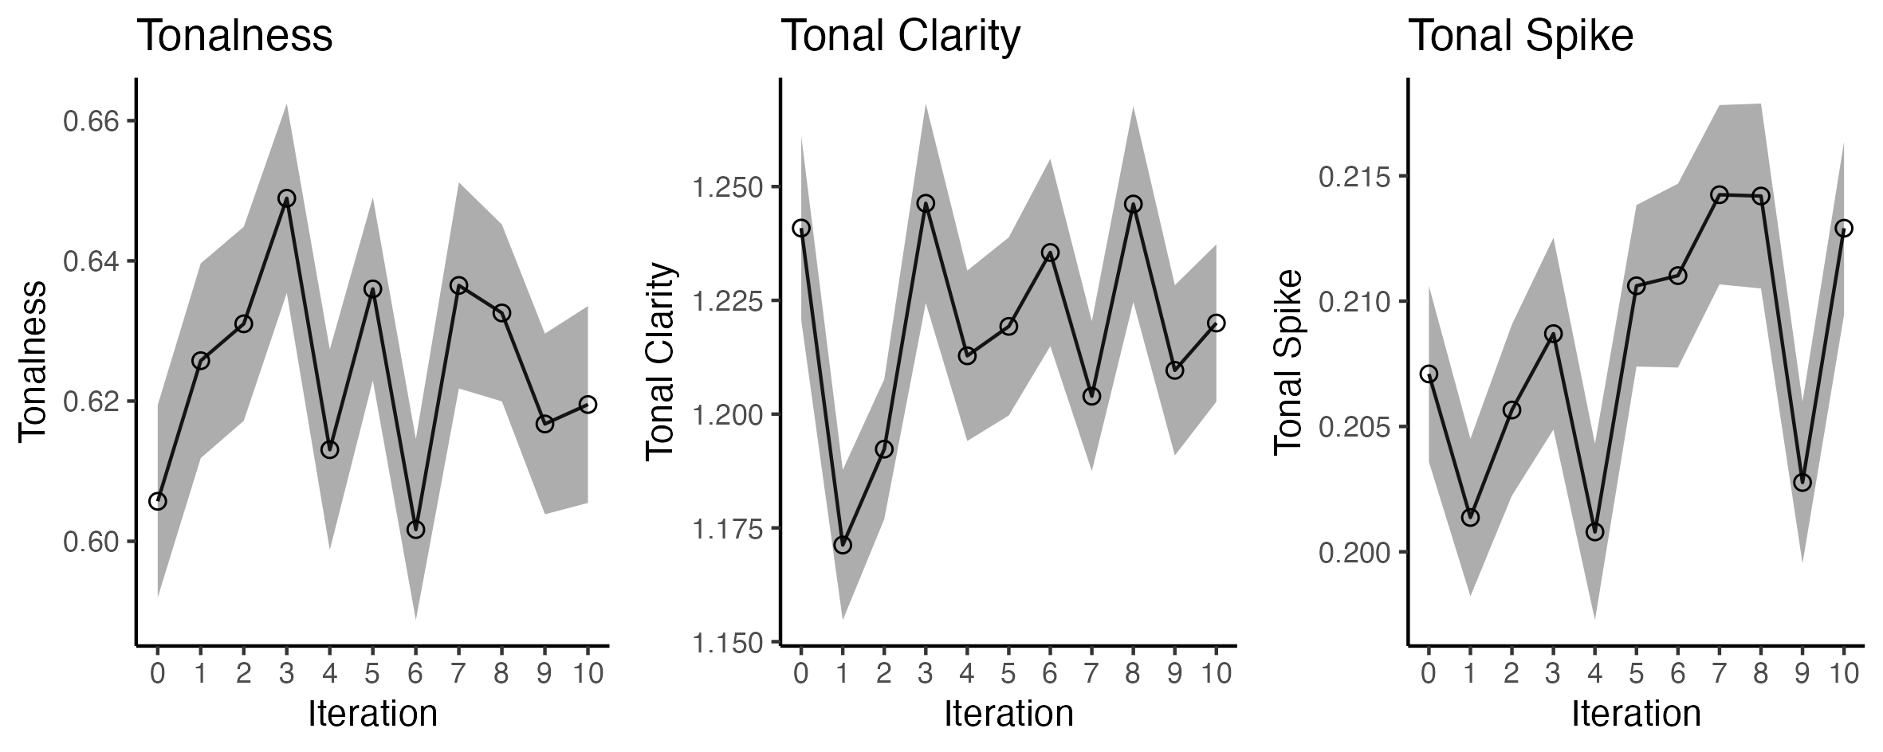
Tonal features from melodies over time
Albrecht and Shanahan (2013)
Krumhansl-Schmuckler

Slide 10
To do: validate if the key-finding works more or less ok
Steps
Estimate key by ear using a subsample of melodies (for example):
20 melodies form degree 0
20 melodies form degree 8
20 melodies form degree 9
20 melodies form degree 10
Compare human annotated key with estimated key using algorithm
Try to find out if there is a lot of noise or bad participants in the data
Albrecht and Shanahan (2013)

Slide 11
Trends in melodic features

Slide 12
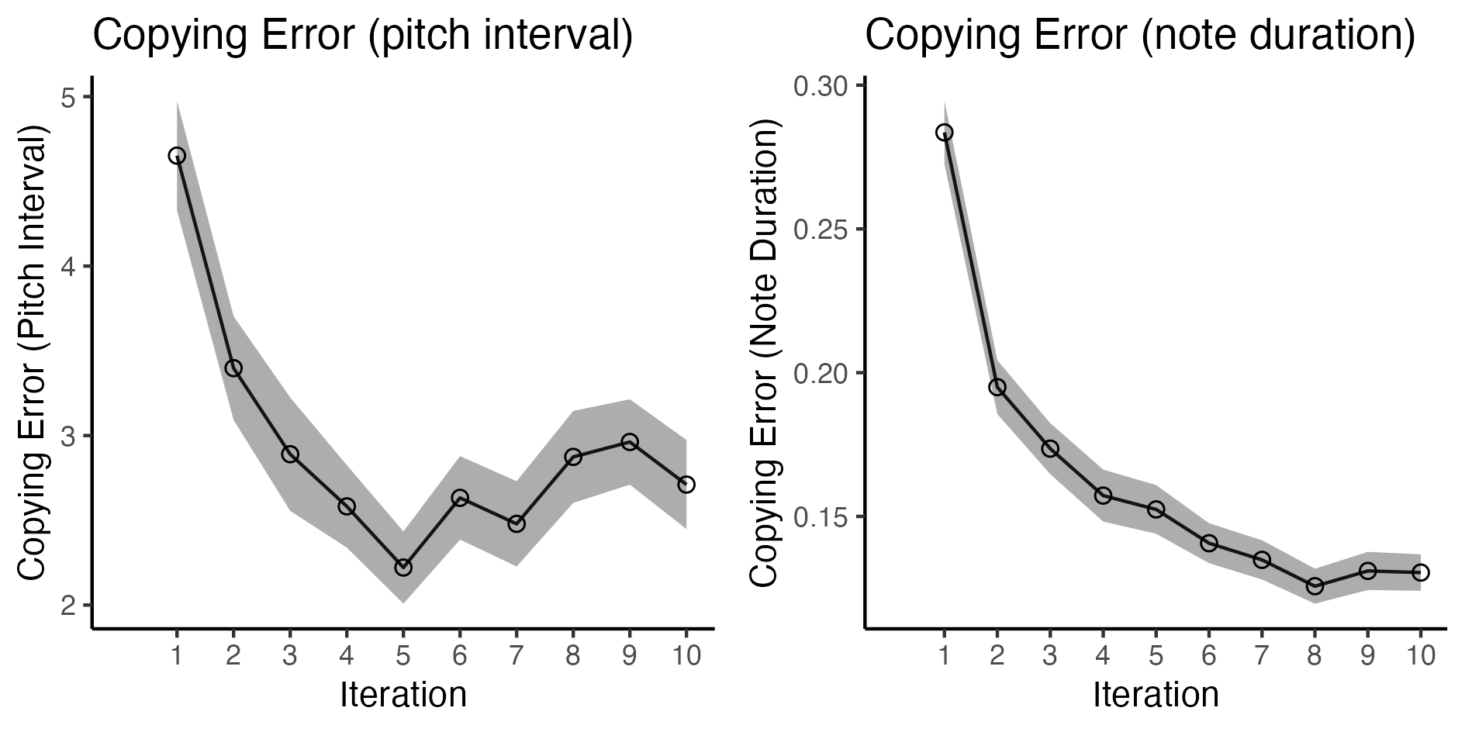
Melodies become easier to learn and transmit over time

Slide 13
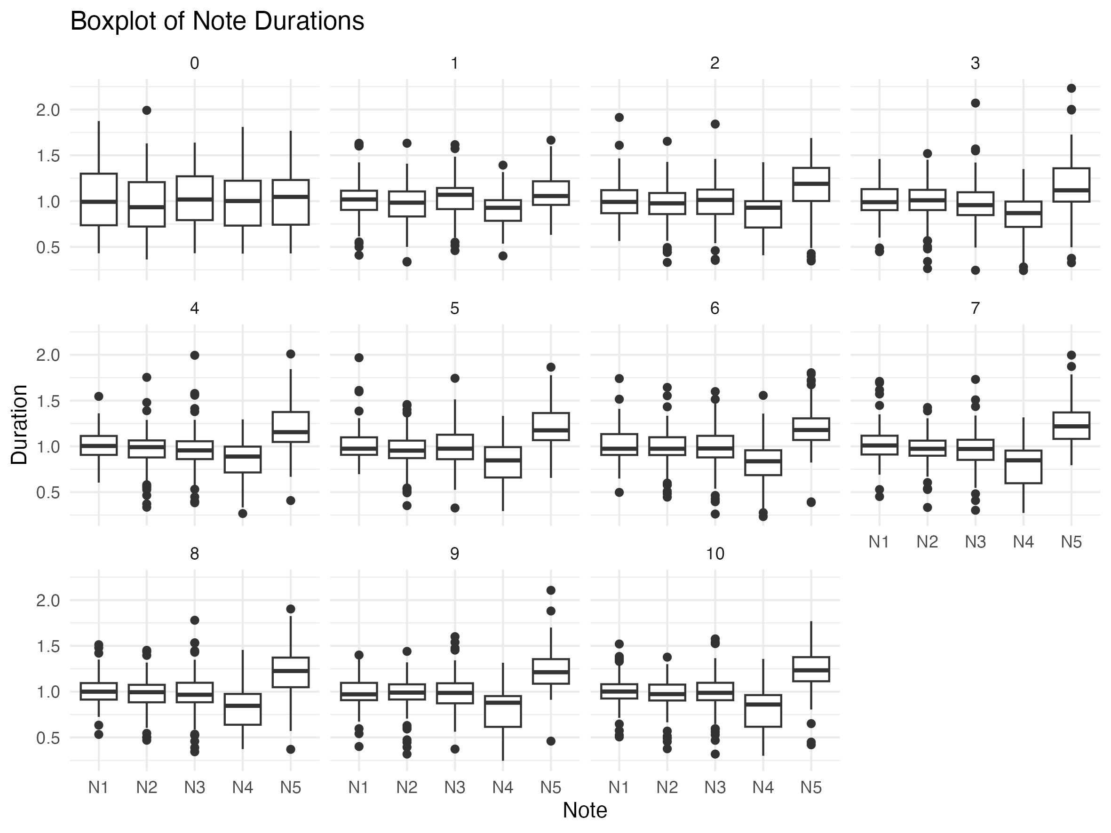
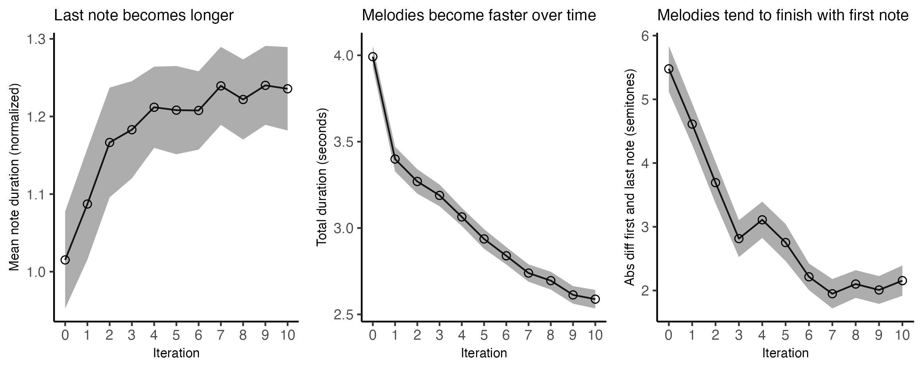
Last note becomes longer than the other notes over time

Slide 14
Last note becomes longer over time, but melodies become faster

Slide 15
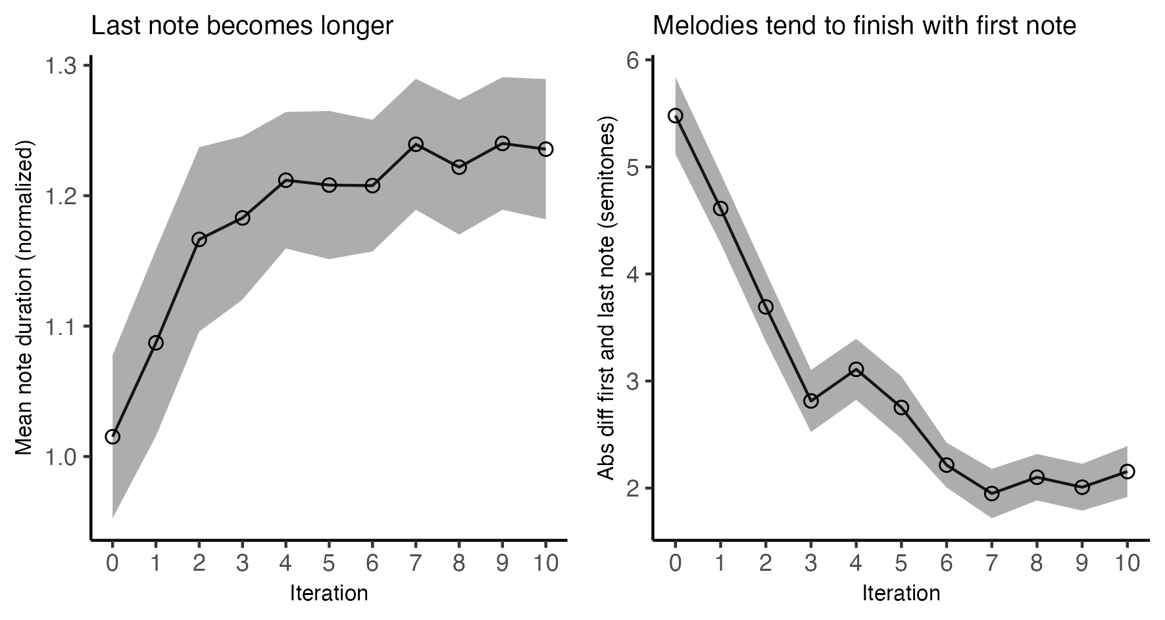
Last note becomes longer over time, and tends to finish with the same note that the first one in the melody

Slide 16
Distribution intervals

Slide 17
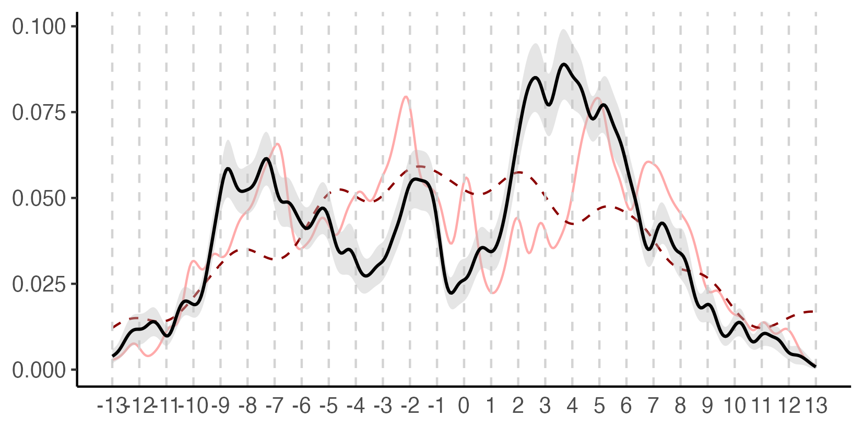
Joint distribution of sung intervals
Random melodies
Density
Last 3 generations
Interval

Slide 18
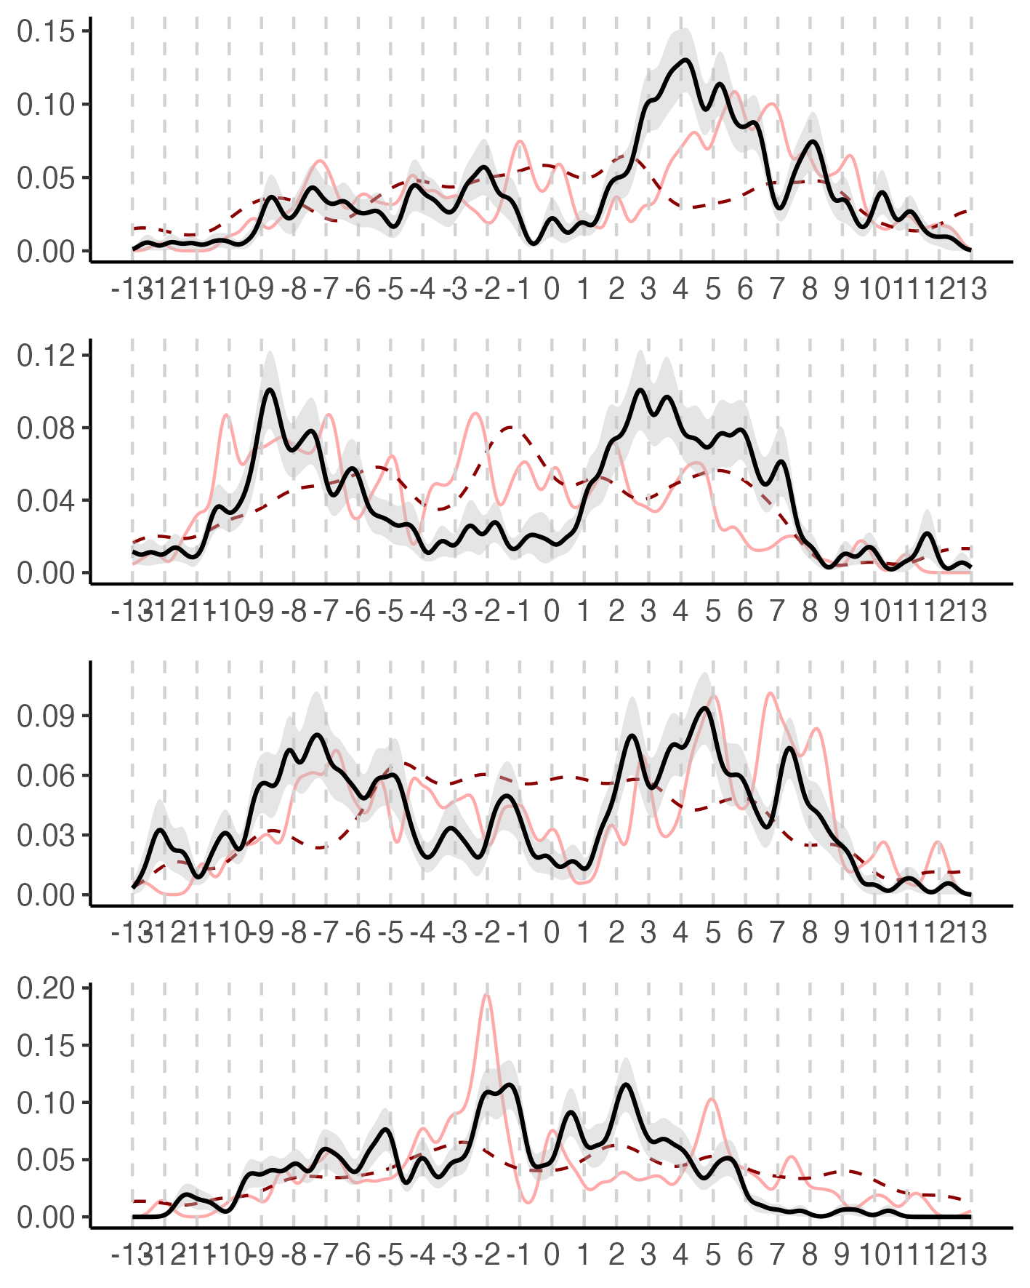
Separate distribution of sung intervals
Interval 1
Interval 2
Interval 3
Interval 4

Slide 19
Melodic Contours

Slide 20
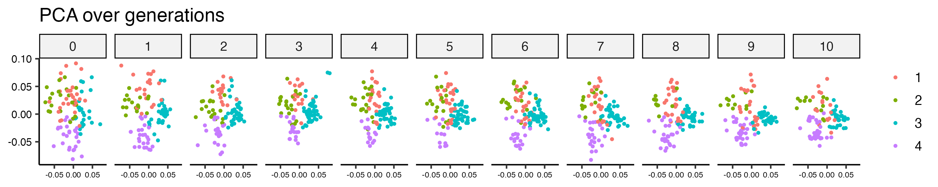
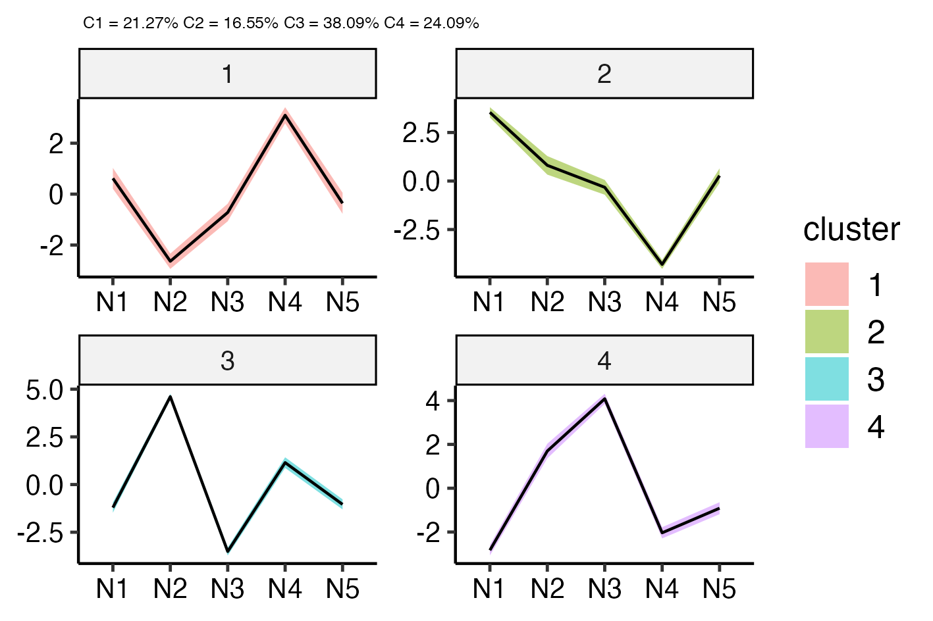
Melodies converge towards melodic prototypes
Average four melodic prototypes

Slide 21
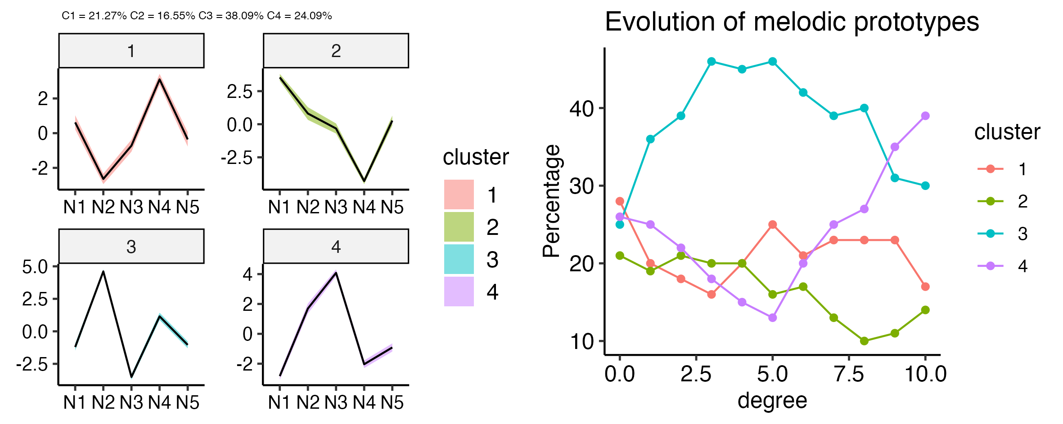
Evolution of melodic prototypes

Slide 22
Figures

Slide 23
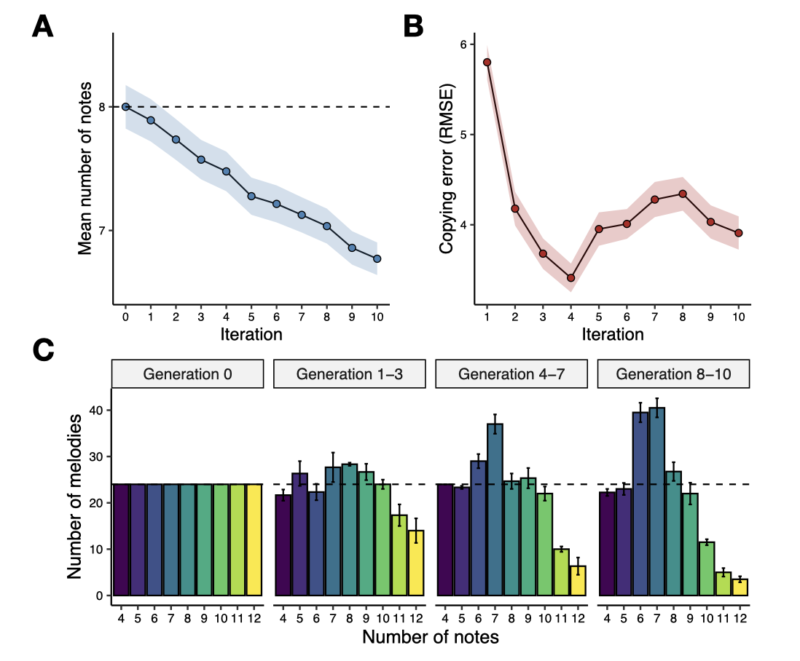
Figure 1

Slide 24
Figure 3

