Slide 1
Independent Validation
Quantitative Aspects
Workshop Session 2

Slide 2
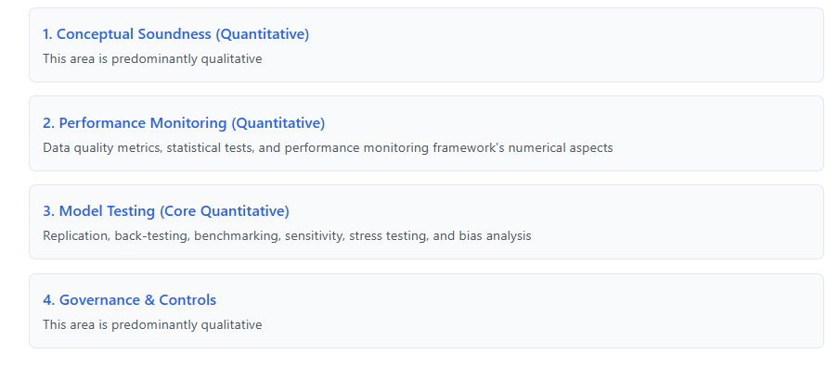
Workshop Structure
❌
✔️
✔️
❌

Slide 3
Choose the approach based on model complexity and available resources. For highly complex third-party models, focus on the documentation without getting lost in implementation details.
✔️
Code Review Focus
Review Documentation
Validate Key Formulas
Manual Testing Focus
Develop Test Scripts
Create Benchmarks
Analyze Input/Output
Performance

Slide 4
Ongoing Performance Monitoring
?
!
What is OPM?...

Slide 5
Ongoing Performance Monitoring
?
!
Ongoing Performance Monitoring—OPM—is an internal framework, sometimes unofficial, designed to detect and manage the risks associated with models after they’ve been deployed.

Slide 6
Ongoing Performance Monitoring
Ongoing Performance Monitoring—OPM—is an internal framework, sometimes unofficial, designed to detect and manage the risks associated with models after they’ve been deployed.
ML
AI
Statistical
Ohhh
Data Drift and Performance Metrics
Ohhh
Hallucinations or harmful outputs over time
Ohhh
Variable significance levels (p values), residuals or performance metrics
AUC, F1, Precision, Recall, MAE, RMSE
Accuracy (RAG), Format Consistency,
Bias
R squared, MAE, RMSE, AIC/BIC, KS Tests

Slide 7
Ongoing Performance Monitoring
Ongoing Performance Monitoring—OPM—is an internal framework, sometimes unofficial, designed to detect and manage the risks associated with models after they’ve been deployed.
?
Data Intake
Processing
Model Output
Who decides what’s “normal” or “abnormal”? Often, it’s left to teams or individuals.
abnormal
normal

Slide 8
Ongoing Performance Monitoring
abnormal
normal
Ongoing Performance Monitoring—OPM—is an internal framework, sometimes unofficial, designed to detect and manage the risks associated with models after they’ve been deployed.
!
Retrain
Document and
test
Data Intake
Processing
Model Output
Document and
test
This eliminates the guesswork by establishing clear frameworks that act as an early warning system
Retrain
Who decides what’s “normal” or “abnormal”? Often, it’s left to teams or individuals.

Slide 9
Ongoing Performance Monitoring
Metrics
Thresholds
Action plans

Slide 10
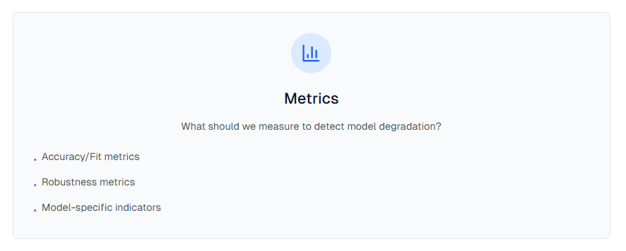
Ongoing Performance Monitoring
ML
AI
Statistical
Accuracy (RAG), Format Consistency,
Bias
R squared, MAE, RMSE, AIC/BIC, KS Tests
AUC, F1, Precision, Recall, MAE, RMSE

Slide 11
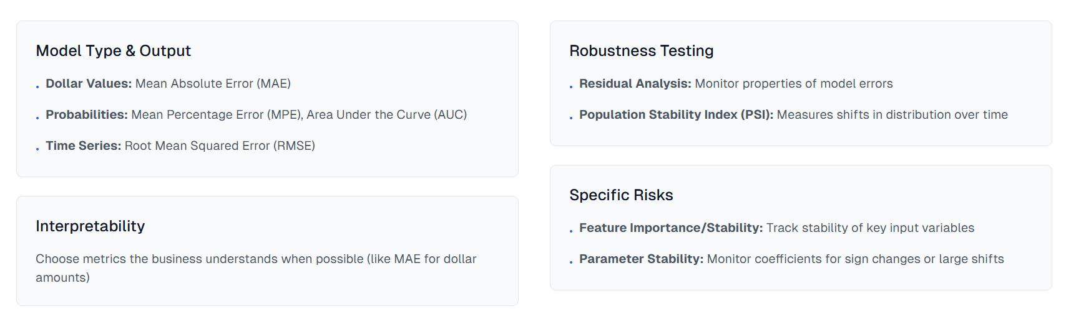
Ongoing Performance Monitoring
Selecting Metrics

Slide 12
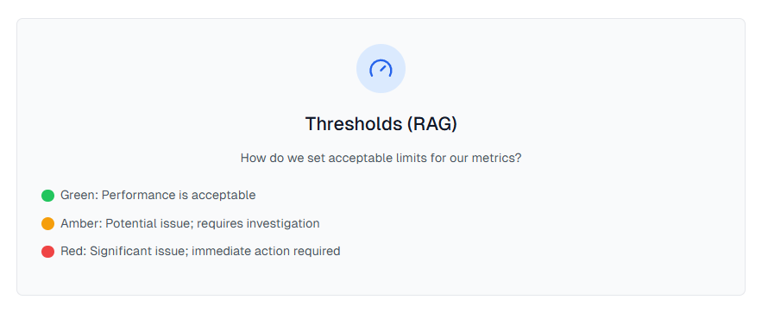
Ongoing Performance Monitoring

Slide 13
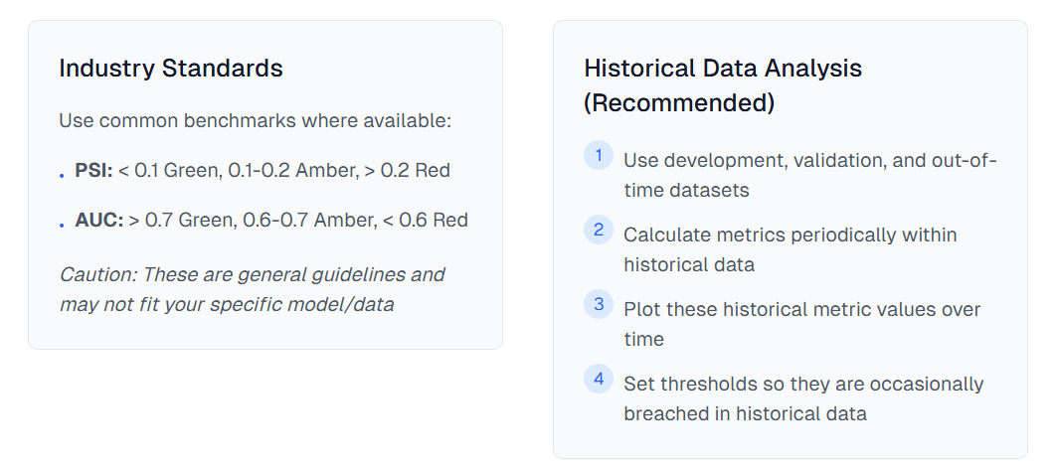
Ongoing Performance Monitoring
Setting Thresholds
Thresholds should trigger alerts during known periods of stress or change in the historical data. This builds confidence that the thresholds are meaningful.

Slide 14
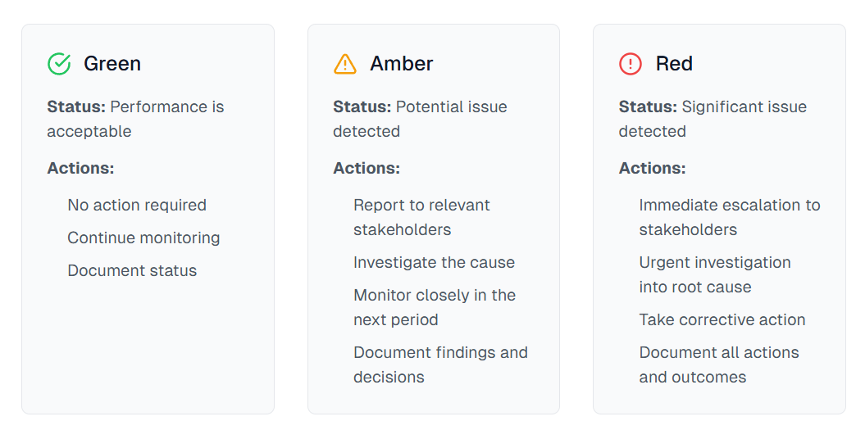
Ongoing Performance Monitoring
Action Plans

Slide 15

Ongoing Performance Monitoring
Crucial Part of Model Lifecycle
OPM is essential for managing risk over time after model deployment
Careful Selection Required
Requires thoughtful selection of metrics, frequency, and thresholds based on historical analysis
Well-Defined Action Plans
Clear action plans are critical for responding effectively when thresholds are breached
Complementary Role
OPM complements, but does not replace, rigorous and robust initial model development

Slide 16
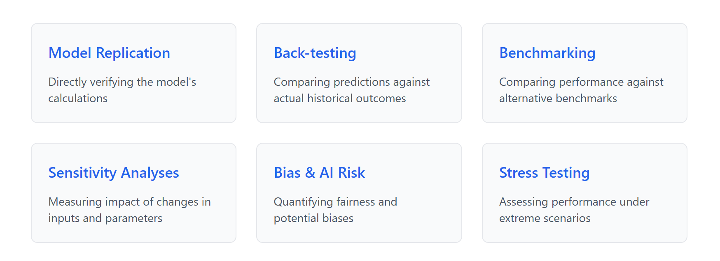
Model Testing

Slide 17
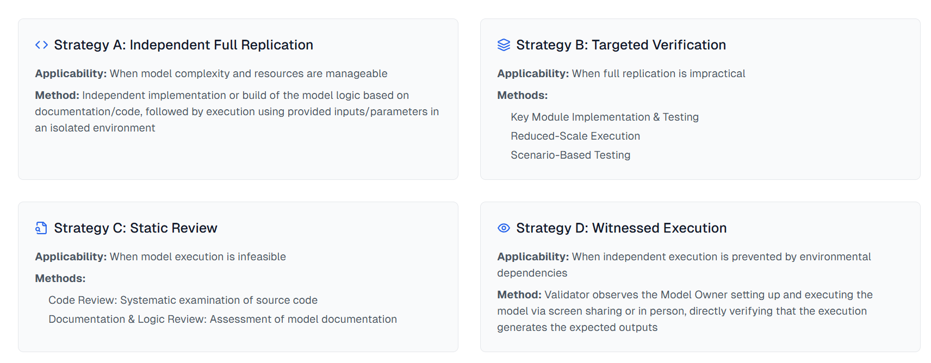
Model Testing
Model Replication

Slide 18
Cheat Sheet
?
!
Model Testing
Model Replication
A. Independent Full replication
B. Targeted Verification
✅ You have enough time.
✅ Your computer can handle the model (CPU, RAM, software).
✅ The model isn't excessively complex to rebuild/run.
Build or configure the model independently on your system.
Run it with the provided inputs/settings.
Compare your output directly to the owner's expected results.
❌ Full Replication (A) is too slow, too hard, or needs too much computing power.
✅ You still want to test parts of the model execution.
Option 1: Re-code and run only the most important calculation steps yourself.
Option 2: Run the owner's original code, but simpler (less data, fewer steps, shorter time).
Option 3: Run the owner's original code, but only for a few specific test inputs.
C. Static Review
D. Witnessed Run
Schedule a live session (e.g., screen share call) with the model owner.
Watch them set up and run the model using the exact code/data/settings provided.
Visually confirm the results generated during the session match the documented expected results.
Read the computer code carefully. Does it match the documentation? See obvious errors?
Read the documentation carefully. Is the logic clear? Does the math make sense? Is it complete?
❌ Running the model (even simplified) is impractical or impossible for you (needs special hardware/software you don't have, takes days to run).
❌ You absolutely cannot run the model yourself (due to complex setup, secret environment, etc.).

Slide 19
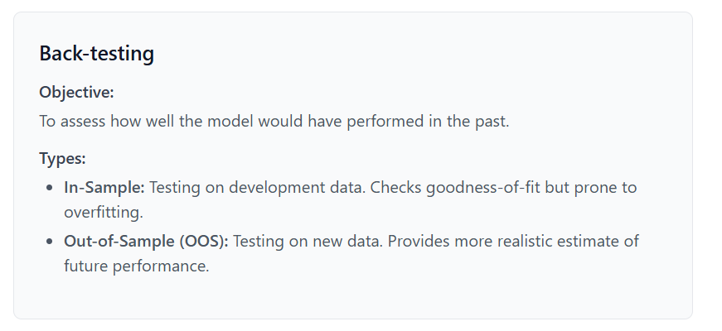

Model Testing
Back Testing
Back Testing

Slide 20
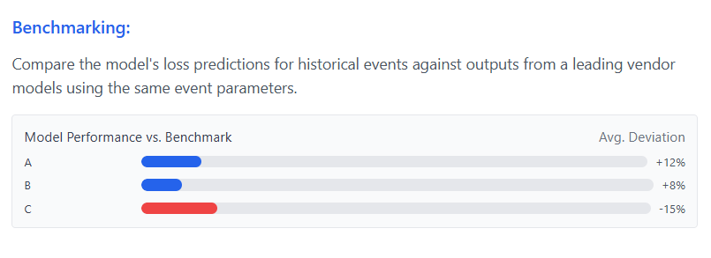
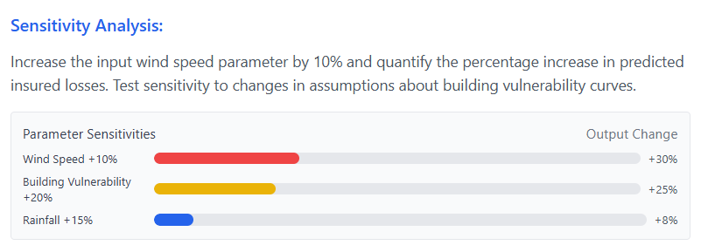
Model Testing
Benchmarking, Sensitivity Analysis, and Stress Testing
Benchmarking
Rationale
Results
Sensitivity Analyses
Rationale
Results
Stress Testing
Rationale
Results

Slide 21
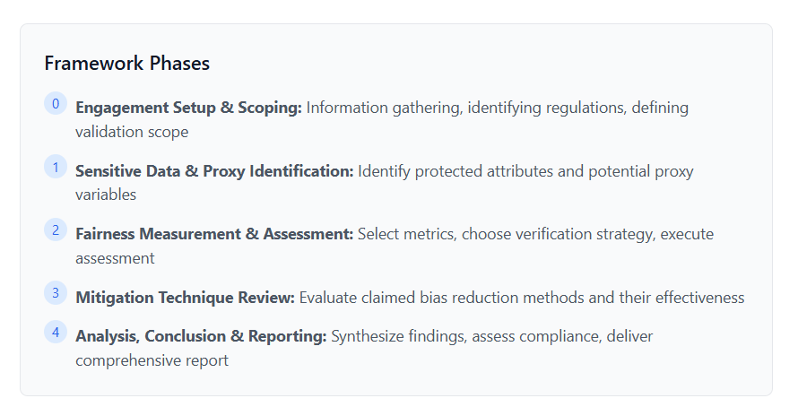
Model Testing
To independently assess models for potential bias against protected classes, ensuring compliance with regulations and ethical standards.
Bias and Fairness Testing

Slide 22
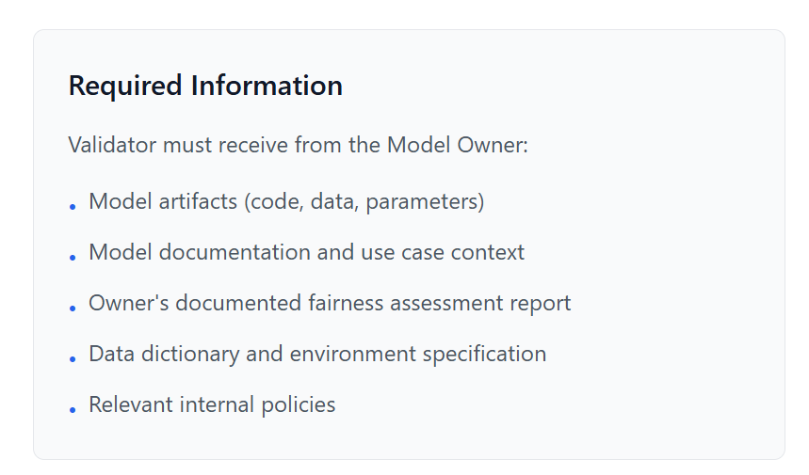
Model Testing
?
!
Bias and Fairness Testing
A. Independent Fairness Calculation
Independently compute fairness metrics using standard tools/libraries. Compare results against the owner's documented report and defined thresholds.
B. Targeted Recalculation
Replicate specific key metric calculations claimed in the owner's report or test specific subgroups/scenarios. Compare against documented claims.
C. Review Owner's Assessment
Critically analyze the owner's documented fairness report and methodology for soundness, completeness, and reasonableness.

Slide 23
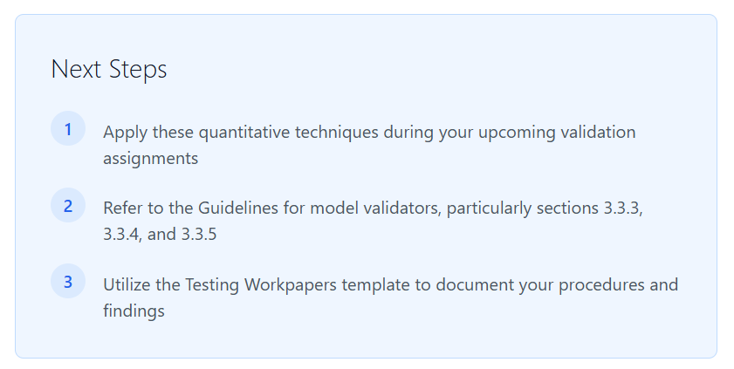
Thank You

