Slide 1
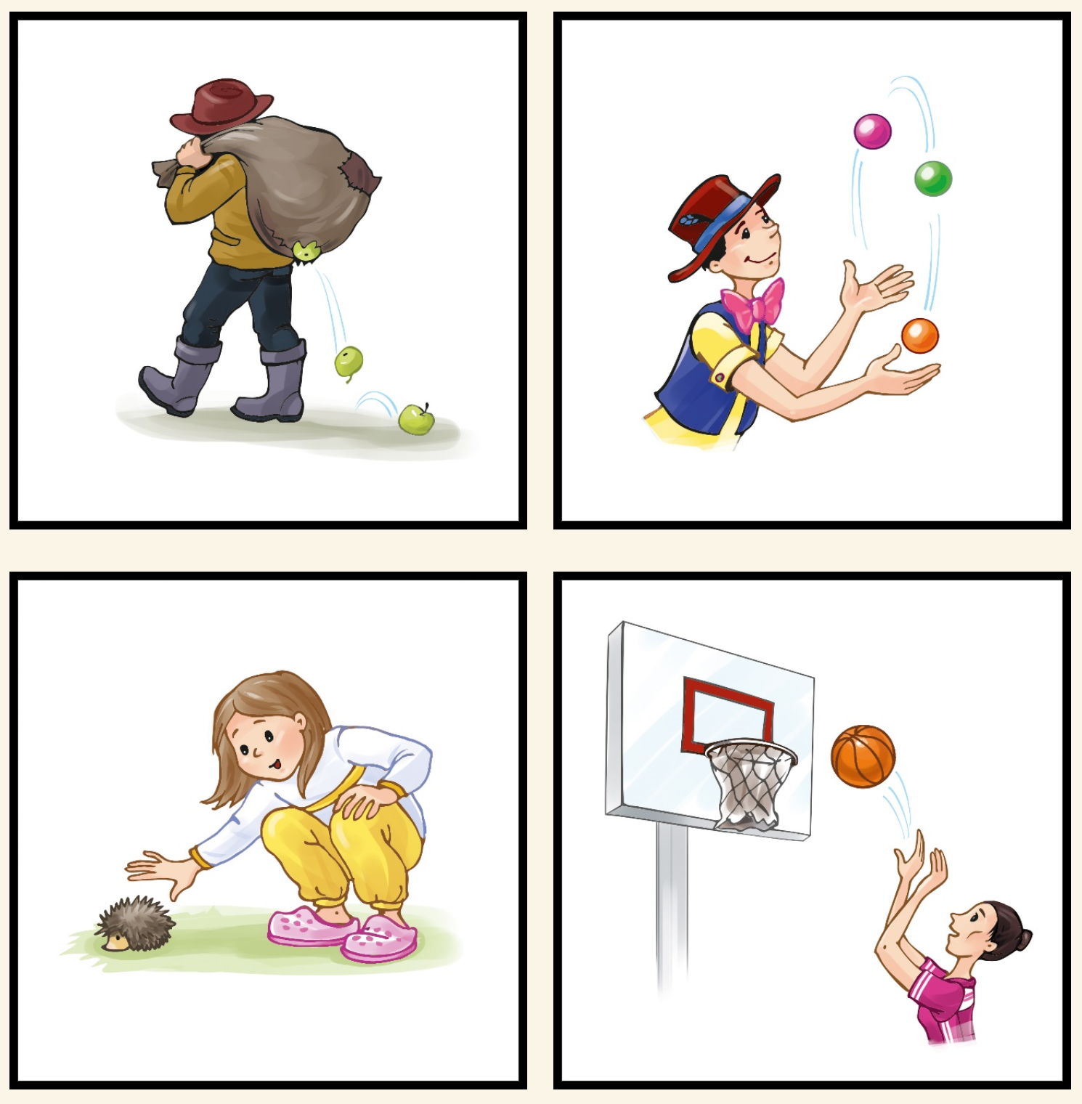
Phonological distractor
”verlieren”
(to lose)
Target word
”jonglieren”
(to juggle)
Unrelated distractor
”anfassen”
(to touch)
Semantic distractor
”werfen”
(to throw)

Slide 2
Phonological distractor
”verlieren”
(to lose)
Target word
”jonglieren”
(to juggle)
Semantic distractor
”werfen”
(to throw)
Unrelated distractor
”anfassen”
(to touch)

