Slide 1
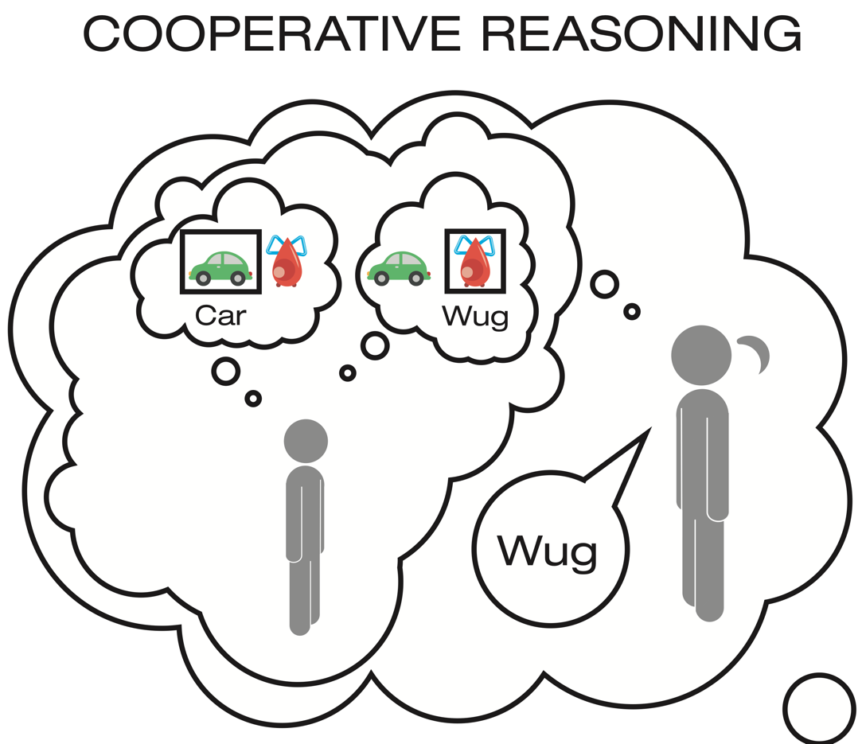
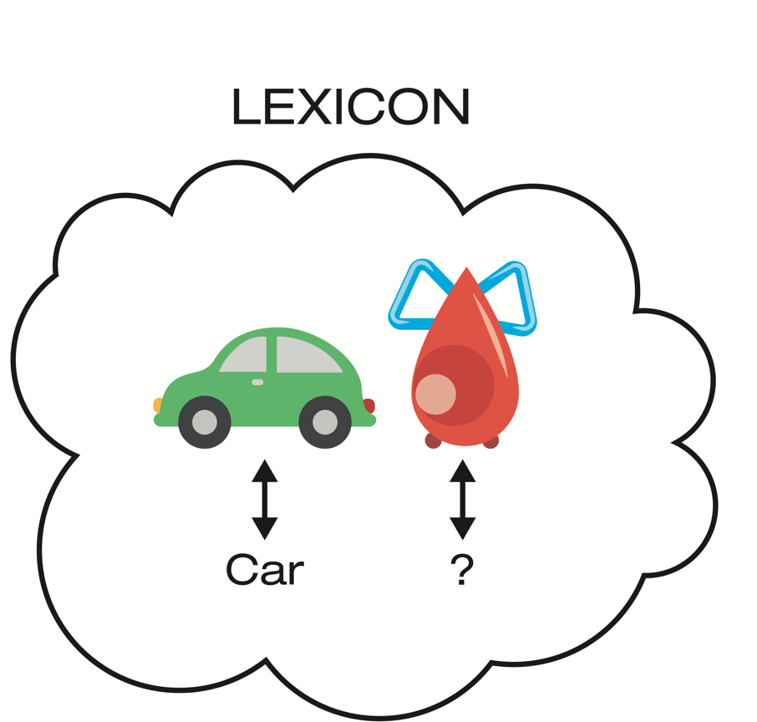
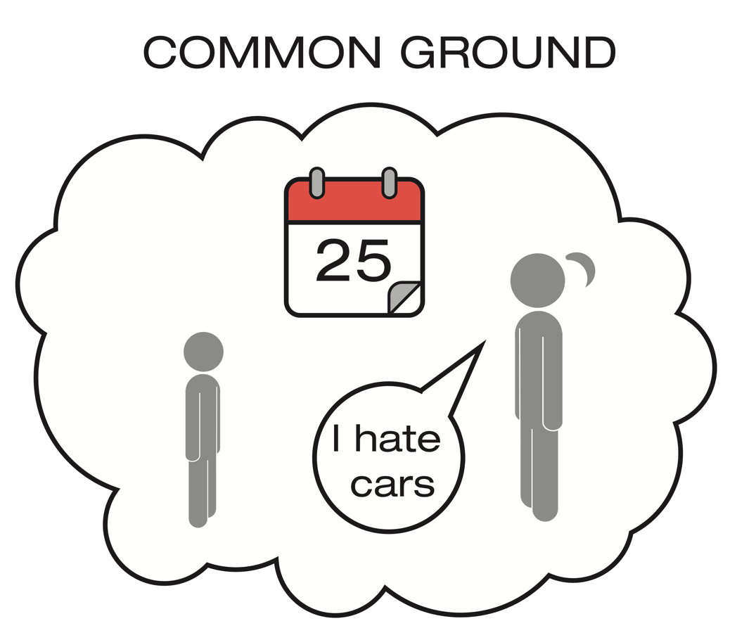
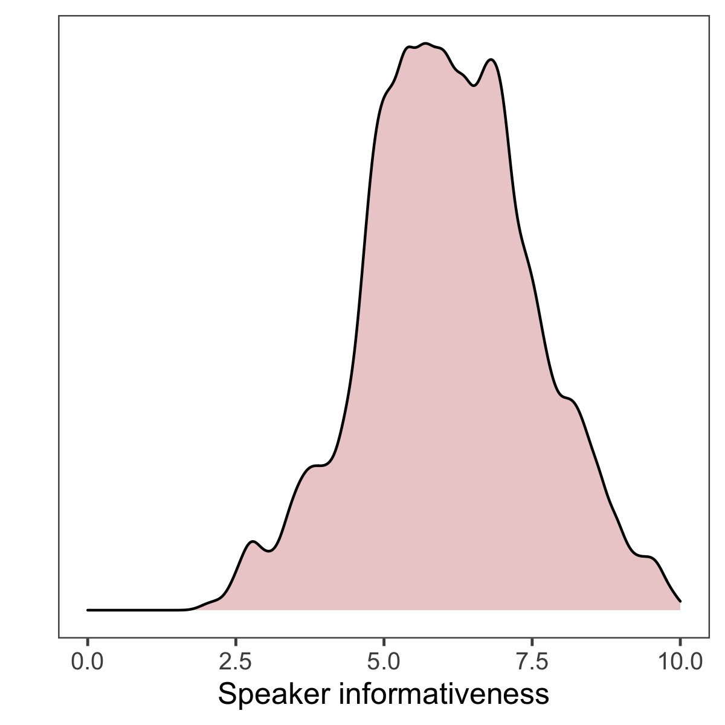
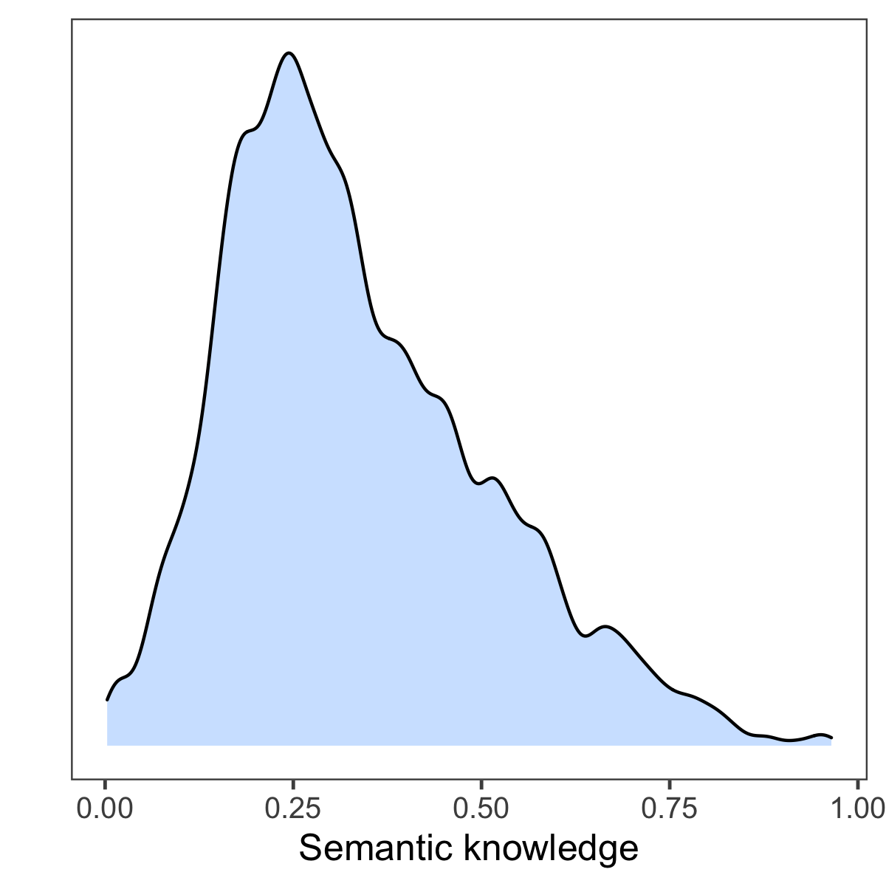
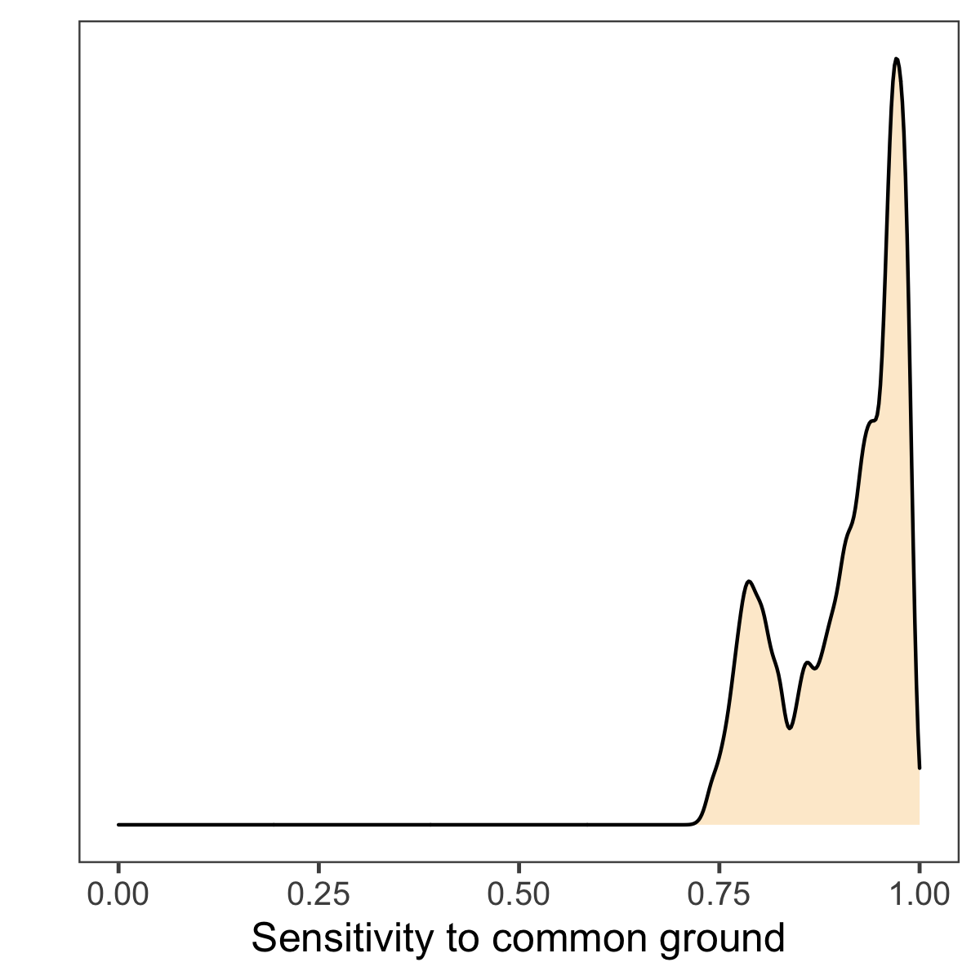
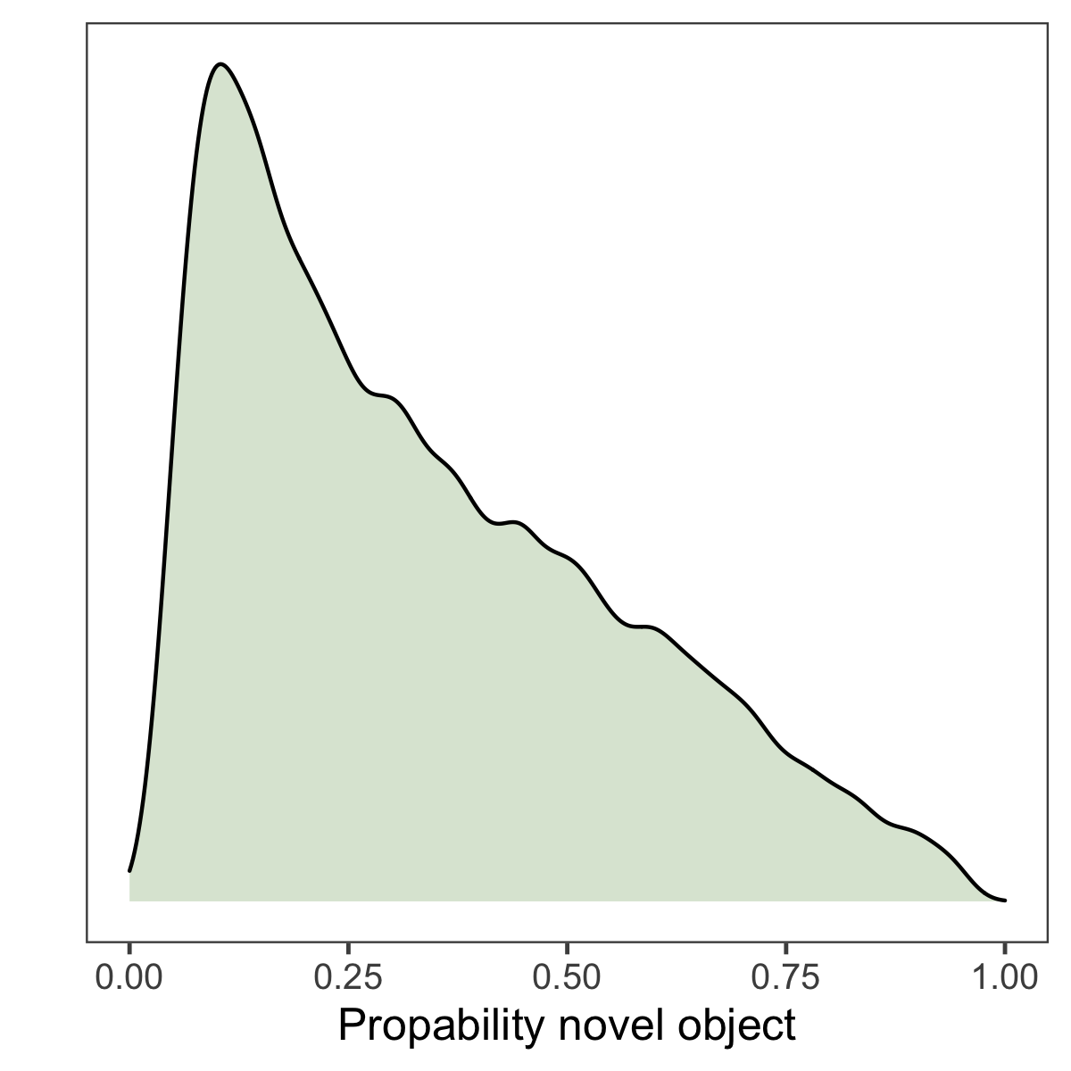
Notes:
Instead of group level trajectories we estimate parameters for each individual using the same tasks as before. Because we do this on an item level for semantic knowledge, we added a comprehension and production task for each object

Slide 2
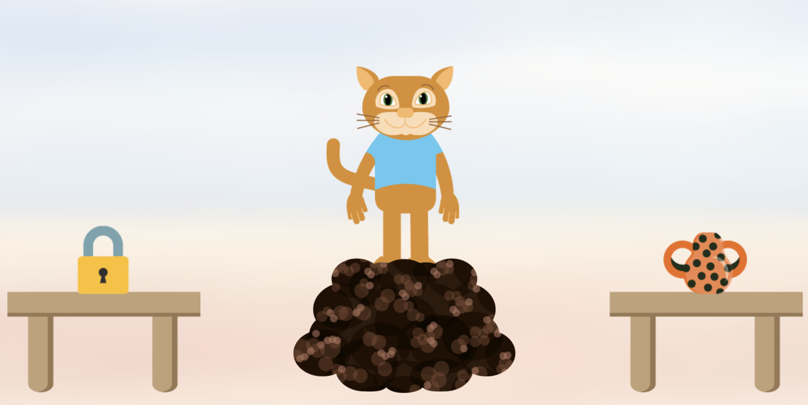
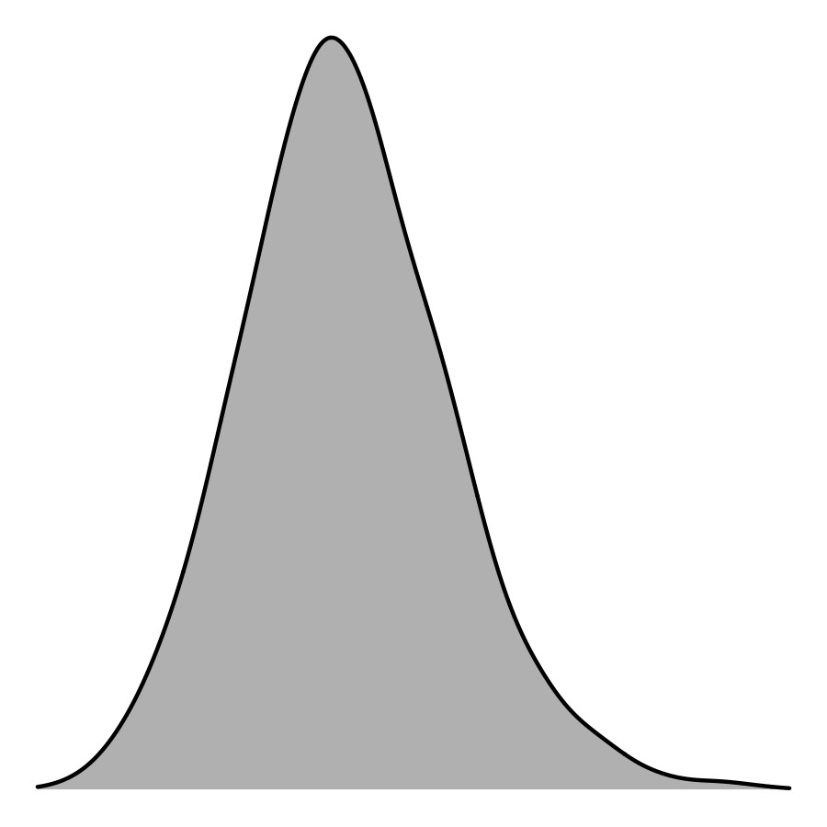

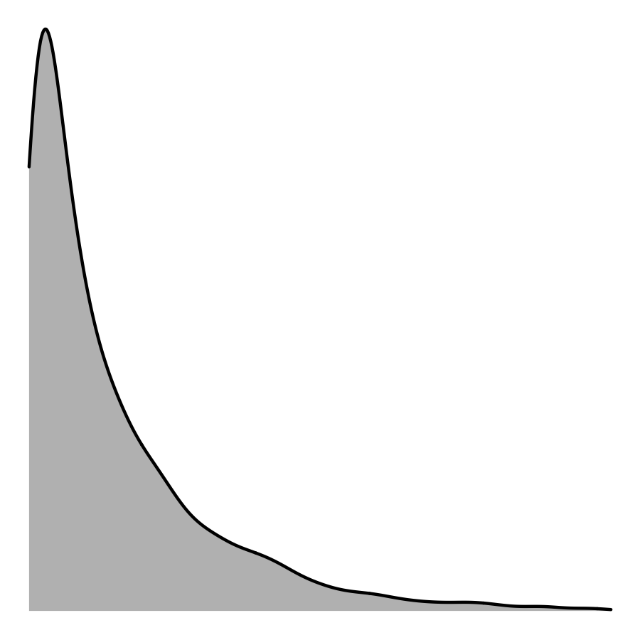
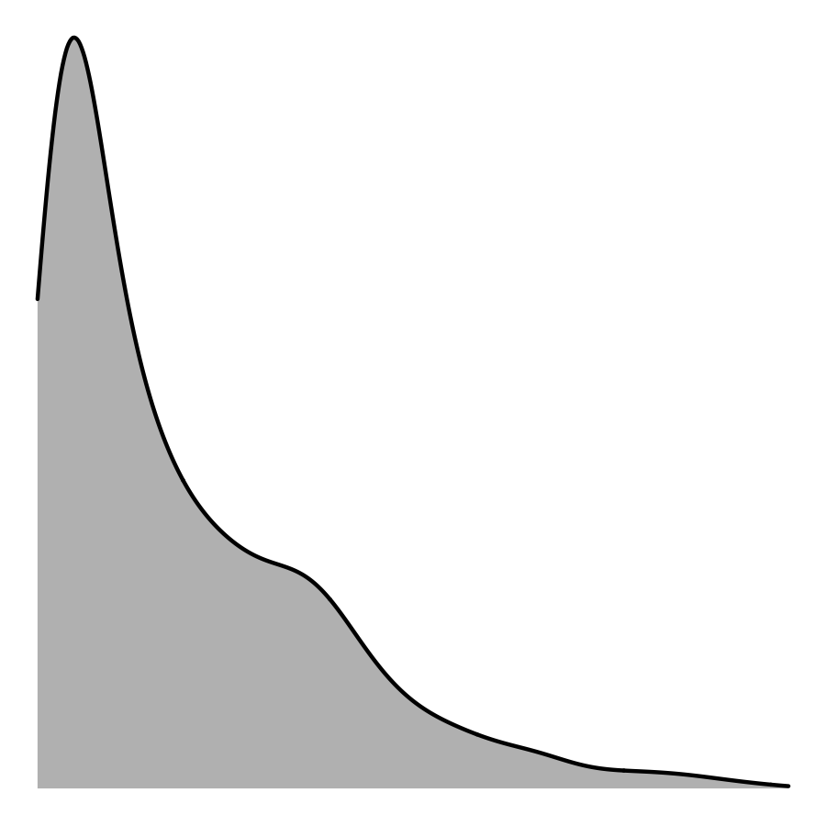


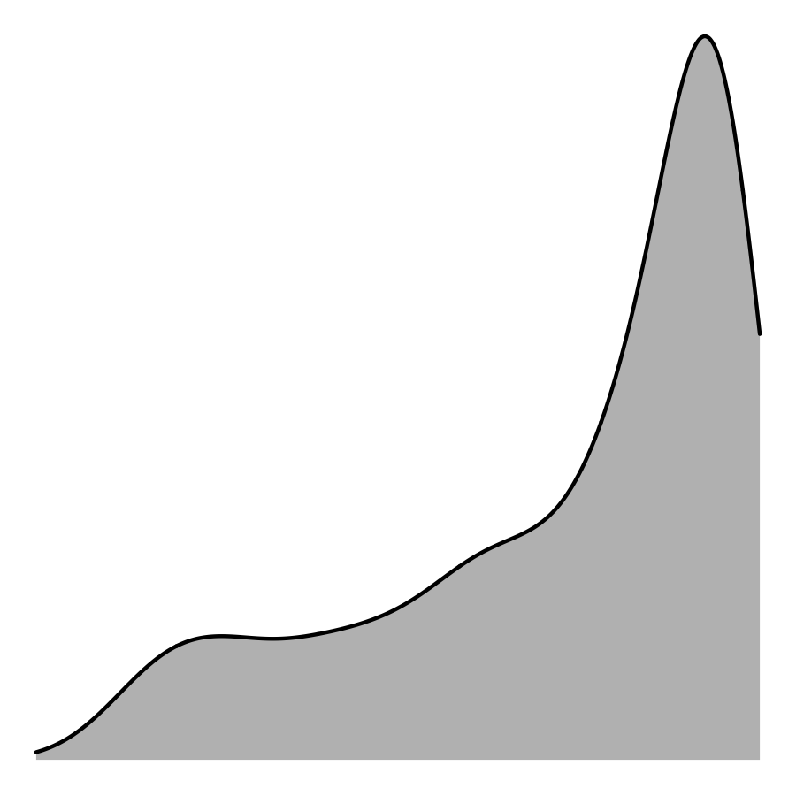
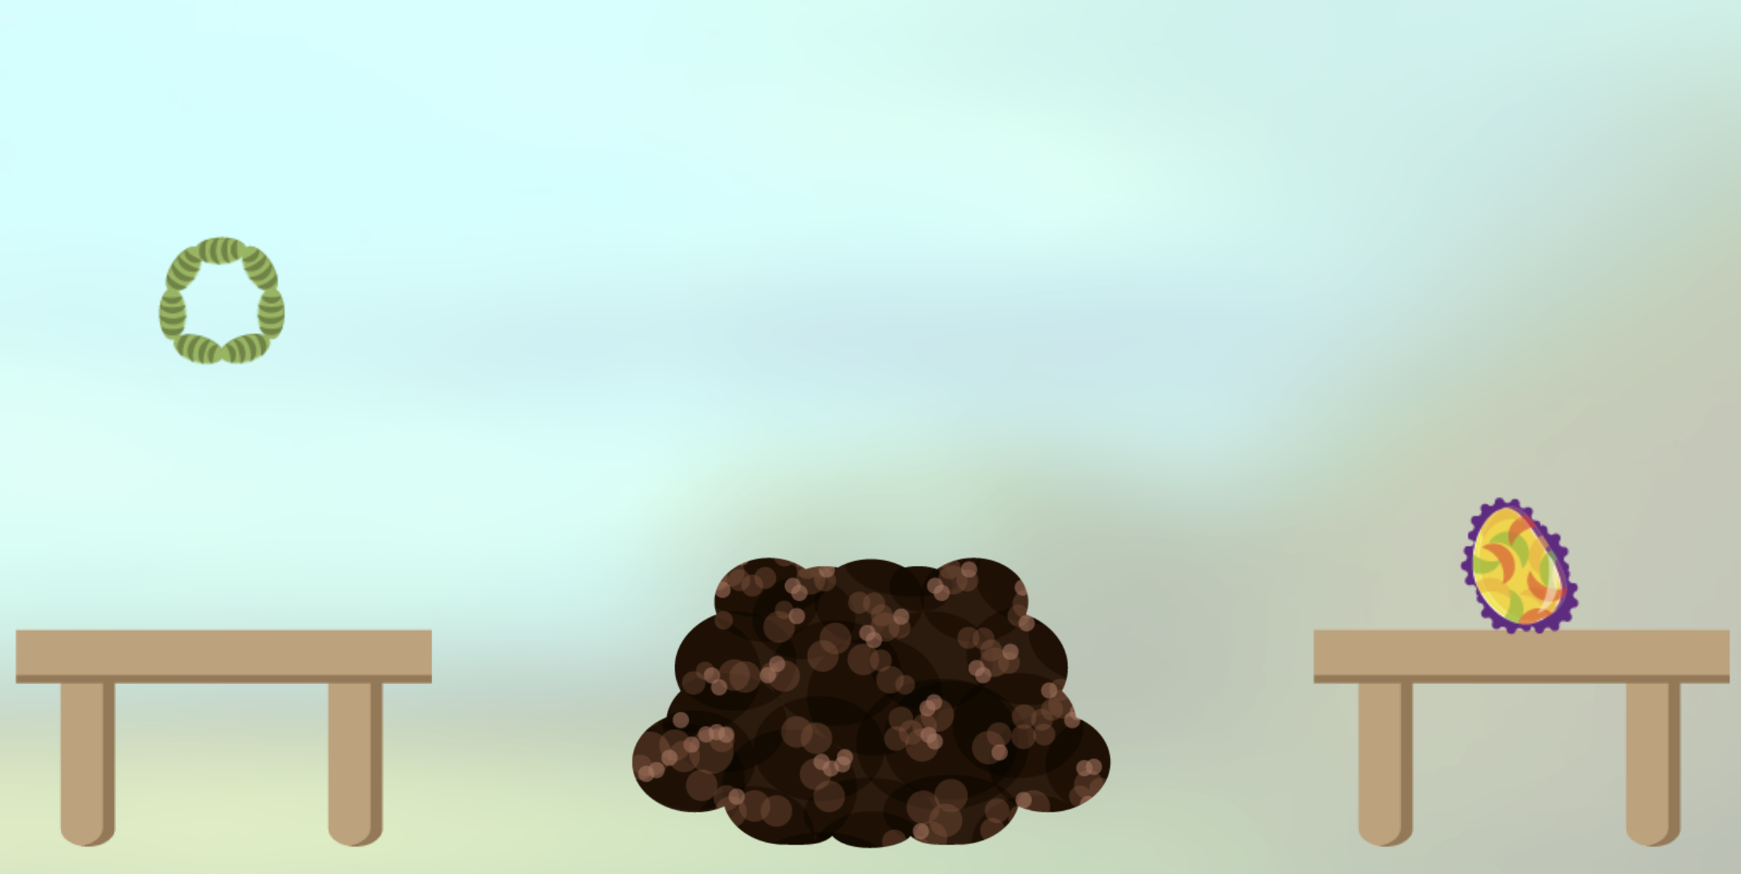
Mutual exclusivity
Speaker informativeness
Word comprehension
Semantic knowledge
Model prediction
Combination
RSA
Word production
Sensitivity to common ground
Discourse novelty

Slide 3
Evaluating model predictions
flip(MAP(model_prediction))
N = 60 children

Slide 4
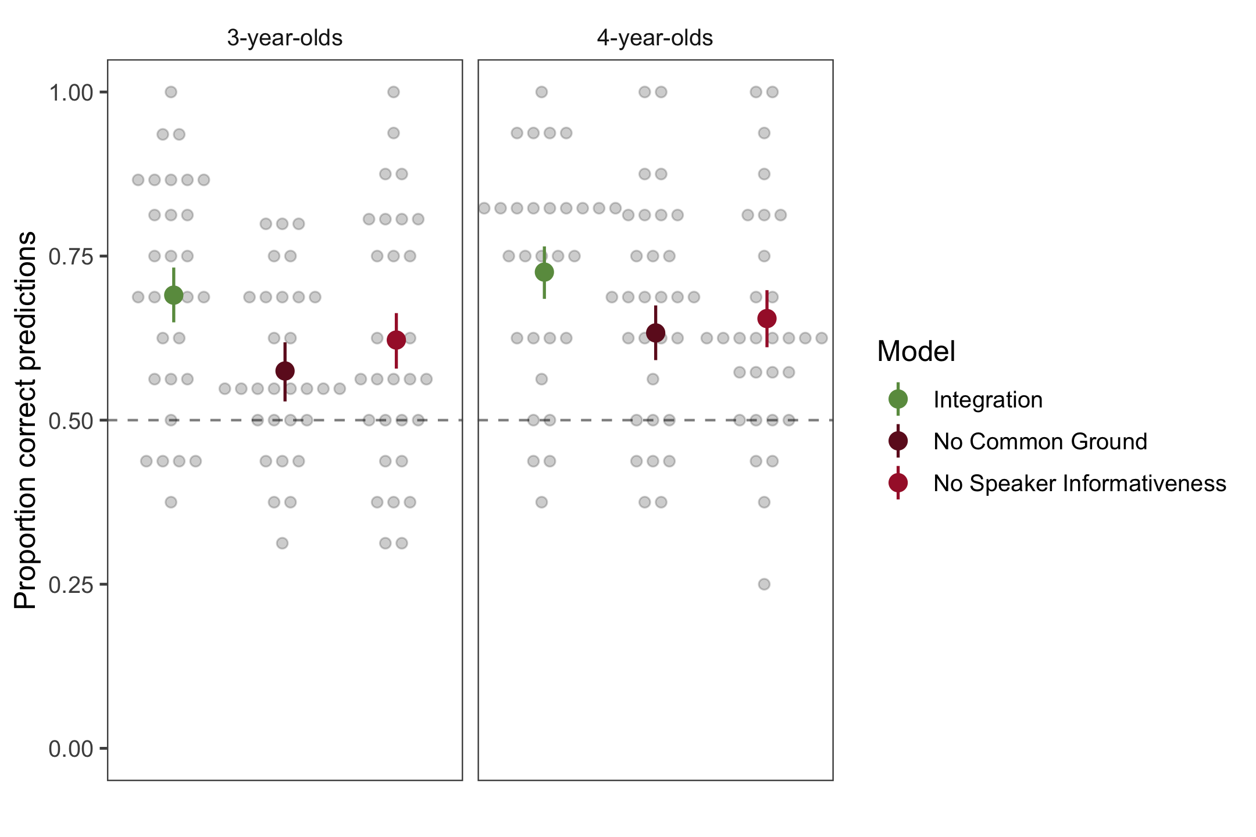
Evaluating model predictions
flip(MAP(model_prediction))
N = 60 children

Slide 5
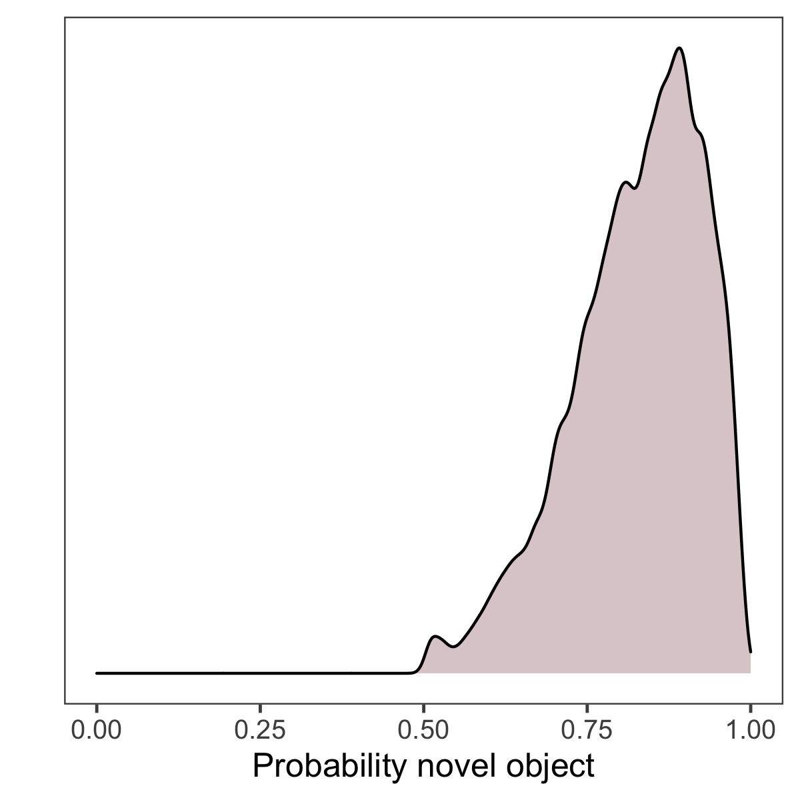
Evaluating model predictions
flip(MAP(model_prediction))
N = 60 children

