Slide 1

AI-Driven Predictive Maintenance
for GMP Manufacturing
(Regeneron IOPS)
Technical Case Study Presentation
Emmanuel Oyekanlu
(Nov 4, 2025)

Slide 2
Presentation overview
The challenge, proposed solution & business impact
Solution architecture overview
Data strategy and GMP compliance
Hybrid AI model architecture
Model explainability and SHAP analysis
Infrastructure & Deployment Strategy
GMP Validation & Compliance
Monitoring & Continuous Improvement
Implementation Roadmap & Conclusion
Questions & Further Discussions

Slide 3
The challenge, proposed solution & business impact
THE CHALLENGE:
- Fixed-schedule maintenance: inefficient & costly
- Unplanned downtime = product loss + compliance risks
- Reactive approach limits operational excellence
OUR SOLUTION: PREDICTIVE MAINTENANCE AS A SERVICE
Core Pillars:
DATA INTEGRITY - ALCOA+ principles foundation
MODEL RELIABILITY - Accurate & interpretable AI
GMP COMPLIANCE - Validated from day one
EXPECTED BUSINESS IMPACT:
▶ 15-20% reduction in unplanned downtime
▶ 10-15% maintenance cost reduction
▶ enhanced product quality & supply reliability
▶ data-driven continuous improvement
▶ Waste reduction

Slide 4
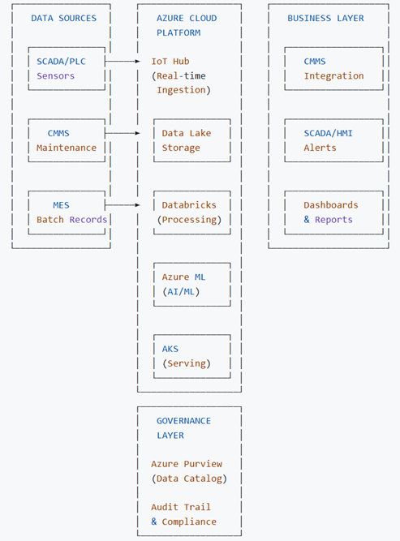
GMP PREDICTIVE MAINTENANCE ARCHITECTURE OVERVIEW (Cloud Layer ONLY)

Slide 5
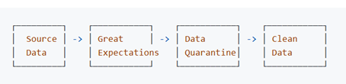
Data Strategy and GMP Compliance
DATA SOURCES INTEGRATION, DATA COLLECTION & PREPROCESSING STRATEGY
• Real-time Sensors: Temperature, Pressure, Vibration, pH
• Maintenance Records: CMMS work orders & failure codes
• Operational Data: Batch records, SOP execution logs
GMP DATA QUALITY FRAMEWORK:
ALCOA+ PRINCIPLES: Attributable, Legible, Contemporaneous, Original, Accurate
MISSING DATA HANDLING:
• KNN Imputation for sensor data. Mean vs Mode data imputation. SMOTE
• Data filling for time-series gaps
• Complete audit trail of all transformations
• Redundant data removal

Slide 6
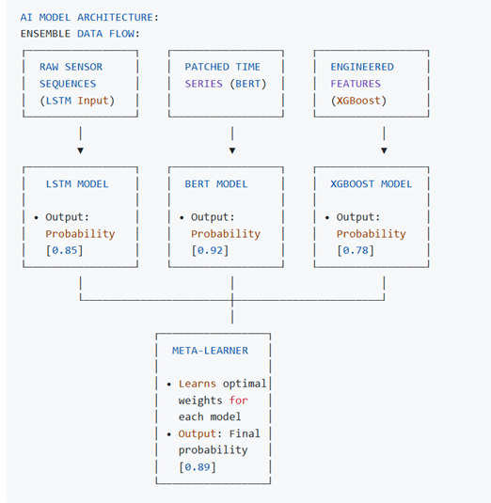
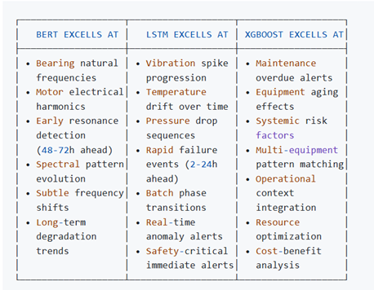
Hybrid AI model architecture
Specific Failure Detection Capabilities

Slide 7
Hybrid AI model architecture

Slide 8

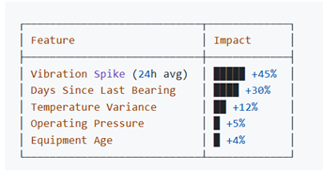
Model Explainability and SHAP Analysis
Model Interpretability for GMP Compliance
We don't just get a prediction; we get a reason
SHAP (Shapley Additive Explanations):
• Feature importance scoring for every prediction
Audit-ready explanations for regulatory compliance
Engineer-friendly diagnostics
Example prediction explanation:
prediction: 92% probability of bearing failure in 48 hours

Slide 9
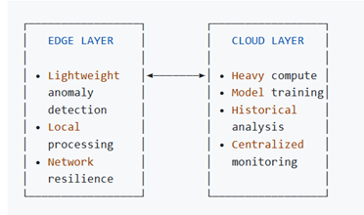
Infrastructure & Deployment Strategy
On-Prem Deployment in some Instances: Docker Hub, CI/CD
Cloud Infrastructure & Scalability
Azure platform selection:
IoT Hub: Real-time sensor data ingestion
Data Lake Storage: Single source of truth
Azure Databricks: Feature engineering & training
Azure ML: Model management & pipelines
AKS (Kubernetes): Scalable model serving
Deployment Strategies:
Canary release: Single production line evaluation
Shadow Mode: Prediction without actions (for some time)
Gradual Rollout: Expand with validation
Full Scale Deployment: Kubernetes, Helm files, HPC (Nvidia Run:ai) ?

Slide 10
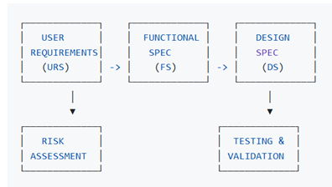
GMP Validation & Compliance
Compliance by Design: GAMP 5 framework, EU GMP Annex11, FDA 21 CFRPart 11
Validation Lifecycle:
Key Validation Deliverables:
Installation Qualification (IQ): Infrastructure setup
Operational Qualification (OQ): System functionality
Performance Qualification (PQ): Business process validation
Audit Trail & Change Control:
Immutable logs for all data transformations
Model versioning with electronic signatures
Formal change control for model updates
Complete documentation for regulatory inspections

Slide 11
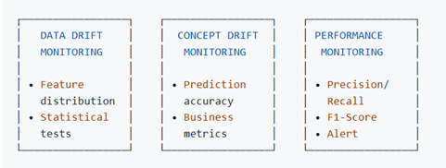
Monitoring & Continuous Improvement
AUTOMATED RETRAINING PIPELINE:
Trigger Conditions: Performance degradation (F1-score drop >10%)
Scheduled retraining (quarterly)
Significant process changes
Data drift detection
BUSINESS KPI MONITORING:
Mean Time Between Failures (MTBF)
Maintenance cost per unit
Unplanned downtime hours
False positive/negative rates

Slide 12
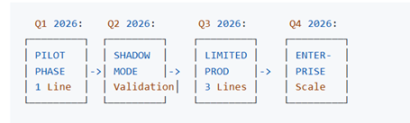
Implementation Roadmap & Conclusion
Implementation Roadmap & Success Metrics
Success Metrics & KPIs:
Operational: >15% reduction in unplanned downtime
Financial: >10% reduction in maintenance costs. Waste reduction
Quality: Zero compliance incidents
Adoption: >90% maintenance team satisfaction
Long-term Vision:
Foundation for Digital Twin capabilities
Expansion to quality prediction models
Cross-functional AI platform for IOPS
Industry-leading GMP AI practices

Slide 13
Question and Further Discussions

Slide 14
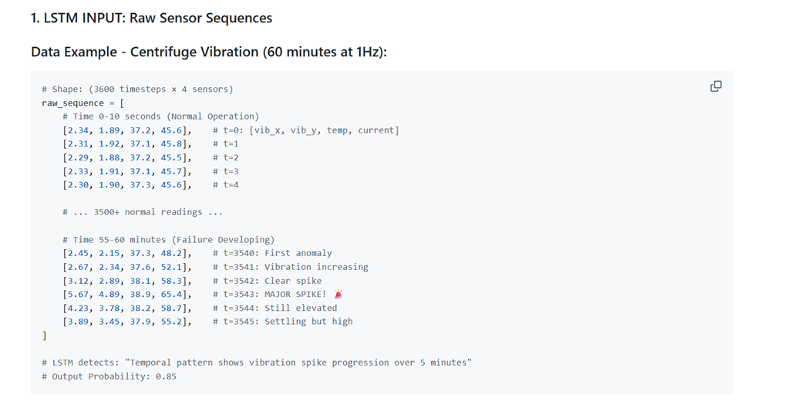
Appendix (LSTM Input)

Slide 15
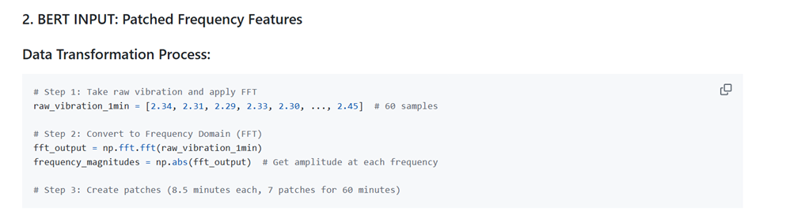
Appendix (Bert Input)

Slide 16
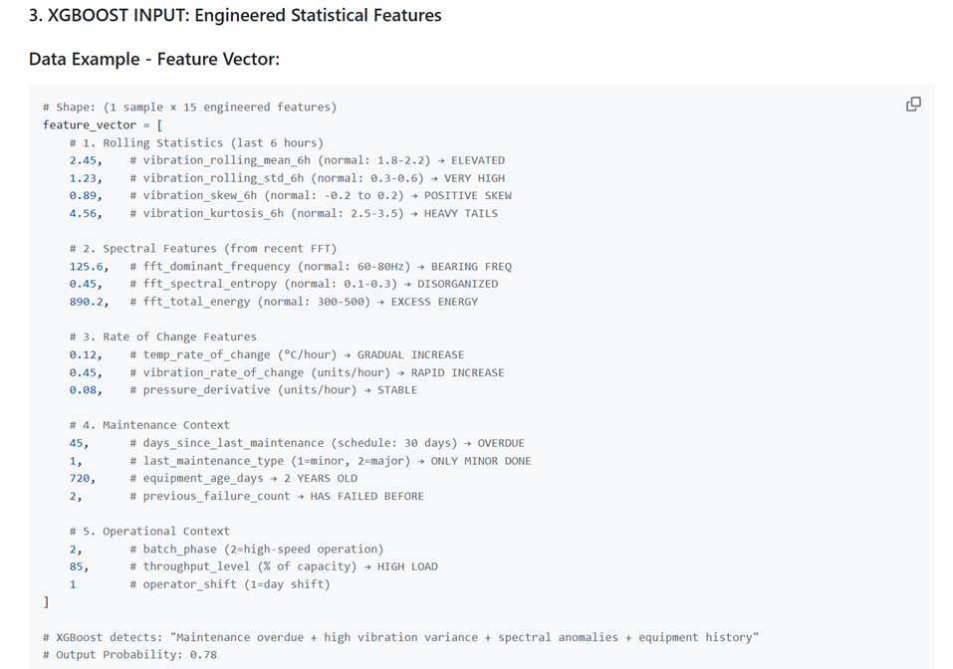
Appendix (XGBoost)

