Slide 1
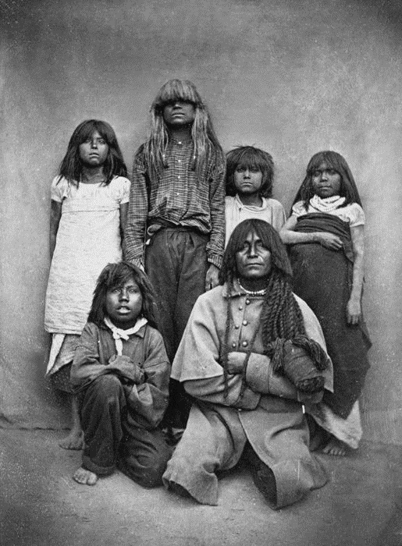
Analysing Diabetes Dataset
Manuel A. Castro R.
Last Updated: 15/01/22
Notes:
Image taken from https://www.legendsofamerica.com/wp-content/uploads/2018/12/PimaIndiansCarloGentile1870.jpg

Slide 2
Context
• Diabetes is one of the most frequent diseases worldwide and the number of diabetic patients is growing over the years. The main cause of diabetes remains unknown, yet scientists believe that both genetic factors and environmental lifestyle play a major role in diabetes.
• A few years ago, research was done on a tribe in America which is called the Pima tribe (also known as the Pima Indians). In this tribe, it was found that the ladies are prone to diabetes very early. Several constraints were placed on the selection of these instances from a larger database. In particular, all patients were females at least 21 years old of Pima Indian heritage.
Text taken from the original Word Document

Slide 3


The Notebook
To access the notebook click here
import pandas as pd #Data manipulation
import numpy as np #Numerical - Statstical manipulation
from plotly.subplots import make_subplots #Plots library
import plotly.express as px
import plotly.graph_objects as go #these two libraries will help us to plot the data
# These libraries help us to build, train and test the logistic regression model
from sklearn import metrics
from sklearn.linear_model import LogisticRegression
from sklearn.metrics import classification_report, confusion_matrix
from sklearn.model_selection import train_test_split
Notes:
Collab image: https://www.marketing-branding.com/wp-content/uploads/2020/07/google-colaboratory-colab-guia-completa.jpg
Python logo: https://logos-world.net/wp-content/uploads/2021/10/Python-Symbol.png
Collab notebook: https://colab.research.google.com/drive/1-mmYxuia9_XsvzwAwnz8ARIbJih34FrM?usp=sharing

Slide 4
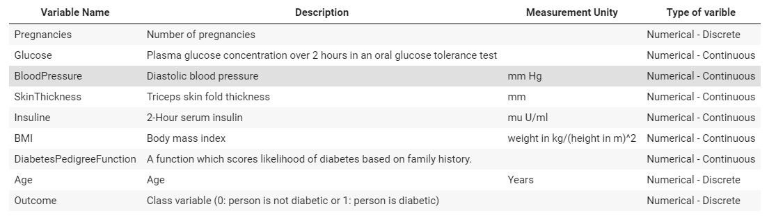
The Dataset
Note: in this case, age variable is discrete even it could be continuous, just the years as whole number were taken.
Notes:
Collab image: https://www.marketing-branding.com/wp-content/uploads/2020/07/google-colaboratory-colab-guia-completa.jpg
Python logo: https://logos-world.net/wp-content/uploads/2021/10/Python-Symbol.png
Collab notebook: https://colab.research.google.com/drive/1-mmYxuia9_XsvzwAwnz8ARIbJih34FrM?usp=sharing

Slide 5
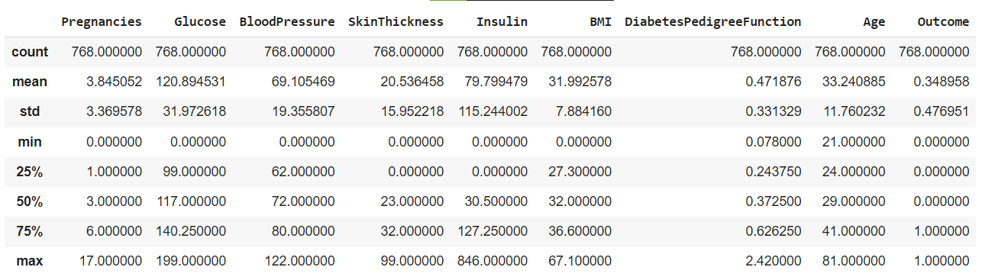
The Dataset
Notes:
Collab image: https://www.marketing-branding.com/wp-content/uploads/2020/07/google-colaboratory-colab-guia-completa.jpg
Python logo: https://logos-world.net/wp-content/uploads/2021/10/Python-Symbol.png
Collab notebook: https://colab.research.google.com/drive/1-mmYxuia9_XsvzwAwnz8ARIbJih34FrM?usp=sharing

Slide 6
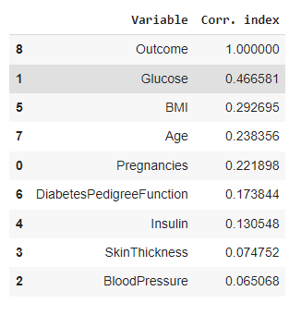
The Dataset
The variable of interest is the Outcome variable that indicates if a women is diabetic or not.
The correlation matrix suggest that there are not strong correlations, but Glucose, BMI and Age are the top 3 correlated variables that could help us to predict if a women is diabetic or not.
Notes:
Collab image: https://www.marketing-branding.com/wp-content/uploads/2020/07/google-colaboratory-colab-guia-completa.jpg
Python logo: https://logos-world.net/wp-content/uploads/2021/10/Python-Symbol.png
Collab notebook: https://colab.research.google.com/drive/1-mmYxuia9_XsvzwAwnz8ARIbJih34FrM?usp=sharing

Slide 7
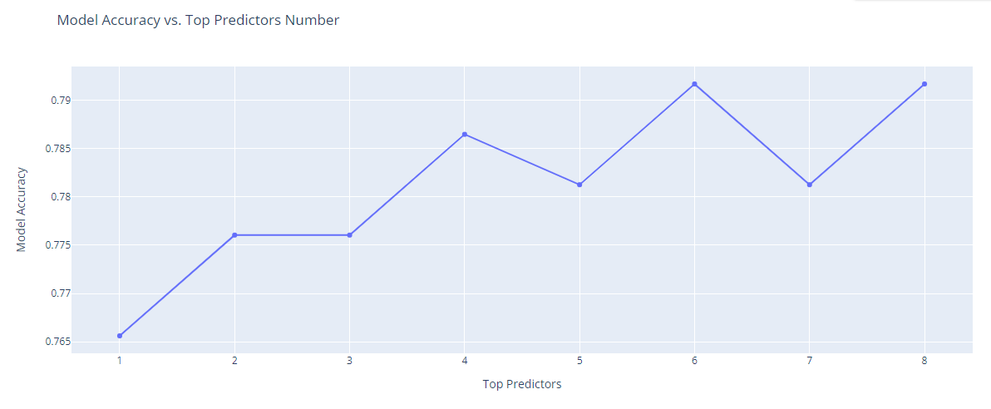
Further Analysis
We can predict if a women would be diabetic with a 79% accuracy approx., but it is just one approach we can take from the dataset we have.
Notes:
Collab image: https://www.marketing-branding.com/wp-content/uploads/2020/07/google-colaboratory-colab-guia-completa.jpg
Python logo: https://logos-world.net/wp-content/uploads/2021/10/Python-Symbol.png
Collab notebook: https://colab.research.google.com/drive/1-mmYxuia9_XsvzwAwnz8ARIbJih34FrM?usp=sharing

Slide 8

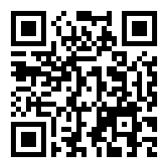
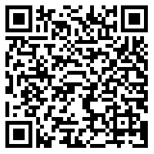
Resourses
Repository link
Jupyter Notebook link

