Slide 2
TRACK 2 EVIDENCE
EmPay HRMS documentation
Agent-ready developer docs for the EmPay HRMS REST API
empay-api-docs.thally.app

Slide 3
Documentation at a glance
A complete developer reference and workflow site
12 substantive pages with clear navigation
49
Quickstart, task guides, troubleshooting, and changelog
49-operation OpenAPI reference
API operations
Published at empay-api-docs.thally.app

Slide 4
Developer workflow
From product understanding to task completion and recovery
Understand the product
Complete a real workflow
Recover when something goes wrong

Slide 5
One guide, seven surfaces
“Request and review leave” was verified on September 5, 2026
HTML for human readers
Markdown for agent retrieval
JSON and JSON-LD for structured consumers
Search, agent index, and MCP for discovery and invocation

Slide 6
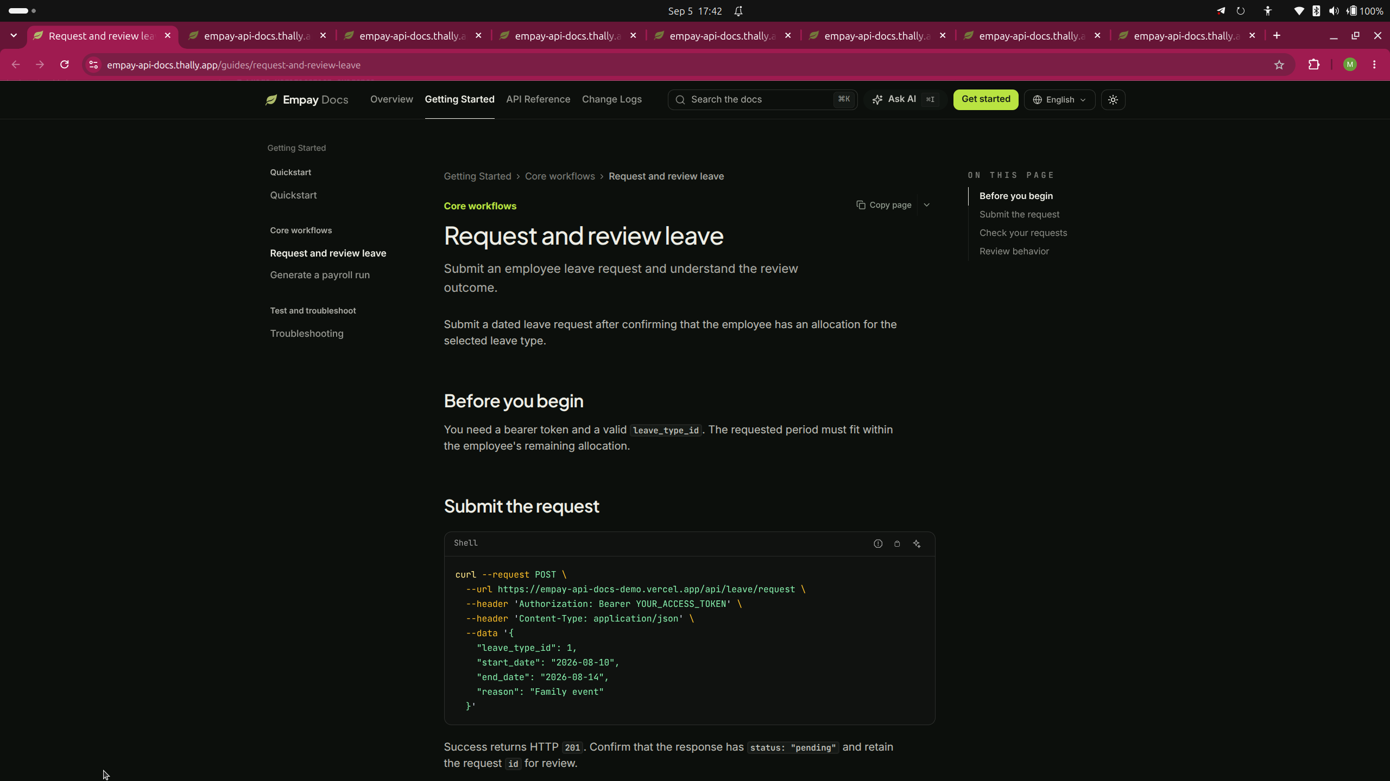
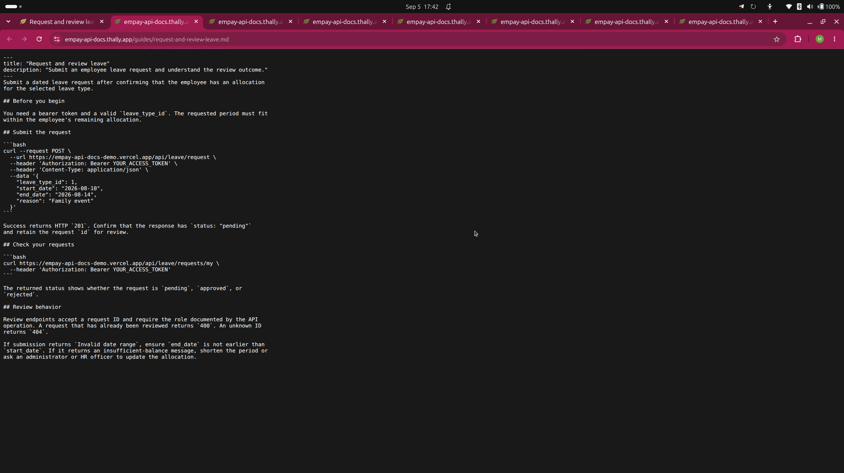
HTML and Markdown evidence
The same guide is readable by humans and agents
HTML
Markdown

Slide 7
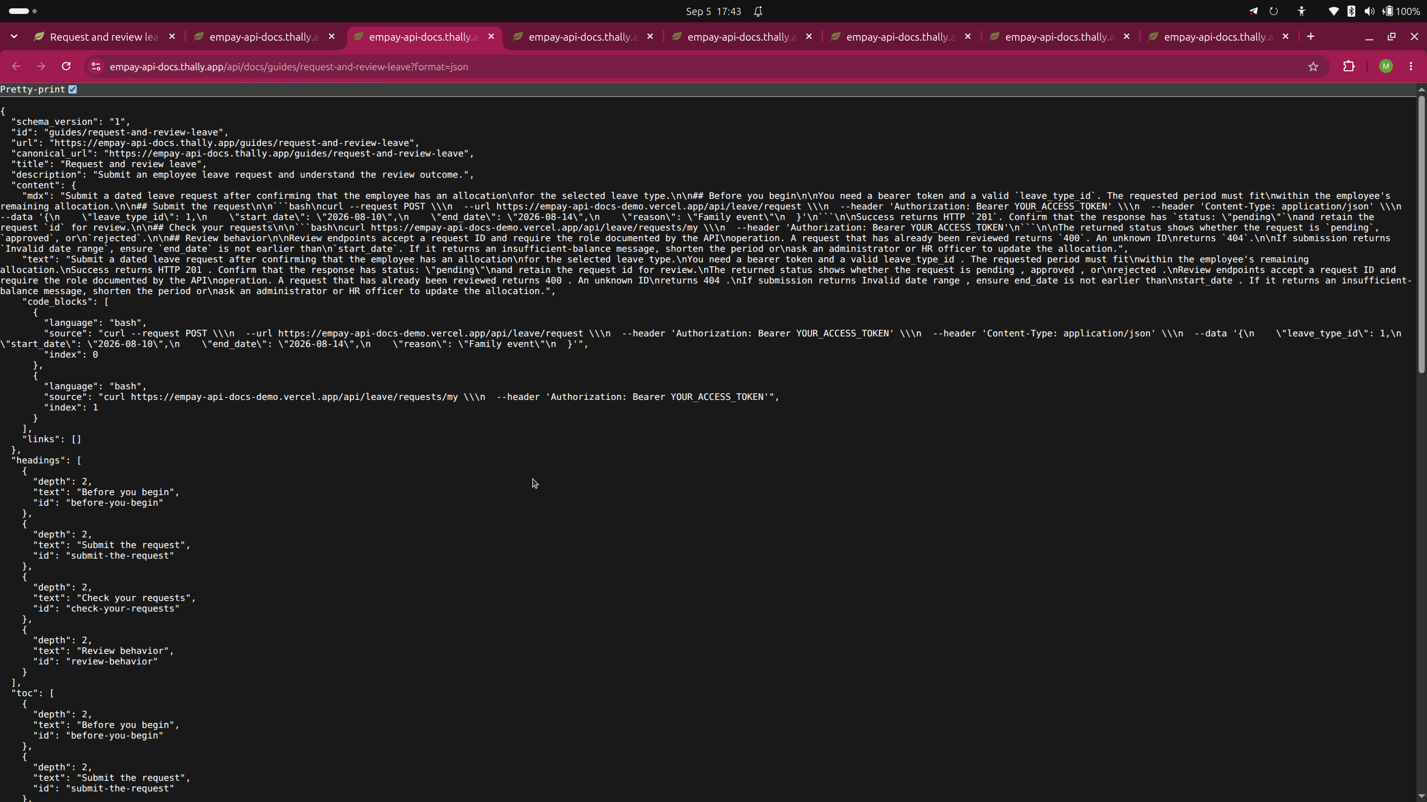
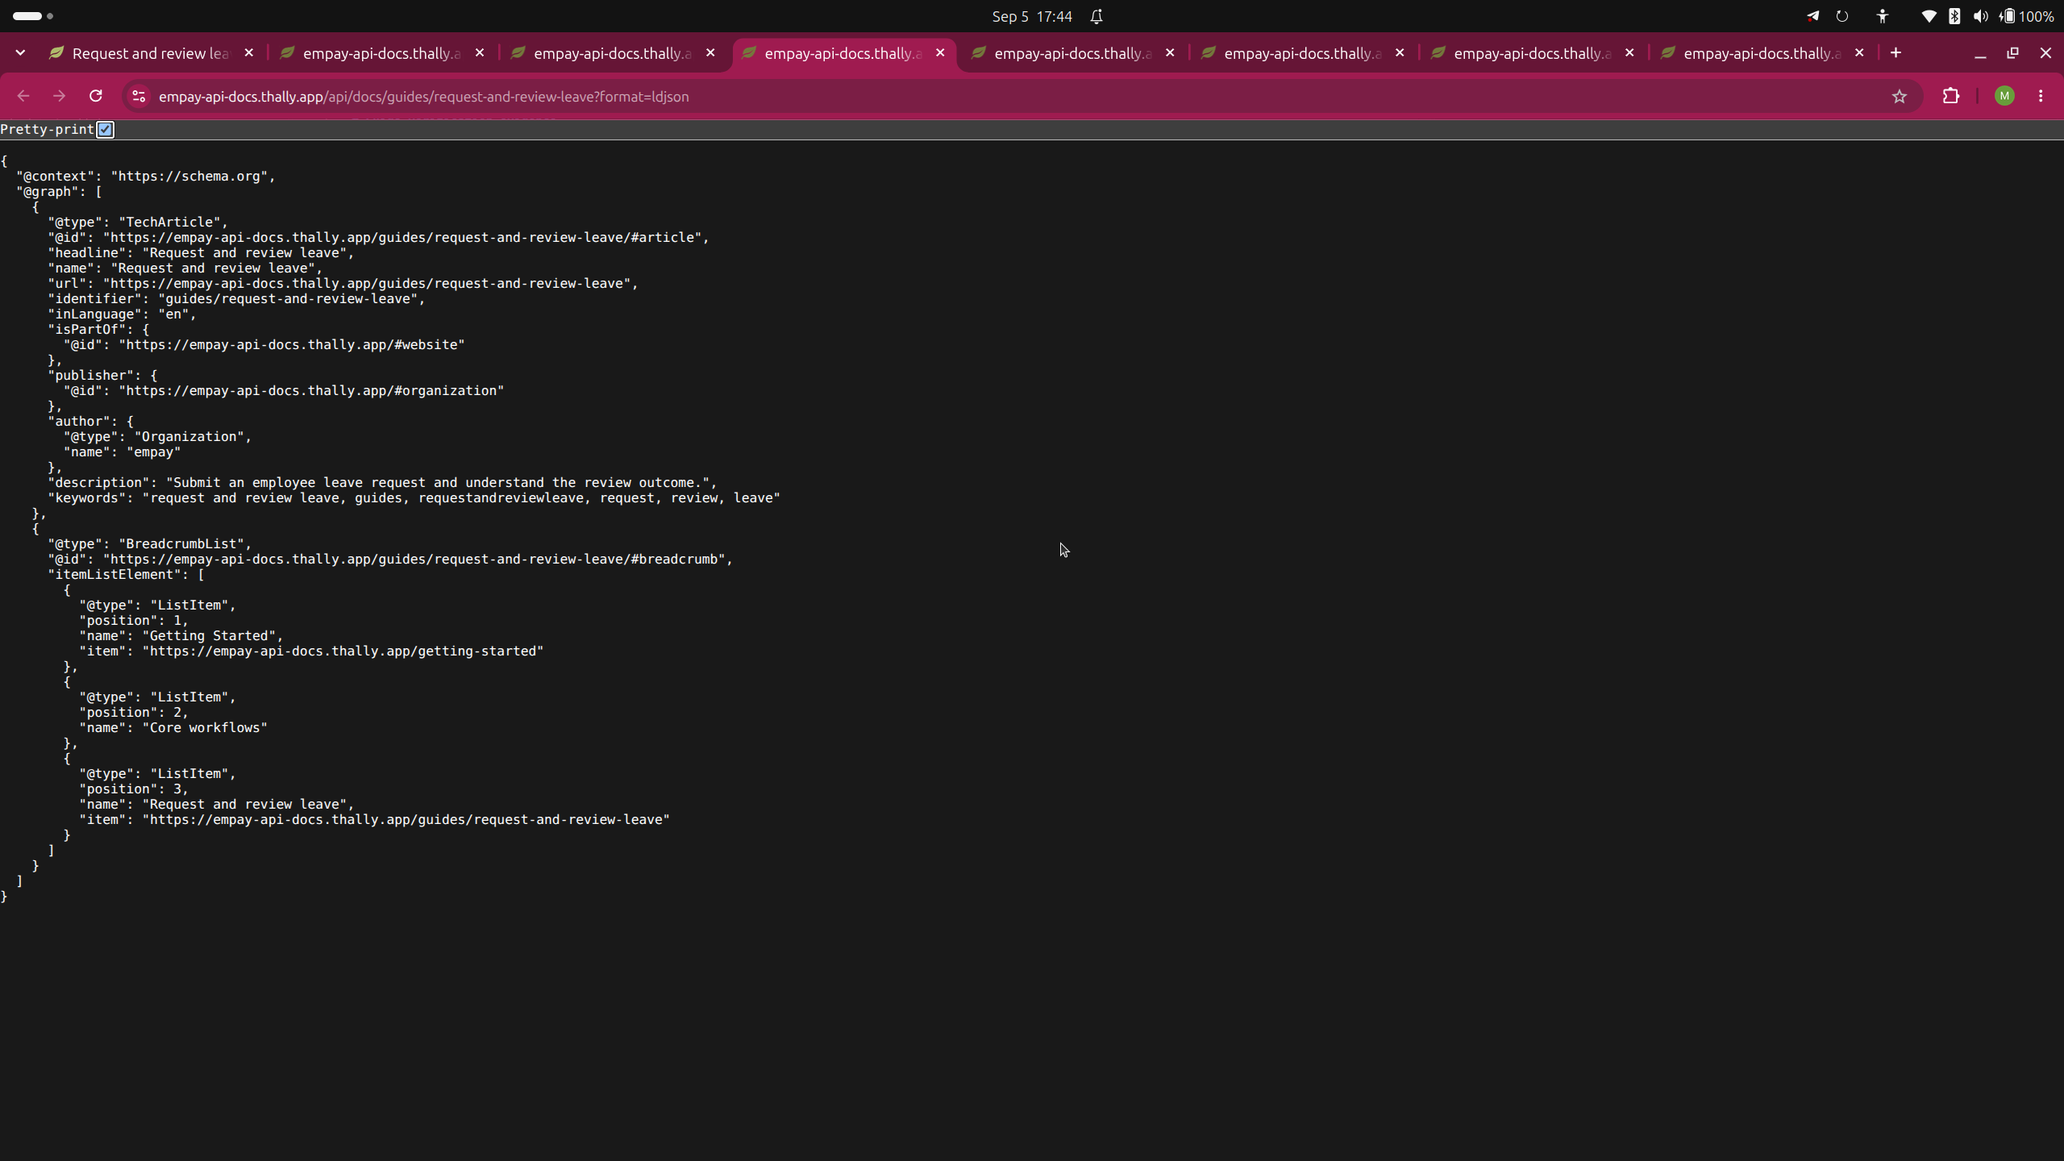
Structured evidence
JSON and JSON-LD expose the guide to machine clients
JSON
JSON-LD

Slide 8
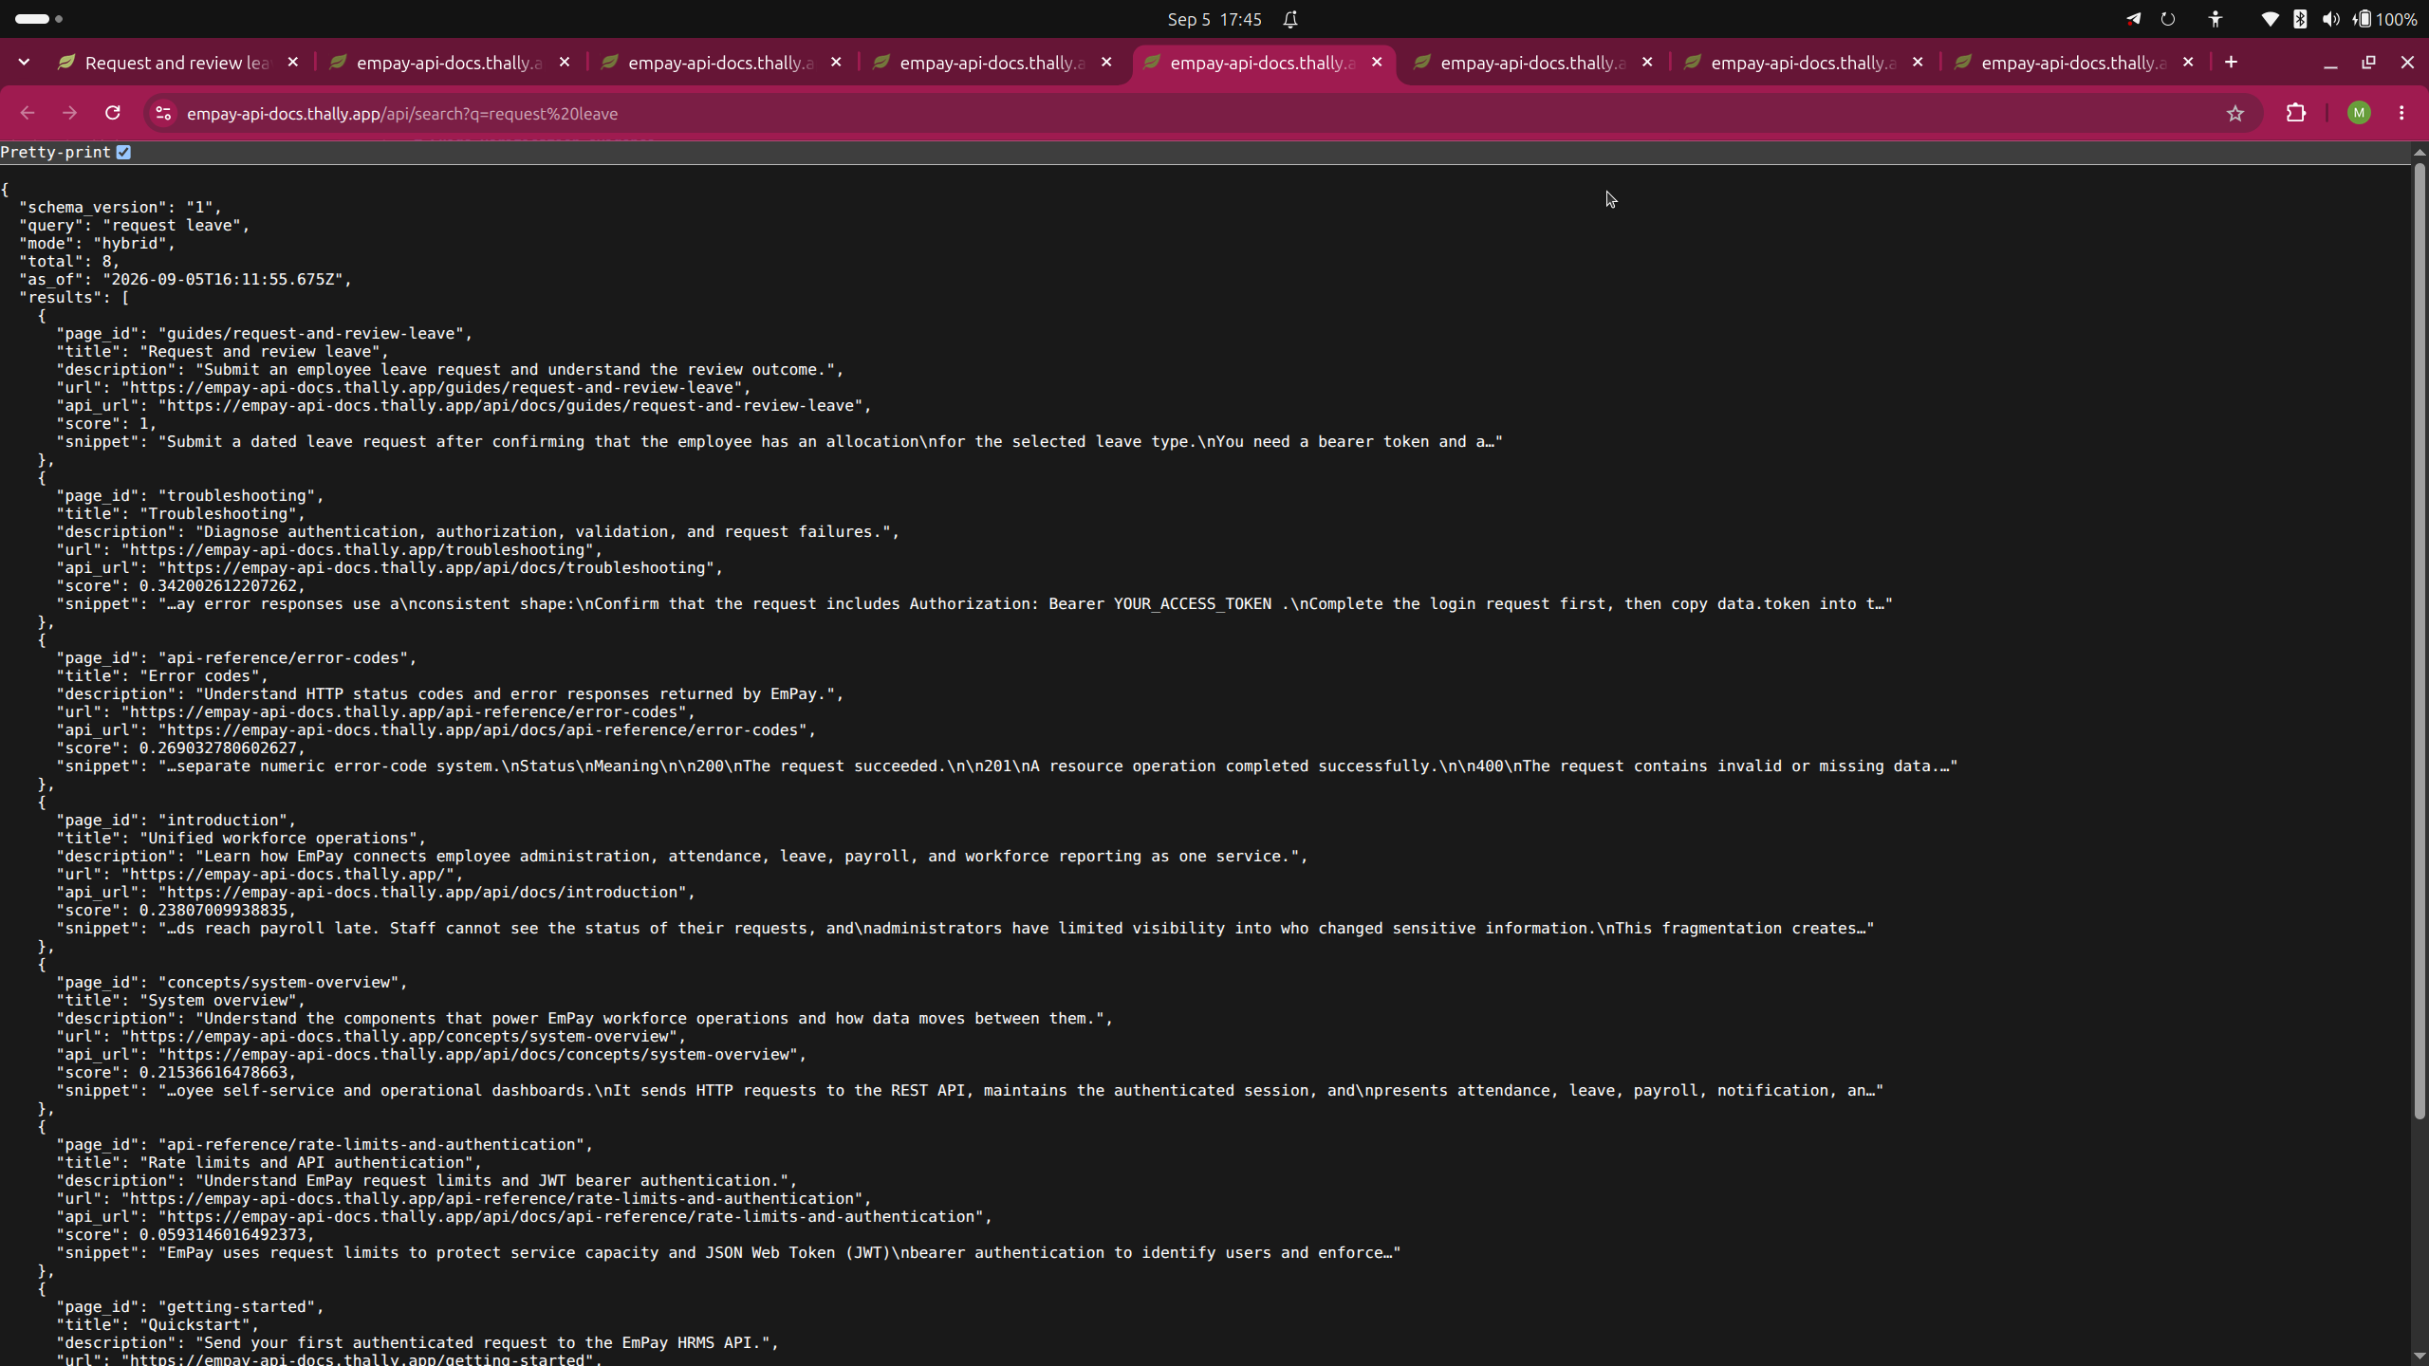
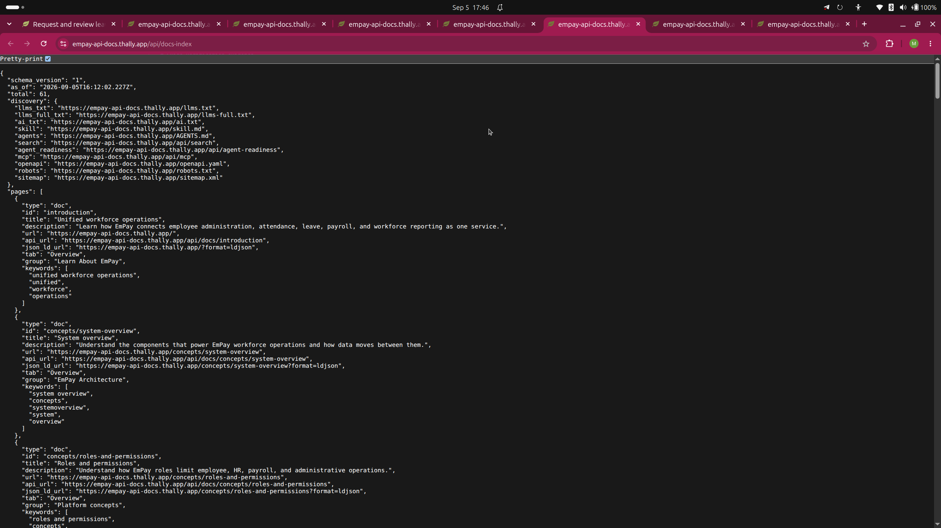
Discovery evidence
Search and the agent index locate the guide
Search
Agent index

Slide 9
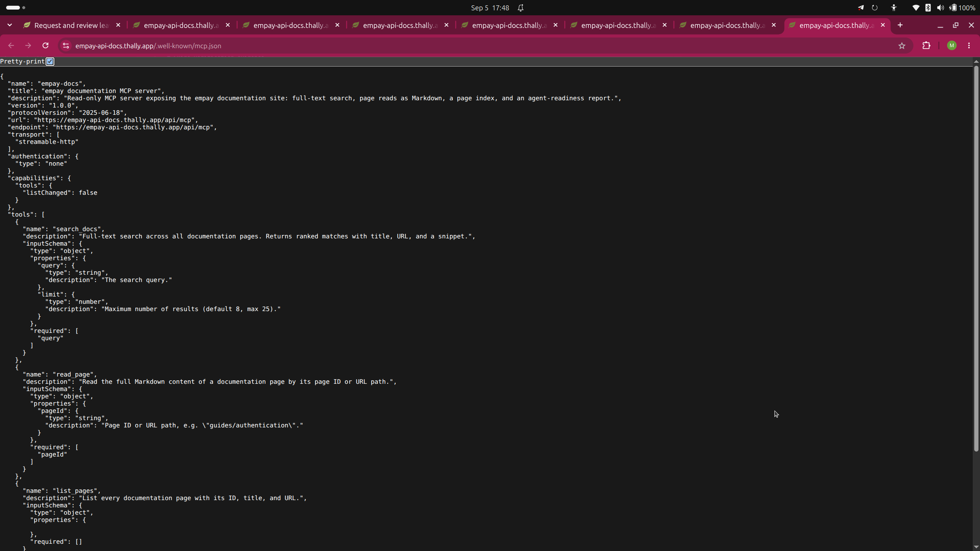
MCP evidence
The MCP endpoint initializes successfully
MCP server response

Slide 10
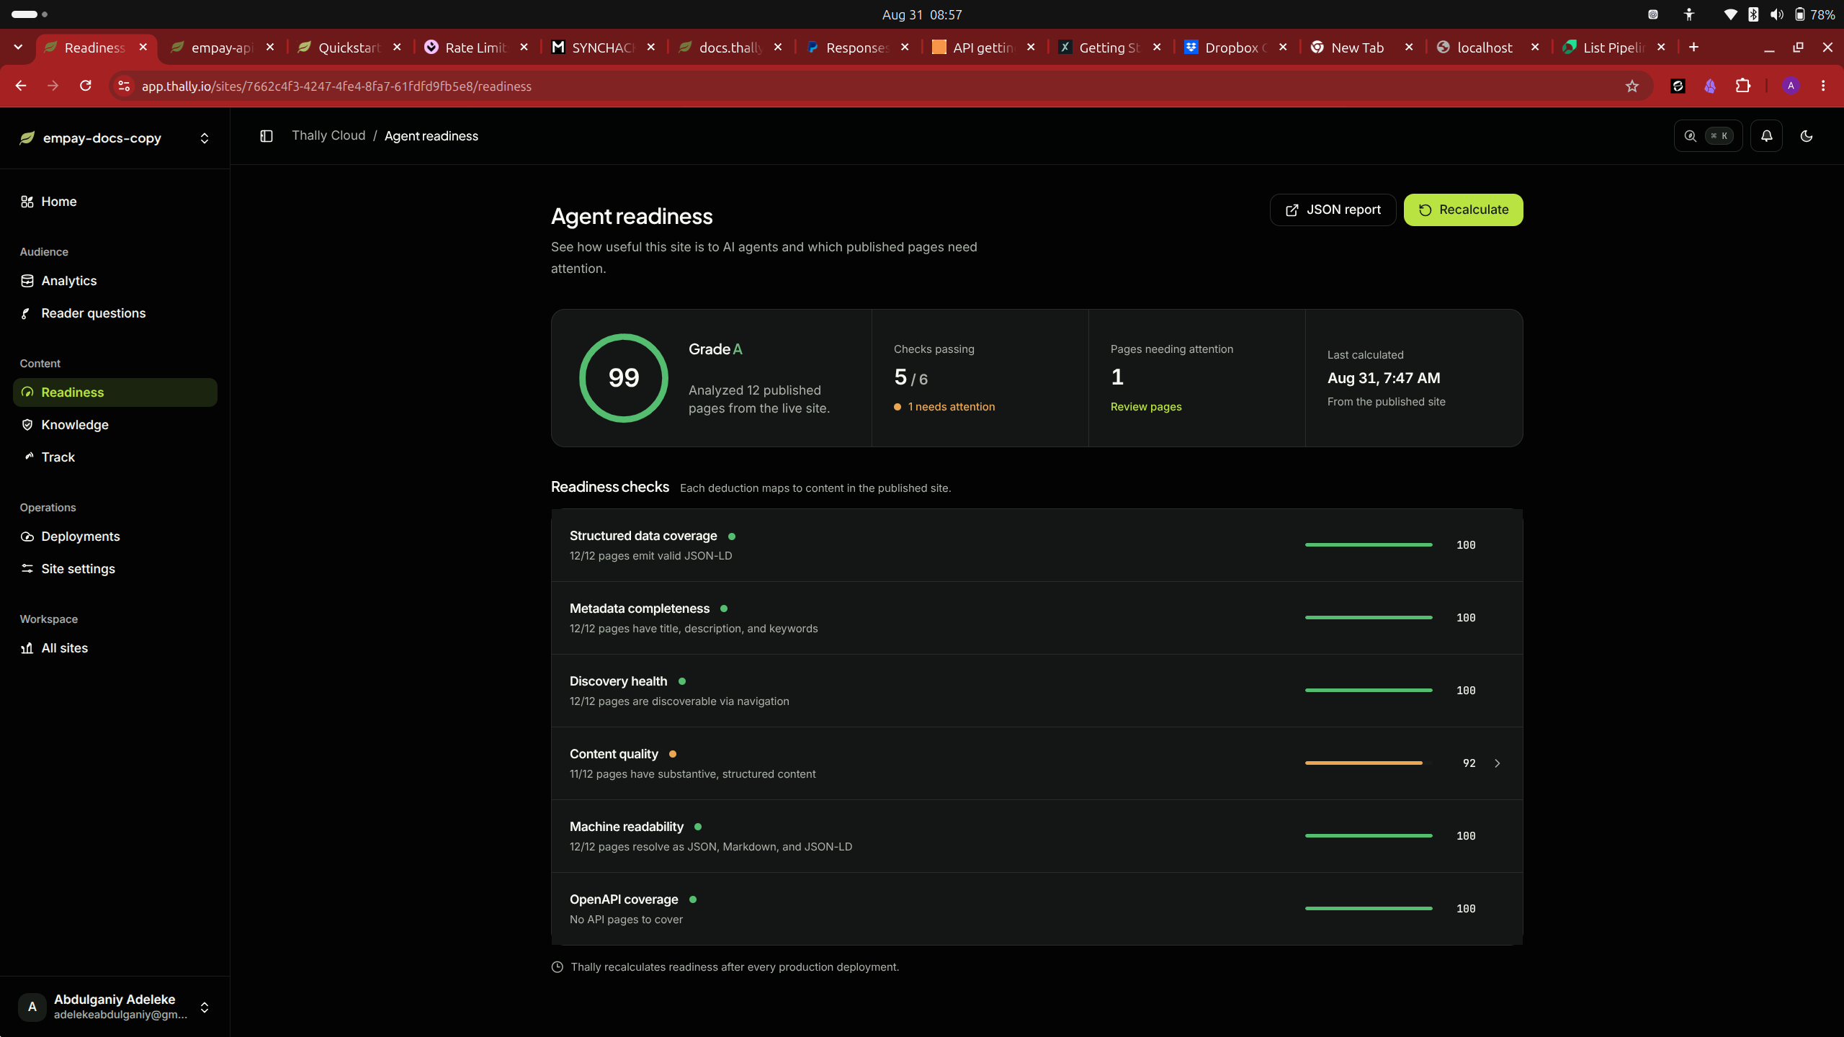
Agent Readiness before
Initial published site
Score: 99/100 (A)
5 of 6 checks passed
Content quality: 92% (11/12 pages)
Finding: /changelog had no content heading
Agent Readiness before

Slide 11
Reviewed improvement
Thally identified the changelog finding
Author added “## Documentation updates” above the release entries
Meaning preserved
Issue resolved for both human and machine readers

Slide 12
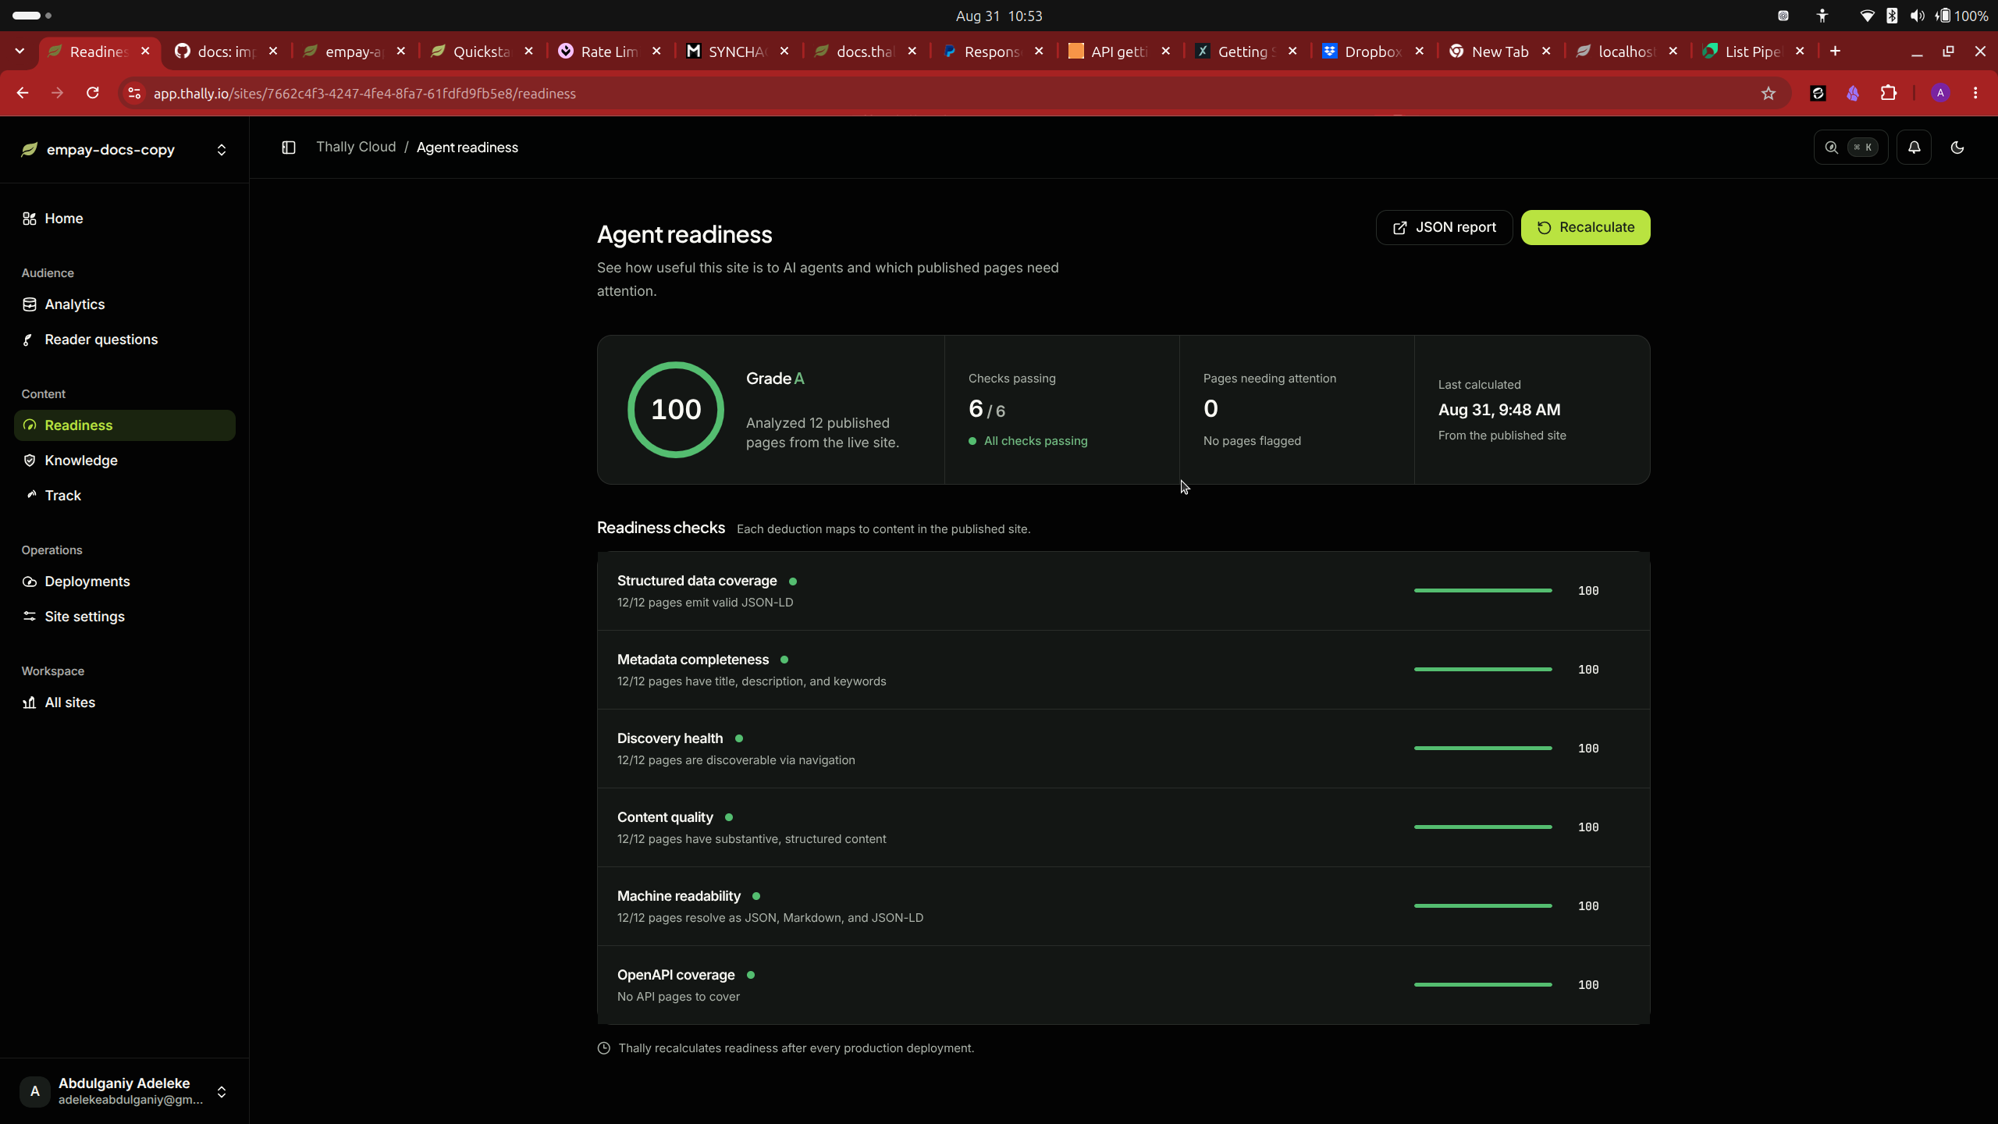
Agent Readiness after
Revised published site
Score: 100/100 (A)
6 of 6 checks passed
Content quality: 100%
Pages needing attention: 0
Agent Readiness after

Slide 13
Reproducible submission
Clean clone at commit 923c5f6
Install
Thally check
351 tests
Production build

