Slide 1

UN FRAMEWORK PER IL NATURAL LANGUAGE PROCESSING:
ANALISI PRESTAZIONALE PER LA RISOLUZIONE DI TASK DI TEXT CLASSIFICATION E NAMED ENTITY RECOGNITION IN AMBIENTE DISTRIBUITO
Bachelor’s Degree
Advisor:
Prof. Roberto Basili
Co-rapporteur:
Prof. Danilo Croce
Candidate:
Manuel Di Lullo
Macroarea di Scienze Matematiche, Fisiche e Naturali - Corso di Laurea in Informatica a.a. 2020/2021

Slide 2

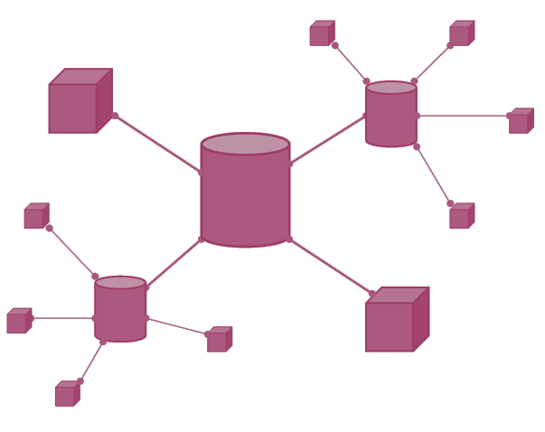

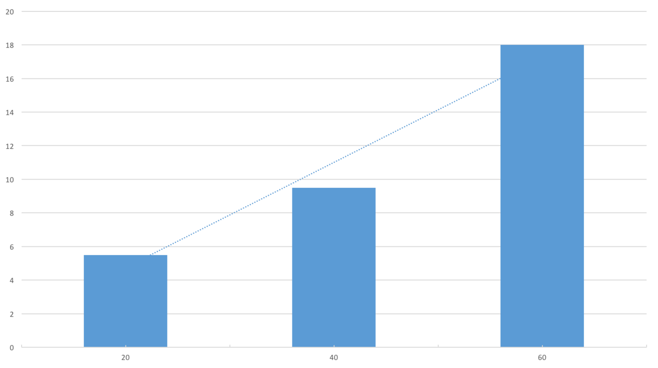
Aim of the thesis
Study and definition of the Hadoop ecosystem for distributed calculation of unstructured data
Implementation of a distributed environment with the help of Hadoop and Apache Spark
1
2
Study of models for the resolution of linguistic tasks and the Spark NLP framework
Experimental model evaluation. Measurement of the accuracy and scalability of the solution.
3
4

Slide 3




An example of distributed computing
Field of computer science that studies distributed systems, that are systems that consist of numerous computers that interact with each other through a network in order to achieve a common goal.
Model example: master/slave architecture
Worker 1
Worker 2
Master
Worker n

Slide 4




Proposed solution
Data processing in distributed environment
Scheduling and resource management
File management in distributed environment

Slide 5




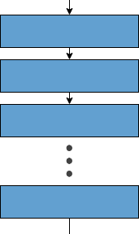
Distributed computing with Spark e Hadoop
Master node
Worker 1
Client
Worker n

Slide 6
Risultati ottenuti
Per la risoluzione dei task sono stati utilizzati diversi modelli, tra cui: BERT, Universal Sentence Encoder e GloVE
Risultati in termini di accuratezza
Risultati in termini di scalabilità*
Task | Risultato
Text Classification | 89%
Named Entity Recognition | 87%
# Esempi: 750.000 | 1 esecutore | 2 esecutori
BERT | 8h 6min 03s
4h 6min 05s
*Valutazione effettuata soltanto sul task di text classification

Slide 7
Conclusions
Scalability
Accuracy
Prospects
Great results:
Execution times decrease linearly with respect to the number of executors
Significant results
State-of-the-art tools and models easily implementable
Learn more about the options provided by the framework
Experimentation on larger clusters
Use of different models
Testing of heterogeneous datasets

Slide 8
Thank you!
Are there any questions?

