Slide 1

CY BB-SA 3.0, Wikipedia user: Balkhovitin

Slide 2

CY BB-SA 3.0, Wikipedia user: Hans Stieglitz

Slide 3

CY BB-SA 2.5, Wikipedia user: Luca Galuzzi

Slide 4
No internet connection!

Slide 5
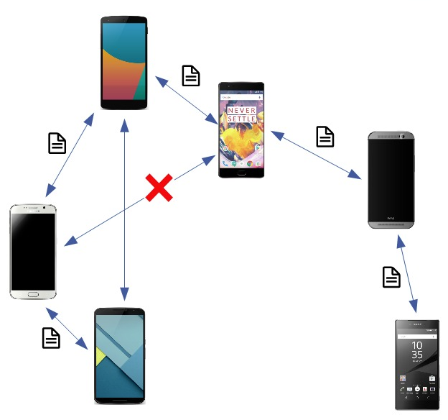
We made our own Network
Message Flooding network
Simple API
Asynchronous only
Chat App as demonstration
Public key cryptography for privacy

