Slide 1
Typescript
It’s JavaScript but not terrible

Slide 2
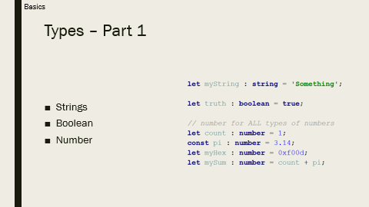
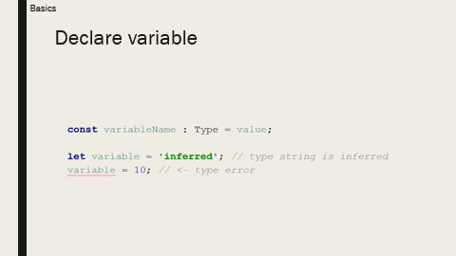
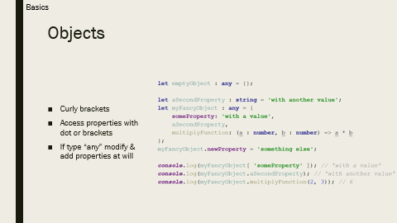
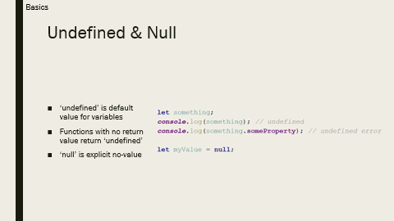
Basics

Slide 3
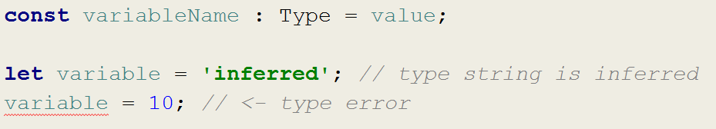
Declare variable
Basics

Slide 4
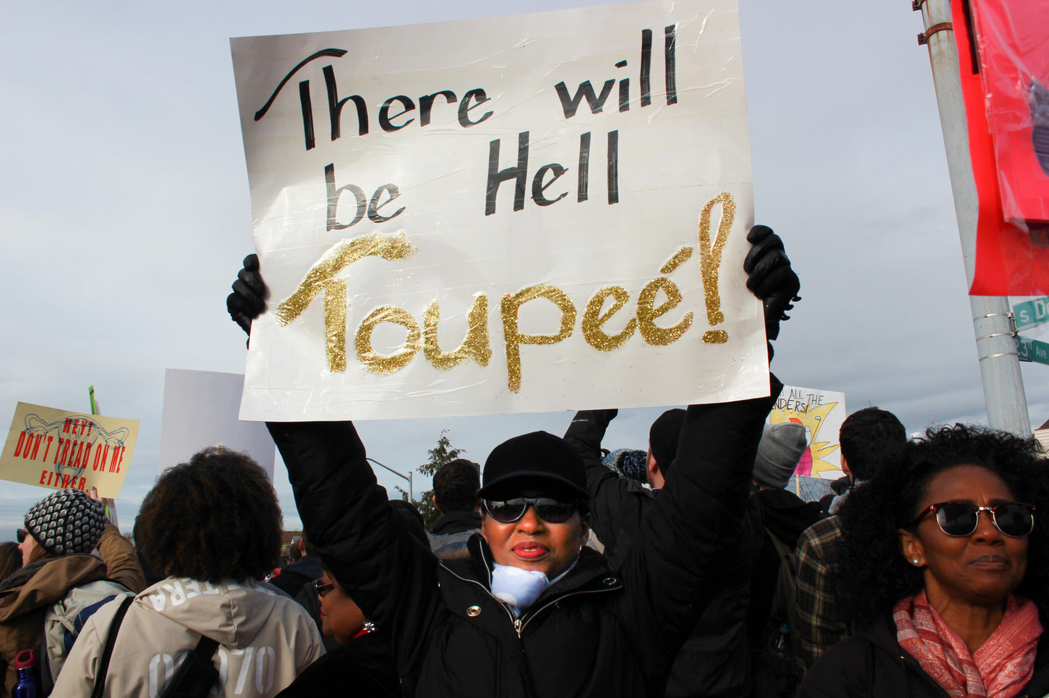

Using
VAR
is
FINE

Slide 5
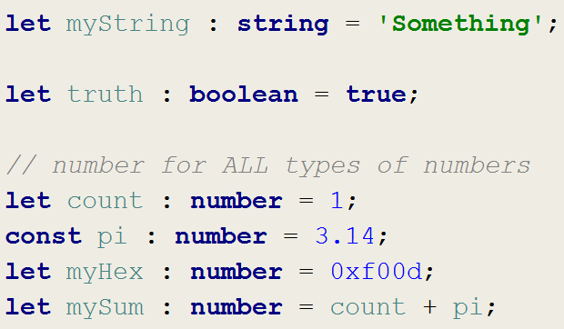
Types – Part 1
Basics
Strings
Boolean
Number

Slide 6
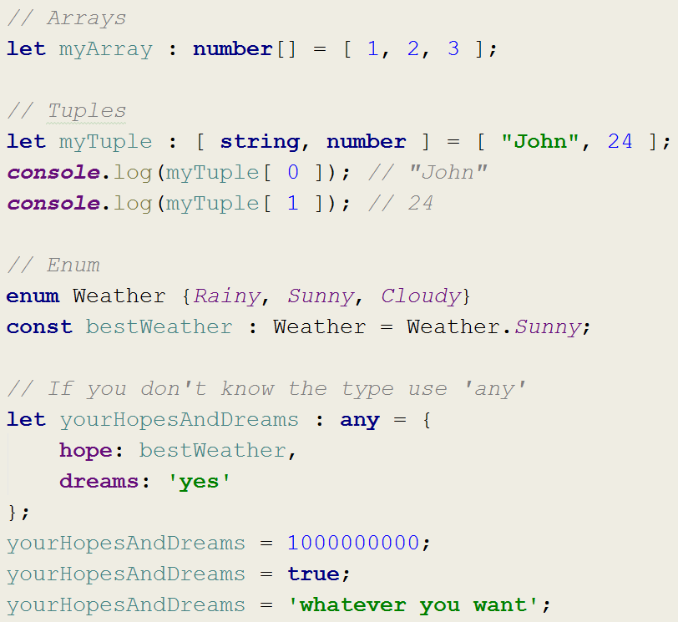
Types – Part 2
Basics
Arrays
Tuples
Enums
Any

Slide 7
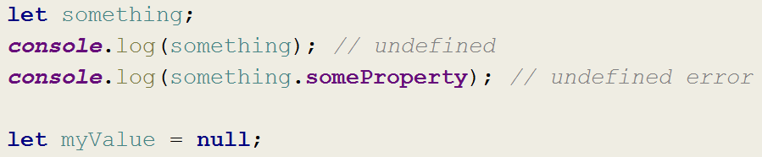
Undefined & Null
Basics
‘undefined’ is default value for variables
Functions with no return value return ‘undefined’
‘null’ is explicit no-value

Slide 8
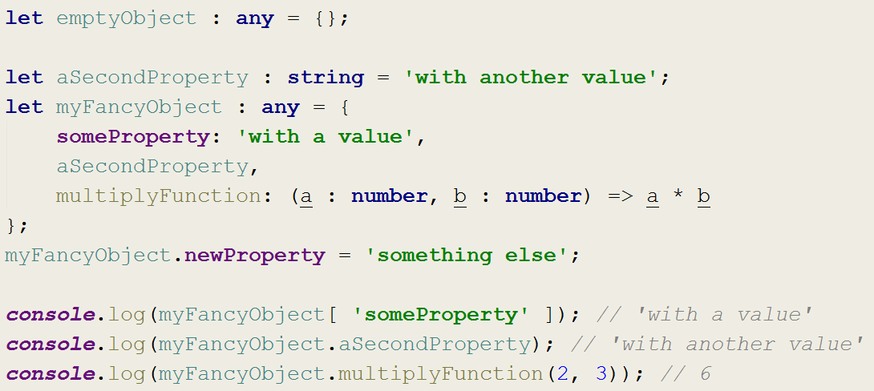
Objects
Basics
Curly brackets
Access properties with dot or brackets
If type “any” modify & add properties at will

Slide 9
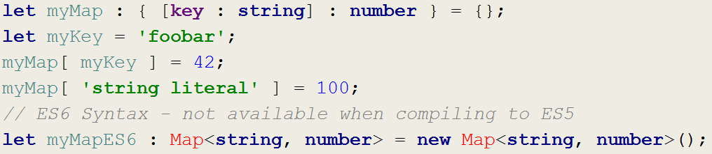
Maps
Basics
Actually just objects
Strings or numbers can be key
With ES6 nicer syntax

Slide 10
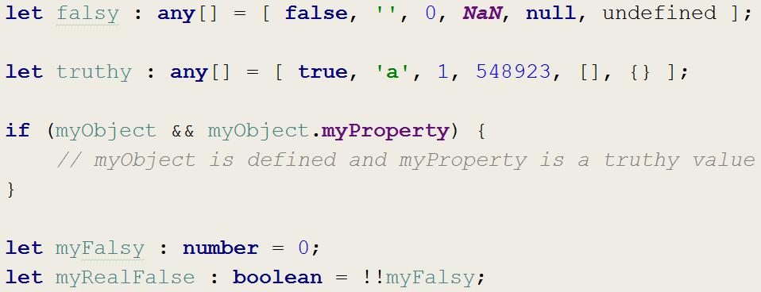
Truthy & Falsy
Basics
Non-booleans are interpreted as booleans
Allow for simple undefined/null checks
Can be converted to real booleans by double negation (‚!!‘)

