Slide 1
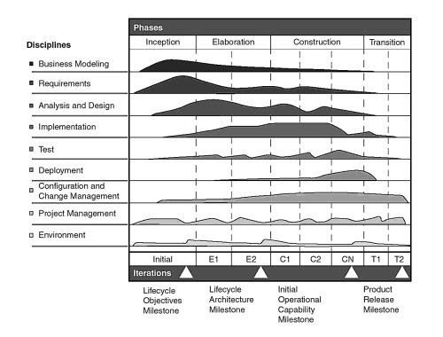
Phases
Disciplines
Inception
Elaboration
Construction
Transition
Business Modeling
Requirements
Analysis and Design
Implementation
Test
Deployment
Configuration and Change Management
Project Management
Environment
Initial
E1
E2
C1
C2
CN
T1
T2
Iterations
Lifecycle Objectives Milestone
Lifecycle Architecture Milestone
Initial Operational Capability Milestone
Product Release Milestone

