Slide 1
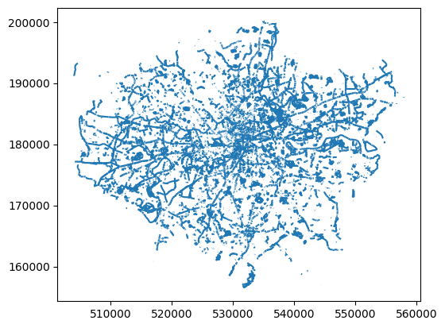
Cycling Infrastructure’s
Impact on Road safety
Group 4:
Laura Gamba R.
Soki Kimura
Hardik Sangwan
Amandeep Singh
Albright Besung
Manuella C. de Paulo

Slide 2
Cycling Infrastructure’s
Impact on Road Safety
In London
Group 4:
Laura Gamba R.
Soki Kimura
Hardik Sangwan
Amandeep Singh
Albright Besung
Manuella C. de Paulo

Slide 3
Topic-Cycling Infrastructure’s Impact on Road Safety in London
London's cycling infrastructure upgrades enhances road safety, lowering incidents. This study analyses the correlation between infrastructure improvement and reduced incidents, highlighting infrastructure's pivotal role in fostering safer urban environments for cyclists.
Data Sources
TfL road safety data
Cycling Infrastructure
Limitations
Study limitations include sparse data on cycling infrastructure parameters such as traffic volume per section and challenges in integrating cycle and road lane networks effectively.

Slide 4
Summary- Our Analysis reveals a correlation between enhanced cycling infrastructure parameters such as cycle routes and reduced road incidents for cyclists. That said, advancements in cycling infrastructure contribute to safer urban environments for cyclists.
Recommendation-

Slide 5
Plots

Slide 6
In London, advancements in cycling infrastructure have significantly enhanced road safety by reducing accidents. Through meticulous analysis, this study delves into the correlation between upgraded cycling infrastructure and diminished road incidents, shedding light on the vital role of infrastructure development in fostering safer urban environments for cyclists .

