Slide 1
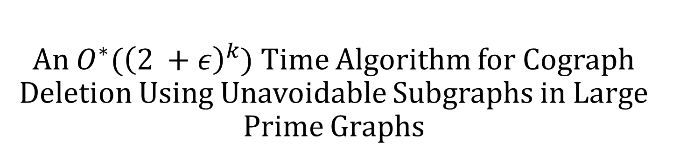
An $O^{∗}({\left(2 +ε\right)}^{k}$) Time Algorithm for Cograph Deletion Using Unavoidable Subgraphs in Large Prime Graphs
Manuel Lafond Université de Sherbrooke
Francis Sarrazin Université de Sherbrooke

Slide 2

Let $C$ be a graph class.
$C$-deletion problem
Input: graph $G$
Parameter: $k$
Question: can $G$ be made to belong to $C$ by deleting at most $k$ edges?
$C$-completion problem: can we add at most $k$ edges?
$C$-editing problem: can we add/delete at most k edges?
In this work: $C=ℋ$-free for some set of graphs $ℋ$.
$ℋ$-free means that no induced subgraph is isomorphic to a graph in$ℋ$.

Slide 3
Let $C$ be a graph class.
$C$-deletion problem
Input: graph $G$
Parameter: $k$
Question: can $G$ be made to belong to $C$ by deleting at most $k$ edges?
$C$-completion problem: can we add at most $k$ edges?
$C$-editing problem: can we add/delete at most k edges?
In this work: $C=ℋ$-free for some set of graphs $ℋ$.
$ℋ$-free means that no induced subgraph is isomorphic to a graph in$ℋ$.

Slide 4

Let $C$ be a graph class.
$C$-deletion problem
Input: graph $G$
Parameter: $k$
Question: can $G$ be made to belong to $C$ by deleting at most $k$ edges?
$C$-completion problem: can we add at most $k$ edges?
$C$-editing problem: can we add/delete at most k edges?
In this work: $C=ℋ$-free for some set of graphs $ℋ$.
$ℋ$-free means that no induced subgraph is isomorphic to a graph in $ℋ$.

Slide 5
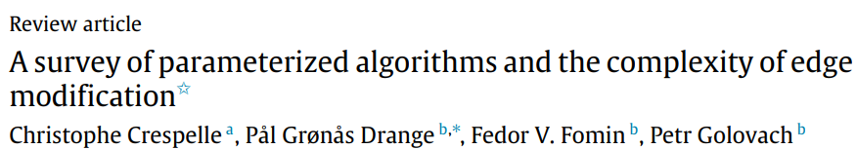
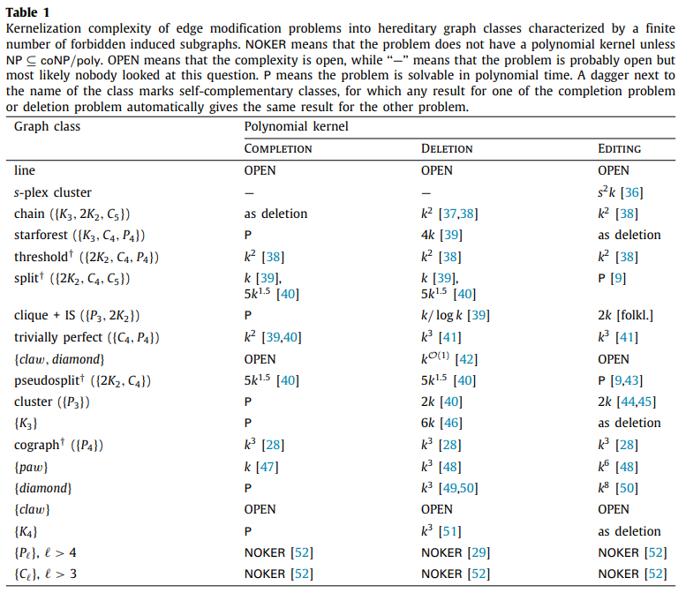

Slide 6

Cograph modification problems
A cograph is a $P_{4}$-free graph.
Cograph modification problems have applications in bioinformatics, social network analysis, and others.
Cograph-deletion
Simple textbook $O^{∗}(3^{k})$ time algorithm.
$O^{∗}\left({2.562}^{k}\right)$ [Nastos & Gao, 2012]
$O^{∗}\left({2.303}^{k}\right)$ [Tsur, 2020]
Common approach: find a $P_{4}$, look at local structure around this $P_{4}$, get better branching (but more cases).
[Tsur, 2020] needs a python script to generate and analyze possible cases.

Slide 7
Cograph modification problems
A cograph is a $P_{4}$-free graph.
Cograph modification problems have applications in bioinformatics, social network analysis, and others.
Cograph-deletion
Simple textbook $O^{∗}(3^{k})$ time algorithm.
$O^{∗}\left({2.562}^{k}\right)$ [Nastos & Gao, 2012]
$O^{∗}\left({2.303}^{k}\right)$ [Tsur, 2020]
Common approach: find a $P_{4}$, look at local structure around this $P_{4}$, get better branching (but more cases).
[Tsur, 2020] needs a python script to generate and analyze possible cases.

Slide 8
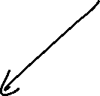
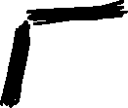

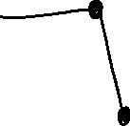
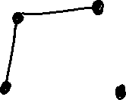

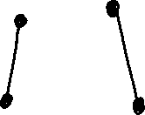
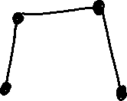

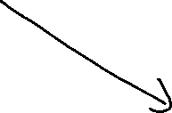


Slide 9
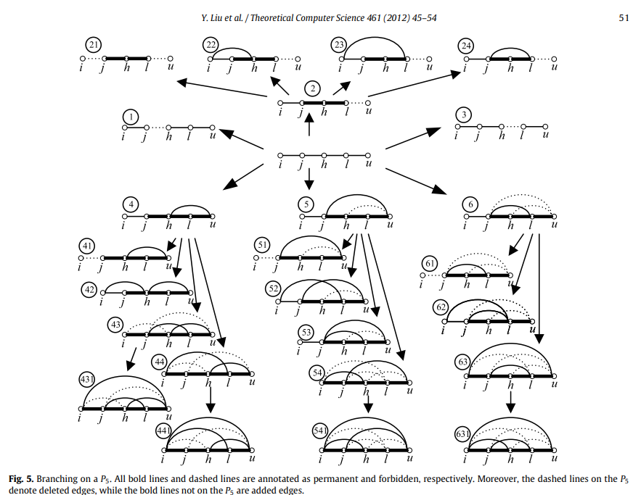

Slide 10
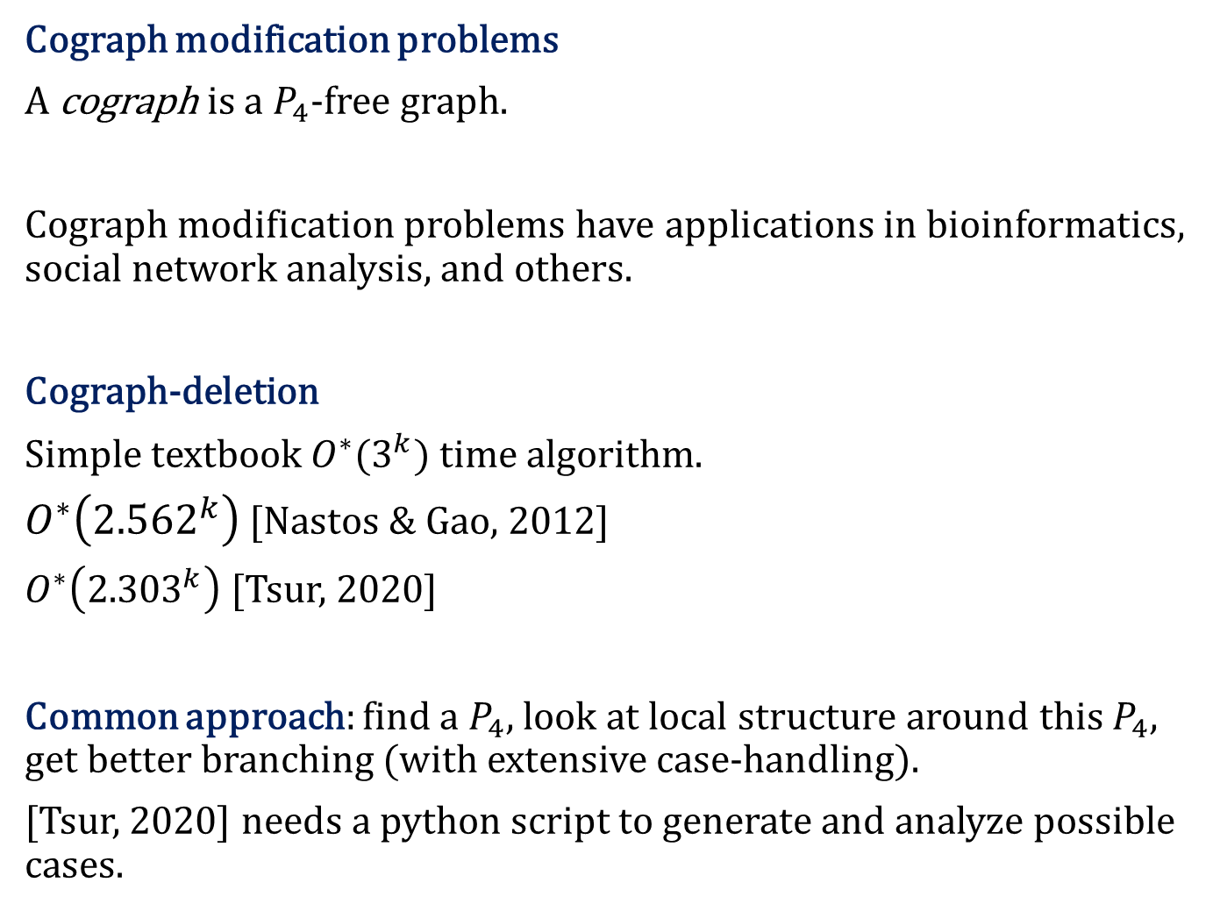
Cograph modification problems
A cograph is a $P_{4}$-free graph.
Cograph modification problems have applications in bioinformatics, social network analysis, and others.
Cograph-deletion
Simple textbook $O^{∗}(3^{k})$ time algorithm.
$O^{∗}\left({2.562}^{k}\right)$ [Nastos & Gao, 2012]
$O^{∗}\left({2.303}^{k}\right)$ [Tsur, 2020]
Common approach: find a $P_{4}$, look at local structure around this $P_{4}$, get better branching (with extensive case-handling).
[Tsur, 2020] needs a python script to generate and analyze possible cases.

Slide 11
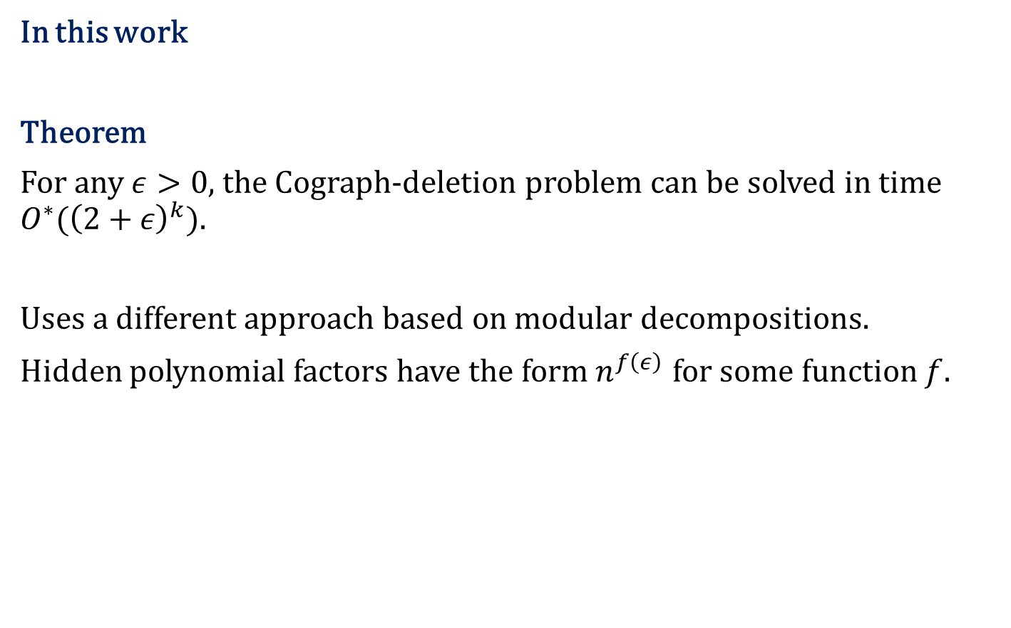
In this work
Theorem
For any $ε>0$, the Cograph-deletion problem can be solved in time $O^{∗}({\left(2+ε\right)}^{k})$.
Uses a different approach based on modular decompositions.
Hidden polynomial factors have the form $n^{f\left(ε\right)}$ for some function $f$.

Slide 12
Modules, modular decompositions, and prime graphs

Slide 13
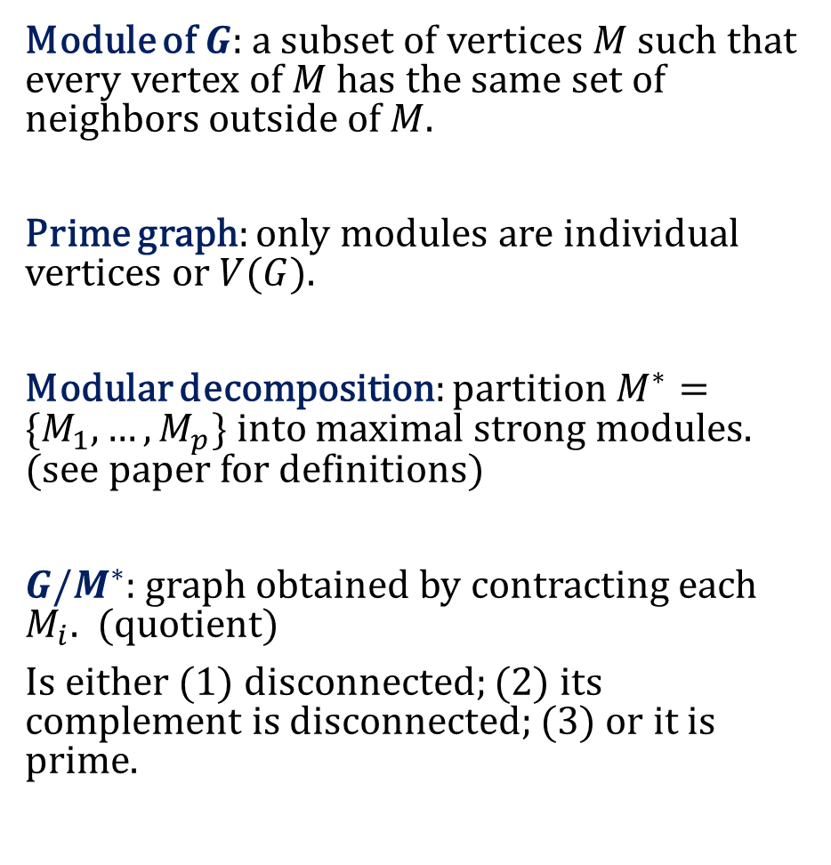
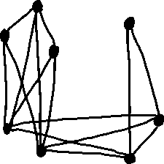
Module of $G:$a subset of vertices $M$ such that every vertex of $M$ has the same set of neighbors outside of $M$.
Prime graph: only modules are individual vertices or $V(G)$.
Modular decomposition: partition $M^{∗}=\{M_{1},…,M_{p}\}$ into maximal strong modules. (see paper for definitions)
$G/M^{∗}$: graph obtained by contracting each $M_{i}$. (quotient)
Is either (1) disconnected; (2) its complement is disconnected; (3) or it is prime.

Slide 14
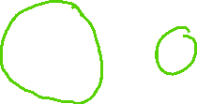


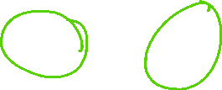


Module of $G:$a subset of vertices $M$ such that every vertex of $M$ has the same set of neighbors outside of $M$.
Prime graph: only modules are individual vertices or $V(G)$.
Modular decomposition: partition $M^{∗}=\{M_{1},…,M_{p}\}$ into maximal strong modules. (see paper for definitions)
$G/M^{∗}$: graph obtained by contracting each $M_{i}$. (quotient)
Is either (1) disconnected; (2) its complement is disconnected; (3) or it is prime.

Slide 15
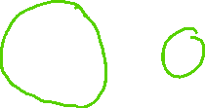
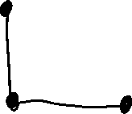






Module of $G:$a subset of vertices $M$ such that every vertex of $M$ has the same set of neighbors outside of $M$.
Prime graph: only modules are individual vertices or $V(G)$.
Modular decomposition: partition $M^{∗}=\{M_{1},…,M_{p}\}$ into maximal strong modules. (see paper for definitions)
$G/M^{∗}$: graph obtained by contracting each $M_{i}$. (quotient)
Is either (1) disconnected; (2) its complement is disconnected; (3) or it is prime.

Slide 16







A general $ℋ$-free modification approach
Compute $M^{∗}=\{M_{1},…,M_{p}\}$.
Solve each $G[M_{i}]$ recursively.
Solve $G/M^{∗}$.
Apply the edge modifications of $G$ corresponding to those on $G/M^{∗}$.

Slide 17






A general $ℋ$-free modification approach
Compute $M^{∗}=\{M_{1},…,M_{p}\}$.
Solve each $G[M_{i}]$ recursively.
Solve $G/M^{∗}$.
Apply the edge modifications of $G$ corresponding to those on $G/M^{∗}$.

Slide 18





A general $ℋ$-free modification approach
Compute $M^{∗}=\{M_{1},…,M_{p}\}$.
Solve each $G[M_{i}]$ recursively.
Solve $G/M^{∗}$.
Apply the edge modifications of $G$ corresponding to those on $G/M^{∗}$.

Slide 19






A general $ℋ$-free modification approach
Compute $M^{∗}=\{M_{1},…,M_{p}\}$.
Solve each $G[M_{i}]$ recursively.
Solve $G/M^{∗}$.
Apply the edge modifications of $G$ corresponding to those on $G/M^{∗}$.

Slide 20
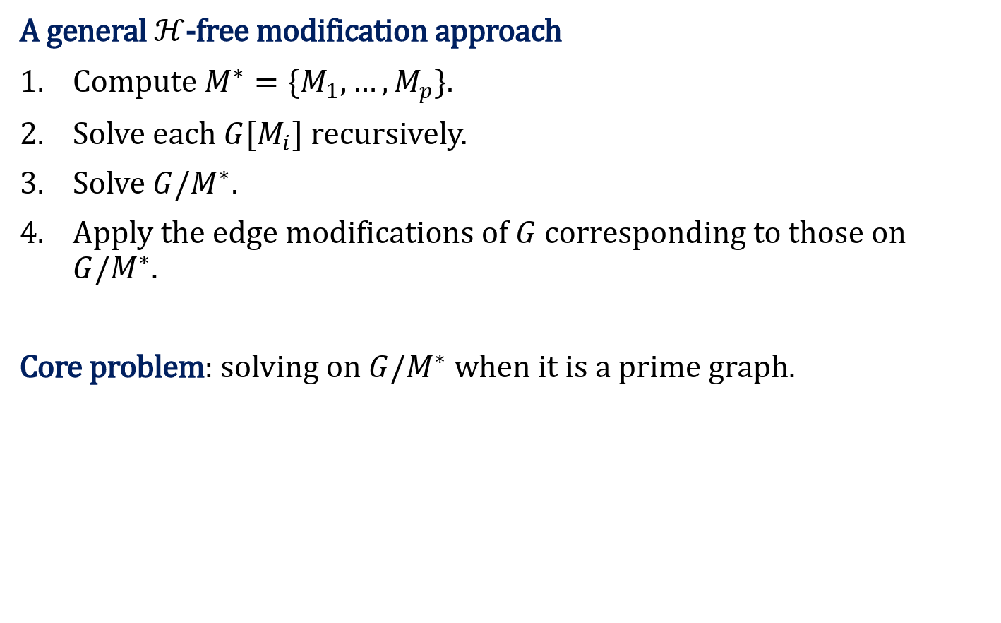
A general $ℋ$-free modification approach
Compute $M^{∗}=\{M_{1},…,M_{p}\}$.
Solve each $G[M_{i}]$ recursively.
Solve $G/M^{∗}$.
Apply the edge modifications of $G$ corresponding to those on $G/M^{∗}$.
Core problem: solving on $G/M^{∗}$ when it is a prime graph.

Slide 21
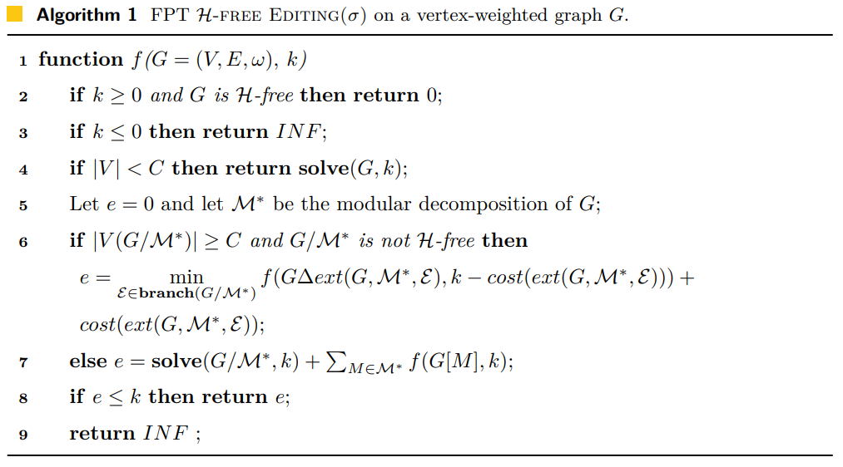

Slide 22


Slide 23

Theorem
Algorithm 1 is correct if and only if every minimal graph in $ℋ$ is prime.
(minimal: does not contain an induced copy of another graph in $ℋ$)
Graphs of size 1 or 2 in $ℋ$ are trivial to handle, let us ignore them.
No graph of size 3 is prime.
$P_{4}$ is the only prime graph of size 4.
Smallest possible $ℋ$that this works on: $ℋ=\{P_{4}\}$
Note: "only if" needs to show that:
If $ℋ$ has some minimal non-prime graph, then there are infinitely many non-$ℋ$-free graphs but such that each $G\left[M_{i}\right]$ and $G/M^{∗}$ are $ℋ$-free.

Slide 24
Theorem
Algorithm 1 is correct if and only if every minimal graph in $ℋ$ is prime.
(minimal: does not contain an induced copy of another graph in $ℋ$)
Graphs of size 1 or 2 in $ℋ$ are trivial to handle, let us ignore them.
No graph of size 3 is prime.
$P_{4}$ is the only prime graph of size 4.
Smallest possible $ℋ$that this works on: $ℋ=\{P_{4}\}$
Note: "only if" needs to show that:
If $ℋ$ has some minimal non-prime graph, then there are infinitely many non-$ℋ$-free graphs but such that each $G\left[M_{i}\right]$ and $G/M^{∗}$ are $ℋ$-free.

Slide 25
Theorem
Algorithm 1 is correct if and only if every minimal graph in $ℋ$ is prime.
(minimal: does not contain an induced copy of another graph in $ℋ$)
Graphs of size 1 or 2 in $ℋ$ are trivial to handle, let us ignore them.
No graph of size 3 is prime.
$P_{4}$ is the only prime graph of size 4.
Smallest possible $ℋ$that this works on: $ℋ=\{P_{4}\}$
Note: "only if" needs to show that:
If $ℋ$ has some minimal non-prime graph, then there are infinitely many non-$ℋ$-free graphs but such that each $G\left[M_{i}\right]$ and $G/M^{∗}$ are $ℋ$-free.

Slide 26
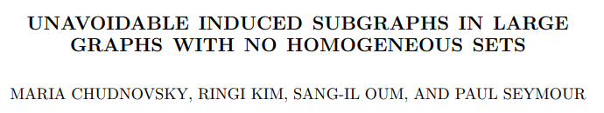
Unavoidable induced subgraphs in prime graphs

Slide 27
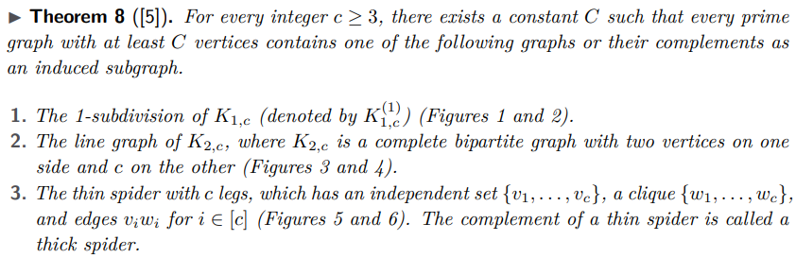
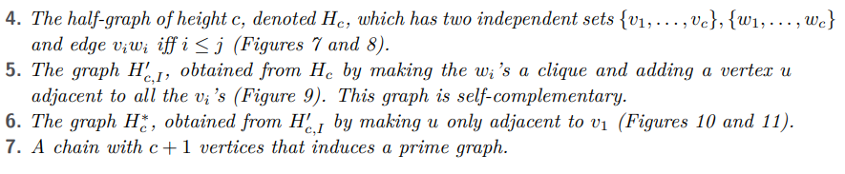

Slide 28
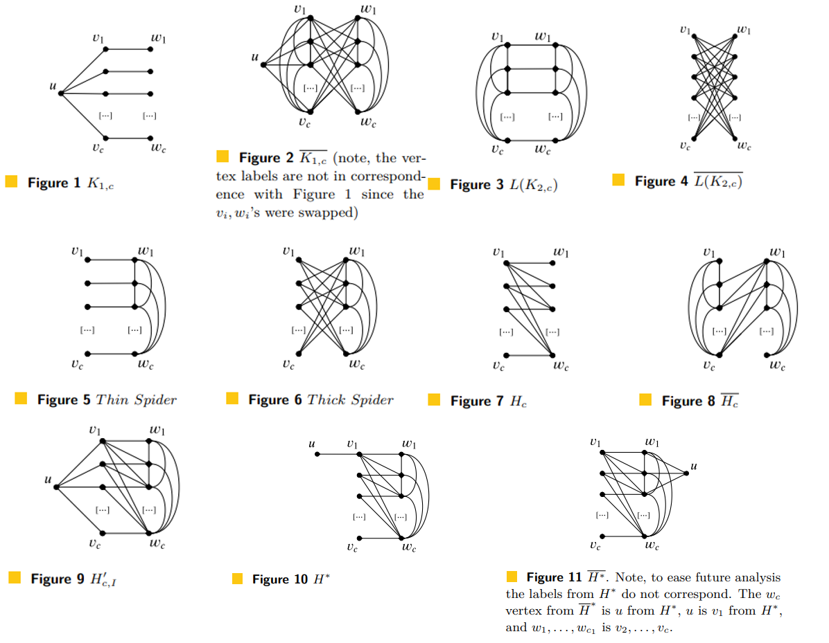

Slide 29













Slide 30
The cograph-deletion algorithm

Slide 31
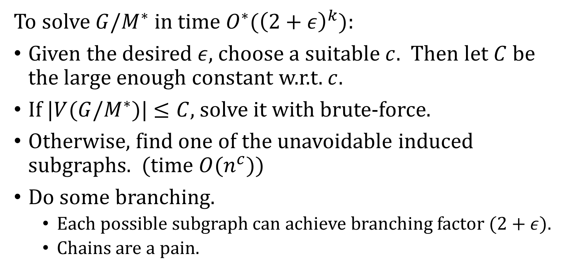
To solve $G/M^{∗}$ in time $O^{∗}({\left(2+ε\right)}^{k})$:
Given the desired $ε$, choose a suitable $c$. Then let $C$ be the large enough constant w.r.t. $c$.
If $|V(G{/M}^{∗})|$ $≤C$, solve it with brute-force.
Otherwise, find one of the unavoidable induced subgraphs. (time ${O(n}^{c})$)
Do some branching.
Each possible subgraph can achieve branching factor $(2+ε)$.
Chains are a pain.

Slide 32
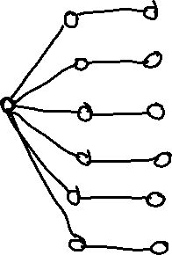

Slide 33

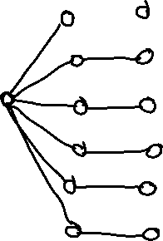

Slide 34







Slide 35



Slide 36


















Slide 37
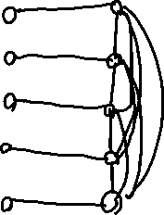

Slide 38

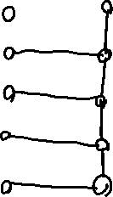


Slide 39




Slide 40


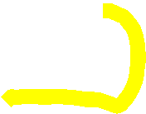

Slide 41
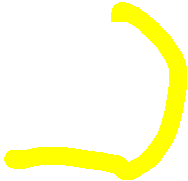



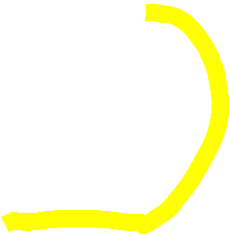

Slide 42











Slide 43





Slide 45
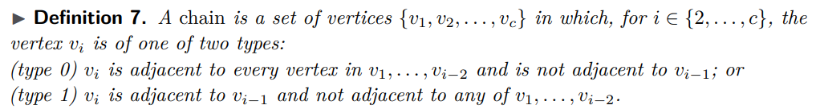

Slide 46


Slide 47
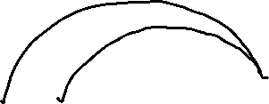





Slide 48
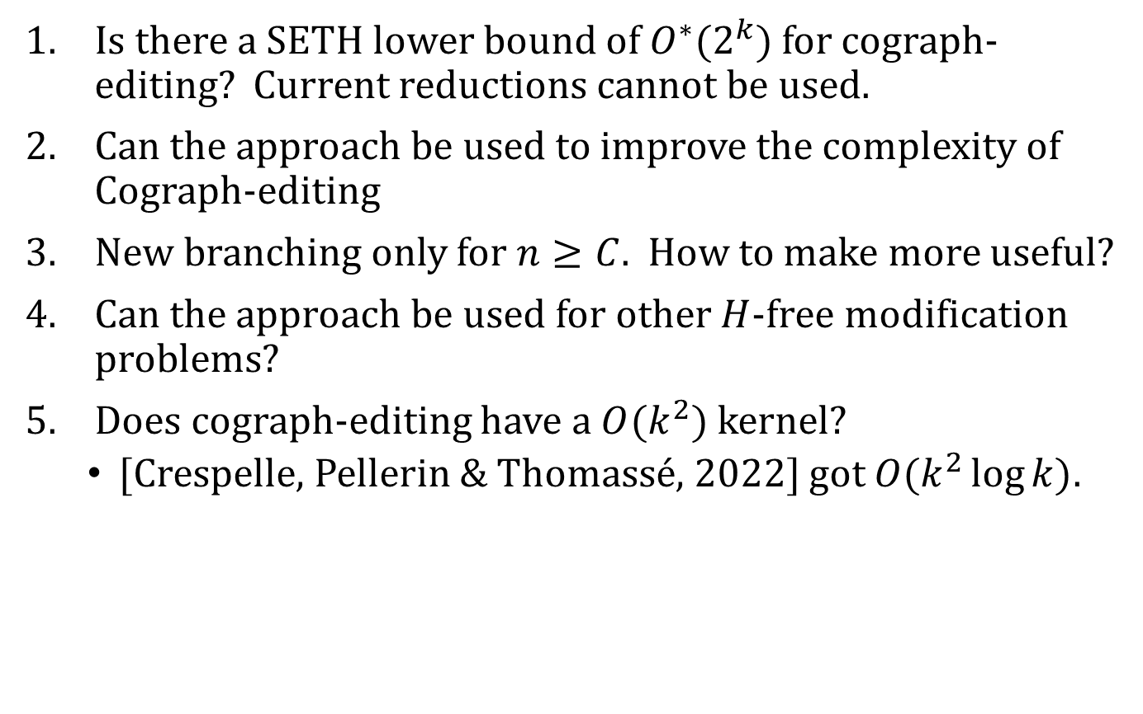
Open questions
Is there a SETH lower bound of $O^{∗}(2^{k})$ for cograph-editing? Current reductions cannot be used.
Can the approach be used to improve the complexity of Cograph-editing
New branching only for $n≥C$. How to make more useful?
Can the approach be used for other $H$-free modification problems?
Does cograph-editing have a $O(k^{2})$ kernel?
[Crespelle, Pellerin & Thomassé, 2022] got $O(k^{2}\log{k})$.

