Slide 1
Constructing incompatibility graphs of trees in optimal output-sensitive time
Manuel Lafond Université de Sherbrooke

Slide 2

Clusters in trees
Given a (rooted) tree $T$ and a node $v∈T$, $cluster_{T}(v)$ is the set of leaf taxa that descend from $v$.
$$clusters\left(T\right)= \{cluster_{T}\left(v\right):v∈T\}$$

Slide 3
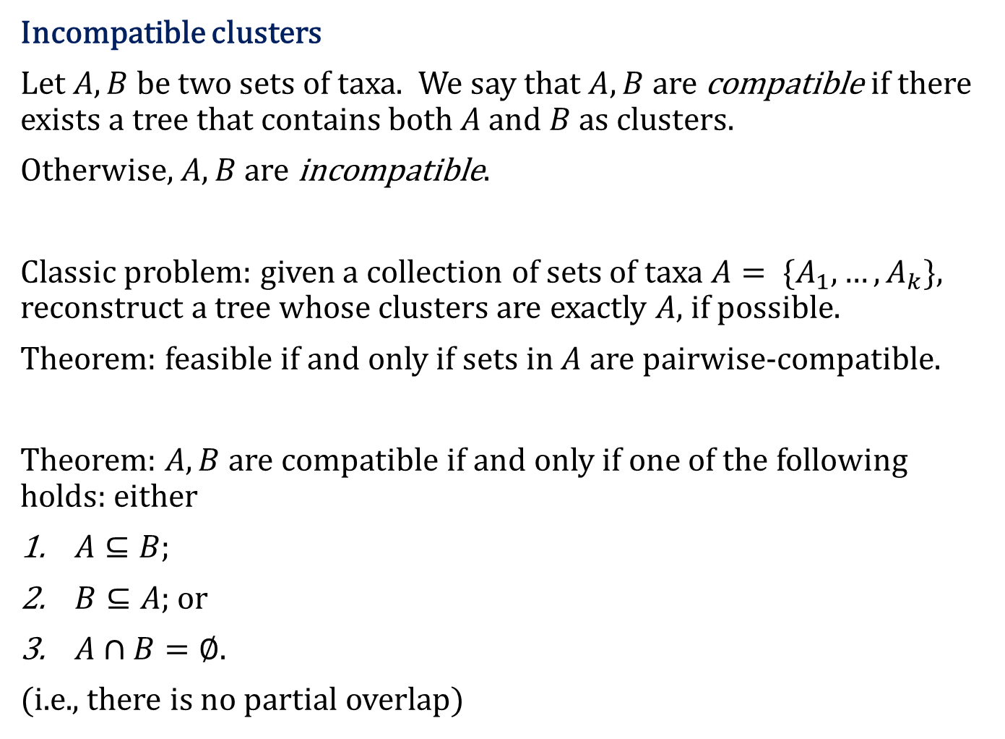
Incompatible clusters
Let $A,B$ be two sets of taxa. We say that $A,B$ are compatible if there exists a tree that contains both $A$ and $B$ as clusters.
Otherwise, $A,B$ are incompatible.
Classic problem: given a collection of sets of taxa $A= \{A_{1},…,A_{k}\}$, reconstruct a tree whose clusters are exactly $A$, if possible.
Theorem: feasible if and only if sets in $A$ are pairwise-compatible.
Theorem: $A,B$ are compatible if and only if one of the following holds: either
$A⊆B;$
$B⊆A$; or
$A∩B=∅$.
(i.e., there is no partial overlap)

Slide 4

Incompatibility graphs
Let $T_{1},T_{2}$ be two trees. Then $G(T_{1},T_{2})$ is the incompatibility graph of $T_{1},T_{2}$. It has:
one vertex for each cluster of $T_{1}$ and each cluster of $T_{2}$;
an edge between clusters $X$ and $Y$ if and only if $X,Y$ are incompatible.

Slide 5
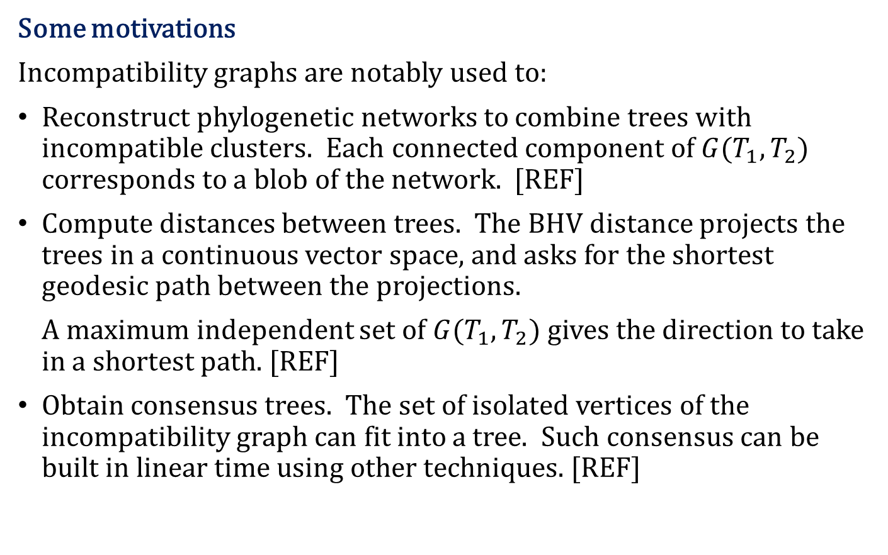
Some motivations
Incompatibility graphs are notably used to:
Reconstruct phylogenetic networks to combine trees with incompatible clusters. Each connected component of $G(T_{1},T_{2})$ corresponds to a blob of the network. [REF]
Compute distances between trees. The BHV distance projects the trees in a continuous vector space, and asks for the shortest geodesic path between the projections.
A maximum independent set of $G(T_{1},T_{2})$ gives the direction to take in a shortest path. [REF]
Obtain consensus trees. The set of isolated vertices of the incompatibility graph can fit into a tree. Such consensus can be built in linear time using other techniques. [REF]

Slide 6
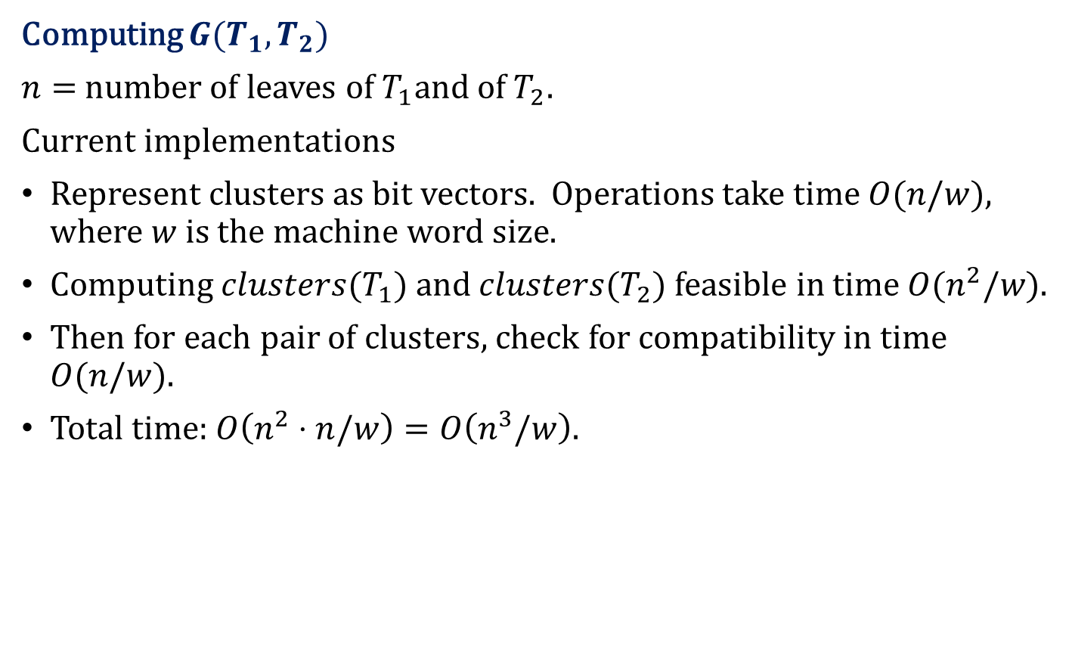
Computing $G(T_{1},T_{2})$
$n=$number of leaves of $T_{1}$and of${ T}_{2}$.
Current implementations
Represent clusters as bit vectors. Operations take time $O(n/w)$, where $w$ is the machine word size.
Computing $clusters(T_{1})$ and $clusters(T_{2})$ feasible in time $O(n^{2}/w)$.
Then for each pair of clusters, check for compatibility in time $O(n/w$).
Total time: $O\left(n^{2}⋅n/w\right)=O\left(n^{3}/w\right).$

Slide 7

Computing $G(T_{1},T_{2})$
Argument: $O(n^{2})$ is a lower bound on the complexity, because incompatibility graphs can have $Θ\left(n^{2}\right)$ edges.
Need quadratic time just to write the output.
Yes but...

Slide 8
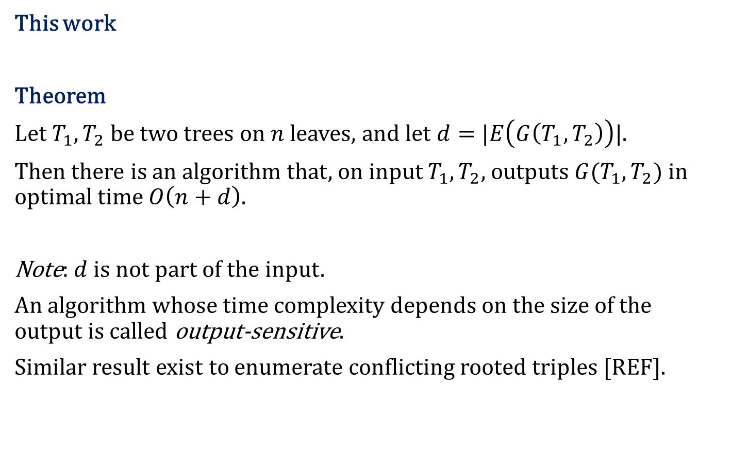
This work
Theorem
Let $T_{1},T_{2}$ be two trees on $n$ leaves, and let $d=|E\left(G\left(T_{1},T_{2}\right)\right)|$.
Then there is an algorithm that, on input $T_{1},T_{2}$, outputs $G(T_{1},T_{2})$ in optimal time $O\left(n+d\right).$
Note: $d$ is not part of the input.
An algorithm whose time complexity depends on the size of the output is called output-sensitive.
Similar result exist to enumerate conflicting rooted triples [REF].

Slide 9
The algorithm

Slide 10

for each node $v∈V(T_{1})$ in a post-order traversal
enumerate only the nodes $w$ of $V(T_{2})$ such that $cluster_{T_{1}}(v)$ and $cluster_{T_{2}}(w)$ are incompatible
add $\{v,w\}$ to $G(T_{1},T_{2})$

Slide 11
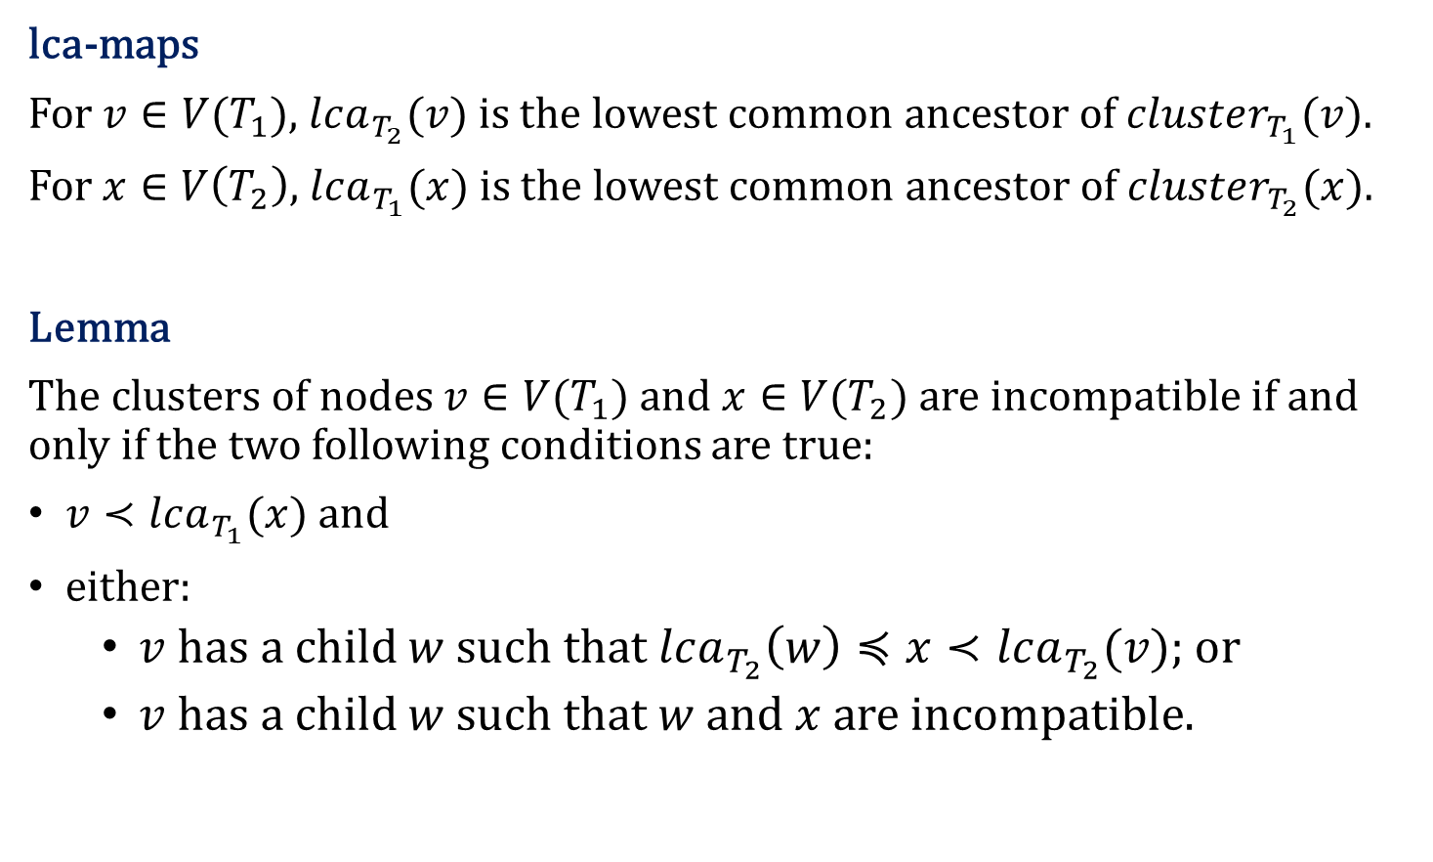
lca-maps
For $v∈V(T_{1})$, $lca_{T_{2}}(v)$ is the lowest common ancestor of $cluster_{T_{1}}(v)$.
For $x∈V\left(T_{2}\right)$, $lca_{T_{1}}(x)$ is the lowest common ancestor of $cluster_{T_{2}}(x)$.
Lemma
The clusters of nodes $v∈V(T_{1})$ and $x∈V(T_{2})$ are incompatible if and only if the two following conditions are true:
$v≺lca_{T_{1}}(x)$ and
either:
$v$ has a child $w$ such that $lca_{T_{2}}\left(w\right)≼x≺lca_{T_{2}}(v)$; or
$v$ has a child $w$ such that $w$ and $x$ are incompatible.

Slide 12
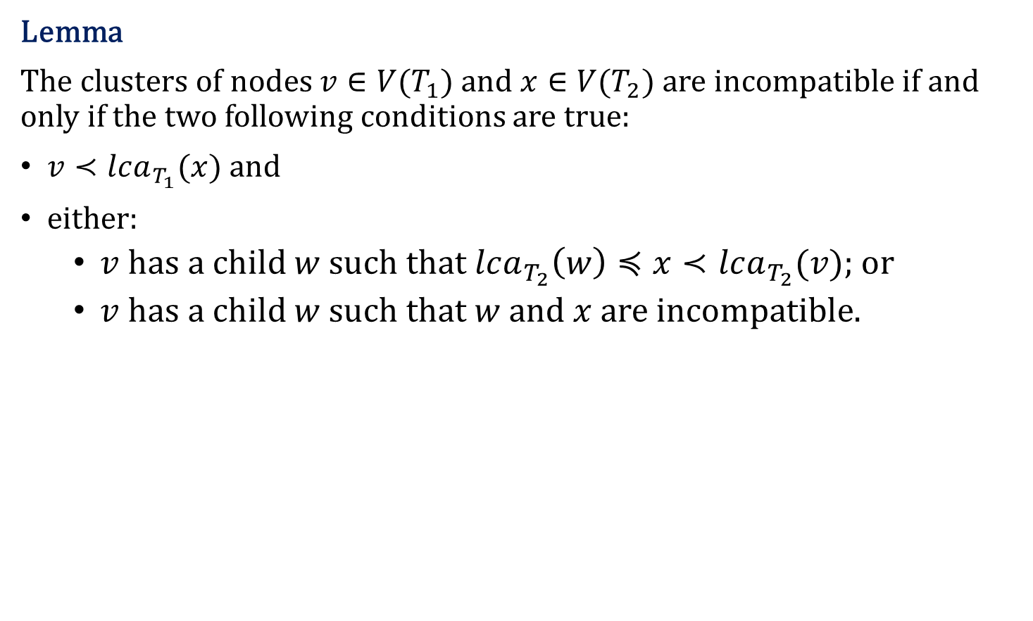
Lemma
The clusters of nodes $v∈V(T_{1})$ and $x∈V(T_{2})$ are incompatible if and only if the two following conditions are true:
$v≺lca_{T_{1}}(x)$ and
either:
$v$ has a child $w$ such that $lca_{T_{2}}\left(w\right)≼x≺lca_{T_{2}}(v)$; or
$v$ has a child $w$ such that $w$ and $x$ are incompatible.

Slide 13
Lemma
The clusters of nodes $v∈V(T_{1})$ and $x∈V(T_{2})$ are incompatible if and only if the two following conditions are true:
$v≺lca_{T_{1}}(x)$ and
either:
$v$ has a child $w$ such that $lca_{T_{2}}\left(w\right)≼x≺lca_{T_{2}}(v)$; or
$v$ has a child $w$ such that $w$ and $x$ are incompatible.

Slide 14
Lemma
The clusters of nodes $v∈V(T_{1})$ and $x∈V(T_{2})$ are incompatible if and only if the two following conditions are true:
$v≺lca_{T_{1}}(x)$ and
either:
$v$ has a child $w$ such that $lca_{T_{2}}\left(w\right)≼x≺lca_{T_{2}}(v)$; or
$v$ has a child $w$ such that $w$ and $x$ are incompatible.

Slide 15
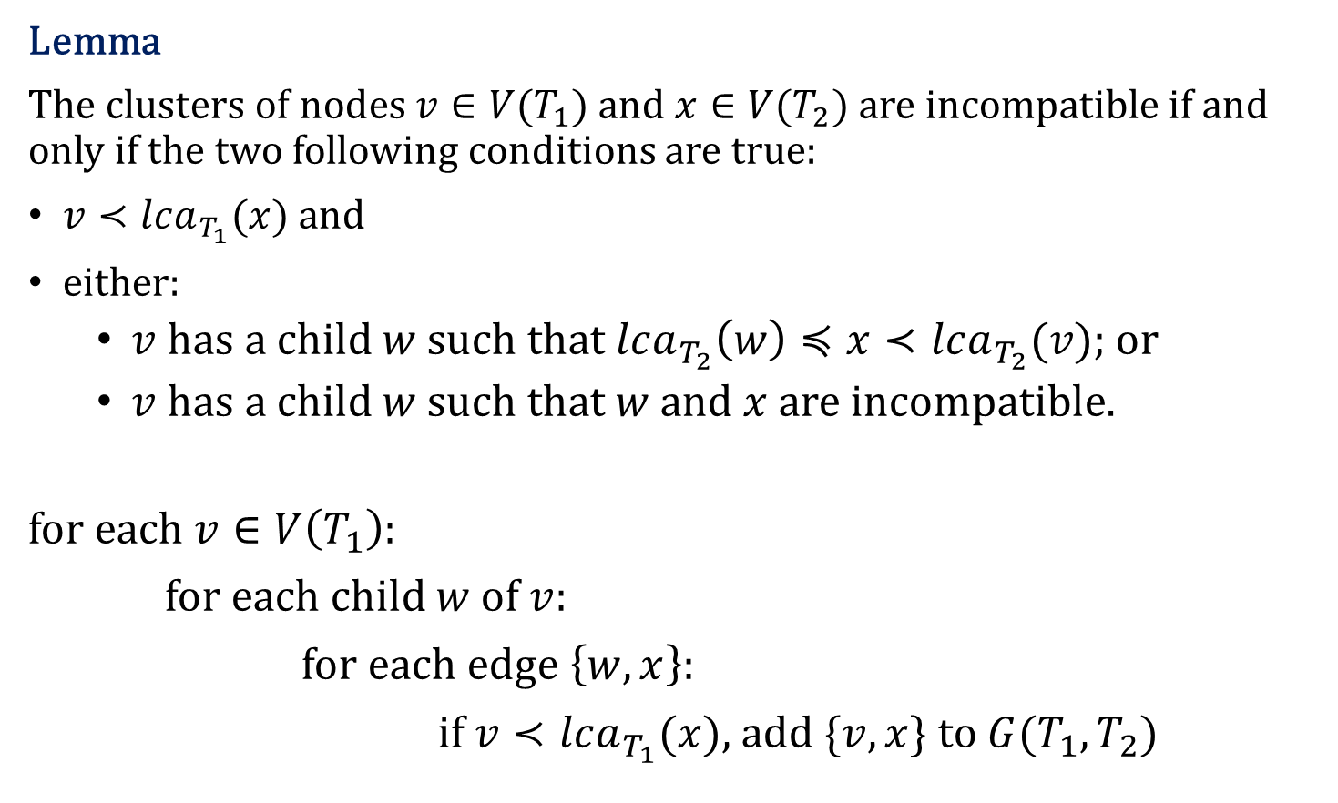
Lemma
The clusters of nodes $v∈V(T_{1})$ and $x∈V(T_{2})$ are incompatible if and only if the two following conditions are true:
$v≺lca_{T_{1}}(x)$ and
either:
$v$ has a child $w$ such that $lca_{T_{2}}\left(w\right)≼x≺lca_{T_{2}}(v)$; or
$v$ has a child $w$ such that $w$ and $x$ are incompatible.
for each $v∈V\left(T_{1}\right):$
for each child $w$ of $v:$
for each edge $\left\{w,x\right\}:$
if $v≺lca_{T_{1}}(x)$, add $\{v,x\}$ to $G(T_{1},T_{2})$

Slide 16
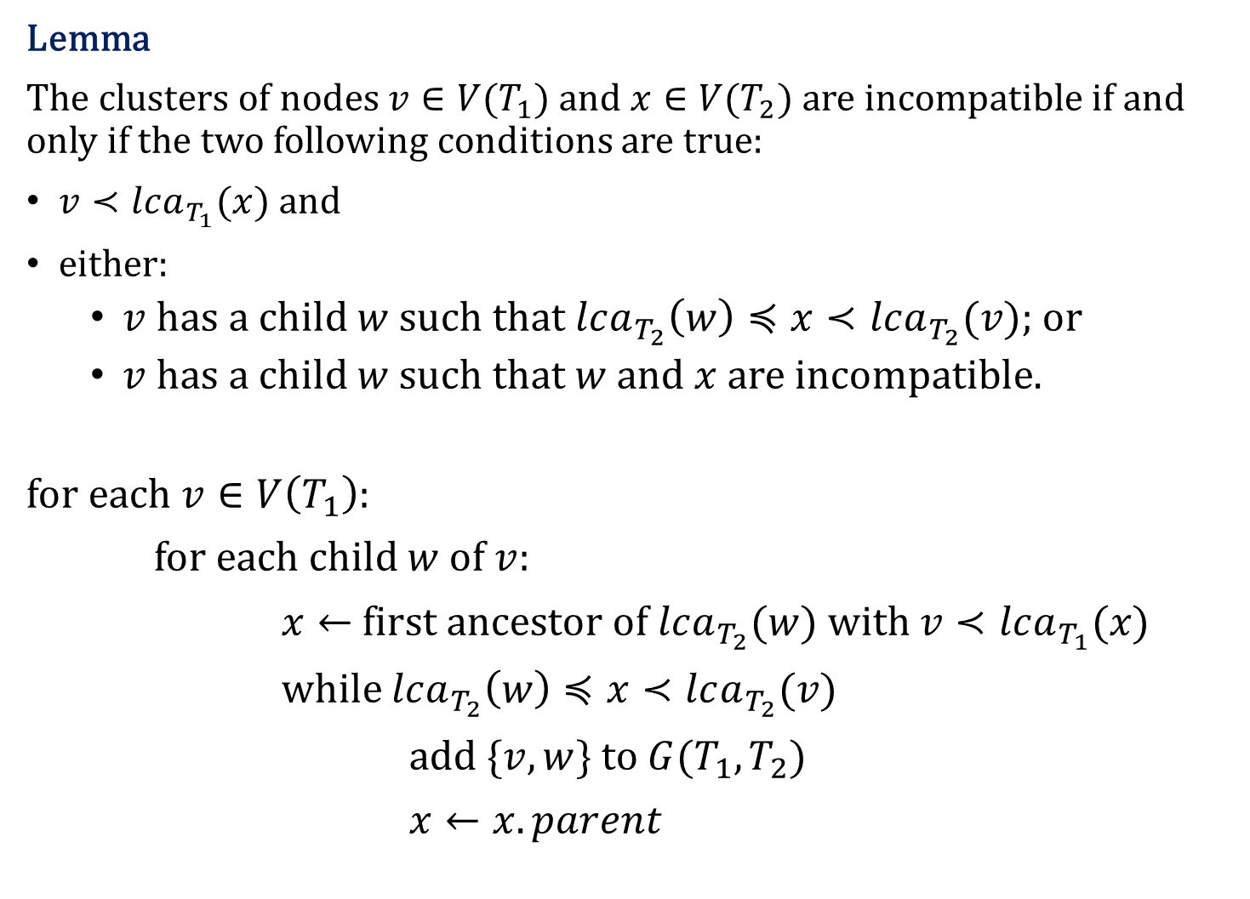
Lemma
The clusters of nodes $v∈V(T_{1})$ and $x∈V(T_{2})$ are incompatible if and only if the two following conditions are true:
$v≺lca_{T_{1}}(x)$ and
either:
$v$ has a child $w$ such that $lca_{T_{2}}\left(w\right)≼x≺lca_{T_{2}}(v)$; or
$v$ has a child $w$ such that $w$ and $x$ are incompatible.
for each $v∈V\left(T_{1}\right):$
for each child $w$ of $v:$
$x←$ first ancestor of $lca_{T_{2}}(w)$ with $v≺lca_{T_{1}}(x)$
while $lca_{T_{2}}\left(w\right)≼x≺lca_{T_{2}}(v)$
add $\{v,w\}$ to $G(T_{1},T_{2})$
$x←x.parent$

Slide 17
Experiments

Slide 18
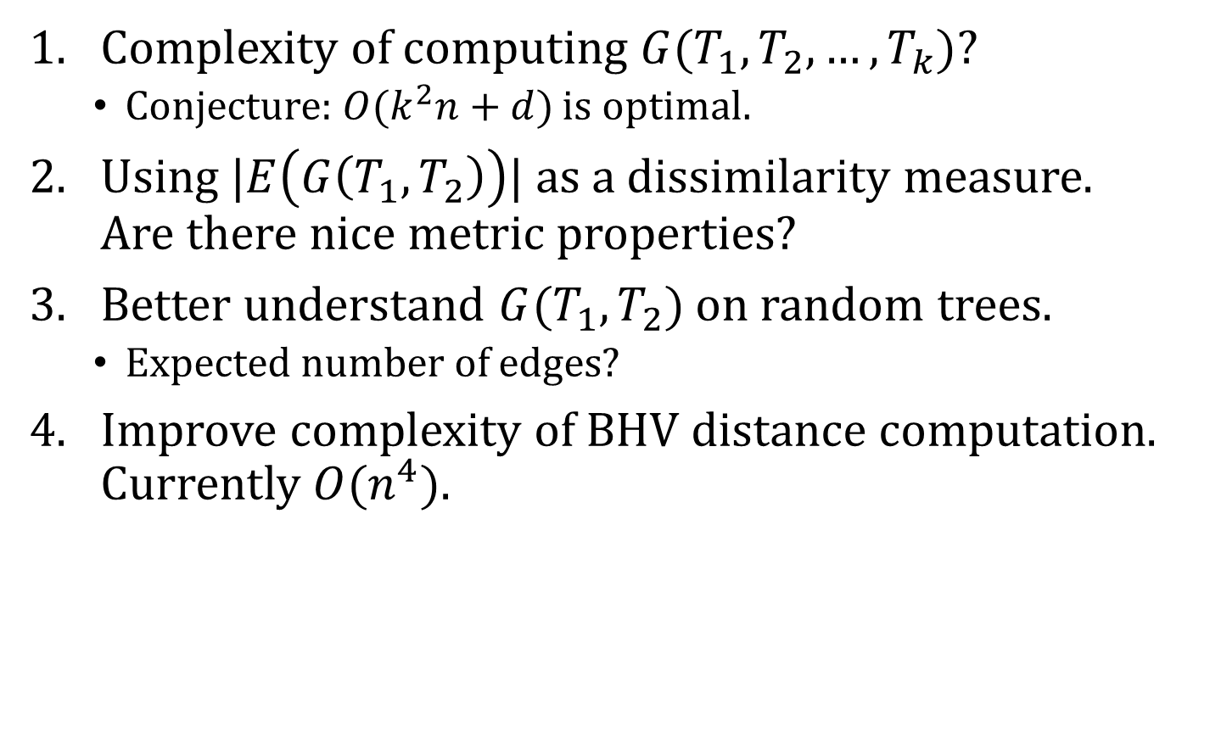
Future work
Complexity of computing $G(T_{1},T_{2},…,T_{k})$?
Conjecture: $O(k^{2}n+d)$ is optimal.
Using $|E\left(G\left(T_{1},T_{2}\right)\right)|$ as a dissimilarity measure. Are there nice metric properties?
Better understand $G(T_{1},T_{2})$ on random trees.
Expected number of edges?
Improve complexity of BHV distance computation. Currently $O(n^{4})$.

