Slide 1
Consolidated Variant Generation with SERGe
Michaela Meier
Presentation: 29.11.2018

Slide 2
Consolidated Variant Generation with SERGe
old „variant generation“ renamed to
Solitary Variant Generator
new, additional variant generation:
Consolidated Variant Generator

Slide 3
Consolidated Variant Generation with SERGe
Default: disabled
To enable it:
Org.sidiff.editrule.generator.serge > Configuration > enable_consolidatedvariants = true;

Slide 4
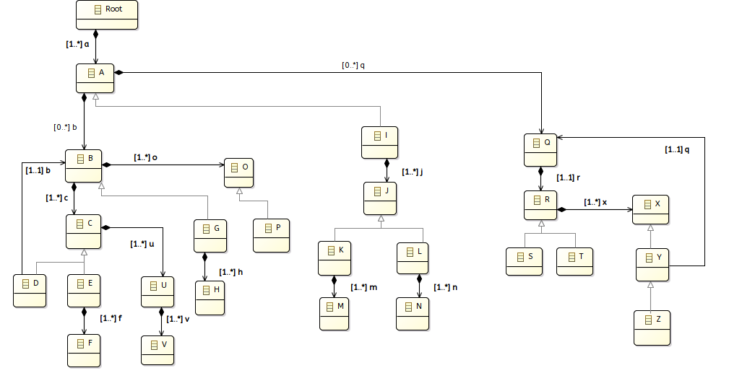
Consolidated Variant Generation with SERGe
Create_Q_In_A_(q)

Slide 5
Consolidated Variant Generation with SERGe
Create_Q_In_A_(q)
All possible variants:
Core:
Root A Q
Variants:
R X,
T X,
S X,
R Z Q,
R Y Q,
T Z Q,
T Y Q,
S Z Q,
S Y Q

Slide 6
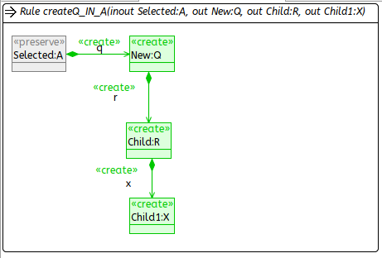
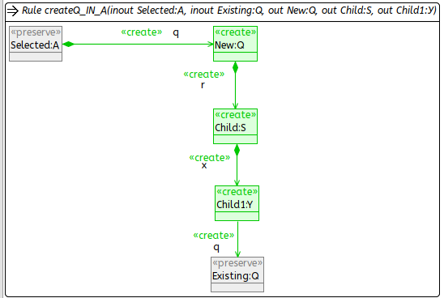
Consolidated Variant Generation with SERGe
Create_Q_In_A_(q)
‚original‘ module generation
solitary variants derivation

Slide 7
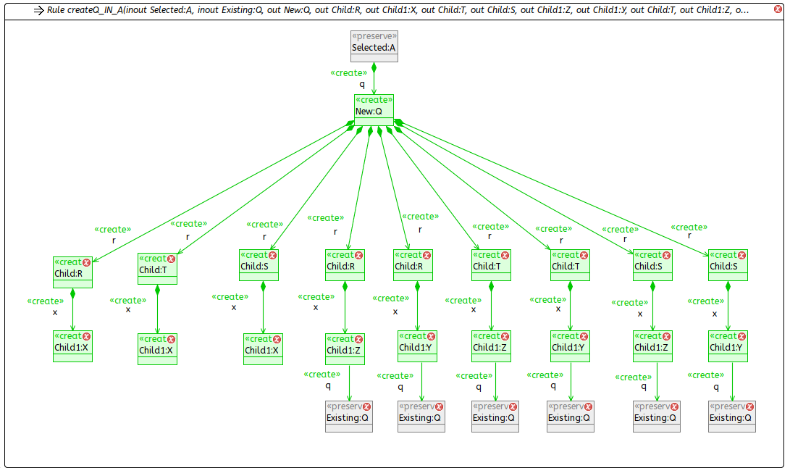
Consolidated Variant Generation with SERGe
Create_Q_In_A_(q)
consolidated variants
in one module

Slide 8
Consolidated Variant Generation with SERGe
core
v1
...
...
...
...
...
...
...
vn

Slide 9
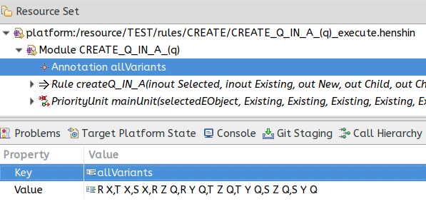
Consolidated Variant Generation with SERGe

Slide 10
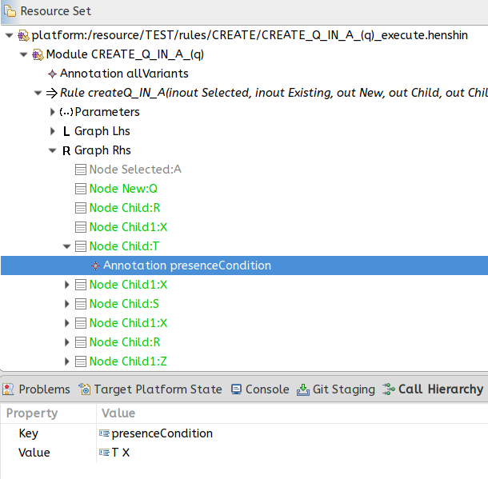
Consolidated Variant Generation with SERGe

Slide 11
Consolidated Variant Generation with SERGe
Restrictions:
Only CREATE rules are considered
rules containing abstract <<create>> elements not dimissed yet
no element type exclusion implemented (as with everything on the xml configuration)

Slide 12
Consolidated Variant Generation with SERGe
How it works?
Basically:
Sequences of all variants are calculated for one module
Nodes/Edges are replicated and extended and recurved for every
sequence

Slide 13
Consolidated Variant Generation with SERGe
STEP 1 :: Init sequence:
R X // the core (Root A Q) is further on omitted
STEP 2 ::
2.1 Consider first „top most, lefthand side“ supertype replacement option
[R] X
2.2 Create additional sequences for all possible sub types by copy
=> R X
S X
T X
STEP 3 ::
3.1 Consider next, „top most, lefthand side“ super type replacement option:
R [X]
3.2 Create additional sequences for all possible sub types by copy
=> R X
S X
T X
R Y {Q} //further sub sequences added also; i.e. {Q}
R Z {Q} //further sub sequences added also; i.e. {Q}
3.3 Create additional sequences for all possible sub types in former sequences
=> R X
S X
T X
R Y {Q}
R Z {Q}
S Y {Q}
S Z {Q}
T Y {Q}
T Z {Q}
STEP 4 :: Consider next unvisited sequence in the previous list, go back to step 2
until no sub type replacement option is left
sequence generation algorithm

Slide 14
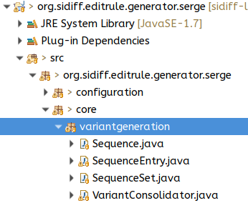
Consolidated Variant Generation with SERGe
Allgorithmic part can be found in:

Slide 15
Consolidated Variant Generation with SERGe
Default: consolidated variant generation is disabled
To enable it:
Org.sidiff.editrule.generator.serge > Configuration > set enable_consolidatedvariants = true;
Everything is merged into master branch by now

