Slide 1

SiLift: Extending EMF Compare with an Operational View on Model Differences
Timo Kehrer
Software Engineering Group
University of Siegen
Eclipse DemoCamp
Stuttgart, 17.07.2013
http://pi.informatik.uni-siegen.de/Projekte/SiLift

Slide 2
Outline
Introduction
The SiLift Approach
End-user Tool Environment
Summary

Slide 3

Context: Model-driven Development

Slide 4
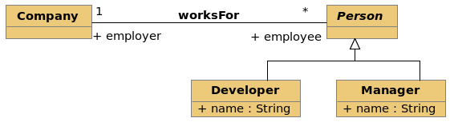
Model evolution
rev. 1.1

Slide 5
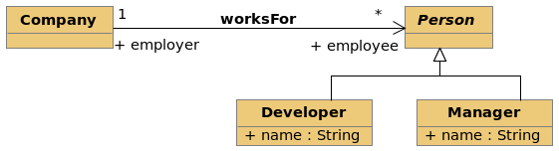
Model evolution
rev. 1.1
Design Decision:
Restrict association
navigability
rev. 1.2
X

Slide 6
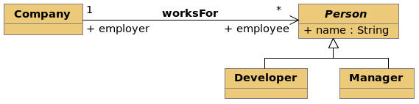
Model evolution
rev. 1.1
Design Decision:
Restrict association
navigability
rev. 1.2
Refactoring:
Pull up attribute
rev. 1.3

Slide 7
Model versions and variants
1.1
1.2
1.3
1.2.2.1

Slide 8
3-Way model merging
1.1
base model
1.2
1.3
1.2.2.1
changed version A
changed version B

Slide 9
Model patching
1.1
origin model
1.2
„propagate changes“
target model
1.3
1.2.2.1
changed model

Slide 10
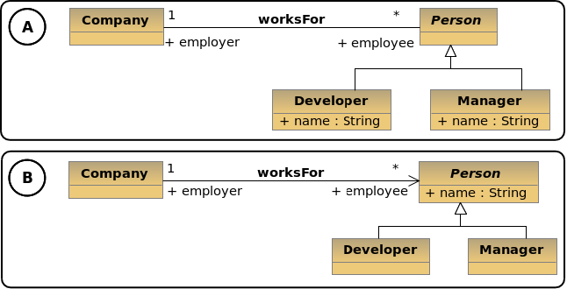
Basic challenge: Model comparison

Slide 11
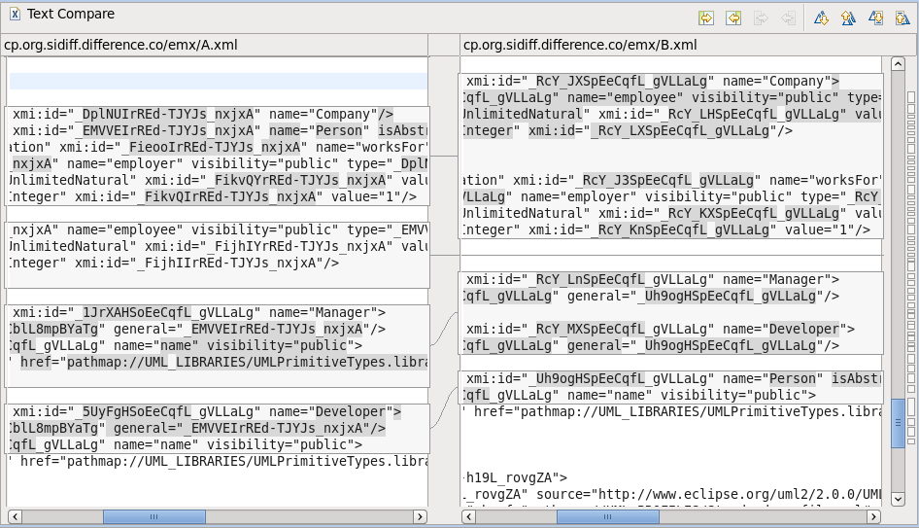
What textual difference tools report...

Slide 12
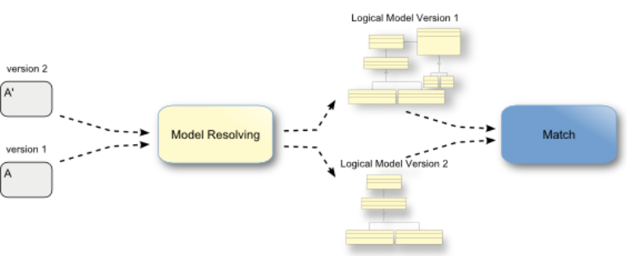
The processing pipeline of EMF Compare
Part 1: Matching
1
2
Generic Matchers, e.g.
XMI ID
Functional ID
Content matching strategy
Custom Matching Engine

Slide 13
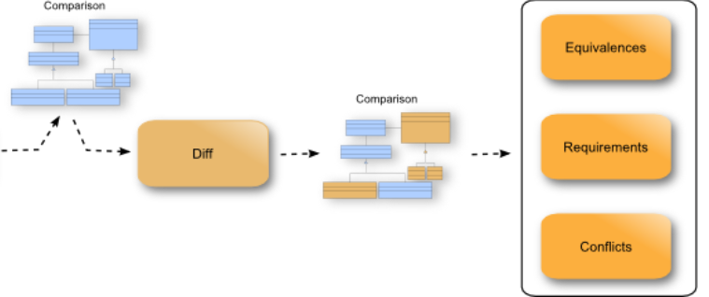


The processing pipeline of EMF Compare
Part 2: Differencing
1
Generic solutions operating
on the models' ASG
„low-level“ changes
Adaption to custom high-level edit operations

Slide 14
Outline
Introduction
The SiLift Approach
End-user Tool Environment
Summary

Slide 15
Overall goal: Lift model versioning to the abstraction level of edit operations
High-level changes:
Complex editing
commands
Difference
Recognition
Conflict & Dependency
Analysis
Patching &
Merging
Low-level
model changes
Difference
Recognition
Conflict & Dependency
Analysis
Patching &
Merging

Slide 16

Basic approach
Edit rules
Difference
Derivation
Edit
Operation
Detection
Conflict &
Dependency
Analysis
Low-level
Changes
Edit
Operations

Slide 17
Sample edit rule: „pullUpAttribute“
(theoretical foundation)
pullUpAttribute(a)
Sup
Sup
a : dt
Sub
Sub'
Sub
Sub'
Sub'
Sub'
a : dt
a : dt
a : dt
a : dt
LHS
RHS

Slide 18
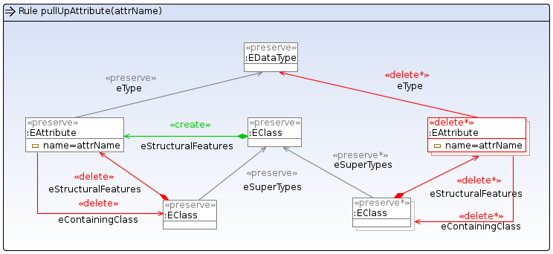

Sample edit rule: „pullUpAttribute“
(implementation in EMF Henshin)

Slide 19
Outline
Introduction
The SiLift Approach
End-user Tool Environment
Summary

Slide 20
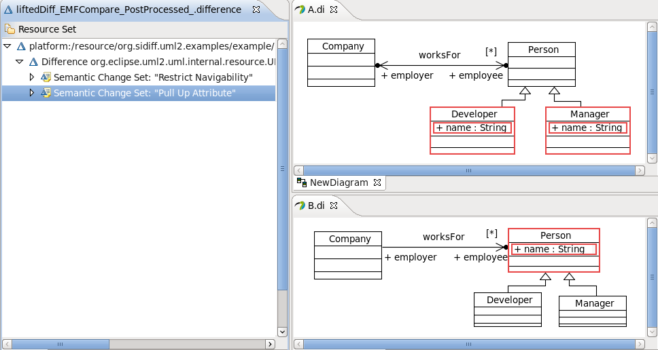
Difference Viewer

Slide 21
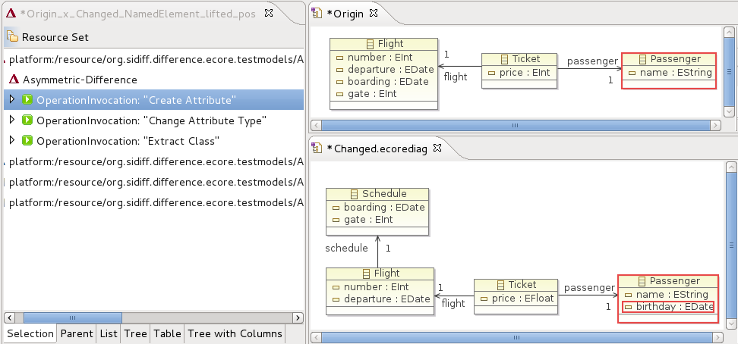
Consistency-preserving editing of patches
base model
v0
v1
changed model
'

Slide 22
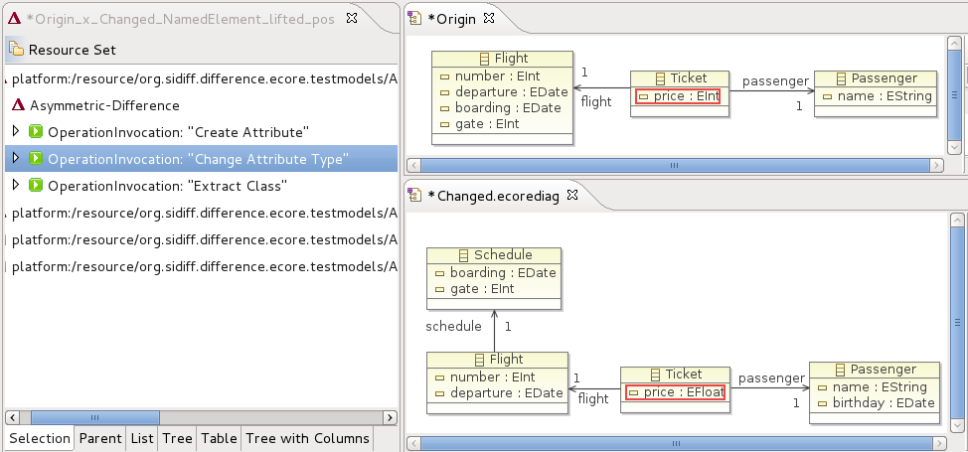
Consistency-preserving editing of patches
base model
v0
v1
changed model
'

Slide 23
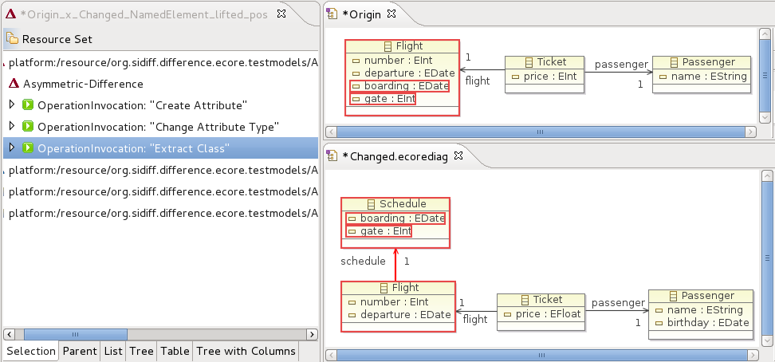
Consistency-preserving editing of patches
based model
v0
v1
changed model
'

Slide 24
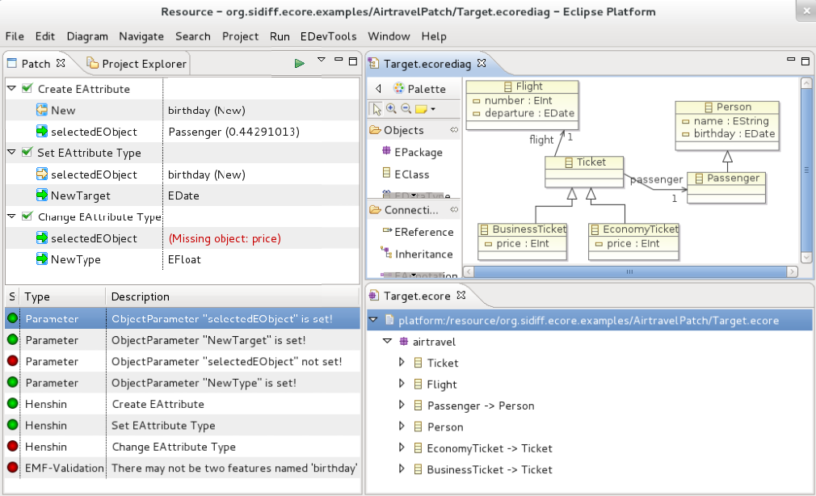
Controlled application of model patches

Slide 25
Controlled application of model patches
Retrieval of
operation context

Slide 26
Controlled application of model patches
Operation execution log

Slide 27
Controlled application of model patches
Modifyable
Target model

Slide 28
Controlled application of model patches
Result of the
patch application

Slide 29
Outline
Introduction
The SiLift Approach
End-user Tool Environment
Summary

Slide 30
Summary
Unit of change; high-level edit operations
Formal foundation; graph transformation concepts
Support for complex edit operations
High-level conflict and dependency detection
Consistency-preserving patching

Slide 31
Further information
SiLift project web site:
http://pi.informatik.uni-siegen.de/Projekte/SiLift
Timo Kehrer, Pit Pietsch, Hamed Shariat Yazdi, Udo Kelter. Detection of High-Level Changes in Evolving Java Software. WSR 2013
Udo Kelter, Timo Kehrer, Dennis Koch. Patchen von Modellen. Software Engineering 2013
Timo Kehrer, Udo Kelter, Manuel Ohrndorf, Tim Sollbach. Understanding Model Evolution through Semantically Lifting Model Differences with SiLift. ICSM 2012
Timo Kehrer, Udo Kelter, Gabriele Taentzer. Integrating the Specification and Recognition of Changes in Models. WSR 2012
Timo Kehrer, Udo Kelter, Gabriele Taentzer. A Rule-Based Approach to the Semantic Lifting of Model Differences in the Context of Model Versioning. ASE 2011

