Slide 1

SiDiff
Tutorial Introduction
(originally presented in Stuttgart, June 28th/29th 2011)

Slide 2
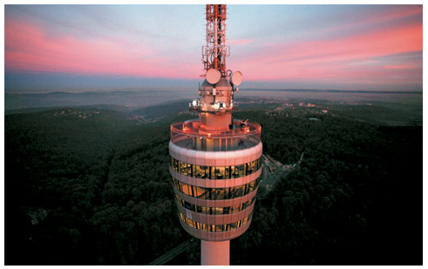
SiDiff Overview

Slide 3
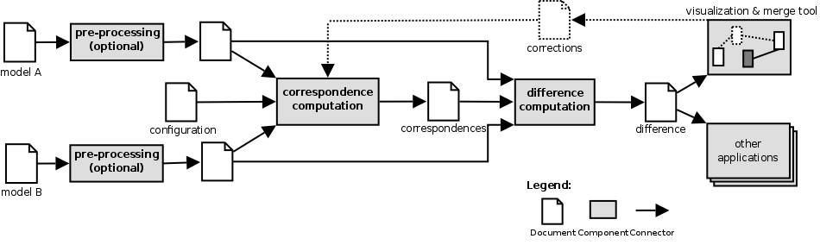
Architecture Overview

Slide 4
Architecture Overview
e.g. DOM-parser
for ASCET XML-files

Slide 5
Architecture Overview
That's what we talk about
the next two days...

Slide 6
Matching Approaches implemented in SiDiff
Different correspondence computation (matching) services in SiDiff:
  ID-based matching
  Hash-based matching
  Iterative matching based on similarities

Slide 7

Running Example

Slide 8
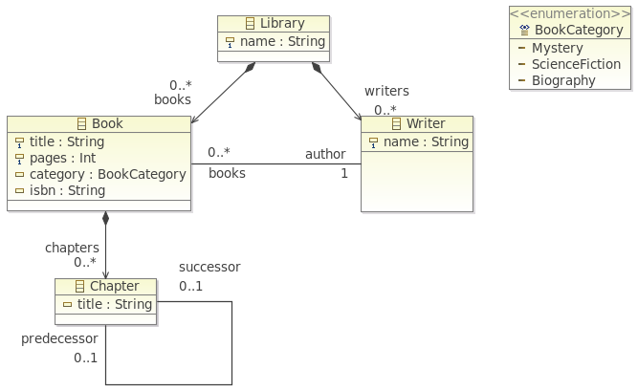
The EMF Library Example

Slide 9
A Console Application
Activator.java: The OSGi Activator – doing some initalization stuff
ConsoleDiff.java: The OSGi IApplication – the „main routine“
CompareInterface.java: A facade offering convenient access to SiDiff
Correspondences.java: A wrapper providing convenient access to the SiDiff matching results
resource folder: Configuration files on which we will have a closer look later on

Slide 10
Program Arguments
(In Terms of our
Example Console App)
-left: the file which contains the first model
-right: the file which contains the second model
-options: Used here for activating/deactivating the different matching services:
  „ID-based“ [true|false]
  „Hash-based“ [true|false]
  „Similarity-based“ [true|false]

Slide 11
Useful Non-SiDiff Program Args
-console
-consoleLog
-debug
Find more information in OSGi and Eclipse documentations...

Slide 12
General SiDiff VM Arguments
(cont'd)
  -DECORE_MAPPING={true|false}
  -DFORCE_TRANSFORMATION={true|false}
  -DDEBUGGERS=“{debugger},...,{debugger}“

Slide 13
General SiDiff VM Arguments
  -DLOGCHANNEL="{channel}" -specifies logging
    TeePipeChannel – Log to multiple outputs
      -DTEEPIPECHANNELS
    ConsoleLogChannel – Log to Console
    FileLogChannel – Log into File
      -DLOGFILE=“{file-name}“
    OSGILogChannel – Use OSGI Log facility
  -DLOGEVENTS="{events}" – Log specified Events
    '*' allowed
  -DLOGMODULES="{modules}" – Log specified Modules
    '*' allowed

Slide 14
Useful Non-SiDiff VM-Arguments
-Dosgi.noShutdown=true (No shutdown of OSGi console)
-ea (Enable Java assertions)
See OSGi, Eclipse and Java documentation for further details...

Slide 15

Chapter 1: ID-based Matching

Slide 16
Lessons
Using surrogates (Lesson 1)
Inspecting the results (Lesson 1 and 2)
Getting in touch with internal model representation (Lesson 1)
Building signatures (Lesson 2 and 3)

Slide 17
Inspecting the Matching Results
Reading the console output
Using SiDiff Debugger on OSGi console, with the following commands:
command | semantics
resources | lists known resources (i.e. model files)
debuggers | lists known debuggers
debug [debugger] [method] [params...] | executes the given method of the given debugger with the given parameters
dbhistory | lists recently used commands ('dbhistory clear' clears the list)

Slide 18
Inspecting the Matching Results
The most important commands:
command | semantics
debug cd matched cs [0|1] | Inspect matching table
debug cd unmatched cs [0|1] | Inspect umatched elements
debug sd similarities ss [0|1] | Inspect similarity table
debug ad annotations [0|1] | Inspect model annotations
Used Shortcuts:
  cs: CorrespondencesService
  cd: CorrespondencesDebugger
  sd: SimilaritiesDebugger
  ss: SimilaritiesService
  ad: AnnotationDebugger

Slide 19
Annotating the Input Models
What annotations are:
  Annotations are key-value-pairs that can be attached to any model element
  Annotations are used to configure the ID-based and the Hash-based matcher
Annotation mechanism:
  Basically a visitor pattern implementation
  Annotators compute the annotation values
  Annotators are configured in terms of a configuration file

Slide 20
DerivedIDAnnotator
Annotator to compose a unique Object-ID/Signature and for use with exact one Type!
The generated ID is composed of a (optional) remote, and at least one (but arbitrary many) local Attribute Values.
Annotation Key must be: DERIVED_ID
Parameter-String Syntax:
  Local and remote parts are seperated by '::'
  There can be any count of remote parts, seperated by '?' - The first one that deliver a result will be used.
  If many local attribute names are given, they are separated by ','
  See Path Engine Syntax (Appendix)

Slide 21
How to Debug Annotations?
Use the SiDiff Debugger from OSGi console:
  debug ad annotations [0|1]
Serialize annotations as XML document:
  In terms of our Console Application, we can use the flags -importonly and -annotate as program arguments

Slide 22
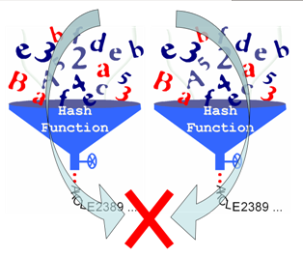
Chapter 2: Hash-based Matching

Slide 23
Lessons
Specify how to build hash values (Lesson 1)
Getting in touch with the problem of duplicate hash values (Lesson 2)
Polymorphic annotations (Lesson 3)

Slide 24
HashAnnotator
Annotator to compute hash values.
Annotation key must be HASH
This annotator builds signatures in a subtractive way:
  It includes a fixed set of information in the hash value,
  whereas some of these information can be subtracted by the use of configuration parameters:

Slide 25
HashAnnotator
Parameter | Semantics
localPositionAnnotationKey = <KEY>, | Local position in the model. Is used, i.e. hashed, only in cases where global moves are forbidden.
referencedObjectsPositionAnnotationKey = <KEY>, | How to hash referenced objects?
globalMoveAllowed = true|false, | Allow global moves of elements
suppressChildren = <containment1>;<containment2>;..., | Suppress hashing of children of the given containment references (containment1, ...)
ignoreOrder = <ref1>;<ref2> ..., | Ignore order for objects which are referenced through the given references (ref1, ...)
exclude = <feature1>;<feature2> ... | Exclude the given features from hash value building

Slide 26
Path Annotators
Usual convention: Annotation Key is PATH
TypePathAnnotator
  Uses type information, i.e. name of the meta class, as path segment.
  Parameter: none
AttributePathAnnotator
  Uses the value of an attribute as path segment.
  Parameter: name = <name-of-attr>

Slide 27

Chapter 3:
Iterative Matching based on Similarities

Slide 28
Lessons
Similaritiy calculation based on elements' local properties (Lesson 1)
The limitations of local properties (Lesson 2)
Similaritiy calculation based on elements' "neighbourhood" (Lesson 3)
Cyclic dependencies of similarities and similarity flooding (Lesson 4)
Controlling the similarity flooding (Lesson 5)
Propagation und top-down matching (Lesson 6)

Slide 29
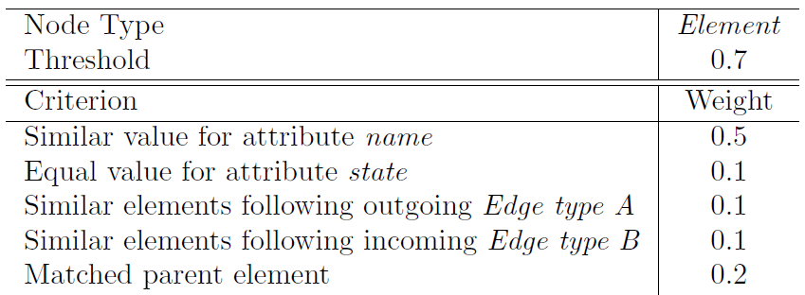
Similarity Calculation:
Basic Principle

Slide 30
Compare Functions
Compare functions calculate the weighted result of one criterion of the overall similarity of a pair of nodes
They usually use a comparator to do the comparsion (see appendix)
There exist three policies that determine the SiDiff behavior in case of missing features:
  mandatory: An Exception is thrown
  fulfilled: We assume a similarity of 1.0
  unfulfilled: We assume a similarity of 0.0

Slide 31
„Standalone“ Compare Functions
MaximumSimilarity:
returns always a similarity value of 1.0f
<CompareFunction
class="MaximumSimilarity" weight="1.0"/>
MinimumSimilarity:
returns always a similarity value of 0.0f
<CompareFunction
class="MinimumSimilarity" weight="1.0"/>

Slide 32
Conditional Compare Function
This compare function compares two nodes depending on a condition. If the condition is true the similarity is going the be calculated using the compare functions nested in the Then-element, otherwise the compare functions Else-element are going to be executed.
There exist a lot of conditions which are available in SiDiff (see next slide)

Slide 33
Conditions
SameParentTypeCondition
  This condition tests whether the parents of an element has same type.
  Parameter: none
ParentMatchedCondition
  This condition checks if the parents of the elements are matched. In case they are, true is returned, otherwise false.
  Parameter: none
SameContainingFeatureCondition
  Tests whether the parents of an element do have the same type and if an element is contained in the parents via the same reference type
  Parameter: none
EqualAttributeValueCondition
  This condition tests whether two attribute values are equal. In case they are true is returned, otherwise false. It is assured by assertion that both nodes are not null.
  Parameter: The name of the attribute to test the value of

Slide 34
Conditions (cont'd)
FixedAttributeValueCondition
  This conditions compares the toString()-representations of the values of the specified attributes with the given string. In case they are equal true is returned, otherwise false.
  Parameters:
    1. Attribute
    2. String to be used for comparison

Slide 35
Compare Functions and Comparators
Compare Function:
  WHAT (i.e. Which model element(s)) is subject to our comparison...?
  Determine the sets of elements which shall be compared
Comparator:
  HOW is a comparison accomplished...?
  Determines similarities based on the properties of an element:
    Some comparators must have additional inner comparators.
    Powerful concept, but quite complex

Slide 36
Similarity Configuration
Global Settings
  documentType:
    Our model type
  normalizeWeights:
    Normalize the sum of weights of all compare functions of a specific type to a maximum similarity value of 1.0
Compare Functions and Comparators
  see Appendix

Slide 37
Matching Configuration:
Global Settings
matcherPrefix: Where are the matchers located if no package prefix is given? (usually "org.sidiff.core.matching.matcher")
documentType: Our document type (the meta model URI)
firstPassSequencedMatcher: Sequenced matcher during initial iteration
defaultSequencedMatcher: Sequenced matcher during the following iterations
defaultTopDownMatcher: Default top down matcher, usually "Propagation"

Slide 38
Type-specific Configurations
threshold: What do we require as minimum similarity required for establishing correspondences?
allowLocalMove: Do we allow local moves?
allowGlobalMove: Do we allow global moves?
alwaysComputeSimilarity: Compute similarity in each iteration, or is similarity value stable and does not depend on similarity flooding?
independentMatching: Can we match independently or just in a top down phase?
topDownMatcher: What is our top down strategy, do we propagate or not propagate a match?

Slide 39
Different Top-Down Matchers in SiDiff
The top-down matcher can be configured to automatically start a top-down run when two elements of a type are matched (otherwise, specify "NoPropagation").
It can be configured to be more or less selective when matching children of the just matched elements:
The top-down matcher "Propagation" behaves in a way that children are only matched if they are globally optimal candidates for each other.
The top-down matcher "GreedyPropagation" is the normal case, children are matched if they are locally optimal candidates for each other.
The top-down matcher "GreedyParentForcedMatcher" behaves like the "GreedyPropagation" but even ignores matching thresholds.

Slide 40
Iterative Matching Schedule
Type sequences determine our iterative matching schedule
A sequence will be re-iterated as long as new matches will be found
Sequences can be nested
For each sequence (and each type within a sequence) we can additionally specify local re-iterations:
  iterations=“n“: Number of iterations (defaults to 1)
  repeat=“[true|false]“: Perform n iterations each time or just in the initial sequence? (defaults to false)
If a match is found during local re-iteration, the number of iterations is reset to 0 and local re-iterations will start again

Slide 41

Appendix

Slide 42
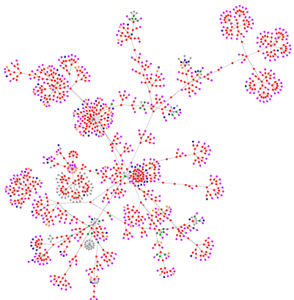
A: Compare Functions and Comparators

Slide 43
Compare Functions using Comparators
Self
Parent
Children
SingleNeighbour
NeighboursSingleReference
MultipleRemoteNodes

Slide 44
Self
The set of elements contains only the current node
Common Example:
<CompareFunction
class="Self" weight="0.1"
parameter="ECAttributeStatic[CEquals;attribute]"/>
  Is the attribute value the same for the two elements under comparison?

Slide 45
Parent
The element set contains only the parent node.
Common Example:
<CompareFunction
class="Parent" weight="0.50" parameter="ECMatched"/>
  Are the parents of the two elements matched?

Slide 46
Children
The set of elements consists of the nodes' children
Common Example:
<CompareFunction
class="Children" weight="0.25"
parameter="SCGreedyMatchedOrSimilar"/>
  Are the children of the two elements matched or similar?

Slide 47
SingleNeighbour
The element set consists of one neighbouring node. This Compare Function only works if the cardinality of the reference is exactly 1.
Common Example:
<CompareFunction
class="SingleNeighbour" weight="0.5"
parameter="ECMatched;referenceName"/>
  Are the neighbour elements of the two elements matched?

Slide 48
NeighboursSingleReference
The element set consists of zero or more neighbouring elements, specified by a reference.
Common Example:
<CompareFunction
class="NeighboursSingleReferenceCF" weight="0.34"
parameter="SCMatched;referenceName"/>
  Are the neighbouring elements of the two elements matched?

Slide 49
RemoteNodes
The element set contains zero or more remote nodes. A path expression is used to navigate from the context to the target nodes.
Common Example:
<CompareFunction
class="RemoteNodes" weight="0.15"
parameter="SCMatched;pathExpression"/>
Are the nodes addressed by the path expression matched?

Slide 50
Compare Functions offering
Control Flow
Conditions can be used to control the comparison
They allow to consider contexts, where the standard comparison would not yield good similiarity values.
Based on the condition, a different set of compare functions is used

Slide 51
Compare Functions offering
Control Flow
General structure:
  <If condition=“<condition>“ parameter=“<param>“ weight=“1.0“>
  <Then>
  <Comparefunction … />
  <Comparefunction … />
  …
  </Then>
  <Else>
  <Comparefunction … />
  …
  </Else>
  </If>

Slide 52
Comparators
Comparators define how elements or their properties are to be compared.
There are different categories of comparators
  (Standard) Comparators,
  ValueComparators,
  ElementComparators,
  ListComparators,
  SetComparators

Slide 53
(Standard) Comparators
Standard comparators have the name prefix „C“. They work on all types of things to compare
Important standard comparators
CEquals
  Compare if the elements or values are equal based on their .equals() method. If they are equal, 1.0f is returned, otherwise 0.0f
...

Slide 54
Value Comparators
Value comparators compare value types, i.e. string and double. Their name starts with the prefix „VC“.
Important Value comparators
VCStringLCS
  Calculates the similiarity of two strings based on their longest common subsequence. Parameter: case-sensitive or -insensitive?
VCStringIndexOf
  This comparator compares two string values based on a their index-of similarity. Parameter: case-sensitive or -insensitive?
VCGauss
  Compares two numerical values based on a gauss-calculation. A scale has to be provided.

Slide 55
Element Comparators
Element comparators compare EObjects, i.e. the elements of the models. They have the name prefix „EC“.
Important element comparators
ECAttributeStatic
  Selects an EAttribute of the two elements to be compared. How the attribute value is to be compared needs to be specified by an inner comparator.

Slide 56
Element Comparators
Important element comparators (cont'd)
ECMatched
  Checks if the two elements are already matched. If they are, 1.0f is returned, otherwise 0.0f.
ECSimiliarity
  Returns the similarity value of the two nodes
ECMatchedOrSimiliar
  First checks if the two nodes are matched. If they are. matched, a similiarty of 1.0f is returned, otherwise the similiarity value is returned.
...

Slide 57
Set Comparators
Set comparators compare two unordered collections of elements. They have the prefix „SC“
Important Set comparators
SCSize
  Return 1.0f if the sets have the same size, otherwise 0.0f is returned
SCMatched
  Returns the number of matched elements between the two sets divided by the size of the bigger set.

Slide 58
Set Comparators
Important Set comparators (cont'd)
SCGreedySimilarity
  Calculates the maximum similiarity degree between the set elements and divides it by the size of the bigger set.
SCGreedyMatchedOrSimiliar
  Calculates the maximum similiarity degree between the set elements and divides it by the size of the bigger set. If elements are matched, a similiarity value of 1.0f is assumed.
...

Slide 59
List Comparators
List comparators compare two ordered collections of elements. They have the prefix „LC“
Important List comparators
LCLongestCommonSubsequence
  This comparator finds the longest common subsequence between the two lists and divides the length by the size of the bigger list. An inner comparator is needed that decides whether or not two elements are corresponding.
...

Slide 60
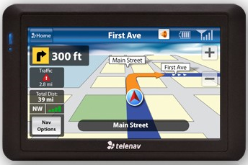
B: SiDiff Path Engine Syntax

Slide 61
Path Engine Syntax
Addressing of “non-local information“
  Used in different contexts
    Compare functions
    Signatures
    ...
  SiDiff Path-Engine
    Set-Navigation over EMF-Models
    Typesafe access to objects
    EPath like Syntax
    Efficient

Slide 62
Path Engine Syntax
Addressing of non-local information
  Navigation consists of navigation steps
    Separated by '/'
  Starts at
    a given context-object (relative path)
      Context-object is always needed
    the root-object set of the Resource (absolute path)
      Root axis
  A path expression does not start with '/'
    A path expression starts with a step!

Slide 63
Path Engine Syntax
Addressing of non-local Information
  A Navigation step consists of
    An axis
    An object-type selection
    An optional condition
  Syntax: {axis}.{axis-parameter}#{typename}[{condition}]
    The need of an axis-parameter depends on the axis
    Typename '*' accepts any type
      only allowed, if context type can be infered uniquely

Slide 64
Path Engine Syntax
Efficient addressing of non-local Information
  Axis-types
    Outgoing computes referenced EObjects
      EReference name has to be specified
      Resulting type will be inferred
    Incoming computes referring EObjects
      EReference name that points to the context has to be specified
      Resulting type cannot be infered
    Parent, Self, Root
      No additional axis parameter
      Resulting type cannot be infered
    ...

Slide 65
Path Engine Syntax
Efficient addressing of non-local Information
  Conditions
    NoBackstep
      Prevent navigation to revisit previous context-objects
    NoCycle
      Prevent navigation to revisit already visited objects
    OCL
      Checks a given OCL-expression
      Expression must be given as nested parameter
    ...

Slide 66
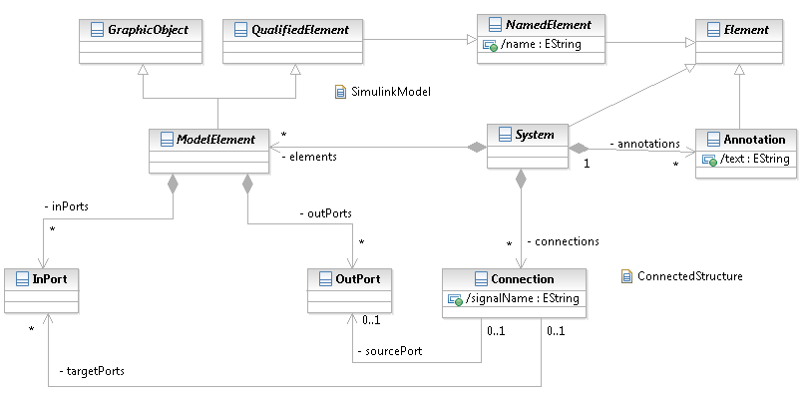
Path Engine Syntax
Efficient addressing of non-local Information
  Example: Meta-Model

Slide 67
Path Engine Syntax
Efficient addressing of non-local Information
  Example: Meta-Model
    Get all connected
    ModelElements

Slide 68
Path Engine Syntax
Efficient addressing of non-local Information
  Example: Meta-Model
    Get connected
    Sources, expect
    shortcuts
    (ModelElements)
Outgoing.inPorts#*/Incoming.targetPorts#Connection/Outgoing.sourcePort#*/parent#ModelElement[NoCycle]
1 2 3 4

