Slide 1

Enhanced Shortcuts to Adiabaticity in Josephson Junction
SFI Frontiers for the Future
19/FFP/6951
Shortcut-Enhanced Quantum Thermodynamics

Slide 2
Motivation for STA
Adiabatic theorem: If the Hamiltonian changes slowly and
then
Reality: Only interested in initial and final state
Problem: Adiabatic protocols are slow
Solution: Shortcuts to adiabaticity

Slide 3
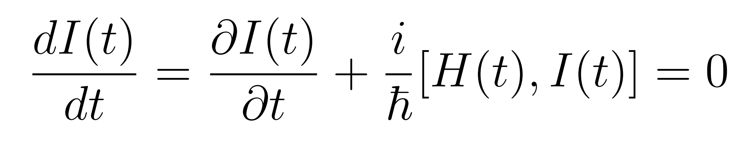
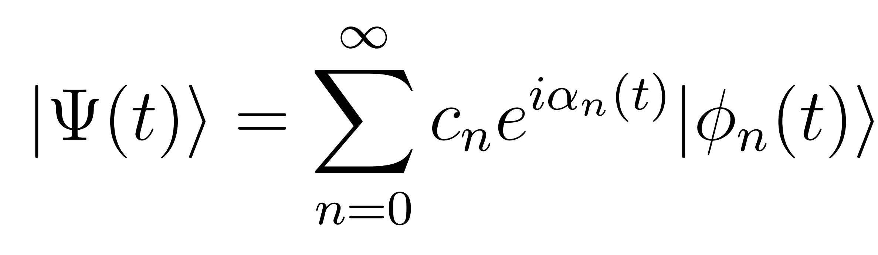
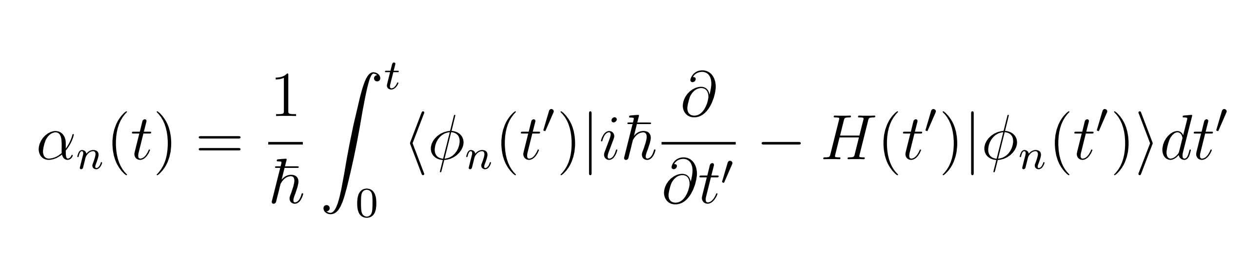
Invariant based STA
Given H(t), find dynamical invariant I(t) with eigenstates [1]
[1] D. Guéry-Odelin, A. Ruschhaupt, A. Kiely, et al. Rev. Mod. Phys. 91, 045001

Slide 4
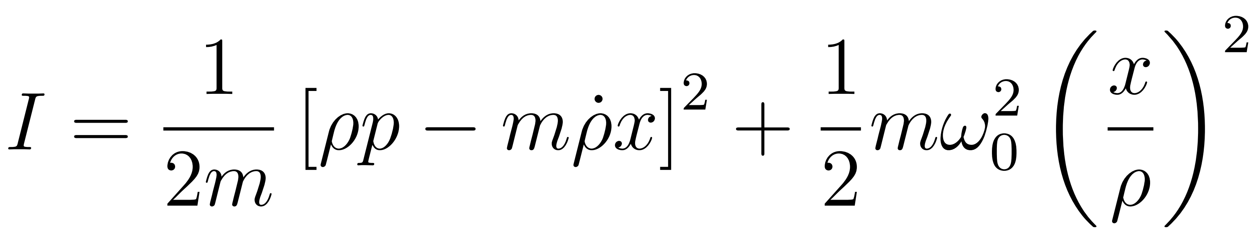
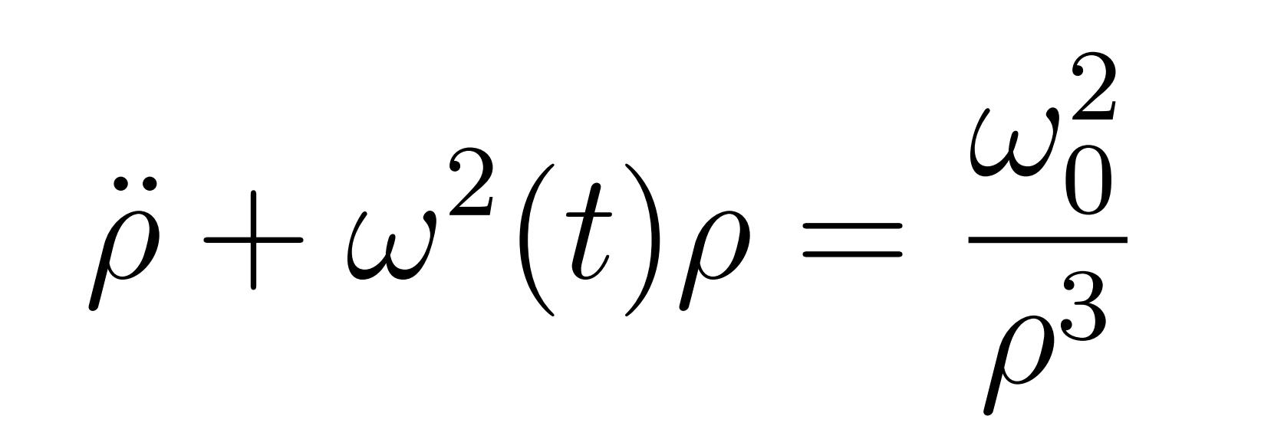
Example: STA in harmonic trap
System: harmonic oscillator
Invariant:
with
We are free to design to inverse engineer

Slide 5
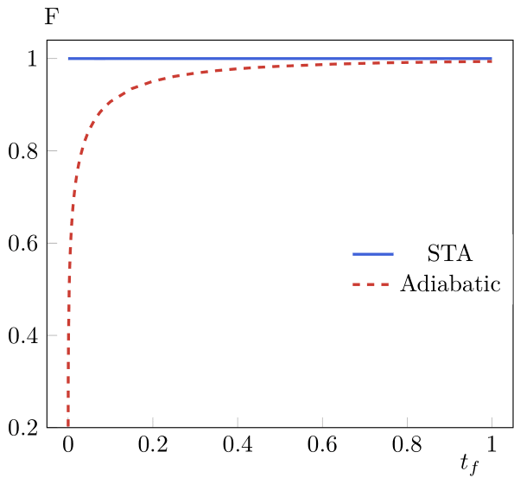
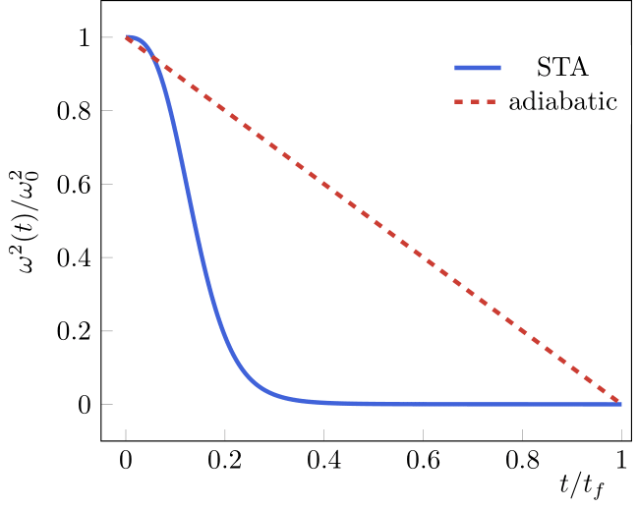
Results

Slide 6
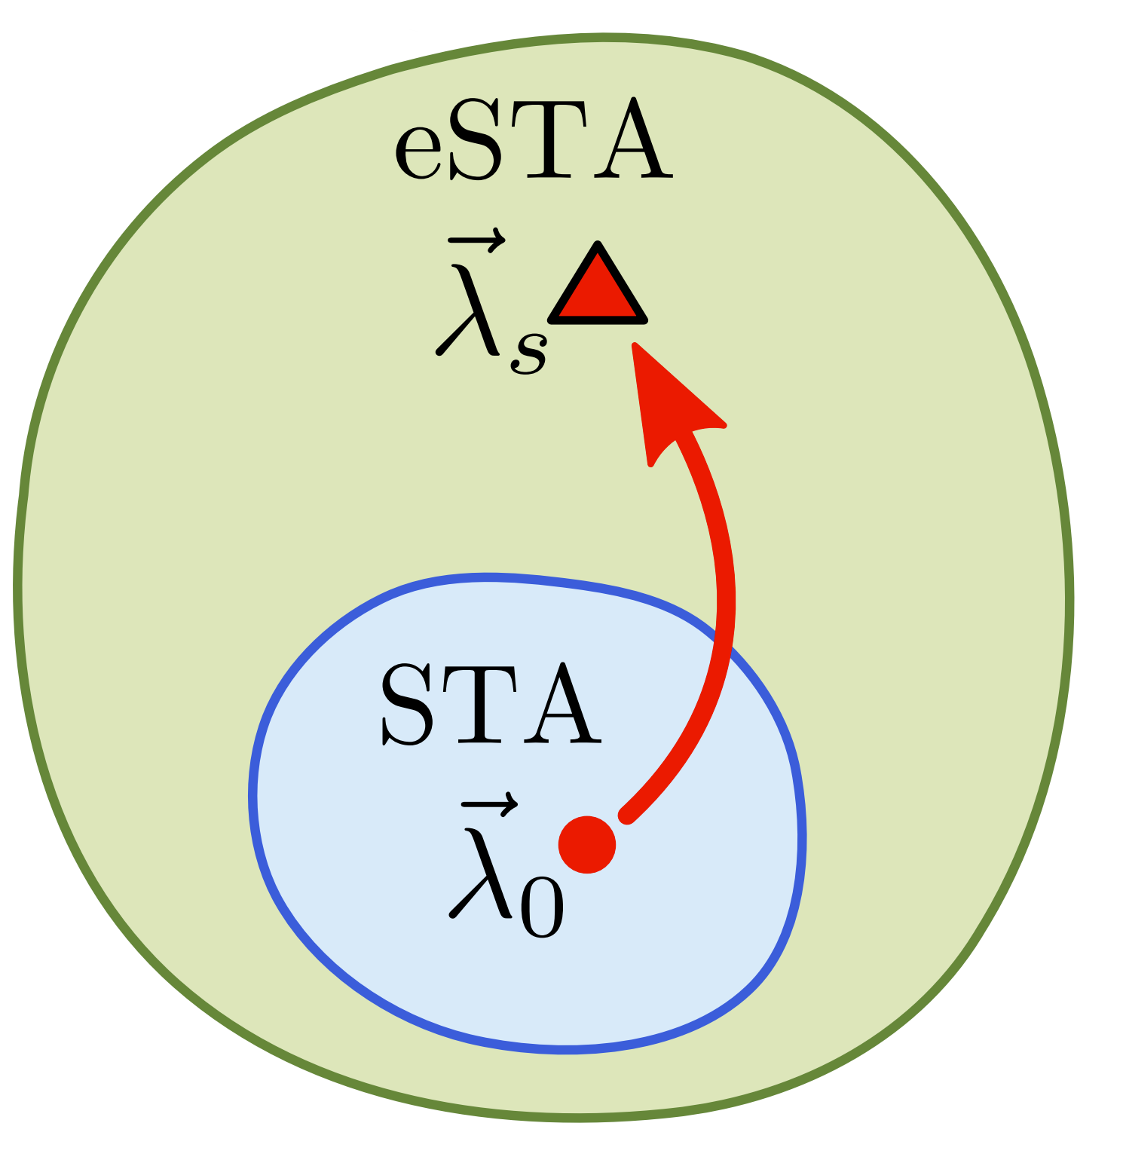
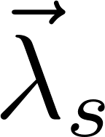
Motivation for eSTA
STA work exactly for a specific set of idealised Hamiltonians
Drop in fidelity and robustness outside of this set
Find a way to extend STA to further settings
Want to find an analytical way to obtain corrections

Slide 7
eSTA Formalism
H_{s} - Hamiltonian of the system
H₀ - Approximated version of H_{s}
- Control parameter
Assumption: Apply STA protocol to H_{s} is close to optimal
Goal: Find best control parameter to use in H_{s}
eSTA gives an analytical formula to get

Slide 8
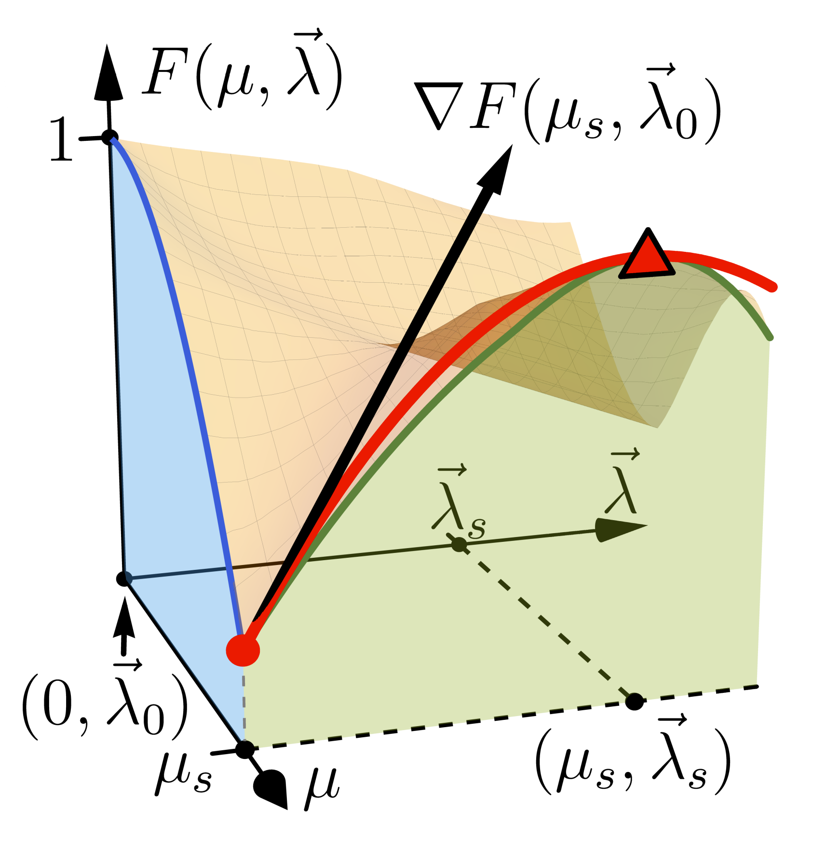
eSTA Formalism

Slide 9
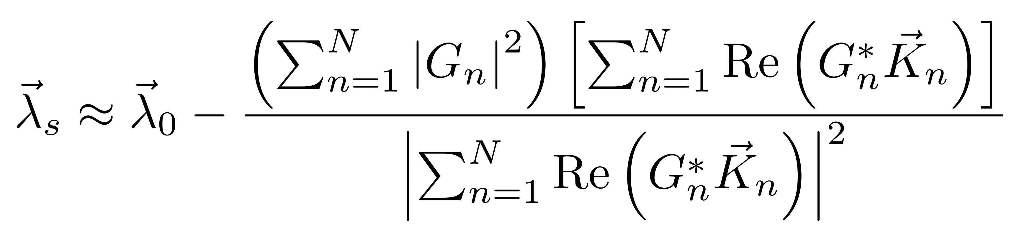
eSTA Corrections
Invariant based STA protocol for H₀
Control parameter for H₀
STA wavefunctions
Reference to calculation and beautiful graphics
C. Whitty, A. Kiely, and A. Ruschhaupt
Phys. Rev. Research 2, 023360

Slide 10
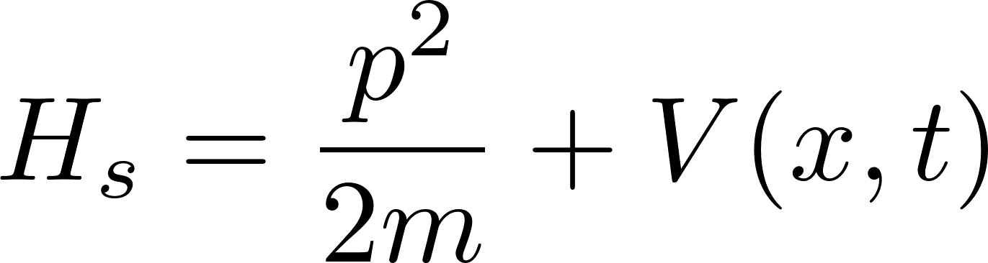
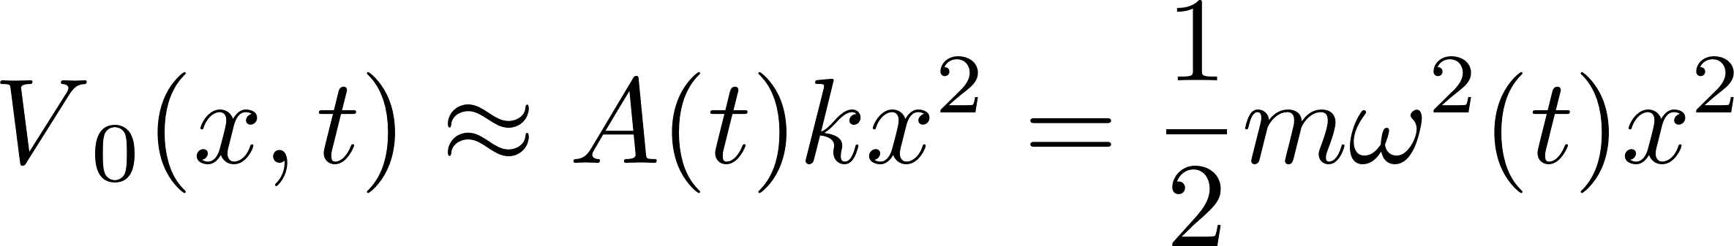
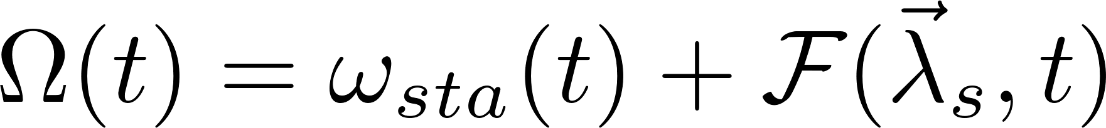
eSTA in (an)harmonic trap
Gaussian dipole trap
Expansion of V(x,t) around 0
Apply STA to H₀ and use eSTA to extend to H_{s}
Result: new control parameter

Slide 11
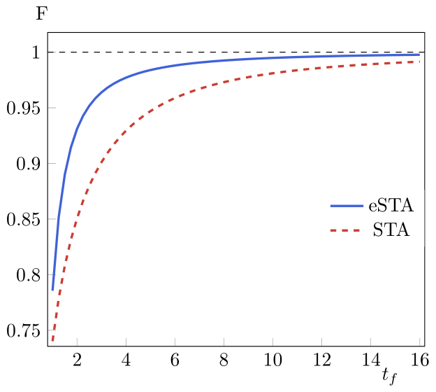
eSTA in (an)harmonic trap
Reference
C Whitty et al 2022 J. Phys. B: At. Mol. Opt. Phys. 55 194003

Slide 12
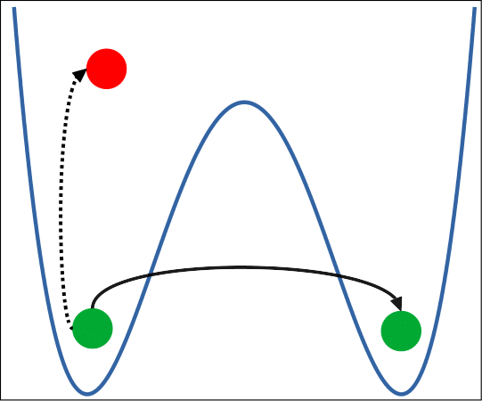
Josephson Junction
System: Double quantum well N particles (two mode approximation). Bose Hubbard Hamiltonian

Slide 13
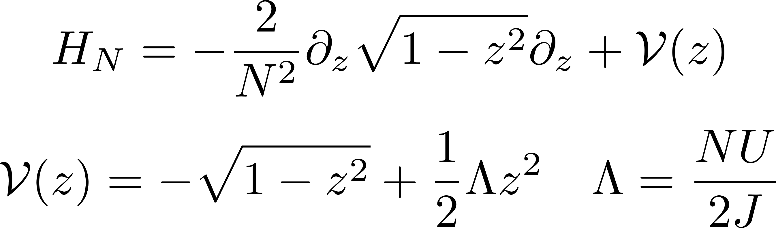
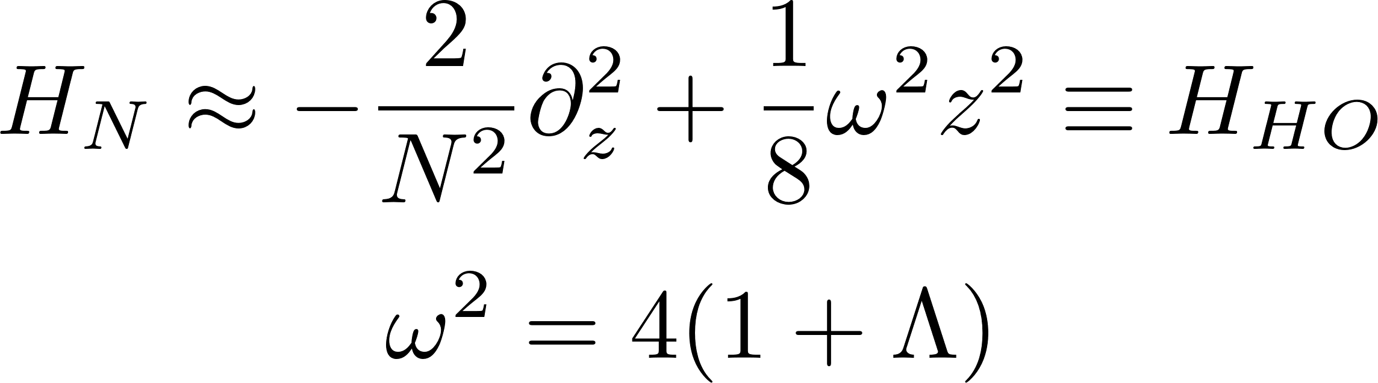
JJ – Approximations
Approximation 1: Systematic expansion of H_{BH} in terms of 1/NJ
Approximation 2: First order approximation of the 1 – z² terms

Slide 14
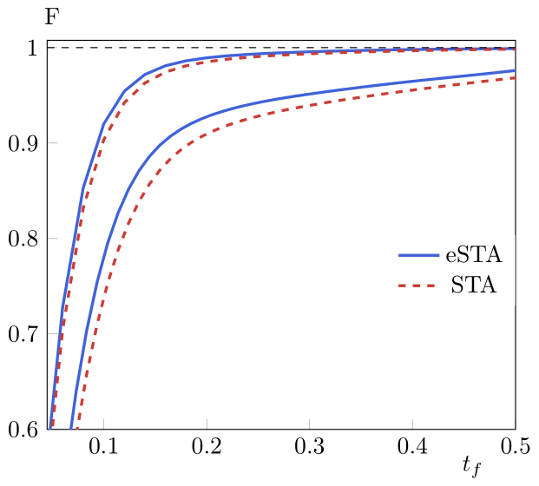
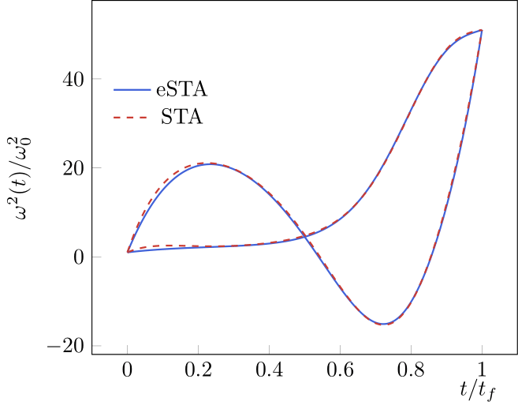
Preliminary Results
N = 30
N = 10

Slide 15
Summary
Brief overview of Shortcuts to Adiabaticity
Application to the Harmonic Trap
Description of enhanced Shortcuts
Application to the Harmonic Trap
Josephson junction
System description and useful approximations
Application of eSTA to the JJ
Results

Slide 16
Outlook and extensions
Apply eSTA corrections to H_{BH}
Extend eSTA to other STA techniques
eSTA applied to open quantum systems
e-STA or eSTA?

Slide 17






The Lads
Andreas Ruschhaupt
(Group leader)
David Rea
(Senior Collaborator)
Jing Li
( Postdoc )
Chris Whitty
(PhD)
Manuel Odelli
(PhD)
Guido De Rosa
(Master)
SFI Frontiers for the Future
19/FFP/6951
Shortcut-Enhanced Quantum Thermodynamics

Slide 18


