Slide 1
Enhanced Shortcuts to Adiabaticity in Josephon Junction

Slide 2
Outline
Brief overview of Shortcuts to Adiabaticity
Application to the Harmonic Trap
Description of enhanced Shortcuts
Application to the Harmonic Trap
Josephson junction
System description and useful approximations
Application of eSTA to the JJ
Results

Slide 3
Motivation for STA
Adiabatic theorem: If the Hamiltonian changes slowly and
then
Reality: Only interested in initial and final state
Problem: Adiabatic protocols are slow
Solution: Shortcuts to adiabaticity

Slide 4
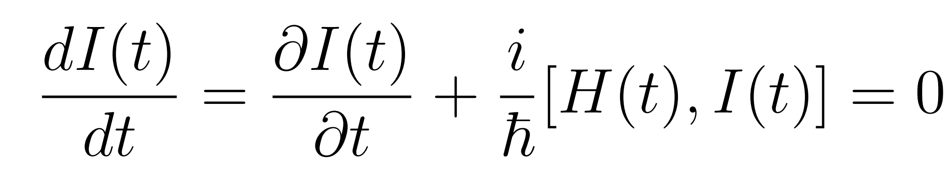
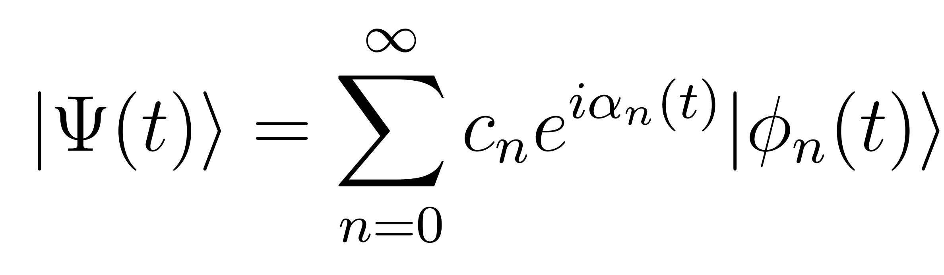
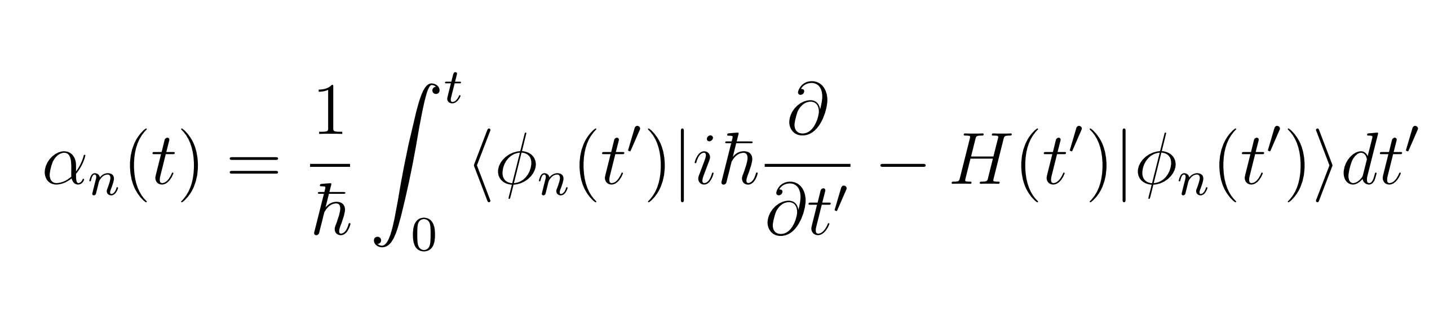
Invariant based STA
Given H(t), find dinamical invariant I(t) with eigenstates

Slide 5
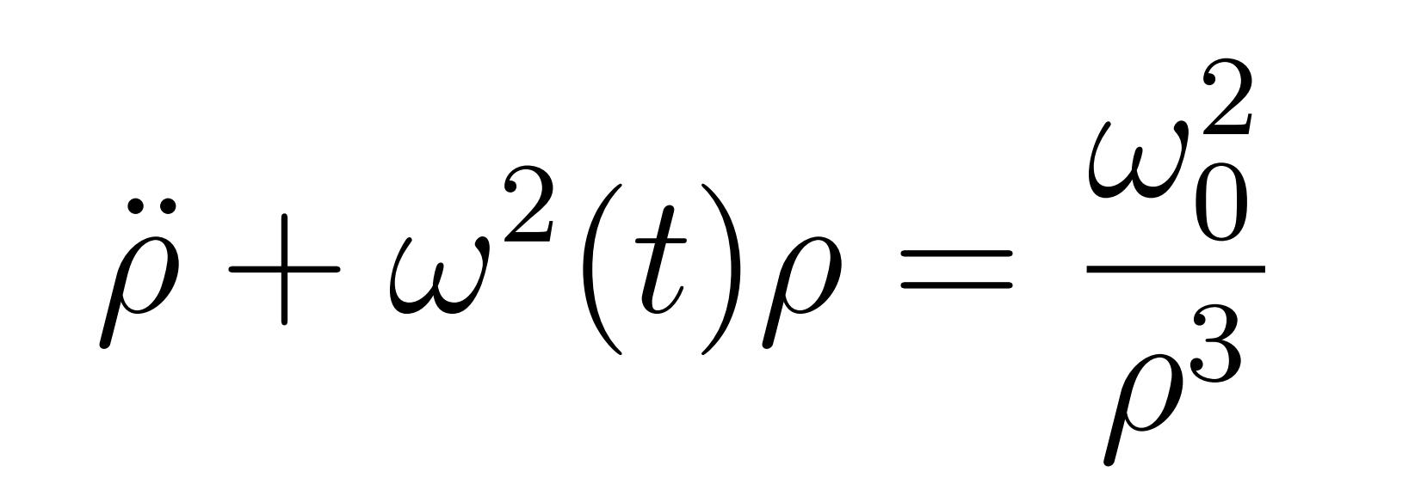
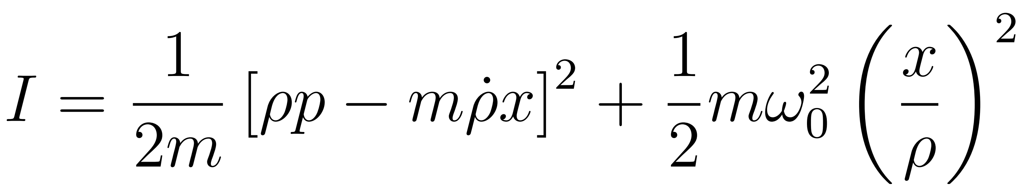

Example: STA in harmonic trap
System: harmonic oscillator
Invariant:
with
We are free to choose to fit all boundary conditions and inverse engineer

Slide 6
Results
Here I’d like to insert 2 graphs: the first about the control parameter (one linear and the other STA) and the resulting fidelity for different final times

Slide 7
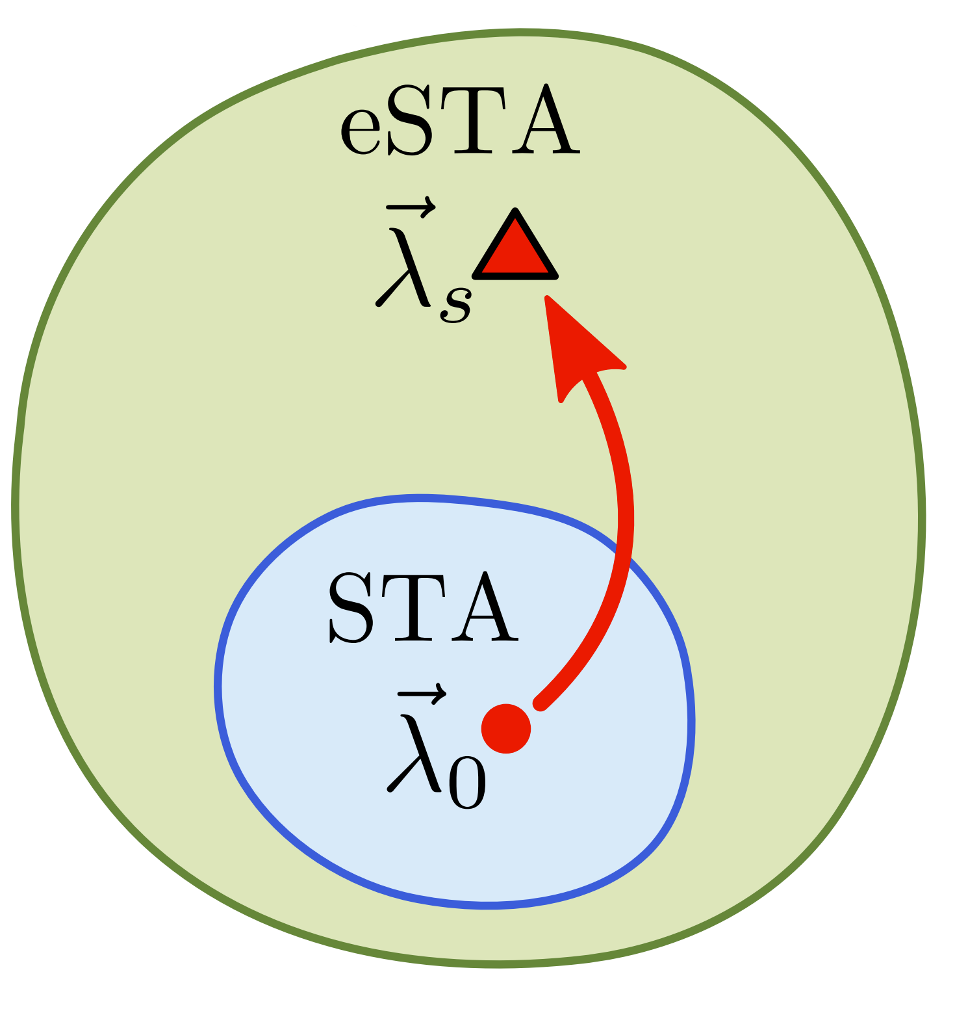
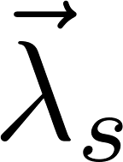
Motivation for eSTA
STA work exactly for a specific set of idealised Hamiltonians
Drop in fidelity and robustness outside of this set
Find a way to extend STA to further settings
Want to find an analytical way to obtain corrections

Slide 8
eSTA Formalism
H_{s} - Hamiltonian of the system
H₀ - Approximated version of H_{μ}
- Control parameter
Assumption: Apply STA protocol to H_{μ} is close to optimal
Goal: Find best control parameter to use in H_{μ}
eSTA gives an analytical formula to get

Slide 10
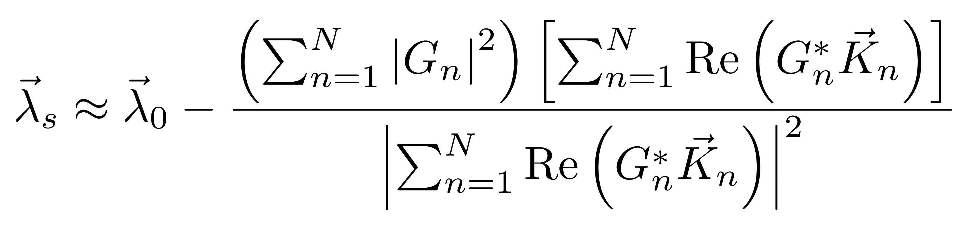
eSTA Formalism
Invariant based STA protocol for H₀
Control parameter for H₀
STA wavefunctions

Slide 11
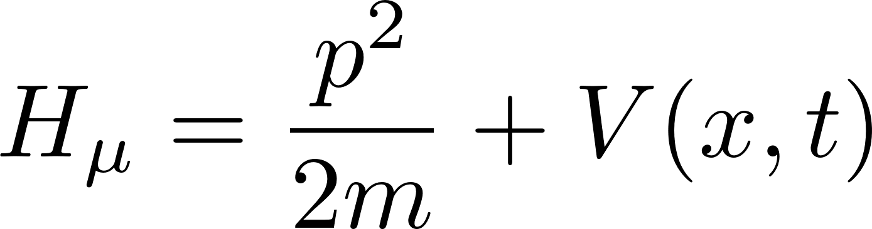
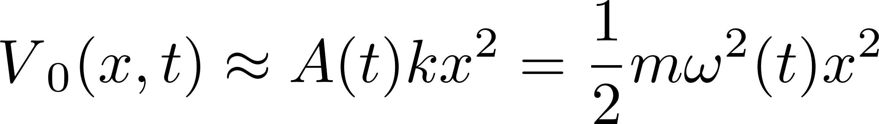
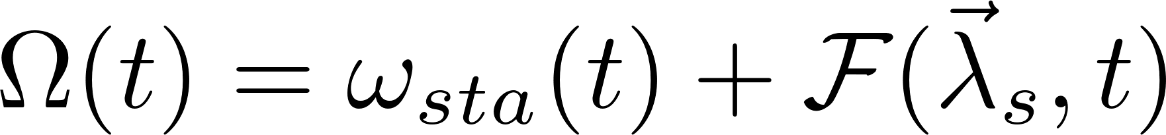
eSTA in (an)harmonic trap
Gaussian dipole trap
Expansion of V(x,t) around 0
Apply STA to H₀ and use eSTA to extend to H_{μ}
Result: new control parameter

Slide 12
eSTA in (an)harmonic trap
Here again I want to put two graphs with the two different control parameters (sTA and eSTA) and the resulting fidelities for different final times

Slide 13
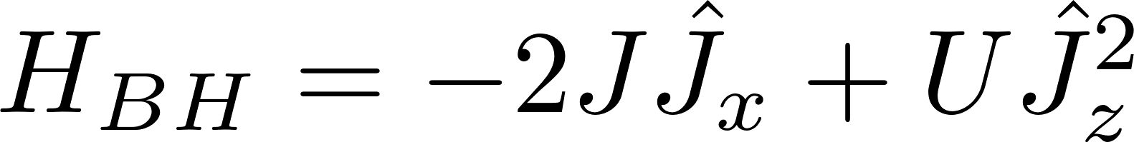
Josephson Junction
System: Double quantum well N particles (two mode approximation). Bose Hubbard Hamiltonian
Here I will plot a schematic version of the Josephson Junction

Slide 14
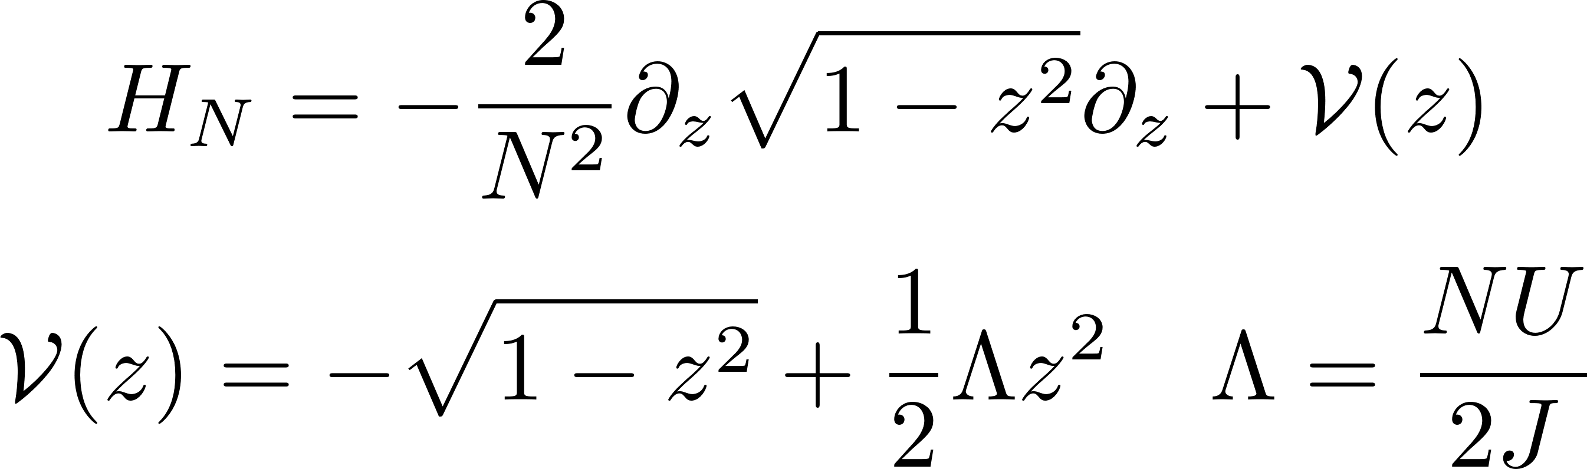
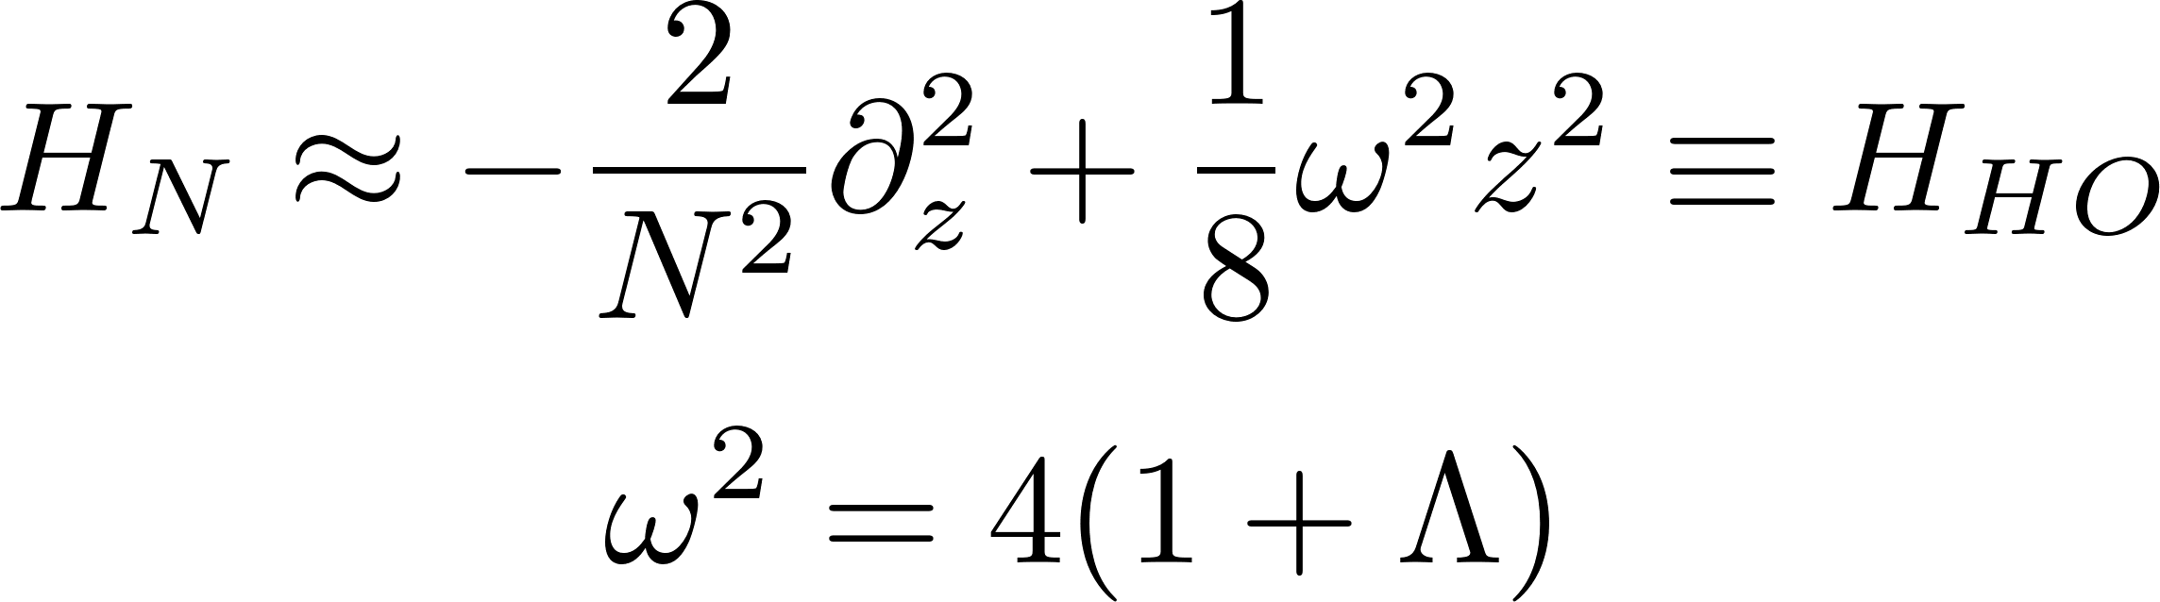
JJ – Approximations
Approximation 1: Systematic expansion of [1] in terms of 1/NJ
Approximation 2: First order approximation of the 1 – z² terms

Slide 15
Preliminary Results
Same as the other two

Slide 16
add graphs with different Ns

Slide 17
Outlook and extensions
Apply eSTA corrections to H_{BH}
Extend eSTA to other STA techniques
Many body

Slide 18
Pictures of the group

Slide 19
Thank you page

