Slide 1


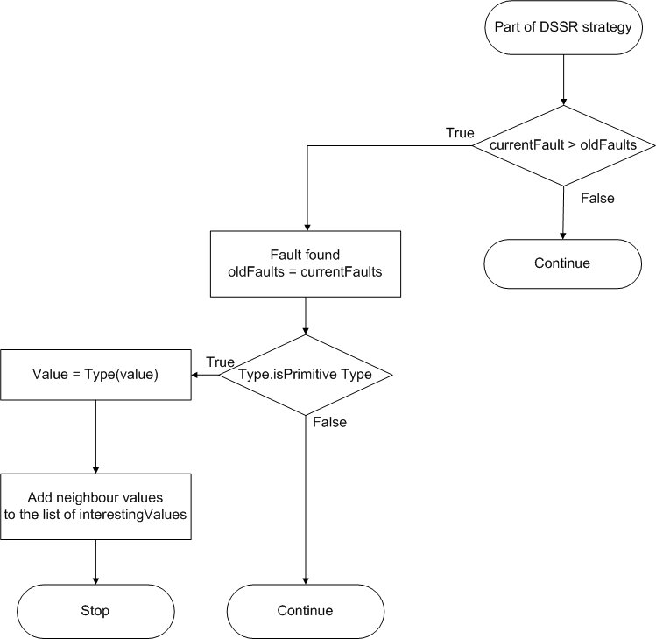
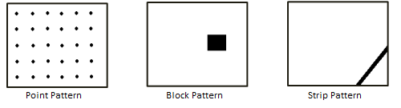
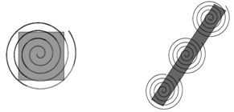
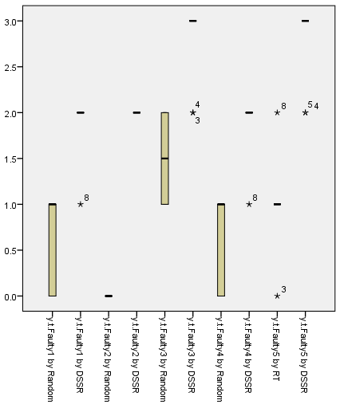
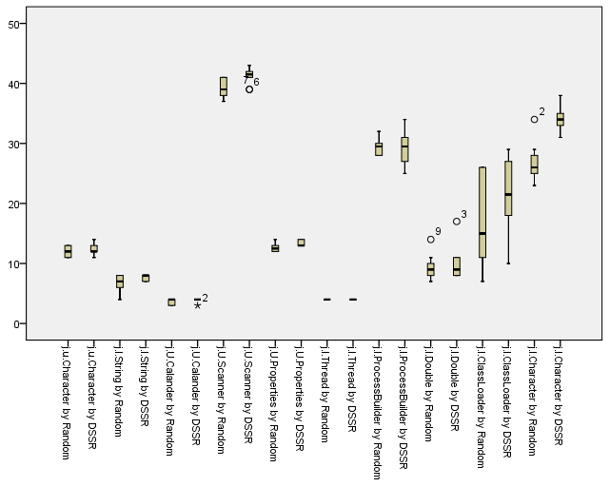
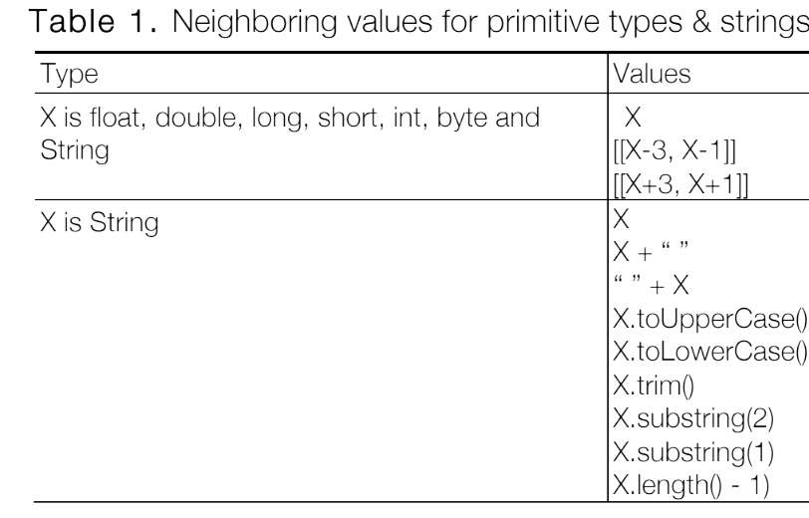
Dirt Spot Sweeping Random Strategy
Mian Asbat Ahmad, Manuel Oriol — Department of Computer Science, University of York, United Kingdom
Introduction
Random testing is a black-box testing technique in which the Software/System Under Test (SUT) is executed against randomly selected test data. Test results obtained are compared either against the oracle deﬁned, using SUT speciﬁcations in the form of assertions/contracts or exceptions deﬁned by the programming language.
Random Plus is a random testing that incorporate the technique of boundary values in random testing. Boundary values are the values on the start, end and middle of particular data type. For example for months in an year can be represented in integer from 1 to 12 and the border values for it can be -3, -2, -1, 0, 4, 5, 6, 13, 14, 15 etc.
According to Chen at al., there are patterns of failure causing inputs across the input domain and they separated these pattern into point, block and strip patterns.
Working of DSSR strategy
In the process the program continuously track the number of faults and once a fault is found in the SUT, the program not only copy the values of the test case but also copy its surrounding values to the variable list of interesting values. From the ﬂowchart it is clear that if the fault ﬁnding value is of a primitive type then the strategy only add objects of that type to the list. Doing this increases size of the list of interesting values for testing thus providing more chances of ﬁnding faults. In Figure 3 DSSR strategy is explained with the help of ﬂowchart.
Motivating Example
The following java code further clarify the concept where DSSR strategy finds the available two faults in 2 MS whereas the pure random and random plus are unable to find the second fault.
Reason for the success of DSSR strategy is that it adds the neighbour values of the first fault (98, 99, 100, 101, 102, 103, 104) to the list of interesting values after the fault is identified. Values from this list has more chances to be picked for new test cases and thus the second fault is found quickly by DSSR. On the other hand random strategy continue to test the program in traditional way.
Conclusions
From the preliminary experiments it is concluded that DSSR strategy is up to 30% more effective in finding faults as compared to random testing. In the experiments DSSR strategy was not only consistent but also found faults that random testing was unable to detect.
DSSR strategy takes the advantage of Random Plus by incorporating border values before starting the test but the addition of fault finding value and its neighbor values, at run time, to the interesting values list make it even more effective specially for programs that have block and strip fault patterns. On the other hand we also found that when the programs do not contain any fault patterns than DSSR strategy takes slightly more time to execute (up to 5%) the test cases which is obvious because of additional steps of adding the fault value and its neighboring values to the list of interesting values and later scanning the list for selection of the test values for executing test cases.
public class Faulty {
public void closer(int x, int y) {
y = 20;
int a [ ] = new int[10];
if ((x > 100) && (x < 102))
{
a[11] = 22;
}
if (( x > 97 ) && ( x < 99))
{
z= ( x + y )/0;
}
}
}
Future Work
Initial results suggested that DSSR strategy is doing better than Pure Random but for concrete results one need to perform extensive testing. Experiments should cover project of different nature, therefore, to get more reliable results our next plan is to test 1000 classes from more than 100 projects of Qualitas Corpus, an independent database of open source Java project.
Fig. 1.Failure patterns across the input domain.
Dirt Spot Sweeping Random strategy
Dirt Spot Sweeping Random (DSSR) strategy is a new random test strategy developed during this study. DSSR strategy is the combination of pure random, random plus/boundary values, and the spot sweeping.
Literature cited
I. Ciupa, B. Meyer, M. Oriol, and A. Pretschner, “Finding faults: Manual testing vs. random+ testing vs. user reports,” in Proceedings of the 2008 19th International Symposium on Software Reliability Engineering, (Washington, DC, USA), pp. 157–166, IEEE Computer Society, 2008.
T. Y. Chen, H. Leung, and I. K. Mak, “Adaptive random testing,” in Advances in Computer Science - ASIAN 2004 (M. Maher, ed.), vol. 3321 of Lecture Notes in Computer Science, pp. 3156–3157, Springer Berlin / Heidelberg, 2005.
B. Beizer, Software testing techniques (2nd ed.). New York,NY, USA: Van Nostrand Reinhold Co., 1990.
M. A. Ahmad, “New strategies for automated random testing of programs.” November 2010.
R. Hamlet, “Random testing,” in Encyclopedia of Software Engineering, pp. 970–978, Wiley, 1994.
Fig. 3. Working Mechanism of DSSR
Experimental Results
For initial experiments we tested 10 classes from JDK and wrote 5 classes of our own. Results of the experiments showed that DSSR strategy is more reliable and found more faults than its predecessor Pure Random as showed in Following figures.
Pre-deﬁned special values are added by random plus prior to testing but to sweep the failure pattern we need to add fault neighboring values at run time after a fault is found in the system. The following table shows the values that are added to the list of interesting values when a fault is found by the test value X while X can be int, double, ﬂoat, long, byte, short, char and String. All values are converted to their respective types before addition to the list of interesting values.
Fig. 2. DSSR covering block and strip patterns.
Purpose of DSSR strategy
The main purpose of DSSR strategy is to improve the performance of random testing by finding maximum number of faults in minimum time.
Acknowledgments
We thank our families, the whole Enterprise Systems Group and specially Prof. Richard Page for their help and support. We also thank the York Doctoral Symposium (YDS) team who provided us the platform to present and share our research and get valuable feedback.
Implementation of DSSR strategy
The DSSR strategy is implemented in York Extensible Testing Infrastructure (YETI) tool. YETI is an automatic random testing tool developed in Java. It is an open source tool capable of testing both procedural and object-oriented software. Its language-agnostic meta model enables it to test programs written in multiple languages including Java, C#, JML and .Net. The core features of YETI includes easy extensibility for future growth, speed of up to one million calls per minute on java code, real time logging, real time GUI support, ability to test programs using multiple strategies and auto generation of test report at the end of the test session.
For further information
Please contact Mian on ma@cs.york.ac.uk,
Dr. Manuel Oriol on manuel@cs.york.ac.uk
For YETI tool visit http://www.yetitest.org

