Slide 1
ex10 · heap file of slotted pages
SlottedPage
Giving 4096 raw bytes a meaning
What the page has to solve
All of the object's state
A frame hands you 4096 raw bytes. Something has to decide what they mean.
Records are fixed length (Person = 21 B), so slot i is pure arithmetic.
Each slot carries one occupancy byte — 0 free, 1 occupied.
The page stores its own slot count and its prev / next page ids: on disk the file is a doubly linked list of pages.
char* buffer_ = nullptr; // not owned
std::size_t record_size_ = 0;
std::size_t capacity_ = 0;
// unset until format() or attach()
Nothing derived is cached. Occupied counts, free slots and chain links are recomputed from the bytes on every call — the bytes cannot drift from themselves.
Layout only. No I/O, no file handle, no pins, no dirty flags — those stay in BufferManager.
Notes:
SlottedPage is a non-owning view over one frame buffer. Its whole job is to interpret 4096 bytes as fixed-length record slots plus bookkeeping. It never touches the disk — the buffer manager owns pinning, dirty marking and write-back.

Slide 2
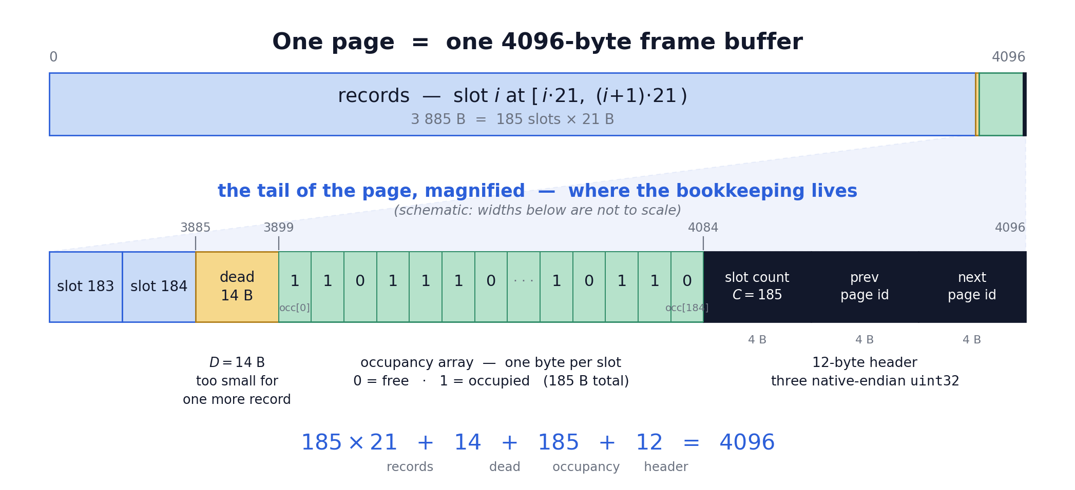
The byte layout
Fixed-length record slots, one occupancy byte each, and the chain links — all inside a single block
kNoPage = 0xFFFFFFFF ends the chain — page id 0 is legal (it is the header page), so 0 can never be the sentinel.
Notes:
C = 185 slots and D = 14 bytes of dead space for the 21-byte Person record. The identity 185*21 + 14 + 185 + 12 = 4096 fills the page exactly. The occupancy array ends exactly where the header begins, which is what makes occupancy_offset simple.

Slide 3
Capacity, dead space, slot arithmetic
The byte math is written once, with names — so the layout table has exactly one counterpart in code.
SlottedPage.cpp
Each slot costs R + 1 bytes
std::size_t slot_capacity(std::size_t record_size) {
return (bufman::kPageSize - kPageHeaderSize)
/ (record_size + 1);
}
std::size_t dead_space(std::size_t record_size) {
return (bufman::kPageSize - kPageHeaderSize)
- slot_capacity(record_size) * (record_size + 1);
}
std::size_t record_offset(std::size_t slot) const {
return slot * record_size_;
}
std::size_t occupancy_offset(std::size_t slot) const {
return kSlotCountOffset - capacity_ + slot;
}
C = ⌊ (4096 − 12) / (R + 1) ⌋
D = (4096 − 12) − C · (R + 1)
record size R | slots C | dead D
21 (Person) | 185 | 14
1 | 2042 | 0
25 | 157 | 2
0 ≤ D ≤ R by construction.
The remainder after whole slots is always smaller than one more record-plus-byte, so it is simply left unused — no compaction, no bump pointer.
Notes:
Every slot pays for itself plus one occupancy byte, which is where the +1 comes from. R = 1 is the degenerate case with no dead space at all; R = 25 leaves 2 bytes. occupancy_offset works backwards from the header so the array always ends exactly at kSlotCountOffset.

Slide 4
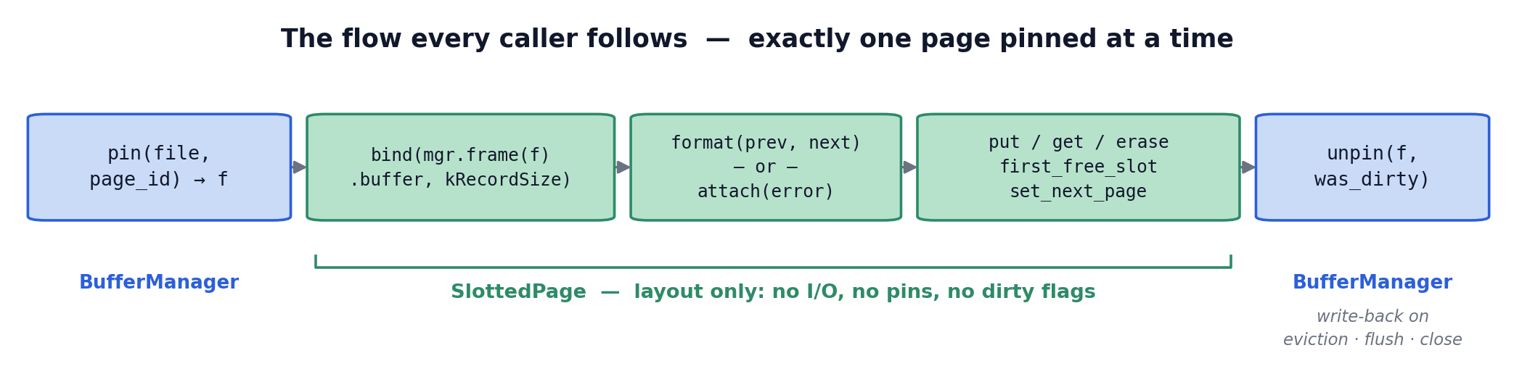
Lifecycle: bind → format or attach
The view binds to a buffer; format() prepares a fresh page, attach() adopts bytes that are already there.
How every caller uses it
attach() is the guard
It reads the stored slot count and compares it with the value recomputed from the bound record size.
A mismatch means corrupted or foreign bytes — a hard error, never silent trust.
mgr.pin(file, page_id, f, error);
SlottedPage page;
page.bind(mgr.frame(f).buffer, bufman::kRecordSize);
page.attach(error); // revalidate the header
// page.put / get / erase / set_next_page ...
mgr.unpin(f, /*was_dirty=*/true, error);
erase() clears one occupancy byte. The record bytes stay behind as garbage — the occupancy array is the single source of truth.
Notes:
bind() touches no bytes — capacity stays 0 until format() or attach() runs, and every record operation is bounds-checked against it. The caller, not the page, decides whether the frame became dirty.

