Slide 1


Database Systems Engineering
Manuel Rodriguez-Martinez, Ph.D.
Tree-based Indexing

Slide 2
Objectives
Describe the tree-based indexing structures
Describe the operations used to search, insert or delete records

Slide 3
Relational DBMS Architecture
Client API
Client
Query Parser
Query Optimizer
Relational Operators
Execution
Engine
File and Access Methods
Concurrency
and Recovery
Buffer Management
Disk Space Management
DB

Slide 4
Tree-based Indexing
Idea:
  Tree-based Data structure is used to order data entries
  Index entries
    Root and internal nodes (pages) in the tree
    Guide “traffic” around to help locate records
  Data entries
    Leave nodes (pages) in the tree
    Contain either
      actual data
      pairs of search key and rid
      pairs of search key and rid-list
  Good for equality and range queries

Slide 5
Range queries
Queries that retrieve group of records that lie inside a range of values
Examples:
  Find the name of all students with a gpa between 3.40 and 3.80
  Find all the items with a prices greater than $50.
  Find all the parts with an average stock amount less than 30.
  Find all the galaxies that are within 10 light year from galaxy NC-1493.
  Find all the images for regions that overlap the area of Puerto Rico.
Note: Trees are also good for equality.

Slide 6
Equality and Range Queries
Equality queries:
  Select pid, pname, price
  From parts
  Where pmaterial = ‘steel’
  Select *
  From parts natural inner join supplies natural inner join supplier
  Where pid = 123
Range queries:
  Select pid, pname, price
  From parts
  Where price between 5 and 10
  Select *
  From parts natural inner join partsales
  Where saledate >= ‘01/01/2022’

Slide 7

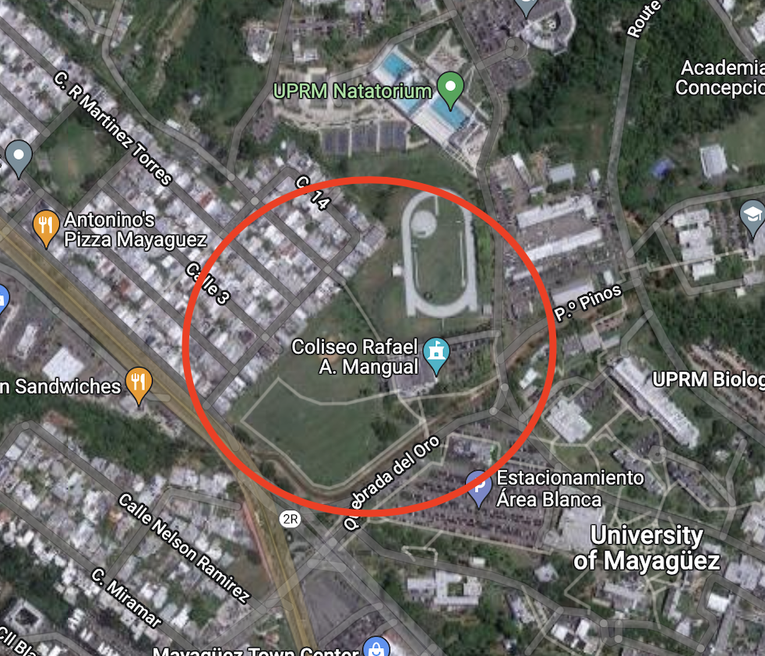
Spatial queries
  Find all houses that are within 1 KM of
  Coliseo Mangual
  Find all the galaxies that are within 10 light years from a red giant.

Slide 8
Tree index structure
Index entries
Index
File
Records are stored at data entries

Slide 9
Three major styles
ISAM
  Static tree index
  Good for alphanumeric data sets
B+-tree
  Dynamic tree index
  Good for alphanumeric data sets
R-tree
  Dynamic tree index
  Good for spatial data sets
    Polygons, maps, galaxies
    Dimensions in a data warehouse
      Parts, sales, date,

Slide 10
General form for index pages
Index pages have
  Key values – number, strings, rectangles (R-tree)
  “Pointers” (i.e., page ids) to child nodes (pages)
  P0 leads to values less than K1
  Pm leads to values greater or equal than Km
  For any other case, Pi points to values greater or equal than Ki, and values less than K _{i+1}
  For R-tree is all about overlapping regions …
P0 | K1 | P1 | K2 | P2 | … | Km | Pm

Slide 11
Some issues to keep in mind
Index entries are contained in pages
Data entries are contained in pages
We expect the root of the tree to stay around in the buffer pool
  Often 3-4 I/Os are need to locate the first group of data items
k1 k2
…
kn
Page 1
Page 2
Page 3
…
Page N

Slide 12
ISAM
Indexed sequential access method (ISAM)
Support insert, delete, search operations
Static index structure based on trees
  Balanced tree
Number of leaves and internal nodes is fixed at file creation time
More space is allocated as overflow pages
  Chained with appropriate leaf
  Long overflow chains are no good.

Slide 13
ISAM Structure
…
…
…
…
Overflow pages

Slide 14
Sample ISAM Tree
 | 40
 | 20 |  | 33
 | 51 |  | 63
10 | 15
20 | 27
33 | 37
40 | 46
51 | 55
63 | 97

Slide 15
ISAM Disk Organization
Data pages are allocated sequentially
  Fixed number of pages at file creation
Index pages are then allocated
  Fixed number of pages at file creation
Overflow pages go at the end of file
  Variable number
  Must be chained with the base data pages
Data pages
Index pages
Overflow pages
ISAM
File
Structure

Slide 16
ISAM Tree After a few insertions
 | 40
Insertions:
23, 48, 41, 42
 | 20 |  | 33
 | 51 |  | 63
10 | 15
20 | 27
33 | 37
40 | 46
51 | 55
63 | 97
Overflow
page
23
48 | 41
42

Slide 17
Search Algorithms
nodeptr find(search key K){
return find_aux(root, K);
}
nodeptr find_aux(nodeptr P, key K){
if P is a leaf then return P
else {
if (k < K1) then return find_aux(node_ptr.P0, K);
else if (k >= Km) then return find_aux(node_ptr.Pm, k);
else {
find Ki such that Ki <= K < Ki+1
return find_aux(node_ptr.Pi, k);
}
}
}
P0 | K1 | P1 | K2 | P2 | … | Km | Pm

Slide 18
Search Algorithm
Above algorithms just finds a pointer to the page where record might be
Once we get the pointer, need to search the value inside the page
  Use either sequential or binary search
If overflow pages exists, need to traverse them
  Lots of overflow pages mean more I/Os
Here need to understand the format of the page
  Determine the how to locate the record
If a range query is issued need to travel adjacent pages to get the appropriate values

Slide 19
Insertion and Deletion
Use search algorithm to find the page where the record(s) should go
Then within this page
  Insert the record
  Delete the record
If not found, then if there are overflow pages,
  Repeat this process on the overflow page

Slide 20
Some Issues
Fan out
  Number of entries in the data pages
  Fixed at file creation
  Often used in the hundreds
Each node has
  N keys
  N + 1 pointers
Oftern, ISAM is built on an existing group of records
  That’s how you determine number of pages and so forth

Slide 21
B+-trees
Dynamic index structure
Adapts its size and height to the pattern of insertion and deletion.
  Balanced tree because all leaf nodes are at the same height
No overflow pages (unless duplicates are there)
Each leaf and internal node has an order
  Capacity of node to hold m keys
  Order d has the property d <= m <= 2d
    Tree of order 1 has between 1 and 2 keys, and between 2 and tree children.
Internal nodes have
  Up to m keys
  Up to m+1 pointers to child nodes
Leaf nodes have the data entries

Slide 22
Example B+Tree
B+ tree with
fan out of 2
 | 40
10 | 15
40 | 80
Internal Nodes have search keys & pointers to child nodes
Data entries have data or pairs of <search key,rid>
Data entries are linked in a doubly linked list (permits scan operations easily).

Slide 23
Example B+tree
 | 38
 | 15
 | 44
10
15 | 25
38
44 | 67

Slide 24
Search Operation
P0 | K1 | P1 | K2 | P2 | … | Km | Pm
findTuples(key, treeSearch(root,key));
  Finds page with tuples with search key and searches tuples
node treeSearch(Node N, Object key)
if (N is a leaf) return N; // find page
else if (key < K1) return treeSearch(N.P0, key);
else if (key >= Km) return treeSearch(N.Pm, key);
else :
for each key Ki in N, i <=1 <(m-1)
if ((Ki <= key) && (key < Ki+1))
return treeSearch(N.Pi. key);

Slide 25
Example: Search on B+tree
 | 38 |  | 40
10 | 15
38 | 39
40 | 56
Search for 15 and 56 is yields results.
Search for 20 does not
In either case, search reaches leaf level and returns page where data might be
  Function find Tuples must use binary or full search within the page to get the actual tuples.

Slide 26
Insert Algorithm
Insertion can be easy, or make the tree get new internal nodes or even grow by one level
Easy case occurs when the target page for insertion has room to accept one more tuples.
Complex case happens when leaf page is full and must be split
Insert operation is O(logm(N)) where m if the number of search keys in the node.

Slide 27
Example: Very Easy insertion
 | 38
Inserting 15
Leaf has room
15
10
38 | 44
 | 38
Leaf page is
simply updated
10 | 15
38 | 44

Slide 28
Example: Easy insertion (part 1)
 | 38
Inserting 67
Leaf has no room
So it must be split
67
10 | 15
38 | 44
 | 38
New page is
allocated & tuples
redistributed
10 | 15
38
44 | 67

Slide 29
Example: Easy insertion (part 2)
 | 38
New Page must
be attached to root
And smallest key
added to root
10 | 15
38
44 | 67
 | 38 |  | 44
10 | 15
38
44 | 67

Slide 30
More Complex Insertion (part 1)
 | 38 |  | 44
10 | 15
38
44 | 67
Insert 25
Cause leftmost
Leaf to split
 | 38 |  | 44
25
10 | 15
38
44 | 67

Slide 31
More Complex Insertion (part 2)
 | 38 |  | 44
10
15 | 25
38
44 | 67
New page and key 15 must be inserted into root
Now the root has no room to get new page
So the root will be root will be split

Slide 32
More Complex Insertion (part 3)
Middle key
New node
38
Old root
 | 15
 | 44
10
15 | 25
38
44 | 67
After splitting root, middle key 38 and new right node must be inserted into to parent
Since we split the root, we need a new root

Slide 33
More Complex Insertion (part 4)
 | 38
New node
Old root
 | 15
 | 44
10
15 | 25
38
44 | 67
New root was created
Tree height increase by one
In practice you try to keep leaf 67% to 75% full
  Avoid splits (they change rid of record)
  Indices are dropped and recreated to alleviate problems (weekly)

Slide 34
Insertion Algorithm (part 1)
insert(root, tuple){
insertAux(root, tuple, newNode, newKey)
if (newNode != null){
Node temp = new Node().
temp.setKey(newKey, 0);
temp.setChild(0, root);
temp.setChild(1, newNode;
root = temp;
}

Slide 35
Insertion Algorithm (part 2)
insertAux(Node N, Tuple T, Node N2, Object key){
if (N is a leaf){
if (N has room)
add T to the page
return;
else {
Node N2 = new Node()
keep first d keys and first d+1 pointers in N,
move remaining keys and pointers to N2
key = smallest key in N2
N.next = N2;
N2.prev = N;
return;
}

Slide 36
Insert Algorithm (part 3)
else { // non-leaf case
for each key Ki in N, i <= 0 <= m
if (Ki <= T.key < Ki+1)
insertAux(N.Pi, T, N2, key);
if (N2 == null) return;
else if N is not full {
Rearrange keys in N to make room for key
Add N2 as a new child of N
N2 = null; key = null;
return;
}

Slide 37
Insert Algorithm (part 4)
else { //Node is full
Node temp = N2;
N2 = new Node();
add key to list of keys to distribute
add temp to list of pointers to distributed
move last d keys and last d+1pointers to N2
keep first d keys and first d+1 pointers in N
key = middle key
return;
}

Slide 38
Erase Algorithm
Idea is to erase elements at the leaf level
  Recall that leaf is the actual page with data
Each leaf and internal node has a limit on number of elements to hold: d <= m <= 2d
If erase make leaf or internal node under-used we need to either
  Redistribute values with sibling node
  Drop the node, and merge its values with a sibling
  In worst case, the erase cascades to the root and the root is dropped in favor of one of its children
    Height of the tree decrease by 1
Erase is O(logm(N))

Slide 39
Easy Erase
 | 38 |  | 44
Erase 15
10 | 15
38
44 | 67
 | 38 |  | 44
10
38
44 | 67

Slide 40
More Complex Erase: Redistribute leaf (I)
 | 38 |  | 44
Erase 38
10
38
44 | 67
 | 38 |  | 44
Need to
See if sibling
Has data to
spare
10
44 | 67

Slide 41
More Complex Erase: Redistribute leaf (II)
 | 38 |  | 44
44 is borrowed
10
44
67
Copy up
67 which is
Min key on
Remaining
child
 | 38 |  | 67
10
44
67

Slide 42
More Complex Erase: Merge leaf (I)
 | 38 |  | 44
Erase 10
10
38
44 | 67
 | 38 |  | 44
Sibling has no
data to spare
38
44 | 67

Slide 43
More Complex Erase: Merge leaf (I)
 | 38 |  | 44
First two nodes
are made 1
38
44 | 67
 | 44
Internal nodes
Keys and pointers
Are re-organized
38
44 | 67

Slide 44
Erase that cause tree height to decrease
 | 38
 | 15
 | 44
10
15 | 25
38
44 | 67
Erase 15

Slide 45
Erase that cause tree height to decrease
 | 38
 | 15
 | 44
10
25
38
44 | 67
Erase 10

Slide 46
Erase that cause tree height to decrease
 | 38
 | 15
 | 44
25
38
44 | 67
Erase 10
Sibling of leftmost child has no data to spare
Leftmost is dropped (merged) with right

Slide 47
Erase that cause tree height to decrease
 | 38
 | 25
 | 44
25
38
44 | 67
But parent of leaf with 25 is cannot have only 1 child
It must be merged with sibling
Index entry of paret must be pulled down and 15 is dropped

Slide 48
Erase that cause tree height to decrease
 | 38
 | 38 |  | 44
25
38
44 | 67
But parent of leaf with 25 is cannot have only 1 child
It must be merged with sibling
Index entry of paret must be pulled down and 15 is dropped
Root must be dropped too

Slide 49
Erase that cause tree height to decrease
 | 38 |  | 44
25
38
44 | 67
A new root is given to the tree
Height decreased by one

Slide 50
Questions ?
Email:
  manuel.rodriguez7@upr.edu

