Slide 1
Image Regression for Plant Severity Assessment
The Challenge
Dataset Preparation
Methodology
    ResNet CNN
    ResNet + SVR
Results
Further Improvements
Discussion and Q&A
Manuel Ramos Calderón

Slide 2
Image Regression for Plant Severity Assessment
The Challenge
Dataset Preparation
Methodology
    ResNet CNN
    ResNet + SVR
Results
Further Improvements
Manuel Ramos Calderón

Slide 3
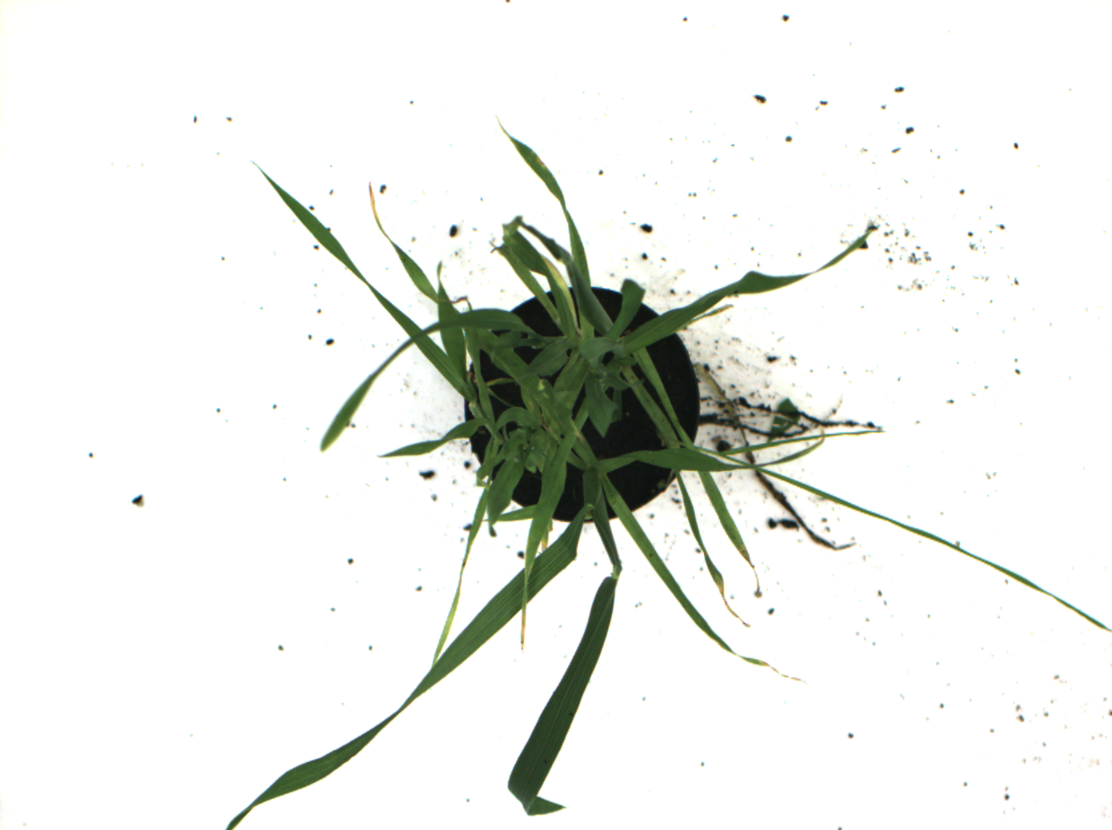
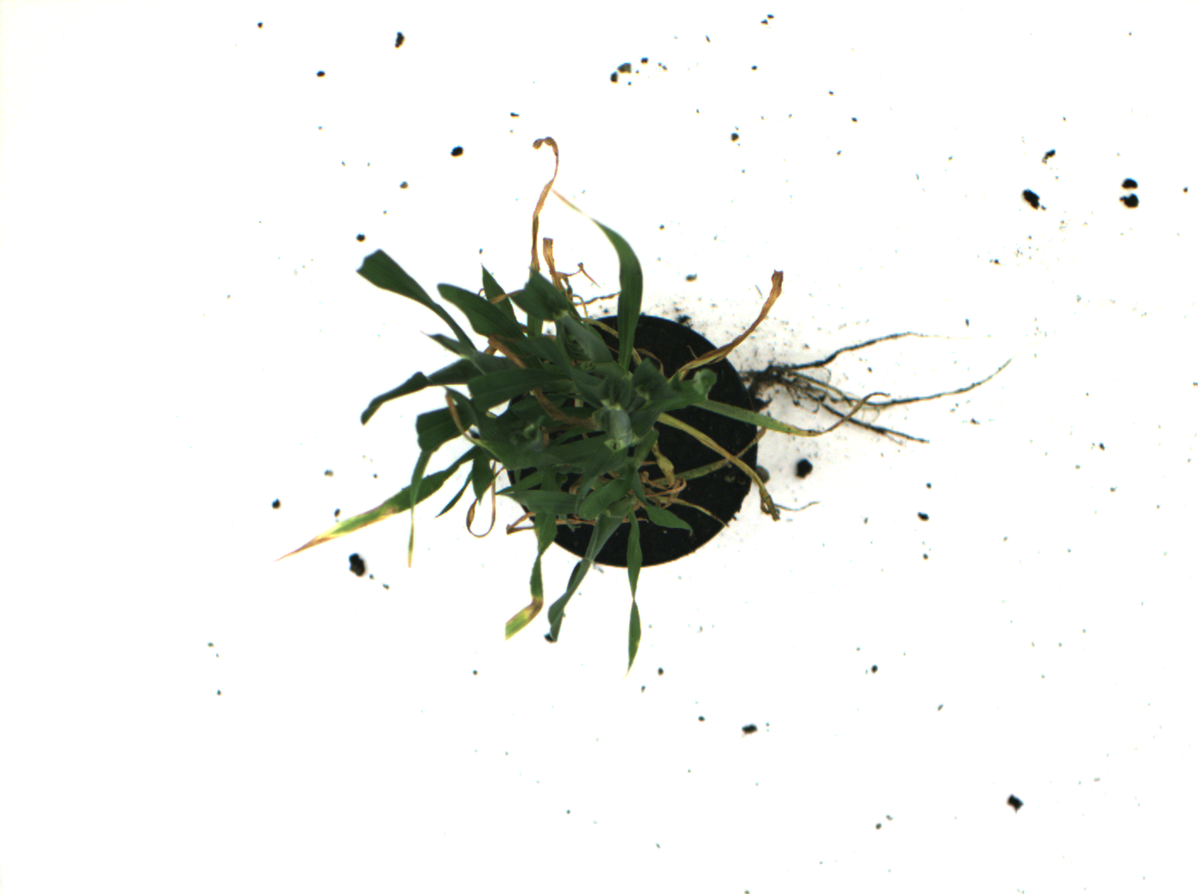
The Challenge
We want to automatically assess the health status of plants infected with a leaf spot disease according to the severity of infection from 0 (healthy) to 100 (strongly infected)
Health Score: 1
Health Score: 95
Manuel Ramos Calderón

Slide 4
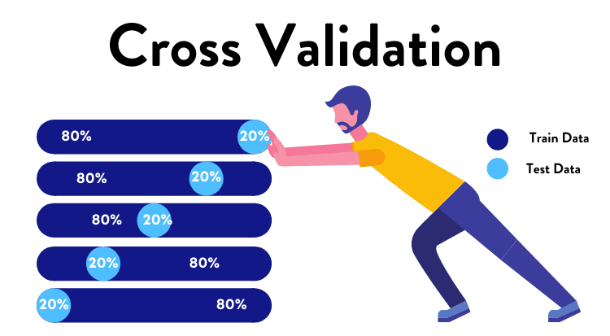
Dataset Preparation
144 graded images of plants photographed from top with a white background of size 1390x1038 pixels.
5-fold cross-validation: 80% training, 10% validation and 10% testing
Visualization of Cross-Validation
Manuel Ramos Calderón

Slide 5
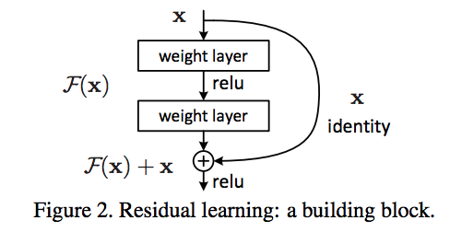
Methology: ResNet CNN
ResNet-18 and ResNet-34 models (Kaiming He et al. 2015)
Trasnsfer Learning → Pretrained on ImageNet dataset
  Residual Conections → Solves Vanishing Gradient
  Low Complexity → Good Baseline
  Easy to train on relatively small datasets
Manuel Ramos Calderón

Slide 6

Methology: ResNet CNN
Modifications in the CNN architecture:
  Substituted the decision layer by a series of dimensional-reducing FC layers interlayed with dropout conections for better regularization.
Conceptual example of FC layers
Manuel Ramos Calderón

Slide 7
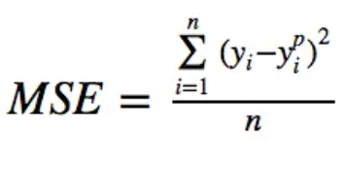
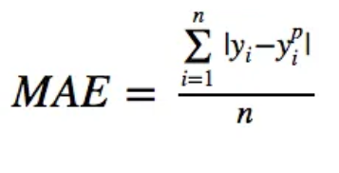
Methology: ResNet CNN
Loss Functions:
  MSE (L2 Loss): Mean Squared Error
  MAE (L1 Loss): Mean Absolute Error
Manuel Ramos Calderón

Slide 8
Methology: ResNet CNN
Optimization Algorithm and Hyperparameters:
  SGD with momentum (Stochastic Gradient Descent)
    Initial LR = 0,0005
    Momentum = 0,9
  Scheduler
    Step size = 4
    Gamma = 0,5
  25 Epochs
  Batch size: 8
Manuel Ramos Calderón

Slide 9
Methology: ResNet CNN
Data Augmentation: used torchvision.transforms to artificially augment the provided dataset for better generalization
  Resize: 344x344 pixels
  RandomRotation: ±180º
  RandomResizedCrop: scale (0.8 – 1.0)
  CenterCrop: 244x244 pixels
  RandomHorizontalFlip: p=0.5
  RandomVerticalFlip: p=0.5
  Normalization: [0-1] as ImageNet guidelines
Manuel Ramos Calderón

Slide 10
Methology: ResNet + SVR
Used trained ResNet-18 model of each fold as feature extractor.
Trained a Support Vector Regressor with Radial Basis Function kernel:
  SVR gives us the flexibility to define how much error is acceptable in our model and will find an appropriate line (or hyperplane in higher dimensions) to fit the data.
  Gamma: auto →
  Epsilon: 0.01
Manuel Ramos Calderón

Slide 11
Results: ResNet CNN
Run 5 training experiments per fold for more statistical significance
Selected the model with minimum validation MAE loss through all the training epochs
FOLD | Best VAL Loss [MAE] | TEST Loss [MAE]
1 | 8,421 | 10,193
2 | 6,541 | 10,04
3 | 5,506 | 8,58
4 | 12,97 | 17,88
5 | 13,59 | 7,19
Average | 9,40 | 10,78
Table 1: ResNet-18 CNN results
Manuel Ramos Calderón

Slide 12
Results: ResNet + SVR
Saberi Anari, M. J et al. (2022)
ResNet-18 CNN model with minimum test loss in each fold as feature extractor
Joined training+validation sets for training and test set for testing
FOLD | Train-Val Loss [MAE] | TEST Loss [MAE]
1 | 4.28 | 6.46
2 | 4.88 | 9.49
3 | 4.64 | 6.06
4 | 5.14 | 19.67
5 | 4.84 | 7.02
Average | 4.76 | 9.74
Table 2: ResNet-18 + SVR results
Manuel Ramos Calderón

Slide 13
Further Improvements
Test-time data augmentation
  Process the test images using random data augmentation policies to mitigate bias
Optimization of training hyperparameters
  In Azure, there are hyperparameters search policies ready to be implemented
Trying bigger CNNs like the EfficientNet family
  EfficientNets-bX allow for bigger input images, lossing less information when resizing the original images
Model ensembling
  All models have a different bias, but an ensemble of inferences is always less biased than separately
Manuel Ramos Calderón

Slide 14

Discussion and Q&A
Thank you for the opportunity and for your time!
Feel free to comment, ask or even critize everything, that is the way we all learn :)
Manuel Ramos Calderón

