Slide 1
DECART Summer School 2019:
MECHANISTIC THINKING WITH MODELS
Day 3: Counterfactual Models

Slide 2
Jincheng Shen, PhD
Department of Population Health Sciences, Division of Biostatistics,
Department of Internal Medicine, Division of Epidemiology,
Department of Family & Preventive Medicine,
School of Medicine, University of Utah
Email: jincheng.shen@hsc.utah.edu
Tel: (801)-213-4007
Course notes: https://github.com/UUDeCART/DeCART_Modeling_2019

Slide 3
Thinking with Counterfactual Outcomes

Slide 4
Personalized Medicine
A catch-all expression for tailoring (personalizing, individualizing) treatment to the individual
Can refer to tailoring by genetic profile, but it also refers to tailoring on “macro” level characteristics, some of which may change over time (symptoms scores, blood pressure, side effects, etc.)

Slide 5
Personalized Medicine
KEY IDEA tailoring treatment to the patient rather than the diagnosis is better because:
heterogeneity in response between patients
heterogeneity in response over time within patients
over-treatment may lead to side-effects, treatment fatigue (poor compliance), and higher costs
under-treatment may yield poorer patient outcomes
Notes:
panel data refers to multi-dimensional data that generally involves measurements over some period of time.

Slide 6
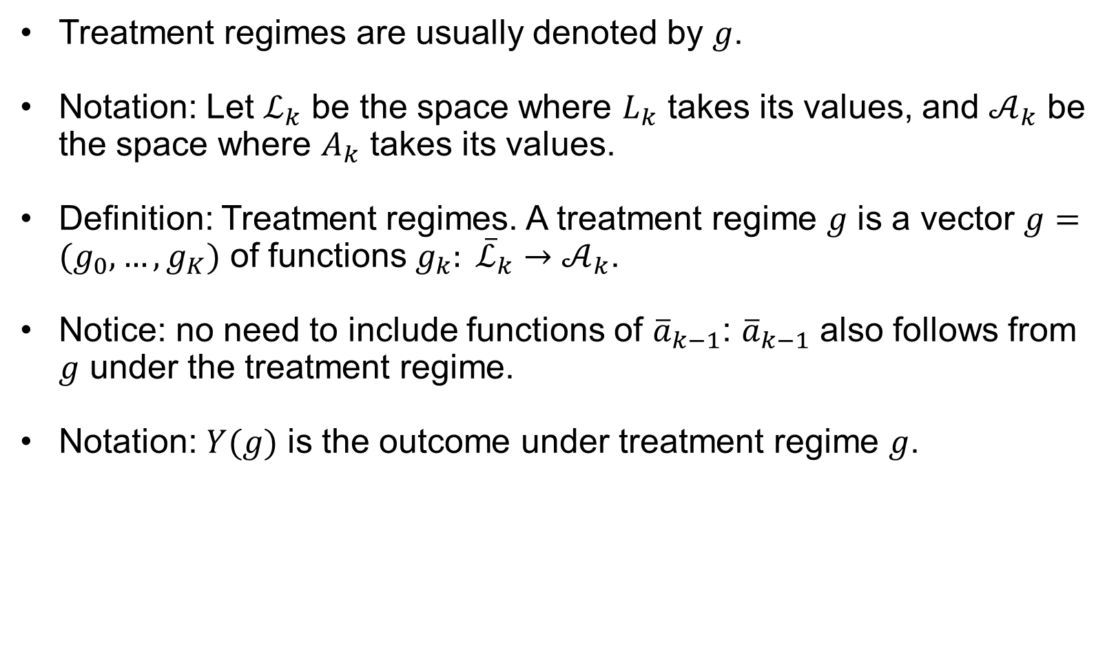
Treatment regimes
Treatment regimes are usually denoted by $g$.
Notation: Let $ℒ_{k}$ be the space where $L_{k}$ takes its values, and $𝒜_{k}$ be the space where $A_{k}$ takes its values.
Definition: Treatment regimes. A treatment regime $g$ is a vector $g=(g_{0},…,g_{K})$ of functions $g_{k}: {\overline{ℒ}}_{k}→𝒜_{k}$.
Notice: no need to include functions of ${\overline{a}}_{k−1}$: ${\overline{a}}_{k−1}$ also follows from $g$ under the treatment regime.
Notation: $Y(g)$ is the outcome under treatment regime $g$.

Slide 7
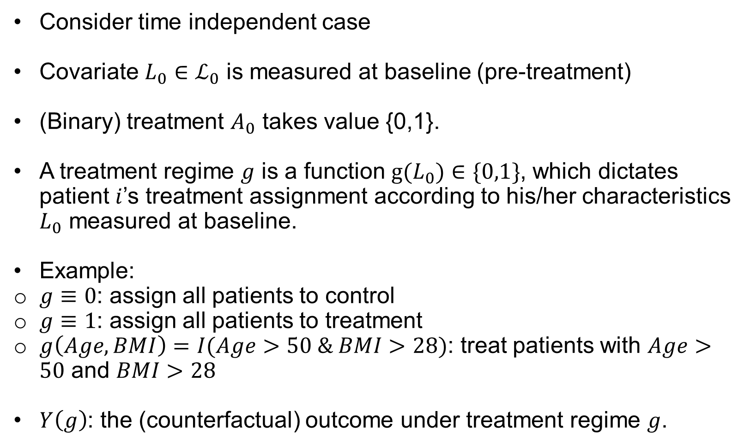
Treatment regimes: Time Independent Case
Consider time independent case
Covariate $L_{0}∈ℒ_{0}$ is measured at baseline (pre-treatment)
(Binary) treatment $A_{0}$ takes value {0,1}.
A treatment regime $g$ is a function $g(L_{0})∈\{0,1\}$, which dictates patient $i$’s treatment assignment according to his/her characteristics $L_{0}$ measured at baseline.
Example:
$g≡0$: assign all patients to control
$g≡1$: assign all patients to treatment
$g\left(Age, BMI\right)=I(Age>50 \& BMI>28)$: treat patients with $Age>50$ and $BMI>28$
$Y\left(g\right)$: the (counterfactual) outcome under treatment regime $g$.

Slide 8
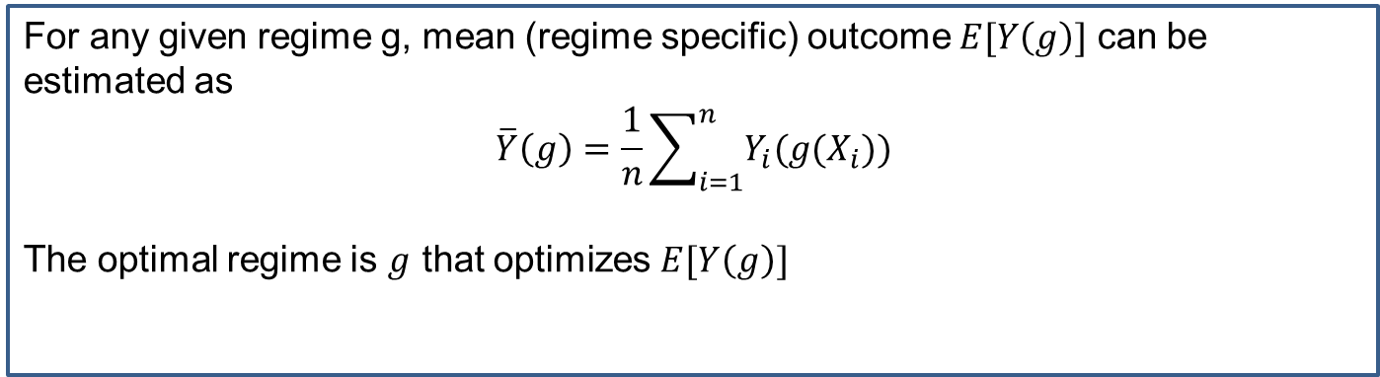
Toy Example
index | X | A | g(X)=I(X>15) | Y | Y(0) | Y(1) | Y(g)
1 | 10 | 0 | 0 | 3 | 3 | 5 | 3
2 | 12 | 0 | 0 | 6 | 6 | 8 | 6
3 | 16 | 0 | 1 | 7 | 7 | 9 | 9
4 | 20 | 0 | 1 | 9 | 9 | 11 | 11
5 | 11 | 1 | 0 | 8 | 6 | 8 | 6
6 | 6 | 1 | 0 | 12 | 10 | 12 | 10
7 | 18 | 1 | 1 | 5 | 3 | 5 | 5
8 | 21 | 1 | 1 | 10 | 8 | 10 | 10
For any given regime g, mean (regime specific) outcome $E[Y\left(g\right)]$ can be estimated as
$$\overline{Y}\left(g\right)=\frac{1}{n}\sum_{i=1}^{n}{Y_{i}(g(X_{i}))}$$
The optimal regime is $g$ that optimizes $E[Y\left(g\right)]$

Slide 9
Emulating A Target Trial
In general, a causal analysis of observational data can be viewed as an attempt to emulate some target trial.
Comparing the effects of different health-related interventions is causal inference for health outcomes.
3 requirements for causal inference:
A well-defined causal question
High-quality data
Valid data analysis

Slide 10
Emulating A Target Trial
A causal analysis of observational data can be viewed as an attempt to emulate some target trial, which is the (hypothetical) randomized trial that we would like to conduct to answer a causal question
The key idea is that suppose we have or are able to estimate all counterfactual outcomes from each patient, we can then mimic outcomes as patients were following any well defined regime or protocol.
However, there is trade-off regarding what causal questions we can answer using this dataset, or equivalently what randomized trial we can emulate using this dataset, this is directly connected to the causal inference assumptions we discussed for various approaches.

Slide 11
Emulating A Target Trial
The target trial concept leads to a simple algorithm for causal inference
Ask a causal question (point at the Target)
Specify the protocol of the Target Trial
Answer the causal question (shoot the Target)
Option A:
Conduct the Target Trial
Option B:
Use observational data to explicitly emulate the Target Trial
Apply appropriate causal inference analytics

Slide 12
Extension: Dynamic Treatment Regime

Slide 13
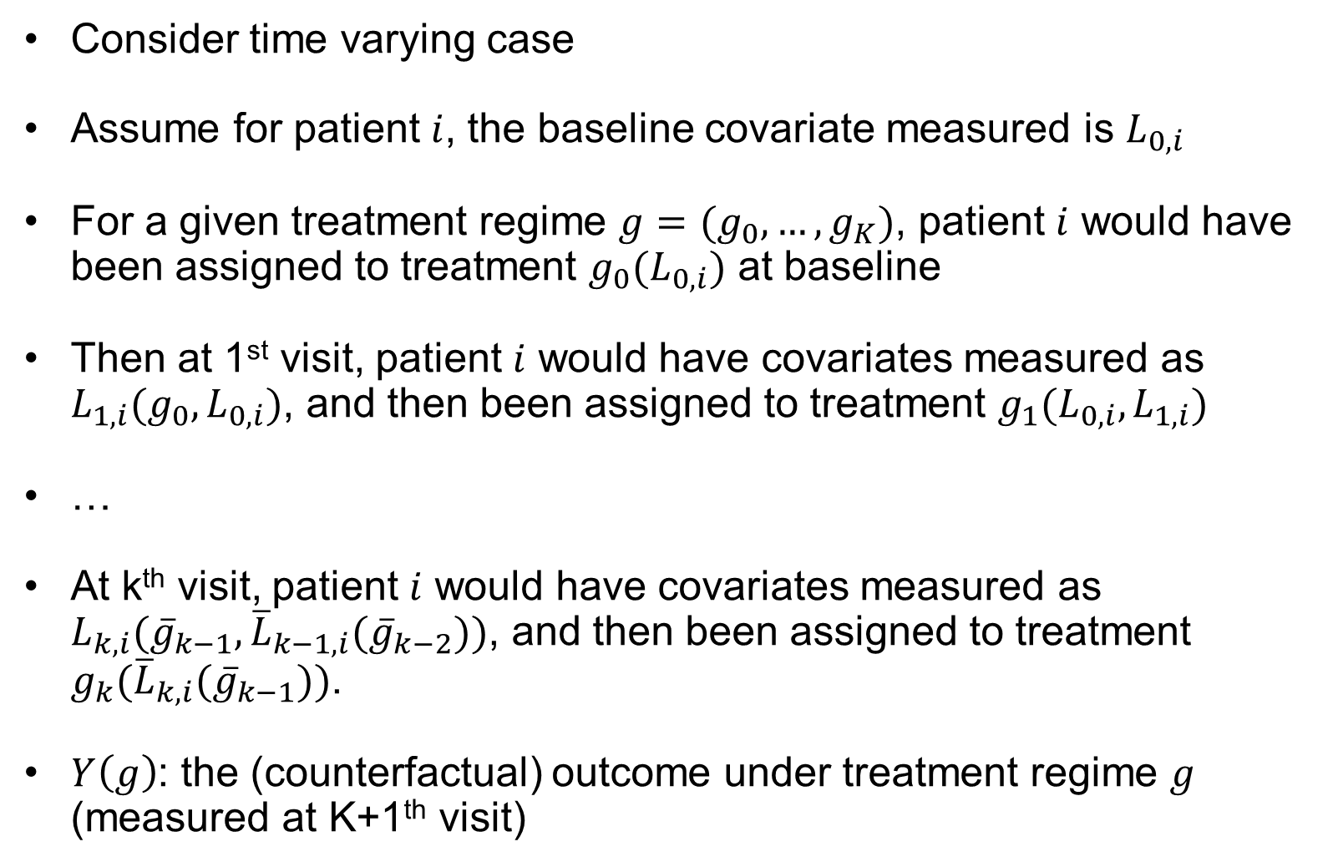
Consider time varying case
Assume for patient $i$, the baseline covariate measured is $L_{0,i}$
For a given treatment regime $g=(g_{0},…,g_{K})$, patient $i$ would have been assigned to treatment $g_{0}(L_{0,i})$ at baseline
Then at 1st visit, patient $i$ would have covariates measured as $L_{1,i}(g_{0},L_{0,i})$, and then been assigned to treatment $g_{1}(L_{0,i},L_{1,i})$
…
At k^{th} visit, patient $i$ would have covariates measured as $L_{k,i}({\overline{g}}_{k−1},{\overline{L}}_{k−1,i}({\overline{g}}_{k−2}))$, and then been assigned to treatment $g_{k}({\overline{L}}_{k,i}({\overline{g}}_{k−1}))$.
$Y\left(g\right)$: the (counterfactual) outcome under treatment regime $g$ (measured at K+1th visit)

Slide 14
A dynamic treatment regime (DTR)
DTR: A set of sequential decision rules, each of which dictates how to make the decision on what to do next for a patient based on observation of the patient up to that point
Allows treatment to be “individualized ” to the patient through a systematic set of rules that operationalize clinical practice
A function that takes covariates and treatment/response history to the current time as arguments and outputs an action to be taken.
A subject’s interval-specific treatment is unknown at the start of a dynamic regime, since treatment depends on time-varying variables.
Notes:
Is $D_{igt}$ same as Gi? Basically the interaction between treatment and time, such as I(treated)*I(post)

Slide 15
A dynamic treatment regime (DTR)
Optimal DTR: It is defined to be the “best possible” regime in the sense that it maximizes some good outcome
Note: DTRs are also known as adaptive treatment strategies.

Slide 16
A dynamic treatment regime: example
For a given cancer patient
Step 1 : Treat with one or more courses of first-line induction chemotherapy A
Intermediate outcome: observe whether “response ” occurs
“Response ” may be defined as complete or partial remission, degree of tumor shrinkage, etc.
Step 2 : If “response ” occurs, give maintenance therapy B
else if “response ” does not occur (so A did not induce a response), try second-line therapy B*
Decision rule: The decision rule to determine the Step 2 treatment takes the variable “response or not” as covariate
Notes:
${E(η}_{igt}\left|G_{i}\right)=0$ means same things as ${cov(G_{i},α}_{g})=0$?
We want to see the E[error] = 0 given both treatment variable and time period since that indicates the two lines in above graph has parallel trend but we are not saying they have to have exactly same trend, otherwise, we would like to see error = 0.

Slide 17
A dynamic treatment regime: example
Individuals following the same regime can have different realized treatment experiences
Subject 1 : Receives A, responds, receives B
Subject 2 : Receives A, does not respond, receives B*
Both subjects' experiences are consistent with following this regime
Do not confuse the regime with the possible realized experiences that can result from following it
“A followed by response followed by B" and “A followed by no response followed by B*” are not 2 regimes . They are possible results of following the single regime.
Notes:
${E(η}_{igt}\left|G_{i}\right)=0$ means same things as ${cov(G_{i},α}_{g})=0$?
We want to see the E[error] = 0 given both treatment variable and time period since that indicates the two lines in above graph has parallel trend but we are not saying they have to have exactly same trend, otherwise, we would like to see error = 0.

Slide 18
A dynamic treatment regime:
There may be more than one possible regime：
More than one possible first-line induction treatment (Step 1), e.g., two options A1 and A2
More than one possible maintenance treatment if response occurs (Step 2), e.g., two options B1 and B2
More than one possible second-line induction treatment if no response occurs (Step 2), e.g., two options B1* and B2*
In general: The number and types of options at each step need not even be the same
Notes:
${E(η}_{igt}\left|G_{i}\right)=0$ means same things as ${cov(G_{i},α}_{g})=0$?
We want to see the E[error] = 0 given both treatment variable and time period since that indicates the two lines in above graph has parallel trend but we are not saying they have to have exactly same trend, otherwise, we would like to see error = 0.

Slide 19
A dynamic treatment regime:
Questions of interest:
What would be the mean outcome (e.g., survival time) if the population were to follow a particular regime?
How do these mean outcomes compare among the possible regimes?
Which one is the optimal regime?
Notes:
${E(η}_{igt}\left|G_{i}\right)=0$ means same things as ${cov(G_{i},α}_{g})=0$?
We want to see the E[error] = 0 given both treatment variable and time period since that indicates the two lines in above graph has parallel trend but we are not saying they have to have exactly same trend, otherwise, we would like to see error = 0.

Slide 20
A dynamic treatment regime:
Possible solutions:
Design a clinical trial in which subjects are randomized to follow different regimes
Use observational follow-up data, e.g., from a registry or other database, where treatments actually received over time have been recorded (with other information) for each subject
Notes:
${E(η}_{igt}\left|G_{i}\right)=0$ means same things as ${cov(G_{i},α}_{g})=0$?
We want to see the E[error] = 0 given both treatment variable and time period since that indicates the two lines in above graph has parallel trend but we are not saying they have to have exactly same trend, otherwise, we would like to see error = 0.

Slide 21
Clinical trials to study dynamic treatment regimes:
SMART: Sequential Multiple Assignment Randomized Trial (Murphy, 2005)
Randomization for Step 1
Randomization for Step 2
Notes:
${E(η}_{igt}\left|G_{i}\right)=0$ means same things as ${cov(G_{i},α}_{g})=0$?
We want to see the E[error] = 0 given both treatment variable and time period since that indicates the two lines in above graph has parallel trend but we are not saying they have to have exactly same trend, otherwise, we would like to see error = 0.

