Slide 1
HORIZON EUROPE IN NEW ZEALAND
PARTNERSHIP OVERVIEW
A growing portfolio with genuinely global reach
The figures below describe signed Horizon Europe projects involving New Zealand organisations.
DISTINCT PROJECTS
NEW ZEALAND ORGANISATIONS
PARTNER COUNTRIES
38
26
54
Each project is counted once
Distinct participating organisations
Countries connected to New Zealand
TOTAL PROJECT VALUE
ALLOCATED TO NEW ZEALAND
€466.5M
€14.6M
Maximum EU contribution to signed projects
Net EU contribution to New Zealand participants
Source: CORDIS project records | Last update: 22 August 2026
01
Notes:
[Sources]
- European Commission CORDIS project records, compiled in the Horizon Europe in New Zealand dataset.
- Dataset last updated 22 August 2026.

Slide 2
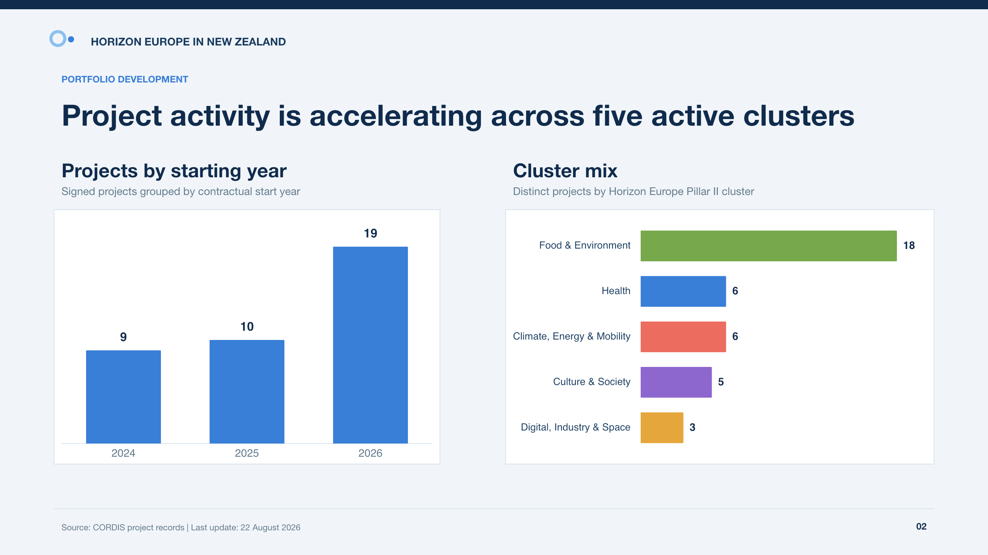
HORIZON EUROPE IN NEW ZEALAND
PORTFOLIO DEVELOPMENT
Project activity is accelerating across five active clusters
Projects by starting year
Cluster mix
Signed projects grouped by contractual start year
Distinct projects by Horizon Europe Pillar II cluster
Source: CORDIS project records | Last update: 22 August 2026
02
Notes:
[Sources]
- European Commission CORDIS project records, compiled in the Horizon Europe in New Zealand dataset.
- Dataset last updated 22 August 2026.

Slide 3
HORIZON EUROPE IN NEW ZEALAND
PARTNER GEOGRAPHY
European depth is matched by collaboration beyond the EU27
Leading EU27 partners
Leading non-EU partners
Top 10 countries by distinct project-country connections
Top 10 countries by distinct project-country connections
Source: CORDIS project records | Last update: 22 August 2026
03
Notes:
[Sources]
- European Commission CORDIS project records, compiled in the Horizon Europe in New Zealand dataset.
- Dataset last updated 22 August 2026.

