Slide 1

MANUFACTOO
No-code MES, built on Odoo

Slide 2

Two different stories.
What actually happens on the line, and what your system says happened.
Written on paper. Typed into a spreadsheet. Entered into the ERP hours later, if at all.

Slide 3

Open Source
The code is open and auditable - yours to inspect, anytime.

Slide 4
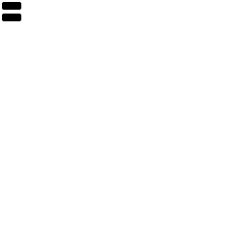
On-Premise
Runs on your own server. Your production data never leaves your company.

Slide 5

Composable
Turn on only the modules your factory actually needs - nothing bloated.

Slide 6

No-Code
Every operator screen is built by dragging and dropping - not by writing software.

Slide 7

Built on Odoo
A live connection to the Odoo you already run - not a copy. Odoo 18 or 19, detected automatically.

Slide 8

GETTING STARTED
Live in minutes.
A guided wizard connects to your real Odoo and detects its version on its own.

Slide 9

STATION DESIGN
Build it yourself.
Drag the fields your operators need onto the screen. No developers required.

Slide 10

ON THE FLOOR
Watch it run.
Read, confirm, done - written back to Odoo the instant it happens.

Slide 11
MANUFACTOO
Open source. On-premise. Built on Odoo.

