Slide 1
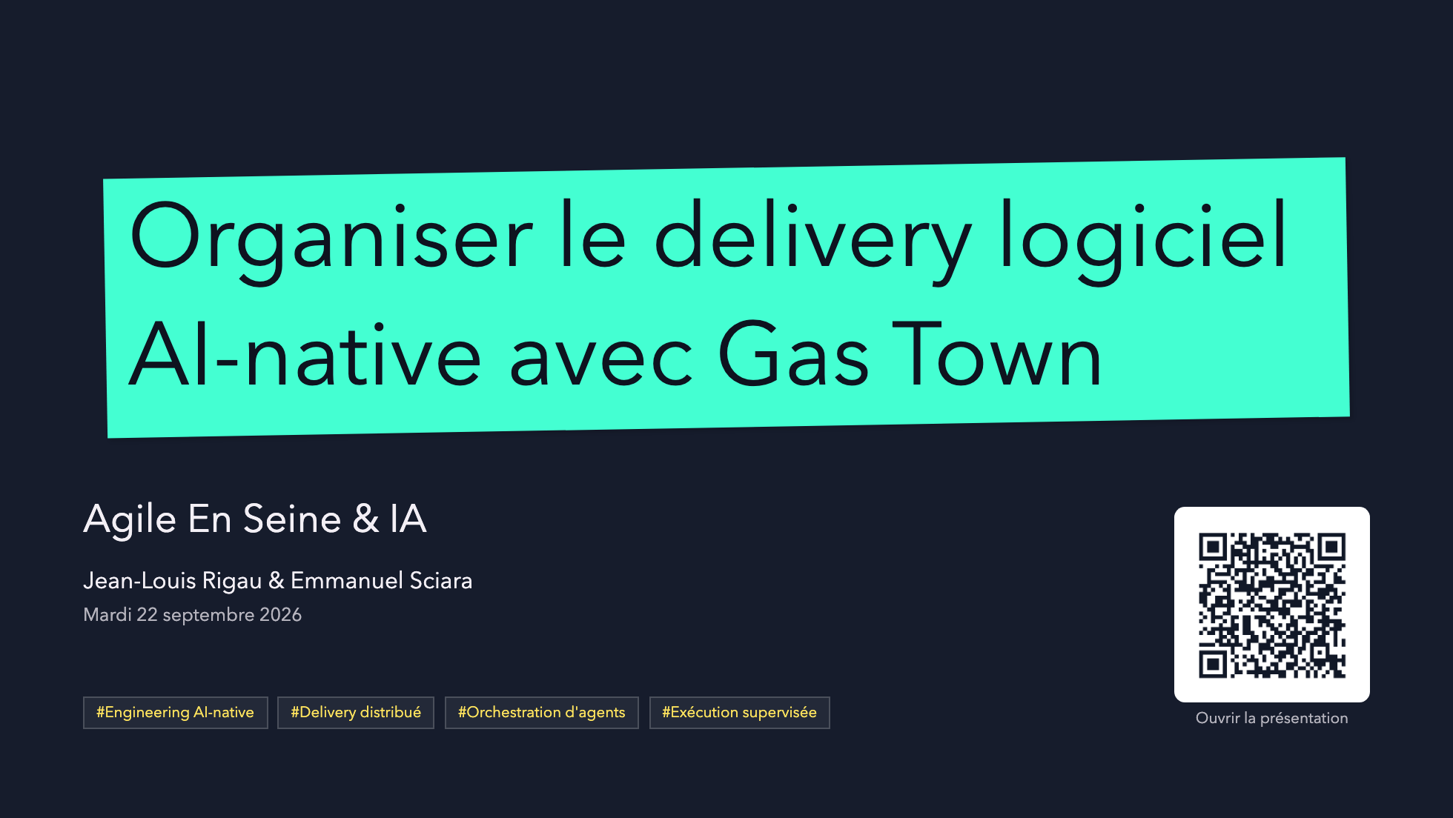
Notes:
Open on the model, not the tooling.
This is not "AI coding faster"; it is how delivery gets organized when AI workers become part of the engineering system.

Slide 2
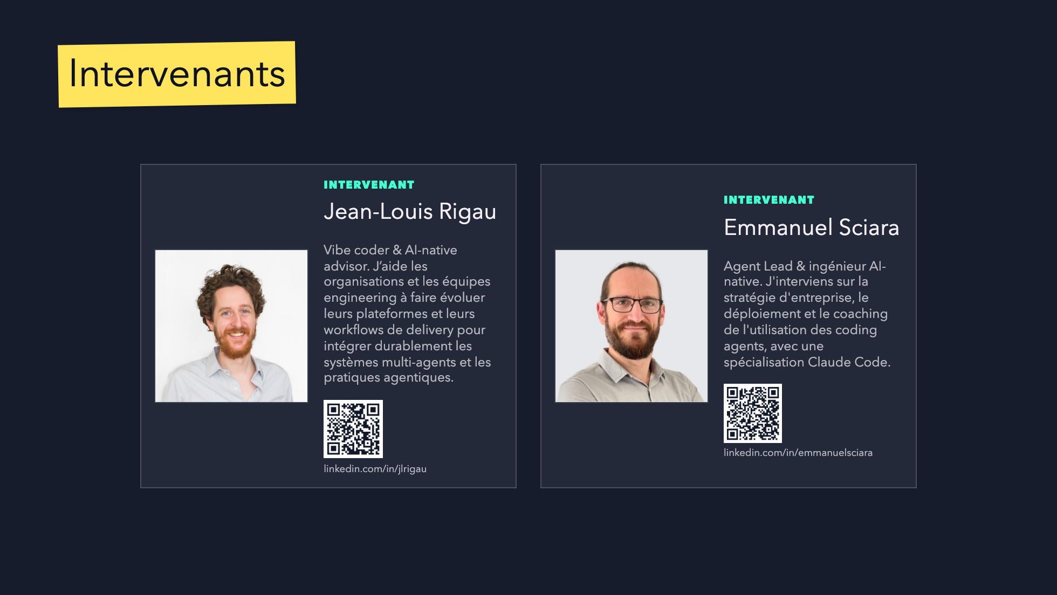
Notes:
Introduce the two presenters before moving into the AI practice evolution.
Keep the slide simple: names, photos, and the angle each speaker brings to the story.

Slide 3
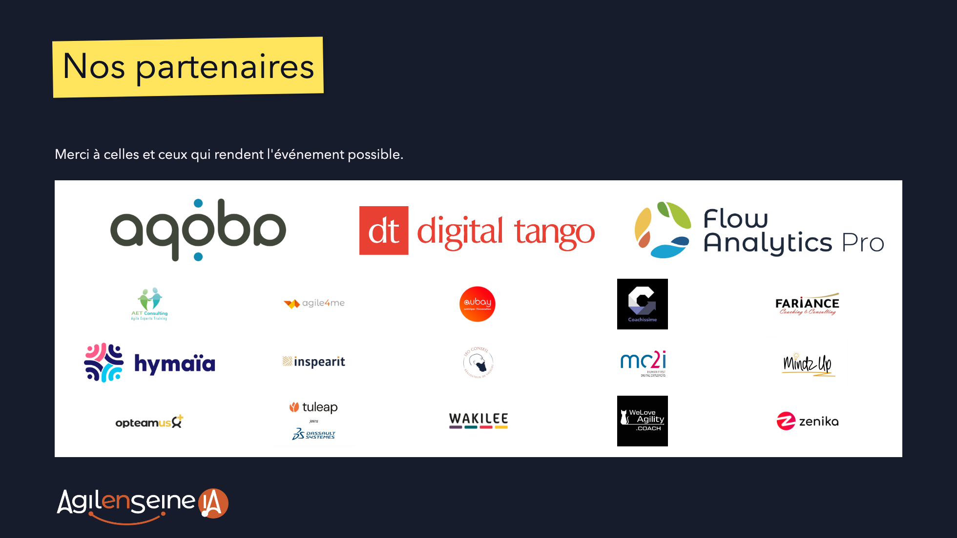
Notes:
Source: initial presentation file provided by the organizers.
Original logos extracted without modification; size hierarchy preserved and logos sorted alphabetically within each sponsorship level.
Briefly thank the event partners before continuing.

Slide 4
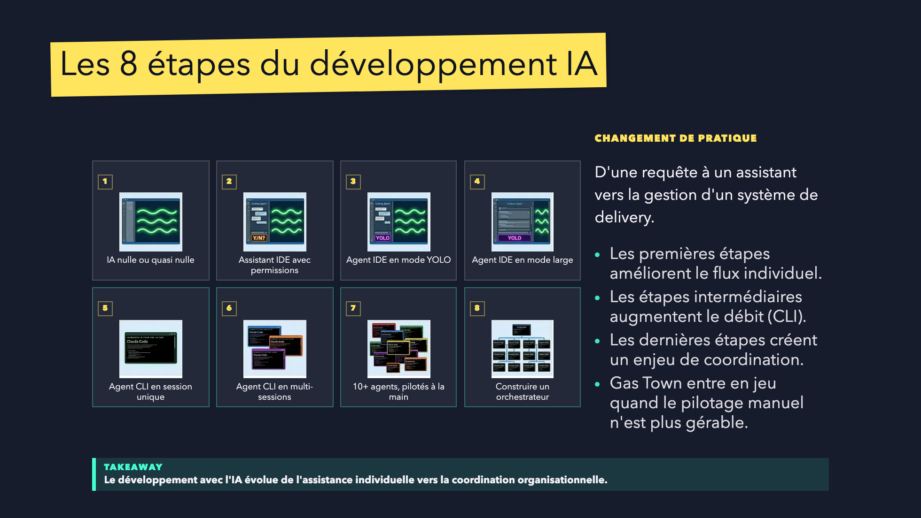
Notes:
Inspired by Steve Yegge's "The 8 Stages of Dev Evolution To AI" framing.
Use this as the bridge from personal AI practice to organizational orchestration.

Slide 5
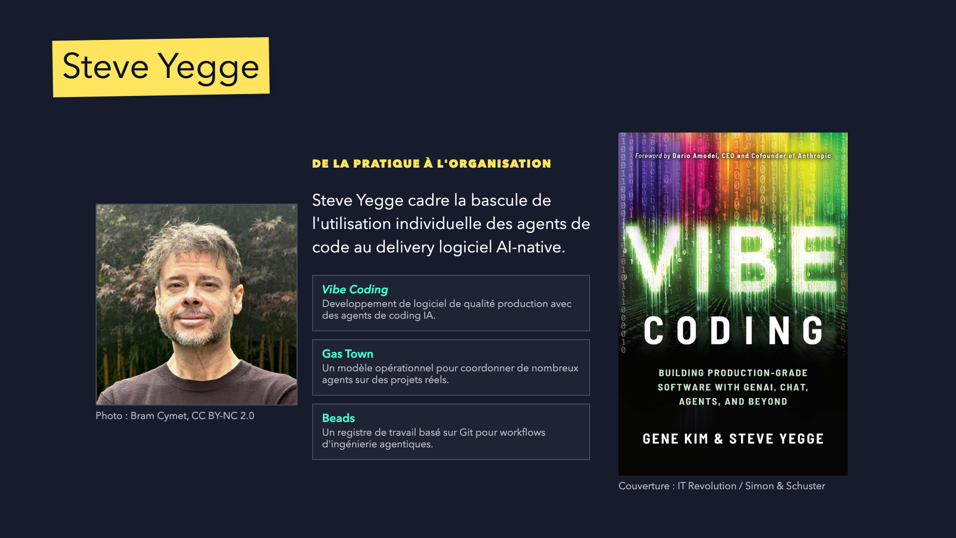
Notes:
Use this slide to ground the story in Steve Yegge's work before introducing the delivery problem.
Keep it short: creator, book, why it matters for the model.

Slide 6
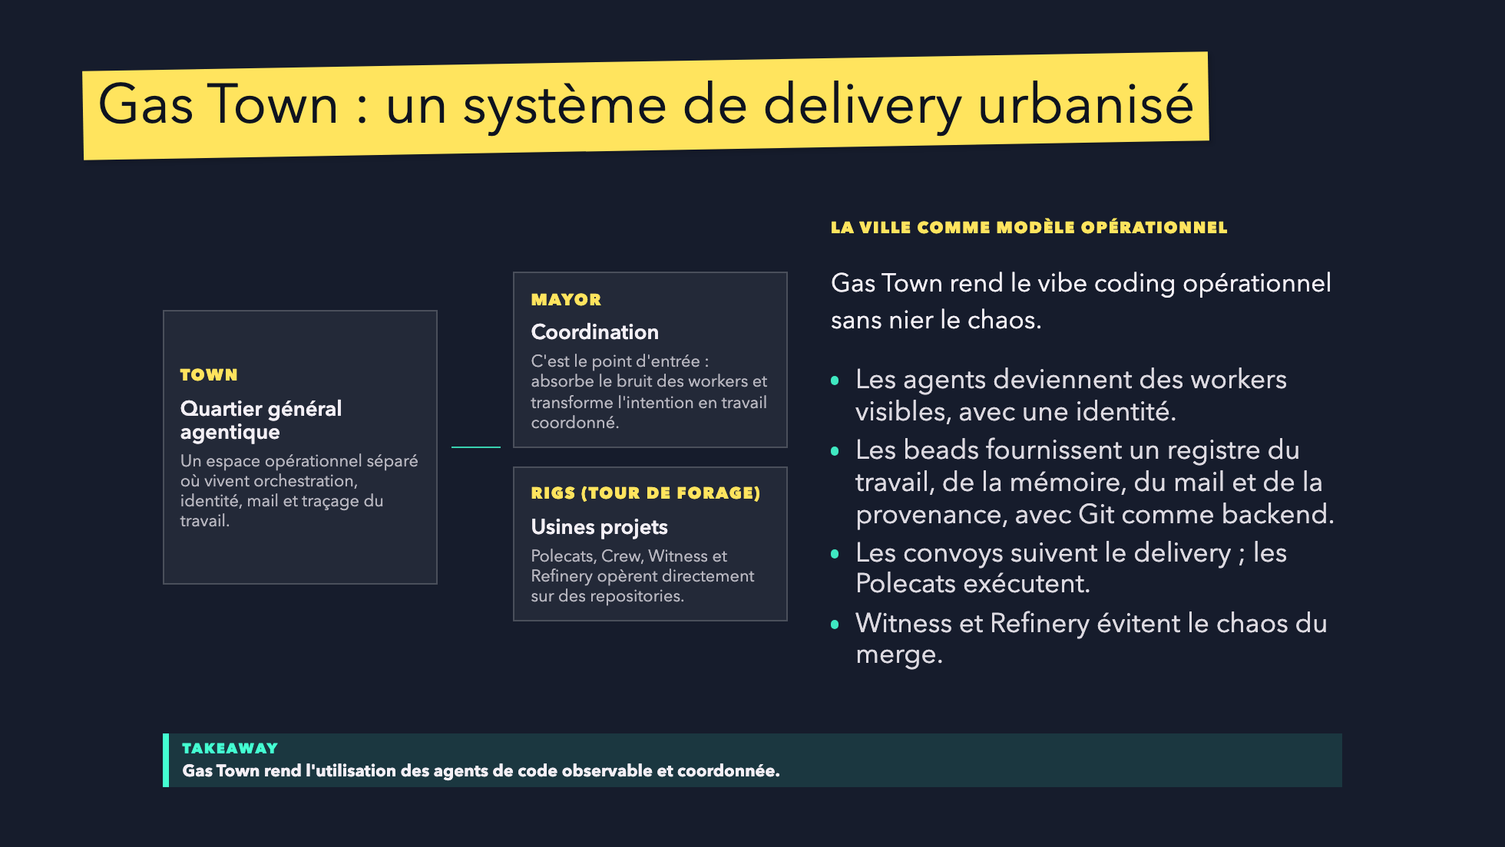
Notes:
Use this slide as the atmosphere and vocabulary bridge before the problem slide.
The story: Gas Town starts from vibe-coding chaos, then adds city-like operating roles so delivery can be supervised.

Slide 7
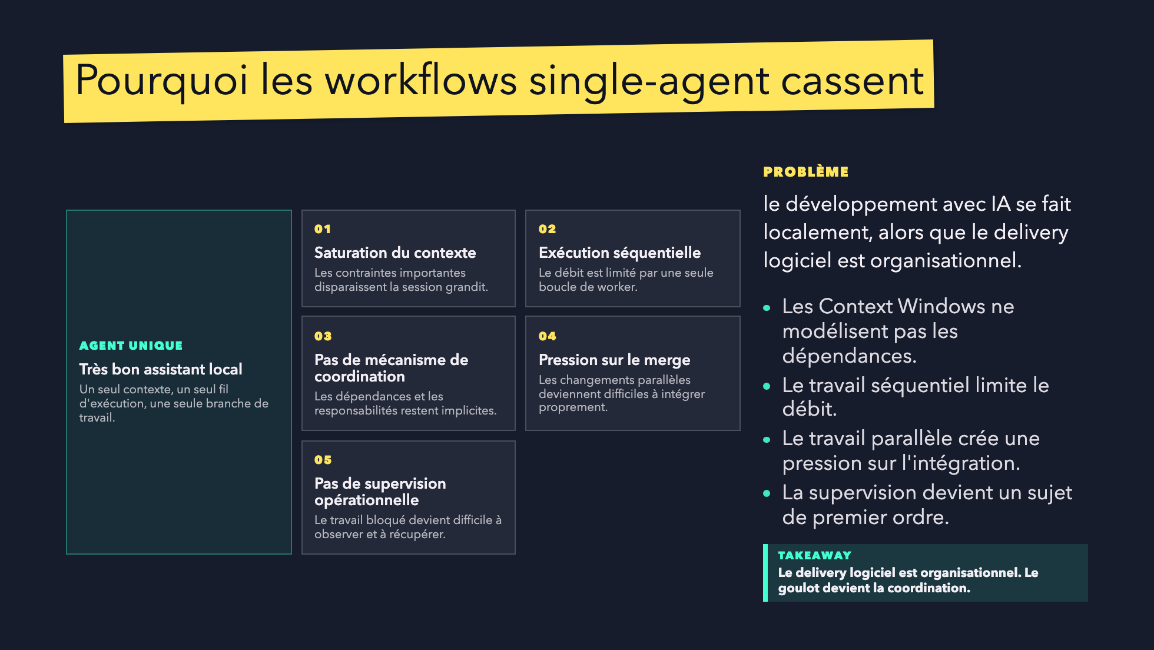
Notes:
The audience should understand why Gas Town exists before we introduce roles.
The bottleneck is not just model intelligence; it is coordination.

Slide 8
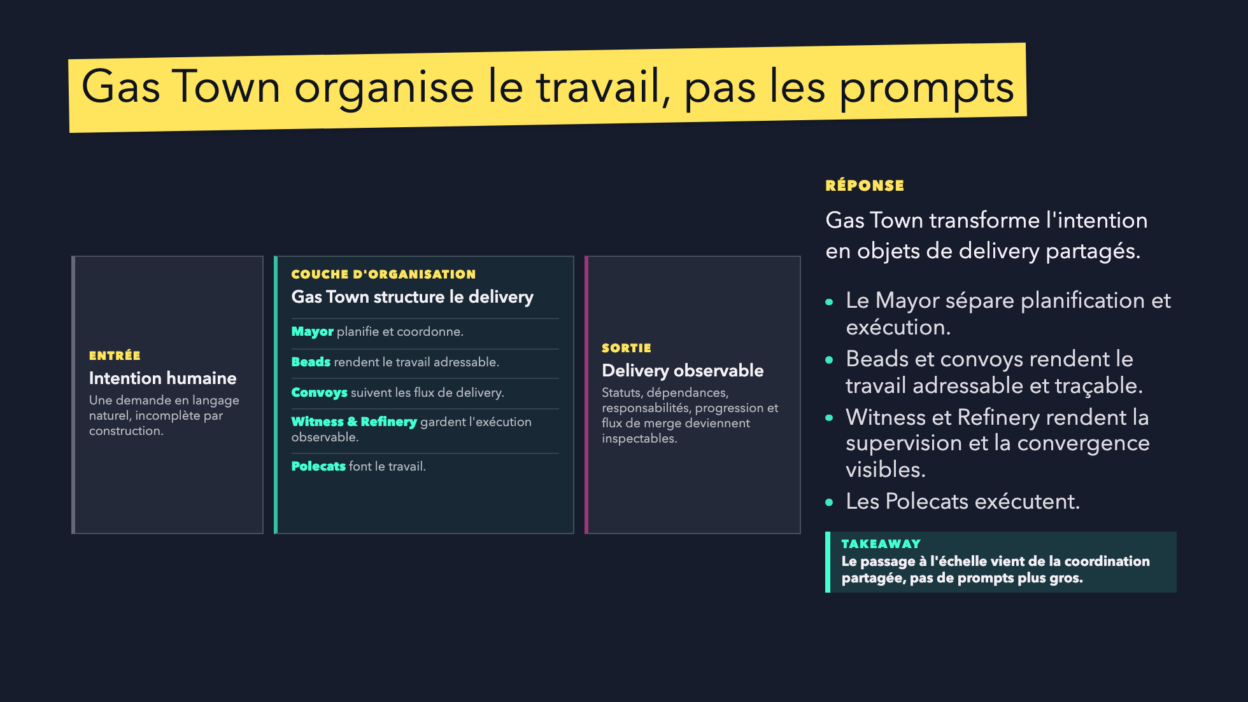
Notes:
Use this slide to position Gas Town as an AI-native delivery organization.
Avoid tool tour language.

Slide 9
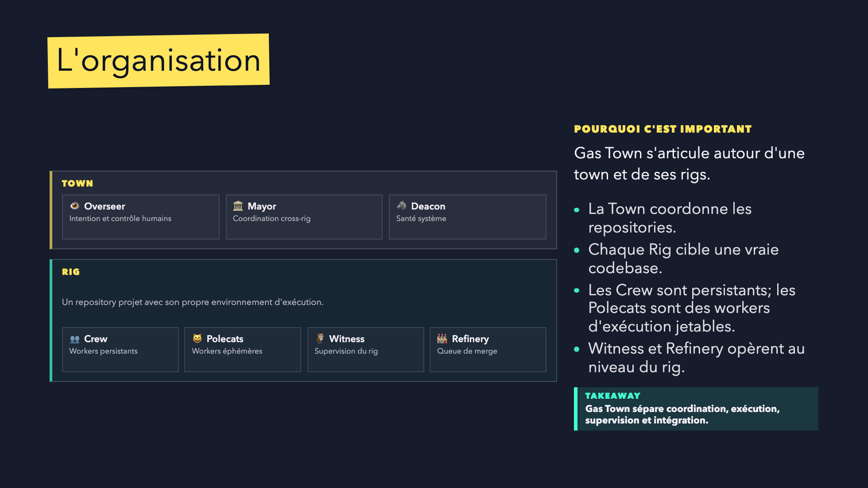
Notes:
This is a central slide. The key line is:
The Mayor coordinates work. Polecats execute it.

Slide 10
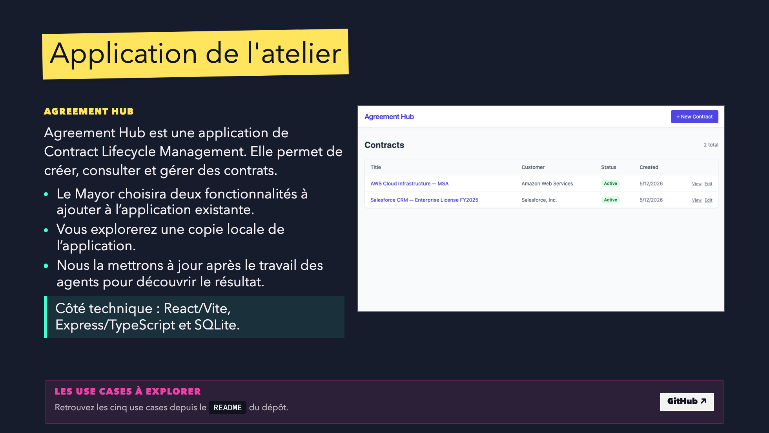

Slide 11
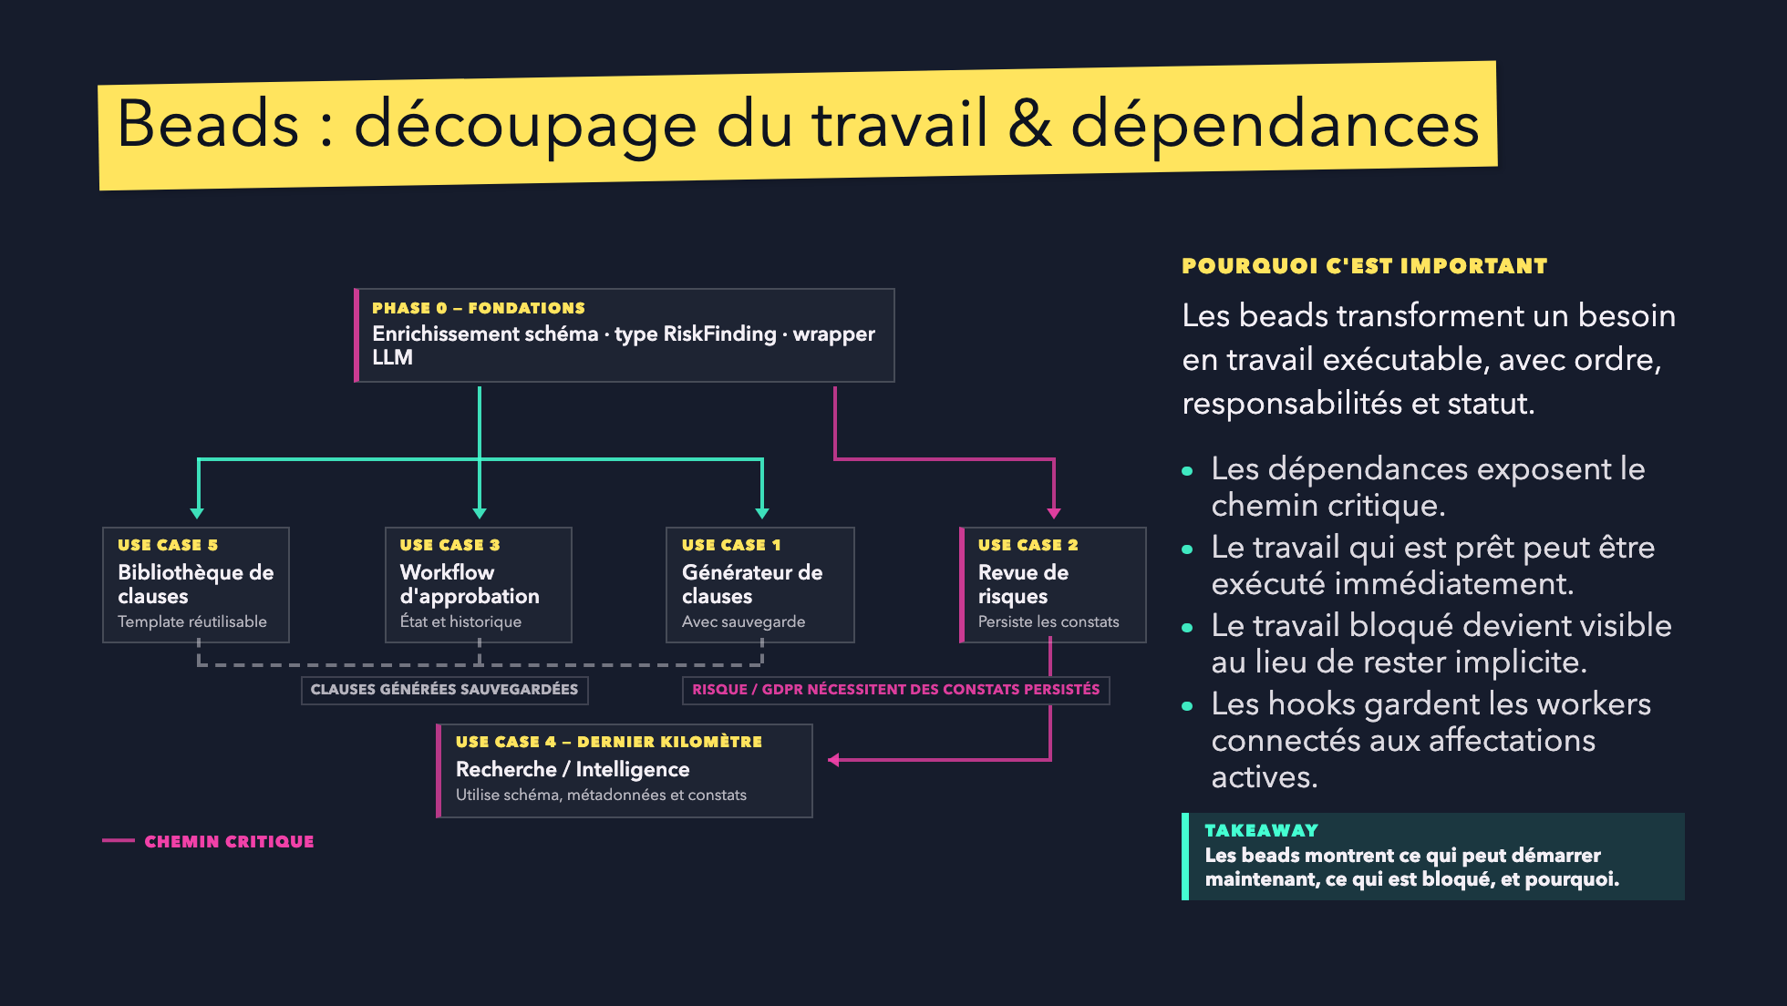
Notes:
Use this slide to explain why dependency management matters.
The important point: work becomes executable and inspectable.

Slide 12
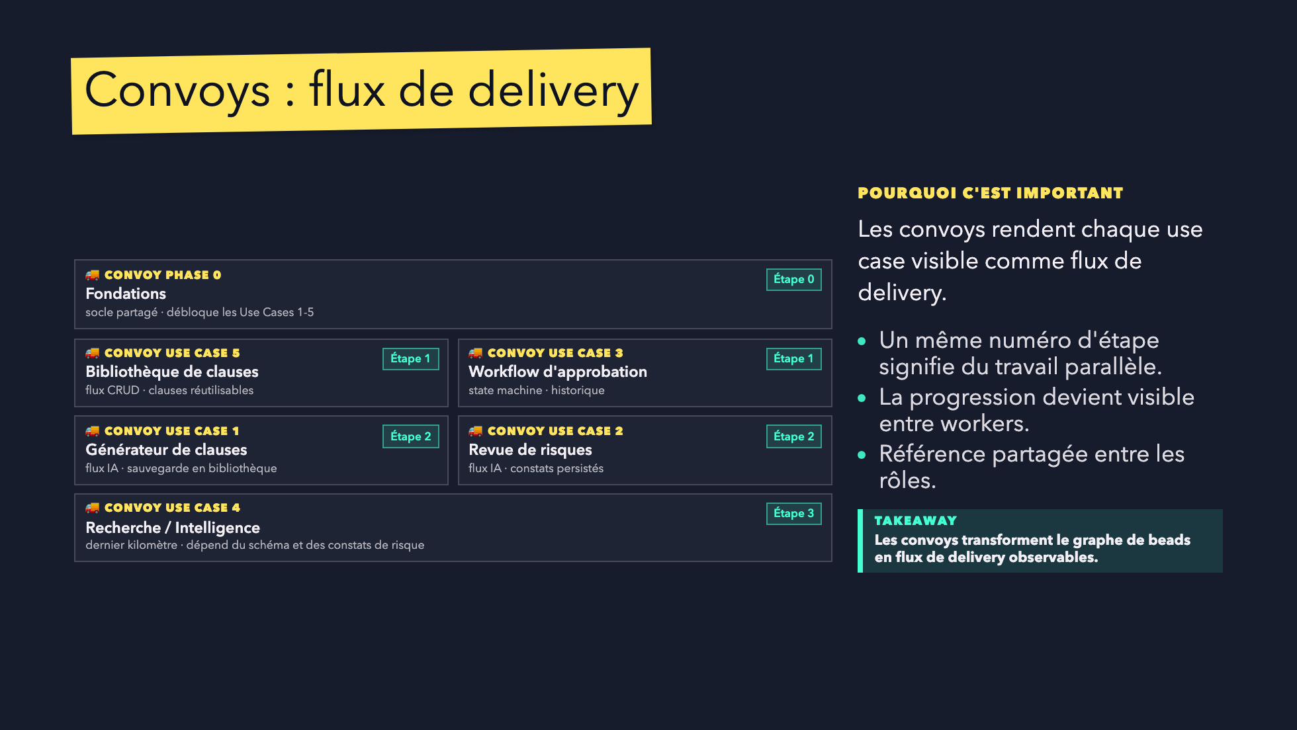
Notes:
Convoys should feel operational, not decorative.
They are the shared handle for distributed delivery.

Slide 13
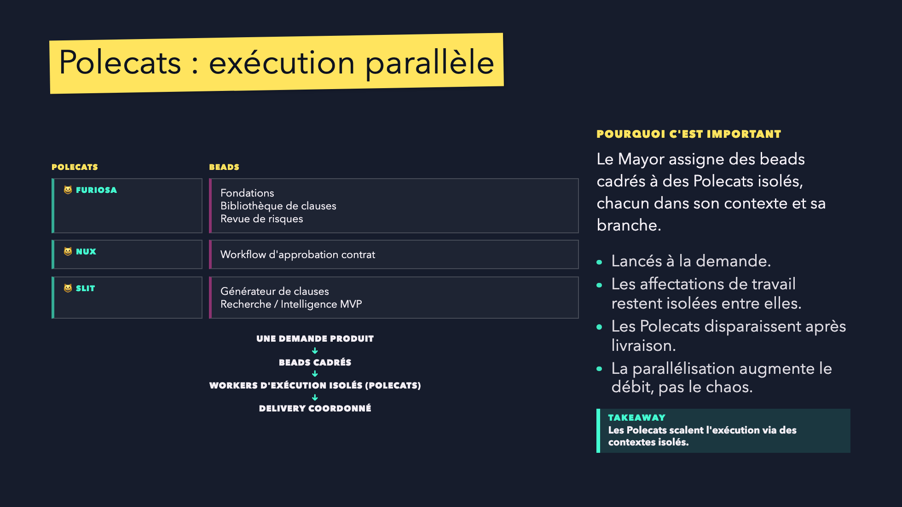
Notes:
This is the "wow" moment, but keep it engineering-oriented.
The claim is throughput through isolated execution.

Slide 14
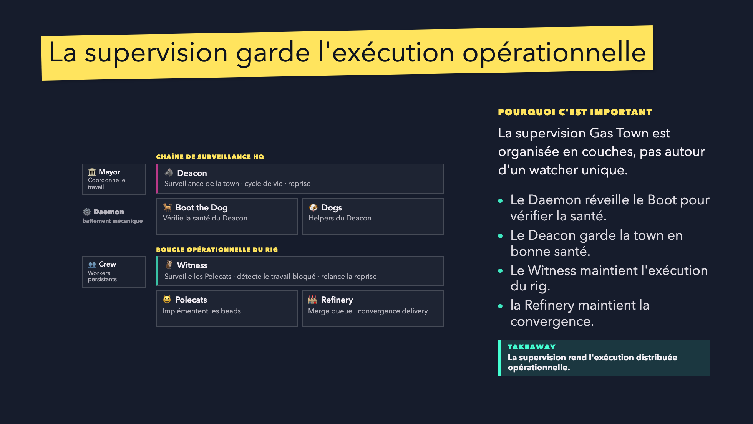
Notes:
Important for DiliTrust: supervision and control are not optional.
This slide turns distributed execution into an operational system.

Slide 15
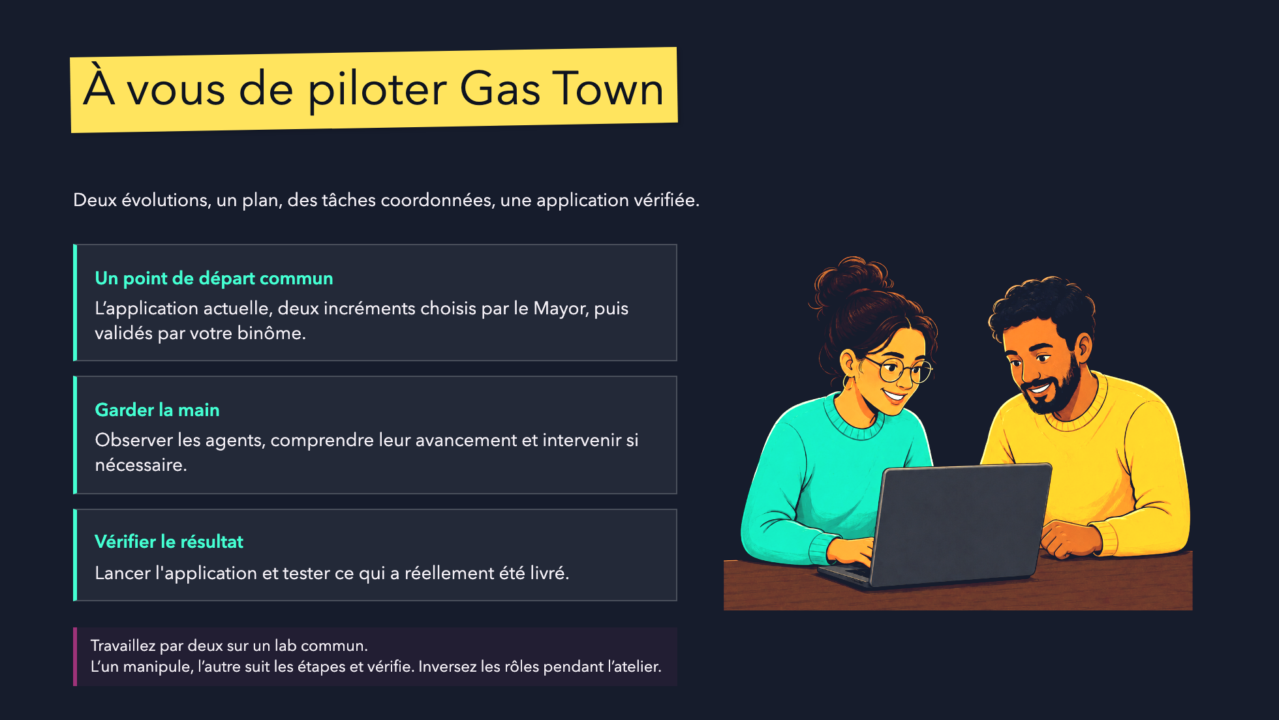

Slide 16
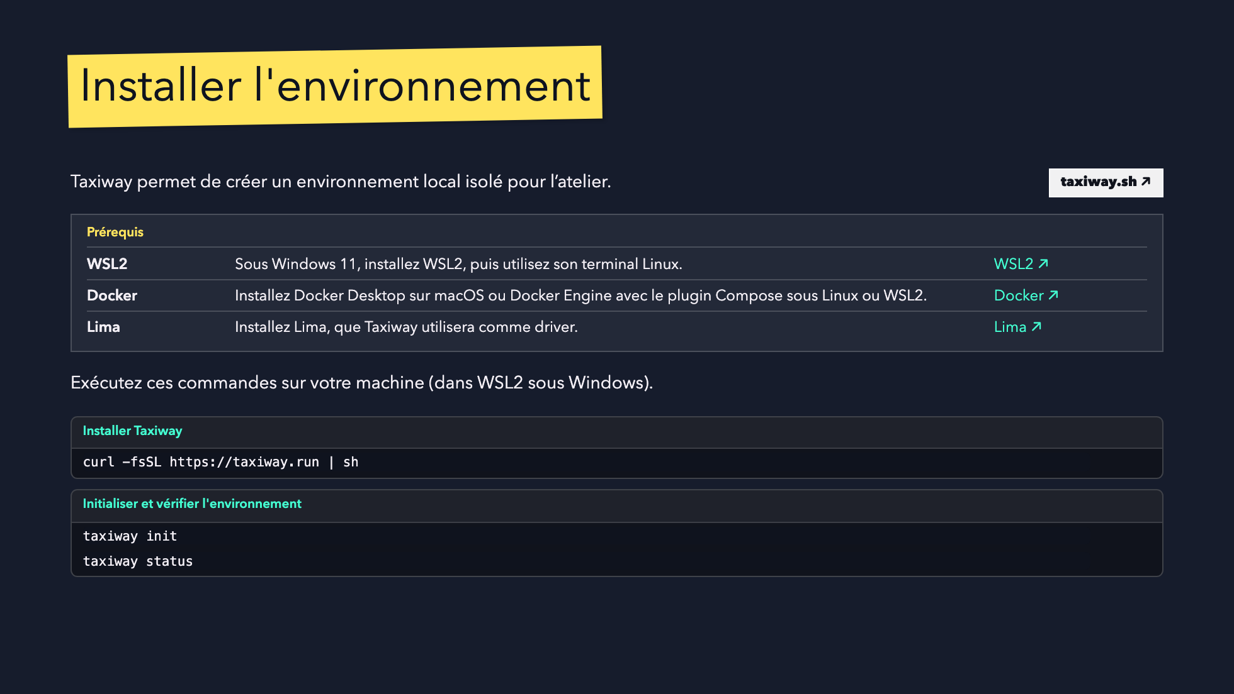

Slide 17
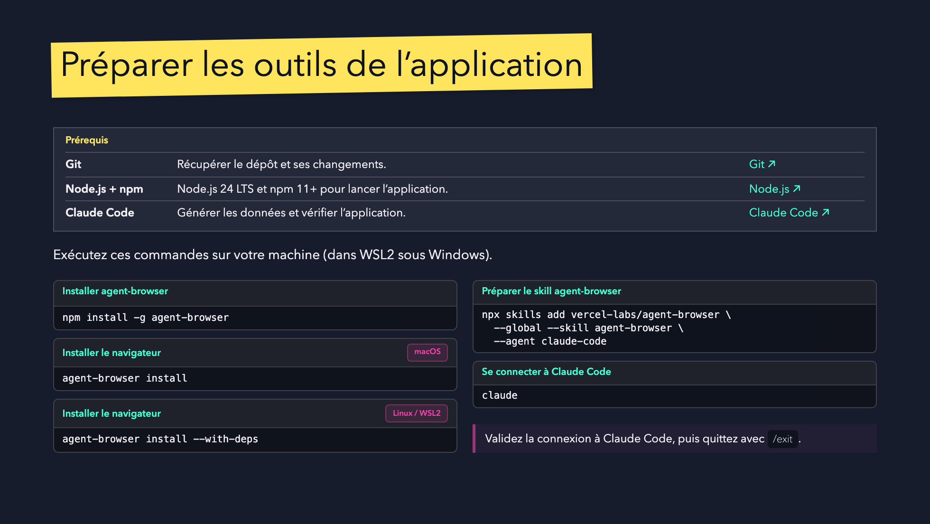

Slide 18
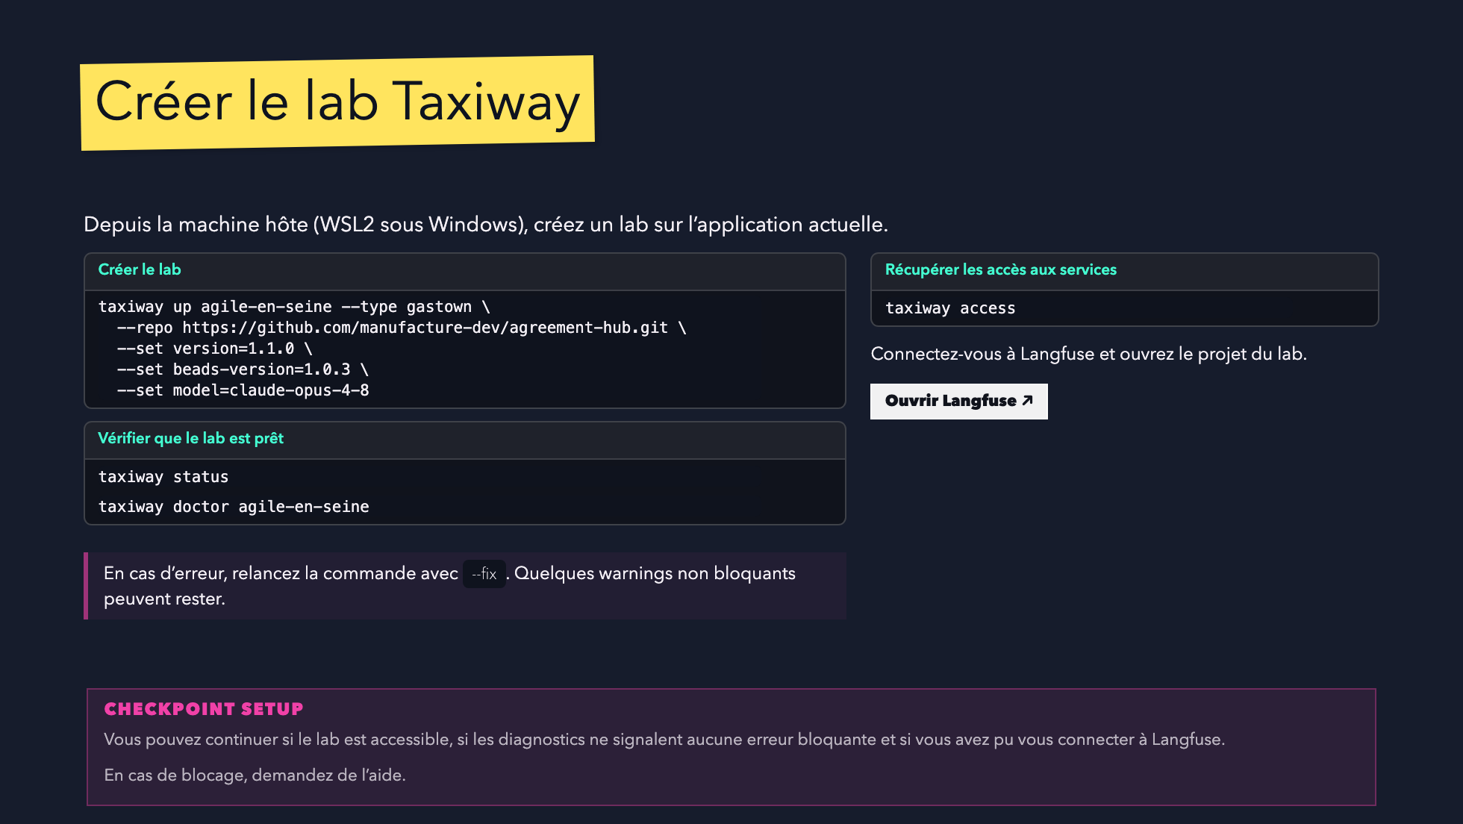

Slide 19
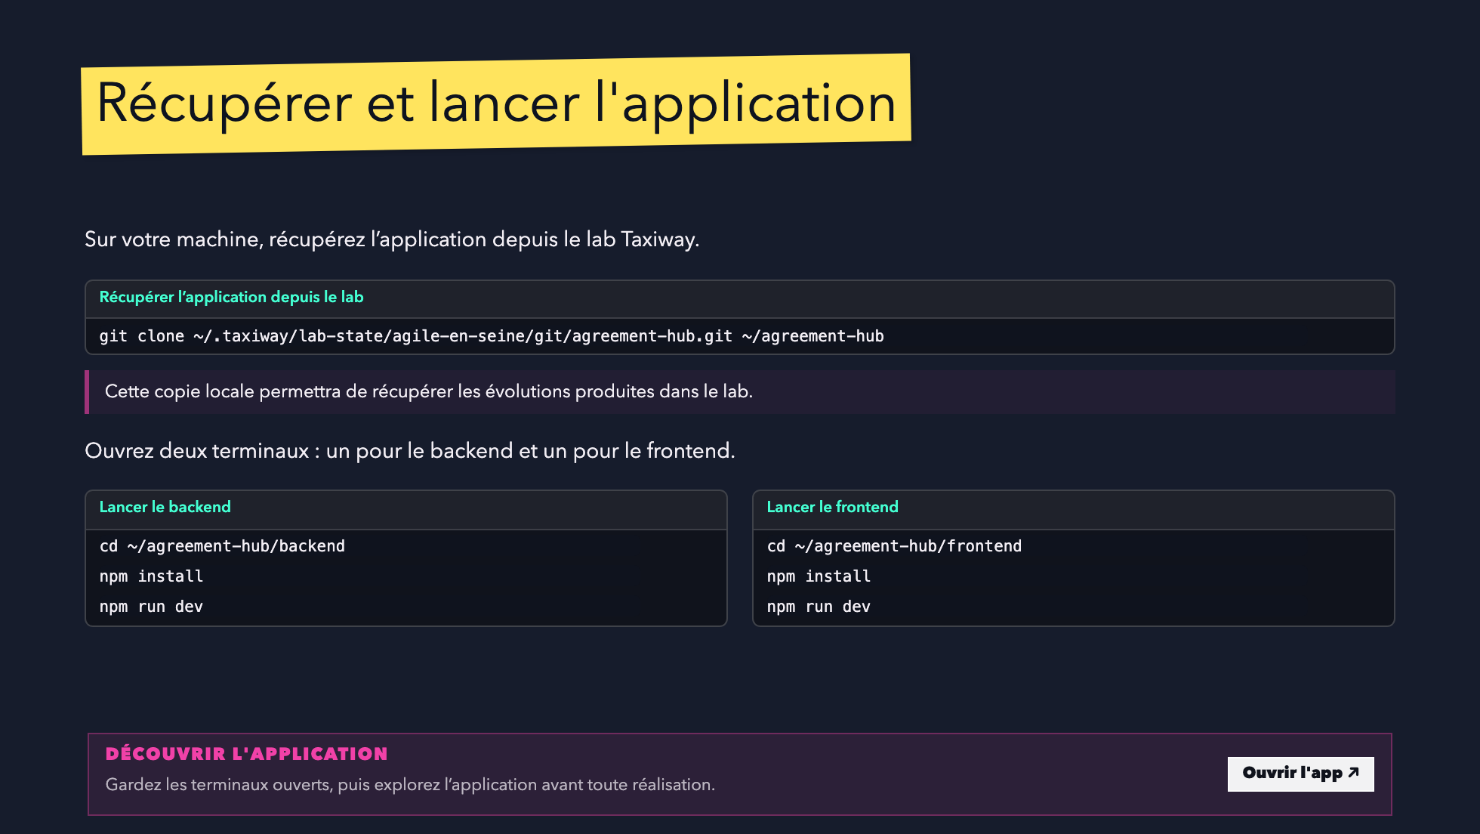

Slide 20
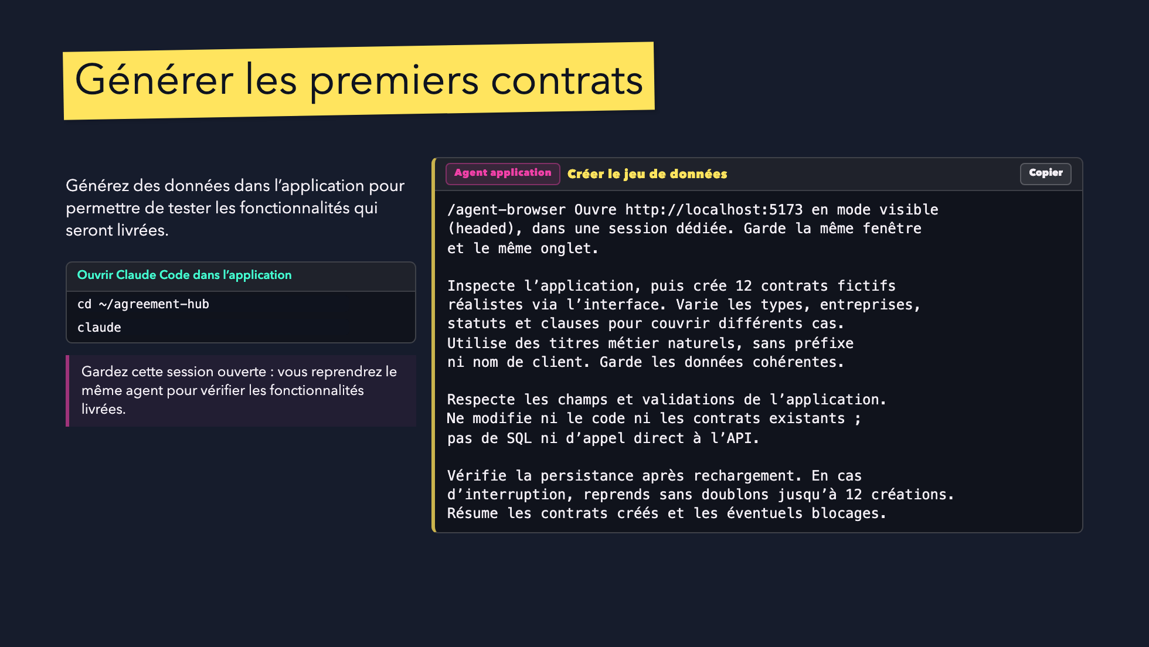

Slide 21
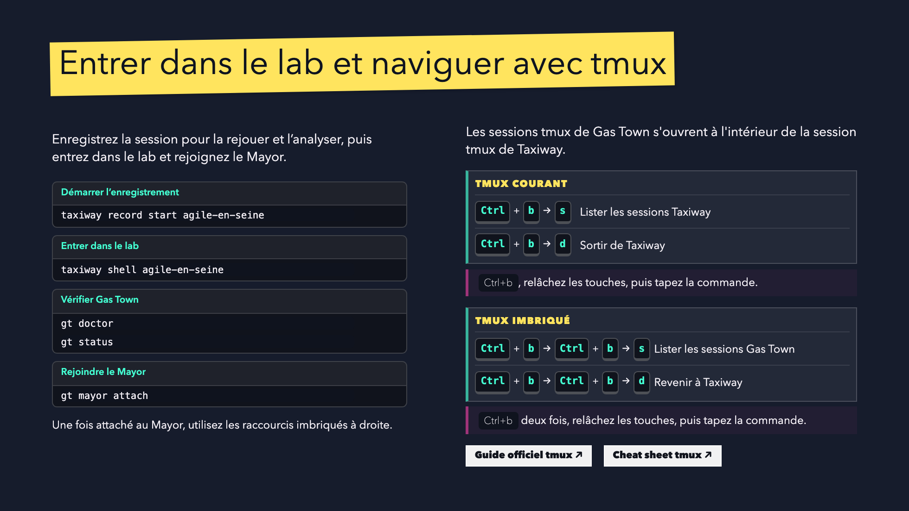

Slide 22
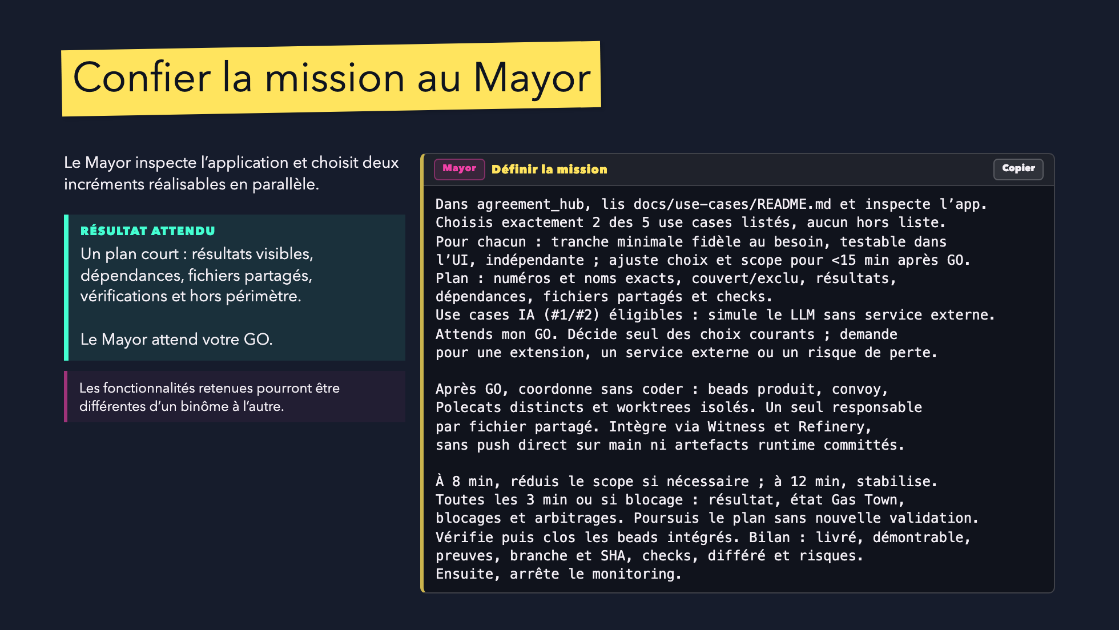

Slide 23
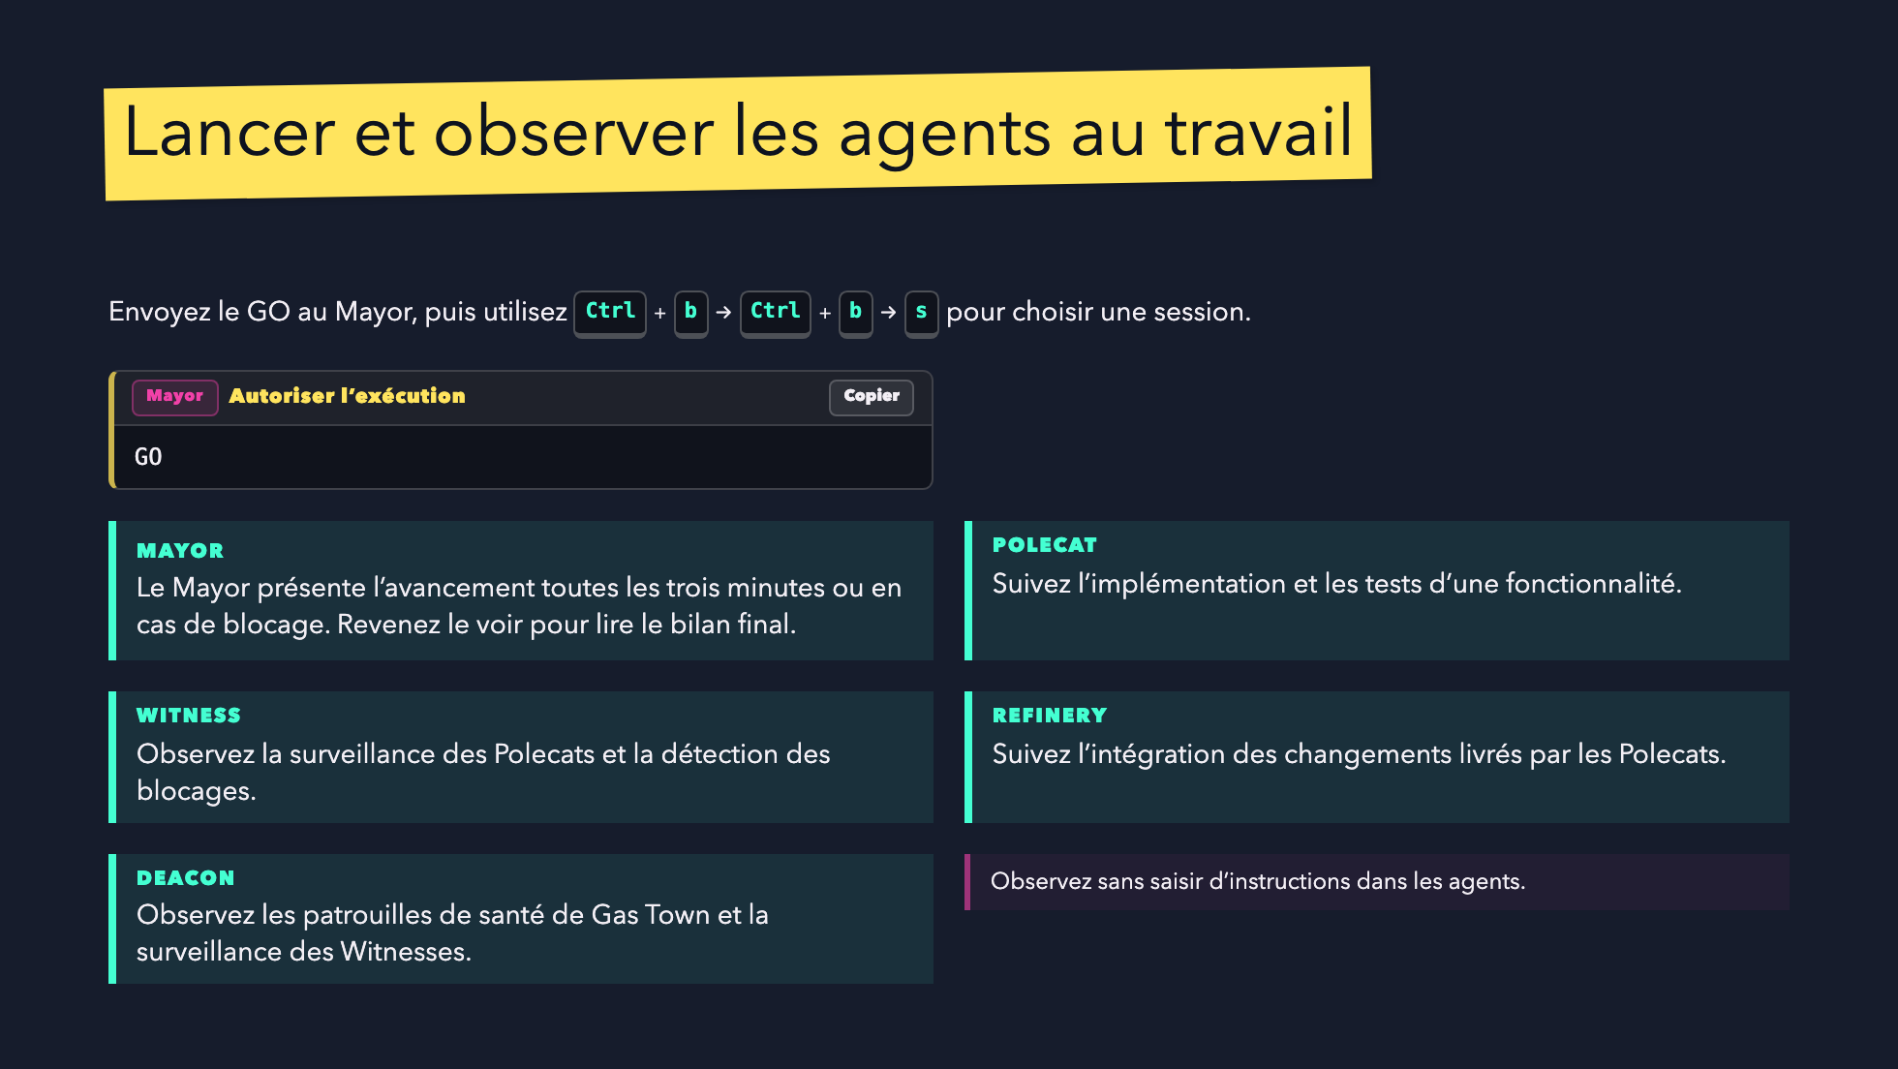

Slide 24
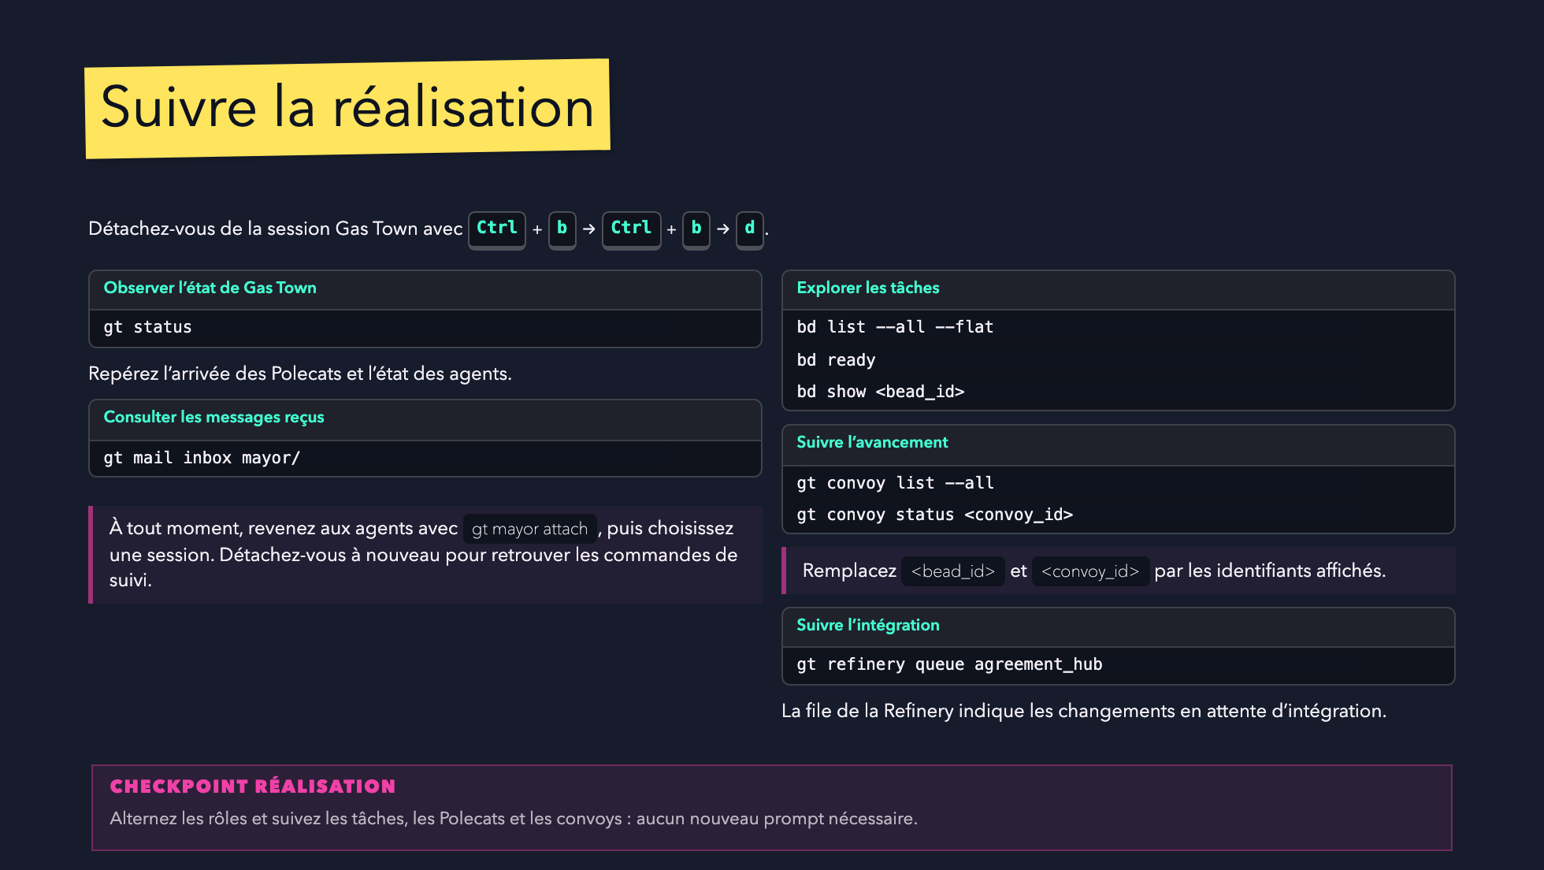

Slide 25
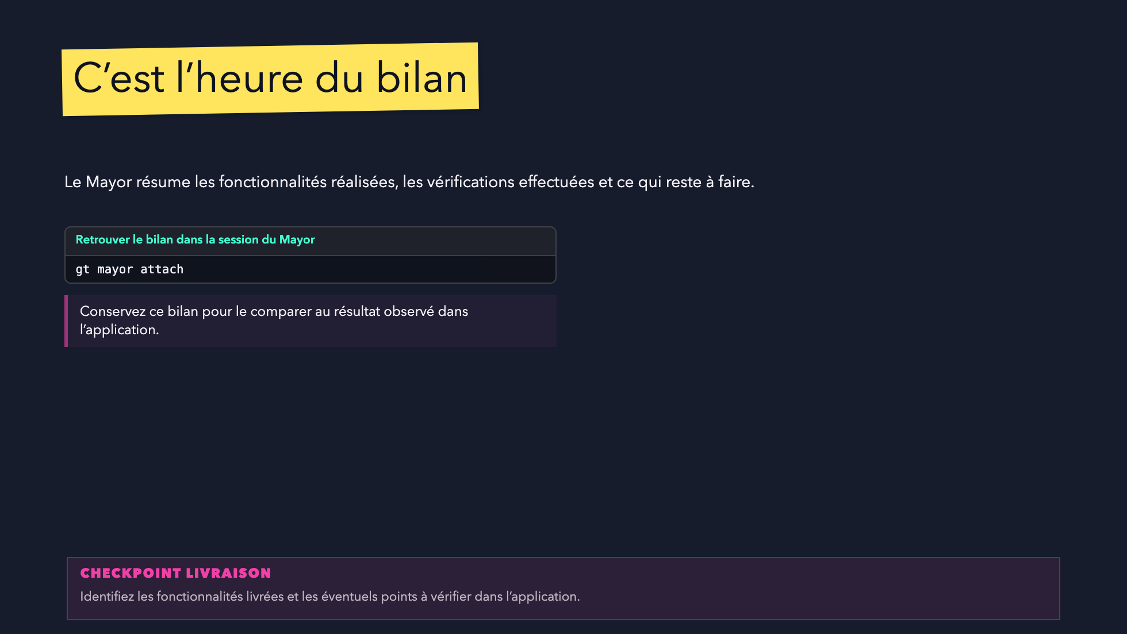

Slide 26
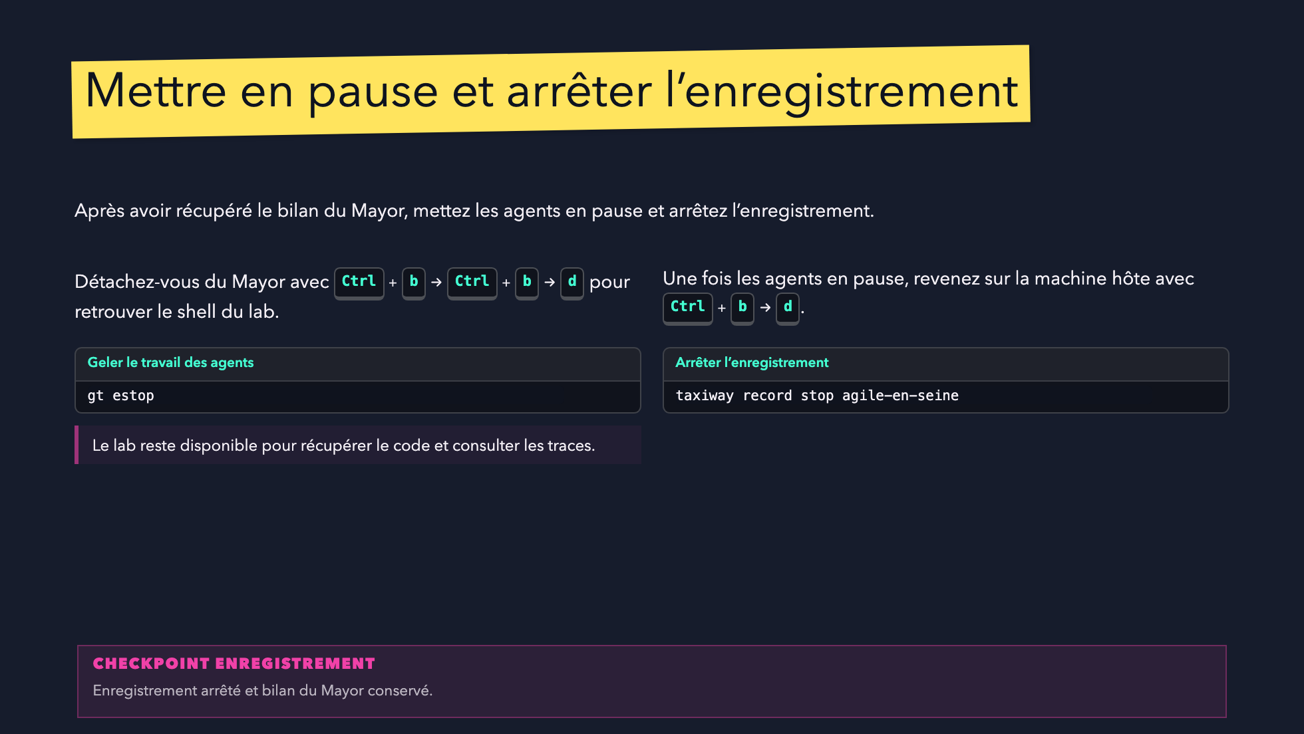

Slide 27
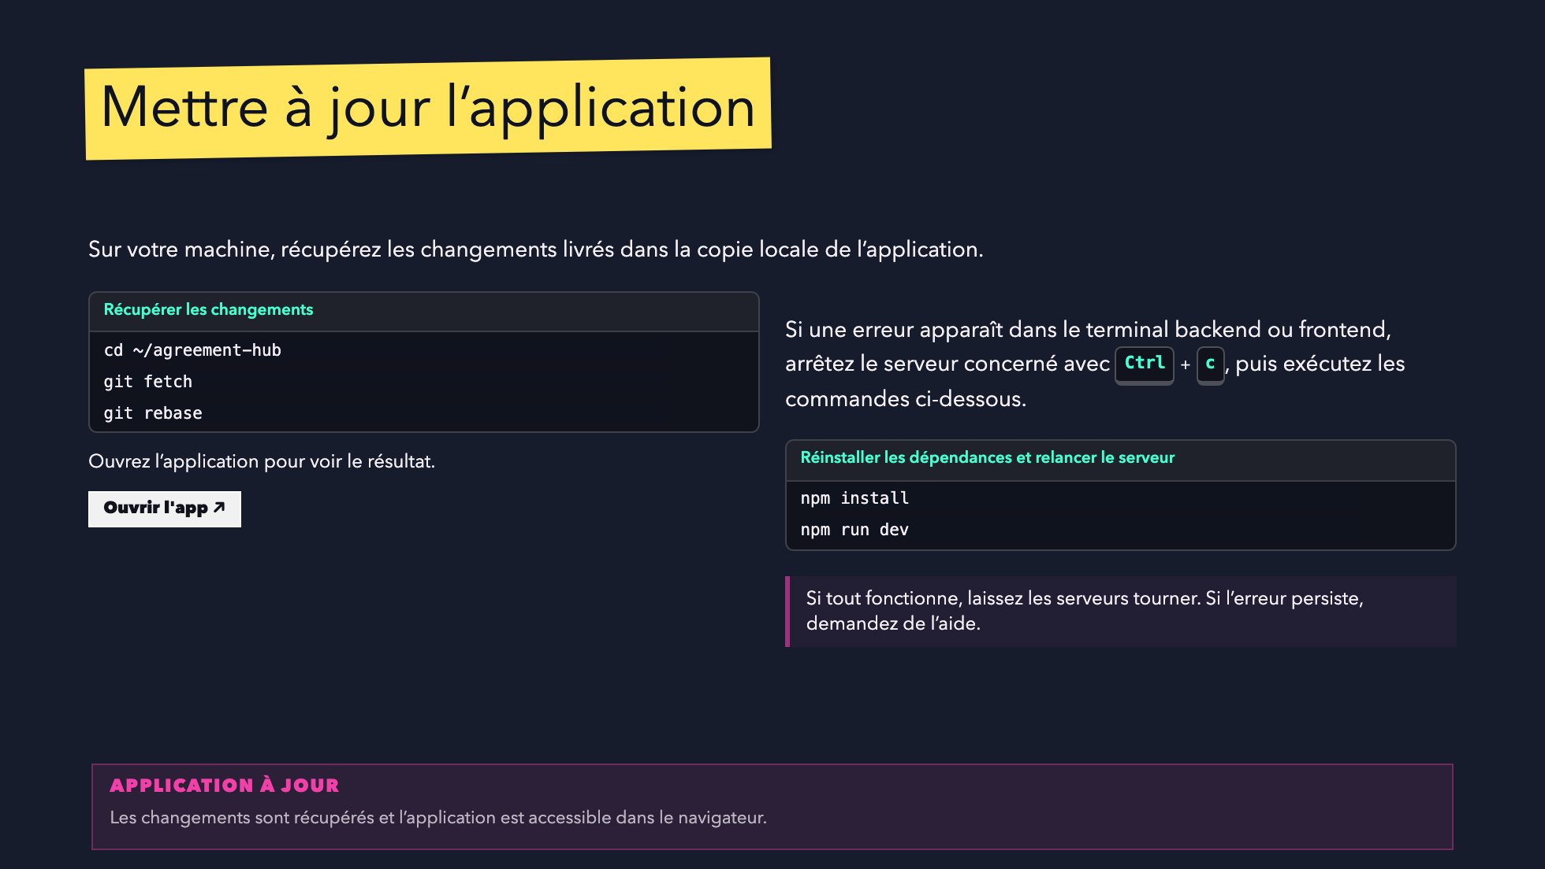

Slide 28
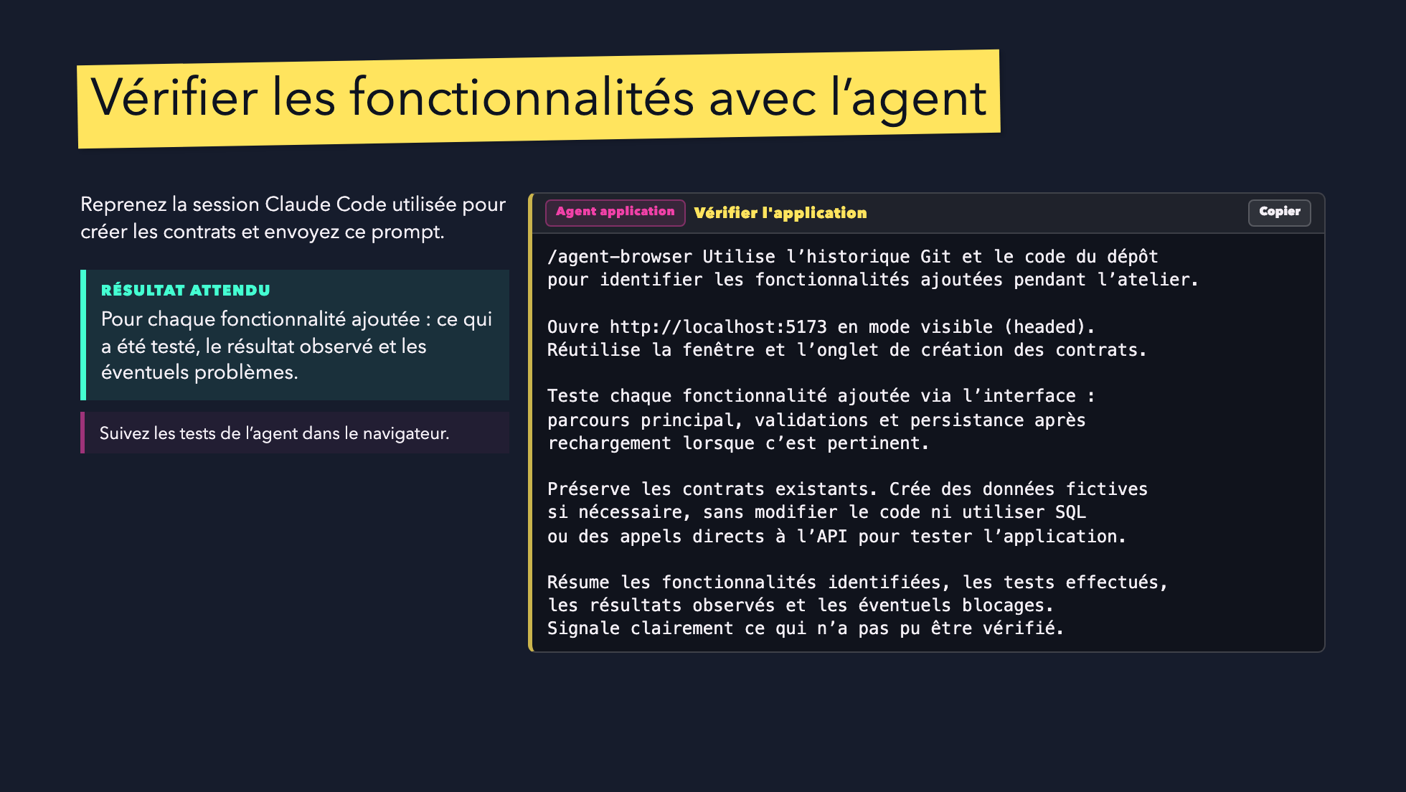

Slide 29
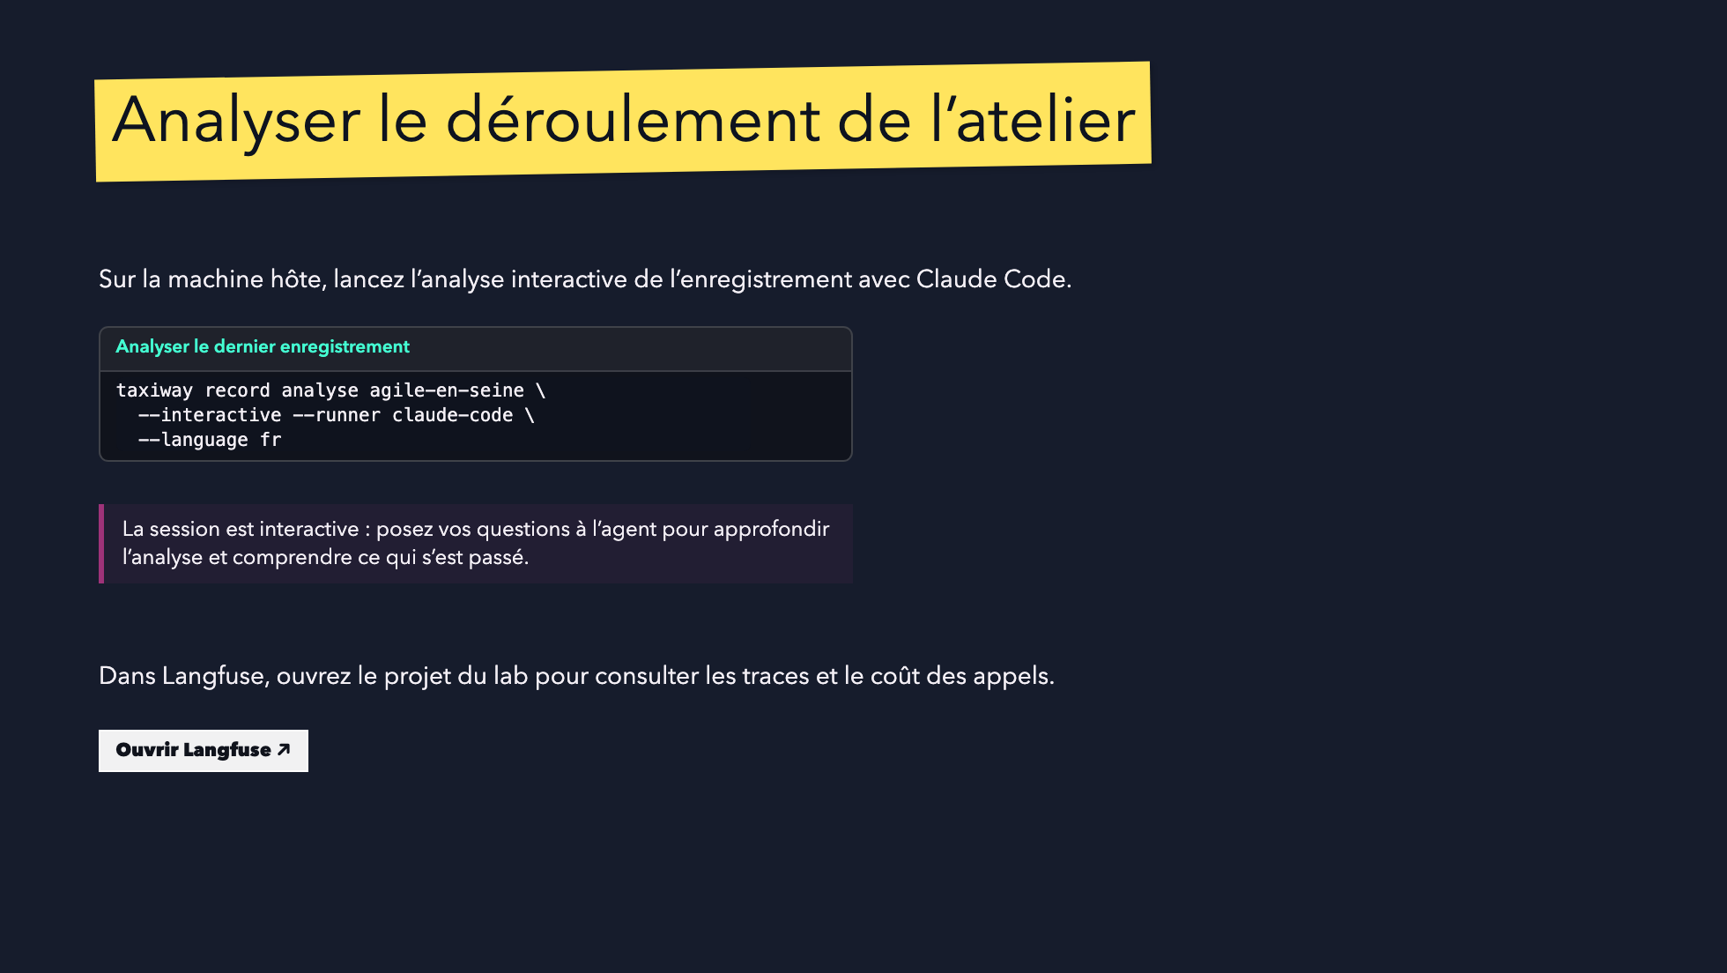

Slide 30
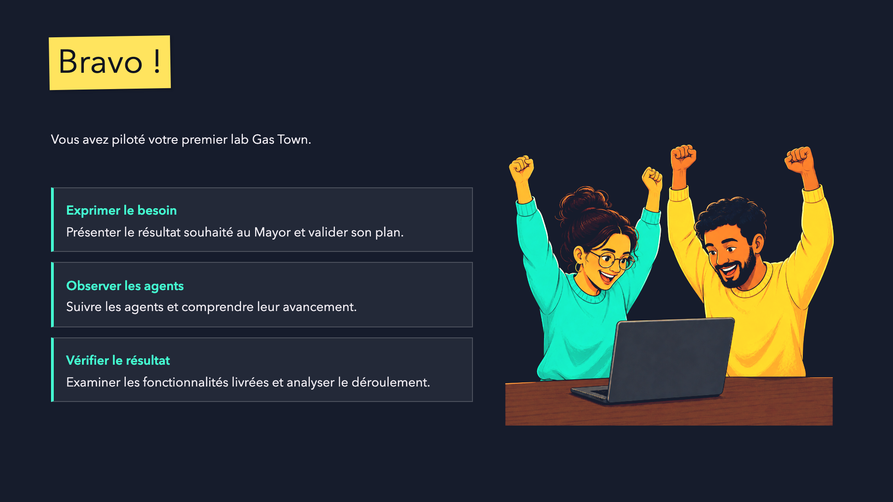
Notes:
Close the hands-on workshop and acknowledge every pair's progress.
Oral transition: how can this workflow become reusable? Continue with formulas.

Slide 31
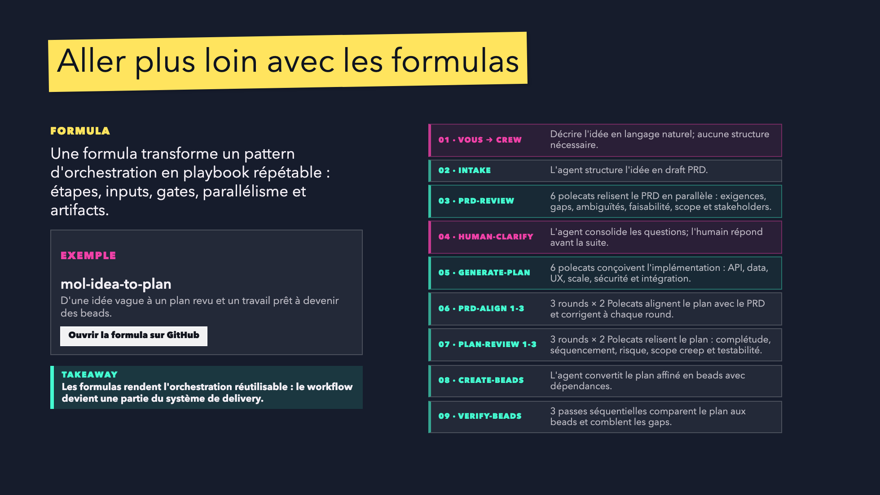
Notes:
Use this slide after the live proof to show how the model can become reusable.
The mol-idea-to-plan formula is the concrete example: vague idea to reviewed plan to beads.

Slide 32
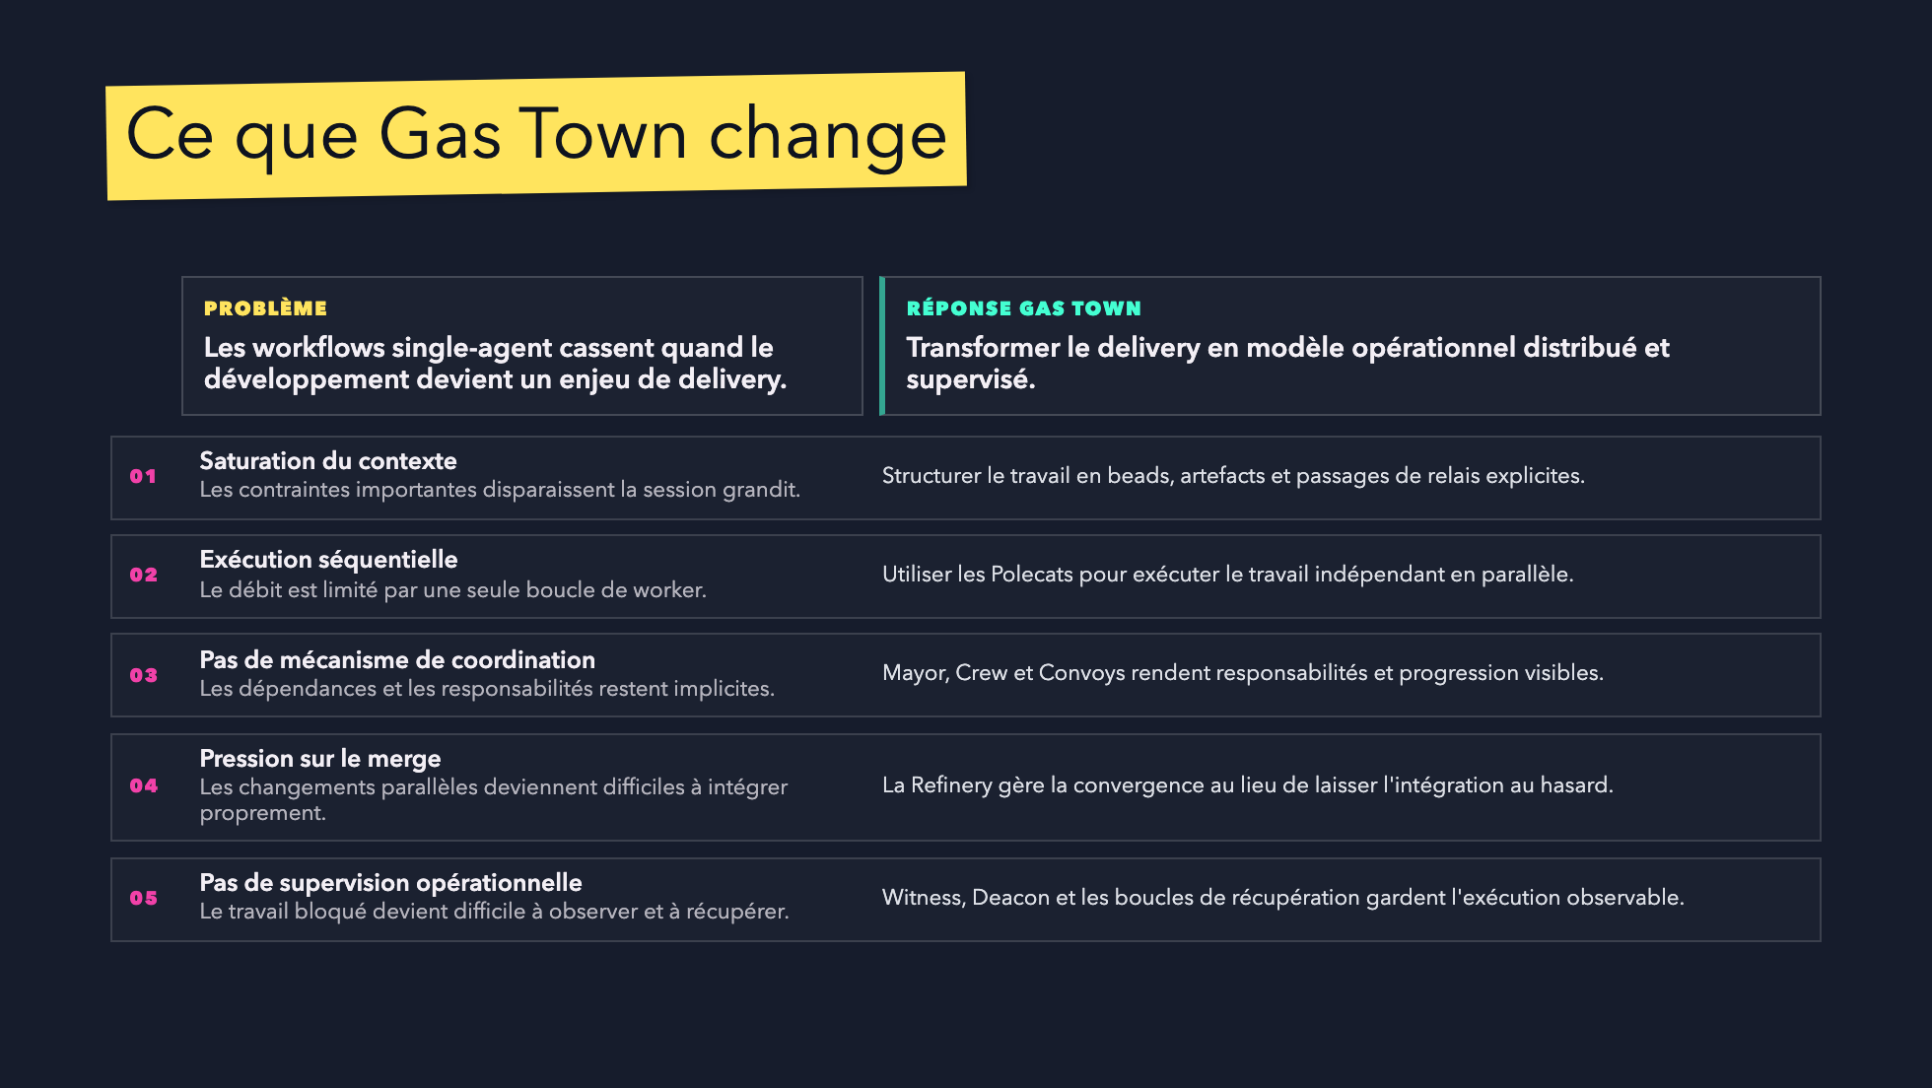
Notes:
This closes the conceptual loop with the exact five problems introduced earlier.

Slide 33
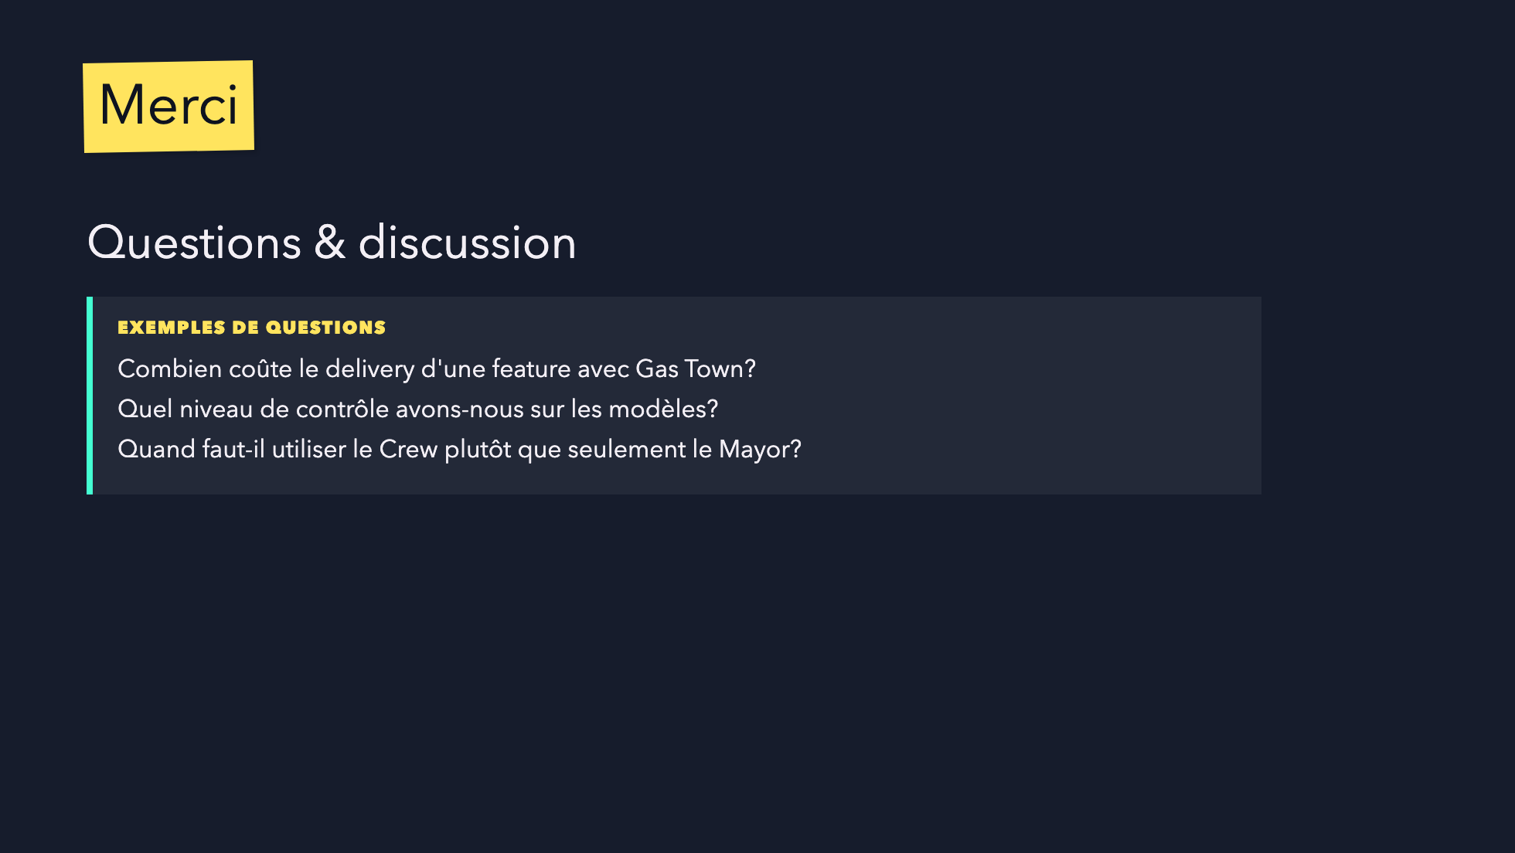
Notes:
Final slide for Q&A.
Keep it quiet. Do not add new concepts.

Slide 34
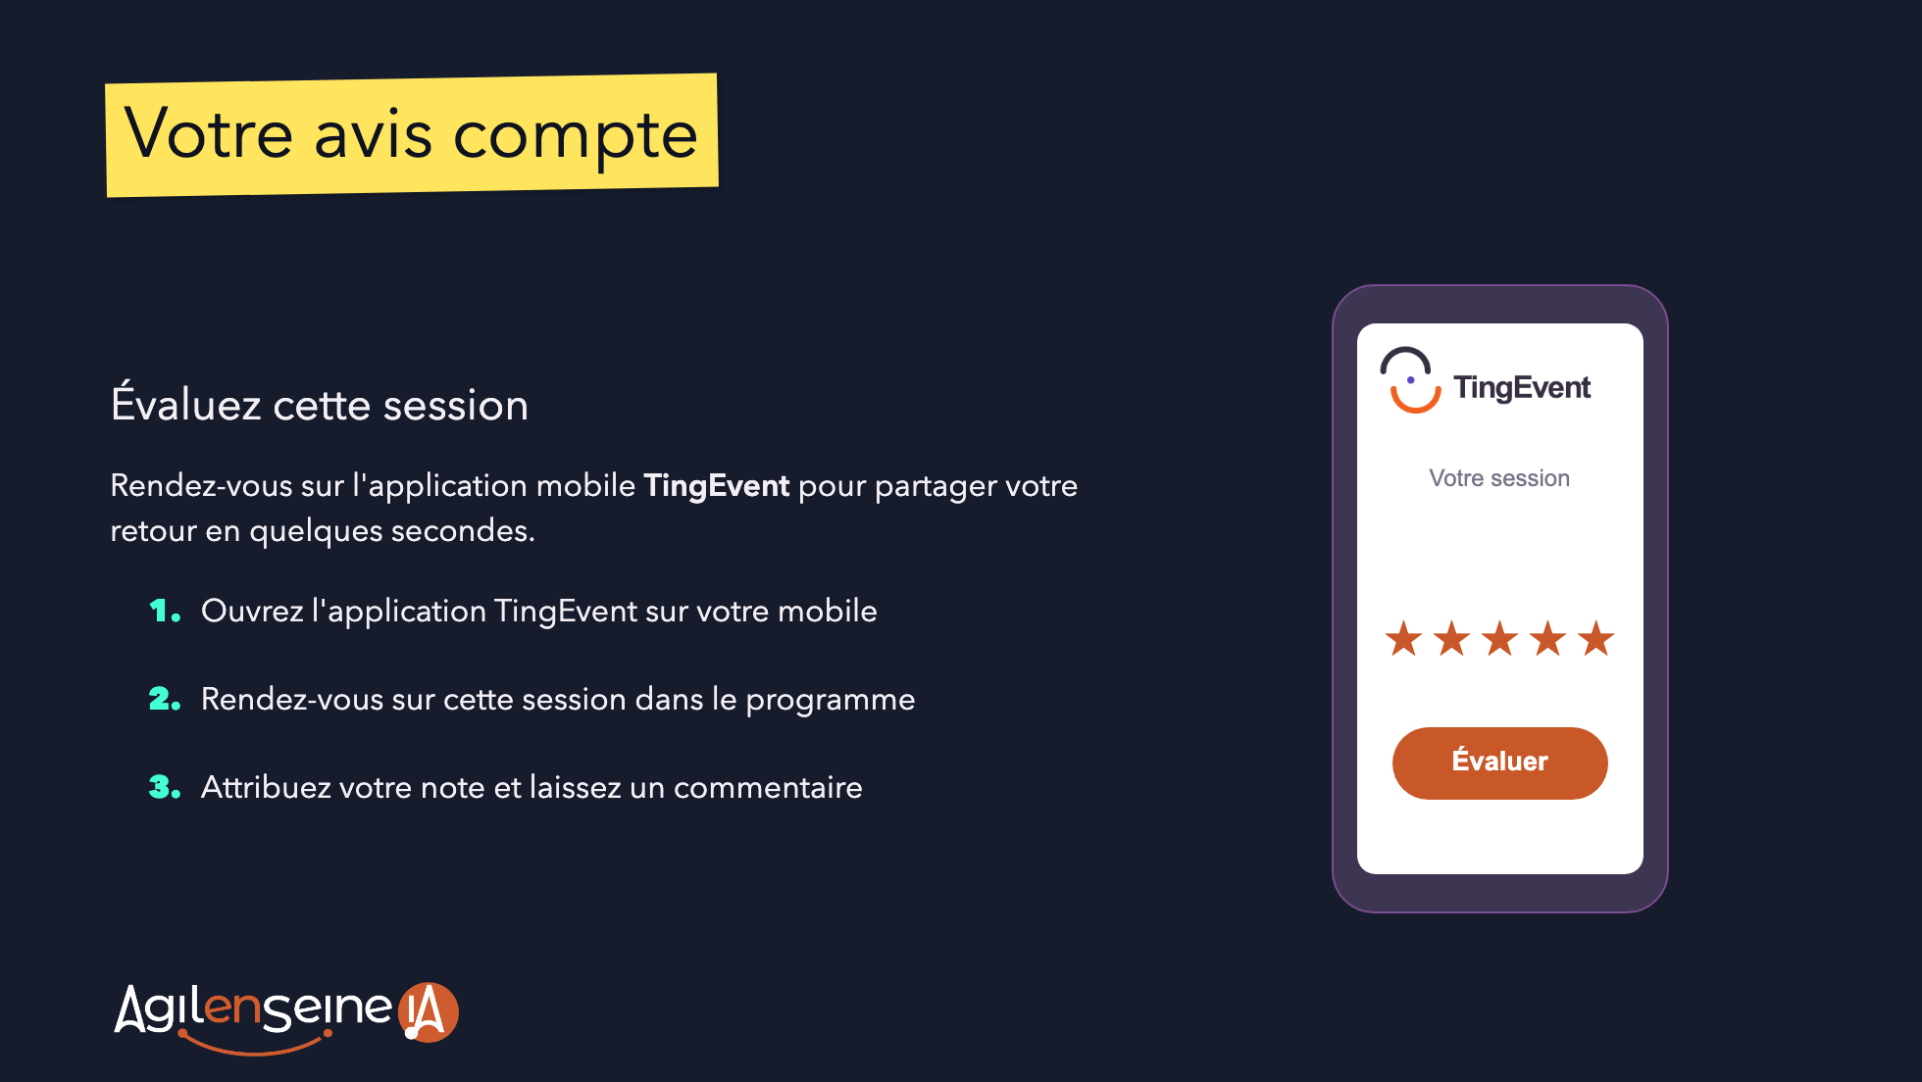
Notes:
Source: Template_AESIA_2026_erratum.pptx, slide 10, provided by the organizers.
https://docs.google.com/presentation/d/1B-g804N3BMTrr-1yCUjOD-iK_Gu7SZoQ/edit
Original wording and assets; phone recreated from the template's shapes and coordinates.
The phone's rating label is illustrative, not a working button. No confirmed QR/link is supplied.
Keep this as the final slide, after thanks and questions.

